Slide 1
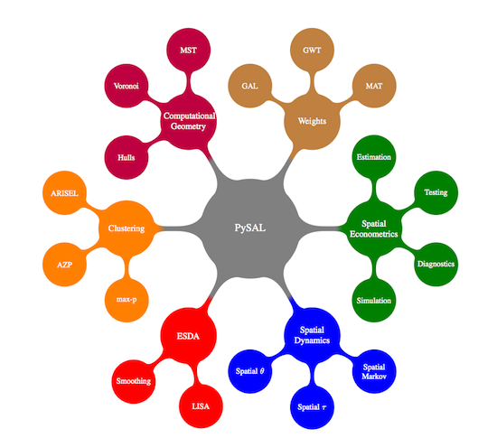
Notes:
Based on the structure of pysal, it has six categories, including data operation (i.e. spatial weights and essential computational geometry functions), data exploration (i.e. clustering methods and exploratory spatial data analysis) and spatial modeling (i.e. spatial dynamics and spatial econometrics).

Slide 2
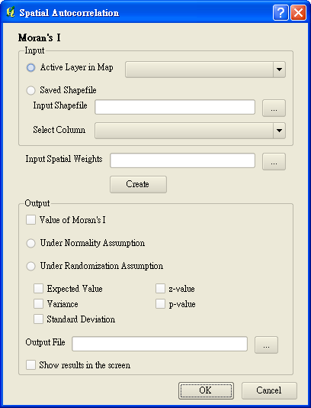
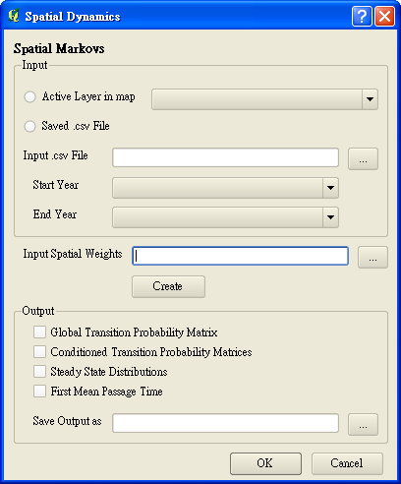
GUI Interface
Notes:
My design can separate into three parts: input data file, input weights file and output.

Slide 3
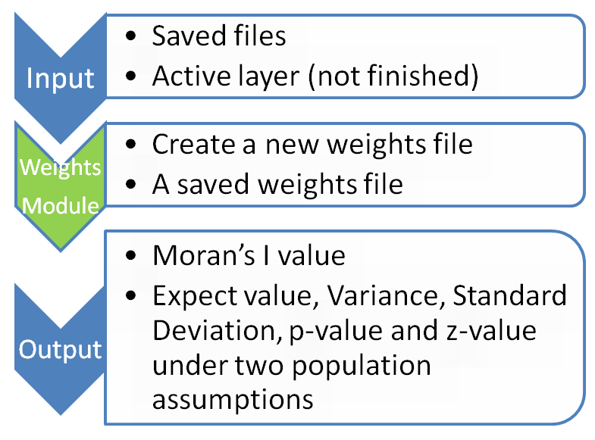
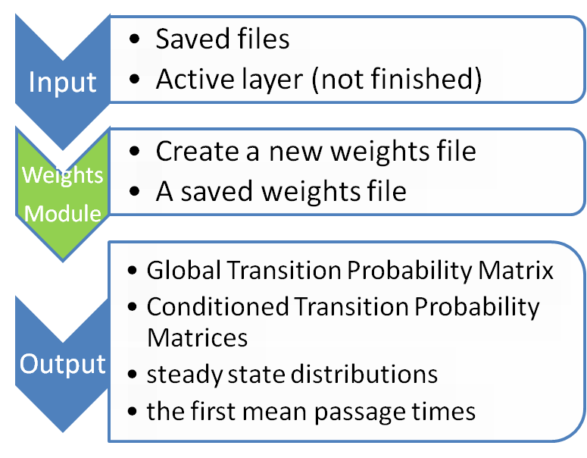
Structures
Notes:
Species distribution, personal incomes, populations. It evaluates whether the pattern expressed is clustered, dispersed, or random
Null hypothesis is “there is no spatial clustering of the values associated with the geographic features in the study area.”When p-value is small and z value is large, it will reject the null hypothesis and show positive Moran’s I value.
If you want to know more about population, Pysal has already build in functions to estimate based on your samples. It can adapt to two population assumptions: normality and randomness assumptions.
How do spatial phenomena changes over time and space?

Slide 4
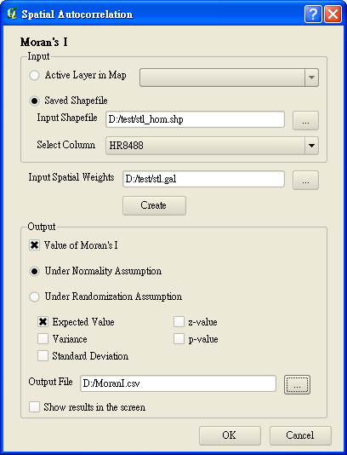
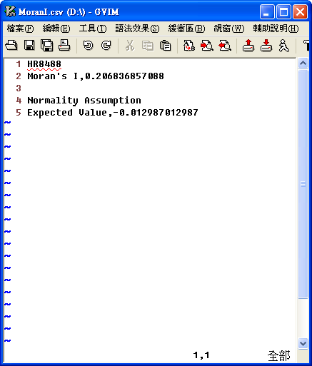
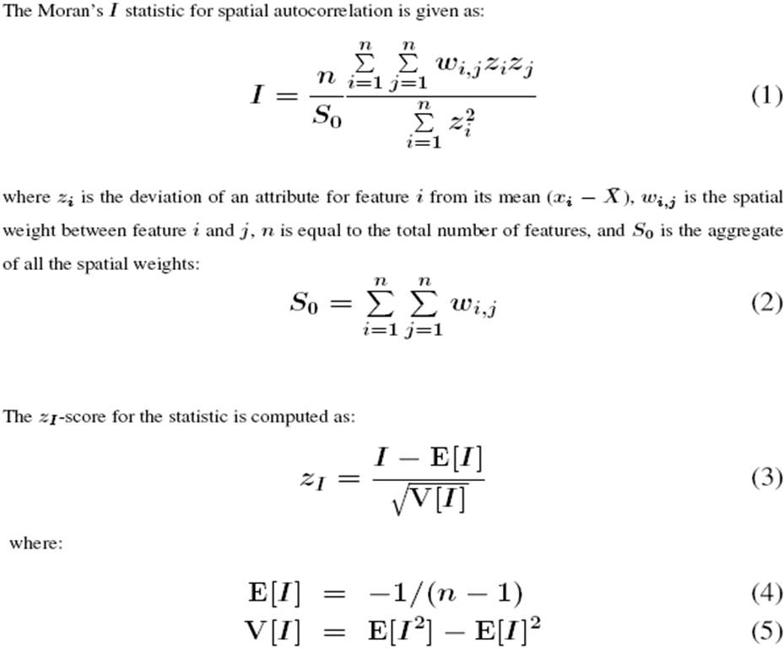
Output Sample-- Moran’s I
Notes:
Two covariances of the deviations between any point and mean multiply to judge whether they are similar or not.
Spatial weights of any two points divide by whole spatial weights

Slide 5
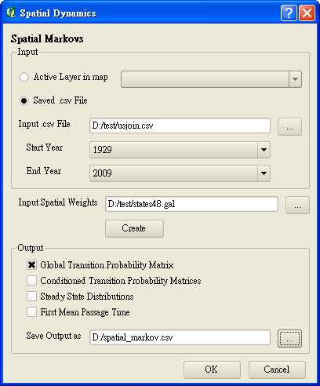
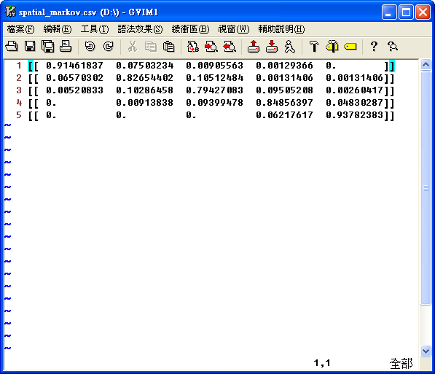

Output Sample-- Spatial Markov
Notes:
Changes over space and time
Any change in specific time from the initial situation equals to the first situation that multiply to the transition probabilities of next stages.
That is to say, after the first situation, transition probability matrix will multiply along with time.
For example, the sample data have five classes from 1920 to 2009.
the transition dynamics are split across economies who have spatial lags in different quintiles at the beginning of the year.

Slide 6
Additional improvements
Active layer:
  Set a filter to exclude raster files (done)
  Get the file path (unfinished)
Create New Weights file: simplify steps
  Call weight module
  Reopen saved file
Show results and simple explanations in the screen

Slide 7
