Slide 1
Kernel Density Estimation in Python
JENNIFER CARLSON
SCOTT KELLEY
AL TAFOLLA
ELLIE VOLOSIN
GPH 598: GEOCOMPUTATION
FINAL PROJECT
FALL 2011

Slide 2
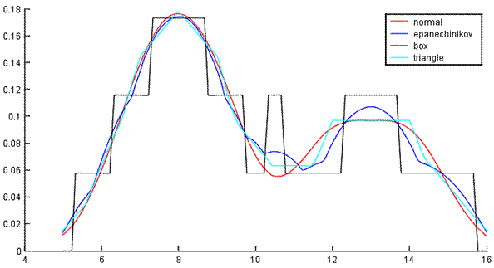
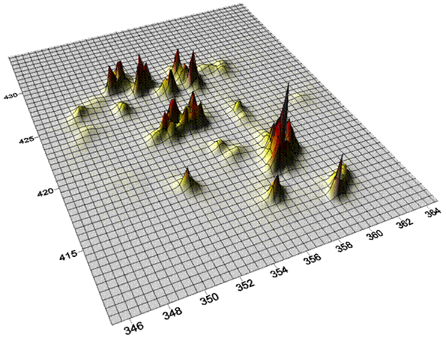
INTRODUCTION
KERNEL

Slide 3
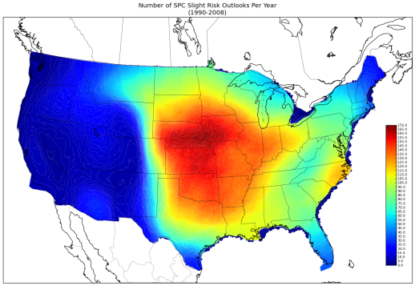
INTRODUCTION
UTILITY

Slide 4
INTRODUCTION
CENTRALIZING
PySAL and STARS

Slide 5
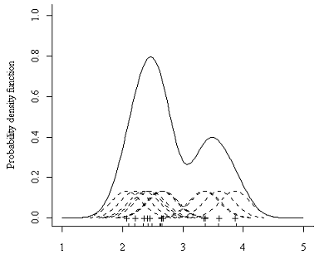
KERNEL CALCULATIONS
Display of kernel calculations
Images

Slide 6
KERNEL CALCULATIONS
EQUATION TABLE
GAUSSIAN, TRIANGULAR, UNIFORM
Equations + Image examples

Slide 7
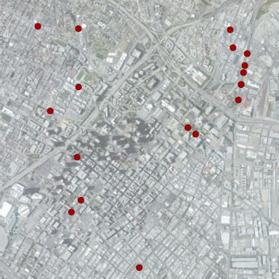
INPUTS AND OUTPUTS
IN: List (x₁,y₁,x₂,y₂,…x_{n},y_{n})
OUT: Kernel value
Throughout AOI - Matrix
(x₁,y₁, z….x_{n}², y_{n}², z)
At user-specified point
(x,y,z)

