Slide 1
Kernel Density Estimation in Python
JENNIFER CARLSON
SCOTT KELLEY
AL TAFOLLA
ELLIE VOLOSIN
GPH 598: GEOCOMPUTATION
FINAL PROJECT
FALL 2011

Slide 2
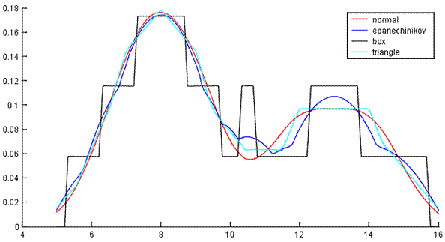
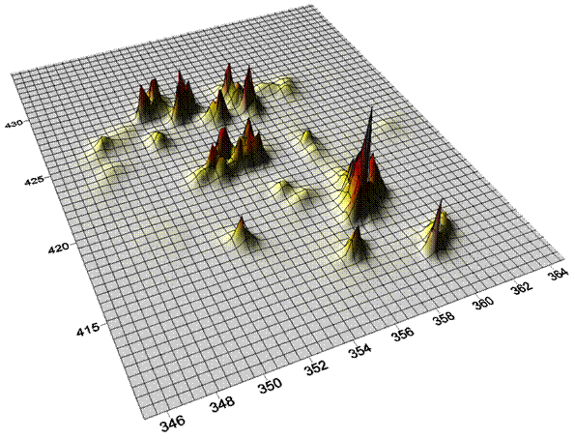
INTRODUCTION
KERNEL

Slide 3
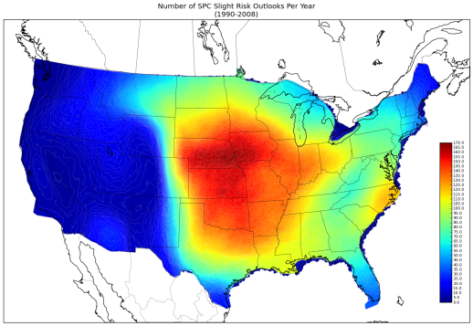
INTRODUCTION
UTILITY

Slide 4
INTRODUCTION
CENTRALIZING
PySAL and STARS

Slide 5
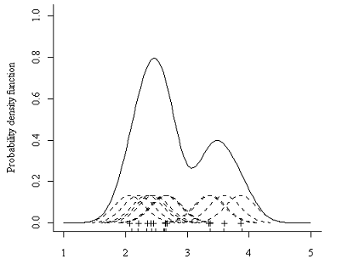
KERNEL CALCULATIONS
Display of kernel calculations
Images

Slide 6
KERNEL CALCULATIONS
EQUATION TABLE
GAUSSIAN, TRIANGULAR, UNIFORM
Equations + Image examples

Slide 7
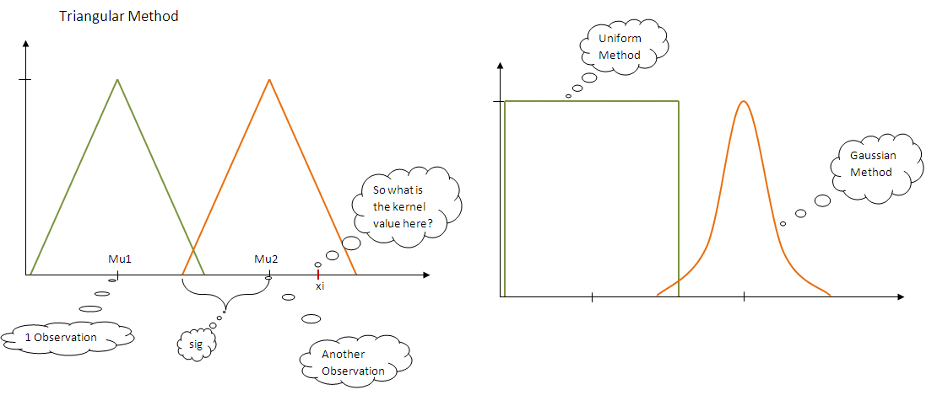
KERNEL CALCULATION IMAGES

Slide 8
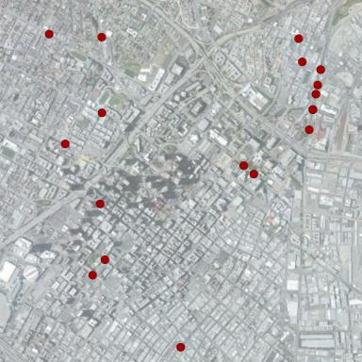
INPUTS AND OUTPUTS
IN: List (x₁,y₁,x₂,y₂,…x_{n},y_{n})
OUT: Kernel value
Throughout AOI - Matrix
(x₁,y₁, z….x_{n}², y_{n}², z)
At user-specified point
(x,y,z)

Slide 9
PROGRAMMING FLOW CHART
Create Class Kernel
Choose your Calculation Function
Function: preplists
Input Points
Bandwidth and Resolution
Format Input Observation Points
Format Output Grid Points
Create Kernel Values for Points in Grid
Create Kernel Values for a Specific Point

Slide 10
CALCULATION FUNCTION
User never sees this function
For now only includes Gaussian, Triangular, and Unifrom methods
def calculation (mu, xi, sig, method)
if method is Gaussian
run the Gaussian calculation for given inputs
elif method is Triangular
is the grid point within the bandwidth?
run the triangular calculation for given inputs
elif method is Unifrom
is the grid point within the bandwidth?
run the uniform calculation for given inputs

Slide 11
KERNEL DENSITY FUNCTIONS
Three “grid” functions are available to run on a variable k that is class Kernel:
k.gaussian()
k.triangular()
k.uniform()
Three “point” functions are also available
k.gaussian_point (x-value, y-value)
k.triangular_point (x-value, y-value)
k.uniform_point (x-value, y-value)
The point functions require the user to enter the x and y values while the grid functions simply use the inputs from the Kernel class definition

Slide 12
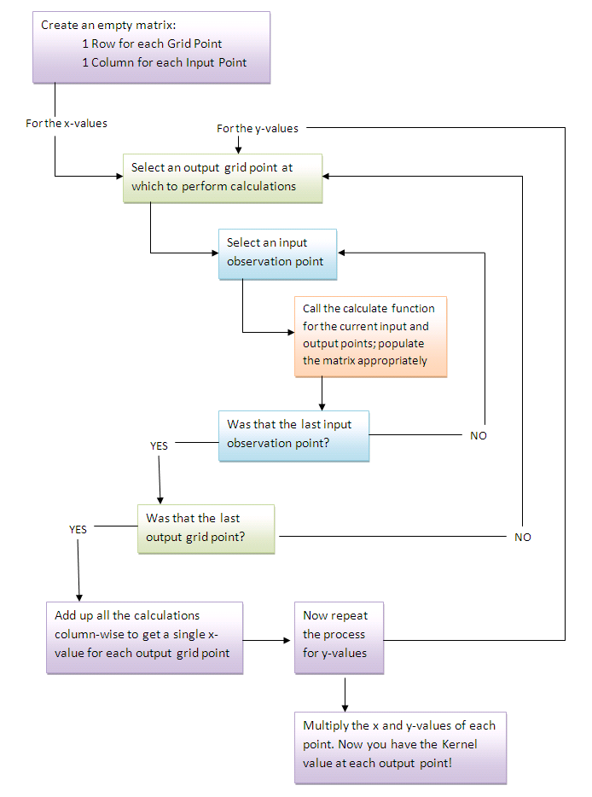
METHOD FUNCTION FLOW
When using the grid functions there are two for loops
One for loop cycles through output grid points
An inner for loop cycles through input observation points
When using the point functions there is only one for loop
Loops through the input observation points

