Slide 1
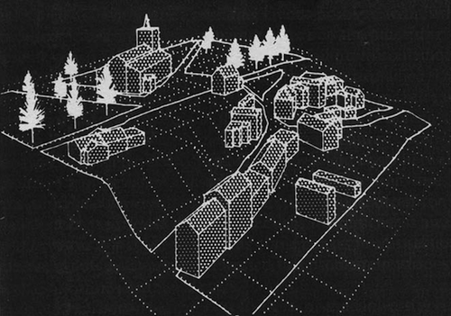
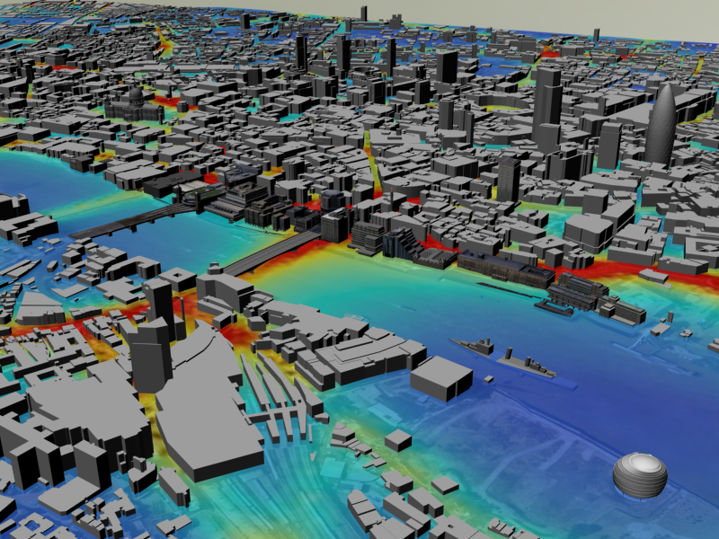
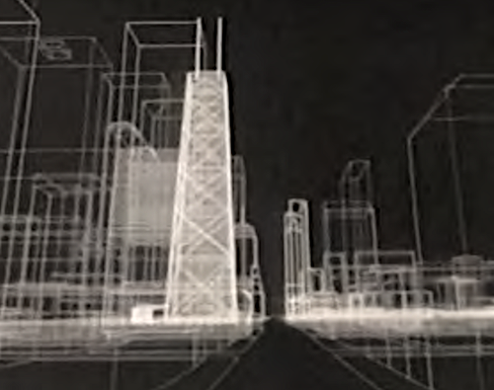
Visualisation of Central London 2005
3D
PC Model
1980
Wire Frame Chicago 1983
Batty, M. (2024) Digital twins in city planning, Nature Computational Science, 4, 192–199
https://doi.org/10.1038/s43588-024-00606-7

Slide 2
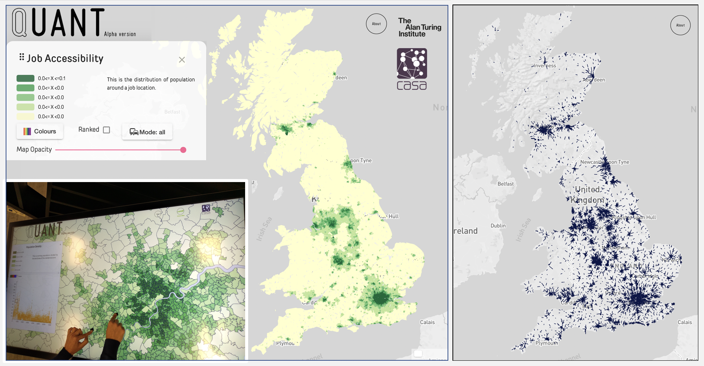
A Digital Twin
for British Cities
(c)
Average Work Flows
(b)
(a)

