Slide 1
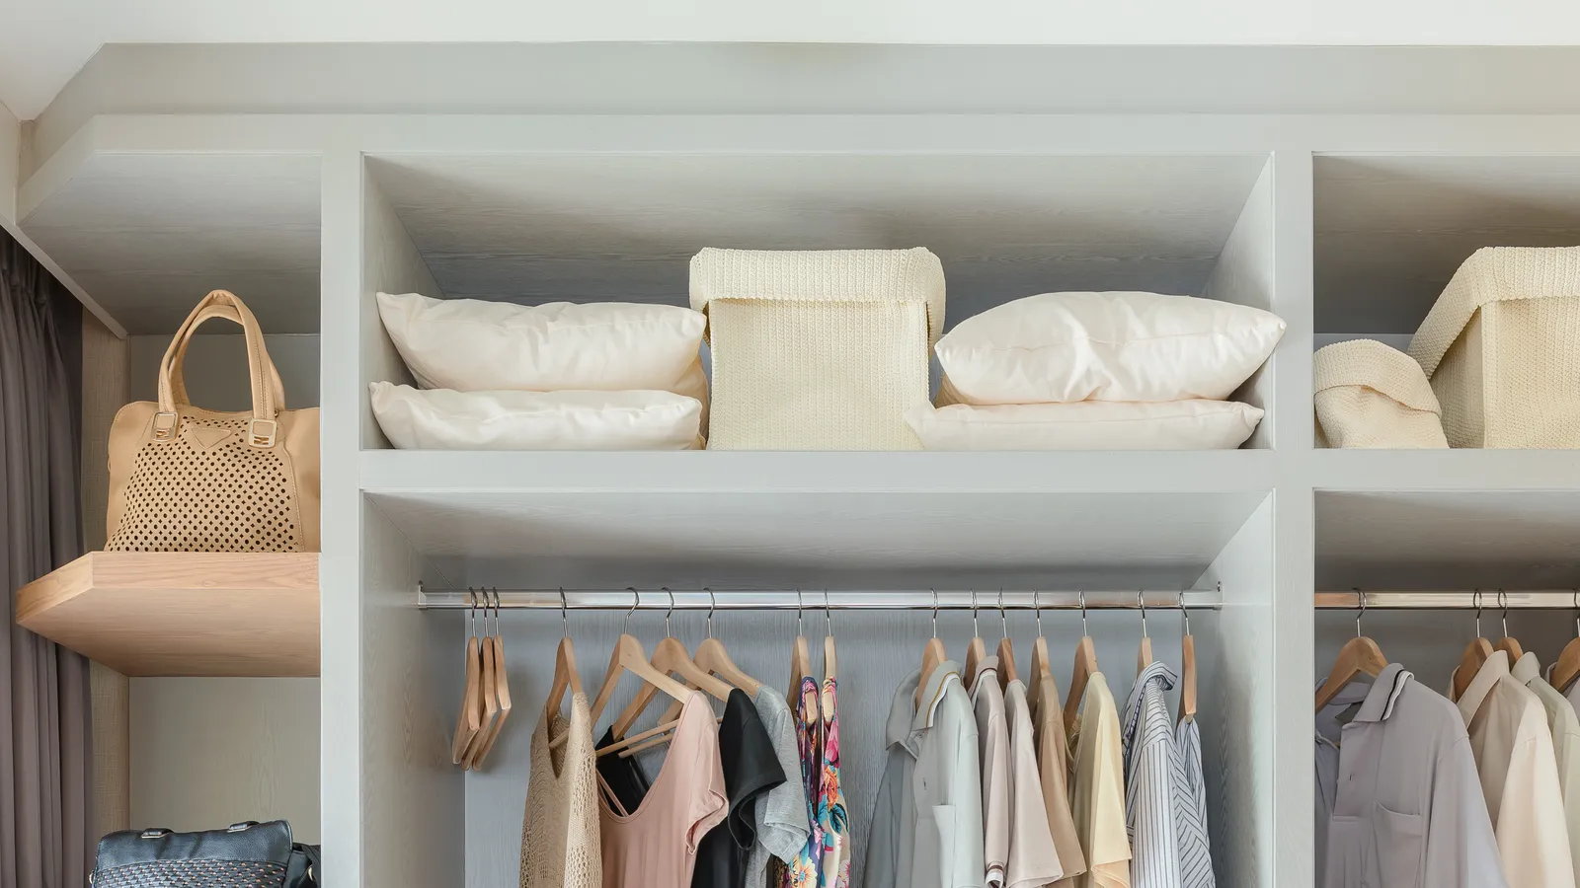
MyCloset: Wireframes and User Stories
Patrick Dorion, Josh Rosenthal, Anthony Litterio

Slide 2
Example User Stories (more on separate upload file on Canvas)
As a fashion enthusiast, I want to keep track of my wardrobe, so I know when I need to refresh my style
As someone moving homes, I want to help keep inventory of my belongings so I can check what to keep or donate

Slide 3
Example Log-in Page
Welcome to MyCloset!
Email@address.com
Sign In
password

Slide 4
Example Landing Page
What do you want to do today?
See what's in my closet
Add a new item to my closet
Clean out the closet!

Slide 5
Patrick's Closet
Example View Closet Page
Item Name | Value | Date Added
Navy Polo | $20.00 | 5/12/2019
Green J Crew Pants | $55 | 1/14/2015
Gucci Belt with Copper Clasp | $60 | 5/1/2010
Blue Pajama Bottoms | $13 | 7/6/2019
Timex Watch | $50 | 1/5/2001
Camp T-Shirt | $0 | 4/5/1995
Add a new item to my closet
Clean out the closet

Slide 6
Add a new item to Patrick's Closet
Example Add to Closet Page
Add item name
Add item cost
Add date item purchased
Add item to my closet
Never mind, take me back

Slide 7
Remove items from Patrick's Closet
Example Remove from Closet Page
Check boxes or some other way to choose the items to remove
Item Name | Price | Date Added
Navy Polo | $20.00 | 5/12/2019
Green J Crew Pants | $55 | 1/14/2015
Gucci Belt with Copper Clasp | $60 | 5/1/2010
Blue Pajama Bottoms | $13 | 7/6/2019
Timex Watch | $50 | 1/5/2001
Camp T-Shirt | $0 | 4/5/1995
X
X
Remove these items from my closet
Never mind, take me back

Slide 8
Nice, you made some space!
After removing items
Item Name | Price | Date Added
Navy Polo | $20.00 | 5/12/2019
Gucci Belt with Copper Clasp | $60 | 5/1/2010
Total Value for Donations | $80
Forwards to a google maps search for donation centers near this address
Shows total value of the items removed
Click here to find the nearest donation center
Take me back to my closet
My Zip Code

