Slide 1
Surplus Production Models for Adaptive Fisher Behavior
JD Reigrut
24 April 2026

Slide 2
Surplus Production Model
B_{t+1} = B_{t} + rB_{t}(1-B_{t} / K) – q EB_{t}
Where:
B is the stock biomass at time t
r is the intrinsic growth rate
K is the environmental carrying capacity
q is the catchability coefficient
E is fishing effort
Notes:
A surplus production model is a simple population dynamics model used for fisheries stock assessment. The objective of a surplus production model is to estimate the Maximum Sustainable Yield (MSY) using limited data, to identify the optimum harvest effort that avoids depleting the stock. The equation for the surplus production model is:
The catchability coefficient ($q$) relates fishing effort to fishing mortality and is assumed to be constant in this equation.
However, the true value of the catchability coefficient changes with increased fishing efficiency, fish density (hyperstability or hyperdepletion), environmental changes, or technological improvements. This has the potential to impact the determined MSY of a stock, having implications for policy development and fisher economic gain. As such, my project aims to evaluate whether assuming a constant catchability coefficient ($q$) in a Bayesian stock assessment leads to biased estimates when fishers are adaptively targeting aggregations.

Slide 3
Research Questions
How does adaptive fisher behavior bias posterior estimates of MSY in a Bayesian surplus production model that assumes constant catchability?
To what extent can informative priors mitigate bias arising from misspecified catchability?
Do Bayesian models that allow for flexible or time-varying catchability better recover true MSY under adaptive fishing behavior?
How does this misspecification affect posterior uncertainty, including CI width?

Slide 4
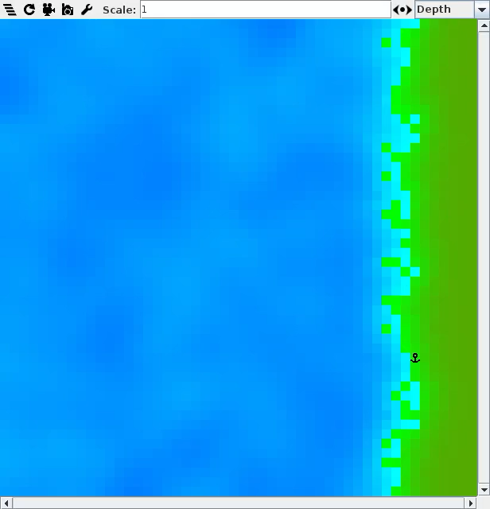
POSEIDON – Fisheries Agent-Based Model
Constants:
K = 3000 fish/cell or approx. 6,375,000 fish in the system
r = 0.35
q = 0.002
True MSY = 557,812
Scenerio A (Fixed Behavior)
Exploration probability = 0.95 (high)
Imitation probability = 0.0 (no imitation)
Scenerio B (Adaptive Behavior)
Exploration probability = 0.05 (low random exploration), Min = 0.01
Imitation probability = 1.0 (high social imitation)
Increment multiplier= 0.03 (learning speed)
Notes:
The POSEIDON model is an interactive agent-based modeling platform that serves as an interactive tool that encodes certain parameters within a dynamic spatial-visual platform. Users of the interface apply values to these parameters to evaluate the effect of various policy interventions on ecological and fisheries outcomes. Using this model, I will be able to simulate fisheries data where fishers are highly exploratory versus where fishers use explore-exploit-imitate to aggregate effort on high-density patches through patterns of exploitation and imitation.
he POSEIDON model was used to simulate fishing scenerios with two different types of fisher behavior. These fisher simulation runs differ only in fisher targeting behavior, all else being held constant.
In Scenerio A - fishers move randomly, catch is roughly proportional to abundance. This means that CPUE is a good index of biomass and constant $q$ is approximately valid.
In Scenerio B - fishers use POSEIDON's adaptive explore-exploit-imitate algorithm to seek out high-density patches. Agents learn to efficiently target remaining fish aggreagations, depleting nearby areas first and expanding outward. CPUE stays high as biomass drops (hyperstability), meaning the constant $q$ assumption is violated.
A simulation of 30 years was run for each scenario with the given parameters.
Species biomass (kg), total catch (kg), average distance from port (km), average last trip hourly income ($), hours out, and effort were collected from the simulation. CPUE was calculated from total catch (kg) and effort.
Two runs with random seeds were conducted for each scenario. The first 5 years were removed to drop potential trends arising from initialization and to remove the learning artifact in the Scenario B.

Slide 5
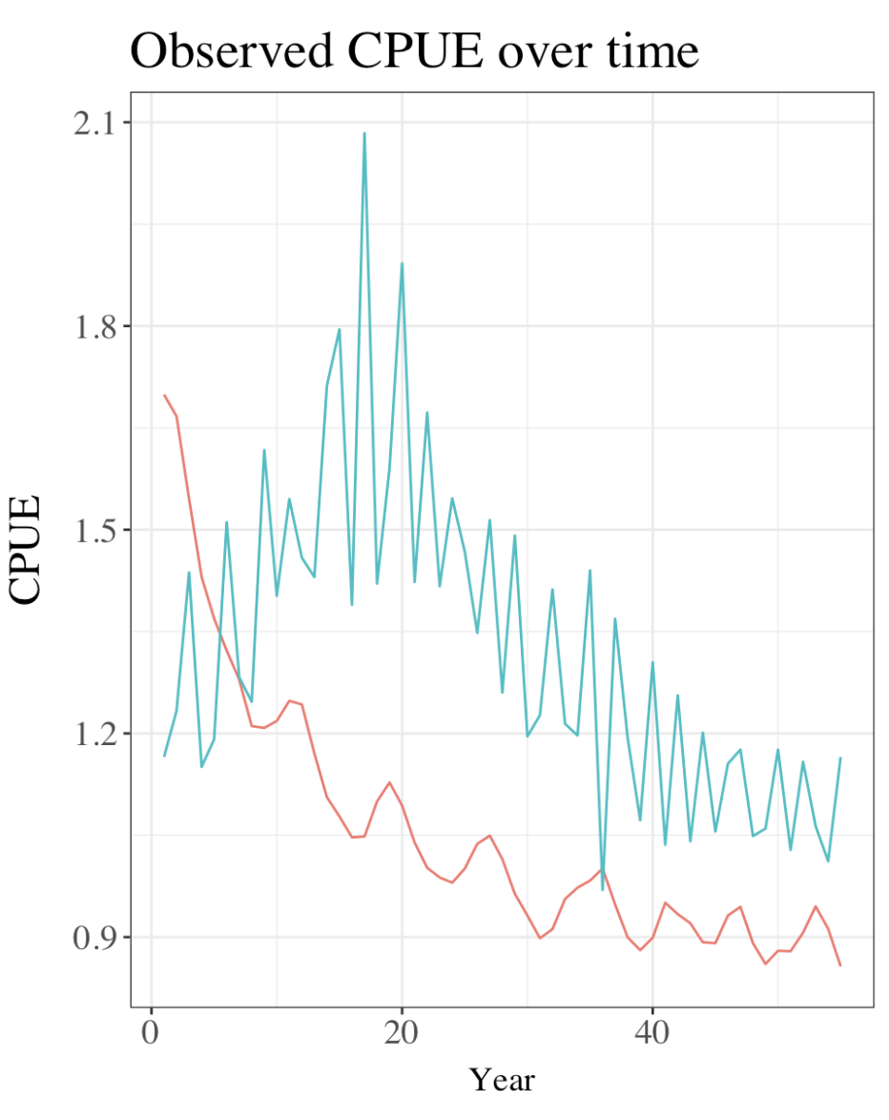
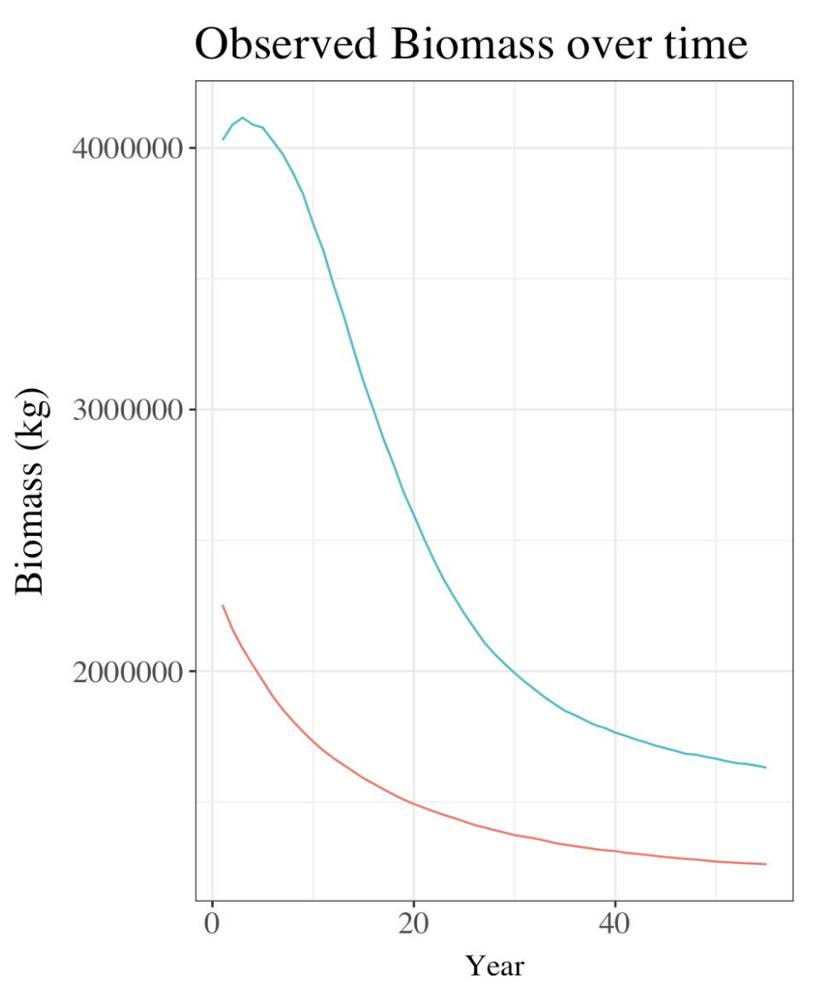
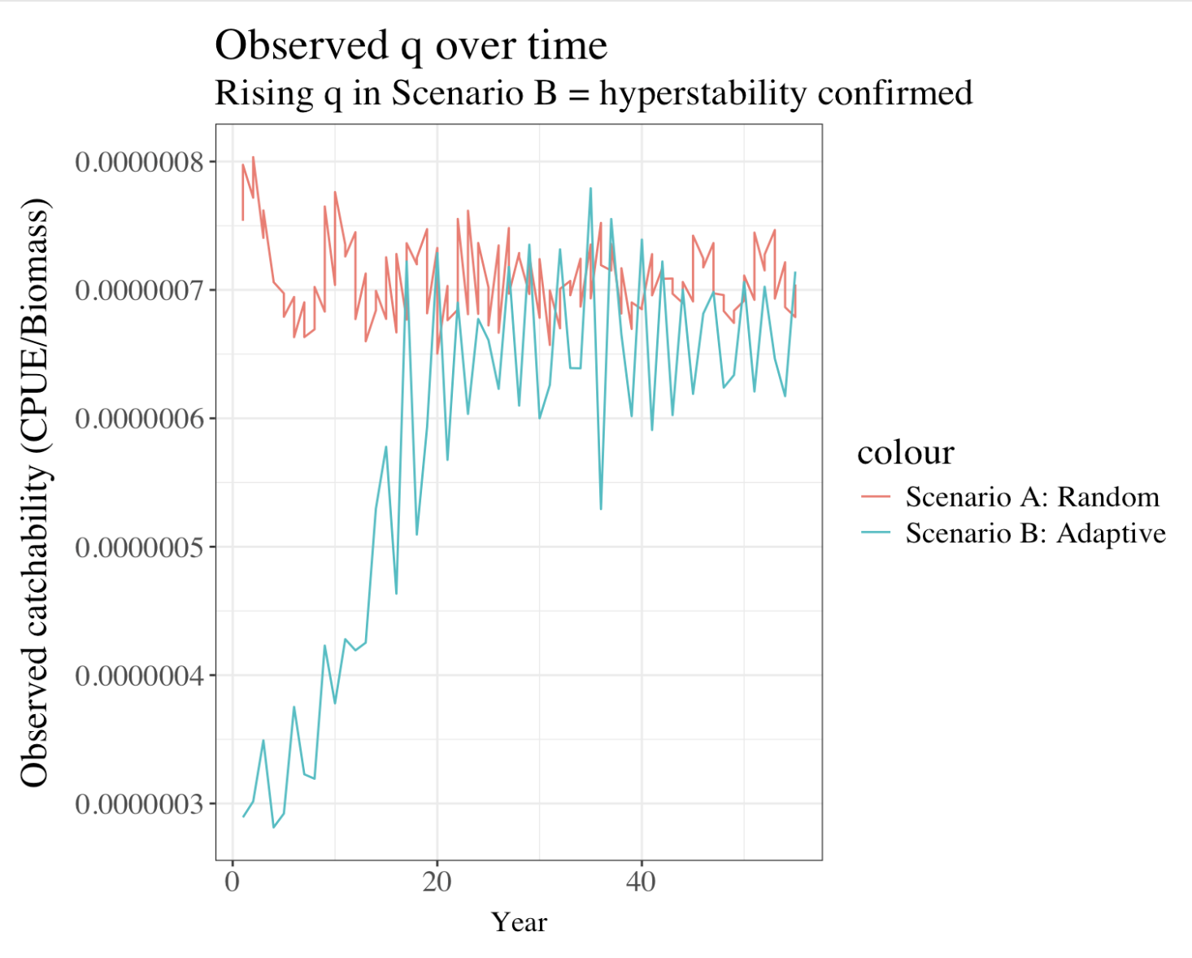
Simulated Data Trends
Notes:
Both Scenarios at year 0 have the same initial biomass. In Scenario A, biomass rapidly decreases initially and steadies to a point of limited decrease in later years, but remains above zero. In Scenario B, the initial biomass spike is caused by the inefficency associated with learning. However, Scenario B shows a similar pattern of rapid decline followed by stabilization.
Scenario A represents consistency with the assumption for a standard population surplus model. The relationship between CPUE and biomass creates a largely flat trend where CPUE decline is proportional with biomass decline over time. The trend indicates that a constant q assumption is largely valid.
In contrast, Scenario B shows hyperstability. The relationship between CPUE and biomass is initially low due to learning restrictions, then increases despite decreasing biomass as a result of advantageous exploitation and imitation behavior. Spatial targeting results in a more volatile pattern as established previously. The trend indicates that a constant q assumption is not valid.

Slide 6
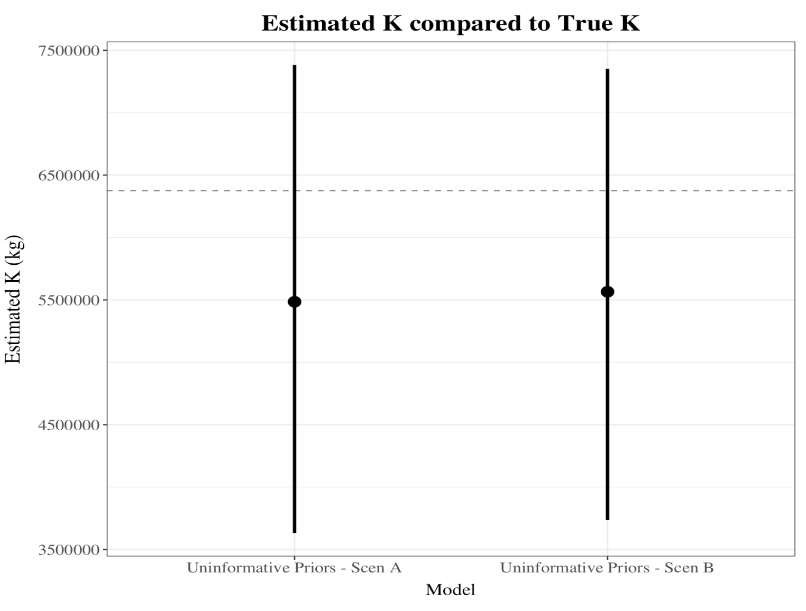
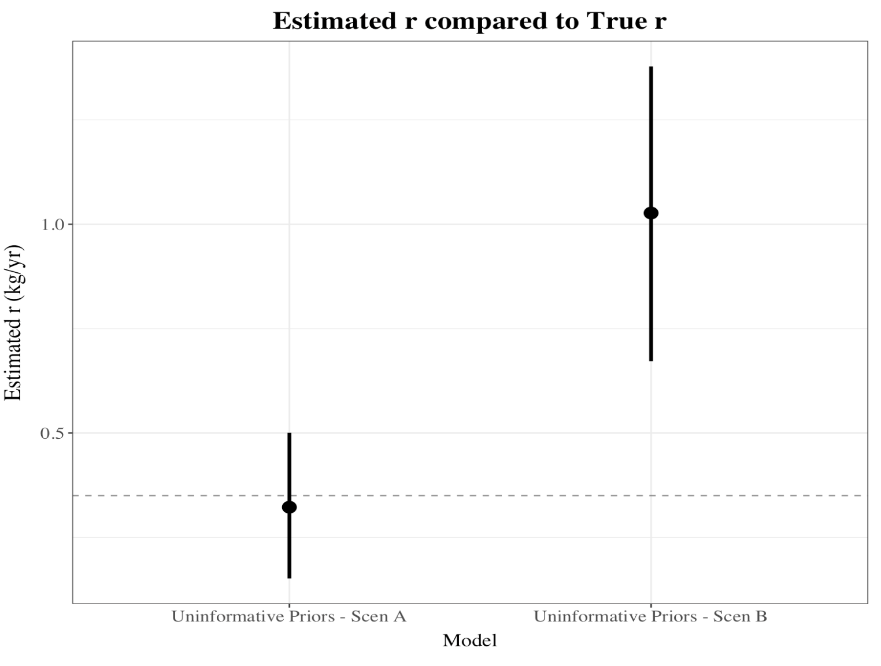
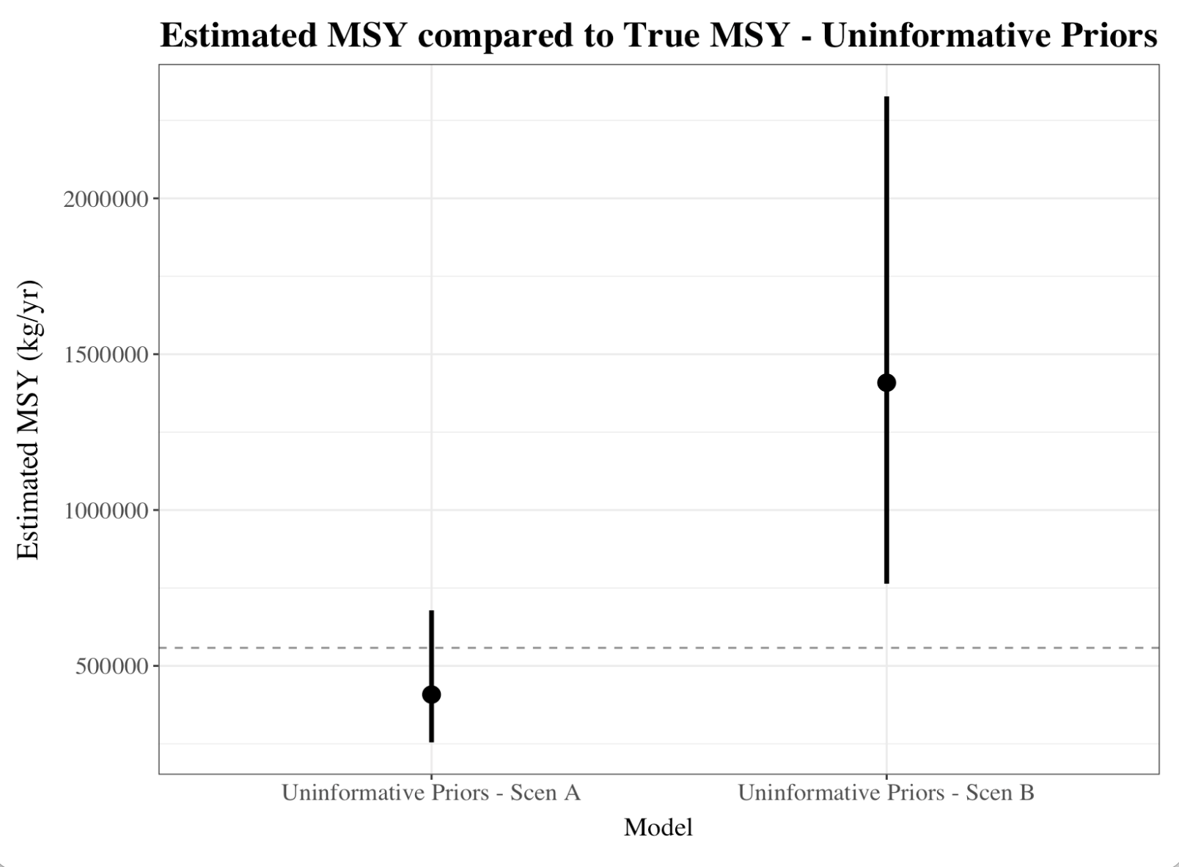
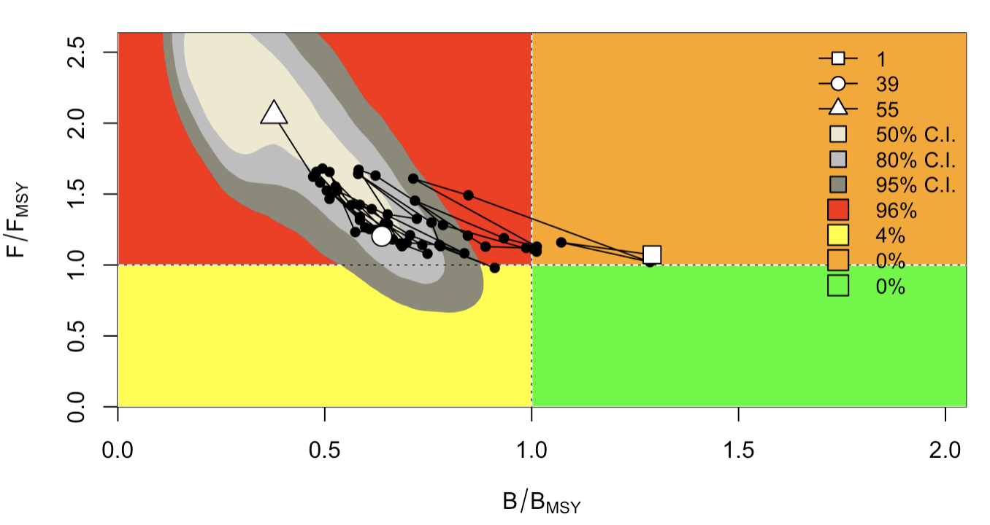
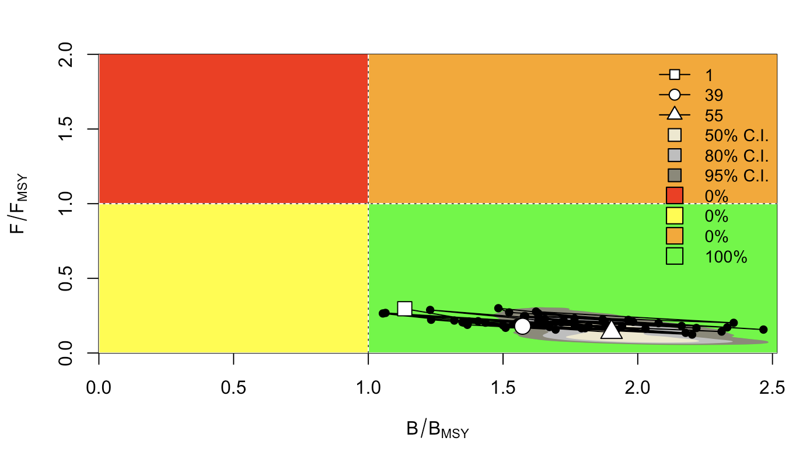
Model 1: Standard Surplus Production
Notes:
Uninformative priors were set using weak information about the system dynamics. These models encode priors that are biologically reasonable for the system but have wide standard deviation to allow for a large amount of variation from the set mean.
A prior of 0.4 with a standard deviaton of 1 was used for r. 0.4 is considered a reasonable estimation for the growth rate of a highly productive species, with true values falling between 0 and 1.
A prior of 4600000 was used for K as an estimation based on 8x the maximum catch, which tends to provide a reasonable estimate. A standard deviation of 2 allows for variance from this set mean.
Uninformative priors do not produce highly accurate posterior coefficient estimates in either Scen A or Scen B. In Scen B, only the true mean MSY is contained in the range of the credible interval. However, the CI is very broad, as the priors are too broad to constrain uncertainty. Overarchingly, the posterior estimates are more accurate in Scen A than in Scen B, however, given the means, both models risk overharvest with estimated MSY values that are greater than true MSY.

Slide 7
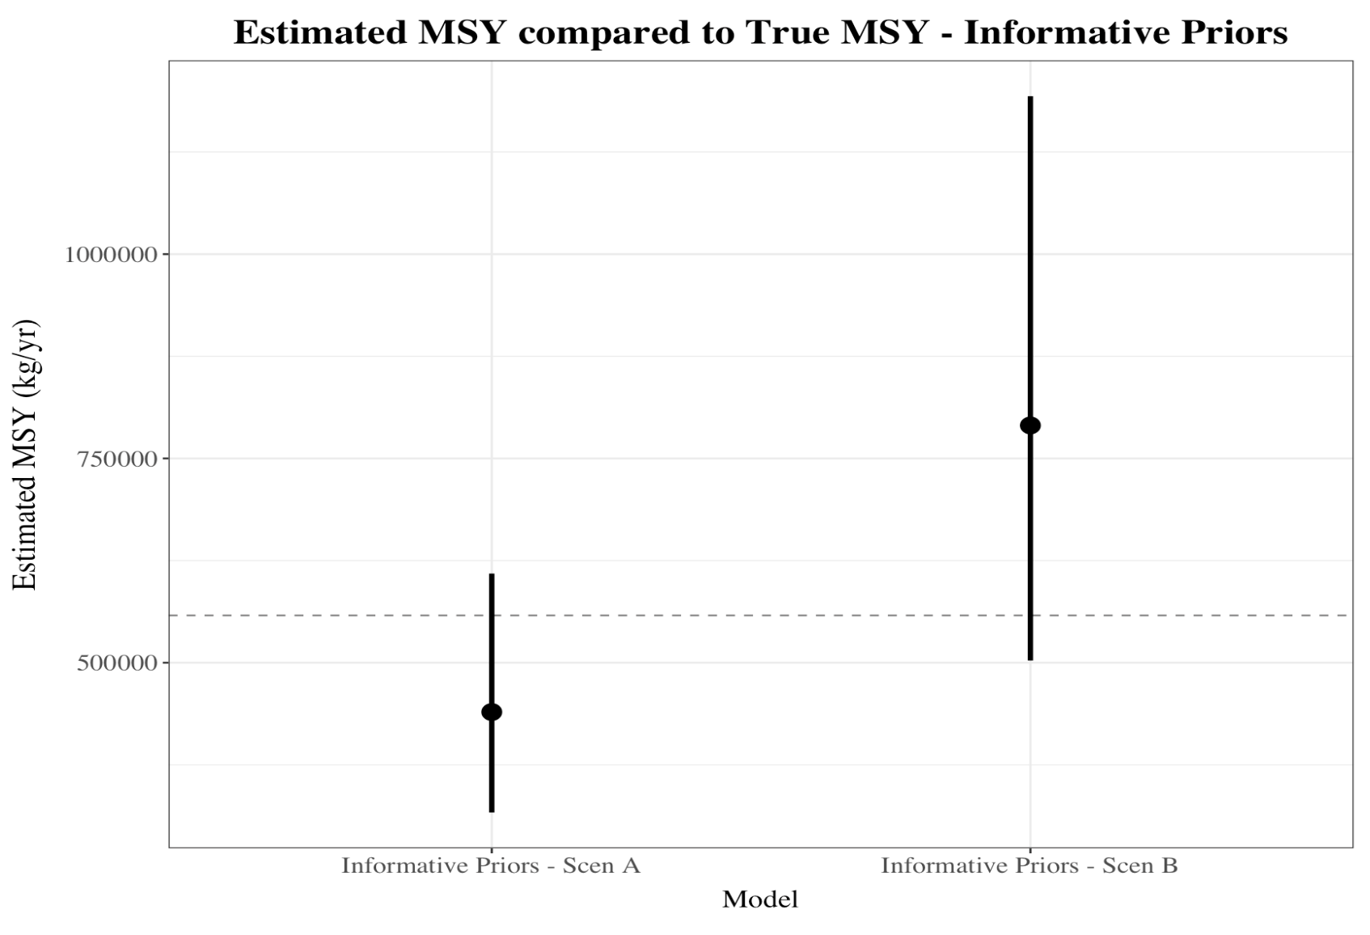
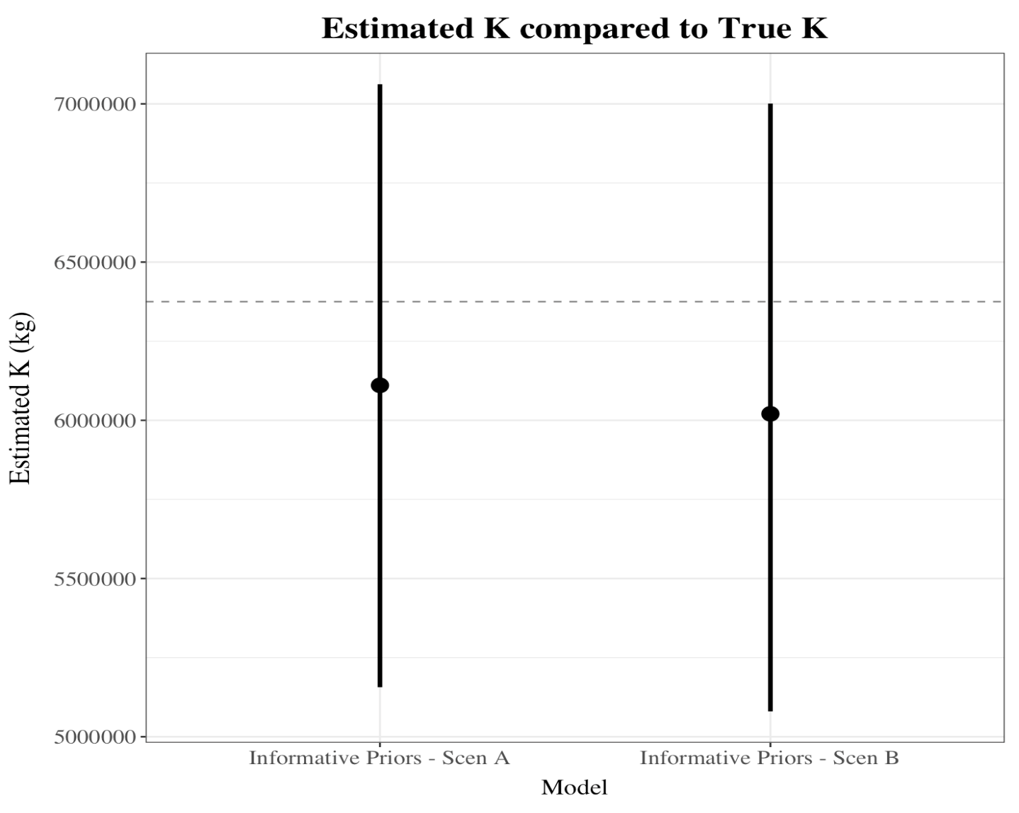
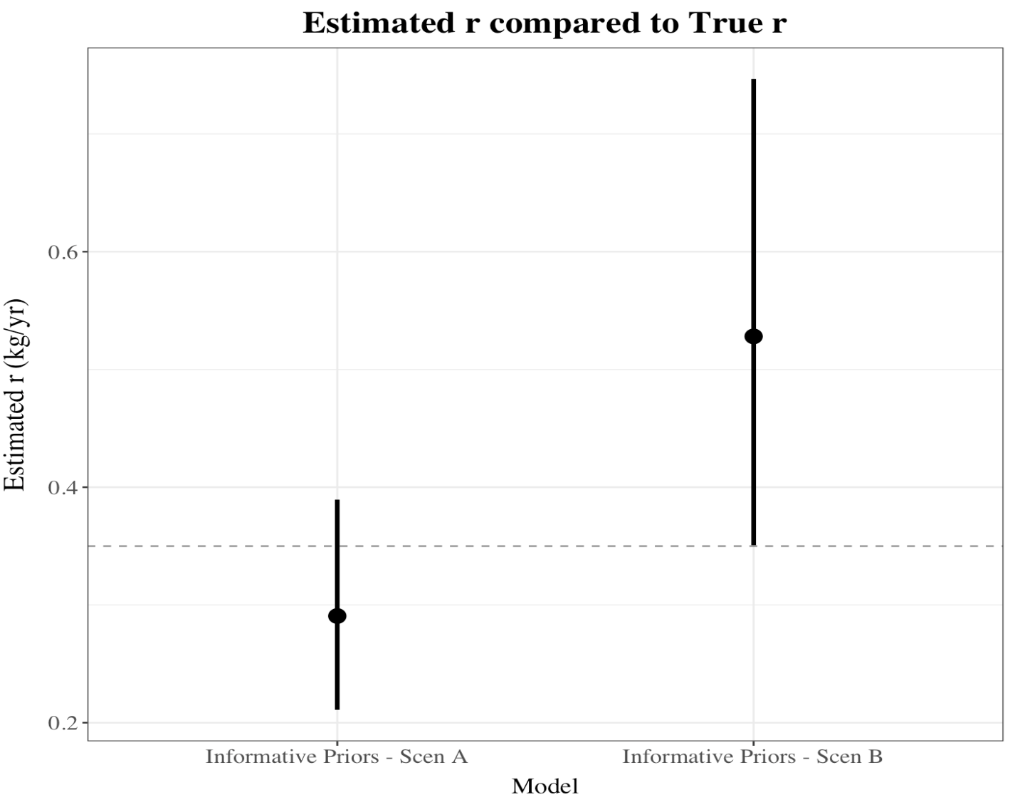
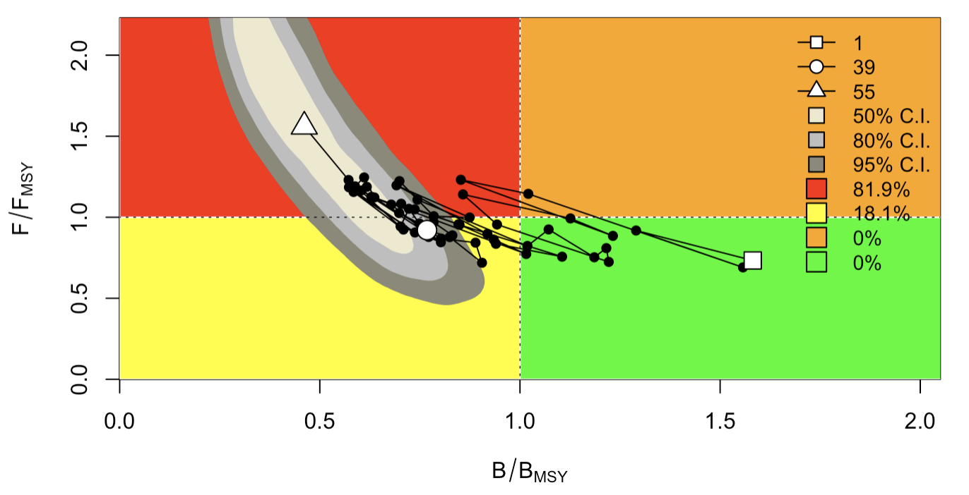
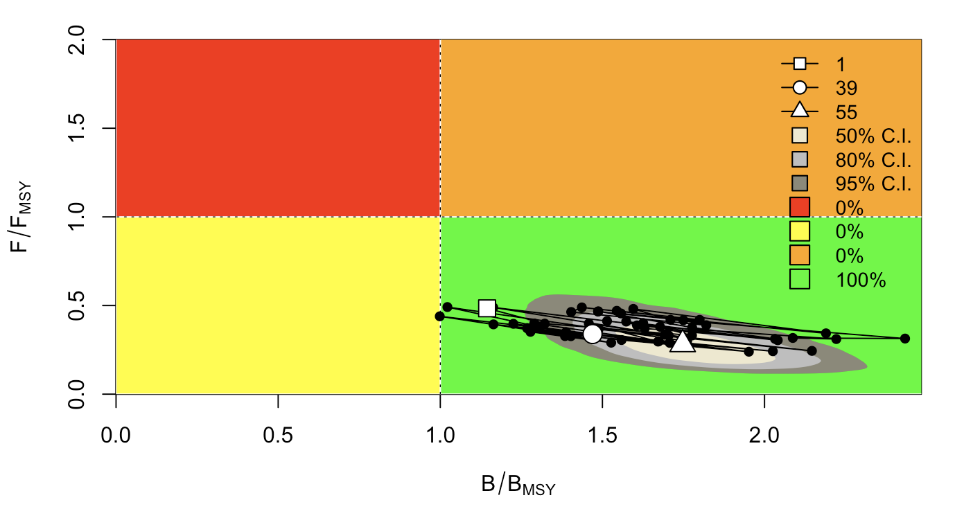
Model 2: Surplus Production with Informative Priors
Notes:
This scenario imitates a fishery in which there is greater biological certainty regarding the true r and K values. In this, the values of r and K are centered at their true value in the simulation, with reduced variation given in the standard deviation.
Both models show posterior estimates for MSY, K, and r that contain the true value. The mean of each of these values is closer to the true value in Scen A than in Scen B, which is to be expected. Additionally, the addition of informative priors reduces the uncertainty in the posterior, as seen in the reduced with of the confidence interval. Both models risk some extent of overharvest, as their estimate of MSY is greater than true MSY.

Slide 8
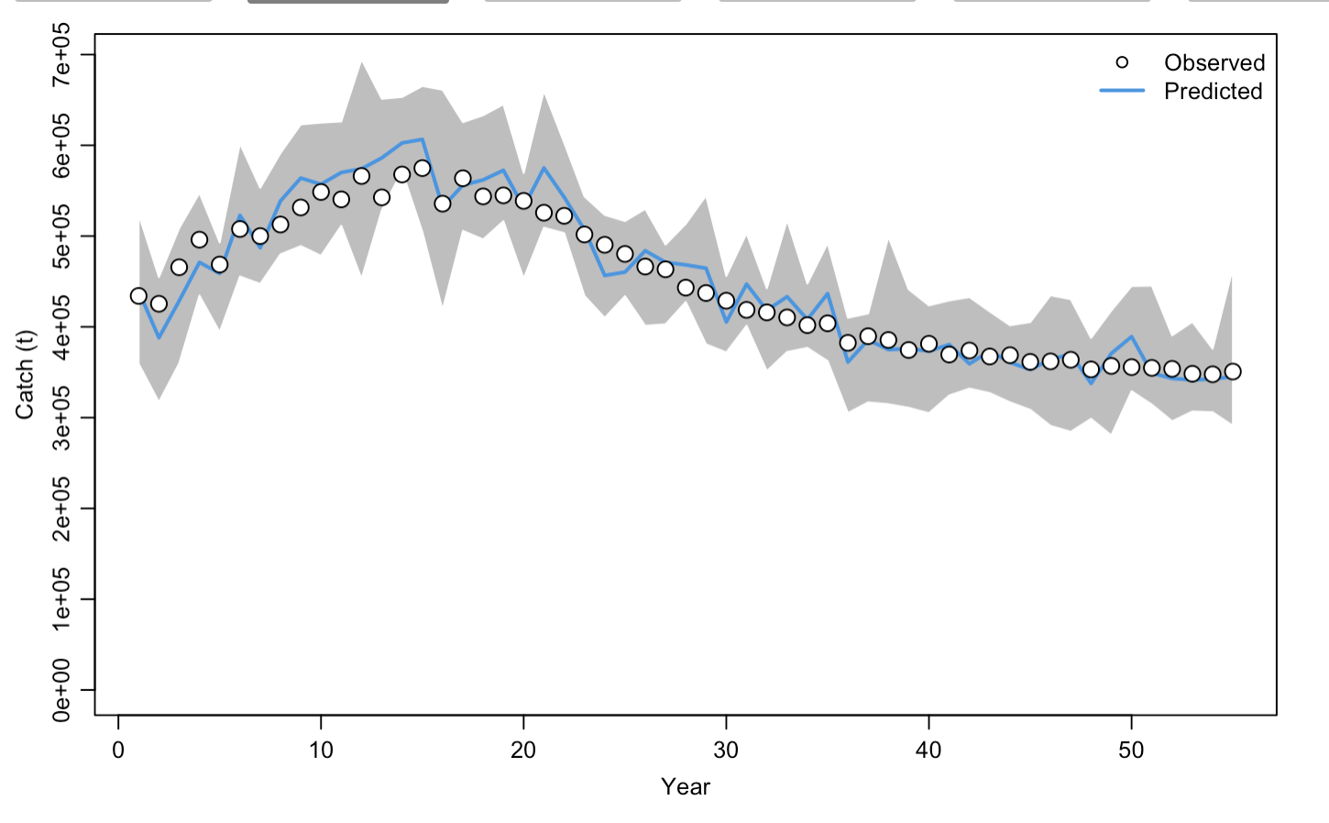
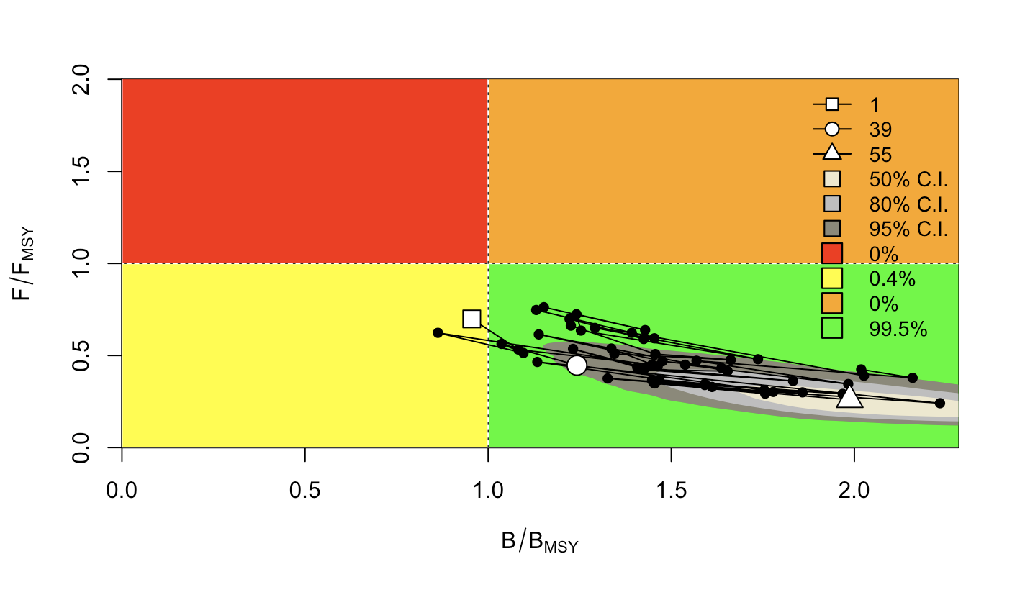
Model 3: Piecewise q
Notes:
This model uses the sets.q function within JABBA to assign catchability to different CPUE indices. This subsets catchability into five different time periods.

Slide 9
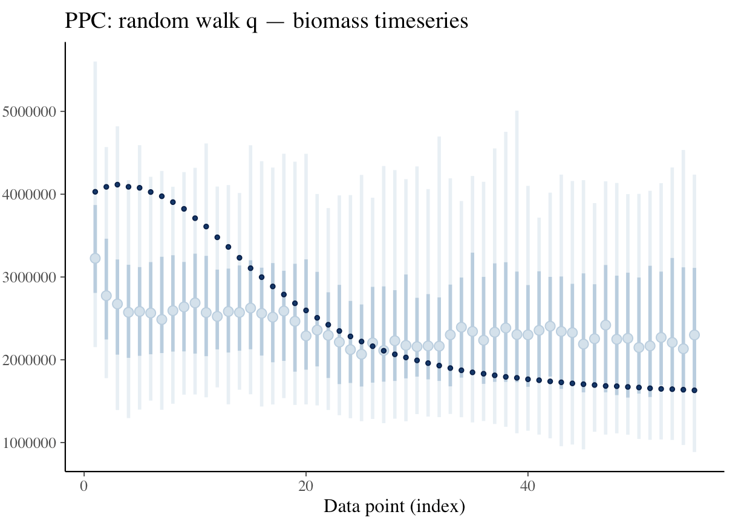
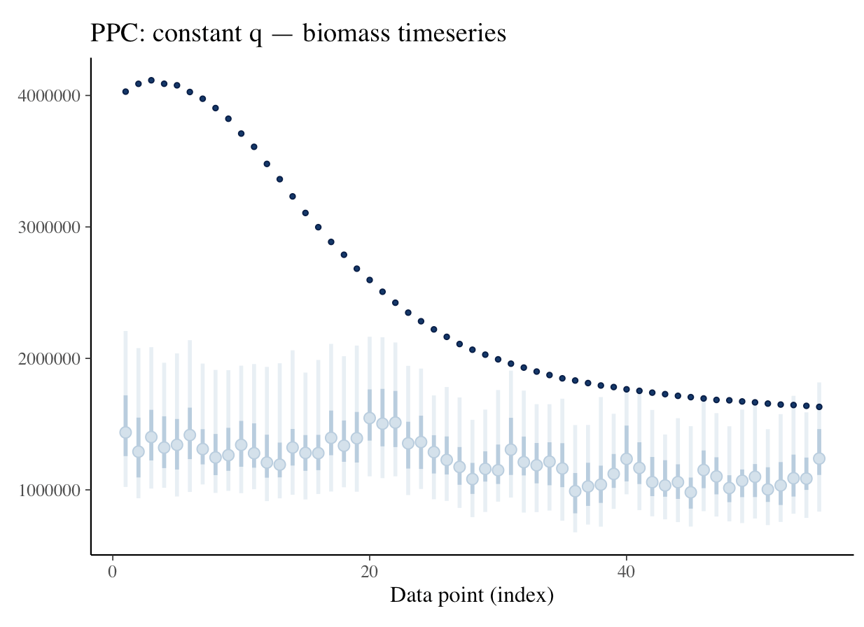
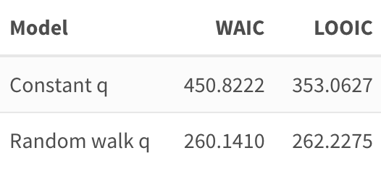
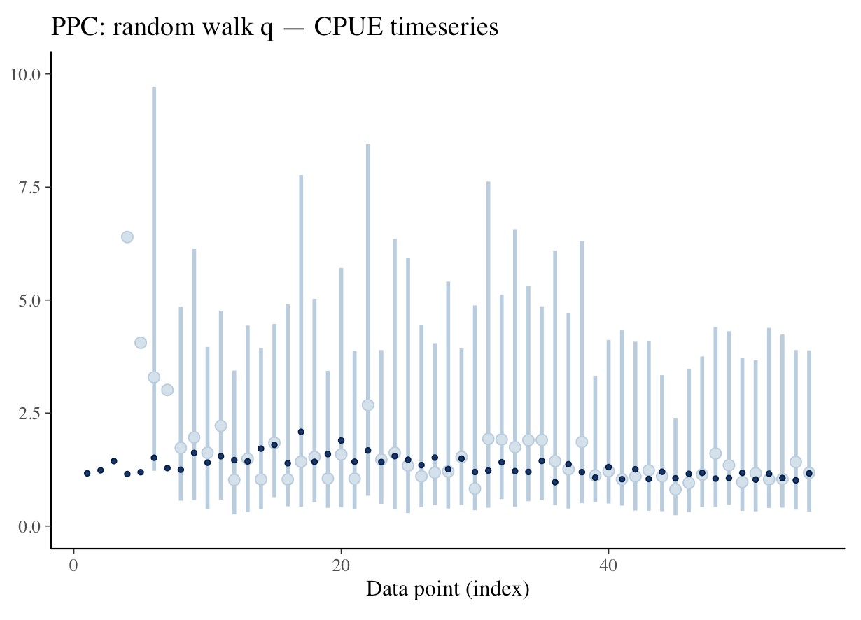
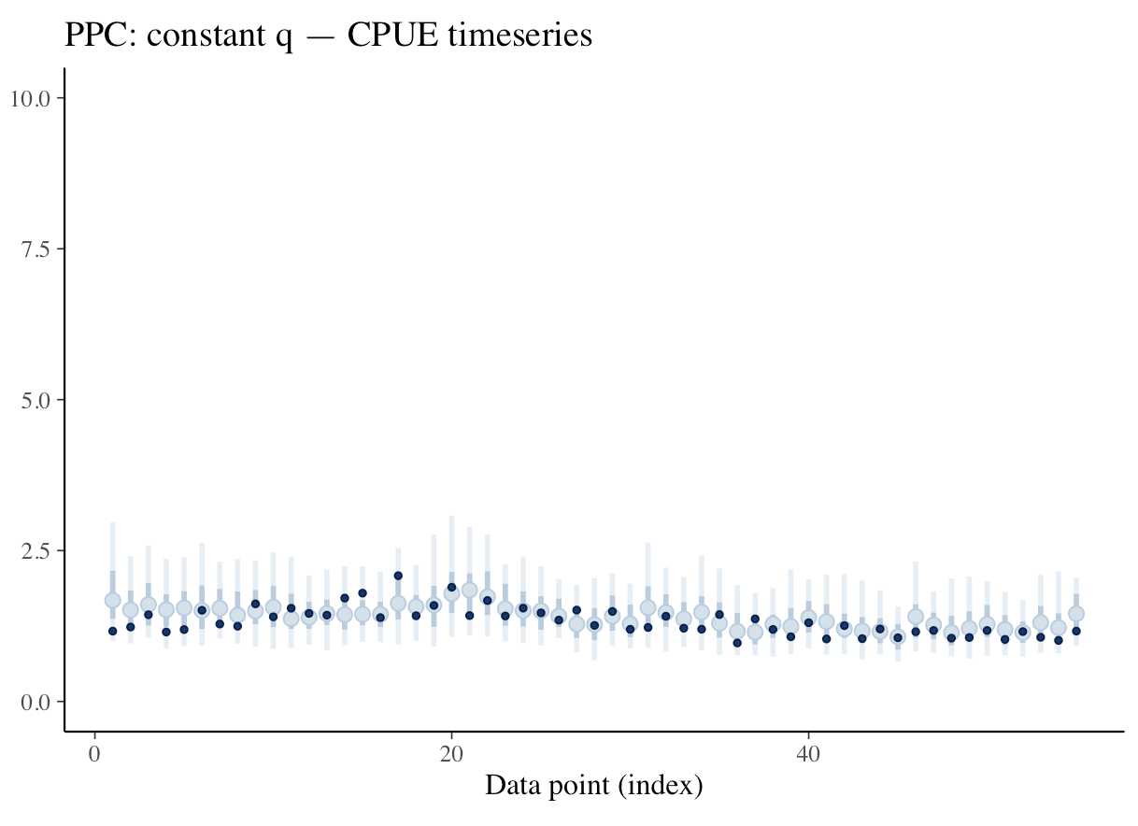
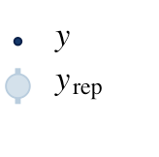
Model 4: Stan Model with Random Walk
Notes:
This model is a Stan model that encodes for a random walk on q in order to allow the model to adapt to variable fisher effiency, rather than forcing it to be constant or piecewise.
Comparing the random walk and constant q Stan models using WAIC and LOOIC, the random walk model is preferred. This indicates that the random walk on q improves the predictive performance of a model when fitting to data that has adaptive fisher behavior.

Slide 10
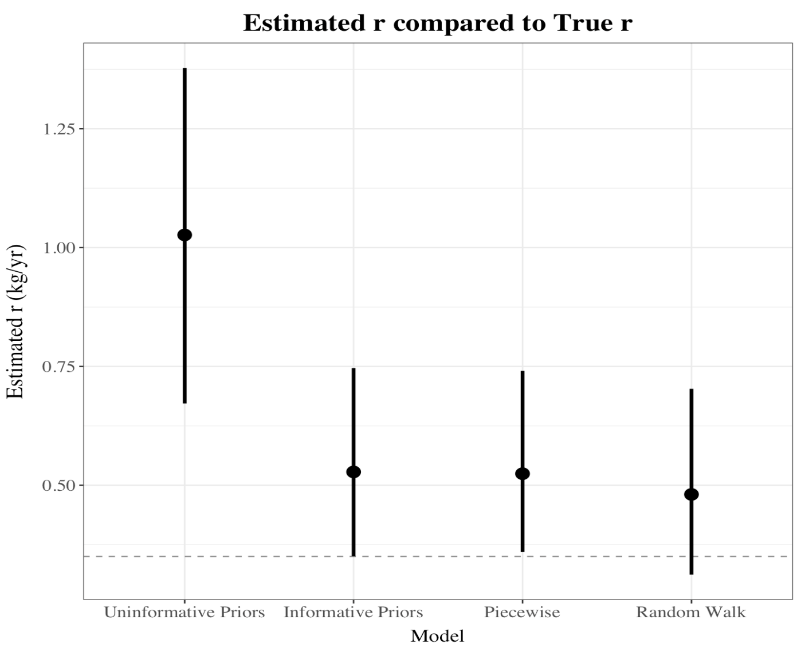
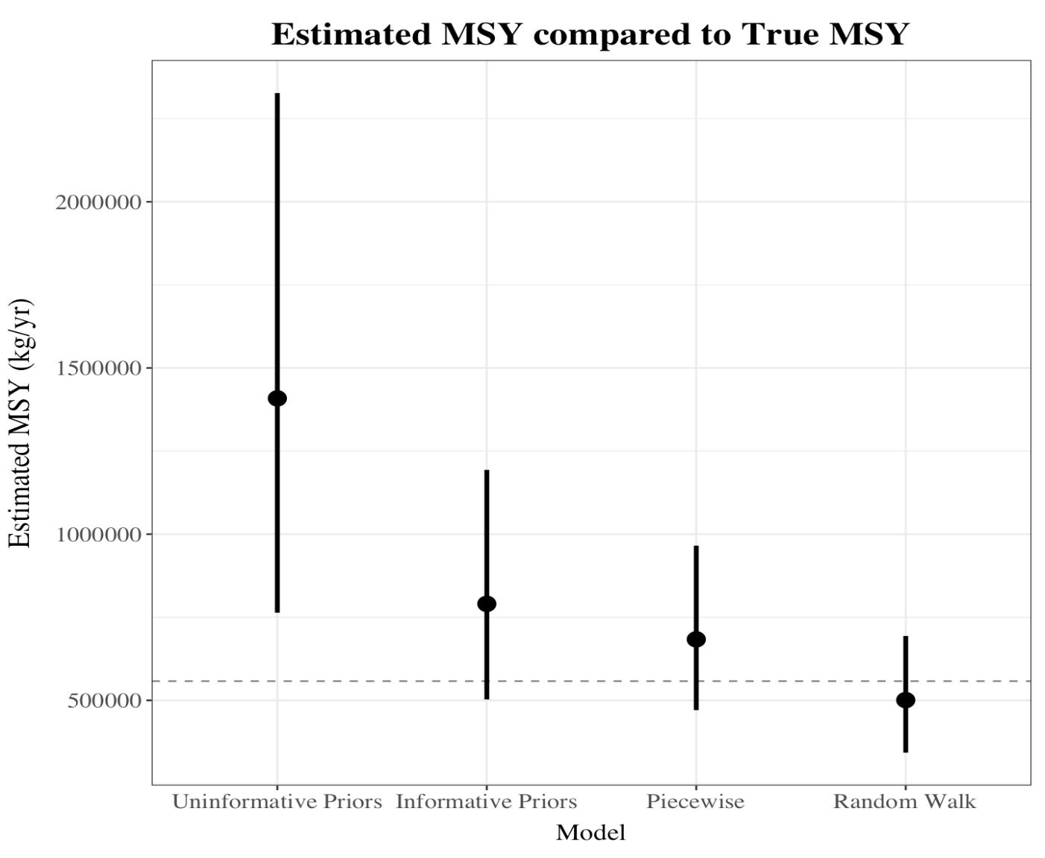
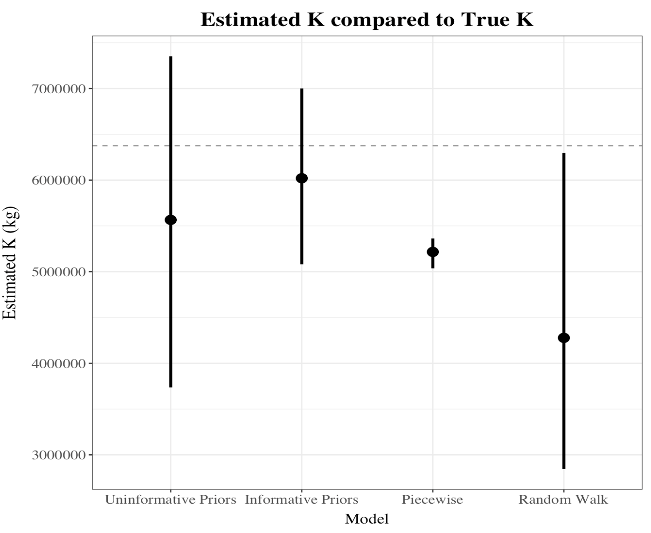
Model Comparison
Notes:
The Random Walk model and informative priors models appear to do the best at estimating MSY, accounting for K and r. While the piecewise model estimates MSY somewhat successfully it is severely biased in its estimate for K.
Overarchingly, these results indicate that data that has a variable (rather than constant) q increases uncertainty when using standard methods for fisheries stock assessment. These have the potential to indicate that the stock is in better condition than it truly is and overestimate MSY, both of which may influence policy setting and result in overharvest.
The use of informative priors, that suggest a strong biological understanding of the fisheries system, work to combat this and decrease the uncertainty in posterior estimatates of stock parameters. Putting a random walk on q performs similarly in its ability to extract accurate estimates of MSY, but can be more time intensive to produce.
These show that it is necessary to consider both the behavior of fishers as well as biological parameters when conducting stock assessments. Given that fisheries policy utilizes levers (TAC, ITQs, etc.) that aim to target human behavior, an understanding of human behavior as well as fisheries parameters allows for decreased uncertainty and greater accuracy in resultant stock assessments.

