Slide 1

REWERSE WG I3:
Composition Framework
&
Tool demo
5 December 2006

Slide 2
Motivational example: Xcerpt modules
R1
subClassOf(X,Y) :-
rdfs:subClassOf(X,Y).
subClassOf(X,Y) :-
rdfs:subClassOf(X,Z),
subclassOf(Z,Y).
Writing
owl:Class
rdfs:subClassOf
R2
CONSTRUCT
writings [ all var X ]
FROM
or { var X rdf:type “Writing”,
and {
var X rdf:type var S,
subClassOf(S, “Writing”)
} }
END
Novel
owl:Class
rdfs:subClassOf
Historical
Novel
owl:Class

Slide 3
http://www.xcerpt.org/inference/subclassof.rx
subClassOf(X,Y) :-
rdfs:subClassOf(X,Y).
subClassOf(X,Y) :-
rdfs:subClassOf(X,Z),
subclassOf(Z,Y).
module
Writing
owl:Class
import http://www.xcerpt.org/inference/subclassof.rx
CONSTRUCT
writings [ all var X ]
FROM
or { var X rdf:type “Writing”,
and {
var X rdf:type var S,
subClassOf(S, “Writing”)
} }
END
rdfs:subClassOf
Novel
owl:Class
program
rdfs:subClassOf
Historical
Novel
owl:Class
data
“White Mughals” rdf:type “Historical Novel”
…
Notes:
Maybe have the program as a pseudo-program?

Slide 4
Outline
Preliminaries
  Xcerpt
  Fragment components
Composition Framework
  Complex composition operators
Examples
  Modules for Xcerpt, revisited
  Ontology modeling decisions
Conclusions

Slide 5
Xcerpt: Introduction (1/2)
Query and transformation language for XML [Schaffertet al., 2004]
Data terms
  Model XML documents
    <book><title>T</title><author>A</author></book>
    book [ title [ “T” ], author [ “A” ] ]
Query terms
  Patterns matching data terms resulting in answer substitutions
  book [ title [ var X ], author [ var Y ] ] → { X / “T”, Y / “A” }
Construct terms
  Data terms with variables to be instantiated
  Builds data terms by applying answer substitutions

Slide 6
Xcerpt: Introduction (2/2)
Xcerpt programs:
  A set of rules of the form:
  head is a construct term
  body is a set of query terms connected using connectives:
    AND or OR
CONSTRUCT
head
FROM
body
END
GOAL
head
FROM
body
END

Slide 7
Xcerpt: Example I
CONSTRUCT
results {
all result {
var Title,
all var Author
}
}
FROM
bib {{
book {{
var Title → title ,
authors {{
var Author → author
}}
}}
}}
END
List all Authors for each Title
data
bib [ book [ title [ “White Mughals” ], authors [ author [ “William Dalrymple” ] ] ] … ]

Slide 8
Xcerpt: Example II
List all Titles for each Author
CONSTRUCT
results {
all result {
all var Title,
var Author
}
}
FROM
bib {{
book {{
var Title → title ,
authors {{
var Author → author
}}
}}
}}
END
data
bib [ book [ title [ “White Mughals” ], authors [ author [ “William Dalrymple” ] ] ] … ]

Slide 9
Xcerpt: Example I + II
CONSTRUCT
results {
all result {
var Title,
all var Author
}
}
FROM
bib {{
book {{
var Title → title ,
authors {{
var Author → author
}}
}}
}}
END
CONSTRUCT
results {
all result {
all var Title,
var Author
}
}
FROM
bib {{
book {{
var Title → title ,
authors {{
var Author → author
}}
}}
}}
END
data
bib [ book [ title [ “White Mughals” ], authors [ author [ “William Dalrymple” ] ] ] … ]

Slide 10
Xcerpt: Example I + II
CONSTRUCT
results {
all result {
var Title,
all var Author
}
}
FROM
bib {{
book {{
var Title → title ,
authors {{
var Author → author
}}
}}
}}
END
CONSTRUCT
results {
all result {
all var Title,
var Author
}
}
FROM
bib {{
book {{
var Title → title ,
authors {{
var Author → author
}}
}}
}}
END
bib {{
book {{
var Title → title ,
authors {{
var Author → author
}}
}}
}}
bib {{
book {{
var Title → title ,
authors {{
var Author → author
}}
}}
}}
data
bib [ book [ title [ “White Mughals” ], authors [ author [ “William Dalrymple” ] ] ] … ]

Slide 11
Fragment components
Construct Component
Variable
Component
Variable
Component
CONSTRUCT
results {
all result {
,
all
}
}
FROM
END
var Title
var Author
bib {{
book {{
→ title ,
authors {{
→ author
}}
}}
}}
Query Component
= variation point
Notes:
“Configure components”
Explain Fragment comopnents, slots (hooks), bind (extend)
Use the phrase: underspecified fragments of the core language (Xcerpt)
Emphasize the flexibility we are provided with wrt. granularity
Can simulate aspects etc.
Explain types

Slide 12
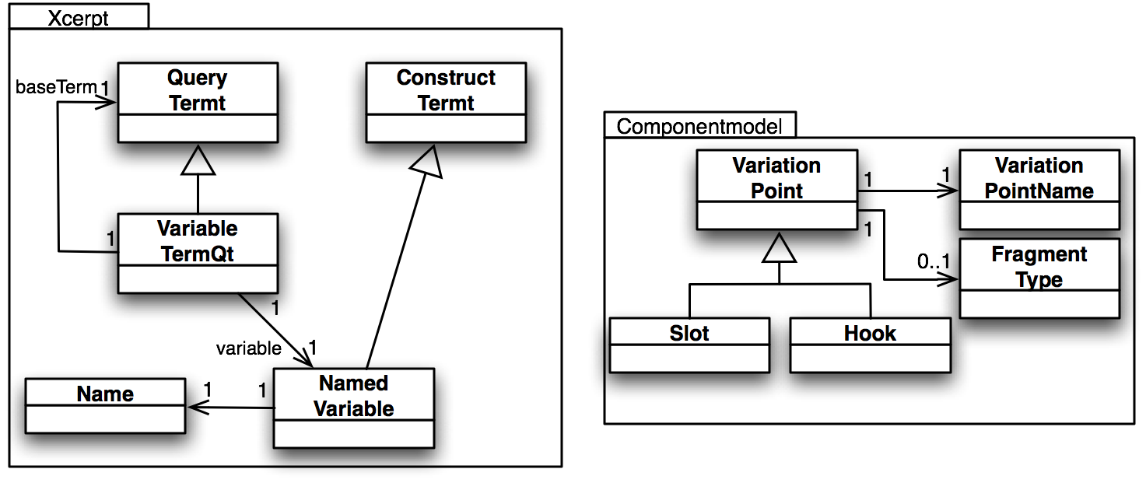
Component model: Xcerpt
Query Component
bib {{
book {{
var Title → title,
authors {{
var Author → author
}}
}}
}}
Type: NamedVariable
Notes:
Extend the Xcerpt grammar with slots for Query, Variable etc.

Slide 13
Component model: Xcerpt
= slot
Query Component
bib {{
book {{
→ title,
authors {{
→ author
}}
}}
}}
Type: ???
Notes:
Extend the Xcerpt grammar with slots for Query, Variable etc.

Slide 14
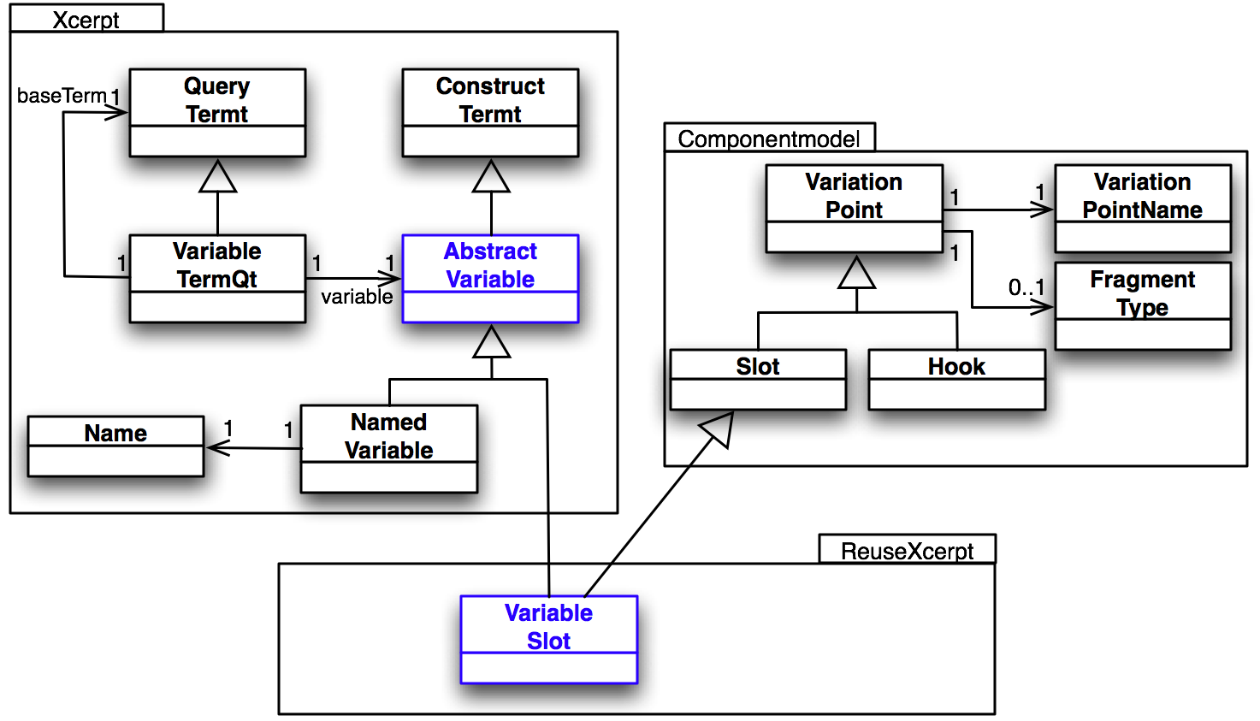
Component model: Xcerpt
= slot
Query Component
bib {{
book {{
→ title,
authors {{
→ author
}}
}}
}}
Type: VariableSlot

Slide 15
Primitive Xcerpt composition – under the hood
…
Slot
Fragment
Common upper-level
models
Program
…
subset of
Metamodel of Xcerpt+
-
Model of the language
rules : CQRule
CQRule
con : Construct
query : QueryTerm
0..*
ASTs of fragments
instance of
Instance of the metamodel
-
Model of a program
CONSTRUCT
…
FROM
…
END
in {
resource {
…
}
}
CONSTRUCT
results { all result {
var Title, all var Author
} }
FROM
in {
resource { "http://bn.com" } ,
bib {{ book {{
var Title → title ,
authors {{ var Author→ author
}} }} }} }
END
→
var Title
var Author

Slide 16
Primitive composition: Summary
Invasive software composition [Aßmann, 2003]
Language independent
  Extend any language to support primitive composition operators for:
    Binding slots (genericity)
    Extending hooks (extensibility)
Can simulate existing grey-box composition techniques
  E.g. aspect orientation
Flexible and general approach, but:
  Not able to address specific language’s needs

Slide 17
Outline
Preliminaries
  Xcerpt
  Fragment components
Composition Framework
  Complex composition operators
Examples
  Modules for Xcerpt, revisited
  Ontology modeling decisions
Conclusions

Slide 18
Fragment components, revisited
Construct Component
Variable
Component
Variable
Component
CONSTRUCT
results {
all result {
,
all
}
}
FROM
END
var Title
var Author
bib {{
book {{
→ title ,
authors {{
→ author
}}
}}
}}
Query Component
= variation point

Slide 19
Composition program
Construct Component
Variable
Component
Variable
Component
CONSTRUCT
results {
all result {
,
all
}
}
FROM
END
bind /title.variable
var Title
var Author
<<S: var1>>
<<S: var2>>
bind /author.variable
bind /title.variable
bib {{
book {{
→ title ,
authors {{
→ author
}}
}}
}}
<<S: query>>
<<S: var1>>
bind /myquery.query
<<S: var2>>
Query Component
bind /author.variable
= variation point

Slide 20
Composition program
Composition program
// load fragments
fragment xcerpt.ConstructRule Program = /main.xcerpt;
fragment xcerpt.Variable Title = /title.variable;
fragment xcerpt.Variable Author = /author.variable;
fragment xcerpt.Query Query = /myquery.query;
// bind fragments
bind var1 on Program with Title;
bind var2 on Program with Author;
bind var1 on Query with Title;
bind var2 on Query with Author;
bind query on Program with Query;
// output result
print Program;
/title.variable
var Title
/main.xcerpt
CONSTRUCT
results {
all result {
all
}
}
FROM
END
/author.variable
bind /title.variable
var Author
<<S: var1>> ,
<<S: var2>>
bind /author.variable
<<S: query>>
bind /title.variable
bib {{
book {{
→ title ,
authors {{
→ author
}}
}}
}}
<<S: var1>>
bind /author.variable
bind /myquery.query
<<S: var2>>
/myquery.query
Notes:
Composition programs are written in a composition language
We can abstract from the composition program and see such a description as a “complex composer”
We can thus imagine that we can define “complex composers” in the same composition language

Slide 21
Defining composers
Composer definition
define composer name (args) {
  // load fragments
  fragment xcerpt.ConstructRule Program = /main.xcerpt;
  fragment xcerpt.Variable Title = /title.variable;
  fragment xcerpt.Variable Author = /author.variable;
  fragment xcerpt.Query Query = /myquery.query;
  // bind fragments
  bind var1 on Program with Title;
  bind var2 on Program with Author;
  bind var1 on Query with Title;
  bind var2 on Query with Author;
  bind query on Program with Query;
  // output result
  print Program;
}
/title.variable
var Title
/main.xcerpt
CONSTRUCT
results {
all result {
all
}
}
FROM
END
/author.variable
bind /title.variable
var Author
<<S: var1>> ,
<<S: var2>>
bind /author.variable
<<S: query>>
bind /title.variable
bib {{
book {{
→ title ,
authors {{
→ author
}}
}}
}}
<<S: var1>>
bind /author.variable
bind /myquery.query
<<S: var2>>
/myquery.query
Notes:
Composition programs are written in a composition language
We can abstract from the composition program and see such a description as a “complex composer”
We can thus imagine that we can define “complex composers” in the same composition language

Slide 22
Complex compositions: Summary
Beyond primitive composers: bind and extend
  User-definable complex composers
Allow language targeted composition operators
Capable composition language needed, for:
  Writing composition programs
  Defining new composers
Implemented and integrated into Eclipse
  E-CoMoGen
  [demo at the end]

Slide 23
Outline
Preliminaries
  Xcerpt
  Fragment components
Composition Framework
  Complex composition operators
Examples
  Modules for Xcerpt, revisited
  Ontology modeling decisions
Conclusions

Slide 24
Example I: Modules for Xcerpt, revisited
Motivation
  No module system exists for Xcerpt
    Globally re-usable rules/functions (XQuery, Logic Programming)
  Compose instead of implementing into an Xcerpt engine
General module system requirements:
  Make available rules to calling module
    Import and Export
  Code protection
    Called module protection
    Calling module protection
Called module
import
export
Calling module

Slide 25
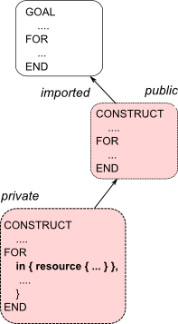

(1) Xcerpt modules: importation
Simple import composer definition
define composer reusexcerpt.ImportComposer(moduleLocation, ruleName, args) {
fragment xcerpt.Program module = -> moduleLocation;
foreach (element : args) {
bind ->element.slot on module with element.value;
}
return module.statements;
}

Slide 26
(1) Xcerpt modules: importation
http://www.xcerpt.org/subclassof.rx
subClassOf(X,Y) :-
rdfs:subClassOf(X,Y).
subClassOf(X,Y) :-
rdfs:subClassOf(X,Z),
subclassOf(Z,Y).
CONSTRUCT
writings [ all var X ]
FROM
or { var X rdf:type “Writing”,
and {
var X rdf:type var S,
subClassOf(S, “Writing”)
} }
END
subClassOf(X,Y) :-
rdfs:subClassOf(X,Y).
subClassOf(X,Y) :-
rdfs:subClassOf(X,Z),
subclassOf(Z,Y).
module
import http://www.xcerpt.org/subclassof.rx
CONSTRUCT
writings [ all var X ]
FROM
or { var X rdf:type “Writing”,
and {
var X rdf:type var S,
subClassOf(S, “Writing”)
} }
END
compose
program
program’

Slide 27
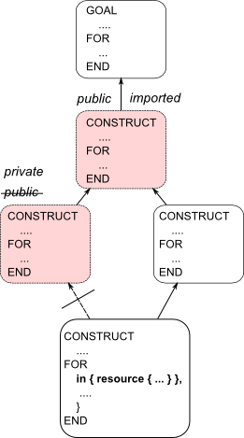
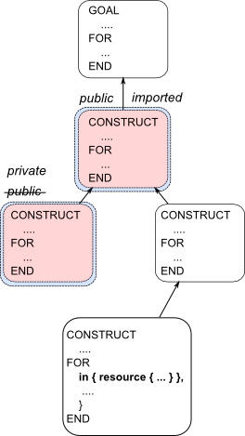
(2) Xcerpt modules: code protection
define composer reusexcerpt.ImportComposer(moduleLocation, ruleName, args) {
fragment xcerpt.Program module = -> moduleLocation;
foreach (r : module.statements) {
if (r instanceof reusexcerpt.ModifiedConstruct
&& r.modifier instanceof reusexcerpt.PublicModifier
&& r.construct.construct.localSpec.label equals ruleName) {
bind r with r.construct;
} else {
if (r instanceof reusexcerpt.ModifiedConstruct) {
bind r with r.construct;
fragment xcerpt.ConstructQueryRule r = r.construct;
}
fragment xcerpt.NCName secretName = ? .xcerpt;
fragment xcerpt.ConstructTerm ct = r.construct;
fragment xcerpt.ConstructTerm ctWrapper = ’<<secretName>> [ <<hiddenCt>> ]’.rxcerpt;
bind hiddenCt on ctWrapper with ct;
bind secretName on ctWrapper with secretName;
bind ct with ctWrapper;
foreach(rule : module.statements) {
traverse(qt : rule.query) {
if (qt instanceof xcerpt.StructuredQt) {
if (qt.localSpec.label equals ct.localSpec.label) {
fragment xcerpt.QueryTerm qtWrapper = ’<<secretName>> [ <<hiddenQt>> ]’.rxcerpt;
bind hiddenQt on qtWrapper with qt;
bind secretName on qtWrapper with secretName;
bind qt with qtWrapper;
}
prune;
} }
}
One solution: wrapping

Slide 28
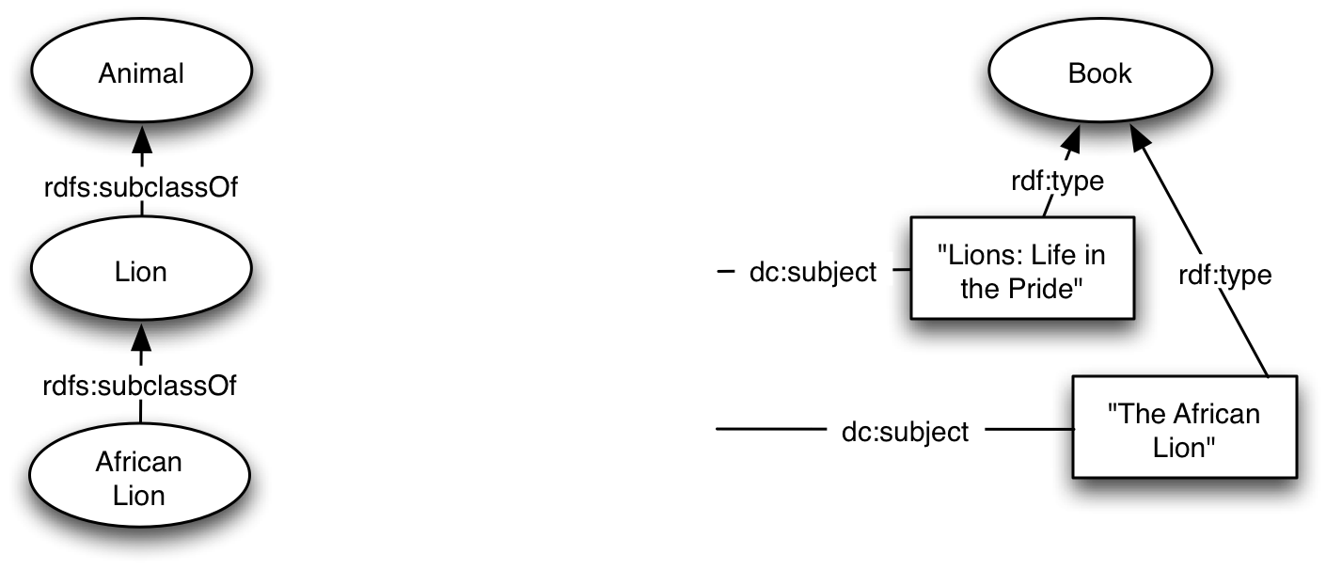
Example II: Ontology modeling decisions
[Reference: http://www.w3.org/TR/swbp-classes-as-values]

Slide 29
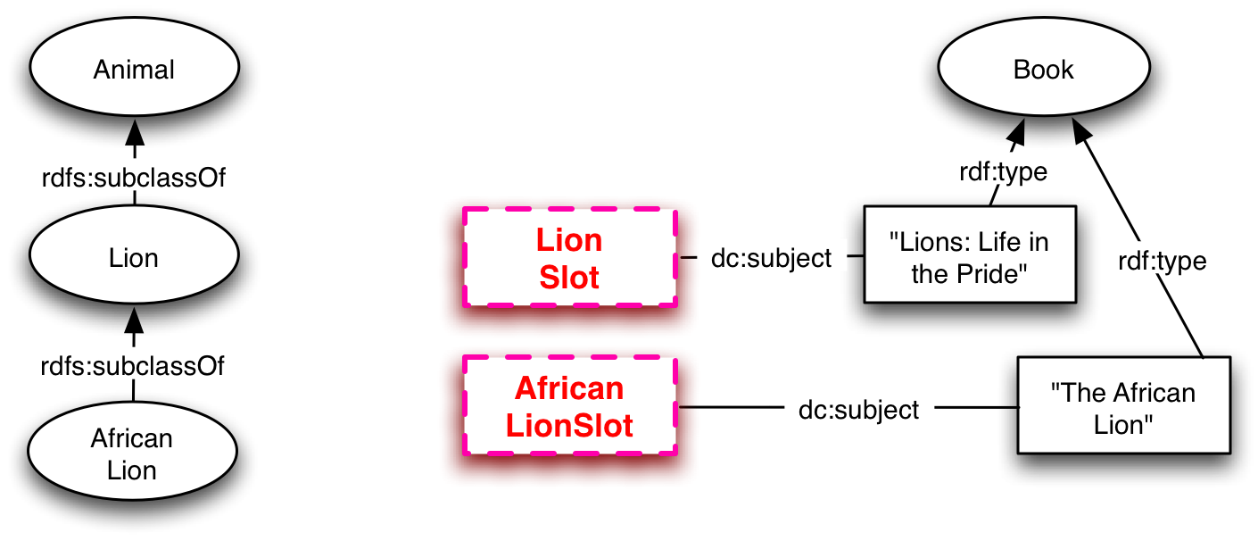
Example II: Ontology fragment components
:LionsLifeInThePrideBook
a :Book;
:bookTitle "Lions: Life in the Pride";
dc:subject << LionSlot >> .
:TheAfricanLionBook
a :Book;
:bookTitle "The African Lion";
dc:subject << AfricanLionSlot >> .

Slide 30
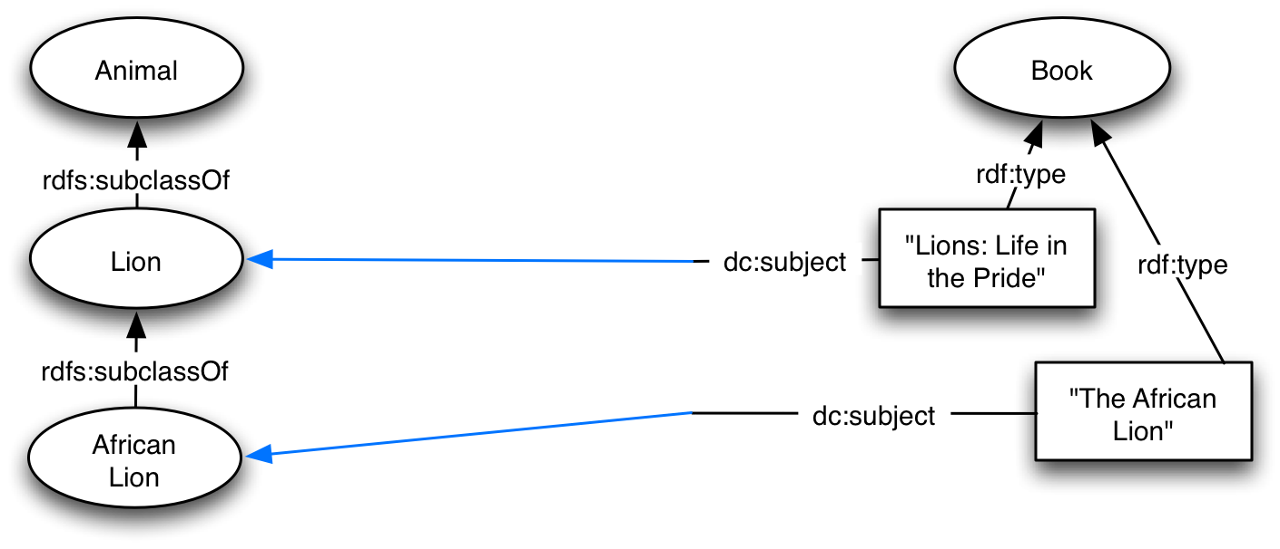
Example II: Ontology composer I
define composer n3pcl.ClassAsPropertyValue1(ontology, valueSlot, valueClassName) {
bind ->valueSlot on ->ontology with valueClassName;
}

Slide 31
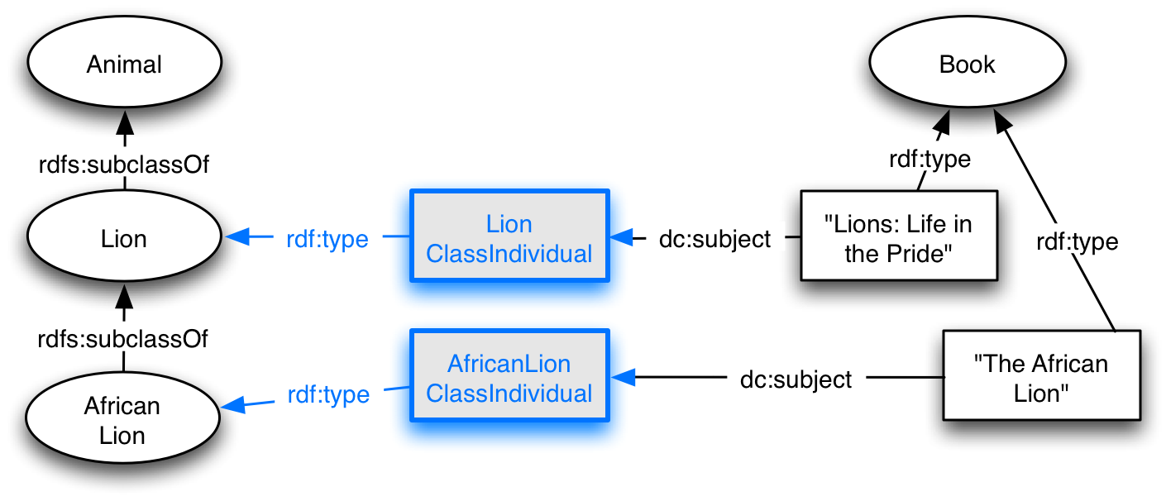
Example II: Ontology composer II
define composer n3pcl.ClassAsPropertyValue2(ontology, valueSlot, valueClassName) {
fragment n3.Resource individualName = ':' + valueClassName + 'ClassIndividual'.n3;
fragment n3.Triple individual = '<<individualName>> a <<className>> .'.rn3;
bind individualName on individual with individualName;
bind className on individual with valueClassName;
bind ->valueSlot on ->ontology with individualName;
bind ontology.subFragment with 'statements[-1]'.fcp;
extend ->ontology with individual;
}

Slide 32
Conclusions
Grey-box composition interesting for the Semantic Web
Based on:
  Language independent primitive composers
Extended with:
  User-definable targeted complex composition operators
Flexible framework to invent and experiment with composition ideas
Examples:
  Query languages (Xcerpt module system)
  Ontology languages (delaying design decisions)
Implementation (E-CoMoGen) integrates into Eclipse

Slide 33
The end
Thank you for your attention!
Now: E-CoMoGen Demo
http://www.st.inf.tu-dresden.de/reuseware

