Slide 1
Reuseware Composition Framework http://reuseware.org
Working Group I3: Annual Meeting
or
Mashupware (v 2.0)
U. Aßmann, J. Henriksson, J. Johannes, S. Zschaler
(Dresden)
February 28, 2007

Slide 2
Component-based development with Reuseware
1
2
components
Language
requirements
Extend
language with
new constructs
Compose
Define suitable
operators
4
3

Slide 3

Component-based development with Reuseware
1
2
components
Language
requirements
Extend
language with
new constructs
Compose
Define suitable
operators
4
3

Slide 4
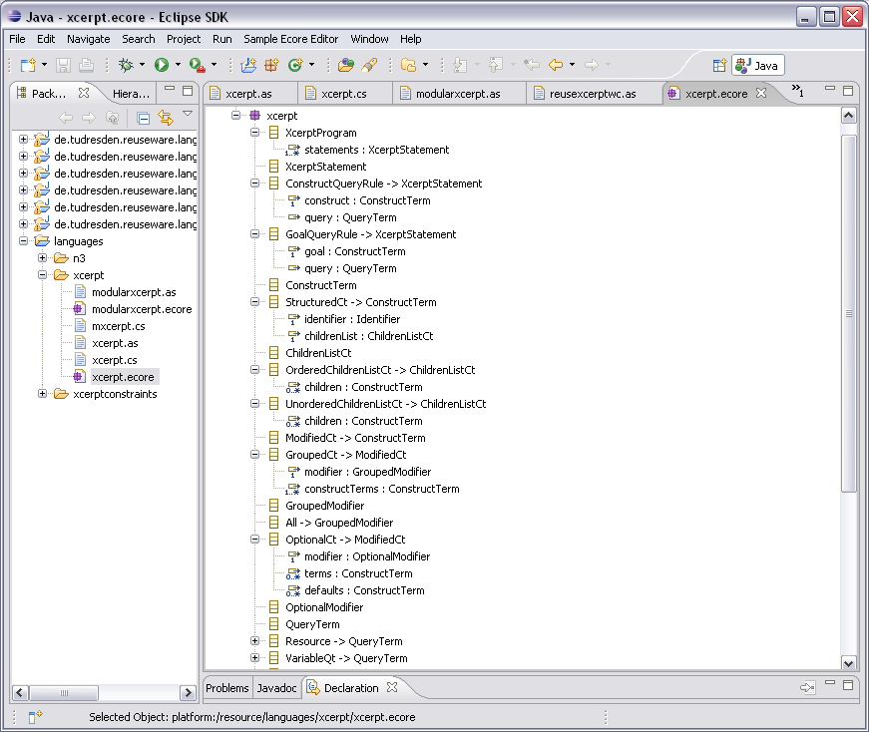

Language definition
Languages described
in Ecore (MOF)
models
Ecore model of Xcerpt

Slide 5
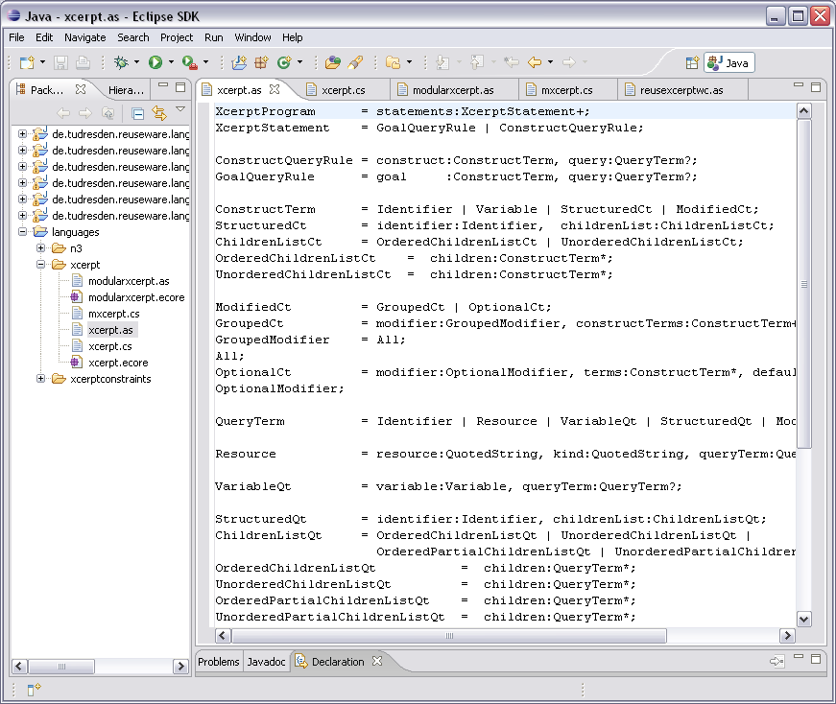
Language definition
EBNF-like syntax
for Ecore models
available
Separation of abstract
and concrete syntax
Abstract syntax of Xcerpt

Slide 6
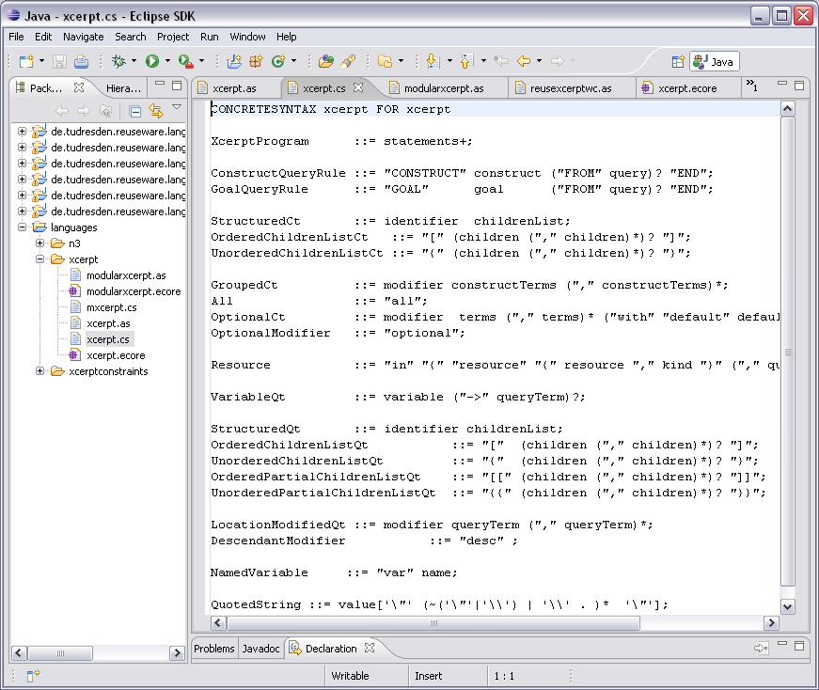
Language definition
EBNF-like syntax
for Ecore models
available
Separation of abstract
and concrete syntax
Concrete syntax of Xcerpt

Slide 7
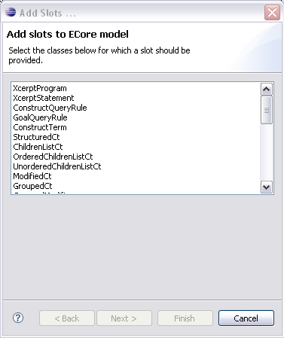
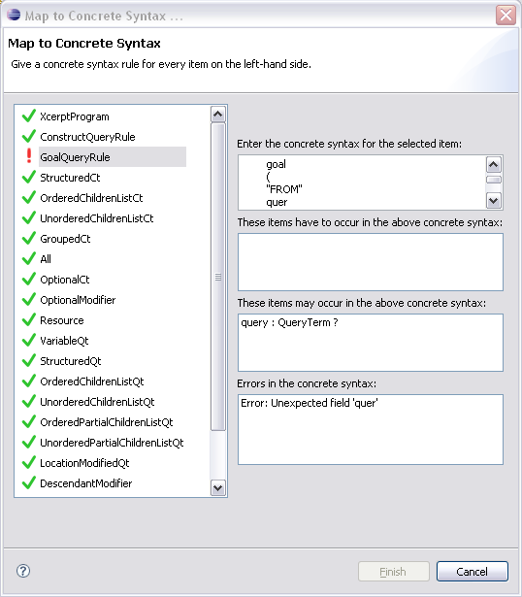
Guided language extension support
Adding constructs for modularity
Defining concrete syntax

Slide 8

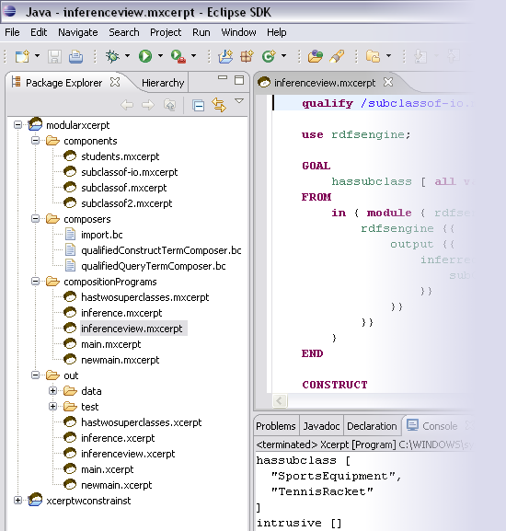
Reuseware
project
Component
library
User-
defined
operators
Composition
program
Composition
recipes/
programs
Composition
results
Result
executed

Slide 9

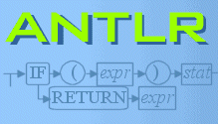

The Reuseware tool
Integrates into Eclipse
for handling your Reuse projects etc.
Parser generation
for your languages
Code generation
for each composition environment
Syntax highlighting
of your languages

Slide 10

See you at the demo (I3)!
Composition
  Reuseware Composition Framework
  Xcerpt module system
  Constraining compositions
  Ontology composition (Notation3)
    Delaying design decisions
Typing XcerptT: types for Xcerpt
Hybrid reasoning DigXcerpt: Xcerpt + DIG

