Slide 1

REWERSE WG I3:
Composition Framework
Jakob Henriksson, 7 December 2006, Munich

Slide 2
Outline
Motivating example: Xcerpt modules
Primitive composition (operators)
  Fragment components
  Component model
Complex composition operators
Example
  Modules for Xcerpt, revisited
Lazy composition
Conclusions

Slide 3
Motivational example: Xcerpt modules
R1
subClassOf(X,Y) :-
rdfs:subClassOf(X,Y).
subClassOf(X,Y) :-
rdfs:subClassOf(X,Z),
subclassOf(Z,Y).
Writing
owl:Class
rdfs:subClassOf
R2
CONSTRUCT
writings [ all var X ]
FROM
or { var X rdf:type “Writing”,
and {
var X rdf:type var S,
subClassOf(S, “Writing”)
} }
END
Novel
owl:Class
rdfs:subClassOf
Historical
Novel
owl:Class

Slide 4
http://www.xcerpt.org/inference/subclassof.rx
subClassOf(X,Y) :-
rdfs:subClassOf(X,Y).
subClassOf(X,Y) :-
rdfs:subClassOf(X,Z),
subclassOf(Z,Y).
module
Writing
owl:Class
import http://www.xcerpt.org/inference/subclassof.rx
CONSTRUCT
writings [ all var X ]
FROM
or { var X rdf:type “Writing”,
and {
var X rdf:type var S,
subClassOf(S, “Writing”)
} }
END
rdfs:subClassOf
Novel
owl:Class
program
rdfs:subClassOf
Historical
Novel
owl:Class
data
“White Mughals” rdf:type “Historical Novel”
…
Notes:
Maybe have the program as a pseudo-program?

Slide 5
Xcerpt: Introduction (1/2)
Query and transformation language for XML [Schaffertet al., 2004]
Data terms
  Model XML documents
    <book><title>T</title><author>A</author></book>
    book [ title [ “T” ], author [ “A” ] ]
Query terms
  Patterns matching data terms resulting in answer substitutions
  book [ title [ var X ], author [ var Y ] ] → { X / “T”, Y / “A” }
Construct terms
  Data terms with variables to be instantiated
  Builds data terms by applying answer substitutions

Slide 6
Xcerpt: Introduction (2/2)
Xcerpt programs:
  A set of rules of the form:
  head is a construct term
  body is a set of query terms connected using connectives:
    AND or OR
CONSTRUCT
head
FROM
body
END
GOAL
head
FROM
body
END

Slide 7
Xcerpt: Example I
CONSTRUCT
results {
all result {
var Title,
all var Author
}
}
FROM
bib {{
book {{
var Title → title ,
authors {{
var Author → author
}}
}}
}}
END
List all Authors for each Title
data
bib [ book [ title [ “White Mughals” ], authors [ author [ “William Dalrymple” ] ] ] … ]

Slide 8
Xcerpt: Example II
List all Titles for each Author
CONSTRUCT
results {
all result {
all var Title,
var Author
}
}
FROM
bib {{
book {{
var Title → title ,
authors {{
var Author → author
}}
}}
}}
END
data
bib [ book [ title [ “White Mughals” ], authors [ author [ “William Dalrymple” ] ] ] … ]

Slide 9
Xcerpt: Example I + II
CONSTRUCT
results {
all result {
var Title,
all var Author
}
}
FROM
bib {{
book {{
var Title → title ,
authors {{
var Author → author
}}
}}
}}
END
CONSTRUCT
results {
all result {
all var Title,
var Author
}
}
FROM
bib {{
book {{
var Title → title ,
authors {{
var Author → author
}}
}}
}}
END
data
bib [ book [ title [ “White Mughals” ], authors [ author [ “William Dalrymple” ] ] ] … ]

Slide 10
Xcerpt: Example I + II
CONSTRUCT
results {
all result {
var Title,
all var Author
}
}
FROM
bib {{
book {{
var Title → title ,
authors {{
var Author → author
}}
}}
}}
END
CONSTRUCT
results {
all result {
all var Title,
var Author
}
}
FROM
bib {{
book {{
var Title → title ,
authors {{
var Author → author
}}
}}
}}
END
bib {{
book {{
var Title → title ,
authors {{
var Author → author
}}
}}
}}
bib {{
book {{
var Title → title ,
authors {{
var Author → author
}}
}}
}}
data
bib [ book [ title [ “White Mughals” ], authors [ author [ “William Dalrymple” ] ] ] … ]

Slide 11
Fragment components
Construct Component
Variable
Component
Variable
Component
CONSTRUCT
results {
all result {
,
all
}
}
FROM
END
var Title
var Author
bib {{
book {{
→ title ,
authors {{
→ author
}}
}}
}}
Query Component
= variation point
Notes:
“Configure components”
Explain Fragment comopnents, slots (hooks), bind (extend)
Use the phrase: underspecified fragments of the core language (Xcerpt)
Emphasize the flexibility we are provided with wrt. granularity
Can simulate aspects etc.
Explain types

Slide 12
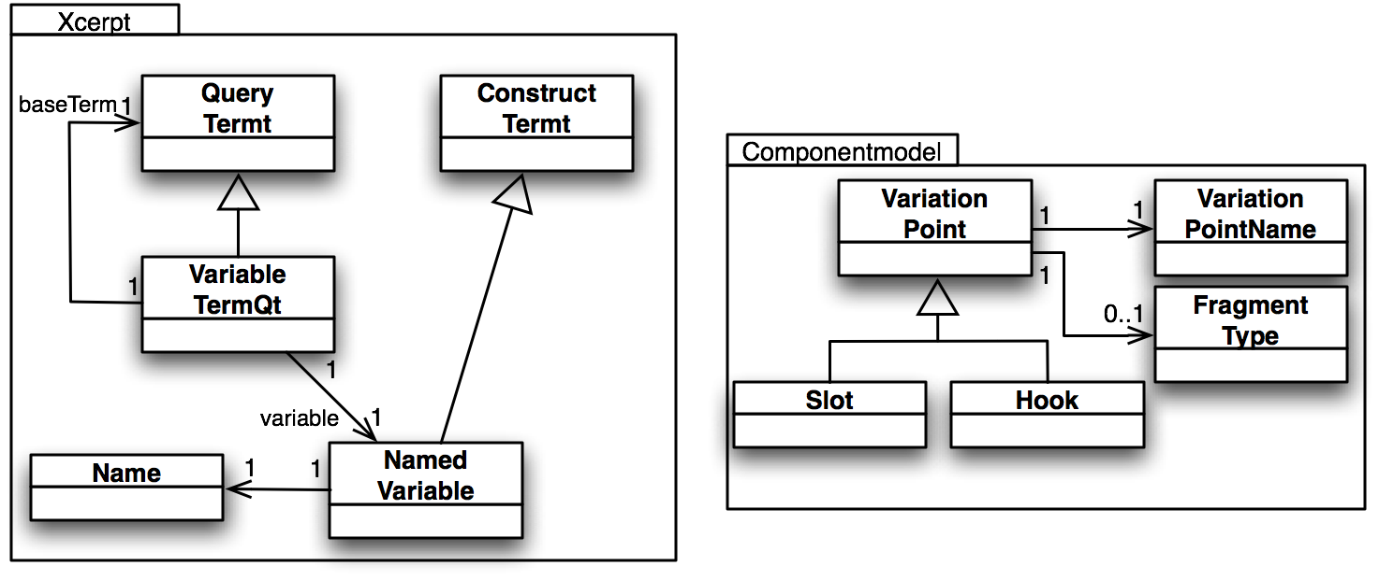
Component model: Xcerpt
Query Component
bib {{
book {{
var Title → title,
authors {{
var Author → author
}}
}}
}}
Type: NamedVariable
Notes:
Extend the Xcerpt grammar with slots for Query, Variable etc.

Slide 13
Component model: Xcerpt
= slot
Query Component
bib {{
book {{
→ title,
authors {{
→ author
}}
}}
}}
Type: ???
Notes:
Extend the Xcerpt grammar with slots for Query, Variable etc.

Slide 14
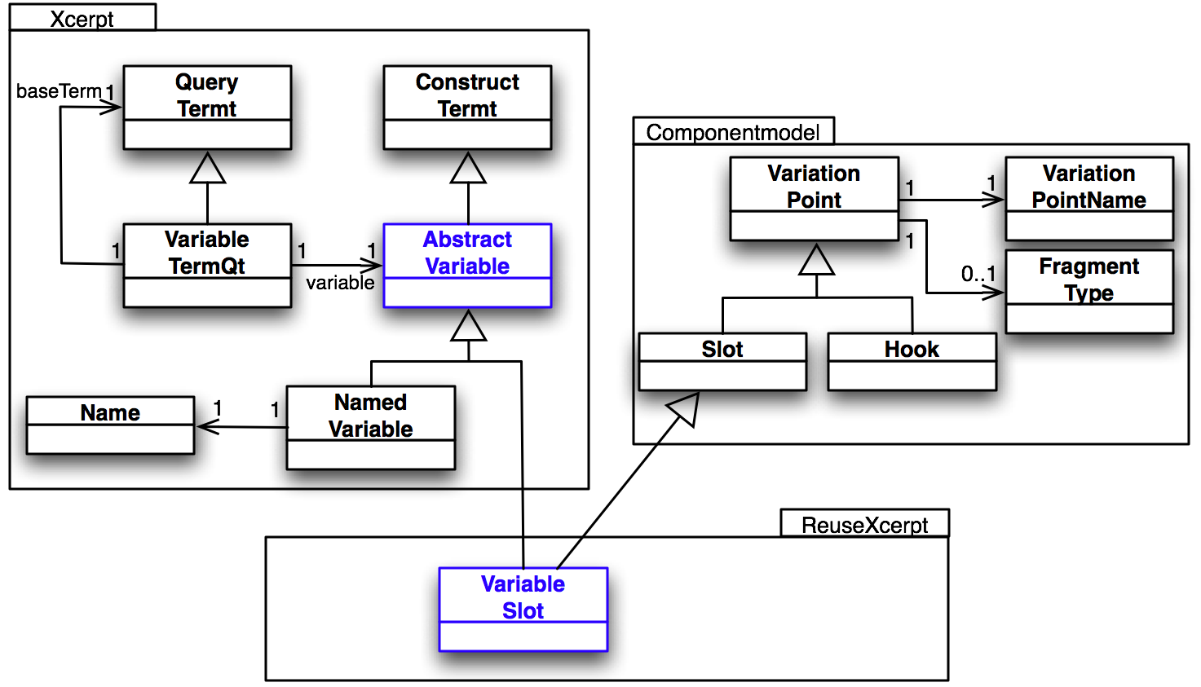
Component model: Xcerpt
= slot
Query Component
bib {{
book {{
→ title,
authors {{
→ author
}}
}}
}}
Type: VariableSlot

Slide 15
Primitive composition: Summary
Invasive software composition [Aßmann, 2003]
Language independent
  Extend any language to support primitive composition operators for:
    Binding slots (genericity)
    Extending hooks (extensibility)
Can simulate existing grey-box composition techniques
  E.g. aspect orientation
Flexible and general approach, but:
  Not able to address specific language’s needs

Slide 16
Outline
Motivating example: Xcerpt modules
Primitive composition (operators)
  Fragment components
  Component model
Complex composition operators
Example
  Modules for Xcerpt, revisited
Lazy composition
Conclusions

Slide 17
Fragment components, revisited
Construct Component
Variable
Component
Variable
Component
CONSTRUCT
results {
all result {
,
all
}
}
FROM
END
var Title
var Author
bib {{
book {{
→ title ,
authors {{
→ author
}}
}}
}}
Query Component
= variation point

Slide 18
Composition program
Construct Component
Variable
Component
Variable
Component
CONSTRUCT
results {
all result {
,
all
}
}
FROM
END
bind /title.variable
var Title
var Author
<<S: var1>>
<<S: var2>>
bind /author.variable
bind /title.variable
bib {{
book {{
→ title ,
authors {{
→ author
}}
}}
}}
<<S: query>>
<<S: var1>>
bind /myquery.query
<<S: var2>>
Query Component
bind /author.variable
= variation point

Slide 19
Composition program
Composition program
// load fragments
fragment xcerpt.ConstructRule Program = /main.xcerpt;
fragment xcerpt.Variable Title = /title.variable;
fragment xcerpt.Variable Author = /author.variable;
fragment xcerpt.Query Query = /myquery.query;
// bind fragments
bind var1 on Program with Title;
bind var2 on Program with Author;
bind var1 on Query with Title;
bind var2 on Query with Author;
bind query on Program with Query;
// output result
print Program;
/title.variable
var Title
/main.xcerpt
CONSTRUCT
results {
all result {
all
}
}
FROM
END
/author.variable
bind /title.variable
var Author
<<S: var1>> ,
<<S: var2>>
bind /author.variable
<<S: query>>
bind /title.variable
bib {{
book {{
→ title ,
authors {{
→ author
}}
}}
}}
<<S: var1>>
bind /author.variable
bind /myquery.query
<<S: var2>>
/myquery.query
Notes:
Composition programs are written in a composition language
We can abstract from the composition program and see such a description as a “complex composer”
We can thus imagine that we can define “complex composers” in the same composition language

Slide 20
Defining composers
Composer definition
define composer name (args) {
  // load fragments
  fragment xcerpt.ConstructRule Program = /main.xcerpt;
  fragment xcerpt.Variable Title = /title.variable;
  fragment xcerpt.Variable Author = /author.variable;
  fragment xcerpt.Query Query = /myquery.query;
  // bind fragments
  bind var1 on Program with Title;
  bind var2 on Program with Author;
  bind var1 on Query with Title;
  bind var2 on Query with Author;
  bind query on Program with Query;
  // output result
  print Program;
}
/title.variable
var Title
/main.xcerpt
CONSTRUCT
results {
all result {
all
}
}
FROM
END
/author.variable
bind /title.variable
var Author
<<S: var1>> ,
<<S: var2>>
bind /author.variable
<<S: query>>
bind /title.variable
bib {{
book {{
→ title ,
authors {{
→ author
}}
}}
}}
<<S: var1>>
bind /author.variable
bind /myquery.query
<<S: var2>>
/myquery.query
Notes:
Composition programs are written in a composition language
We can abstract from the composition program and see such a description as a “complex composer”
We can thus imagine that we can define “complex composers” in the same composition language

Slide 21
Complex compositions: Summary
Beyond primitive composers: bind and extend
  User-definable complex composers
Allow language targeted composition operators
Capable composition language needed, for:
  Writing composition programs
  Defining new composers
Implemented and integrated into Eclipse
  E-CoMoGen
Comment: the whole idea is in line with Modular Xcerpt

Slide 22
Outline
Motivating example: Xcerpt modules
Primitive composition (operators)
  Fragment components
  Component model
Complex composition operators
Example
  Modules for Xcerpt, revisited
Lazy composition
Conclusions

Slide 23
Example I: Modules for Xcerpt, revisited
Motivation
  No module system exists for Xcerpt
    Globally re-usable rules/functions (XQuery, Logic Programming)
  Compose instead of implementing into an Xcerpt engine
General module system requirements:
  Make available rules to calling module
    Import and Export
  Code protection
    Called module protection
    Calling module protection
Called module
import
export
Calling module

Slide 24
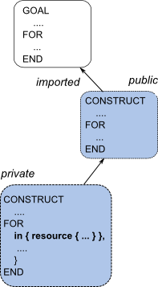

(1) Xcerpt modules: importation
Simple import composer definition
define composer reusexcerpt.ImportComposer(moduleLocation, ruleName, args) {
fragment xcerpt.Program module = ->moduleLocation;
foreach (element : args) {
bind ->element.slot on module with element.value;
}
return module.statements;
}

Slide 25
(1) Xcerpt modules: importation
http://www.xcerpt.org/subclassof.rx
subClassOf(X,Y) :-
rdfs:subClassOf(X,Y).
subClassOf(X,Y) :-
rdfs:subClassOf(X,Z),
subclassOf(Z,Y).
CONSTRUCT
writings [ all var X ]
FROM
or { var X rdf:type “Writing”,
and {
var X rdf:type var S,
subClassOf(S, “Writing”)
} }
END
subClassOf(X,Y) :-
rdfs:subClassOf(X,Y).
subClassOf(X,Y) :-
rdfs:subClassOf(X,Z),
subclassOf(Z,Y).
module
import http://www.xcerpt.org/subclassof.rx
CONSTRUCT
writings [ all var X ]
FROM
or { var X rdf:type “Writing”,
and {
var X rdf:type var S,
subClassOf(S, “Writing”)
} }
END
compose
program
program’

Slide 26
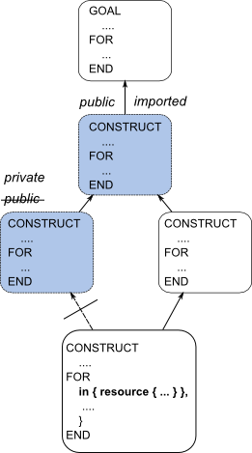
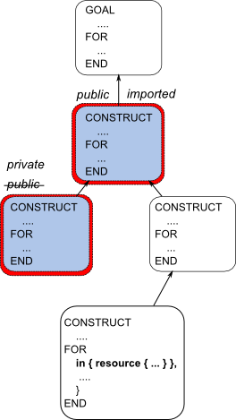
(2) Xcerpt modules: code protection
One solution: wrapping

Slide 27
Discussion: Modular Xcerpt vs. Composition
Modular Xcerpt
  More general wrapping technique for rule encapsulation
  Formally defines how to wrap (rules in) modules
Composition
  Currently assumpes name addressable rules
    Not possible in general
  Can implement the transformation rules of Modular Xcerpt as a complex composer
  Allow for parameterization of modules
    Important for configuring information flow
  Can provide for similar module systems for other rule based languages

Slide 28
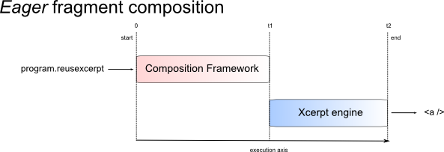
Outlook: Eager vs. Lazy composition

Slide 29
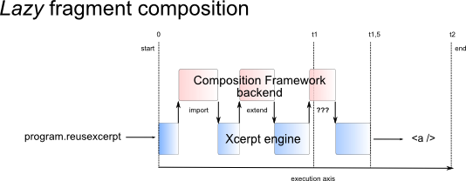
Outlook: Eager vs. Lazy composition

Slide 30
Conclusions
Grey-box composition interesting for the Semantic Web
Based on:
  Language independent primitive composers
Extended with:
  User-definable targeted complex composition operators
Flexible framework to invent and experiment with composition ideas
Examples:
  Query languages (Xcerpt module system)
  Ontology languages (delaying design decisions)
Implementation (E-CoMoGen) integrates into Eclipse

Slide 31
The end

Slide 32
Type composition
element HTML html [ HEAD? BODY ] …
Module A
element HTML2 html [ HEAD2? BODY ] …
Module B
Module A
+
Module B
element HTML html [ HEAD? A_BODY ] …
element HTML2 html [ HEAD2? B_BODY ] …
BODY = A_BODY | B_BODY

Slide 33
Querying aspects?

