Slide 1
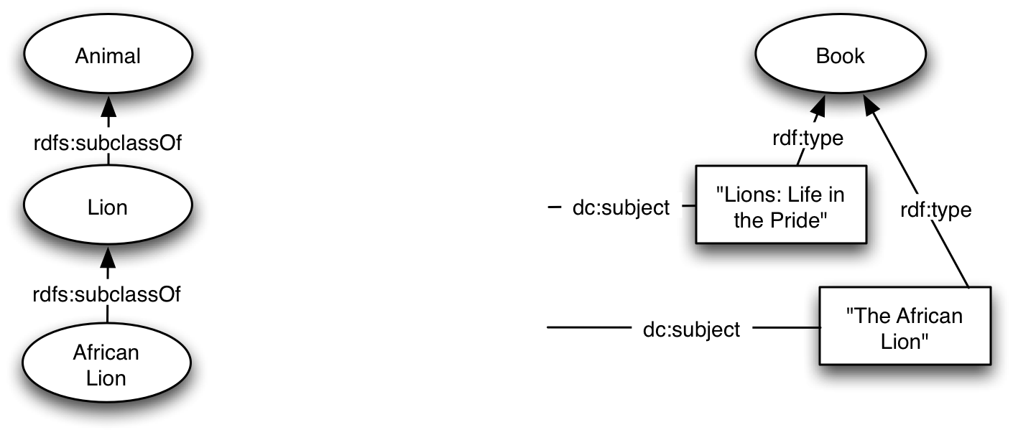
Ontology modeling decisions
Reference: http://www.w3.org/TR/swbp-classes-as-values

Slide 2
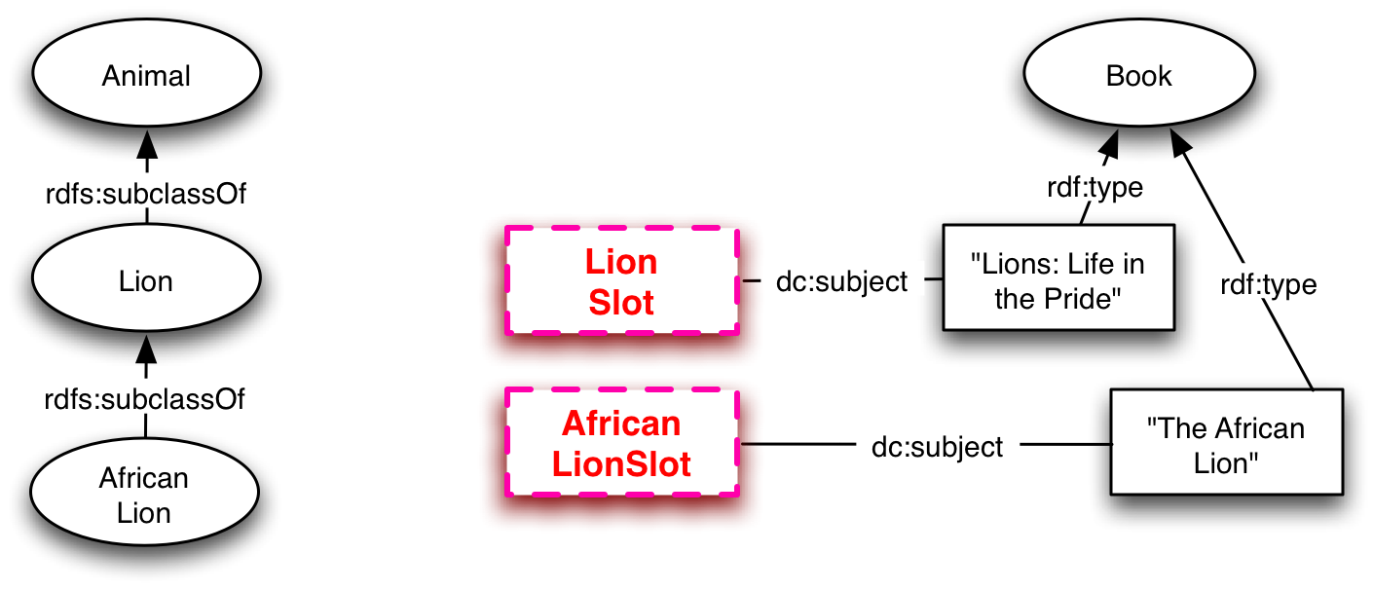
Ontology fragment components
:LionsLifeInThePrideBook
a :Book;
:bookTitle "Lions: Life in the Pride";
dc:subject << LionSlot >> .
:TheAfricanLionBook
a :Book;
:bookTitle "The African Lion";
dc:subject << AfricanLionSlot >> .

Slide 3
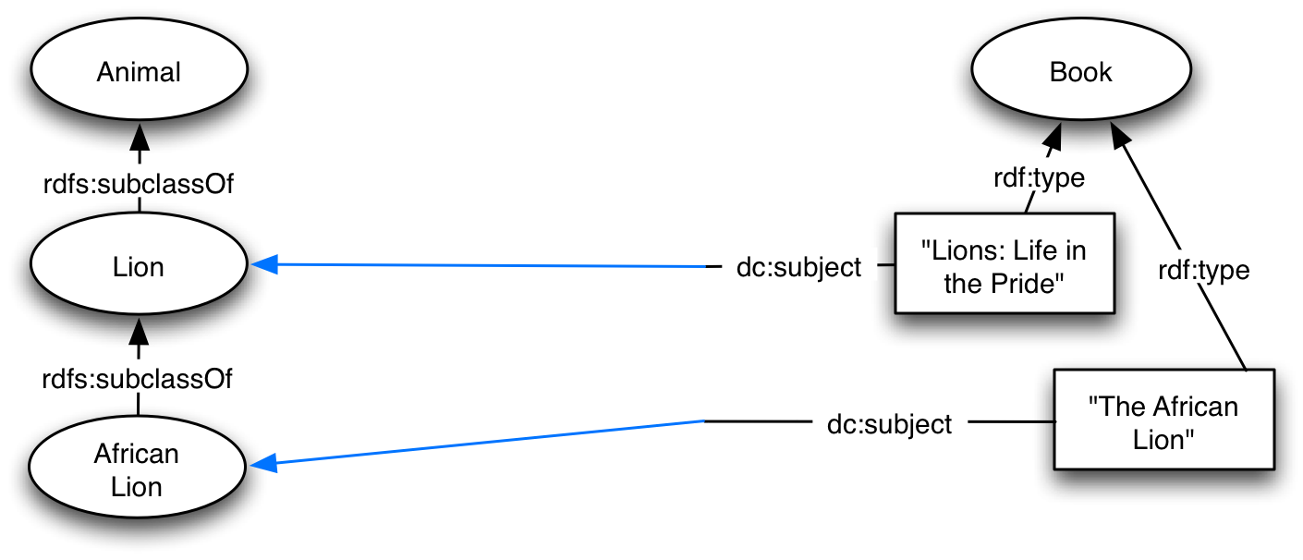
Ontology composer I

Slide 4
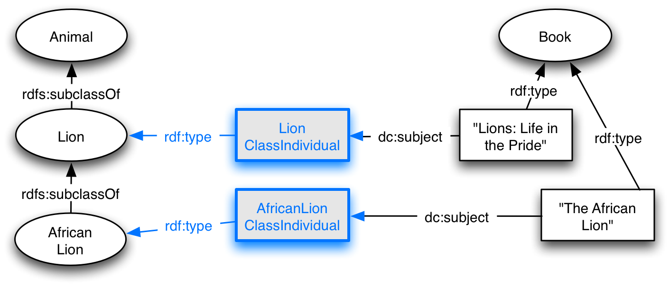
Ontology composer II

