Slide 1
React
JavaScript UI Framework

Slide 2
React Info
Built by Facebook
Used by Facebook
Most starred FE JavaScript framework on Github (~70k)
Open source (BSD 3-Clause License)
https://facebook.github.io/react/
https://github.com/facebook/react

Slide 3
Problems with libs and frameworks
Widgets aren’t self-contained by default
Widgets aren’t reactive by default
State is global
State is mutable
State becomes fragmented
State quickly grows out of control
Code duplication occurs

Slide 4
Ways to manage complexity
Make widgets small
Segment application logic into small, composable bits
Segment application layers into clearly defined sections
Designate a mutable object for state
Lots of documentation and testing

Slide 5
React to the rescue!
Application bits are broken into components
Components are composable
Components are reactive by default
Design patterns such as Flux and Redux define app architecture
State is immutable and predictable (time travel)
State is kept at highest level and trickles down component tree
Components are only updated as needed

Slide 6
What do I like about React?
Modern syntax (ES6)
Functional Programming (everything as a function)
Immutable, self-contained state
Reactive by design
Composable UI
Intuitive

Slide 7
What do burritos have to do with any of this stuff?
Reactorito -> http://reactorito.azurewebsites.net
Built with React
Bootstrapped with create-react-app
Retrieves data from an Azure function
Used kuduscript Node.js app to generate deploy script
Only source is kept in VCS, app is built inside of web app

Slide 8
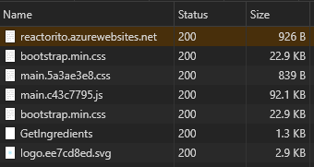
More reactorito stuff…

