Slide 1

Classifying Baseball Pitches with k-Nearest Neighbor and Artificial Neural Networks
Jeremy Reinert

Slide 2
Research Focus
Classify Major League Baseball (MLB) pitches thrown into three classifications:
Fastballs
Changeups
Breakingballs

Slide 3
Related Research
Hamilton et al. [1] used SVM-L (average 79.76% accuracy) and kNN (average 80.88% accuracy) to classify fastball and non-fastball pitches thrown by 236 pitchers during the 2008 and 2009 MLB seasons using data collected by the PITCH f/x system.
Ganeshapillai and Guttag [2] used SVM-L (average 70% accuracy) to classify fastball and non-fastball pitches thrown by 359 pitchers during the 2008 and 2009 MLB seasons using data collected by STATS Inc.
Both sought to classify/predict the next pitch thrown.
“…it is important to clarify a subtle distinction between pitch classification and pitch prediction. The distinction is simply that classification uses post pitch information about a pitch to determine which type it is, where as prediction uses pre-pitch information to classify its type.” – Hamilton et al. [1]

Slide 4
The Dataset
Initial: 2,867,154 pitches thrown during the 2015-2018 MLB seasons and 40 features collected by the PITCH f/x system.
Retrieved from Kaggle.com [3].
File Size: 794 MB.
Final: 2,839,570 pitches thrown during the 2015-2018 MLB seasons and 15 features collected by the PITCH f/x system.
Null values removed.
Intentional balls, pitchout, and unknown pitches removed.
Remaining pitch types rewritten to three classifications: Fastball, Changeup, Breakingball
Fastballs: Cutter, Four-seam Fastball, Splitter, Two-seam Fastball
Changeup: Changeup
Breakingballs: Curveball, Eephus, Knuckle Curveball, Knuckleball, Screwball, Slinker, Slider

Slide 5
The Dataset
Initial Features
px
pz
start_speed
end_speed
spin_rate
spin_dir
break_angle
break_length
break_y
ax
ay
az
sz_bot
sz_top
type_confidence
vx0
vy0
vz0
x
x0
y
y0
z0
pfx_x
pfx_z
nasty
zone
code
type
pitch_type
event_num
b_score
ab_id
b_count
s_count
outs
pitch_num
on_1b
on_2b
on_3b

Slide 6
The Dataset
Features related to the physics of the pitch:
Positioning: px, pz, x, x0, y, y0, z, pfx_x, pfx_z, zone
Movement: break_angle, break_length, break_y, pfx_x, pfx_z, spin_rate, spin_dir
Speed, velocity, acceleration: start_speed, end_speed, ax, ay, az, vx0, vy0, vz0, nasty
Features related to the type of pitch: pitch_type
Unrelated features, game situation, or other:
code, type, sz_bot, sz_top, event_num, b_score, ab_id, b_count, s_count, outs, pitch_num, on_1b, on_2b, on_3b
Feature descriptions:
https://fastballs.wordpress.com/2007/08/02/glossary-of-the-gameday-pitch-fields/
https://trackman.zendesk.com/hc/en-us/articles/115002776647-Radar-Measurement-Glossary-of-Terms

Slide 7
The Dataset
Features dropped due to being unrelated:
code, type, sz_bot, sz_top, event_num, b_score, ab_id, b_count, s_count, outs, pitch_num, on_1b, on_2b, on_3b
Correlation matrix conducted – features dropped due to low correlation coefficient:
zone, nasty, z0, y0, x0, x, vx0, type_confidence, break_length, px

Slide 8
The Dataset
Final Features
pz
start_speed
end_speed
spin_rate
spin_dir
break_angle
break_y
ax
ay
az
vy0
vz0
y
pfx_x
pfx_z
pitch_type ← Dependent Variable

Slide 9
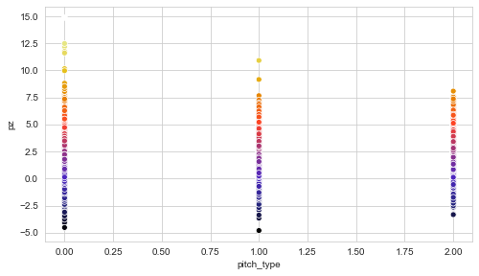
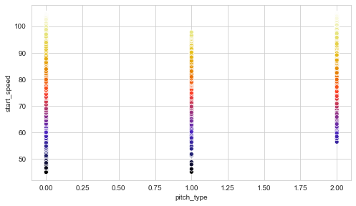
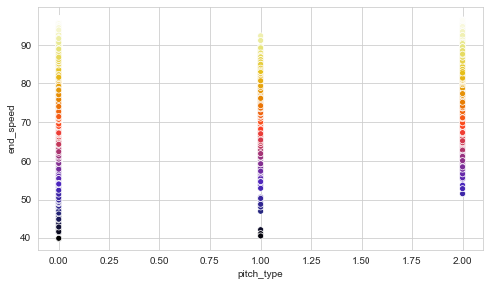
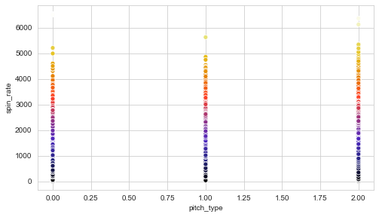
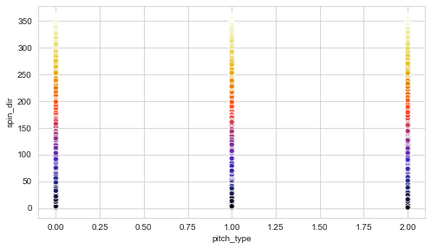
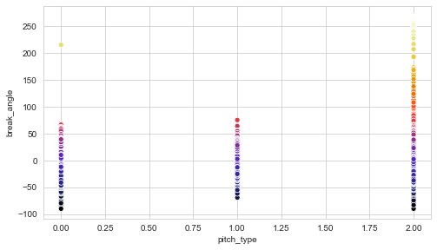
Plotting the data

Slide 10
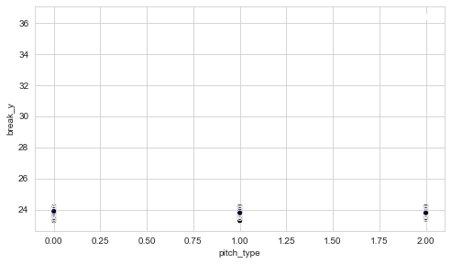
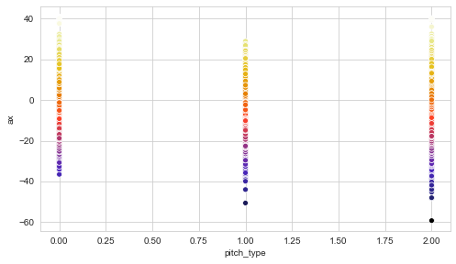
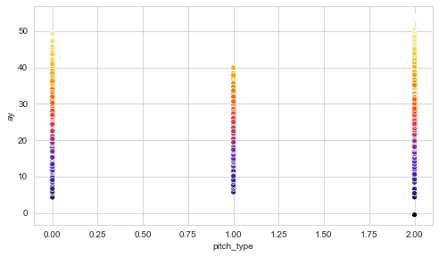
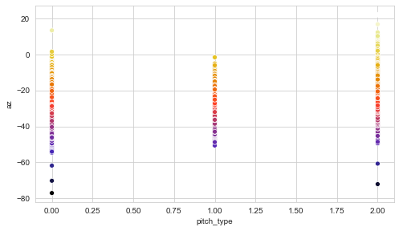
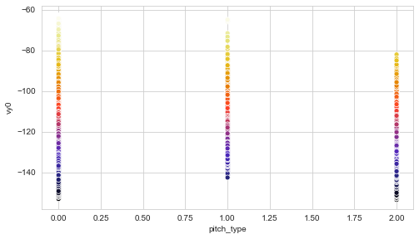
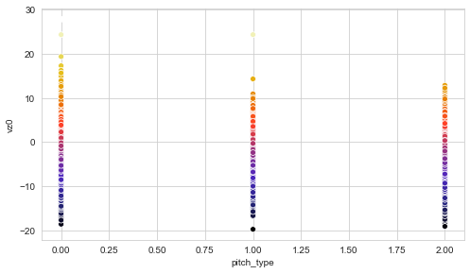
Plotting the data

Slide 11
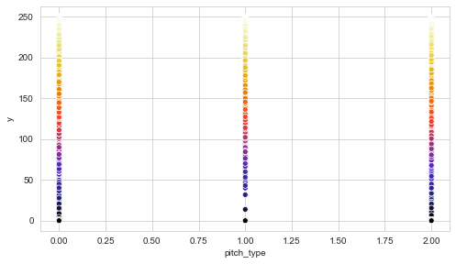
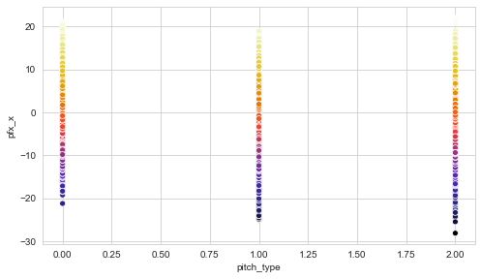
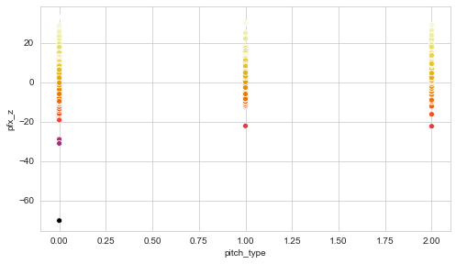
Plotting the data

Slide 12
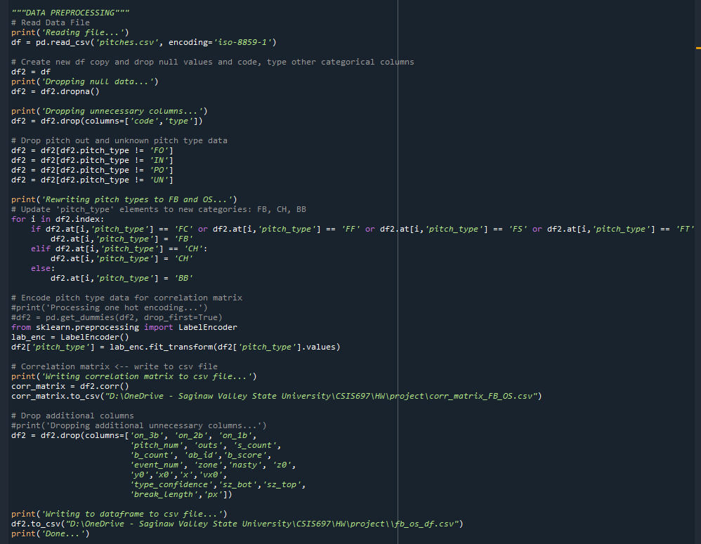
Data preprocessing code

Slide 13
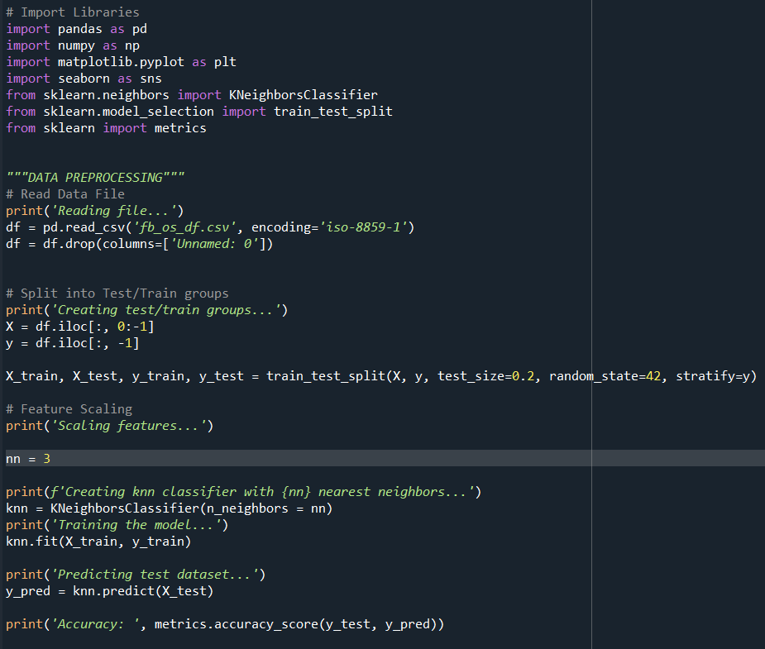
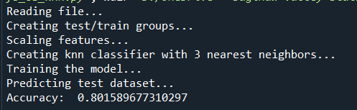
K-NN: 3 Nearest Neighbors
80.16% accurate classifications

Slide 14
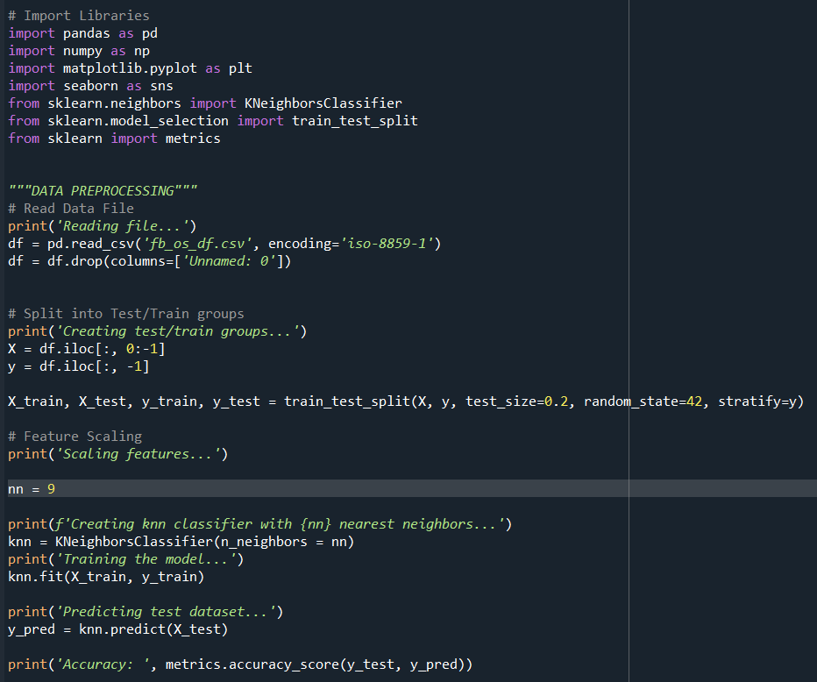
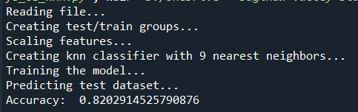
K-NN: 9 Nearest Neighbors
82.03% accurate classifications

Slide 15
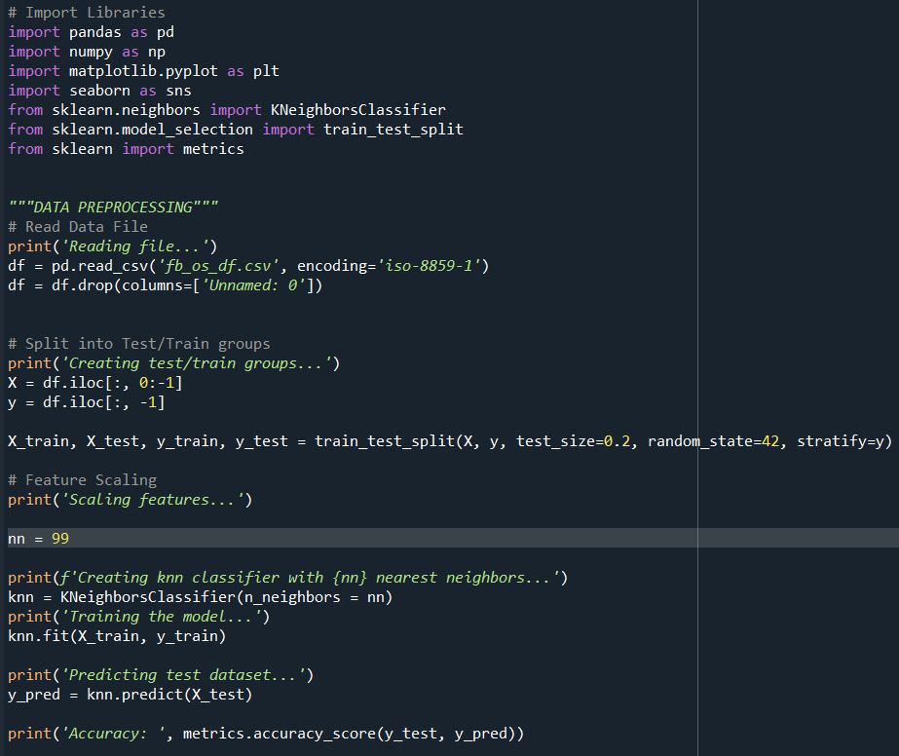
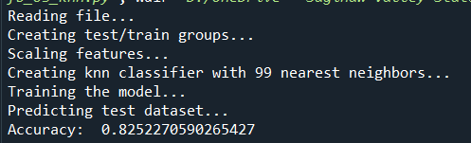
K-NN: 99 Nearest Neighbors
82.52% accurate classifications

Slide 16
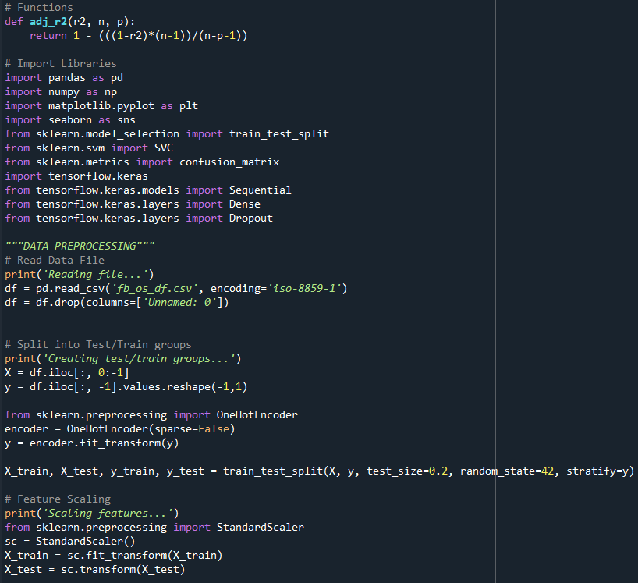
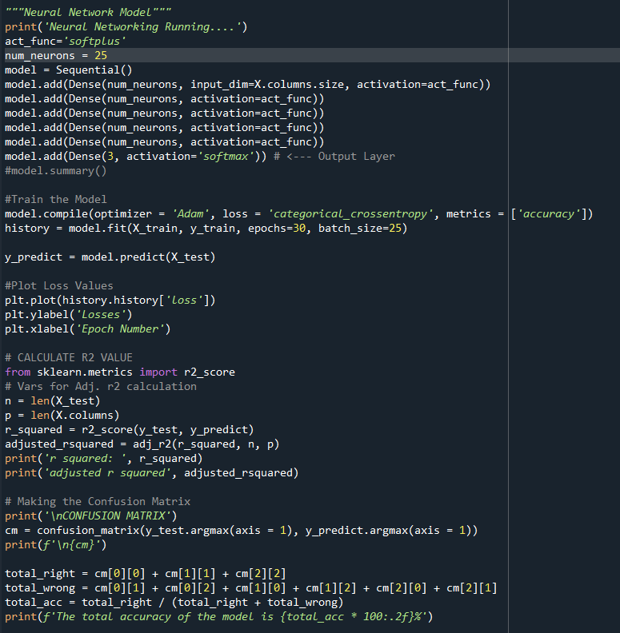
Artificial Neural Network

Slide 17
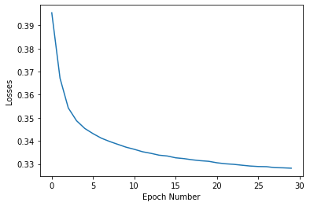
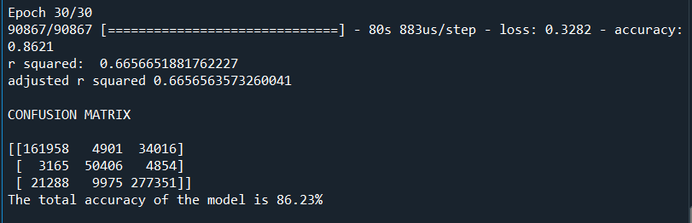
Artificial Neural Network
25 Neurons per Hidden Layer and 5 Hidden Layers
30 Epochs and Batch size of 25
Softplus activation function on hidden layers and Softmax activation function on output layer
Train accuracy = 86.21%
Test accuracy = 86.23%
Test r² = .67

Slide 18
Key Takeaways and Future Attempts
Neural Network (86% accuracy) performed better than k-NN (82% accuracy) model.
Both performed better than prior research on 3 pitch classifications versus two pitch classifications (fastball and non-fastball).
Future Attempts:
Test SVM as a model – did not use here because of the size of my dataset and number of features.
Use a Recurrent Neural Network model to predict the next baseball pitch in a sequence.

Slide 19
Questions?

Slide 20
References
[1] M. Hamilton, P. Hoang, L. Layne, J. Murray, D. Pudgett, C. Stafford, and H. Tran, “Applying machine learning techniques to baseball pitch prediction,” Proceedings of the 3rd International Conference on Pattern Recognition Applications and Methods (ICPRAM-2014), 2014. [Online]. Available: https://pdfs.semanticscholar.org/c56a/36aebb401fe41b34991c8a0933c0ba142caf.pdf?_ga=2.103364352.1273403232.1588030042-1727179774.1587577252.
[2] G. Ganeshapillai and J. Guttag, “Predicting the next pitch,” MIT Sports Analytic Conference 2012, 2012, [Online]. Available: https://pdfs.semanticscholar.org/e455/030bd945ceffcbf2fc99bb12271ee9c013ff.pdf?_ga=2.253095497.1164534633.1607314876-395474371.1607314876.
[3] P. Schale, “MLB pitch data 2015-2018,” Kaggle.com, [Online]. Available: https://www.kaggle.com/pschale/mlb-pitch-data-20152018.

