Slide 1




SIS3316: Python DAQ
J. Ellin¹,
¹UC Berkeley
Department of Nuclear Engineering

Slide 2
Motivation

Slide 3
Motivation (Practical)
OS independent: ethernet UDP communication back-end, PyQT front end
Pure python: interface with other group software written in python
Abstract hardware implementation details to human readable config files
Parse on the fly (or close to it): real(ish) time diagnostics
Modularity: user pooled experience and applications

Slide 4
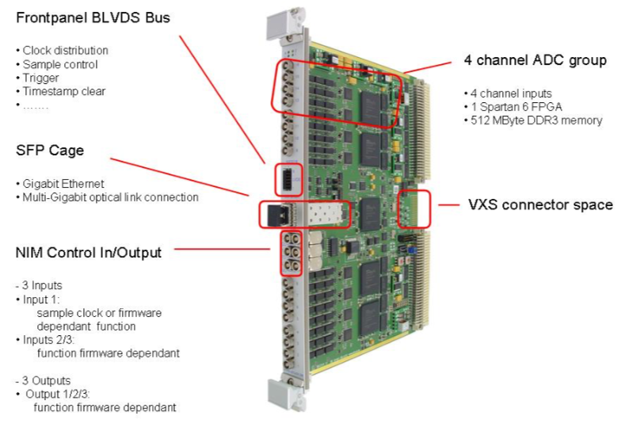
SIS3316

Slide 5
python3316

Slide 6
My Solution
Object Oriented Programming
Software ”Proxy” Objects that can set or recall the state of their own variables
Configuring of each Board with 4 instances:
1. channel class (16)
2. group/FPGA class (4)
3. module class (1)
4. triggers class (1 per other instance)
Data readout sent to parse class that creates a dictionary for further processing
Dictionary is used for passing to “front-end”

Slide 7
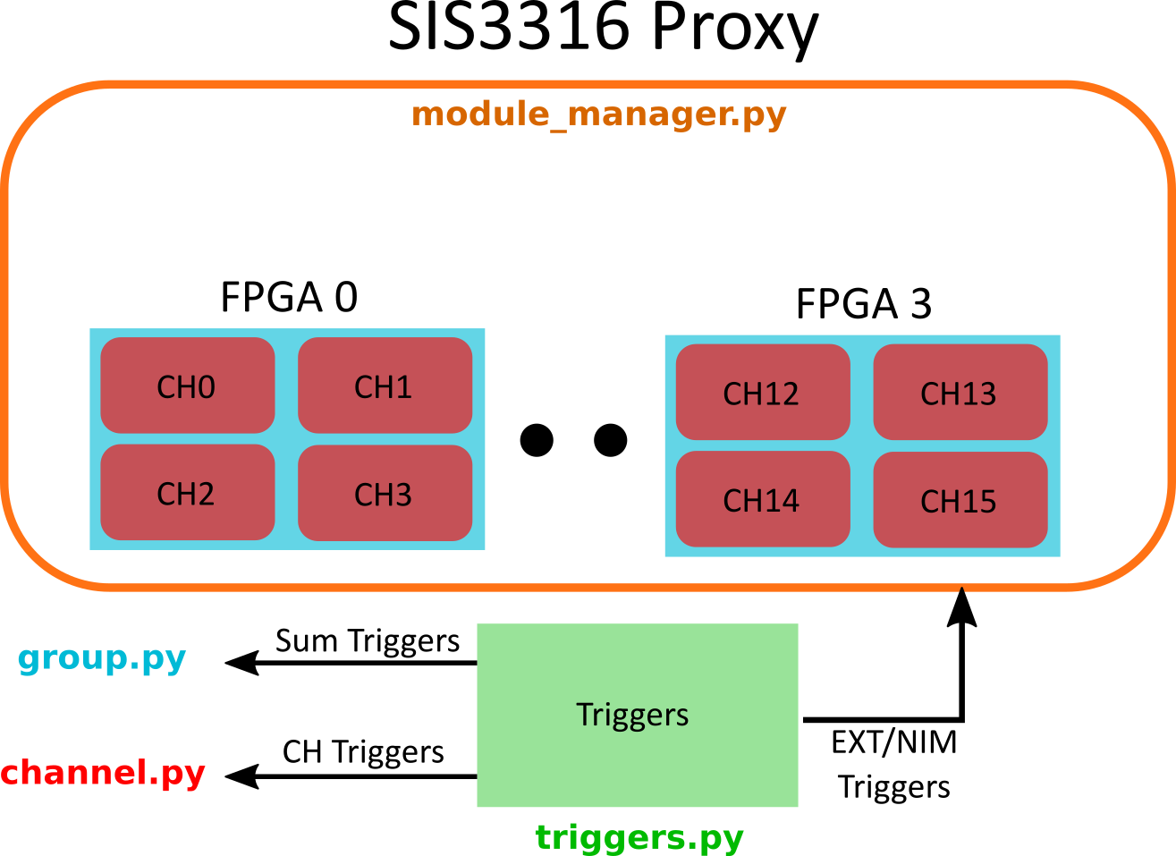
Board Level

Slide 8

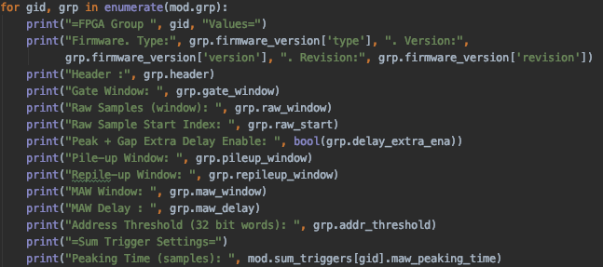
OOP

Slide 9
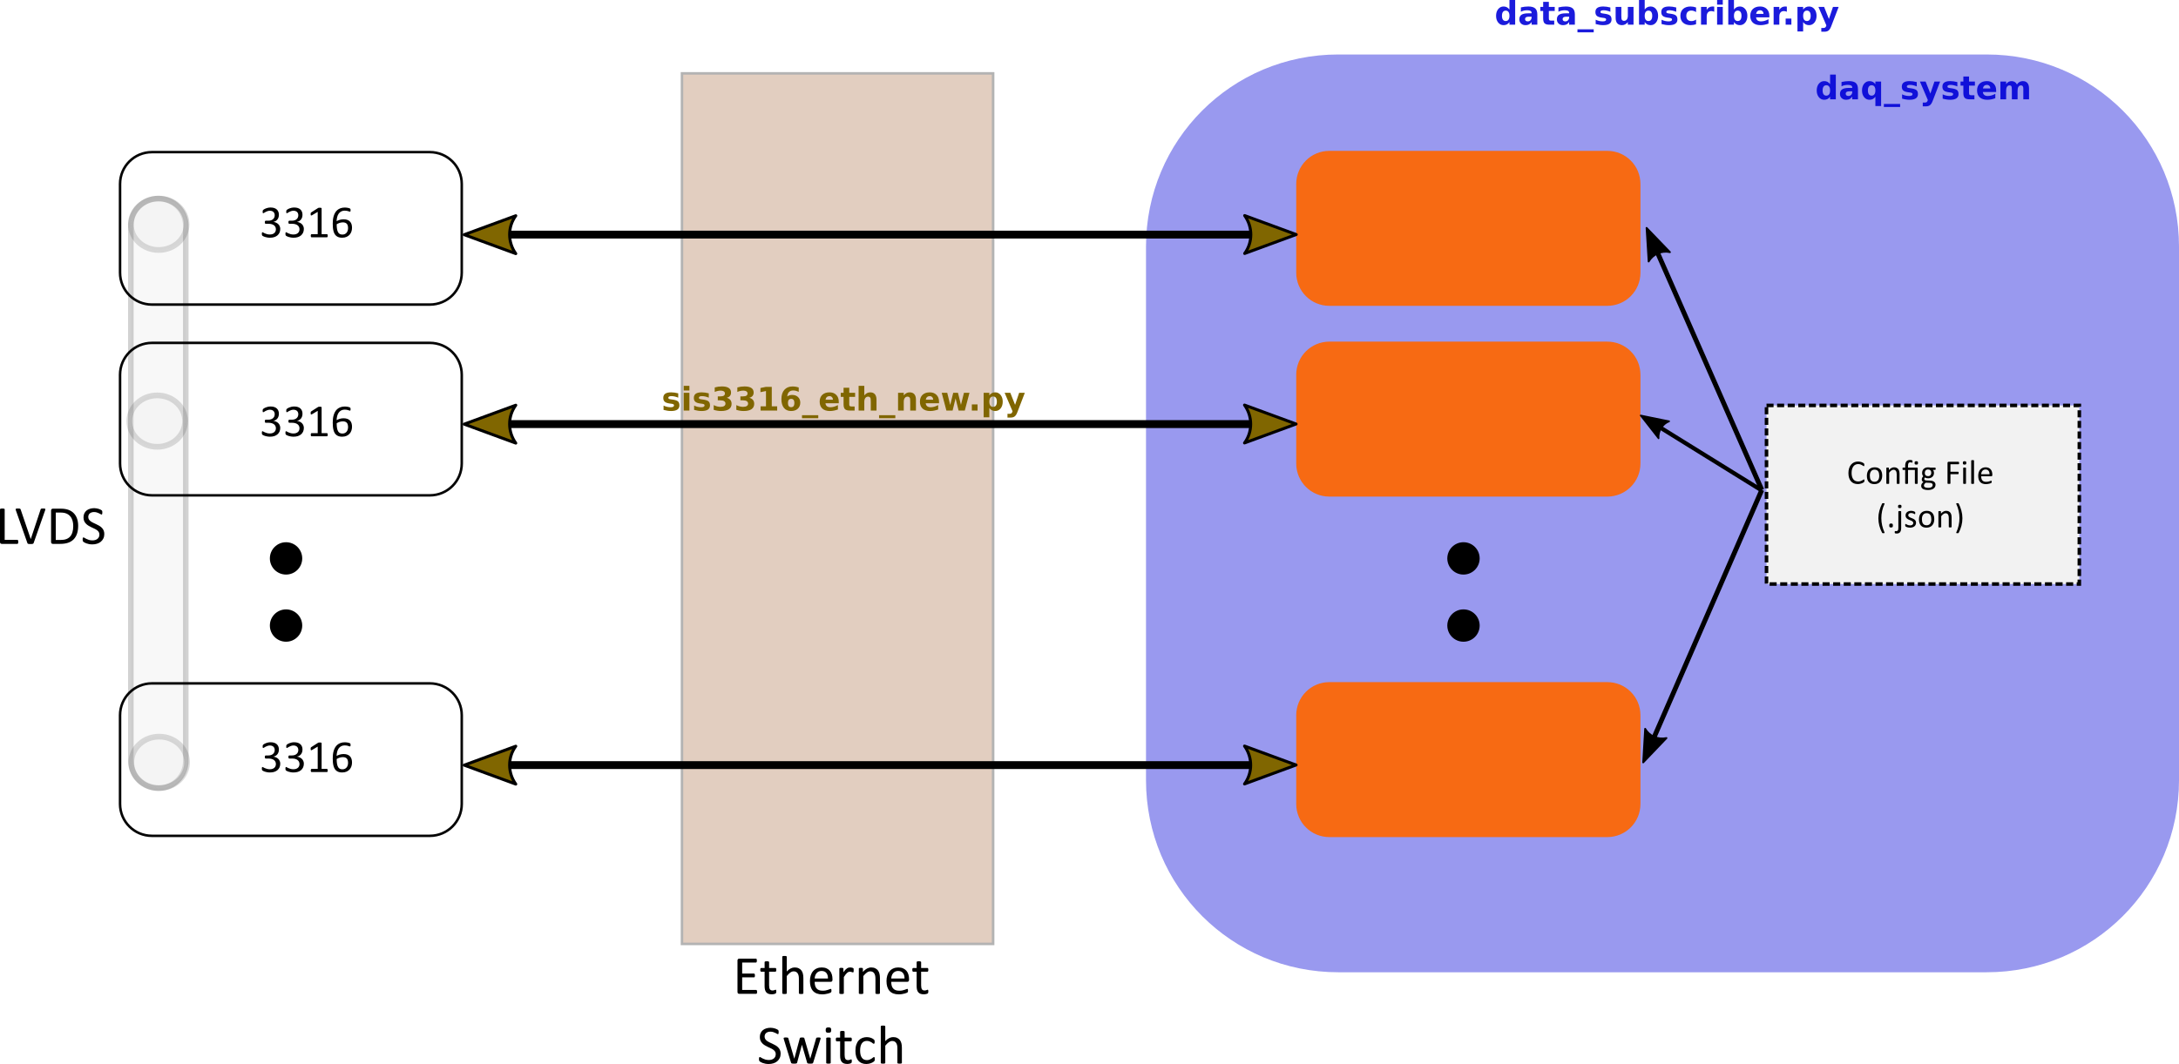
DAQ Level

Slide 10
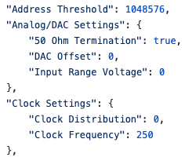
Config File Note
Can list single values (broadcast to all relevant classes)
Can also provide lists/arrays on a per FPGA/Channel level
Will attempt to grow/squeeze provided config values to match number of config properties
Single config can be loaded to all connected boards

Slide 11
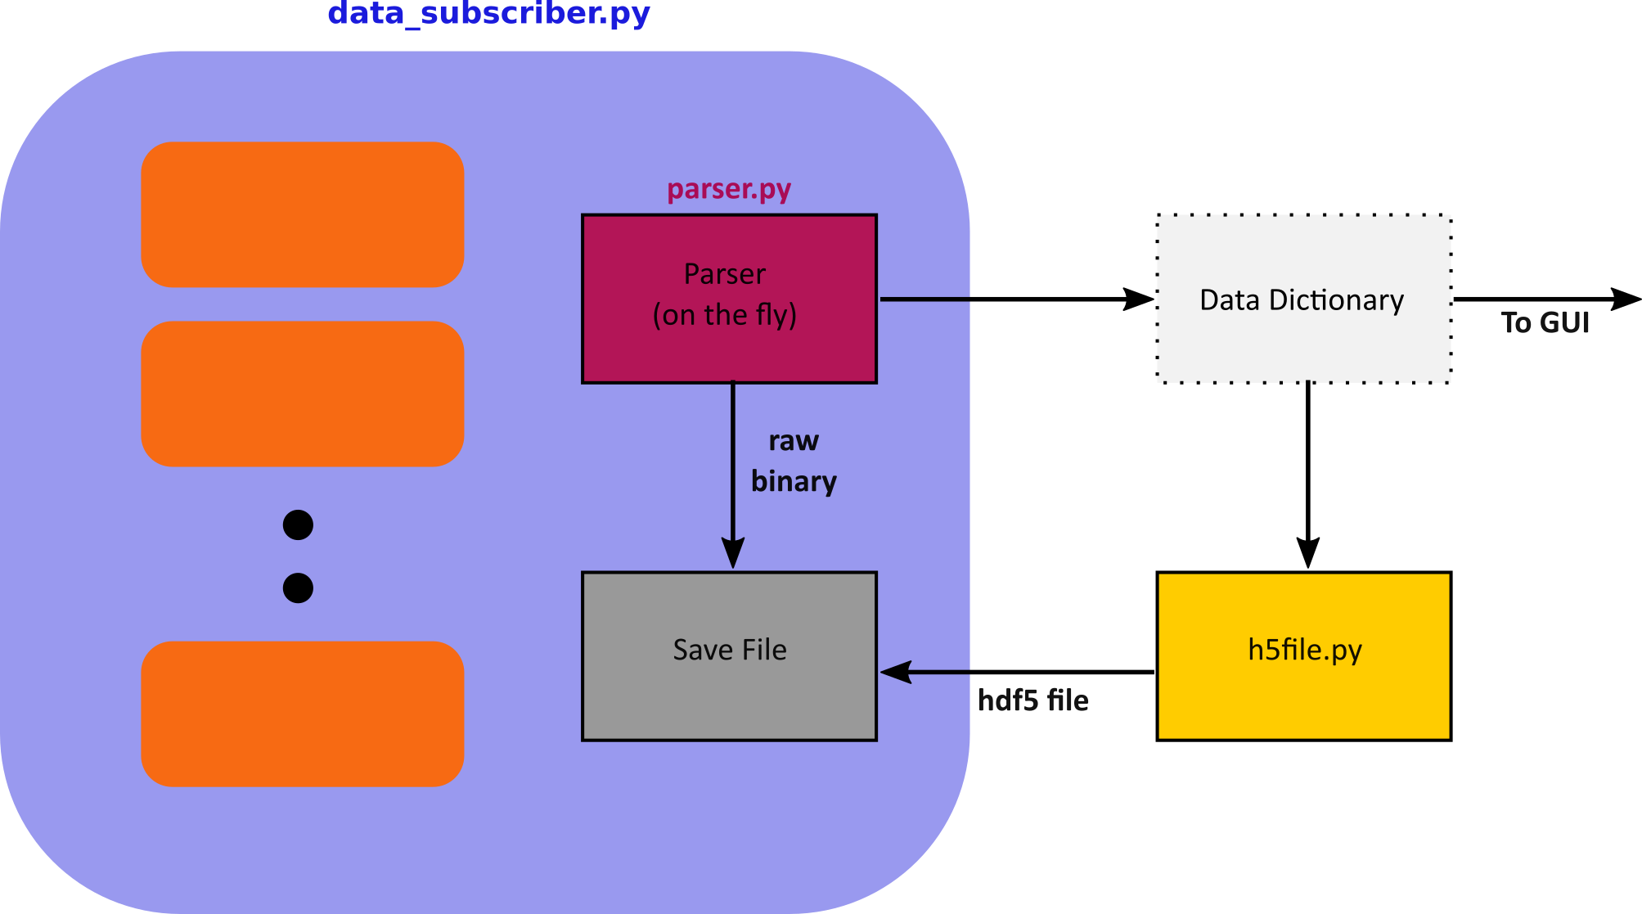
Saving

Slide 12
Data Dictionary Fields (Current)
rid: Global ID
timestamp
det ID
pile-up
Up to 8 user specified accumulator values (integrators)
trigger trapezoidal filter: max value, value before, value after
energy trapezoidal filter: value at trigger, max value
maw data: energy or trigger trapezoidal filter waveforms
raw waveforms
Modeled after Ross B. SIS3302 Code

Slide 13
Saving Notes
Since always have access to the channel state variables and flags the HDF5 file is automatically generated and saved to on the fly per channel
If all parameters are identical across channels, saves all hit data in a table and all raw data in an EArray
If not identical each detector channel gets its own “folder” with its own tables and EArrays
Same class and methods can be used for custom fields such as in event reconstruction

Slide 14
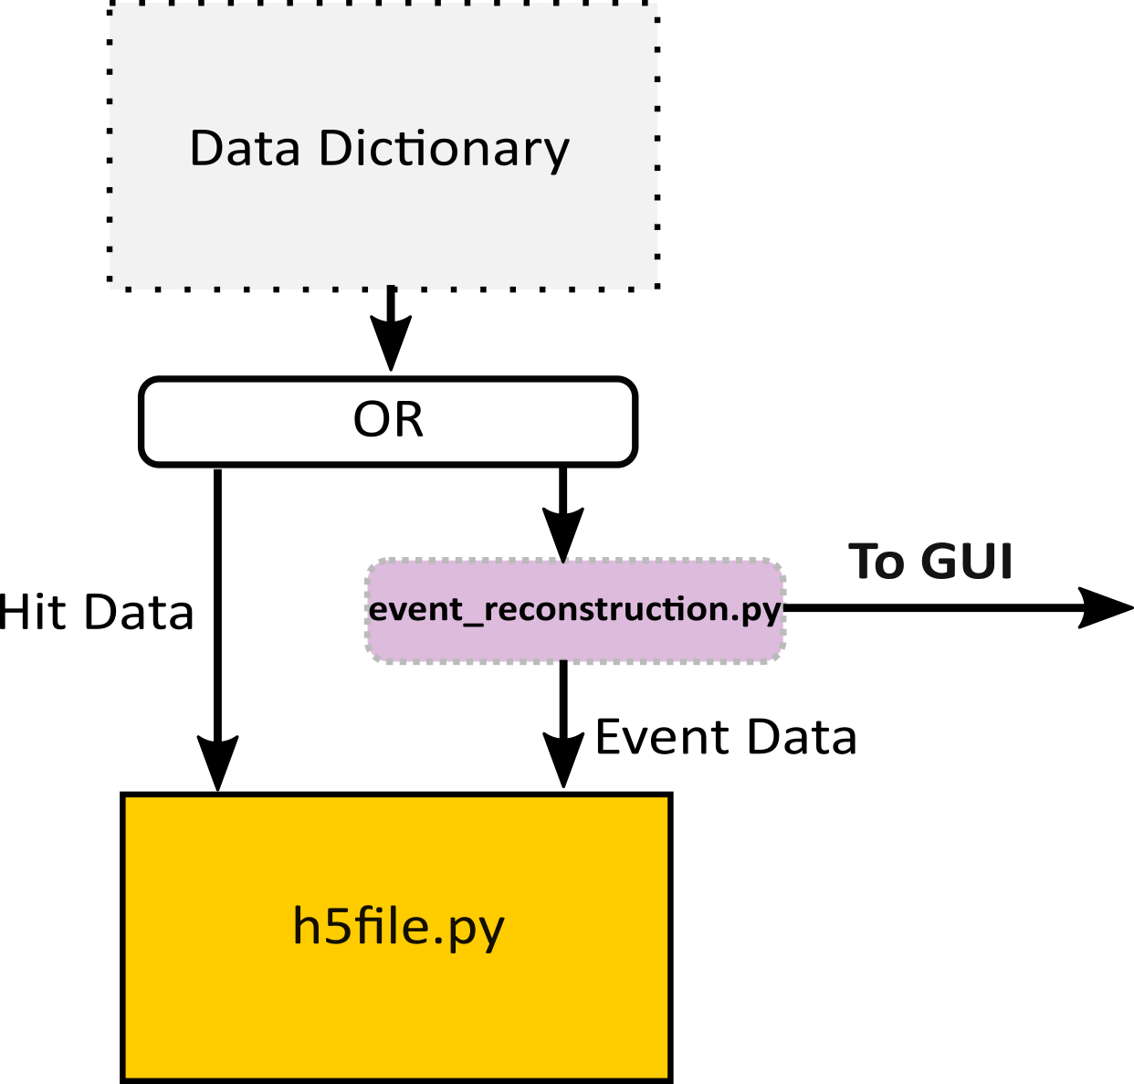
Event Reconstruction
event_reconstruction.py: Application (user) specific threaded class examples could be:
Anger Logic
Compton Imaging
Fitting
List/Bin mode MLEM
DOI
Etc.

Slide 15
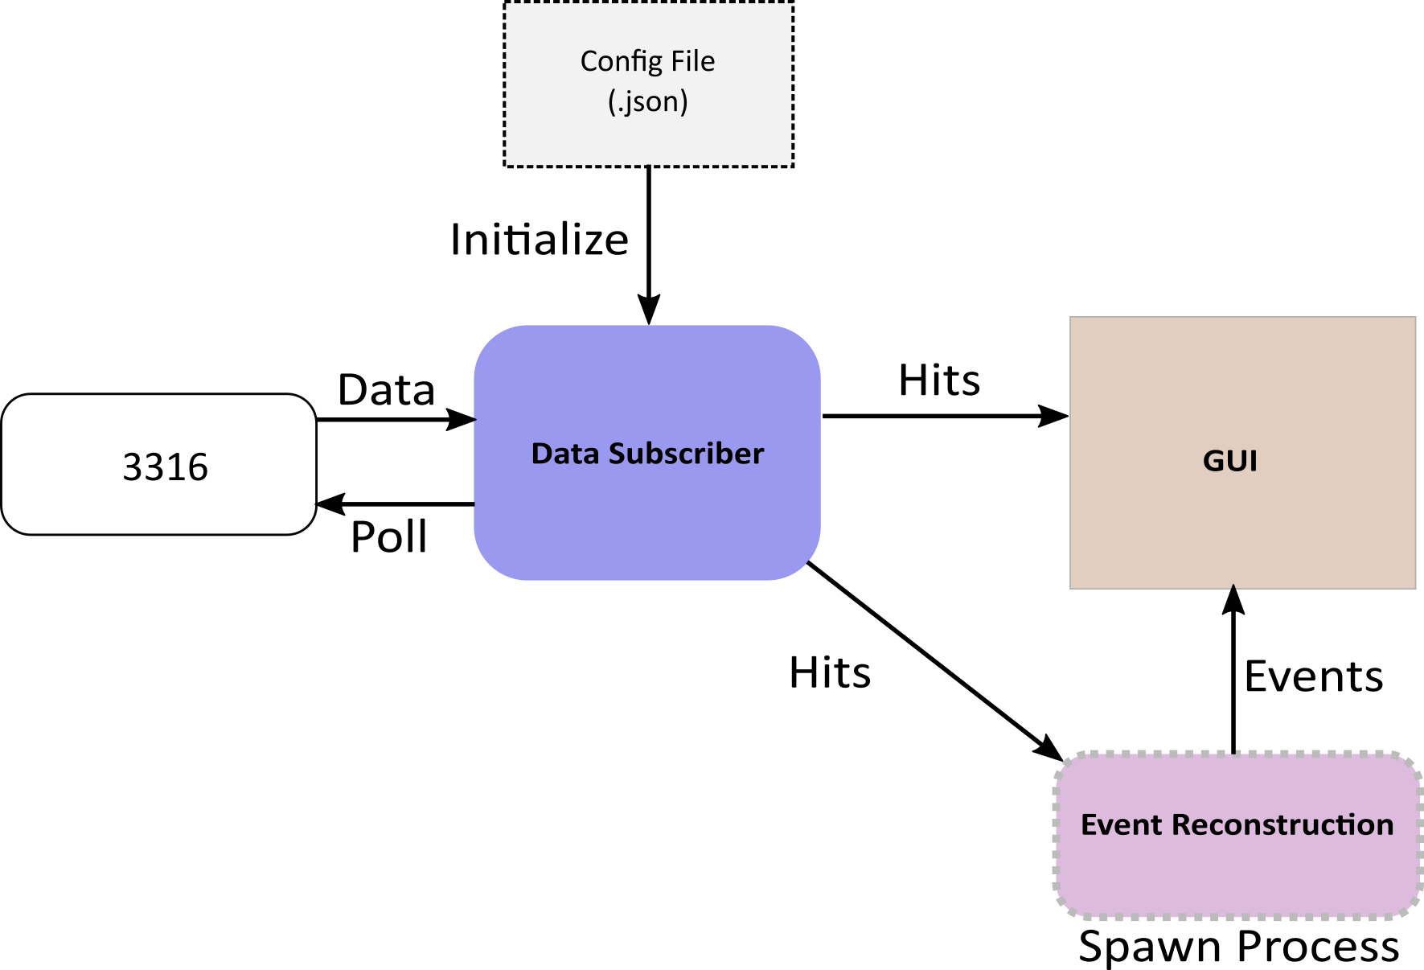
Bird’s Eye

Slide 16
Features (incomplete)
Memory readout based on time and/or memory flags
Internal Triggers
NIM input as Global Veto/Gate
Delay Triggers
Sum Triggers
Energy Filter (semiconductors)
CFD
High Energy Suppression
ADC settings
Clock Frequency
Hardware Readout/ Temperature Readout
Multi-board Synchronization

Slide 17
Wishlist (incomplete)
Inter and Intraboard Coincidence Gate Lookup Tables
NIM input as Trigger Enable
Internal Triggers as External Triggers to FPGAs
Internal Trigger Counters (ex: dead time)
Internal Configurable Histograms
Internal PSD Histograms
NIM Input as “User Counter” (10 ms minimum time)
Extended Raw Waveforms (32 Mb)

