Slide 1
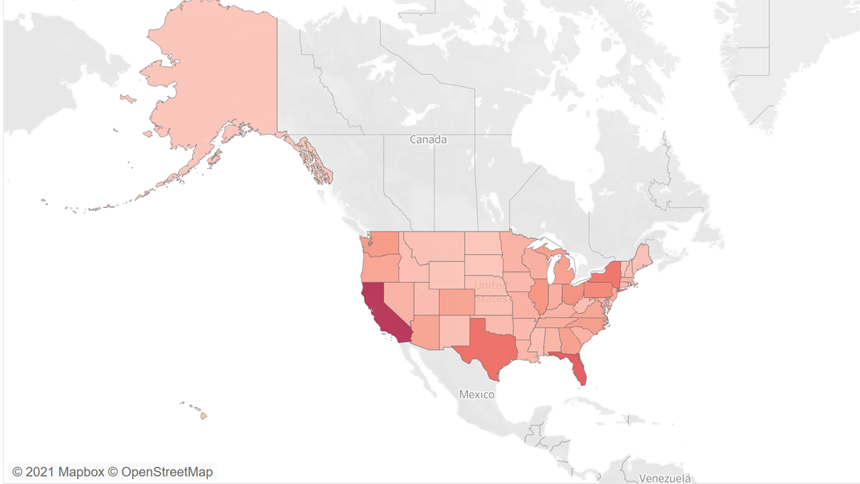
2018 U.S. NMU OF PRESCRIPTION DRUG REPORT
TEAM: Confusion Matrix

Slide 2
What factors contribute to the NMU of prescription drugs among college students?
How does substance usage contribute to drug abuse?
What statistical model to predict the drug abuse level?
TEAM MEMBER:
Jaya Ren
Joanna Shen
Shenghua Zhu
Xingchen Wang
Zhengkun Pan

Slide 3
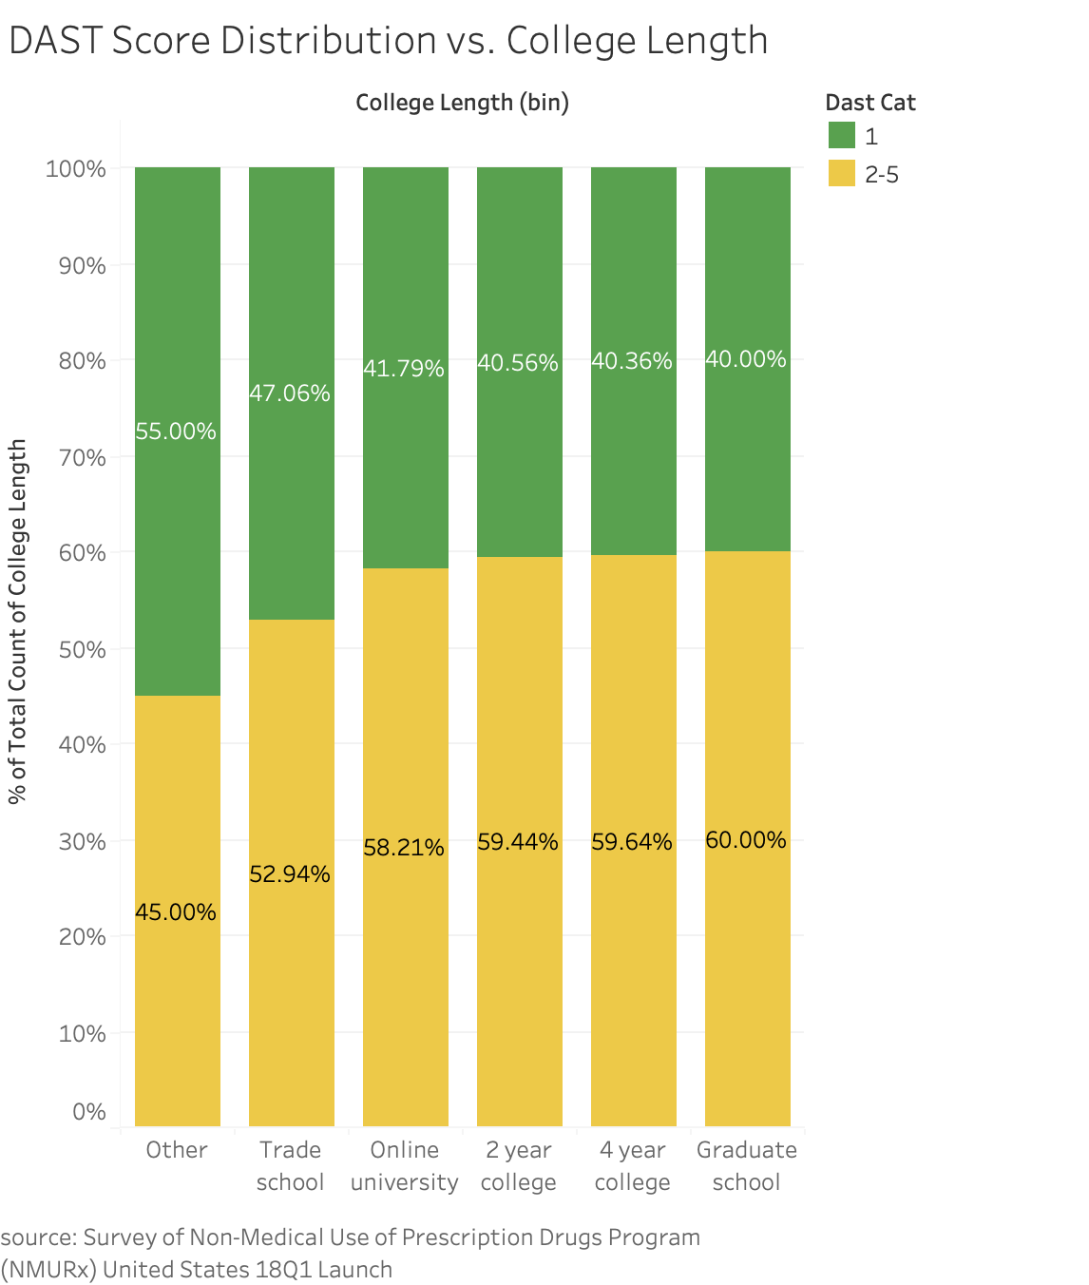

Slide 4
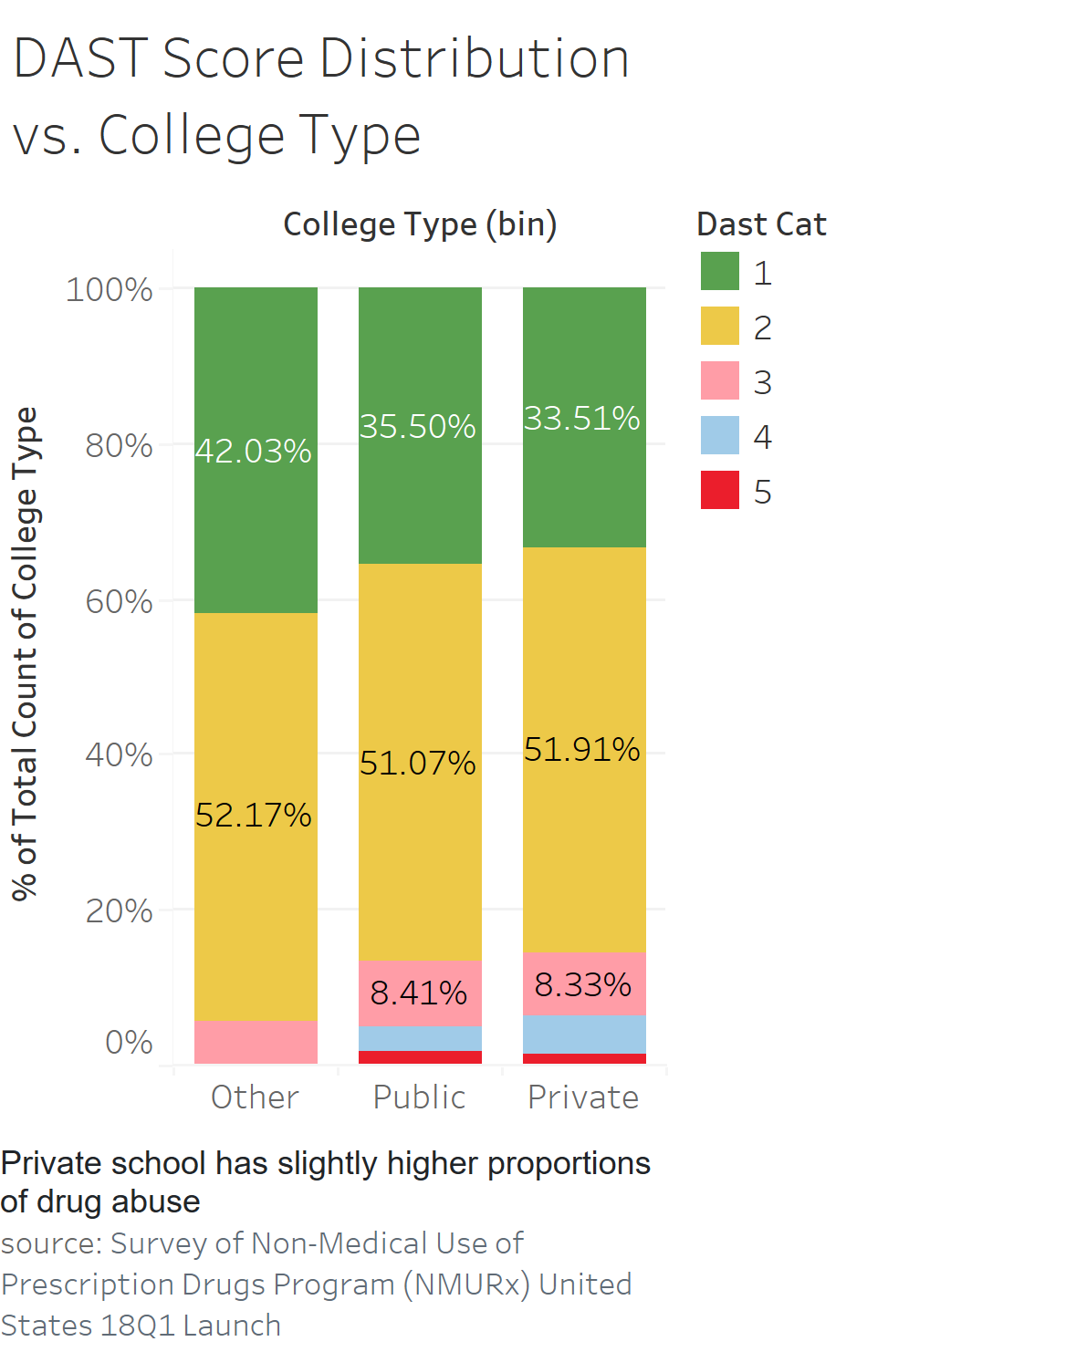
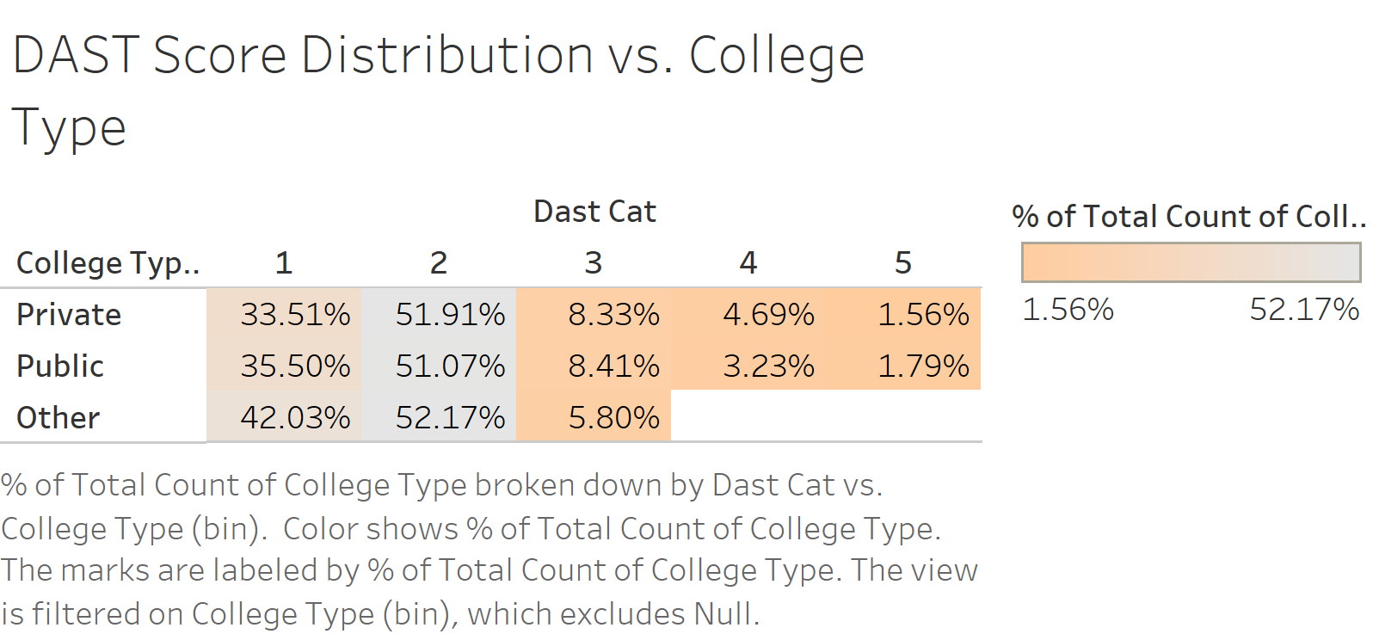

Slide 5
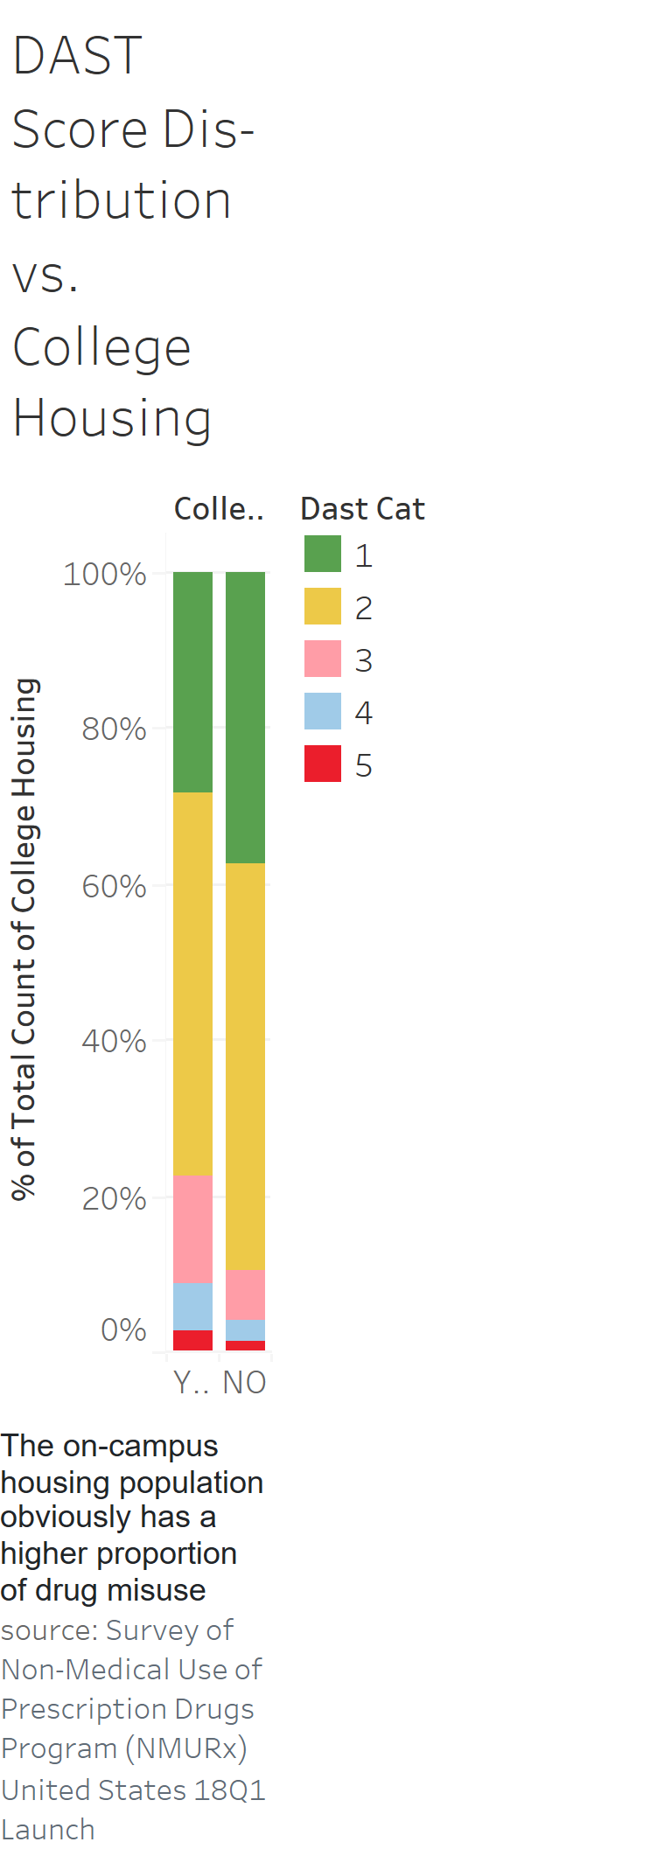
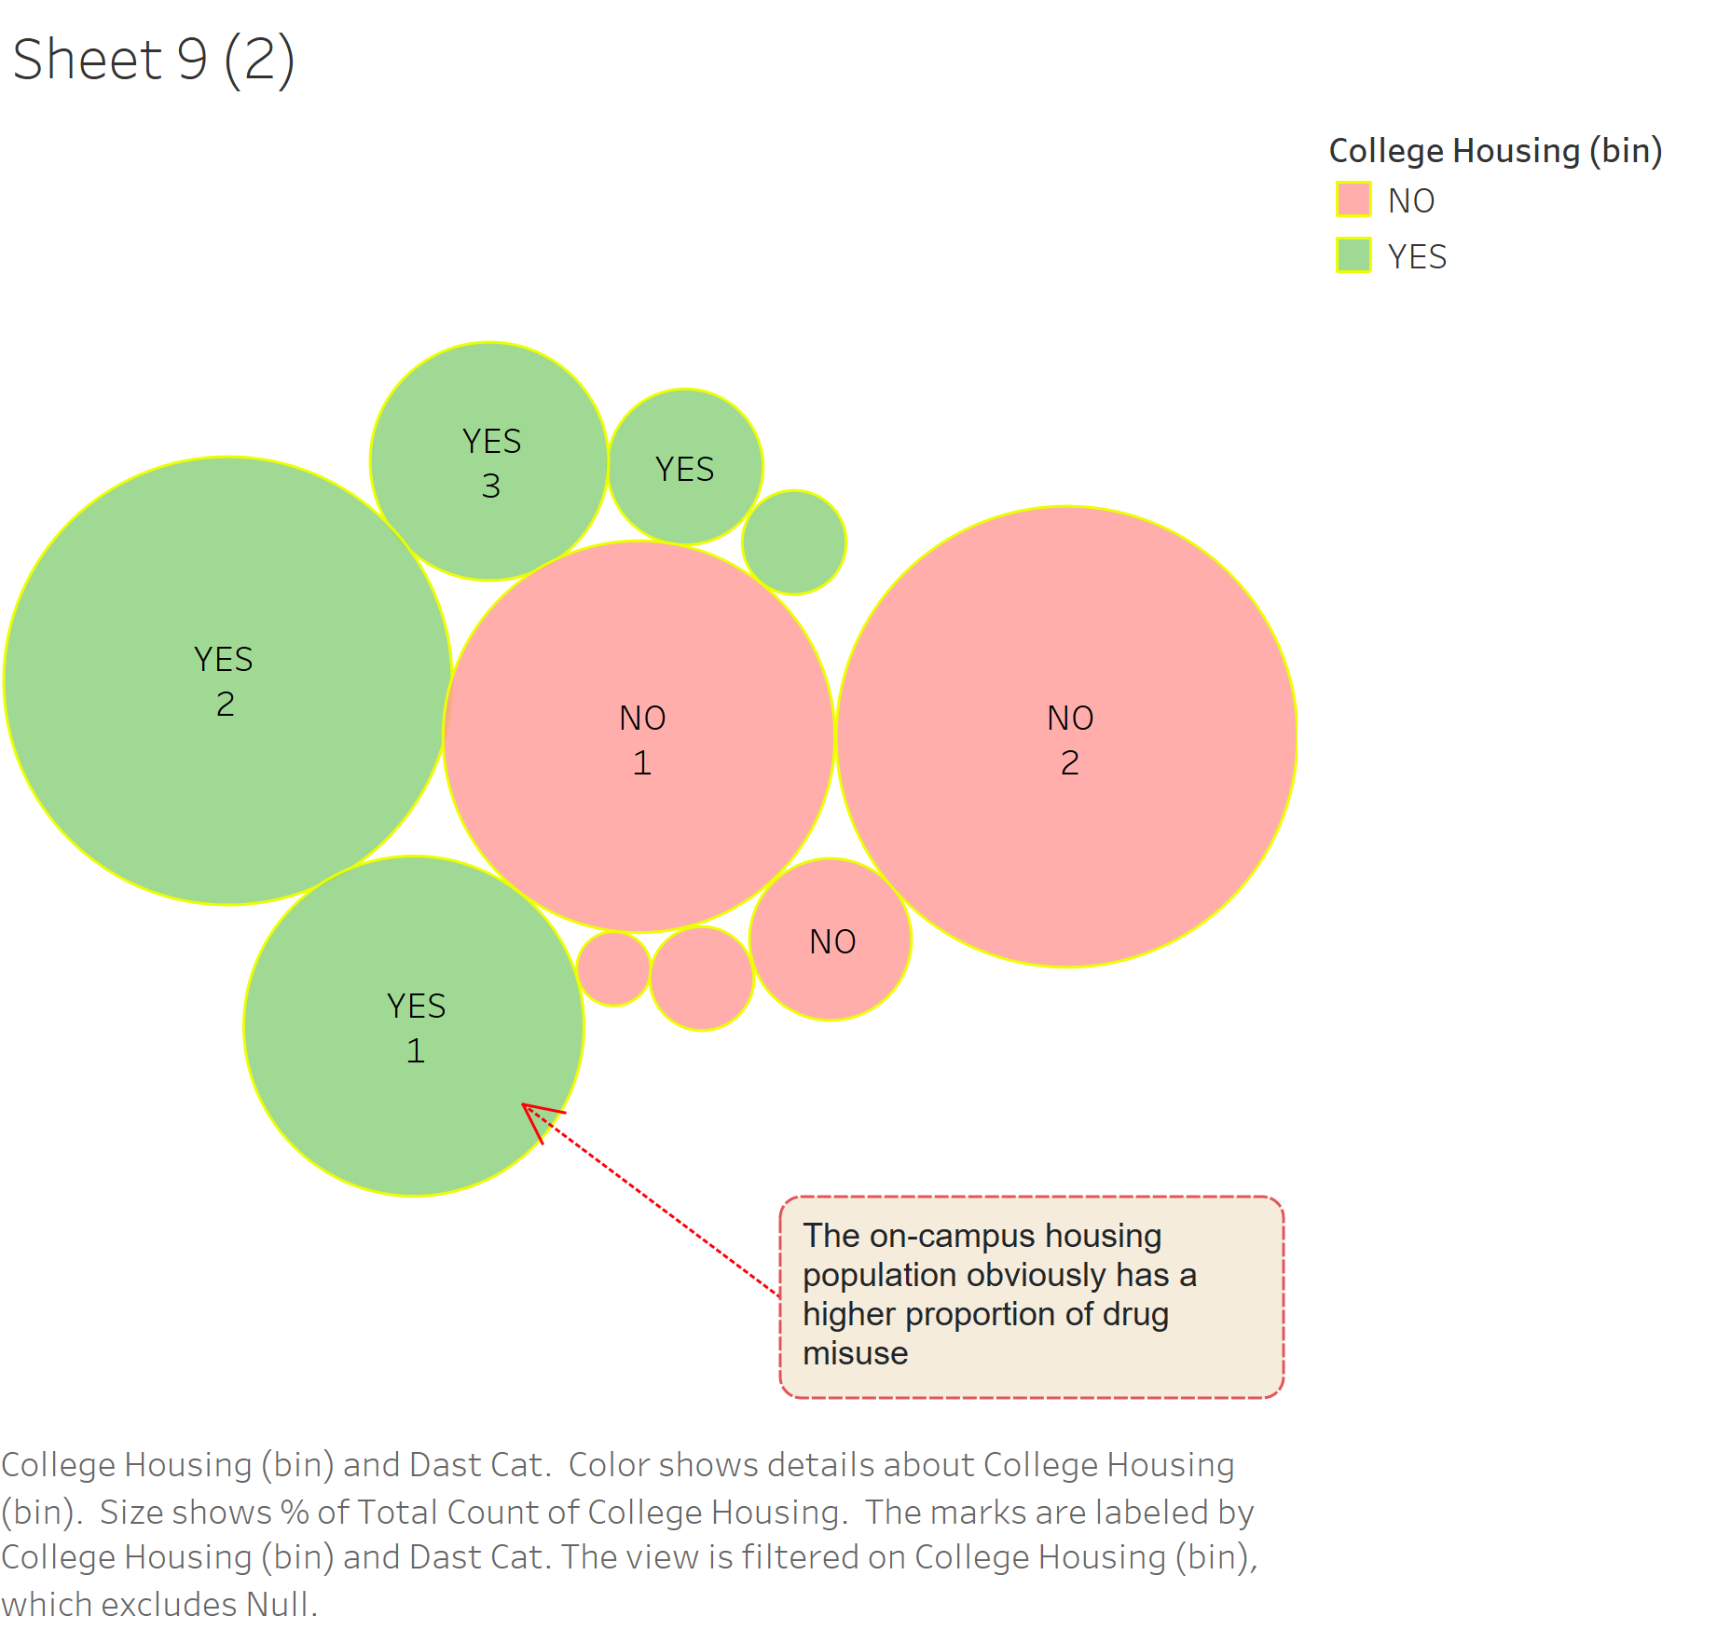

Slide 6
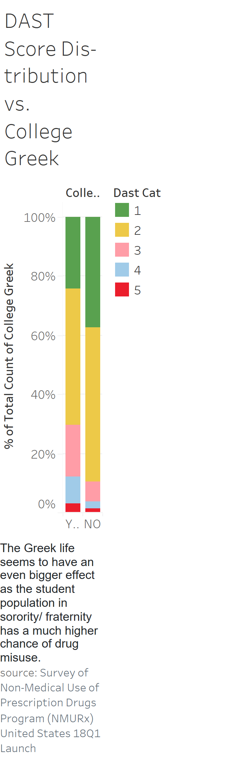
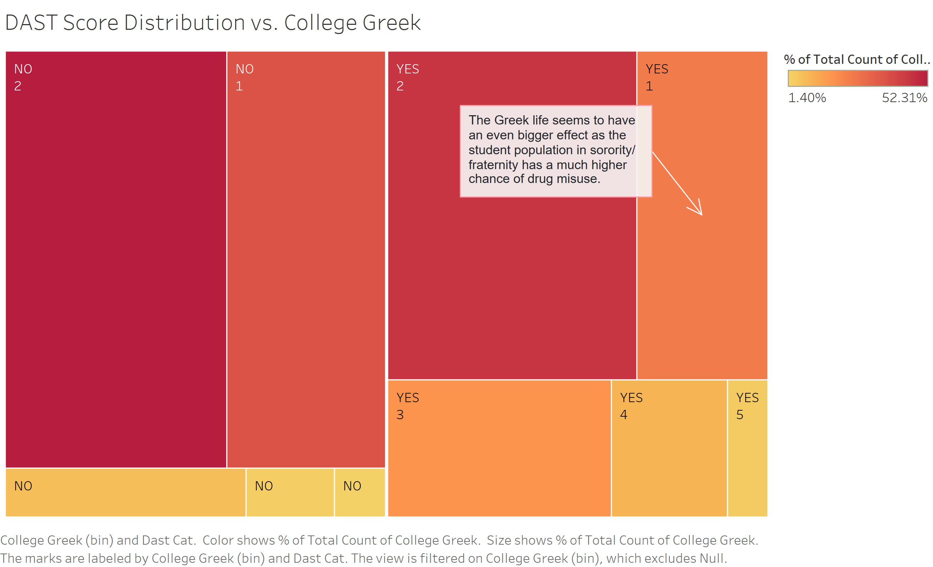

Slide 7
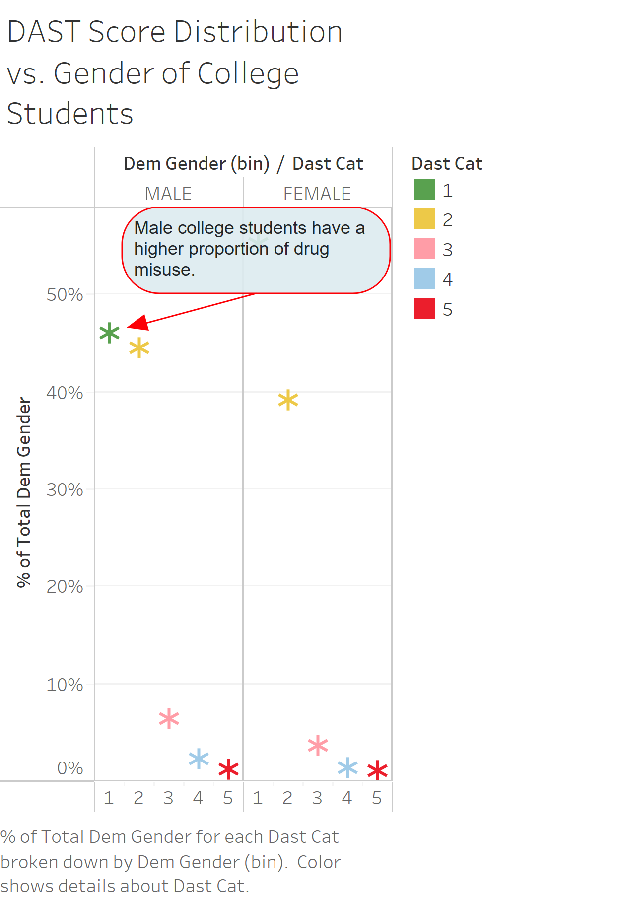
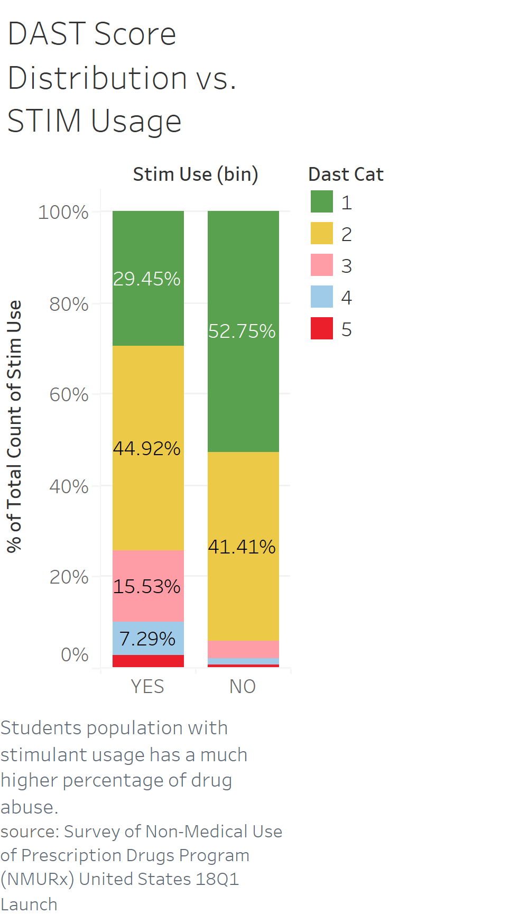

Slide 8
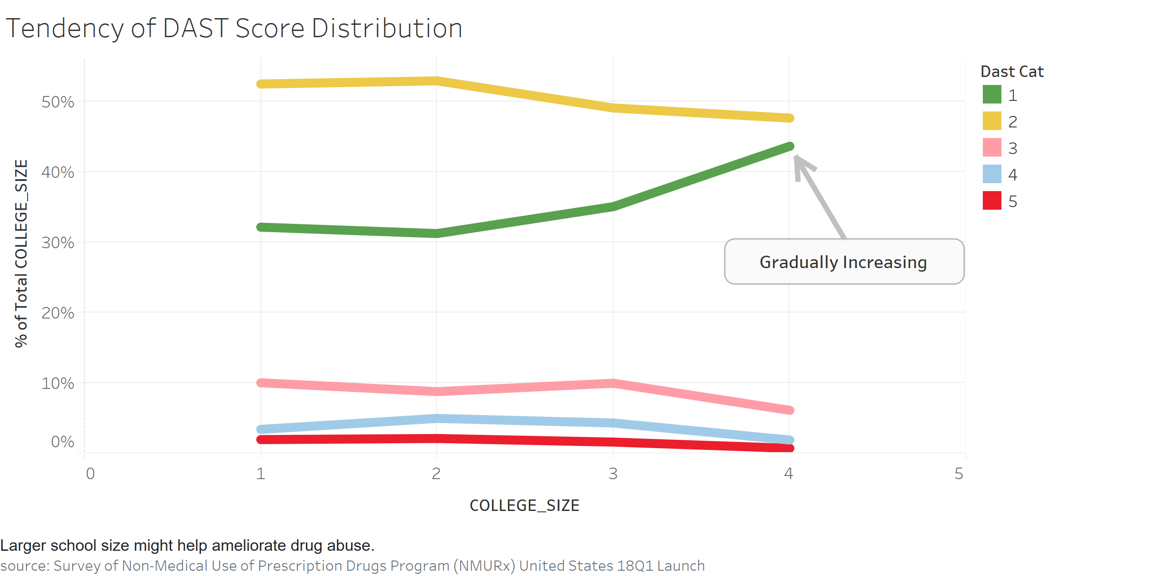

Slide 9
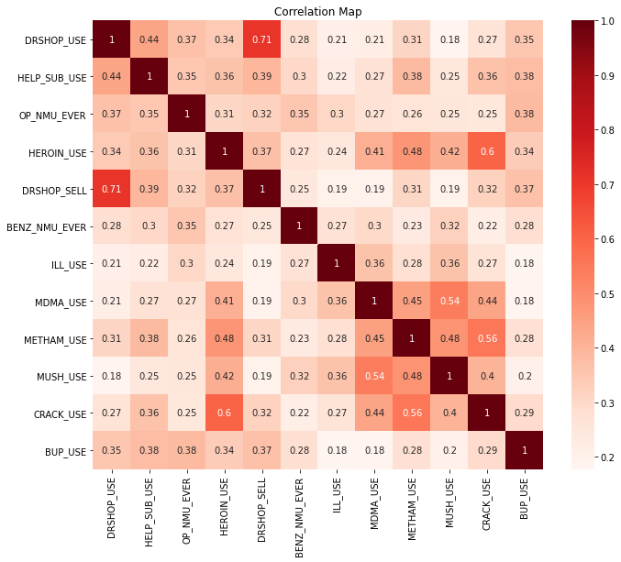

Slide 10
Shorter Questionnaire
QUESTION 1:
Have you ever sought for professional help for prescription drugs or other illegal drugs?

Slide 11
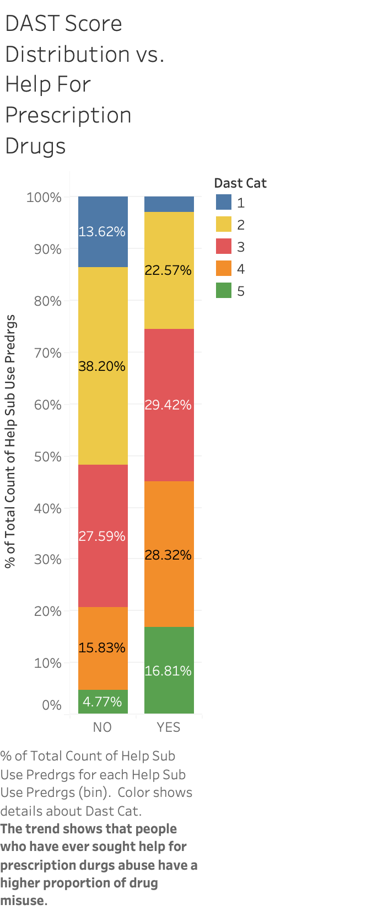
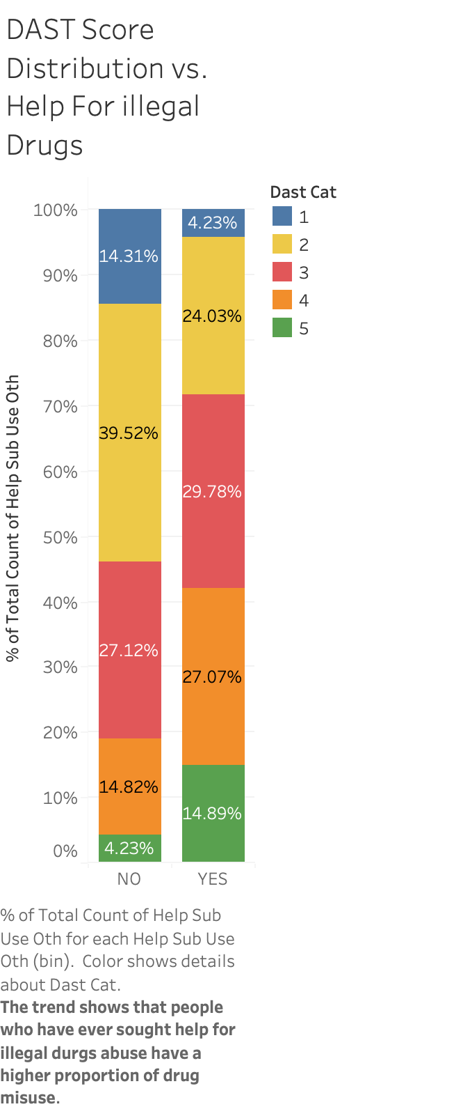
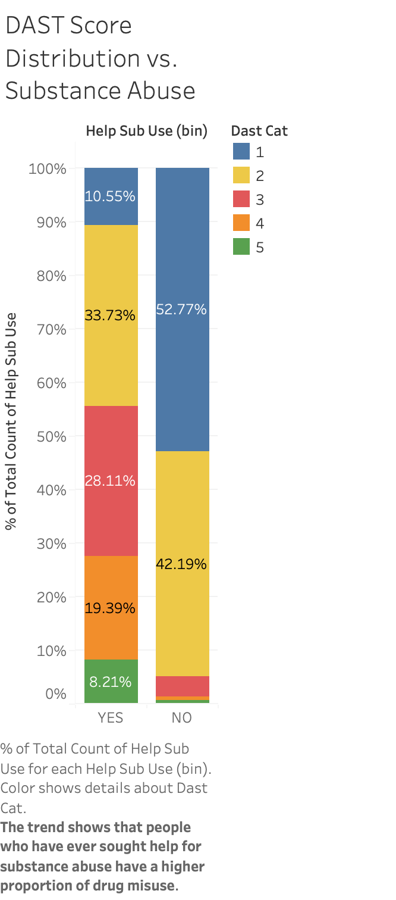

Slide 12
QUESTION 2 :
Have you been prescribed any medications for opioid dependence?

Slide 13
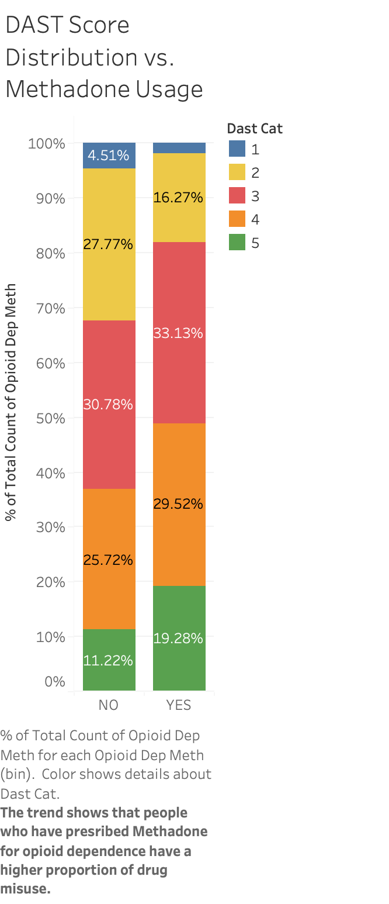
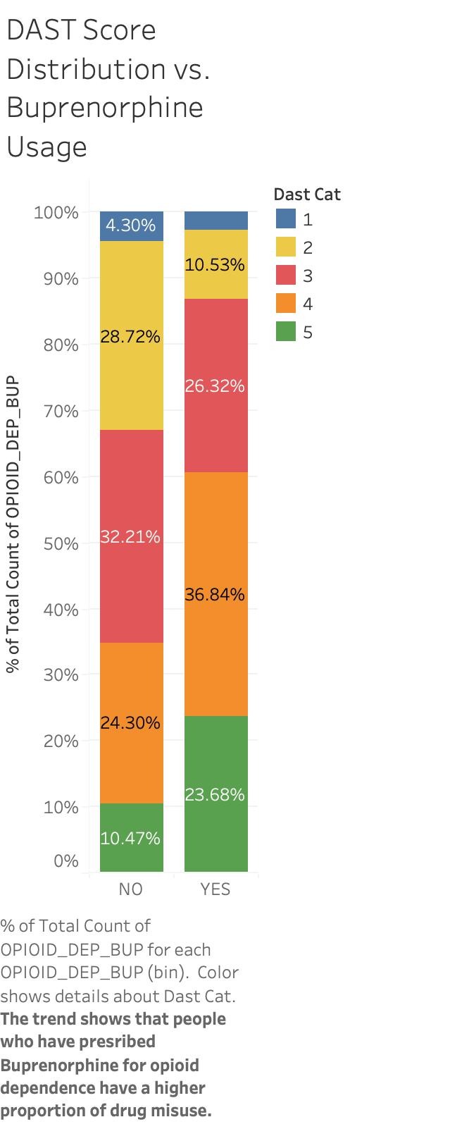
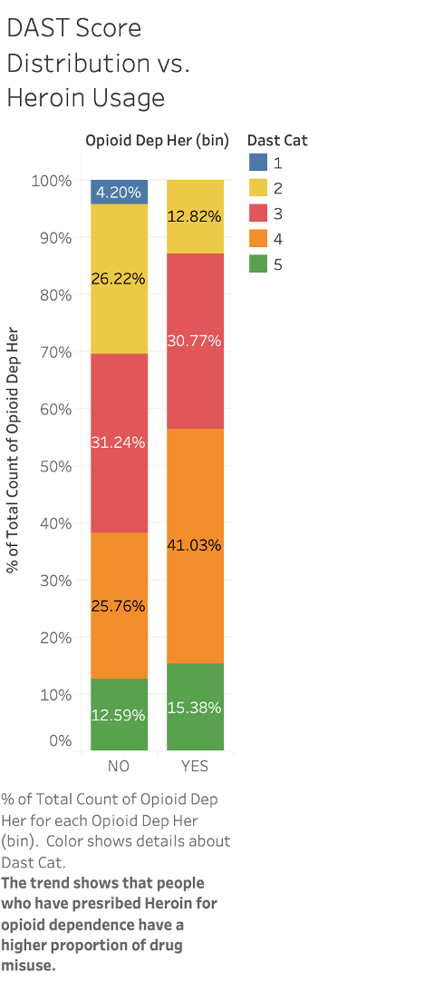
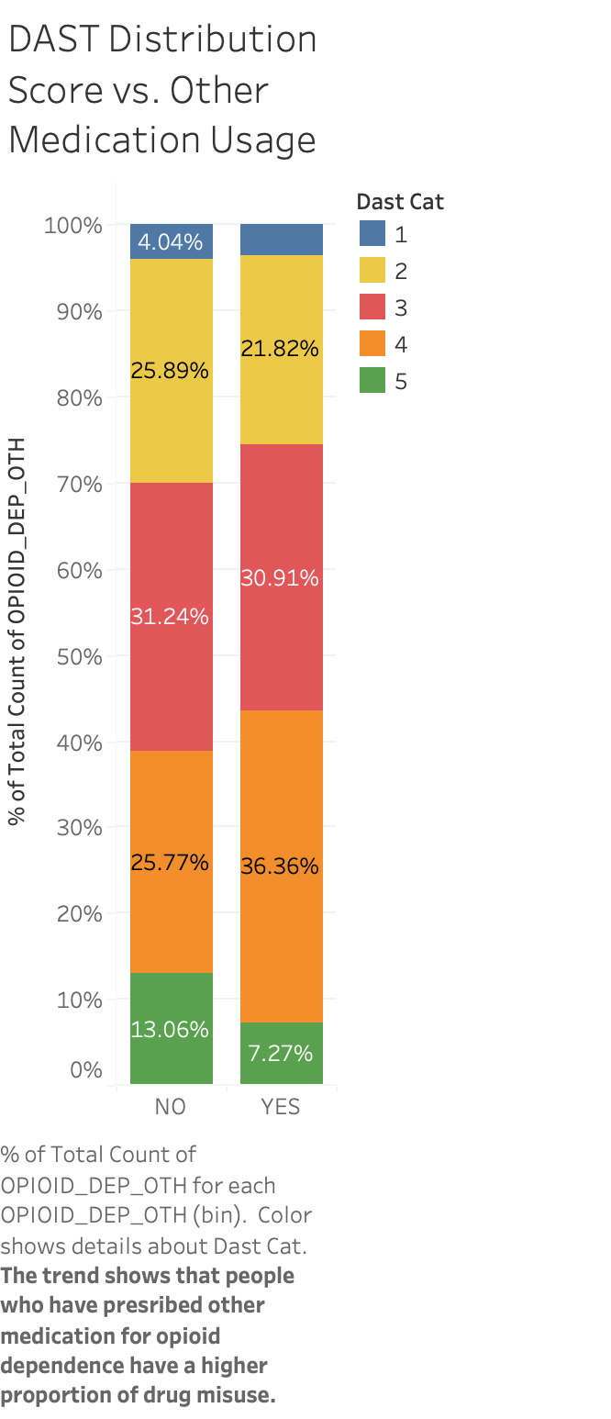

Slide 14
QUESTION 3:
Have you ever received a prescription for an opioid (pain reliever) to treat your chronic pain or acute pain?

Slide 15
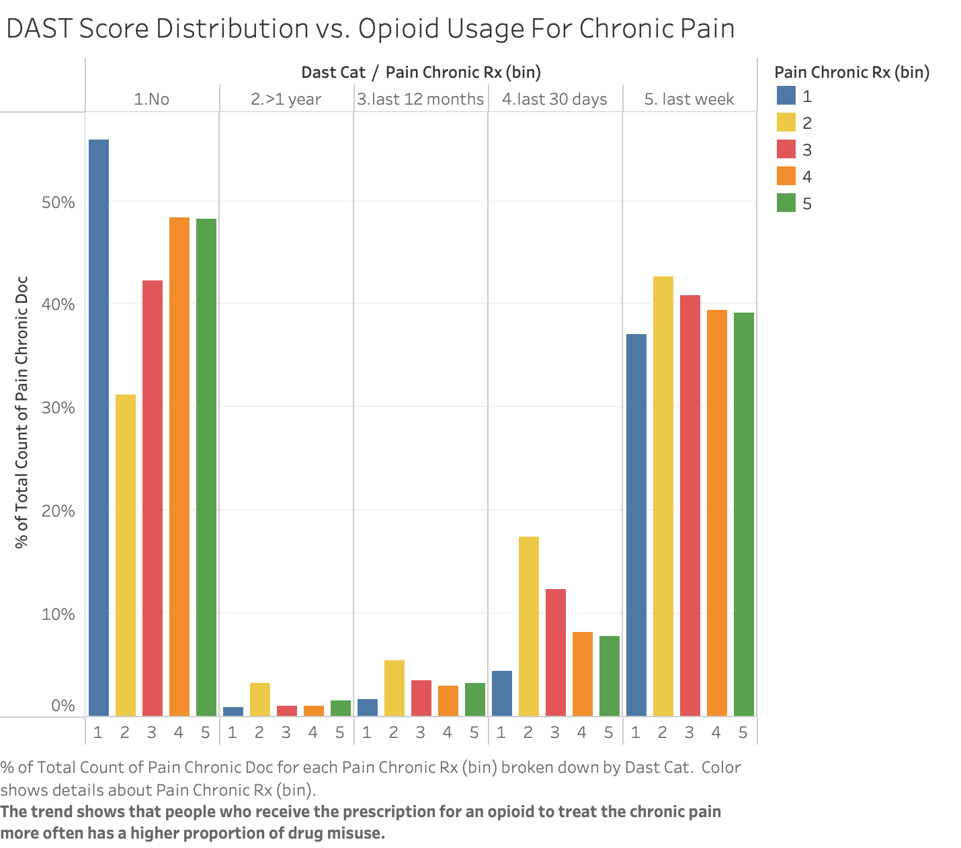

Slide 16
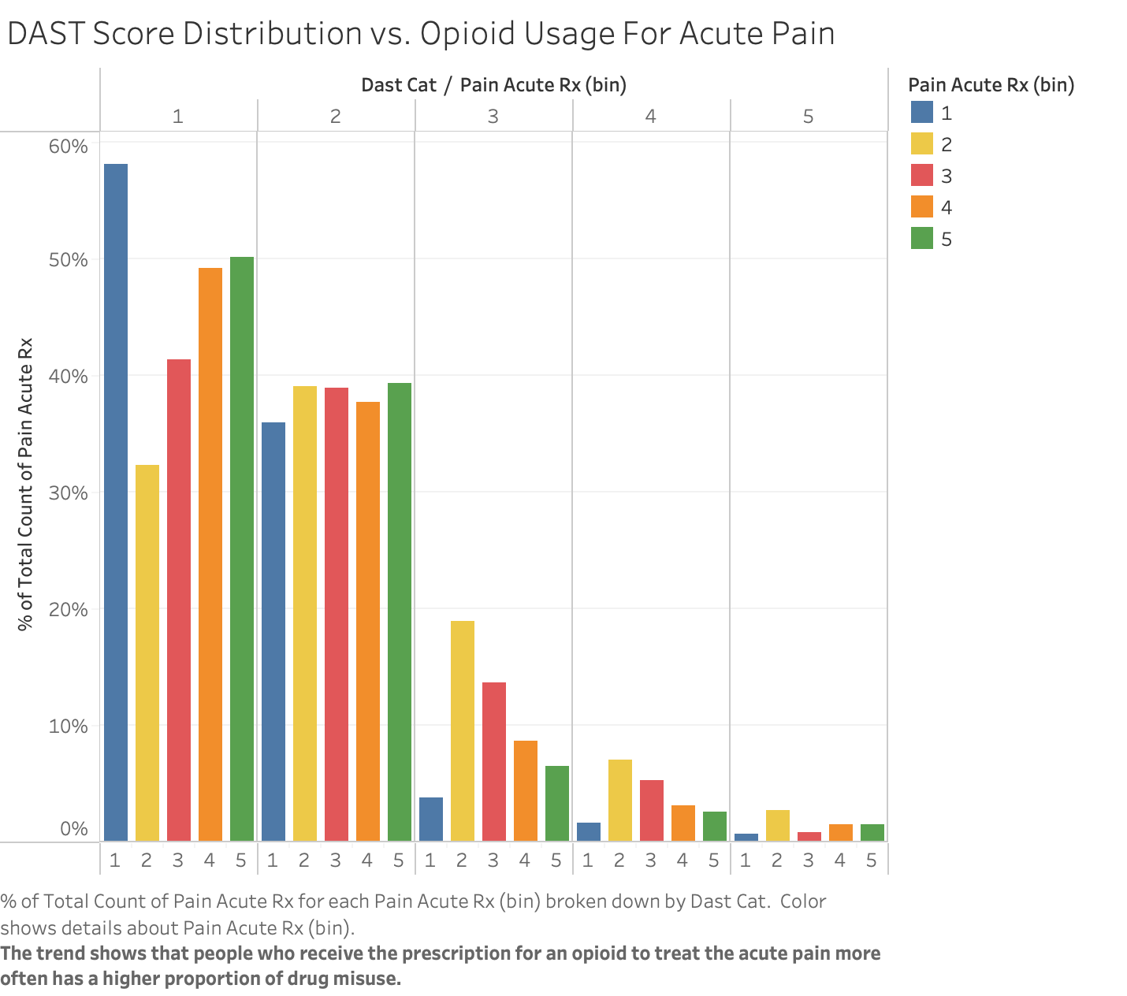

Slide 17
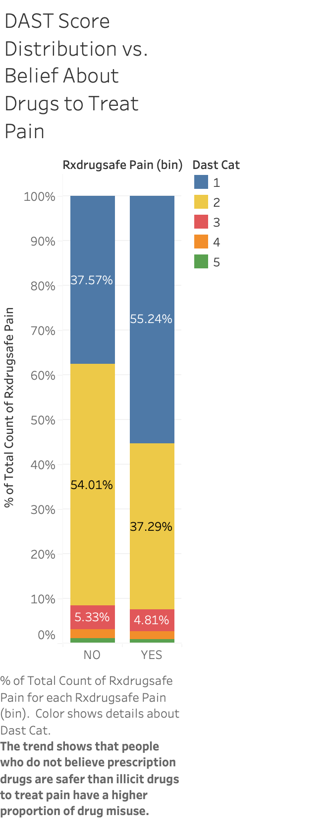
QUESTION 4 :
Do you believe prescription drugs
are safer than illicit drugs
To treat pain?

Slide 18
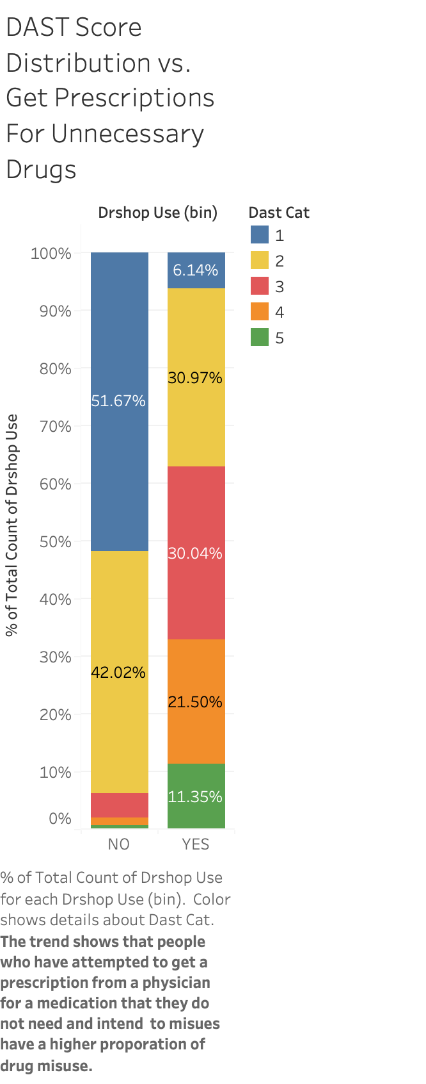
QUESTION 5:
Have you ever attempted to get a prescription
from a physician for a medication that you
did not need and intended to misuse?

Slide 19
QUESTION 6:
Which of the following behaviors do you have ?
Currently use tobacco.
Have more than 7 drinks of alcohol per week.
None of them.

Slide 20
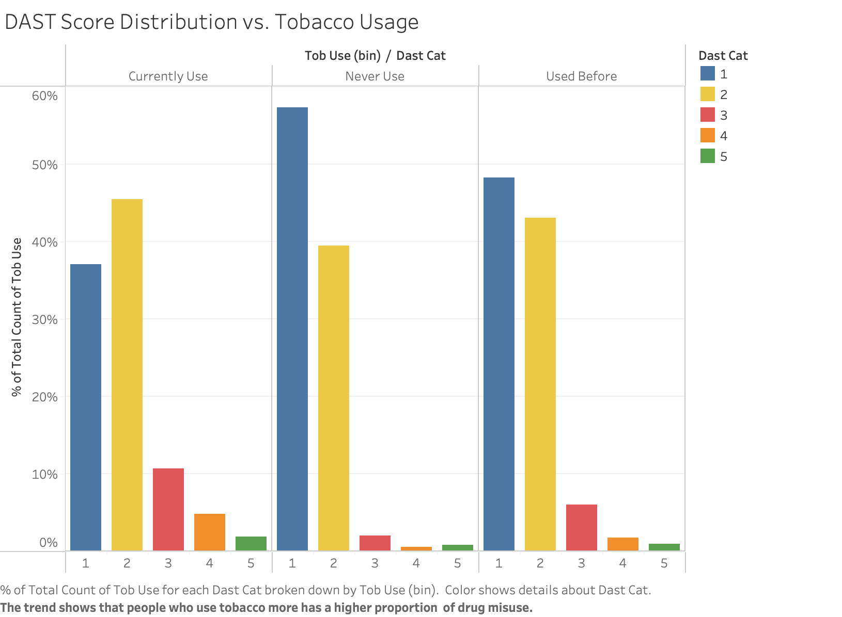

Slide 21
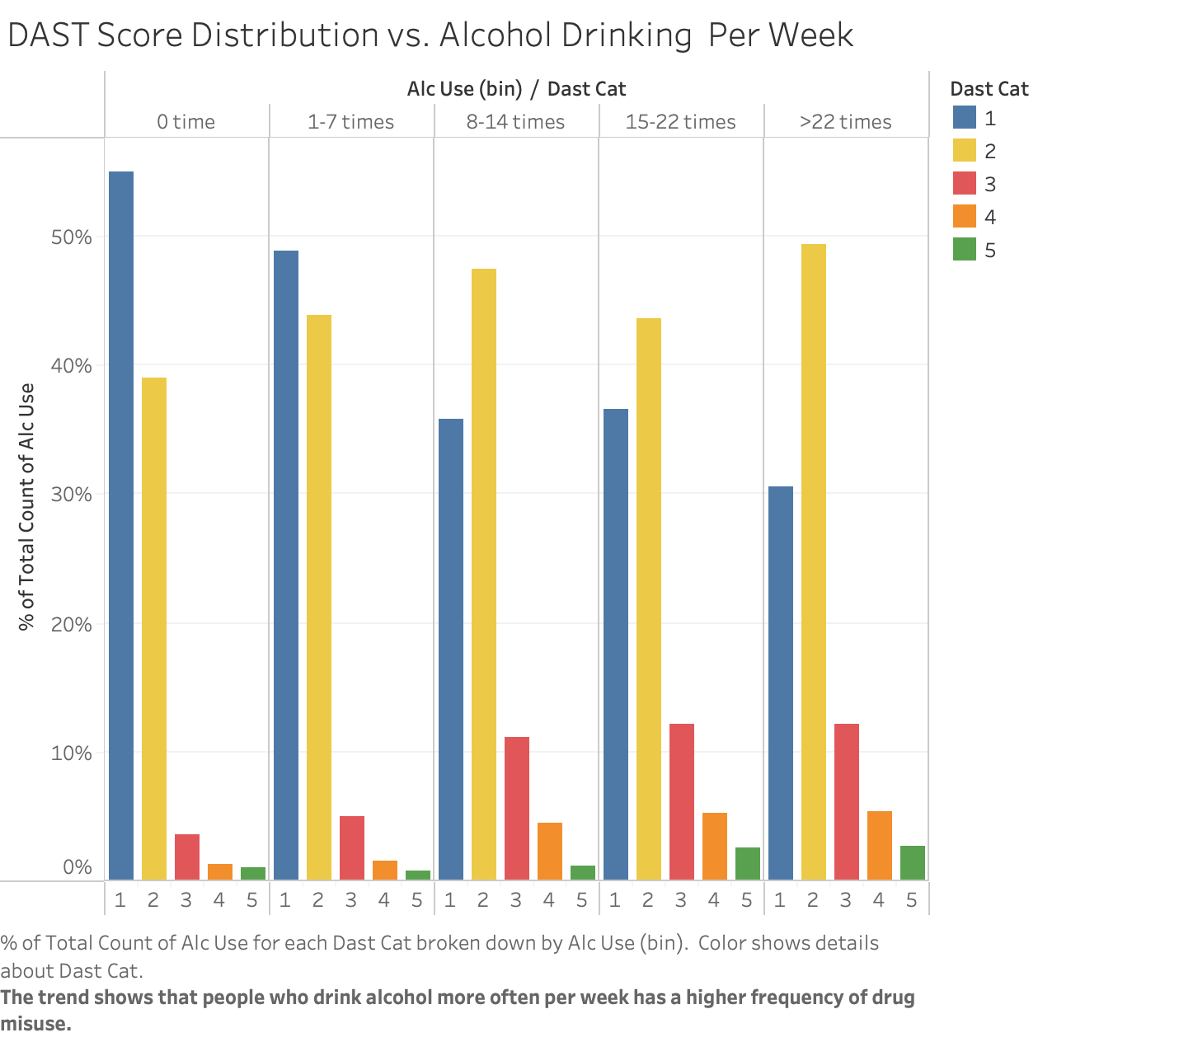

Slide 22
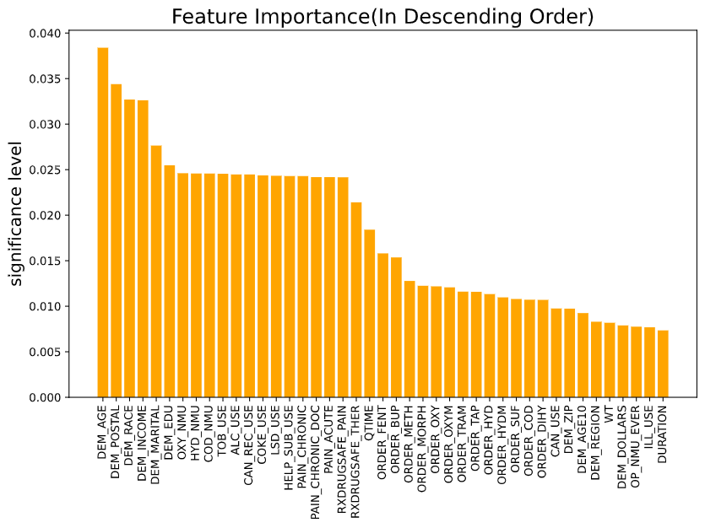
Feature Selection and Model Building
RF Classification
Accuracy: 65%
RMSE: 1.52
Prediction
DAST_CAT | COUNT
1 | 5074
2 | 3771
3 | 123
4 | 27
5 | 8

Slide 23
Thanks for watching!

