Slide 1
Chapter 9: Virtual Memory 虚拟内存
Notes:
1

Slide 2
CHAPTER OBJECTIVES
To describe the benefits of a virtual memory system 介绍虚拟内存系统的益处
To explain the concepts of demand paging, page-replacement algorithms, and allocation of page frames 解释请求式分页的概念、页替换算法及帧分配
To discuss the principle of the working-set model
讨论工作集模型的原理

Slide 3
Chapter 9: Virtual Memory
9.1 Background 背景
9.2 Demand Paging 请求式分页
9.3 Page Replacement 页替换
9.4 Allocation of Frames 帧分配
9.5 Thrashing 抖动

Slide 4
9.1 Background
In many cases, the entire program is not needed.
在许多情况下，（加载）整个程序是没必要的
The ability to execute a program that is only partially in memory would confer many benefits:
允许程序部分加载即可运行会有许多好处：
A program would no longer be constrained by the amount of physical memory.
More programs could be run at the same time, with a corresponding increase in CPU utilization and throughput.
Less I/O would be needed to load or swap each user program into memory, so each user program would run faster.

Slide 5
Virtual memory – separation of user logical memory from physical memory.
虚拟存储－－用户逻辑存储与物理存储分离 （部分加载+交换）
Only part of the program needs to be in memory for execution.
仅部分程序必须在内存，以使其运行
Logical address space can therefore be much larger than physical address space.
从而逻辑地址空间远大于物理地址空间
Allows address spaces to be shared by several processes.
允许地址空间被多个进程共享
Allows for more efficient process creation.
允许更有效的进程创建

Slide 6
Virtual memory can be implemented via:
Demand paging 请求式分页
Demand segmentation 请求式分段
However, segment-replacement algorithms are more complex than are page-replacement algorithms because the segments have variable sizes.
但是，段的替换算法比页替换算法复杂，因为段的大小不同
paged segmentation 段页式

Slide 7
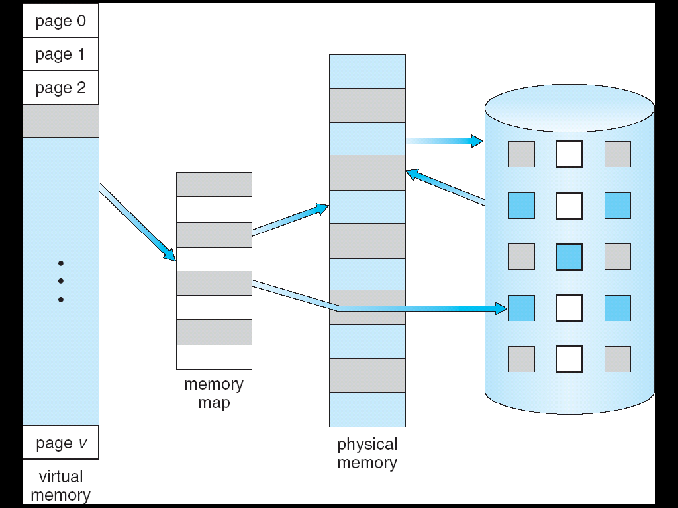
Figure Virtual Memory That is Larger Than Physical Memory

Slide 8
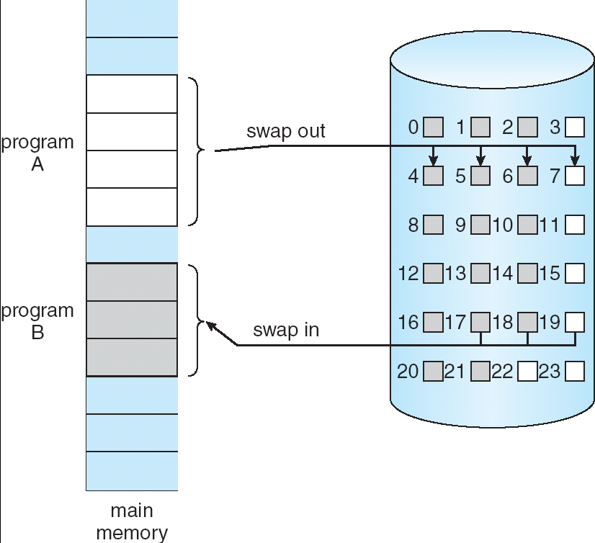
9.2 Demand Paging 请求式分页
Transfer of a Paged Memory to Contiguous Disk Space

Slide 9
A demand-paging system is similar to a paging system with swapping.
请求式分页系统类似于分页系统＋对换
But we use a lazy swapper—pager (页调度程序)
Swapper vs Pager
A pager never swaps a page into memory unless that page will be needed.
A swapper manipulates entire processes.

Slide 10
Basic Concepts 基本概念
Bring a page into memory only when it is needed.
仅当必需的时候加载一个页面
Less I/O needed
Less memory needed
Faster response
More users
Page is needed ⇒ reference to it
invalid reference ⇒ abort
not-in-memory ⇒ bring to memory

Slide 11
Valid-Invalid Bit 有效位
“valid”
the associated page is both legal and in memory.
“invalid”
the page either is not valid(that is ,not in the logical address space of the process),or is valid but is currently on the disk.

Slide 12
Initially valid–invalid bit is set to 0 on all entries.
During address translation, if valid–invalid bit in page table entry is 0 ⇒ page fault .
Frame #
valid-invalid bit
1
1
1
1
0

0
0
page table

Slide 13
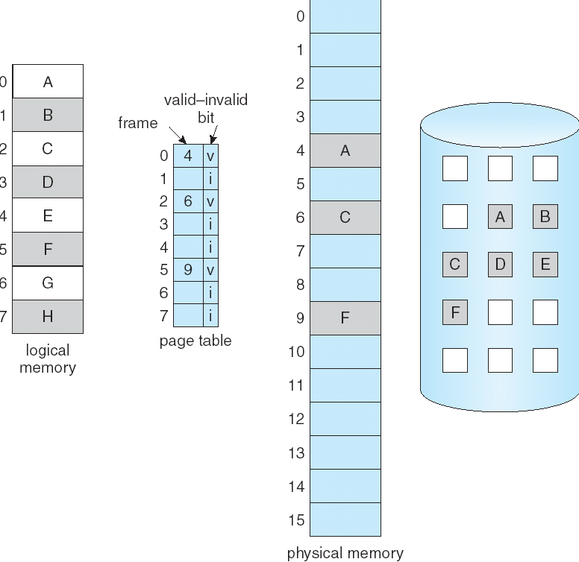
Page Table When Some Pages Are Not in Main Memory

Slide 14
Page Fault 缺页
If there is ever a reference to a page, first reference will trap to OS ⇒ page fault
对一个页面的首次访问将自陷到操作系统－－缺页

Slide 15
OS checks an internal table to decide: OS 检查内置页表以确定
Invalid reference ⇒ abort(terminate the process).
Valid,Just not in memory ⇒page it in.
Get empty frame. 获取空闲帧
Swap page into frame. 对换页面到该帧
Reset tables, validation bit = 1. 重置页表，有效位置1
Restart instruction 重启指令

Slide 16
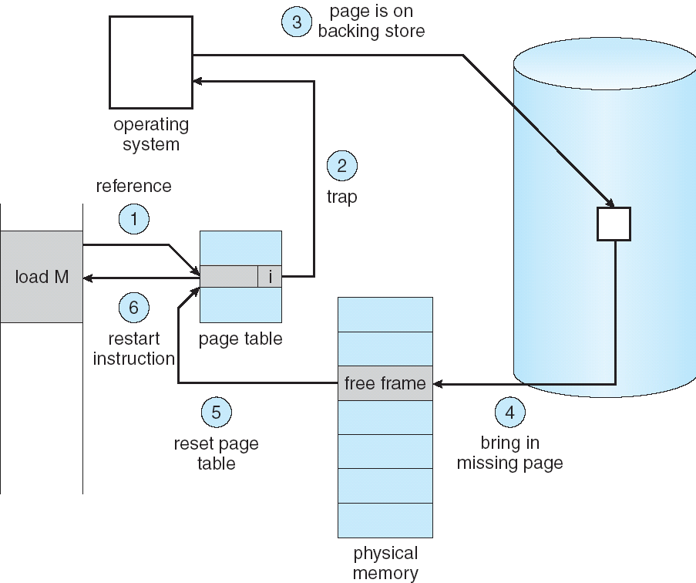
Steps in Handling a Page Fault

Slide 17
Pure demand paging 纯请求式分页
Never bring a page into memory until it is required.
对于任何一个页面，仅当必需时才加载到内存

Slide 18
Theoretically, some programs may access several new pages of memory with each instruction execution
理论上，某些程序每次执行指令可能访问多个新内存页
one page for the instruction and many for data
一个指令页，多个数据页
possibly causing multiple page faults per instruction.
每条指令可能引起多个也错误
Fortunately, programs tend to have locality of reference
幸运的是，程序倾向于访问局部性

Slide 19
The hardware to support demand paging
请求式分页的硬件支持
Page table 页表
valid-invalid bit, protection bits 有效位、保护位
Secondary memory 辅存
swap space 对换空间

Slide 20
What happens if there is no free frame?
Page replacement 页替换
find some page in memory, but not really in use, swap it out.
寻找内存中某些并未真正使用中的页面，将其对换出去
Algorithm 算法
Performance 性能
want an algorithm which will result in minimum number of page faults.
寻求一种算法：该算法导致最小的缺页数

Slide 21
Same page may be brought into memory several times.
同一页面可能会多次被加载到内存

Slide 22
Performance of Demand Paging 请求式分页的性能
Page Fault Rate 0 ≤ p ≤ 1.0
if p = 0 no page faults
if p = 1, every reference is a fault

Slide 23
Effective Access Time (EAT) 有效访问时间
EAT = (1 – p) x ma + p x Page-fault service time
Ma
the memory access time, now ranges from 10 to 200 nanoseconds.
Page-fault service time
page fault overhead + [swap page out ] + swap page in + restart overhead

Slide 24
Example
Memory access time = 100 nanoseconds
An average page-fault service time=25 milliseconds
EAT(in nanoseconds)
= (1 – p) x ma + p x Page-fault service time
= (1 – p) x 100 + p x 25,000,000
=100+24,999,900 x p
The EAT is directly proportional to the page-fault rate.
If we want less than 10-percent degradation,we need
110 > 100+25,000,000 x p
10 > 25,000,000 x p
p < 0.0000004

Slide 25
Disk I/O to swap space is generally faster than that to the file system.
磁盘I/O到对换空间通常比到文件系统快
because swap space is allocated in much larger blocks,and file lookups and indirect allocation methods are not used.
因为对换空间以更大的块进行分配，而不采用文件系统的查找和间接分配方法。

Slide 26
9.3 Page Replacement 页替换
Prevent over-allocation of memory by modifying page-fault service routine to include page replacement.
Use modify (dirty) bit to reduce overhead of page transfers
only modified pages are written to disk.
Page replacement completes separation between logical memory and physical memory
large virtual memory can be provided on a smaller physical memory.

Slide 27
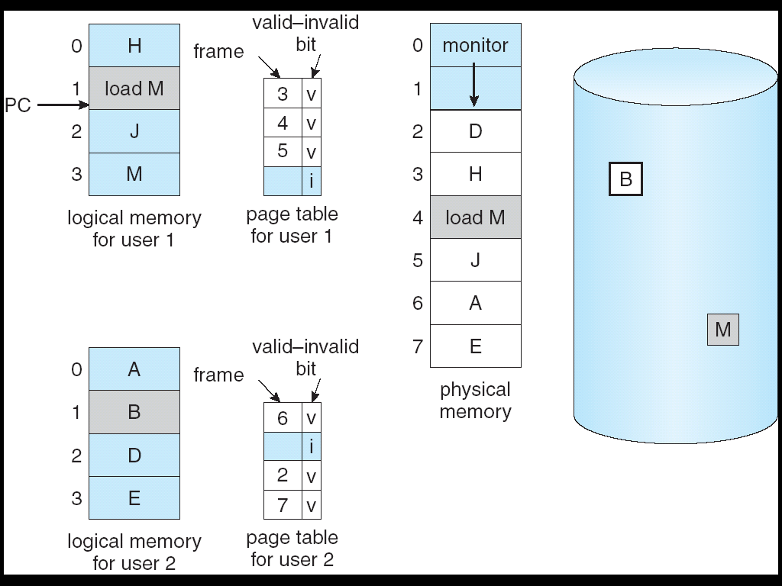
Need For Page Replacement

Slide 28
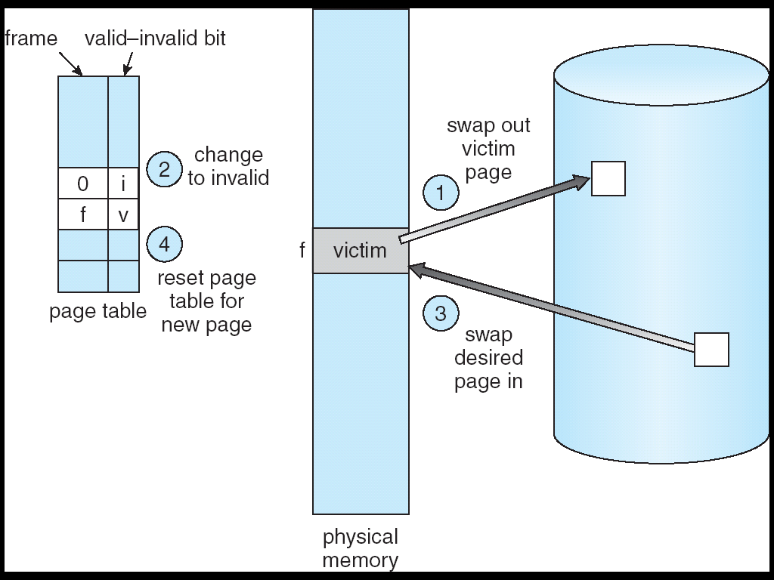
Basic Page Replacement
Page Replacement

Slide 29
The page-fault service routine including page replacement
1. Find the location of the desired page on disk.
2. Find a free frame:
- If there is a free frame, use it.
- If there is no free frame, use a page replacement algorithm to select a victim frame.
-write the victim page to the disk; change the page and frame tables accordingly.

Slide 30
3. Read the desired page into the (newly) free frame. Update the page and frame tables.
4. Restart the process.

Slide 31
modify (dirty) bit
The modify bit for a page is set by the hardware whenever any word or byte in the page is written into.
When we select a victim, examine its modify bit.
set: must write that page to disk.
not set: if the copy of the page on the disk has not been overwritten (by some other page, for example), then we can avoid writing the page to the disk.

Slide 32
Two major problems for demand paging
Frame-allocation algorithm
decide how many frames to allocate to each process.
Page-replacement algorithm
select the frames that are to be replaced.
Want lowest page-fault rate.

Slide 33
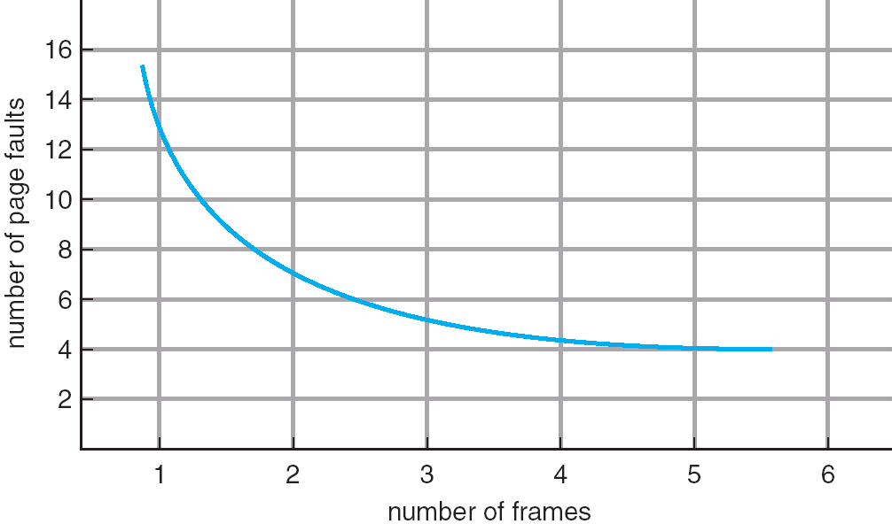
Graph of Page Faults Versus The Number of Frames

Slide 34
Evaluate algorithm by running it on a particular string of memory references (reference string) and computing the number of page faults on that string.
In all our examples, the reference string is
1, 2, 3, 4, 1, 2, 5, 1, 2, 3, 4, 5

Slide 35
FIFO Page Replacement FIFO页替换
Reference string: 1, 2, 3, 4, 1, 2, 5, 1, 2, 3, 4, 5
1
1
5
4
1
1
4
5
2
2
1
5
10 page faults
2
2
1
3
9 page faults
3
3
2
3
3
2
4
4
4
3
3 frames
4 frames

Slide 36
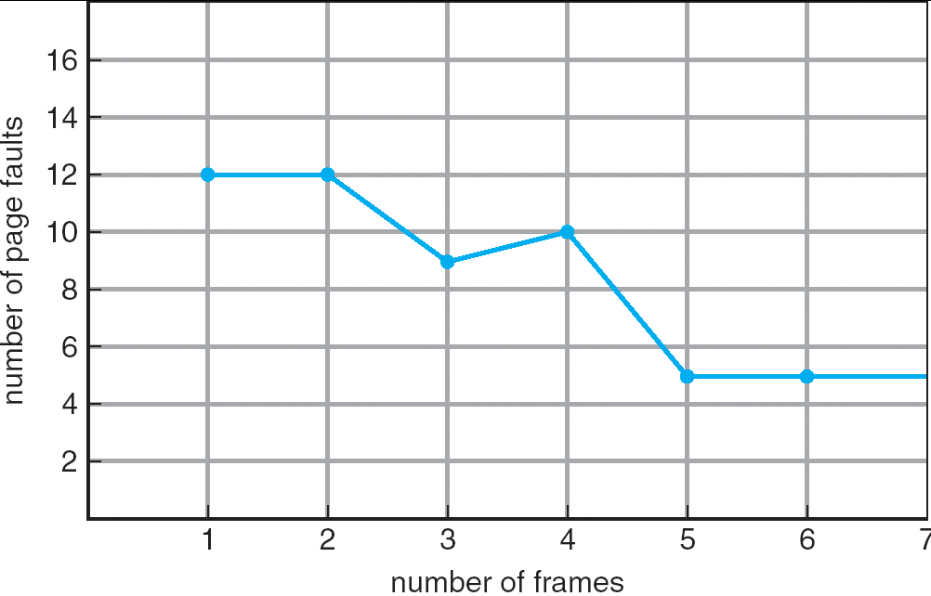
FIFO Illustrating Belady’s Anamoly
FIFO Replacement – Belady’s Anomaly
more frames ⇒ less page faults(not always true)

Slide 37
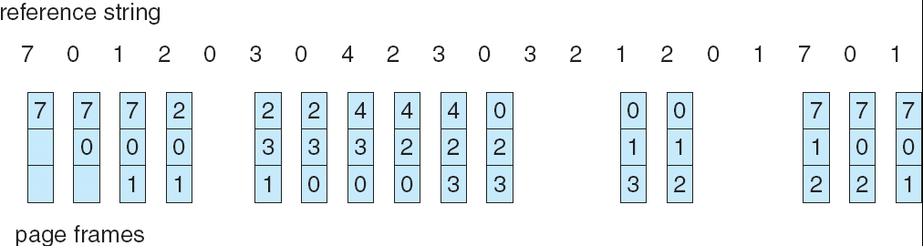
FIFO Page Replacement

Slide 38
Optimal Page Replacement 最优页替换
Replace page that will not be used for longest period of time.
4 frames example: 1, 2, 3, 4, 1, 2, 5, 1, 2, 3, 4, 5
1
4
2
6 page faults
3
4
5

Slide 39
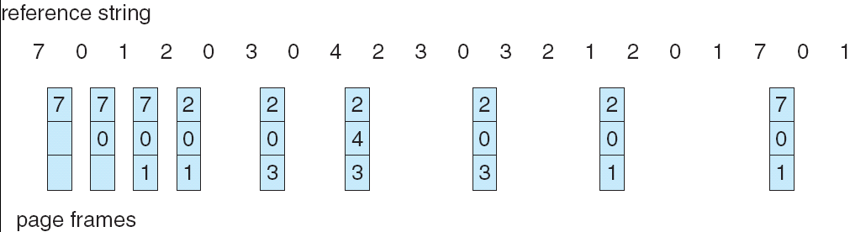
Optimal Page Replacement

Slide 40
How do you know this?
Used for measuring how well your algorithm performs.

Slide 41
Least Recently Used (LRU) Page Replacement 最近最少使用（LRU）算法
Reference string: 1, 2, 3, 4, 1, 2, 5, 1, 2, 3, 4, 5
1
5
2
3
5
4
4
3

Slide 42
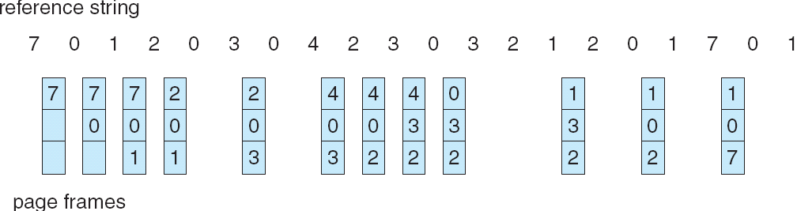
LRU Page Replacement

Slide 43
Counter implementation 计数器实现
Every page entry has a counter; every time page is referenced through this entry, copy the clock into the counter.
When a page needs to be changed, look at the counters to determine which are to change.

Slide 44
Stack implementation 栈实现
– keep a stack of page numbers in a double link form:
Page referenced:
move it to the top
requires 6 pointers to be changed
No search for replacement

Slide 45
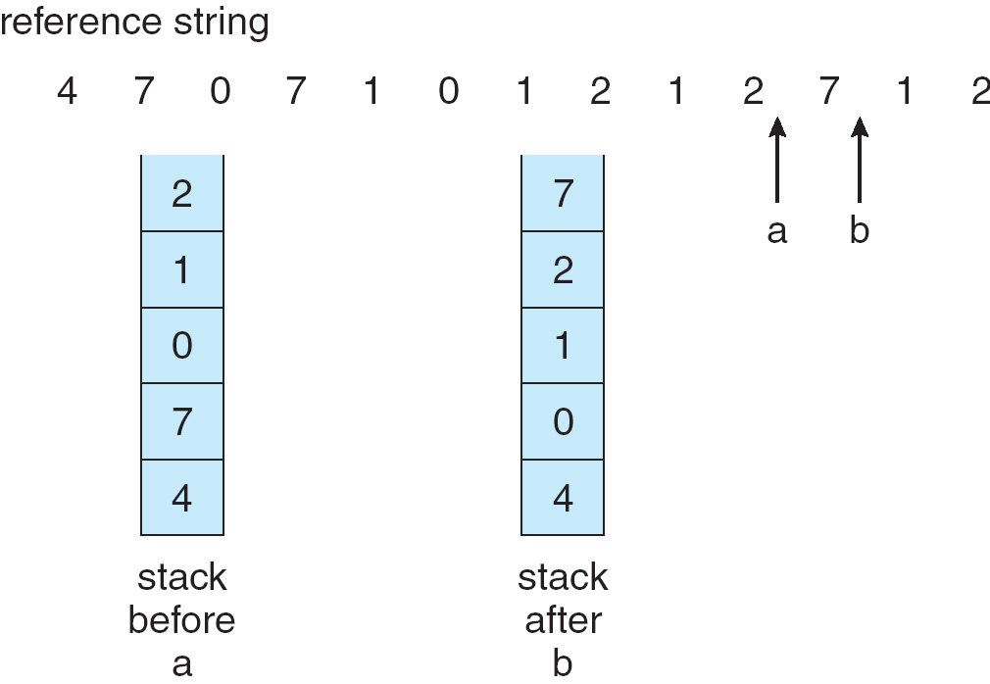
Use Of A Stack to Record The Most Recent Page References

Slide 46
LRU Approximation Algorithms LRU的近似算法（NRU）
Additional-Reference-Bits Algorithm
附加访问位算法
With each page associate a bit, initially = 0
When page is referenced bit set to 1.
Replace the one which is 0 (if one exists). We do not know the order, however.

Slide 47
Second-Chance Algorithm
二次机会算法（时钟算法）
Need reference bit.
Clock replacement.
If page to be replaced (in clock order) has reference bit = 1. then:
set reference bit 0.
leave page in memory.
replace next page (in clock order), subject to same rules.

Slide 48
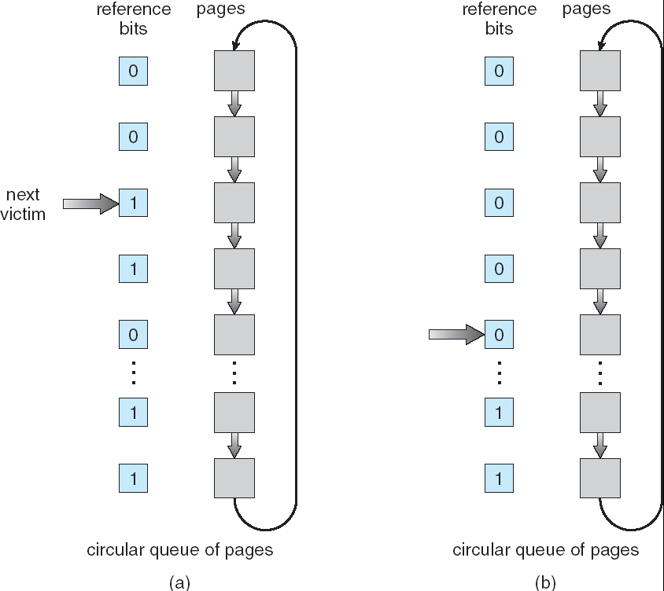
Second-Chance (clock) Page-Replacement Algorithm

Slide 49
Enhanced Second-Chance Algorithm
加强的二次机会算法
by considering both the reference bit and modify bit as an ordered pair.
参考有序对：（访问位，修改位）
1. (0,0)---best page to replace.
2. (0,1)---not quite as good..
3. (1,0)---it probably will be used again soon.
4. (1,1)---worst page to replace.

Slide 50
Counting-Based Page Replacement 基于计数的算法
Keep a counter of the number of references that have been made to each page.
LFU（Least Frequently Used） Algorithm 最不经常使用
replaces page with smallest count. (An actively used page should have a large reference count.)
MFU （Most Frequently Used） Algorithm 最经常使用
based on the argument that the page with the smallest count was probably just brought in and has yet to be used.

Slide 51
Page-Buffering Algorithms 页缓冲算法
Used in addition to a specific page-replacement algorithm. 用于配合特定的页替换算法
Keep a pool of free frames 空闲帧池
When a page fault occurs, a victim frame is chosen as before. How ever, the desired page is read into a free frame from the pool before the victim is written out. When the victim is later written out, its frame is added to the free-frame pool.

Slide 52
Maintain a list of modified pages 脏页列表
Whenever the paging device is idle, a modified page is selected and is written to the disk.Its modify bit is then reset. (It will be clean when it is selected as a victim.)

Slide 53
Keep a pool of free frames, but to remember which page was in each frame 空闲帧池 保留页内容
Since the frame contents are not modified when a frame is written to the disk, the old page can be reused directly from the free-frame pool if it is needed before that frame is reused. No I/O is needed in this case.

Slide 54
Applications and Page Replacement
In certain cases, applications accessing data through the operating system’s virtual memory perform worse than if the operating system provided no buffering at all.
Database 数据库
provides its own memory management and I/O buffering
data warehouses 数据仓库
MFU would actually be more efficient than LRU

Slide 55
Because of such problems, some operating systems give special programs the ability to use a disk partition as a large sequential array of logical blocks, without any file-system data structures.
Raw disk & raw I/O
most applications perform better when they use the regular file-system services

Slide 56
9.4 Allocation of Frames 帧分配

Slide 57
Minimum Number of Frames 最小帧数
Each process needs minimum number of pages.
每个进程加载到内存的页数都有个最小值
This minimum number is defined by the instruction-set architecture.
Example: IBM 370 – 6 pages to handle SS MOVE instruction:
instruction is 6 bytes, might span 2 pages.
2 pages to handle from.
2 pages to handle to.

Slide 58
The minimum number of frames per process is defined by the architecture,
Whereas the maximum number is defined by the amount of available physical memory.
In between, we are still left with significant choice in frame allocation.

Slide 59
Allocation Algorithms分配算法
Two major allocation schemes.
fixed allocation 固定分配
priority allocation 优先级分配

Slide 60
Fixed Allocation 固定分配
Equal allocation
e.g., if 100 frames and 5 processes, give each 20 pages.

Slide 61
Proportional allocation
Allocate according to the size of process.

Slide 62
Priority Allocation 优先级分配
Use a proportional allocation scheme using priorities rather than size.
If process P_{i} generates a page fault,
select for replacement one of its frames.
select for replacement a frame from a process with lower priority number.

Slide 63
Global vs. Local Allocation 全局分配与局部分配
Global replacement 全局替换
– process selects a replacement frame from the set of all frames; one process can take a frame from another.
Local replacement 局部替换
– each process selects from only its own set of allocated frames.

Slide 64
9.5 Thrashing 抖动/颠簸
Thrashing
a process is busy swapping pages in and out.

Slide 65
Cause of Thrashing 抖动的产生
If a process does not have “enough” pages, the page-fault rate is very high. This leads to:
low CPU utilization.
operating system thinks that it needs to increase the degree of multiprogramming.
another process added to the system.

Slide 66
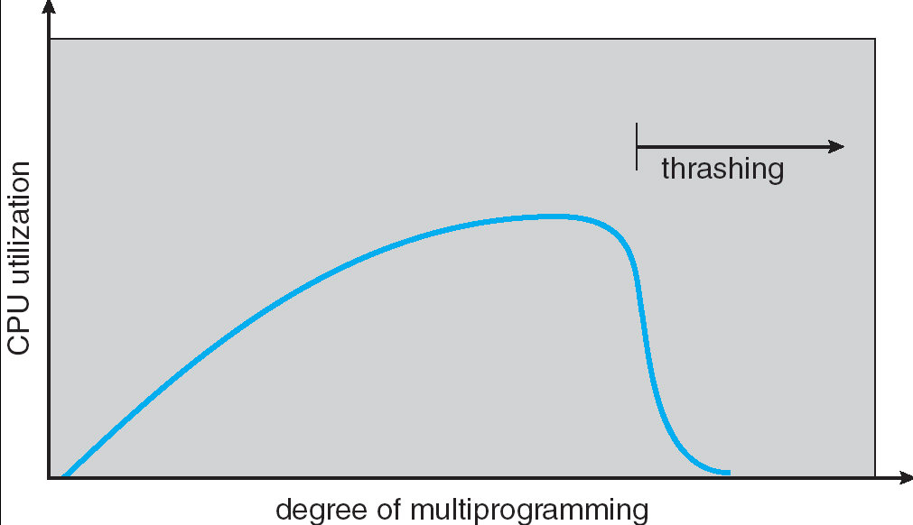
Thrashing

Slide 67
Why does paging work? Locality model
Process migrates from one locality to another.
Localities may overlap.
Why does thrashing occur?
Σ size of locality > total memory size

Slide 68
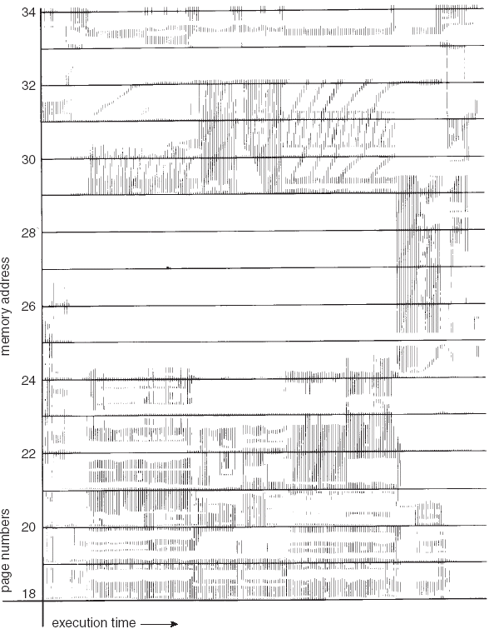
Locality In A Memory-Reference Pattern

Slide 69
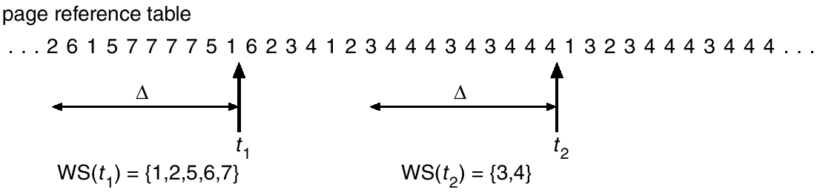
Working-Set Model 工作集模型
working-set window
Δ ≡ working-set window ≡ a fixed number of page references Example: 10,000 instruction
Working-set model

Slide 70
working set
WS_{i} (working set of Process P_{i}) = total number of pages referenced in the most recent Δ (varies in time)
if Δ too small will not encompass entire locality.
if Δ too large will encompass several localities.
if Δ = ∞ ⇒ will encompass entire program.
D = Σ WSS_{i} ≡ total demand frames
if D > m ⇒ Thrashing
Policy: if D > m, then suspend one of the processes.

Slide 71
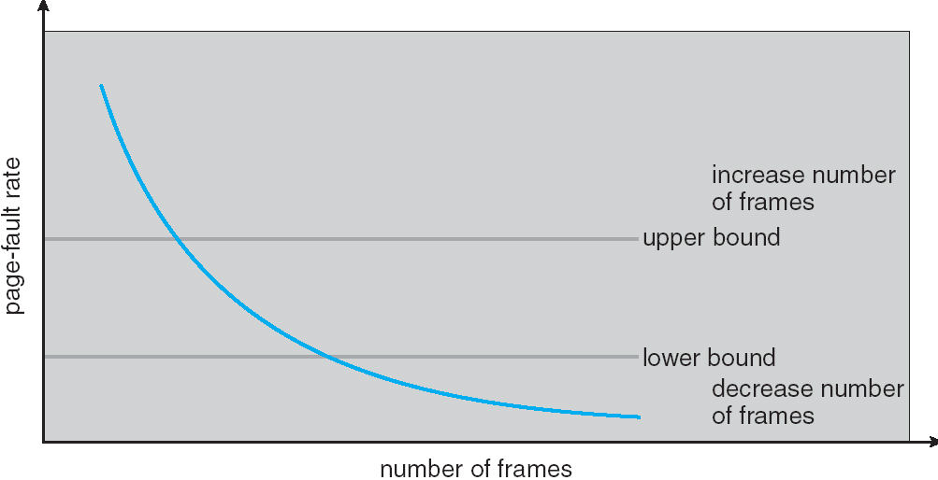
Page-Fault Frequency 缺页率模型
Establish “acceptable” page-fault rate.
If actual rate too low, process loses frame.
If actual rate too high, process gains frame.

Slide 72
Concluding Remarks 结论
Thrashing and the resulting swapping have a disagreeably large impact on performance.
The current best practice in implementing a computer facility is to include enough physical memory, whenever possible, to avoid thrashing and swapping.
From smartphones through mainframes, providing enough memory to keep all working sets in memory concurrently, except under extreme conditions, gives the best user experience.

Slide 73
Exercises
9.2
9.19
9.27

Slide 74
End of Chapter 9

