Slide 1
Part Three– Memory Management
Chapter 8 Main Memory
Chapter 9 Virtual Memory

Slide 2
Chapter 8: Main Memory 主存
8.1 Background 背景
8.2 Swapping 交换
8.3 Contiguous Memory Allocation 连续分配
8.4 Segmentation 分段
8.5 Paging 分页
8.6 Structure of the Page Table 页表结构
8.7 Example: Intel 32 and 64-bit Architectures

Slide 3
8.1 Background 背景
Program must be brought (from disk) into memory and placed within a process for it to be run
issues
Basic Hardware 硬件基础
Address Binding 地址绑定
Logical Versus Physical Address Space 逻辑vs物理地址空间
Dynamic Loading 动态加载
Dynamic Linking and Shared Libraries 动态连接与共享库

Slide 4
Basic Hardware 硬件基础
Main memory and registers are only storage CPU can access directly CPU只能直接访问主存和寄存器
Memory unit only sees a stream of addresses + read requests, or address + data and write requests
any instructions in execution, and any data being used by the instructions, must be in one of these direct-access storage devices

Slide 5
The relative speed of accessing physical memory
Register access in one CPU clock (or less) cycle (时钟周期)
Main memory may take many cycles
causing a processor stall 停顿
Remedy: Cache （高速缓存）sits between main memory and CPU registers
To manage a cache built into the CPU, the hardware automatically speeds up memory access without any operating-system control.

Slide 6
Protection of memory required to ensure correct operation
protect the OS from access by user processes
On multiuser systems, we must additionally protect user processes from one another
This protection must be provided by the hardware
because the operating system doesn’t usually intervene between the CPU and its memory accesses (because of the resulting performance penalty).
Here, we outline one possible implementation

Slide 7
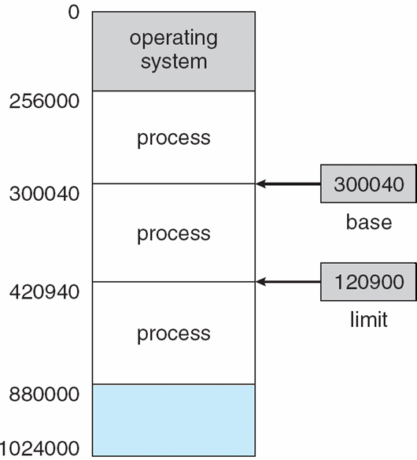
Base and Limit Registers
基址 & 界限寄存器
A pair of base and limit registers define the logical address space
CPU must check every memory access generated in user mode to be sure it is between base and limit for that user
Fig.8.1 A base and a limit register define a logical address space

Slide 8
Figure 8.2 Hardware address protection with base and limit registers.

Slide 9
Address Binding 地址绑定
Program must be brought into memory and placed within a process for it to be run.
Input queue 输入队列
– collection of processes on the disk that are waiting to be brought into memory to run the program.
User programs go through several steps before being run.

Slide 10
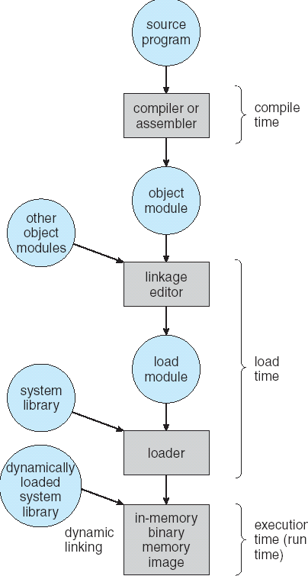
Figure 8.3 Multistep processing of a user program

Slide 11
Addresses represented in different ways at different stages of a program’s life
Source code addresses usually symbolic （符号地址）
such as “count”
Compiled code addresses bind to relocatable addresses （可重定位地址）
i.e. “14 bytes from beginning of this module”
Linker or loader will bind relocatable addresses to absolute addresses （绝对地址）
i.e. 74014
Each binding maps one address space to another

Slide 12
Address binding of instructions and data to memory addresses can happen at three different stages.
Compile time 编译时
If memory location known a priori, absolute code can be generated; must recompile code if starting location changes.
Load time 加载时
Must generate relocatable code if memory location is not known at compile time.

Slide 13
Execution time 运行时
Binding delayed until run time if the process can be moved during its execution from one memory segment to another.
Need hardware support for address maps (e.g., base and limit registers).

Slide 14
Logical Versus Physical Address Space 逻辑地址 vs. 物理地址
Logical & Physical Address
logical address 逻辑地址
An address generated by the CPU
physical address 物理地址
an address seen by the memory unit--that is, the one loaded into the memory-address register of the memory

Slide 15
virtual address 虚拟地址
Logical and physical addresses are the same in compile-time and load-time address-binding schemes.
logical (virtual) and physical addresses differ in execution-time address-binding scheme
In this case, we usually refer to the logical address as a virtual address.

Slide 16
Logical & Physical Address space
Logical-address space 逻辑地址空间
The set of all logical addresses generated by a program;
physical-address space 物理地址空间
the set of all physical addresses corresponding to these logical addresses.
Thus, in the execution-time address-binding scheme, the logical- and physical-address spaces differ.

Slide 17
Memory-Management Unit (MMU) 内存管理单元
Hardware device that at run time maps virtual to physical address
Many methods possible, covered in the rest of this chapter

Slide 18
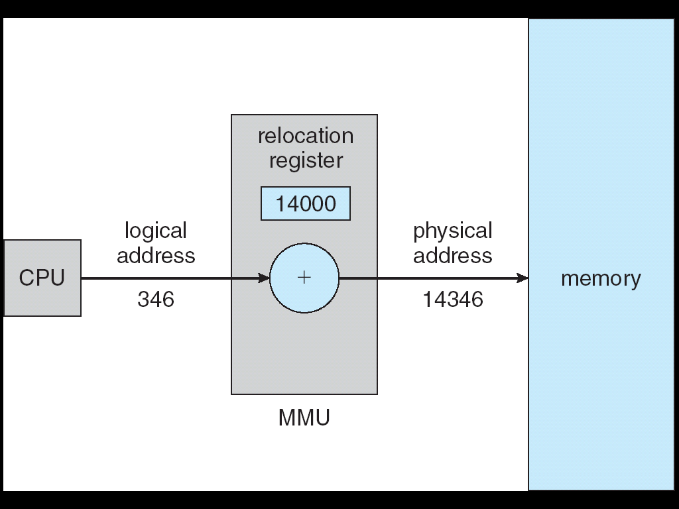
Dynamic relocation using a relocation register

Slide 19
To start, consider simple scheme where the value in the relocation register is added to every address generated by a user process at the time it is sent to memory
Base register now called relocation register （重定位寄存器）
MS-DOS on Intel 80x86 used 4 relocation registers

Slide 20
The user program deals with logical addresses; it never sees the real physical addresses
Execution-time binding occurs when reference is made to location in memory
Logical address bound to physical addresses

Slide 21
Dynamic Loading 动态加载
Routine （例程） is not loaded until it is called
Better memory-space utilization; unused routine is never loaded.
All routines kept on disk in relocatable load format
Useful when large amounts of code are needed to handle infrequently occurring cases.
No special support from the operating system is required
Implemented through program design
OS can help by providing libraries to implement dynamic loading

Slide 22
Dynamic Linking and Shared Libraries 动态连接与共享库
Static linking 静态连接
system libraries are treated like any other object module and are combined by the loader into the binary program image.

Slide 23
Dynamic linking 动态连接
Linking postponed until execution time.
This feature is usually used with system libraries, such as language subroutine libraries.
Without this facility all programs on a system need to have a copy of their language library (or at least the routines referenced by the program) included in the executable image.
This requirement wastes both disk space and main memory.

Slide 24
Stub 存根
Small piece of code, stub, used to locate the appropriate memory-resident library routine, or indicate how to load the library if the routine is not already present.
Stub replaces itself with the address of the routine, and executes the routine

Slide 25
Dynamic linking is particularly useful for libraries
Consider applicability to patching system libraries
Versioning may be needed
System also known as shared libraries (共享库)
Support from the operating system is required

Slide 26
8.2 Swapping 交换
A process can be swapped temporarily out of memory to a backing store, and then brought back into memory for continued execution
一个进程可以临时地交换出内存到辅存，后来被重新加载到内存继续执行
Total physical memory space of processes can exceed physical memory

Slide 27
operating
system
process P₁
①swap out
process P₂
②swap in
user space
backing store
Figure Swapping of two processes using a disk as a backing store.
<
8.27

Slide 28
Standard Swapping
Standard swapping involves moving processes between main memory and a backing store.
标准交换在主存和辅存之间移动进程
Backing store
fast disk large enough to accommodate copies of all memory images for all users;
must provide direct access to these memory images

Slide 29
The system maintains a ready queue consisting of all processes whose memory images are on the backing store or in memory and are ready to run
Whenever the CPU scheduler decides to execute a process, it calls the dispatcher. The dispatcher checks to see whether the next process in the queue is in memory. If it is not, and if there is no free memory region, the dispatcher swaps out a process currently in memory and swaps in the desired process. It then reloads registers and transfers control to the selected process.

Slide 30
Roll out, roll in 滚出滚入
swapping variant used for priority-based scheduling algorithms;
交换的一种变体，用于基于优先级的调度算法
lower-priority process is swapped out so higher-priority process can be loaded and executed.

Slide 31
Constraints 约束
Swap time
Major part of swap time is transfer time
total transfer time is directly proportional to the amount of memory swapped
swap only what is actually used, reducing swap time
Clearly, it would be useful to know exactly how much memory a user process is using, not simply how much it might be using.
other factors
e.g pending I/O

Slide 32
Standard swapping is not used in modern Operating systems 标准交换不用于现代操作系统
It requires too much swapping time and provides too little execution time to be a reasonable memory-management solution

Slide 33
Modified versions of swapping are found on many systems (i.e., UNIX, Linux, and Windows)
Swapping normally disabled（禁用）
start if the amount of free memory falls below a threshold （阈值）amount
Disabled again once memory demand reduced below threshold

Slide 34
Swapping on Mobile Systems
Not typically supported
Flash memory based (Mobile devices generally use flash memory rather than more spacious hard disks as their persistent storage.)
Small amount of space
Limited number of write cycles
Poor throughput between flash memory and CPU on mobile platform

Slide 35
Instead of using swapping, when free memory falls below a certain threshold:
Apple’s iOS asks apps to voluntarily relinquish （主动放弃）allocated memory
Read-only data (such as code) are removed from the system and later reloaded from flash memory if necessary.
Data that have been modified (such as the stack) are never removed
Any applications that fail to free up sufficient memory may be terminated by the operating system

Slide 36
Android terminates apps if low free memory, but first writes application state to flash for fast restart
Developers for mobile systems must carefully allocate and release memory to ensure that their applications do not use too much memory or suffer from memory leaks.
移动系统开发者必须注意内存的分配和释放，以确保应用程序不使用太多的内存或发生内存泄露
Both iOS and Android support paging, so they do have memory-management abilities.

Slide 37
8.3 Contiguous Memory Allocation 连续分配
Main memory is usually divided into two partitions
Resident operating system 常驻的操作系统
usually held in low memory with interrupt vector.
User processes 用户进程
held in high memory.
Each process contained in single contiguous section of memory
每个进程存储在一个单一连续区

Slide 38
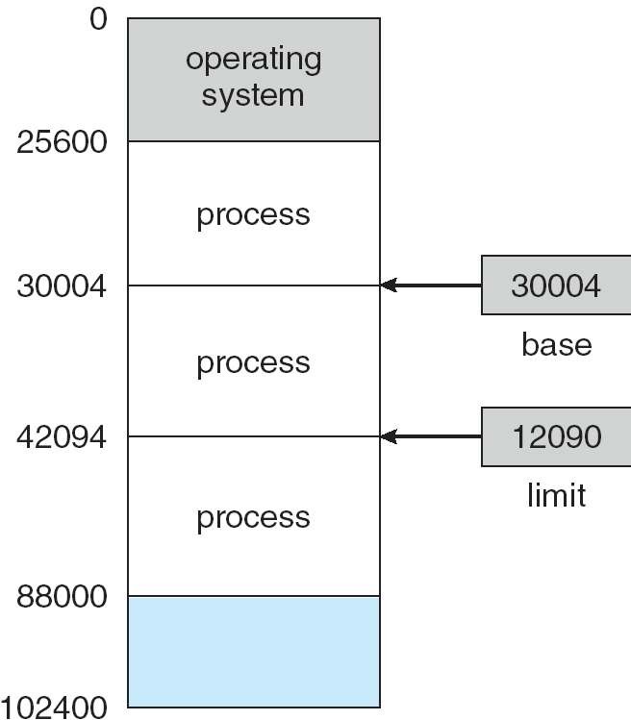

Slide 39
Memory Protection 内存保护
Relocation-register scheme 重定位寄存器方案
used to protect user processes from each other, and from changing operating-system code and data.
Relocation register 重定位寄存器
contains value of smallest physical address;
limit register 界限寄存器
contains range of logical addresses – each logical address must be less than the limit register.

Slide 40
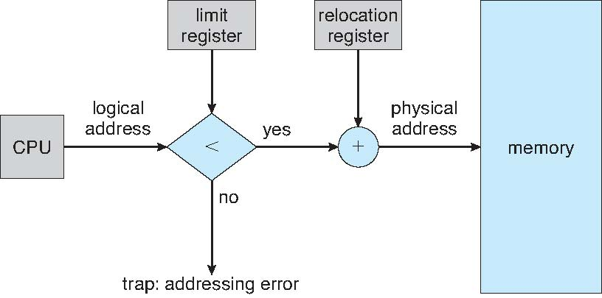
Figure 8.6 Hardware support for relocation and limit registers.

Slide 41
Memory Allocation 内存分配
Fixed-sized partitions scheme 固定分区
Each partition may contain exactly one process
Originally used by the IBM OS/360 operating system but is no longer in use
called MFT--Multiprogramming with a Fixed number of Tasks operating system （任务数固定的多道系统）

Slide 42
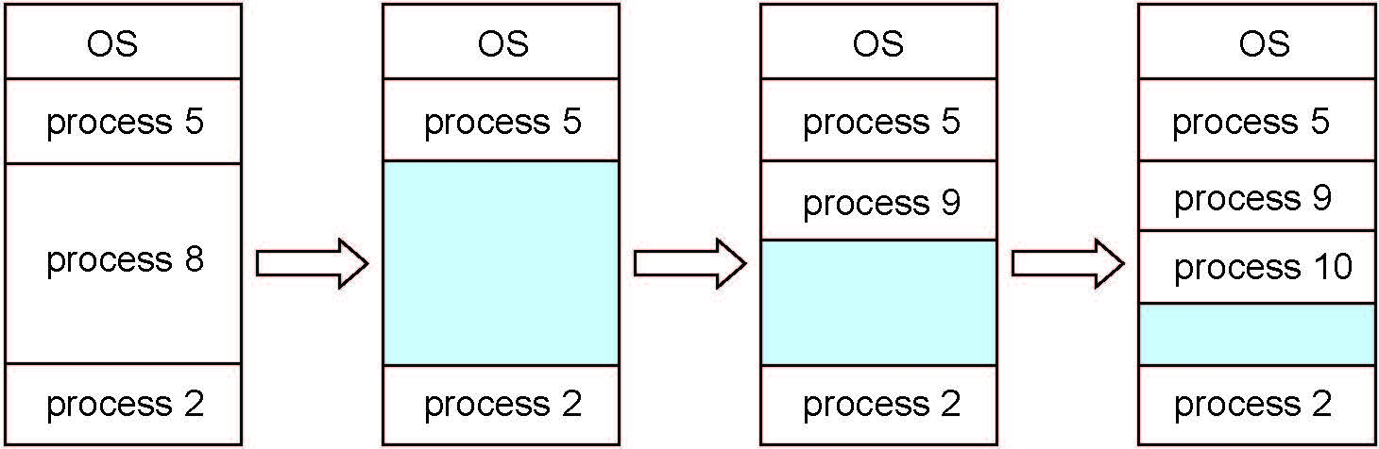
Variable-partition scheme 可变分区
Hole – block of available memory; holes of various size are scattered throughout memory.
When a process arrives, it is allocated memory from a hole large enough to accommodate it.
Operating system maintains information about: a) allocated partitions b) free partitions (hole)
Called MVT--Multiprogramming with a Varable number of Tasks

Slide 43
Dynamic Storage-Allocation Problem 动态存储分配问题
First-fit 首次适应
Allocate the first hole that is big enough.
Best-fit 最佳适应
Allocate the smallest hole that is big enough;
must search entire list, unless ordered by size.
Produces the smallest leftover hole.

Slide 44
Worst-fit 最差适应
Allocate the largest hole;
must also search entire list.
Produces the largest leftover hole.
First-fit and best-fit better than worst-fit in terms of speed and storage utilization

Slide 45
Fragmentation 碎片
External Fragmentation 外部碎片
– total memory space exists to satisfy a request, but it is not contiguous.
Internal Fragmentation 内部碎片
– allocated memory may be slightly larger than requested memory; this size difference is memory internal to a partition, but not being used.

Slide 46
Reduce external fragmentation by compaction （紧缩）
Shuffle memory contents to place all free memory together in one large block.
Compaction is possible only if relocation is dynamic, and is done at execution time.

Slide 47
8.4 Segmentation 分段
Background 背景
The user’s (or programmer’s) view of memory is not the same as the actual physical memory.
Indeed, dealing with memory in terms of its physical properties is inconvenient to both the operating system and the programmer.

Slide 48
Motivation 动机
If the hardware could provide a memory mechanism that mapped the programmer’s view to the actual physical memory
The system would have more freedom to manage memory,
while the programmer would have a more natural programming environment.
Segmentation--Memory-management scheme that supports user view of memory

Slide 49
Basic Method
User’s view: A program is a collection of segments
A segment is a logical unit such as:
main program,
procedure,
function,
method,
object,
local variables, global variables,
common block,
stack,
symbol table, arrays

Slide 50
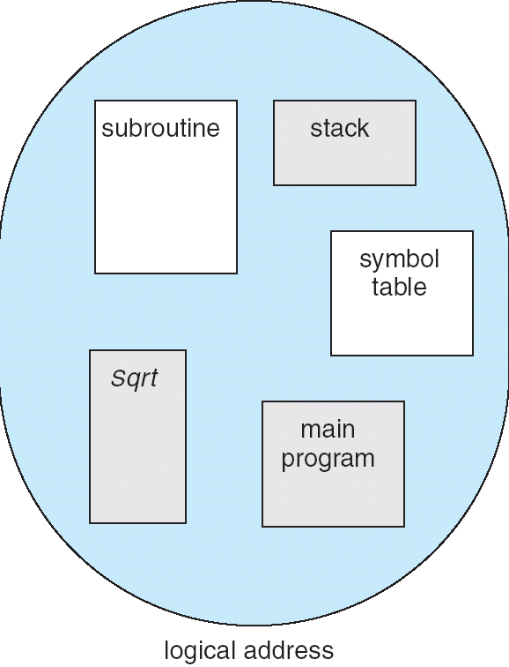
User’s View of a Program

Slide 51
1
1
4
2
3
4
2
3
user space
physical memory space
Logical View of Segmentation

Slide 52
Segmentation（分段）
a memory-management scheme that supports this user view of memory. A logical-address space is a collection of segments.
该内存管理方案支持用户视图：逻辑地址空间是段的集合。
Each segment has a name and a length.
每段有一个段名和段长

Slide 53
The programmer specifies each address by two quantities:
segment name
Offset
程序员通过两个量来指定每个地址：段名、偏移量
For simplicity of implementation，a logical address consists of a two tuple:
实现时，为简单起见，逻辑地址由一个二元组组成：
<segment-number, offset>

Slide 54
Normally, the compiler automatically constructs segments reflecting the input program. 通常，编译器自动地为输入的程序构建段。
A C compiler might create separate segments for the following:
1. The code
2. Global variables
3. The heap, from which memory is allocated
4. The stacks used by each thread
5. The standard C library
The loader would take all these segments and assign them segment numbers.

Slide 55
Segmentation Hardware 分段硬件
Segment table 段表
maps two-dimensional user-defined addresses into one-dimensional physical;
each table entry has:
segment base– contains the starting physical address where the segments reside in memory.
基址－－该段在内存的起始物理地址
segment limit– specifies the length of the segment.
限长－－段的长度

Slide 56
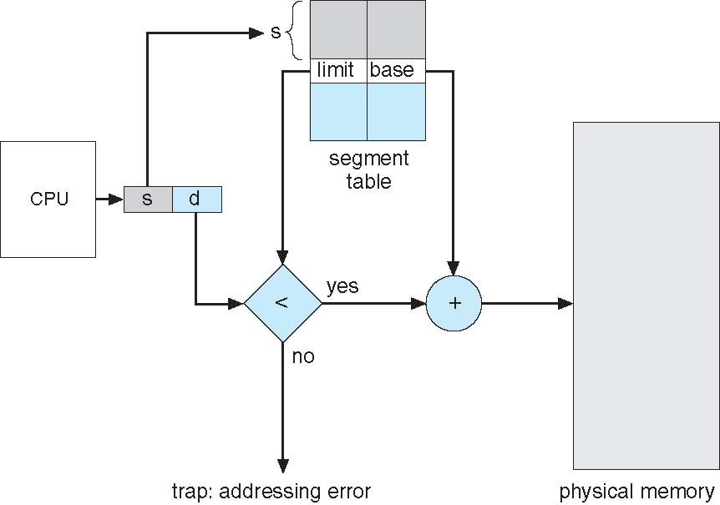
Segmentation Hardware

Slide 57
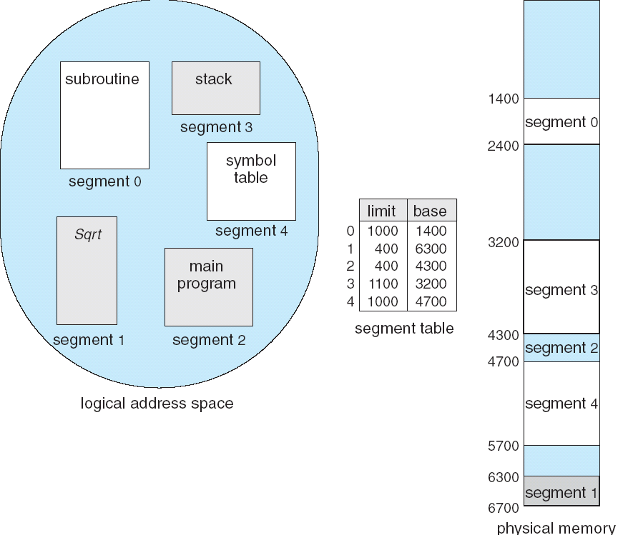
Example of Segmentation

Slide 58
Segment-table base register (STBR) 段表基址寄存器
points to the segment table’s location in memory.
指向段表在内存中的位置
Segment-table length register (STLR)段表长度寄存器
indicates number of segments used by a program;
指示程序用到的段数
segment number s is legal if s < STLR

Slide 59
Protection 保护
With each entry in segment table associate:
validation bit ： 0 ⇒ illegal segment
有效位
read/write/execute privileges
读/写/执行 权限
Sharing 共享
shared segments
same segment number

Slide 60
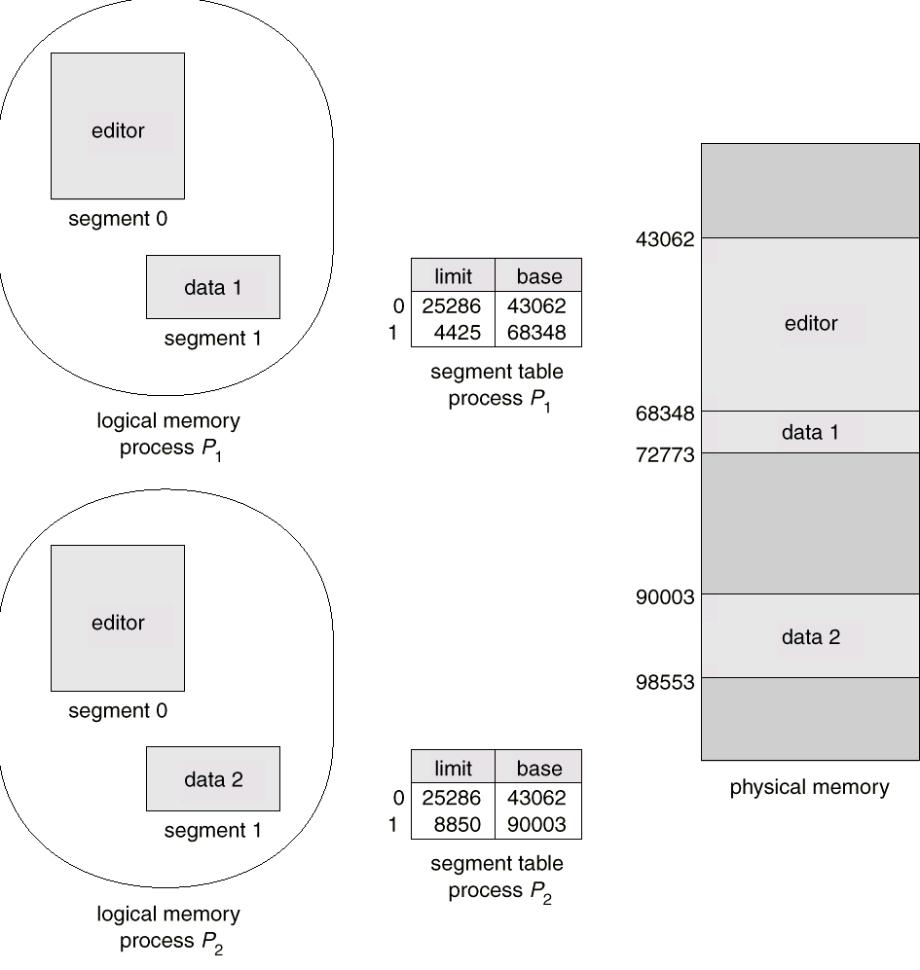
Sharing of Segments

Slide 61
Allocation 分配
Since segments vary in length, memory allocation is a dynamic storage-allocation problem.
由于段长是变化的，所以内存分配是一个动态存储分配问题。
first fit/best fit
external fragmentation

Slide 62
Fragmentation 碎片
Segmentation may cause external fragmentation, when all blocks of free memory are too small to accommodate a segment.
we can compact memory whenever we want

Slide 63
How serious a problem is external fragmentation for a segmentation scheme? Would long-term scheduling with compaction help?
外部碎片问题对分段管理的影响有多严重？带有紧缩功能的长程调度是否奏效呢？
The answers depend mainly on the average segment size.
答案主要取决于段的平均大小

Slide 64
At one extreme, we could define each process to be one segment.
This approach reduces to the variable-sized partition scheme.
At the other extreme, every byte could be put in its own segment and relocated separately.
This arrangement eliminates external fragmentation altogether; however, every byte would need a base register for its relocation, doubling memory use!

Slide 65
Generally if the average segment size is small, external fragmentation will also be small.
通常，如果段的平均尺寸比较小，则外部碎片也会比较小
Because the individual segments are smaller than the overall process, they are more likely to fit in the available memory blocks.
因为段通常比一般进程要小，所以貌似更容易适合空闲内存块
Of course, the next logical step--fixed-sized, small segments--is paging.

Slide 66
8.5 Paging 分页
Noncontiguous 非连续
avoids external fragmentation 避免了外部碎片
solves the considerable problem of fitting memory chunks of varying sizes onto the backing store 解决了不同大小的内存块到辅存的适应问题

Slide 67
Basic Method
Paging scheme
Frame 帧
Divide physical memory into fixed-sized blocks called frames
size is power of 2, between 512 bytes and 16 Mbytes
Page 页
Divide logical memory into blocks of same size called pages

Slide 68
Keep track of all free frames; To run a program of size n pages, need to find n free frames and load program.
page table 页表
Set up a page table to translate logical to physical addresses.
Internal fragmentation 内碎片

Slide 69
Address Translation Scheme 地址转换方案
Address generated by CPU is divided into:
Page number (p) 页号
– used as an index into a page table which contains base address of each page in physical memory.
Page offset (d) 页内偏移量
– combined with base address to define the physical memory address that is sent to the memory unit.
the displacement within the page
page number
page offset
an index into the page table
p
d
m-n
n

Slide 70
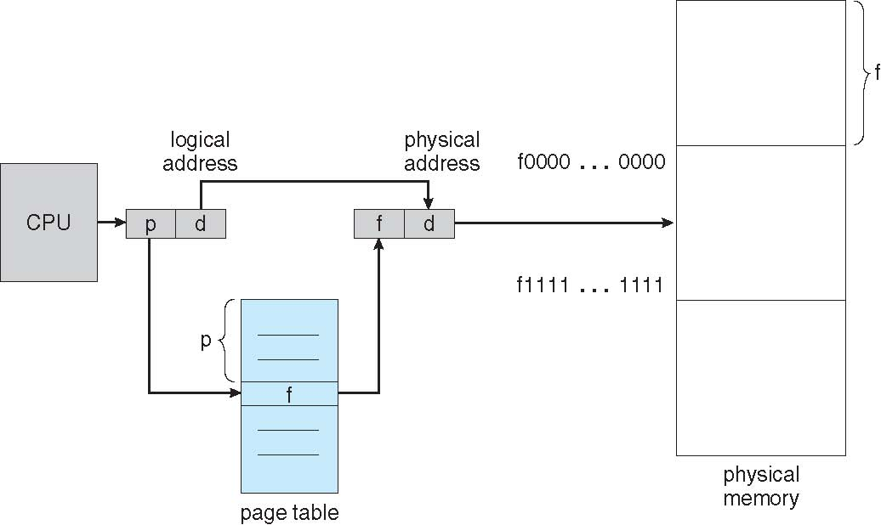
Figure 8.10 Paging hardware

Slide 71
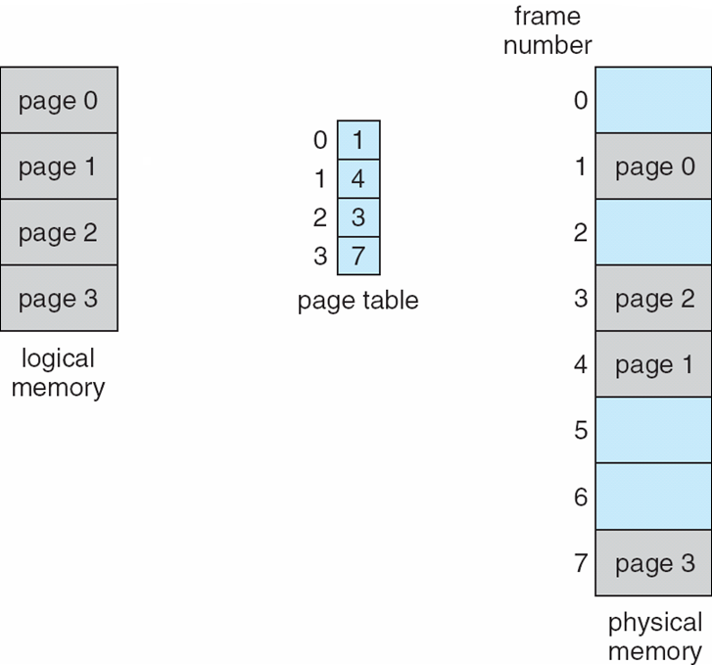
Figure 8.11 Paging model of logical and physical memory

Slide 72
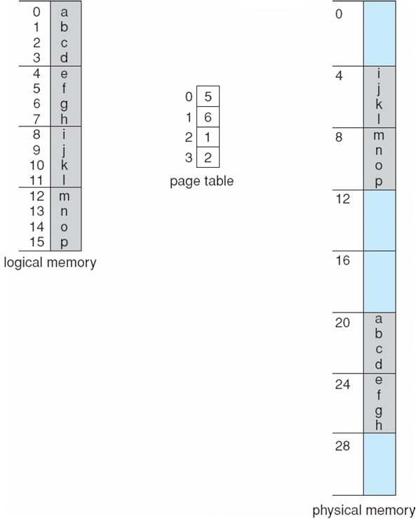
0
Figure Paging example for a 32-byte memory with 4-byte pages.

Slide 73
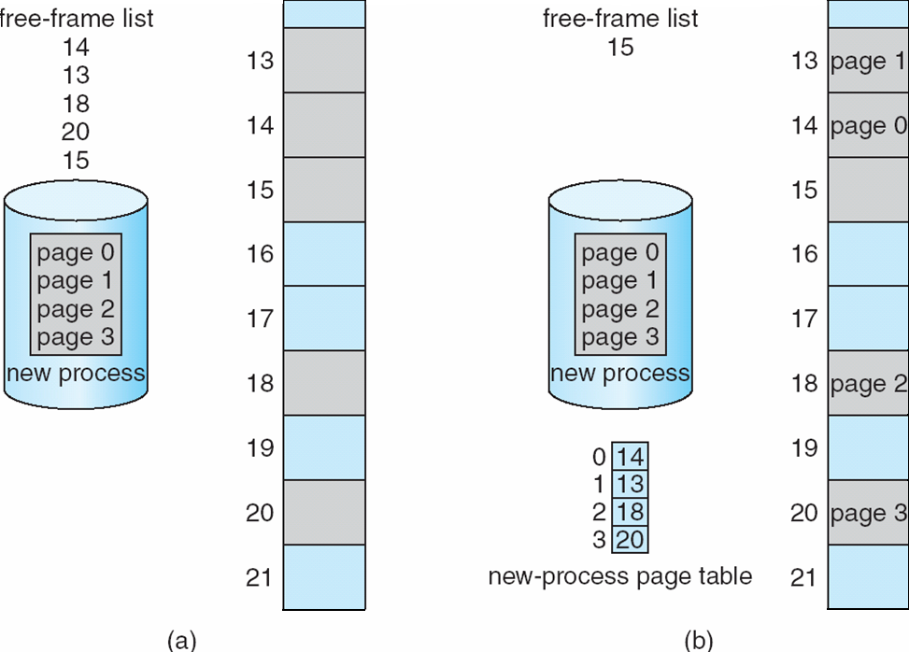
Figure Free frames. (a) Before allocation. (b) After allocation.

Slide 74
Hardware Support
Implementation of Page Table 页表的实现
Page table is kept in main memory.
Page-table base register (PTBR) 页表基址寄存器
points to the page table.
Page-table length register (PTLR) 页表长度寄存器
indicates size of the page table.

Slide 75
Every data/instruction access requires two memory accesses. 每个数据/指令访问需要访问两次内存
One for the page table 访问页表
one for the data/instruction. 访问数据/指令
The two memory access problem can be solved by the use of a special fast-lookup hardware cache
called associative memory or translation look-aside buffers (TLBs)
联想存储器或旁视转换缓冲区

Slide 76
Associative Memory (TLBs) 联想存储器（寄存器）
parallel search 并行查找
Address translation (p, d)
If p is in associative register, get frame # out
Otherwise get frame # from page table in memory

Slide 77
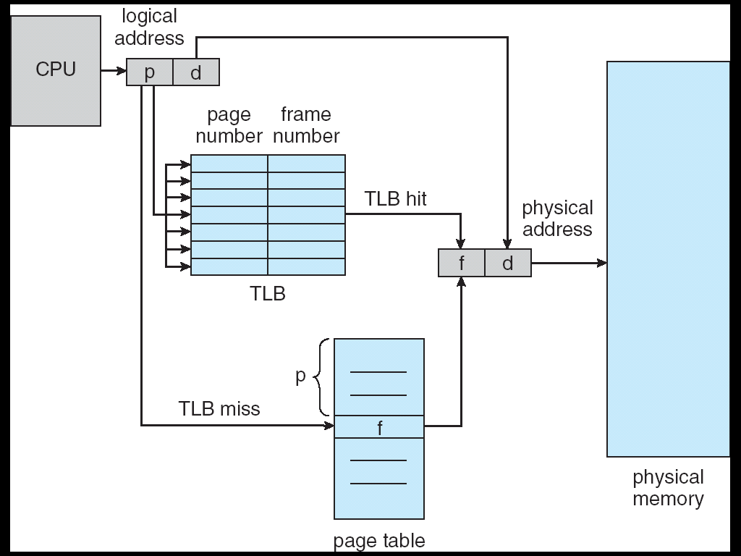
Paging Hardware With TLB

Slide 78
Effective Access Time 有效访问时间
hit ratio 命中率
The percentage of times that a particular page number is found in the TLB

Slide 79
effective access time 有效访问时间
Suppose that, it takes 20 nanoseconds to search the TLB, and 100 nanoseconds to access memory. An 80-percent hit ratio means:
effective access time
= 0.80 X 120 + 0.20 X 220
= 140 nanoseconds.
we suffer a 40-percent slowdown in memory access time---from100 to 140 nanoseconds.
For a 98-percent hit ratio, we have
effective access time = 0.98 x 120 + 0.02 x 220
= 122 nanoseconds.

Slide 80
Protection
Protection Bits 保护位
Protection bits are associated with each frame.
Normally these bits are kept in the page table.
These bits can define a page to be read-write ,read-only , execute-only, and so on.
Every reference to memory goes through the page table to find the correct frame number.
At the same time that the physical address is being computed, the protection bits can be checked to verify that no illegal attempts are being made.
illegal attempts will be trapped to the operating system.

Slide 81
Valid-invalid bit 有效（无效）位
attached to each entry in the page table:
“valid”
indicates that the associated page is in the process’ logical address space, and is thus a legal page.
指示相应的页在该进程的逻辑地址空间中，因而是合法页。
“invalid”
indicates that the page is not in the process’ logical address space.
Illegal addresses are trapped by using the valid-invalid bit.
The operating system sets this bit for each page to allow or disallow accesses to that page.

Slide 82
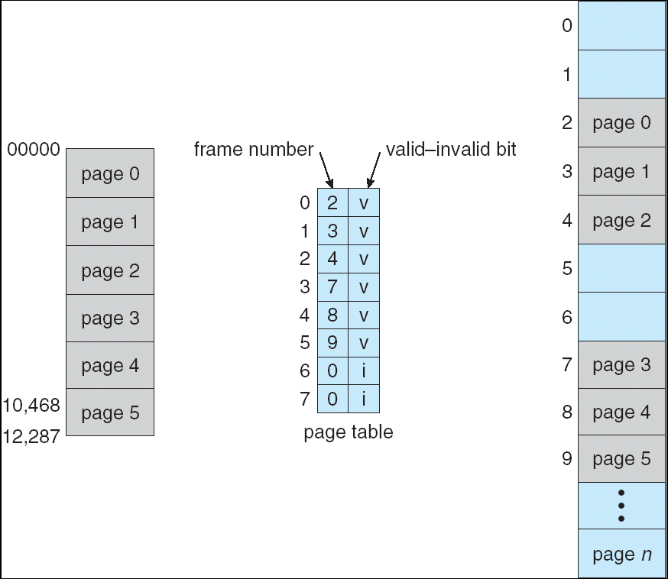
Valid (v) or Invalid (i) Bit In A Page Table
Example:
address space
14bit
(0-16383)
program addresses
0--10468;
page size
---2 KB;

Slide 83
page-table length register (PTLR) 页表长度寄存器
Rarely does a process use all its address range.
In fact, many processes use only a small fraction of the address space available to them.
It would be wasteful in these cases to create a page table with entries for every page in the address range.
Most of this table would be unused, but would take up valuable memory space.

Slide 84
page-table length register (PTLR)
Some systems provide hardware, in the form of a page-table length register (PTLR), to indicate the size of the page table.
This value is checked against every logical address to verify that the address is in the valid range for the process.
Failure of this test causes an error trap to the operating system.

Slide 85
Shared Pages 共享页
Shared code 共享代码
One copy of read-only (reentrant) code shared among processes (i.e., text editors, compilers, window systems).
进程间共享的只读（可重入）代码的拷贝
Private code and data
Each process keeps a separate copy of the code and data.

Slide 86
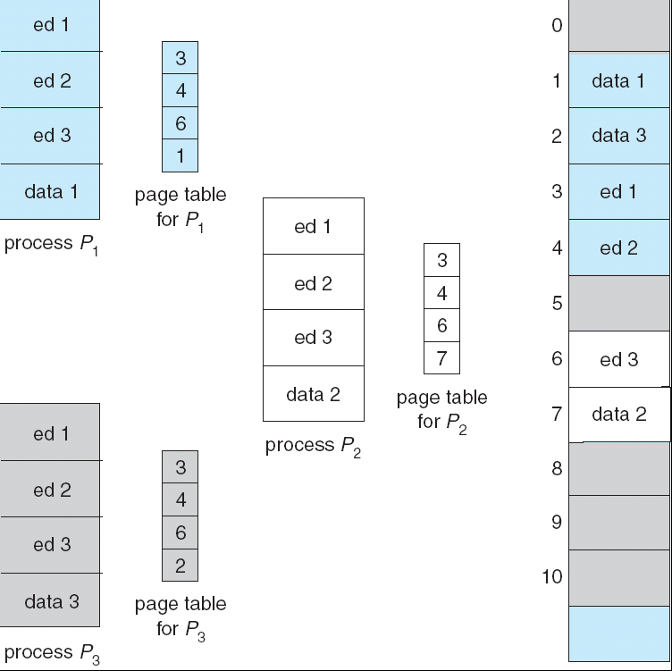
Shared Pages Example

Slide 87
8.6 Structure of the Page Table
Hierarchical Paging 分级分页
Hashed Page Tables 哈希页表
Inverted Page Tables 倒置页表

Slide 88
Hierarchical Page Tables 分级页表
Most modern computer systems support a large logical-address space (2³² to 2⁶⁴). In such an environment, the page table itself becomes excessively large.
多数现代计算机系统支持很大的逻辑地址空间(2³² to 2⁶⁴)，这种环境下，页表本身变得非常大

Slide 89
logical-address space 32-bit;
page size --- 4 KB (2¹²);
each entry--- 4 bytes;
Example:
page table entries:?
---may consist of up to 1 million (2³²/2¹²).
physical-address space for the page table alone:
--- may need up to 4 MB
Logical address:
page number
page offset
p
d
20
12
Clearly, we would not want to allocate the page table contiguously in main memory.

Slide 90
● Two-Level Paging Algorithm 两级分页算法
---the page table itself is also paged
logical-address space 32-bit;
page size --- 4 KB (2¹²);
page number
page offset
p
p₁
p₂
d
d
20
12
10
10
12
page the page table
the displacement within the page of the outer page table
an index into the outer page table

Slide 91
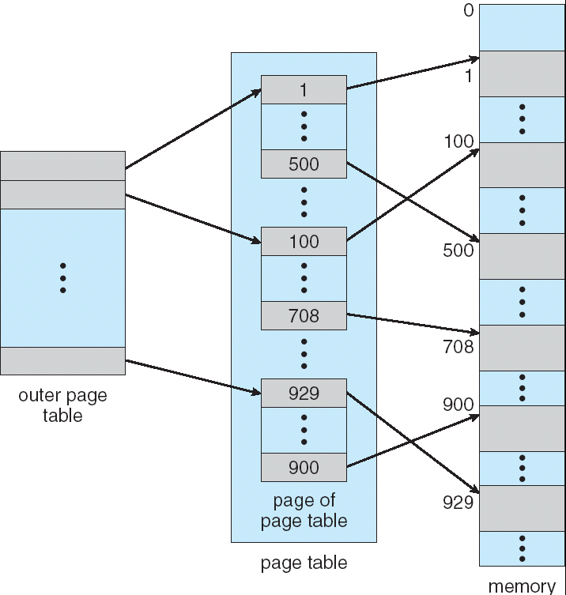
Two-Level Page-Table Scheme

Slide 92
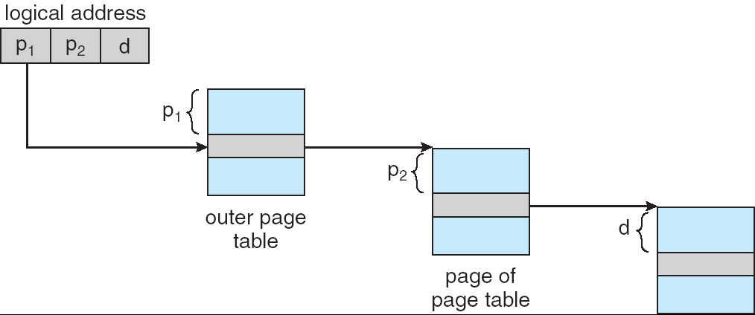
Address-Translation Scheme
Address-translation scheme for a two-level 32-bit paging architecture
Because address translation works from the outer page table inwards, this scheme is also known as a forward-mapped page table.
The Pentium-II uses this architecture.

Slide 93
● Three-Level Paging Algorithm 三级分页算法
For a system with a 64 bit logical-address space, a two-level paging schemes no longer appropriate.
Example:
logical-address space 64-bit;
page size --- 4 KB (2¹²);
The inner page table---1 page long---2¹⁰ 4 entries
Outer page
Inner page
offset
Three-level Logical address:
2nd Outer page
Outer page
inner page
offset
Two-level paging
Logical adress:
p₁
p₁
p₂
p₂
d
p₃
d
42
32
10
10
10
12
12

Slide 94
Hashed Page Tables 哈希页表
Common in address spaces > 32 bits.
常用于地址空间>32位（的系统）
The virtual page number is hashed into a page table. This page table contains a chain of elements hashing to the same location.
虚拟页号被哈希到一个页表中。该页表（每个页表项）包含一个元素链（链中的每个元素哈希到相同位置）
Virtual page numbers are compared in this chain searching for a match. If a match is found, the corresponding physical frame is extracted.
将虚拟页号（依次）与链中的每个元素做比较以寻找匹配。如果匹配被找到，则相应的物理帧被提取。

Slide 95
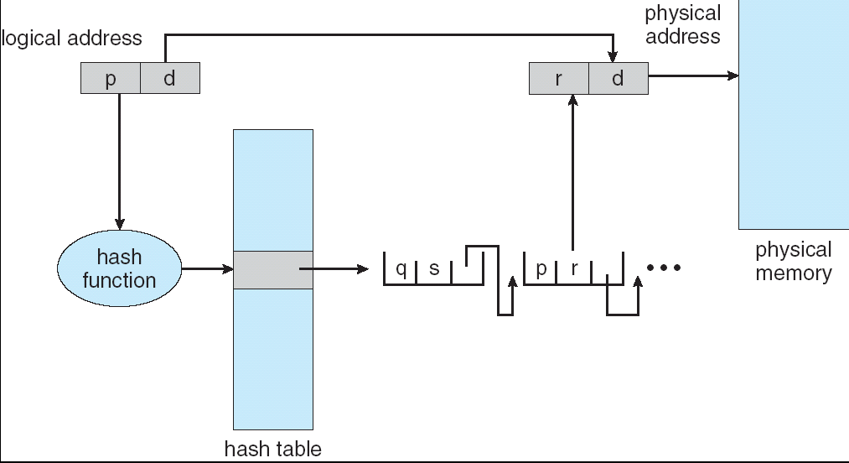
Hashed Page Table

Slide 96
Inverted Page Table 倒置页表
One entry for each real page of memory.
每个实内存页对应一个表项
Entry consists of the virtual address of the page stored in that real memory location, with information about the process that owns that page.
每个页表项包含存储在该实存位置的页的虚拟地址，以及关于该页所属进程的信息。
Decreases memory needed to store each page table, but increases time needed to search the table when a page reference occurs.
相对于存储每个页表来讲，降低了内存需求，但是，提高了当页访问发生时查找页表的时间
Use hash table to limit the search to one — or at most a few — page-table entries.
（可以）利用哈希表来限制查找一个（些）页表项

Slide 97
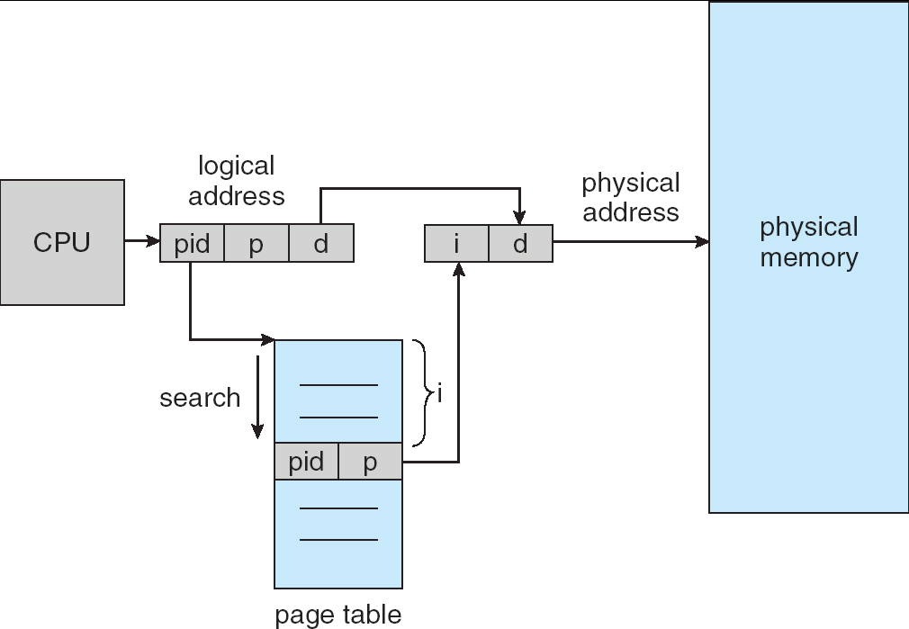
Inverted Page Table Architecture

Slide 98
Exercises
1. Given memory partitions of 100 KB, 500 KB, 200 KB, 300 KB, and 600 KB (in order), how would each of the first-fit, best-fit, and worst-fit algorithms place processes of 212 KB, 417 KB, 112 KB, and 426 KB (in order)? Which algorithm makes the most efficient use of memory?
2. Consider a logical-address space of eight pages of 1,024 words each mapped onto a physical memory of 32 frames.
a. How many bits are in the logical address?
b. How many bits are in the physical address?

Slide 99
Exercises
3. Consider a paging system with the page table stored in memory.
a. If a memory reference takes 200 nanoseconds, how long does a paged memory reference take?
b. If we add TLBs, and 75 percent of all page-table references are found in the TLBs, what is the effective memory reference time? (Assume that finding a page-table entry in the TLB takes zero time, if the entry is there.)

Slide 100
End of Chapter 8

