Slide 1
Part Four Storage Management
Chapter 10 Mass-Storage Structure
Chapter 11 File-System Interface
Chapter 12 File-System Implementation
Chapter 13 I/O Systems

Slide 2
Chapter 10: Mass-Storage Structure 大容量存储结构
10.1 Overview of Mass-Storage Structure
10.2 Disk Structure 磁盘结构
10.3 Disk Attachment 磁盘连接
10.4 Disk Scheduling 磁盘调度
10.5 Disk Management 磁盘管理
10.6 Swap-Space Management 交换空间管理
10.7 RAID Structure RAID结构

Slide 3
10.1 Overview of Mass-Storage Structure

Slide 4
Magnetic Disks 磁盘
Magnetic disks provide bulk of secondary storage of modern computers 现代计算机由磁盘提供大量二级存储
Drives rotate at 60 to 250 times per second
Transfer rate 传输率
rate at which data flow between drive and computer
Positioning time (random-access time) 定位时间
is time to move disk arm to desired cylinder (seek time)
and time for desired sector to rotate under the disk head (rotational latency)

Slide 5
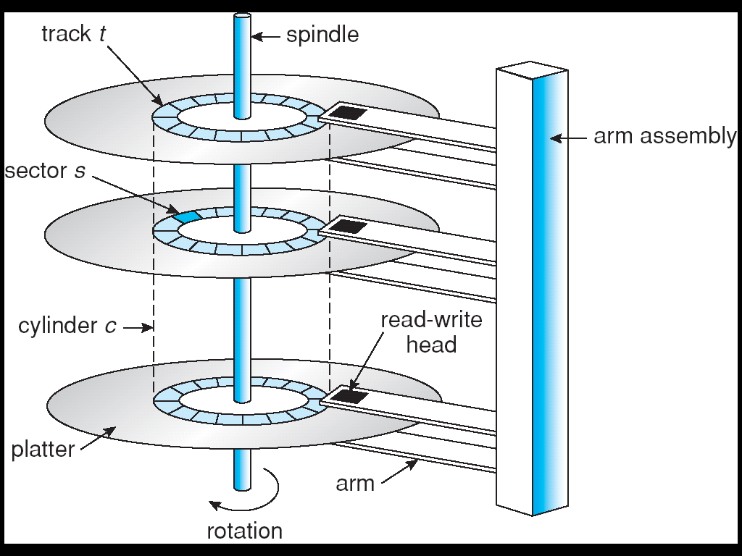
<Moving-head Disk Mechanism> >

Slide 6
Head crash 磁头碰撞
results from disk head making contact with the disk surface--That’s bad
Disks can be removable(可移动的)
Drive attached to computer via I/O bus
Busses vary, including EIDE, ATA, SATA, USB, Fibre Channel, SCSI
Host controller in computer uses bus to talk to disk controller built into drive or storage array

Slide 7
Solid-State Disks 固态盘
Solid-state disks, or SSDs
old technologies are used in new ways
Nonvolatile memory used like a hard drive
Many technology variations
DRAM with a battery
to allow it to maintain its state in a power failure
flash-memory technologies

Slide 8
SSDs have the same characteristics as HDDs but
More Reliable
because they have no moving parts
Faster
because they have no seek time or rotational latency
consume less power

Slide 9
More expensive per megabyte(MB)
Less capacity
shorter life span
So their uses are somewhat limited
used in storage arrays,
where they hold file-system metadata that require high performance
used in some laptop computers
to make them smaller, faster, and more energy-efficient

Slide 10
Magnetic Tapes
Magnetic tape 磁带
Was early secondary-storage medium
Relatively permanent and holds large quantities of data
Access time slow
Random access ~1000 times slower than disk
Mainly used for backup, storage of infrequently-used data, transfer medium between systems
Kept in spool and wound or rewound past read-write head
Once data under head, transfer rates comparable to disk
20-200GB typical storage
Common technologies are 4mm, 8mm, 19mm, LTO-2 and SDLT

Slide 11
10.2 Disk Structure
Disk drives are addressed as large 1-dimensional arrays of logical blocks, where the logical block is the smallest unit of transfer.
磁盘驱动器被编址为逻辑块的一维排列，逻辑块是最小的传输单元。
Low-level formatting creates logical blocks on physical media

Slide 12
The 1-dimensional array of logical blocks is mapped into the sectors of the disk sequentially.
一维逻辑块序列被顺序地映射到磁盘扇区
Sector 0 is the first sector of the first track on the outermost cylinder
Mapping proceeds in order through that track, then the rest of the tracks in that cylinder, and then through the rest of the cylinders from outermost to innermost
Logical to physical address should be easy
Except for bad sectors
Non-constant # of sectors per track via constant angular velocity （恒定角速度）

Slide 13
Constant linear velocity (CLV) && Constant angular velocity (CAV) 恒线速度与恒角速度
CLV
The farther a track is from the center of the disk，the more sectors it can hold 离中心越远的磁道具有越多的扇区
The drive increases its rotation speed as the head moves from the outer to the inner tracks to keep the same rate of data moving under the head.
Used in CD-ROM and DVD-ROM drives

Slide 14
CAV
the density of bits decreases from inner tracks to outer tracks to keep the data rate constant 数据密度由内向外逐步下降，从而保持恒定的数据速率
the disk rotation speed can stay constant
used in hard disks

Slide 15
10.3 Disk Attachment 磁盘连接
Computers access disk storage in two ways
via I/O ports --host-attached storage 主机连接
via a remote host in a distributed file system--network-attached storage 网络连接

Slide 16
10.4 Disk Scheduling 磁盘调度
The OS is responsible for using hardware efficiently
for the disk drives, this means having a fast access time and disk bandwidth.
操作系统需要高效地使用硬件－－对于磁盘驱动器，这意味着具有快速的访问时间和磁盘带宽。

Slide 17
Access time has two major components
Seek time is the time for the disk are to move the heads to the cylinder containing the desired sector.
寻道时间：磁盘的磁头移动到包含请求扇区的柱面所需要的时间。
Minimize seek time 最小化寻道时间
Seek time ≈ seek distance
Rotational latency is the additional time waiting for the disk to rotate the desired sector to the disk head.
旋转延迟：磁盘旋转请求扇区到磁头下面所需时间

Slide 18
Disk bandwidth 磁盘带宽
the total number of bytes transferred, divided by the total time between the first request for service and the completion of the last transfer.
总传输字节数, 除以总时间(从第一个服务请求到最后一次传输结束)
We can improve both the access time and the bandwidth by managing the order in which disk I/O requests are serviced.

Slide 19
I/O request I/O请求
specifies: input or output mode, disk address, memory address, number of sectors to transfer
OS maintains queue of requests, per disk or device
Idle disk can immediately work on I/O request, busy disk means work must queue

Slide 20
Several algorithms exist to schedule the servicing of disk I/O requests.
We illustrate them with a request queue (0-199).
98, 183, 37, 122, 14, 124, 65, 67
Head pointer 53

Slide 21
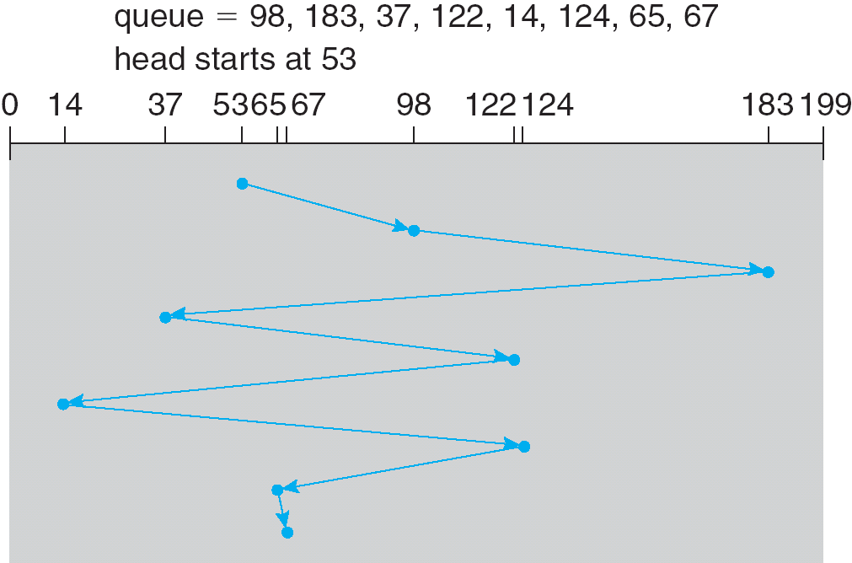
FCFS Scheduling 先来先服务调度
Illustration shows total head movement of 640 cylinders.

Slide 22
SSTF Scheduling 最短寻道时间优先调度
Selects the request with the minimum seek time from the current head position.
选择距磁头当前位置寻道时间最小的请求
a form of SJF scheduling;
SJF调度的一种形式
may cause starvation of some requests.
可能引起某些请求的饥饿

Slide 23
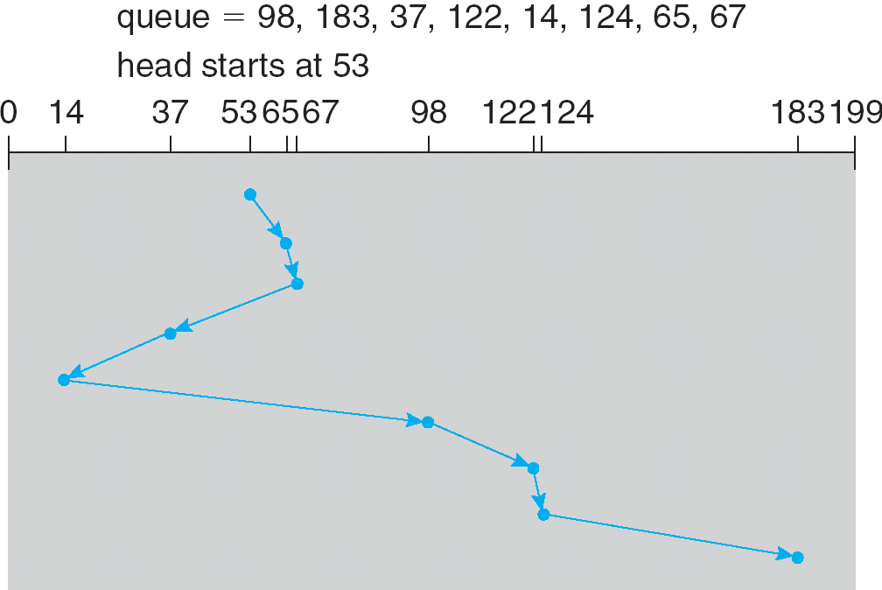
SSTF disk scheduling
(Illustration shows total head movement of 236 cylinders.)

Slide 24
SCAN Scheduling 扫描调度
The disk arm starts at one end of the disk, and moves toward the other end, servicing requests until it gets to the other end of the disk, where the head movement is reversed and servicing continues.
磁臂由磁盘的一端开始移向另一端，期间服务请求，直到到达另一端，磁头转向，服务继续。
Sometimes called the elevator algorithm(电梯算法).
LOOK

Slide 25
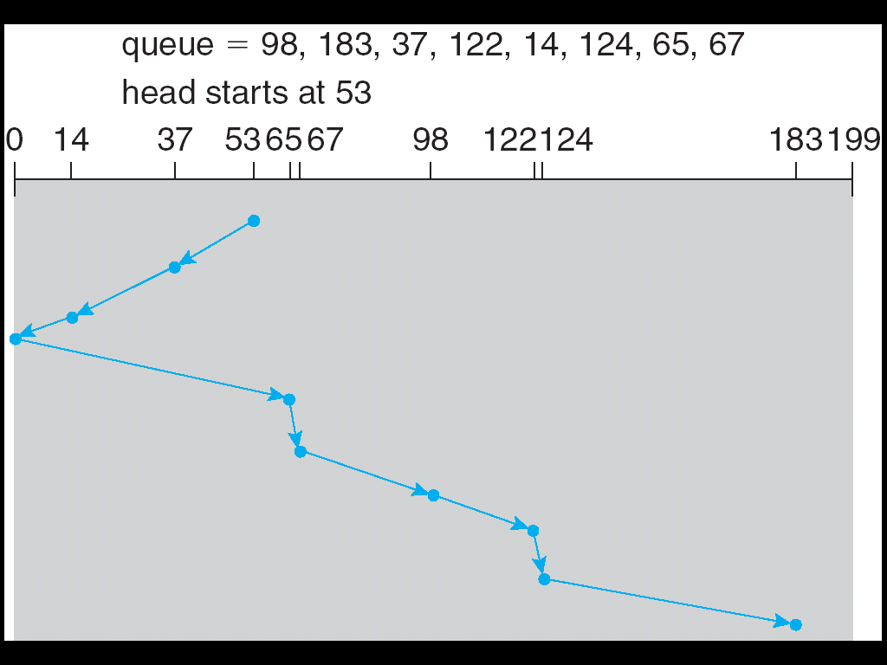
SCAN disk scheduling
Illustration shows total head movement of 208 cylinders.

Slide 26
C-SCAN Scheduling 循环扫描
Provides a more uniform wait time than SCAN.
比SCAN算法有更加均衡的等待时间
The head moves from one end of the disk to the other. servicing requests as it goes. When it reaches the other end, however, it immediately returns to the beginning of the disk, without servicing any requests on the return trip.
磁头由磁盘的一端移向另一端时服务于请求。但是，当到达另一端时立即返回磁盘的起始端，返回时不服务于任何请求。
Treats the cylinders as a circular list that wraps around from the last cylinder to the first one.
将柱面作为环形列表（将最后一个柱面与第一个柱面连接起来）

Slide 27
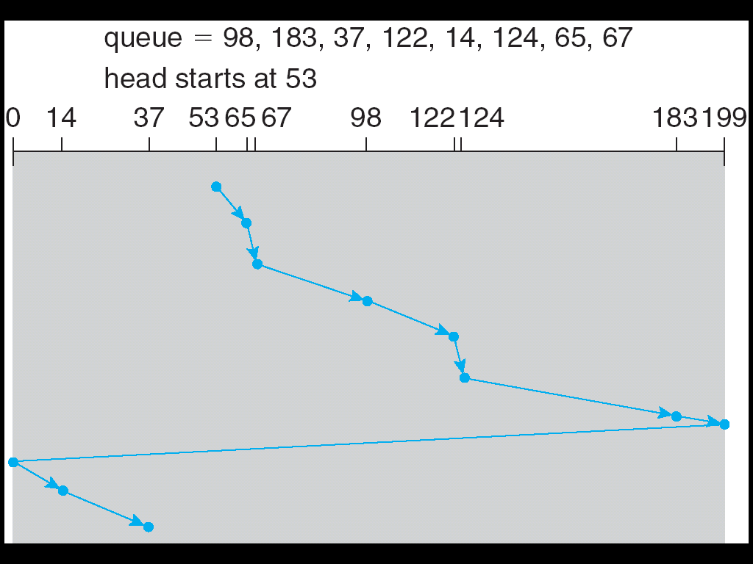
C-SCAN disk scheduling

Slide 28
C-LOOK Scheduling 循环-回看调度
Version of C-SCAN
Arm only goes as far as the last request in each direction, then reverses direction immediately, without first going all the way to the end of the disk.
磁臂移到每个方向的最后一个请求即马上转向，而不是走到端点才转向。

Slide 29
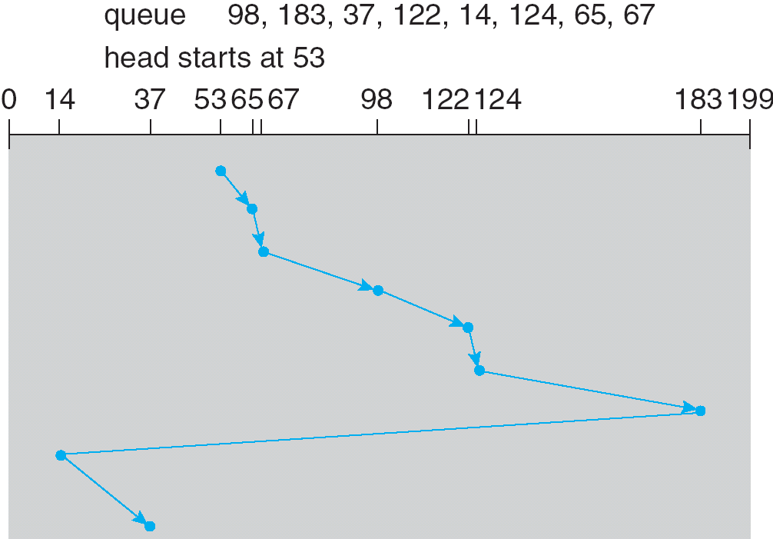
C-LOOK disk scheduling

Slide 30
Selection of a Disk-Scheduling Algorithm
SSTF is common and has a natural appeal
SSTF比较普通且具有自然的吸引力
SCAN and C-SCAN perform better for systems that place a heavy load on the disk. SCAN和C-SCAN对于磁盘负载重的系统表现较好
Performance depends on the number and types of requests.
性能依赖于请求的数量和类型
Requests for disk service can be influenced by the file-allocation method. 磁盘服务请求受文件分配方法的影响

Slide 31
The disk-scheduling algorithm should be written as a separate module of the operating system, allowing it to be replaced with a different algorithm if necessary.
磁盘调度算法应写为操作系统的独立模块，以便在必要时用不同的调度算法进行替换。
Either SSTF or LOOK is a reasonable choice for the default algorithm.
SSTF或LOOK算法是缺省算法的合理选择。

Slide 32
10.5 Disk Management 磁盘管理
Disk Formatting 磁盘初始化
booting from disk 由磁盘引导
bad-block recovery 坏块恢复

Slide 33
Disk Formatting 磁盘格式化
Low-level formatting, or physical formatting
低级格式化（物理格式化）
— Dividing a disk into sectors that the disk controller can read and write, and filling the disk with a special data structure for each sector:
将磁盘划分为磁盘控制器能够读写的扇区，并为每个扇区填入特定的数据结构：
A header:
A data area(usually 512 bytes in size):
A trailer:
The header and trailer contain information used by the disk controller, such as a sector number and an error-correcting code (ECC)
头和尾包含了被磁盘控制器利用的信息，例如扇区号和纠错码

Slide 34
Partition & Logical formatting 分区和逻辑格式化
To use a disk to hold files, the operating system still needs to record its own data structures on the disk.
为使磁盘能够存储文件，OS还必需在磁盘上记录它自己的数据结构
Partition the disk into one or more groups of cylinders.
分区磁盘为一个或多个柱面组
Logical formatting or “making a file system”.
逻辑格式化，即创建一个文件系统

Slide 35
raw disk, raw I/O 生磁盘及生I/O
Some operating systems give special programs the ability to use a disk partition as a large sequential array of logical blocks, without any file-system data structures. ---raw disk, raw I/O
某些操作系统允许特殊的程序把磁盘分区作为一个大的逻辑块的序列，而没有任何文件系统数据结构
For example, some database systems prefer raw I/O because it enables them to control the exact disk location where each database record is stored.
比如，某些数据库系统更喜欢生I/O，因为这样能够控制每条数据库记录所在的精确磁盘位置。

Slide 36
Boot Block 引导块
Boot block initializes system 引导块初始化系统
The bootstrap program initializes all aspects of the system---CPU registers, device controllers, and the contents of main memory---and then starts the OS.
自举程序 初始化系统的各个方面——CPU寄存器、设备控制器以及主存——并启动OS。
The bootstrap is stored in ROM. 自举程序存储在ROM中

Slide 37
Most systems store a tiny bootstrap loader program in the boot ROM, whose only job is to bring in a full bootstrap program from disk. The full bootstrap program can be changed easily.
多数系统只将一个很小的自举加载程序存储在引导ROM中，其唯一的任务是将完整的自举程序从磁盘加载到内存。这样，完整的自举程序容易修改。
Boot block: a disk partition in which the full bootstrap program is stored.
引导块：存储完整自举程序磁盘分区
Boot disk or system disk: a disk that has a boot partition.
引导盘（系统盘）：含引导分区的磁盘

Slide 38
Bad Blocks 坏块
On simple disks, such as some disk with IDE controllers, bad blocks are handled manually.
对于简单的磁盘，比如某些使用IDE控制器的磁盘，可手工处理坏块
If the MS-DOS format command find a bad block while it does a logical format, its writes a special value into the corresponding FAT entry to tell the allocation routines not to use that block.
如果MS-DOS的format命令逻辑格式化时发现坏块，则写一个特定值到相应的FAT项以告知分配例程不要再使用该块。
Chkdsk：搜索坏块，并标记

Slide 39
More sophisticated disks, such as the SCSI disks used in high-end PCs and workstations and servers, are smarter about bad-block recovery.
对于复杂的磁盘，比如用于高端PC、工作站及服务器上的SCSI磁盘，对坏块的恢复更加老到
The controller maintains a list of bad blocks on the disk. The list is initialized during the low-level format at the factory, and is updated over the life of the disk.
控制器维护一个坏块列表。该列表在工厂进行低级格式化时被初始化，并在磁盘使用过程中更新。

Slide 40
Low-level formatting also sets aside spare sectors not visible to the operating system. The controller can be told to replace each bad sector logically with one of the spare sectors. ---sector sparing or forwarding.
低级格式化还预留一些备用扇区，这些扇区对OS是不可见的。控制器可以用这些备用扇区逻辑地替换坏扇区－－扇区备用或转寄。

Slide 41
10.6 Swap-Space Management 交换空间管理
Swap-space
— Virtual memory uses disk space as an extension of main memory.
The main goal for the design and implementation of swap space
provide the best throughput for the virtual-memory system.

Slide 42
Swap-Space Use 对换空间的使用
Swap space is used in various ways by different operating system, depending on the implemented memory-management algorithms.
Systems that implement swapping may use swap space to hold the entire process image.
Paging systems may simply store pages that have been pushed out of main memory.

Slide 43
The amount of swap space needed on a system can vary depending on the amount of physical memory, the amount of virtual memory it is backing, and the way in which the virtual memory is used.

Slide 44
Swap-Space Location 交换空间的位置
Swap-space can be carved out of the normal file system
在普通文件系统上创建
the swap space is simply a large file within the file system, normal file-system routines can be used to create it, name it, and allocate its space.

Slide 45
Swap-Space Location 交换空间的位置
More commonly, swap space can be in a separate disk partition.
在独立的磁盘分区上创建
No file system or directory structure is placed on this space. Rather, a separate swap-space storage manager is used to allocate and deallocate the blocks. This manager uses algorithms optimized for speed, rather than for storage efficiency.
Some operating systems are flexible and can swap both in raw partitions and in file-system space.

Slide 46
10.7 RAID Structure RAID结构
RAID: redundant arrays of inexpensive disks
廉价磁盘冗余阵列
Disk striping uses a group of disks as one storage unit.
multiple disk drives provides:
High Performance via parallelism
Reliability via redundancy.

Slide 47
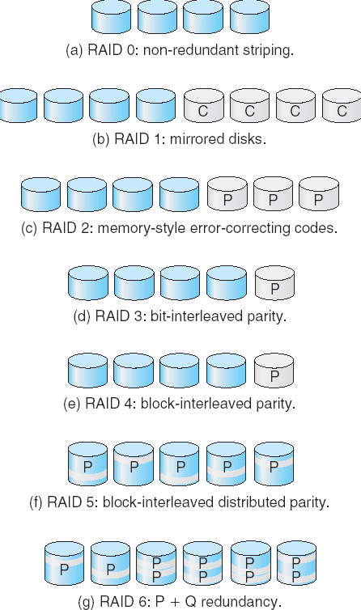
RAID Levels

Slide 48
Today, RAIDs are used for their higher reliability and higher data-transfer-rate, rather than for economic reasons. Hence, RAID means redundant arrays of independent disks 独立磁盘冗余阵列

Slide 49
End of Chapter 10

