Slide 1
Chapter 11: File-System Interface
Notes:
1

Slide 2
Chapter 11: File-System Interface 文件系统接口
The file system provides the mechanism for on-line storage of and access to both data and programs.
文件系统提供对数据及程序的联机存储、访问机制

Slide 3
The file system consists of:
A collection of files; 文件集合
directory structure; 目录结构
Partitions 分区
used to separate physically or logically large collections of directories
用于物理地或逻辑地分开目录集合

Slide 4
Chapter 11: File-System Interface
11.1 File Concept 文件概念
11.2 Access Methods 访问方法
11.3 Directory Structure 目录结构
11.4 File System Mounting 文件系统安装
11.5 File Sharing 文件共享
11.6 Protection 保护

Slide 5
11.1 File Concept 文件概念
file
a named collection of related information that is recorded on secondary storage.
存于辅存上的命名的相关信息
Contiguous logical address space
连续的逻辑地址空间
Types
Data
numeric
character
binary
Program

Slide 6
1. File Attributes 文件属性
Name
– only information kept in human-readable form.
Identifier
– this unique tag, usually a number, identifies the file within the file system; it is the non-human-readable name for the file.
Type
– needed for systems that support different types.
Location
– pointer to file location on device.
Size
– current file size.
Protection
– controls who can do reading, writing, executing.
Time, date, and user identification
– data for protection, security, and usage monitoring.
Information about files are kept in the directory structure, which is maintained on the disk.

Slide 7
2. File Operations 文件操作
Create
Write
Read
Reposition within file – file seek
Delete
Truncate
Open(F_{i})
– search the directory structure on disk for entry F_{i}, and move the content of entry to memory.
Close (F_{i})
– move the content of entry F_{i} in memory to directory structure on disk.

Slide 8
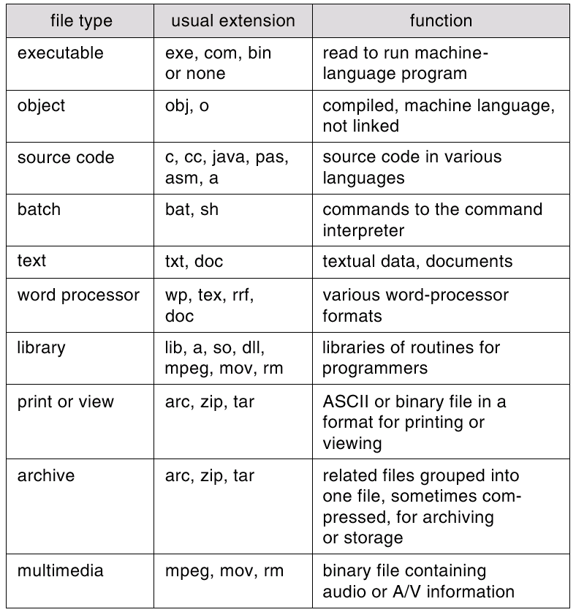
3. File Types – Name, Extension 文件类型

Slide 9
4. File Structure 文件结构
File Structure
None 无结构
- sequence of words, bytes
Simple record structure 简单记录结构
Lines
Fixed length
Variable length
Complex Structures 复合结构
Formatted document
Relocatable load file
Can simulate last two with first method by inserting appropriate control characters.
Who decides:
Operating system
Program

Slide 10
5. Internal File Structure 内部文件
Logical record 逻辑记录
Physical record (block) 物理记录（块）
Packing & Unpacking 打包与解包

Slide 11
记录
主存缓冲区中的物理块
辅存（磁盘）中的物理块
文件结构
访问方法
目录管理
packing
磁盘调度
用户和程序命令
操作，文件名
文件操作函数
I/O
自由空间管理
unpacking
文件分配
用户访问控制
文件管理关注的问题
操作系统关注的问题

Slide 12
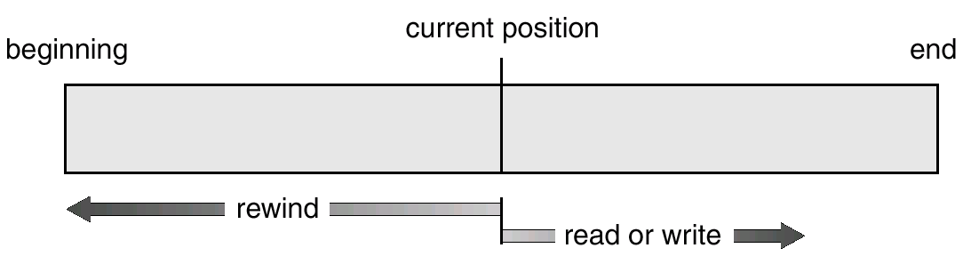
11.2 Access Methods访问方法 1. Sequential Access 顺序访问
Sequential Access
read next
write next
reset
no read after last write
(rewrite)
Sequential-access File

Slide 13
2. Direct Access 直接访问
Direct Access
read n
write n
position to n
read next
write next
rewrite n
n = relative block number

Slide 14
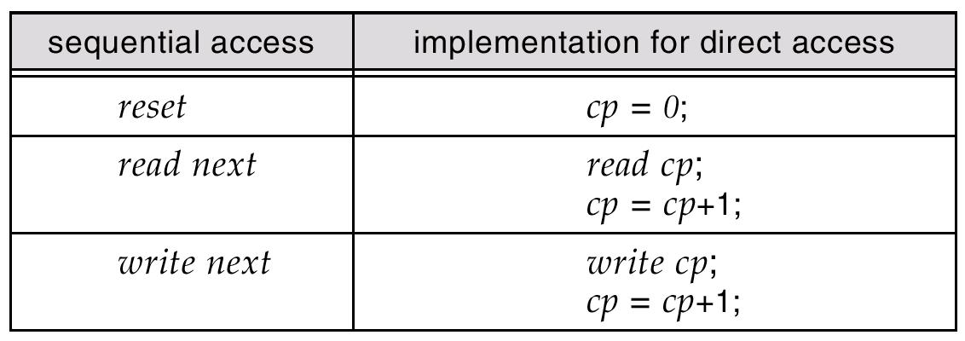
Simulation of Sequential Access on a Direct-access File

Slide 15
3. Other Access Methods
Be built on top of a direct-access method.
建立在直接访问方法基础上
These methods generally involve the construction of a index for the file.
这些方法通常涉及到文件索引的构建

Slide 16
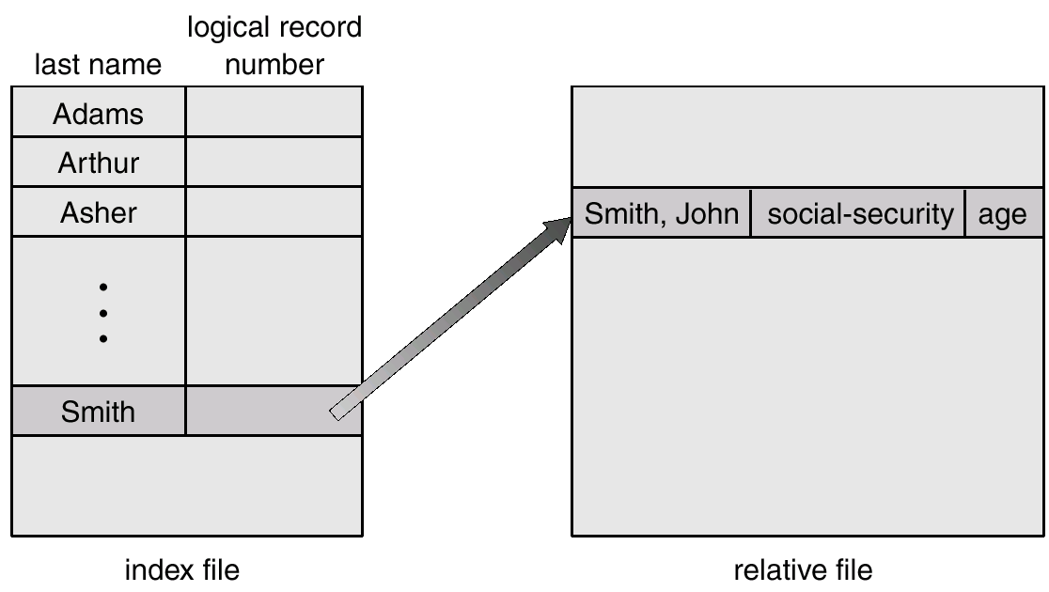
Example of Index and Relative Files

Slide 17
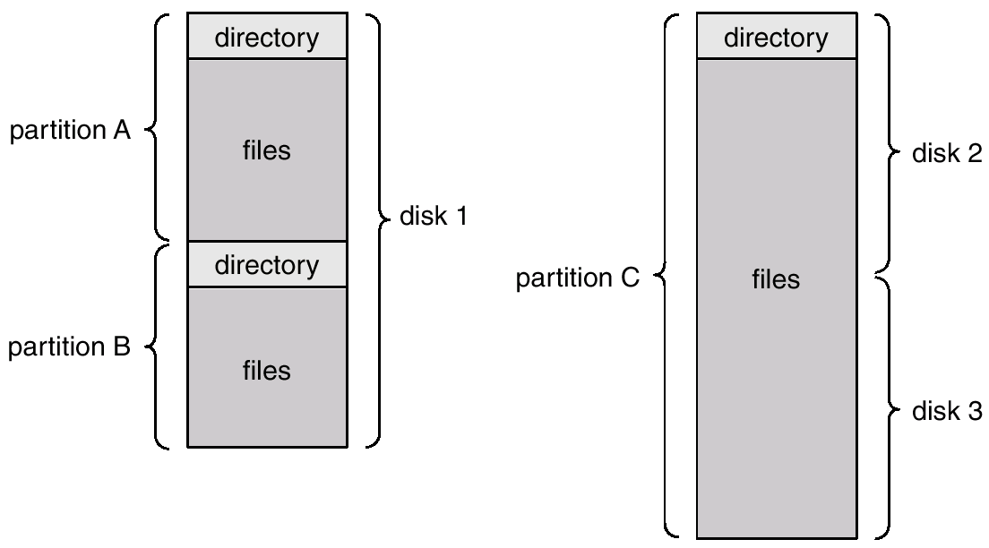
11.3 Directory Structure目录结构
The organization of files is usually done in two parts:
Partitions (minidisks/volumes) 分区（小磁盘/卷）
---a low-level structure in which files and directories reside.
A Typical File-system Organization

Slide 18
Device directory or volume table of contents 设备目录/卷目录
---A collection of nodes containing information about all files.
Directory
Files
F 1
F 2
F 3
F 4
F n
Both the directory structure and the files reside on disk.
Backups of these two structures are kept on tapes.

Slide 19
Information in a Device Directory 目录信息
Name
Type
Address
Current length
Maximum length
Date last accessed (for archival)
Date last updated (for dump)
Owner ID (who pays)
Protection information (discuss later)

Slide 20
Operations Performed on Directory 目录操作
Search for a file
Create a file
Delete a file
List a directory
Rename a file
Traverse the file system

Slide 21
Organize the Directory (Logically) to Obtain
组织目录的目标：
Efficiency 效率
locating a file quickly.
Naming 命名
convenient to users.
Two users can have same name for different files.
The same file can have several different names.
Grouping 分组
logical grouping of files by properties, (e.g., all Java programs, all games, …)

Slide 22
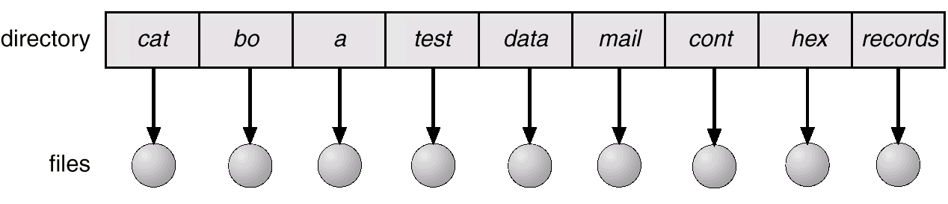
1. Single-Level Directory 单级目录
A single directory for all users.
Naming problem
Grouping problem

Slide 23
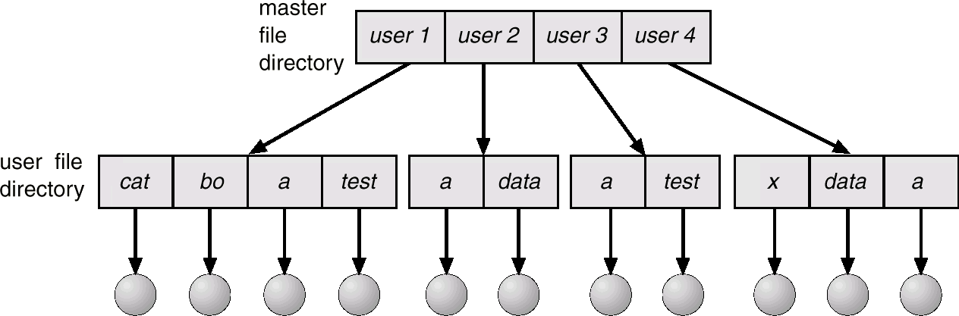
2. Two-Level Directory 二级目录
Separate directory for each user.
Path name
Can have the same file name for different user
Efficient searching
No grouping capability

Slide 24
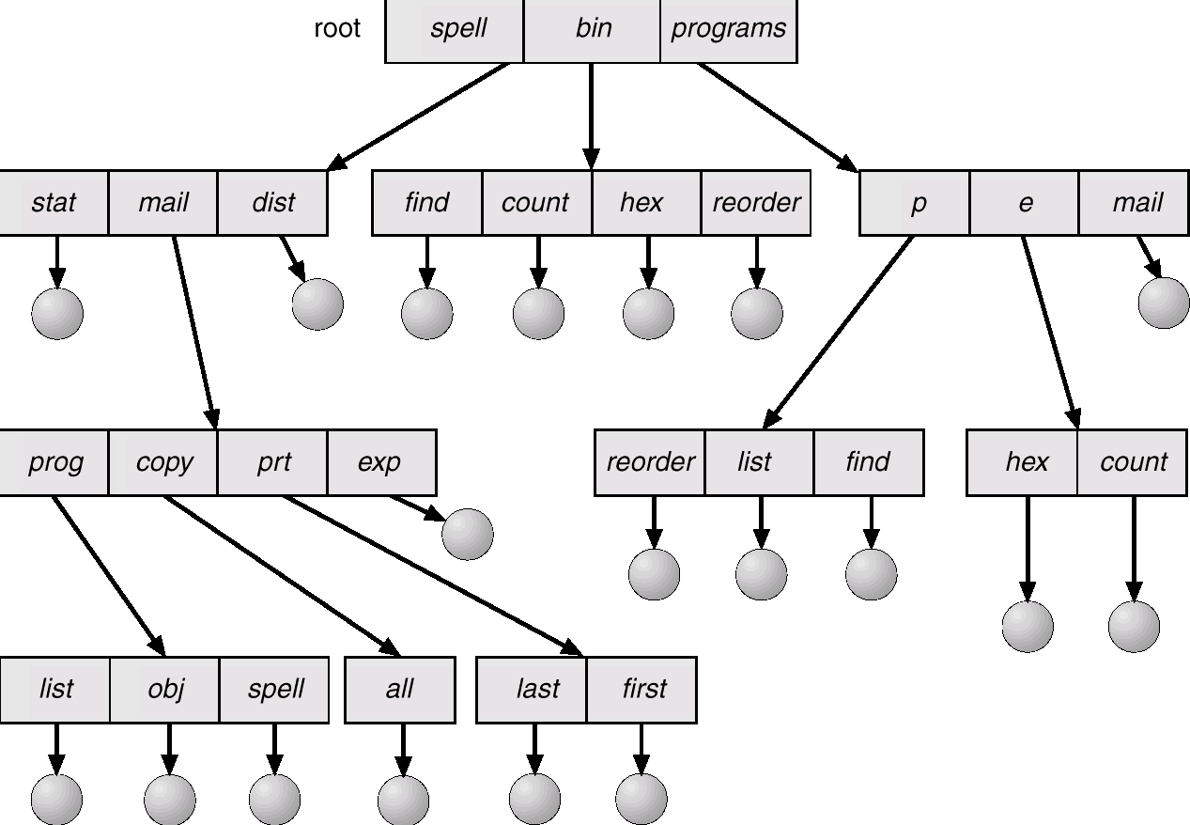
3. Tree-Structured Directories 树形结构目录

Slide 25
Tree-Structured Directories (Cont.)
Efficient searching
Grouping Capability
Current directory (working directory)
cd /spell/mail/prog
type list

Slide 26
Tree-Structured Directories (Cont.)
Absolute or relative path name
Creating a new file is done in current directory.
Delete a file
rm <file-name>
Creating a new subdirectory is done in current directory.
mkdir <dir-name>
Example: if in current directory /mail
mkdir count
mail
prog
copy
prt
exp
count
Deleting “mail” ⇒ deleting the entire subtree rooted by “mail”.

Slide 27
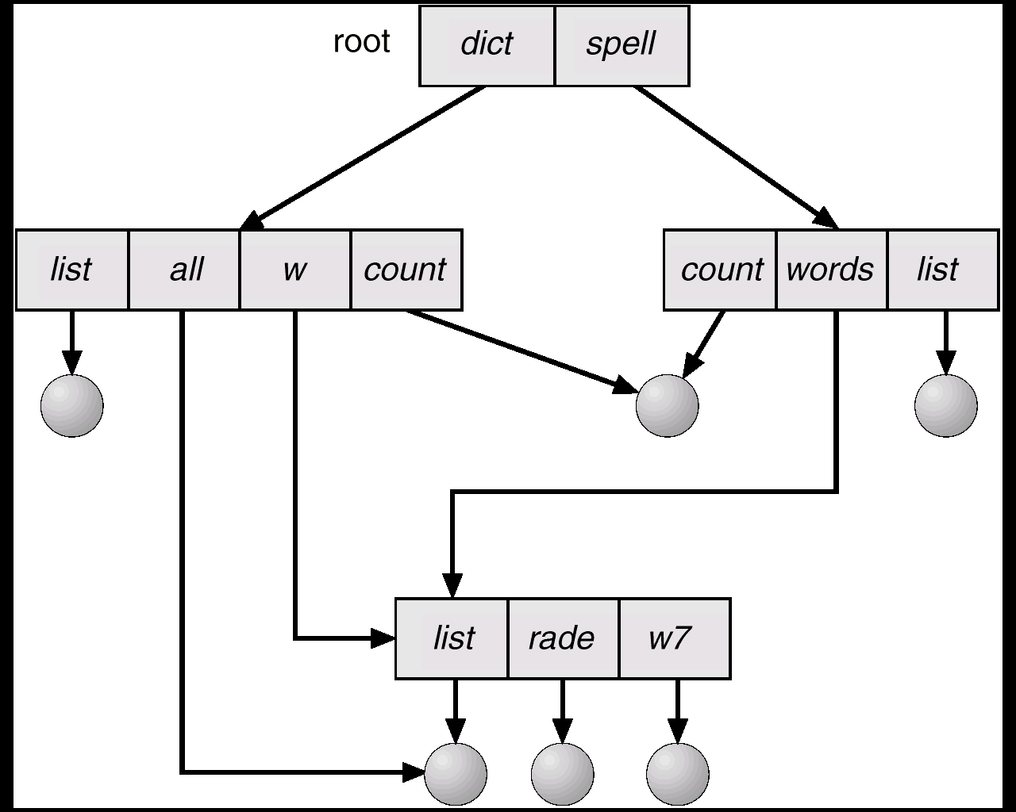
4.Acyclic-Graph Directories 无环图目录
Have shared subdirectories and files
Two different names (aliasing)

Slide 28
Shared files and subdirectories can be implemented in several ways
Link
Duplicate all information about the shared file

Slide 29
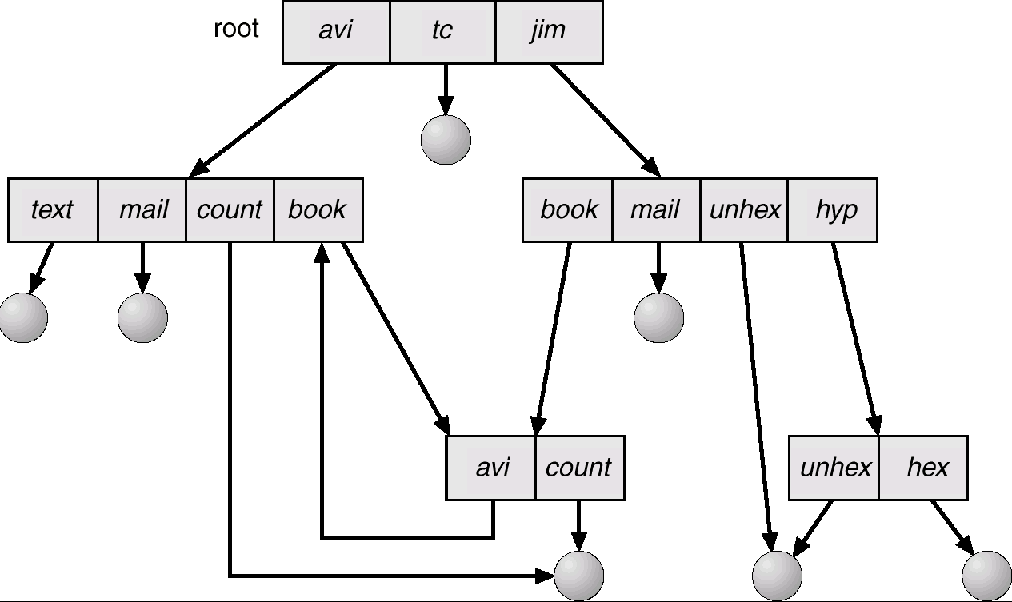
5. General Graph Directory 通用图目录

Slide 30
How do we guarantee no cycles?
Allow only links to file not subdirectories.
Garbage collection.
Every time a new link is added use a cycle detection algorithm to determine whether it is OK.

Slide 31
11.4 File System Mounting文件系统安装
A file system must be mounted before it can be accessed.
A unmounted file system (I.e. Fig) is mounted at a mount point.

Slide 32
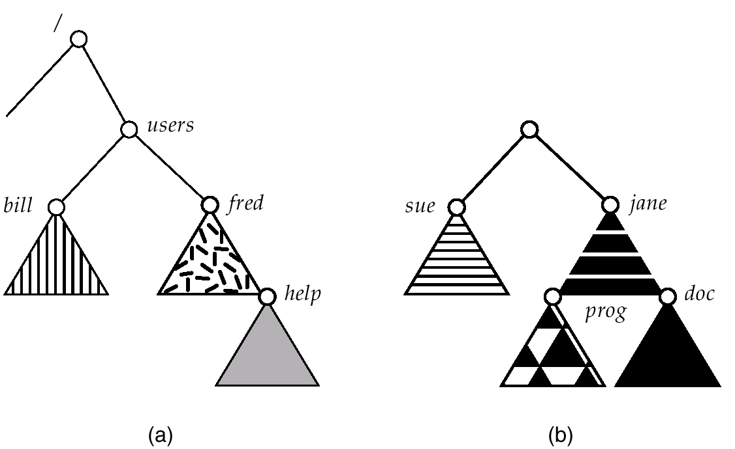
(a) Existing. (b) Unmounted Partition

Slide 33
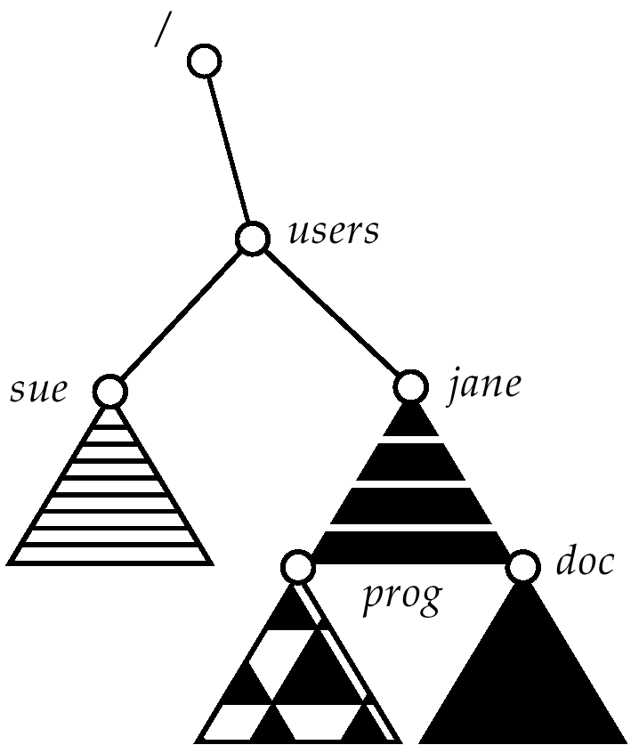
Mount Point

Slide 34
The mount procedure:
The operating system is given the name of the device, and the location within the file structure at which to attach the file system (or mount point).
The operating system verifies that the device contains a valid file system. It does so by asking the device driver to read the device directory and verifying that the directory has the expected format.
The operating system notes in its directory structure that a file system is mounted at the specified mount point.

Slide 35
11.5 File Sharing 文件共享
In this section, we examine more aspects of file sharing.
multiple users and the sharing methods possible
Once multiple users are allowed to share files, the challenge is to extend sharing to multiple file systems, including remote file systems.
Consistency 一致性
there can be several interpretations of conflicting actions occurring on shared files

Slide 36
Sharing of files on multi-user systems is desirable.
Sharing may be done through a protection scheme.
On distributed systems, files may be shared across a network.
Network File System (NFS) is a common distributed file-sharing method.

Slide 37
1. Multiple Users 多用户
The issues of access control and protection.
To implement sharing and protection, the system must maintain more file and directory attributes than on a single-user system.
Most systems have evolved to the concepts of file/directory owner(or user) and group.
Owner 拥有者
the user who may change attributes, grant access, and has the most control over the file or directory.
Group 组
a subset of users who may share access to the file. (Exactly which operations can be executed by group members and other users is definable by the file’s owner.)

Slide 38
The implement of owner and group attributes
Owner: by managing a list of user names and associated user identifiers(user IDs)(In Windows NT parlance, this is a Security ID (SID)).
That user ID is associated with all of the user’s processes and threads.
When they need to be user readable, they are translated back to the user name via the user name list.
Group: by managing a system-wide list of group names and group identifiers.
Every user can be in one or more groups, depending upon operating system design decisions.
The user’s group IDs are also included in every associated process and thread.

Slide 39
The owner and group IDs of a given file or directory are stored with the other file attributes.
When a user requests an operation on a file, the user ID can be compared to the owner attribute to determine if the requesting user is the owner of the file. Likewise, the group IDs can be compared.
The user information within a process can be used for other purposes as well.
如：决定是否允许一个进程对另一个进程某种操作（如，终止，优先权修改等等)
Many system have multiple local file systems, including partitions of a single disk or multiple partitions on multiple attached disks.
In these cases, the ID checking and permission matching are straightforward, once the file systems are mounted.

Slide 40
2. *Remote File Systems 远程文件系统
Through the evolution of network and file technology, file-sharing methods have changed.
ftp: users manually transfer files between machines via programs like ftp.
Distributed File System(DFS) : in which remote directories are visible from the local machine.
World Wide Web: in some ways, the world wide web, is a reversion to the first. A browser is needed to gain access to the remote files, and separate operations (essentially a wrapper for ftp) are used to transfer files.

Slide 41
11.6 Protection 保护
Keep information safe from physical damage(reliability) and improper access(protection).
Reliability: generally provided by duplicate copies of files.
Protection: can be provided in many ways.
Single-user system:
Multiuser system: controlled access.

Slide 42
1. Types of access
File owner/creator should be able to control:
what can be done
by whom
Types of access
Read
Write
Execute
Append
Delete
List

Slide 43
2. Access Control
Mode of access: read, write, execute
Three classes of users
RWX
a) owner access 7 ⇒ 1 1 1 RWX
b) group access 6 ⇒ 1 1 0
RWX
c) public access 1 ⇒ 0 0 1
Ask manager to create a group (unique name), say G, and add some users to the group.
For a particular file (say game) or subdirectory, define an appropriate access.
owner
group
public
chmod
761
game
Attach a group to a file chgrp G game

Slide 44
Appendix
Protection

Slide 45
Goals of Protection 保护的目标
Operating system consists of a collection of objects, hardware or software
Each object has a unique name and can be accessed through a well-defined set of operations.
Protection problem - ensure that each object is accessed correctly and only by those processes that are allowed to do so.

Slide 46
Domain of Protection 保护域
A computer system is a collection of processes and objects.
The operations that are possible may depend on the object.
A process should be allowed to access only those resources for which it has authorization. Furthermore, at any time, a process should be able to access only those resources that it currently requires to complete its task---need-to-know principle（需者方知原则）.

Slide 47
Domain Structure 域结构
A process operates within a protection domain.
Each domain defines a set of objects and the types of operations that may be invoked on each object.

Slide 48
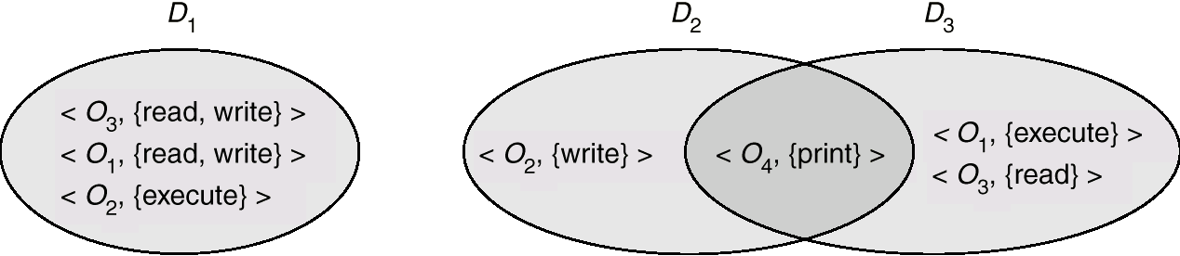
Domain = set of access-rights
Access-right = <object-name, rights-set>
rights-set is a subset of all valid operations that can be performed on the object.
Domains do not need to be disjoint; they may share access rights.

Slide 49
Access Matrix 访问矩阵
View protection as a matrix (access matrix)
Rows represent domains
Columns represent objects
Access(i, j) is the set of operations that a process executing in Domain_{i} can invoke on Object_{j}

Slide 50
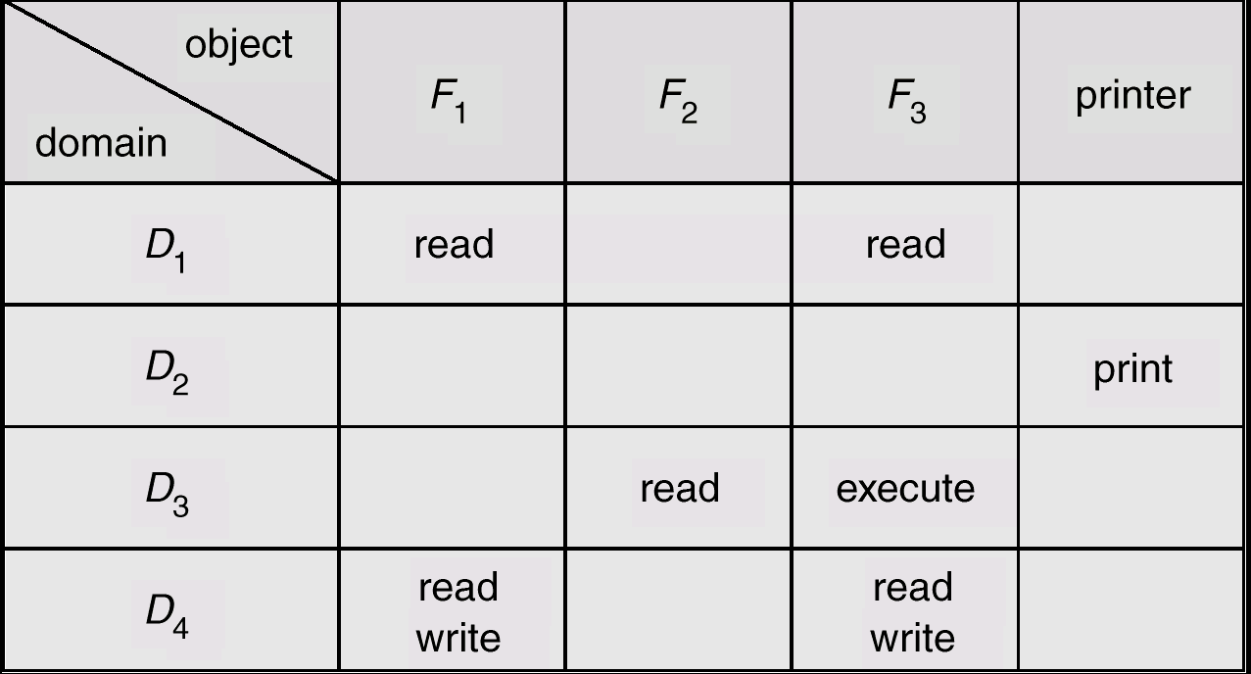
Access Matrix
Figure A

Slide 51
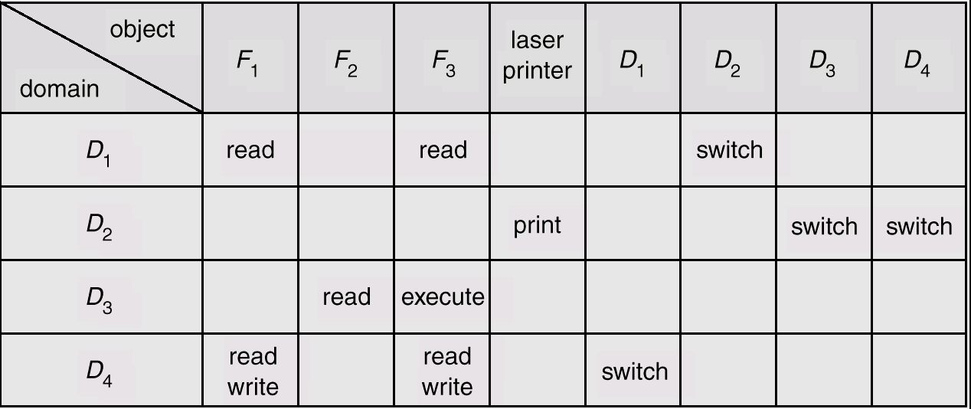
Domain switching from domain Di to domain Dj is allowed to occur if and only if the access right
Figure B
Access Matrix of Figure A With Domains as Objects

Slide 52
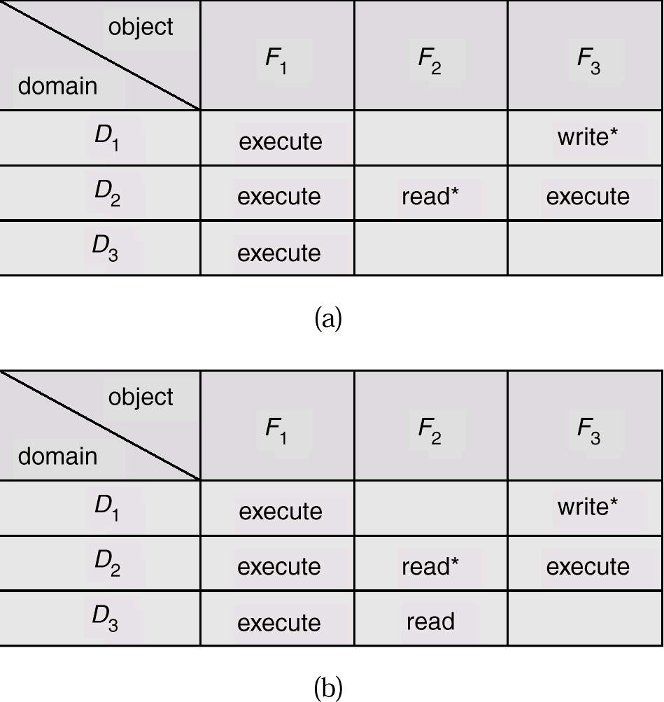
Copy right
Access Matrix with Copy Rights

Slide 53
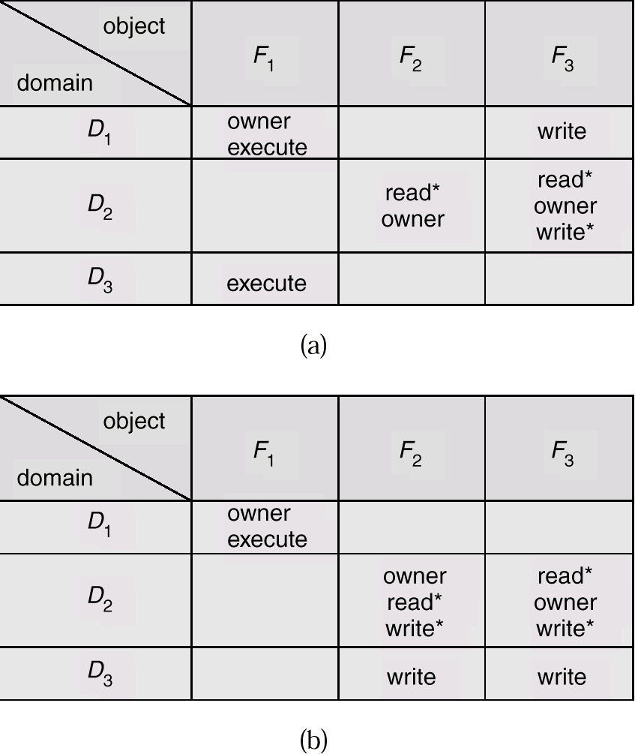
Owner right
Allow addition of new rights and removal of some rights.
Access Matrix With Owner Rights

Slide 54
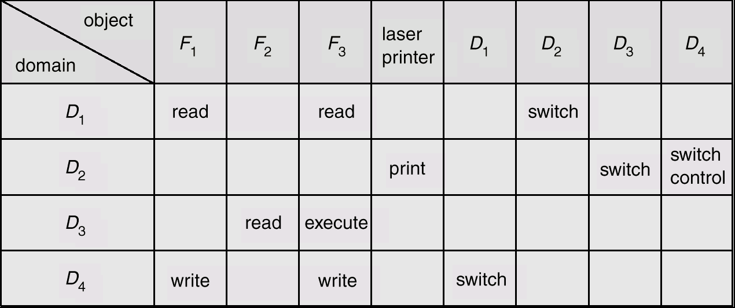
Control right
The copy and owner rights allow a process to change the entries in a column.
The control right is applicable only to domain objects.
Modified Access Matrix of Figure B

Slide 55
Implementation of Access Matrix 访问矩阵的实现
In general, the matrix will be sparse; that is, most of the entries will be empty.
Access Lists for Objects

Slide 56
Access Lists for Objects
Each column = Access-Control List for one object Defines who can perform what operation. Domain 1 = Read, Write Domain 2 = Read Domain 3 = Read 
The resulting list for each object consists of ordered pairs <domain, rights-set>

Slide 57
End of Chapter 11

