Slide 1
Chapter 12: File-System Implementation

Slide 2
Chapter 12 File-System Implementation 文件系统实现
12.1 File-System Structure 文件系统结构
12.2 File-System Implementation 文件系统实现
12.3 Directory Implementation 目录实现
12.4 Allocation Methods 分配方法
12.5 Free-Space Management 空闲空间管理
Exercises

Slide 3
12.1 File-System Structure
I/O transfers between memory and disk are performed in units of blocks.
内存与磁盘间的I/O传输以块为单位
Each block is one or more sectors（扇区）.
File structure
Logical storage unit
Collection of related information
File control block （FCB） 文件控制块
– storage structure consisting of information about a file.
File system resides on secondary storage (disks).
File system organized into layers.

Slide 4
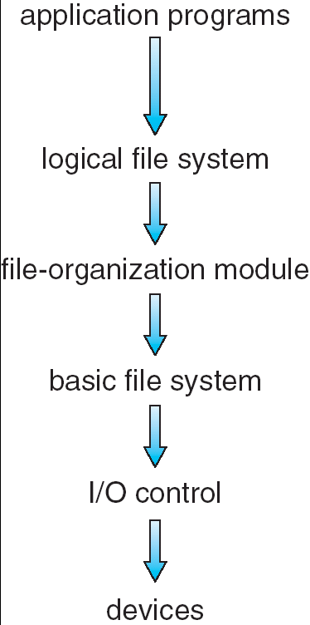
Layered File System
Manages metadata information. 1.manages the directory structure; 2.maintains file structure via file control block(FCB); 3.protection and security.
1.Translate logical block address to physical block address; 2.free space manager.
Issue generic commands to the appropriate device driver
Commands(such as “retrieve block 123”)
device drivers and interrupt handlers to transfer information between the main memory and the disk system.
hardware-specific instructions
(controller)

Slide 5
12.2 File-System Implementation 文件系统实现
In this section, we delve into the structures and operations used to implement file-system operations.
1. Overview
2. Partitions and Mounting 分区及安装
3. Virtual File Systems 虚拟文件系统

Slide 6
Overview
On-disk and in-memory structures used to implement a file system: 磁盘及内存中用以实现文件系统的结构
The on-disk structures:
A boot control block 引导控制块
contains information needed by the system to boot an operating system from that partition.
A partition control block 分区控制块
contains partition details (such as: the number of blocks in the partition, size of the blocks, free-block count and free-block pointers, and free FCB count and FCB pointers).
Directory structure 目录结构
FCB 文件控制块

Slide 7
The in-memory structures :
An in-memory partition table 内存 分区表
containing information about each mounted partition.
An in-memory directory structure 内存 目录结构
that holds the directory information of recently accessed directories.
The system-wide open-file table 系统 打开文件表
contains a copy of the FCB of each open file, as well as other information.
The per-process open-file table 进程 打开文件表
contains a pointer to the appropriate entry in the system-wide open-file table, as well as other information.

Slide 8
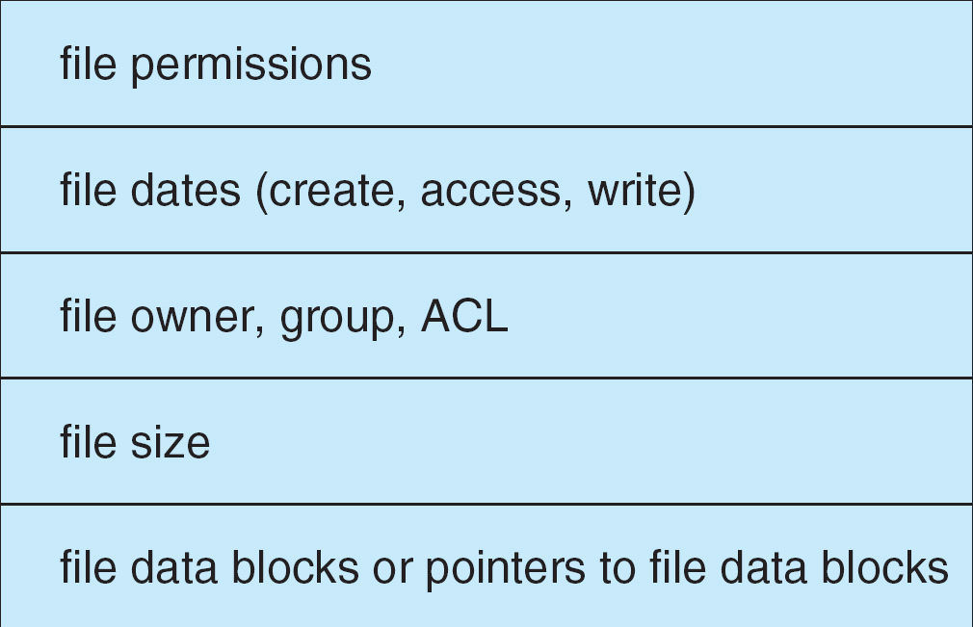
A typical file control block

Slide 9
Create a new file 创建新文件
The process:
An application program calls the logical file system.
Logical file system allocates a new FCB
Read the appropriate directory into memory, updates it with the new file name and FCB, and writes it back to the disk.

Slide 10
About directory
Some operating systems (including UNIX) treat a directory as a file.
Some operating systems (including Windows NT) treat a directories as entities separate from files. (separate system calls for files and directories.)

Slide 11
Open a file 打开文件
The process:
The directory structures is searched for the given file name. (Parts of the directory structure are usually cached in memory to speed directory operations.)
The FCB is copied into a system-wide open-file table in memory.
An entry is made in the per-process open-file table. (with a pointer to the entry in the system-wide open-file table, a pointer to the current location in the file, the access mode in which the file is open, ……)

Slide 12
The open call returns a pointer to the appropriate entry in the per-process open-file table. All file operations are then performed via this pointer.
About the pointer returned by the open call
Unix systems refer to it as a file descriptor(文件描述符)
Windows 2000 refers to it as a file handle （文件句柄）.

Slide 13
Close a file 关闭文件
The process:
The per-process table entry is removed, and the system-wide entry’s open count is decremented.
When all users that have opened the file close it, the updated file information is copied back to the disk-based directory structure and the system-wide open-file table entry is removed.

Slide 14
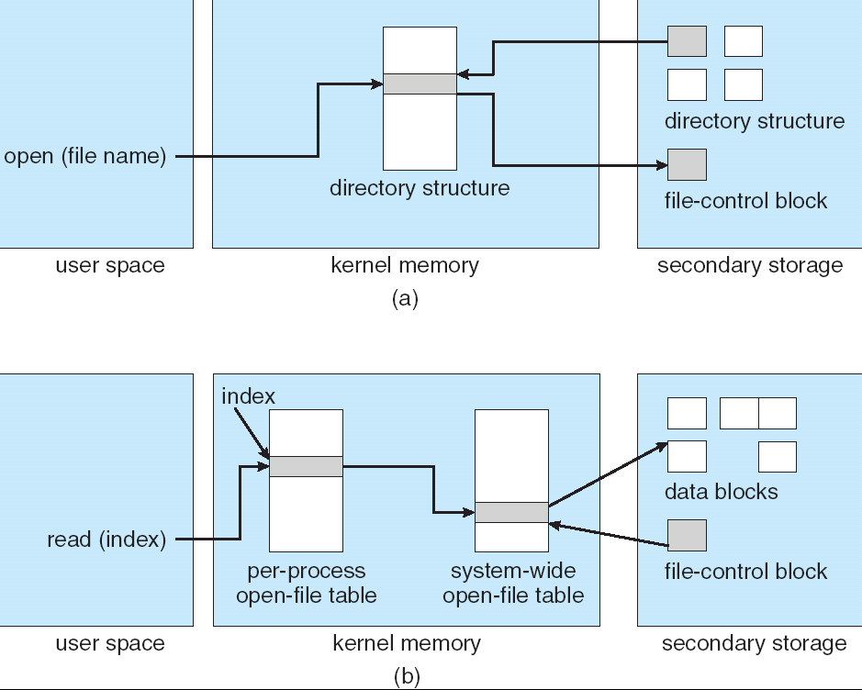
In-Memory file-system structures. (a) File open. (b) File read.

Slide 15
Partitions and Mounting 分区及安装
The layout of disk can have many variations, depending on the operating system.
A disk can be sliced into multiple partitions, or a partition can span multiple disks (---a form of RAID).
Each partition can be:
“raw” : 生分区
containing no file system
Raw disk is used where no file system is appropriate.
Examples: UNIX swap space, some databases.
“cooked” : 熟分区
containing a file system

Slide 16
Boot information 引导信息
can be stored in a separate partition.
it has its own format 具有自己特定的格式
because at boot time the system does not have file-system device drivers loaded and therefore cannot interpret the file-system format. 因为引导时文件系统尚未加载，因此无法理解文件系统格式
it is usually a sequential series of blocks, loaded as an image into memory.
Execution of the image starts at a predefined location, such as the first byte.

Slide 17
root partition 根分区
which contains the operating-system kernel and potentially other system files, is mounted at boot time.
包含OS内核及其他系统文件，引导时安装
Other partitions can be automatically mounted at boot or manually mounted later, depending on the operating system.
其他分区在引导时自动安装，或后来手工安装，取决于操作系统

Slide 18
As part of a successful mount operation, the operating system verifies that the device contains a valid file system.
作为安装操作的一部分，操作系统核实设备包含有效文件系统
It does so by asking the device driver to read the device directory and verifying that the directory has the expected format.
If the format is invalid, the partition must have its consistency checked and possibly correct, either with or without user intervention.

Slide 19
Finally, the operating system notes in its in-memory mount table structure that a file system is mounted, and the type of the file system.
最后，操作系统在内存安装表中注明安装该文件系统及其类型

Slide 20
Virtual File Systems 虚拟文件系统
How does an operating system allow multiple types of file systems to be integrated into a directory structure? How can users seamlessly move between file-system types as they navigate the file-system space?
操作系统如何使不同类型的文件系统可整合到一个目录结构中？
用户如何能够在不同类型文件系统之间无缝迁移？

Slide 21
Virtual File Systems –VFS 虚拟文件系统
provide an object-oriented way of implementing file systems. 提供一种面向对象的文件系统实现方法
VFS allows the same system call interface (the API) to be used for different types of file systems. VFS使同样的系统调用接口（API）用于不同类型的文件系统
The API is to the VFS interface, rather than any specific type of file system. API是面向VFS接口的，而不是任何特定类型的文件系统

Slide 22
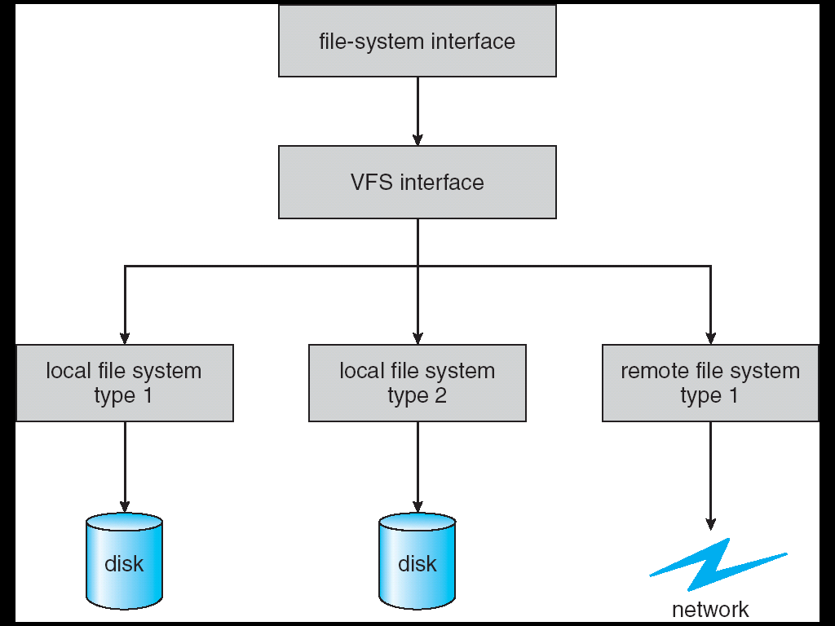
Schematic View of Virtual File System

Slide 23
12.3 Directory Implementation 目录实现
1. Linear list 线性表
Linear list of file names with pointer to the data blocks.
simple to program
time-consuming to execute
2. Hash Table 哈希表
– linear list with hash data structure.
decreases directory search time
collisions – situations where two file names hash to the same location
fixed size

Slide 24
12.4 Allocation Methods 分配方法
An allocation method refers to how disk blocks are allocated for files. 分配方法是指如何将盘块分配给文件
Goal
disk space is utilized effectively and file can be accessed quickly. 磁盘空间的有效利用和文件的快速访问
Three major methods
Contiguous allocation 连续分配
Linked allocation 链接分配
Indexed allocation 索引分配

Slide 25
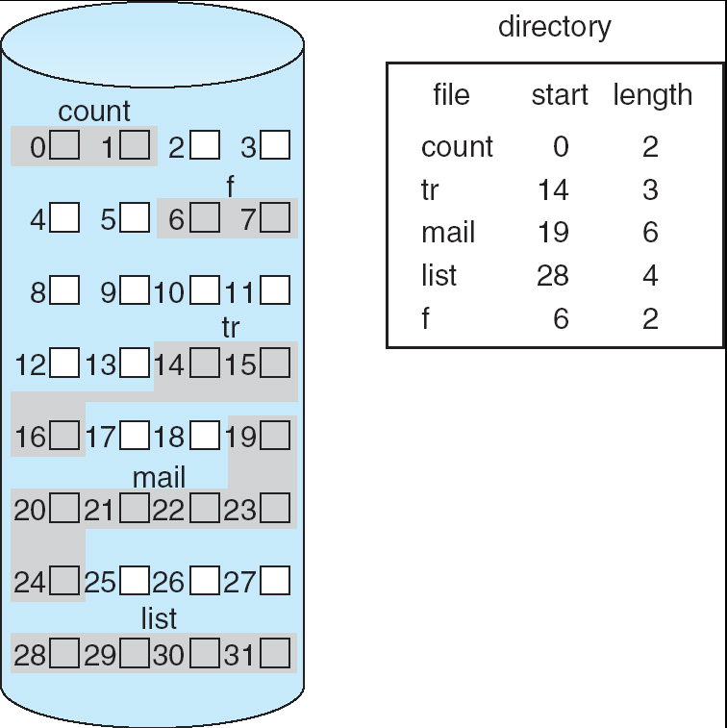
Contiguous Allocation of Disk Space
Contiguous Allocation 连续分配

Slide 26
Contiguous Allocation of Disk Space
Each file occupies a set of contiguous blocks on the disk. 每个文件占用一组连续的盘块
The directory entry for each file indicates the address of the starting block (block #) and the length of the area allocated for this file (number of blocks). 每个文件的目录项指示文件的起始块地址（块号）及存储区域的长度（块数）

Slide 27
Advantages
The least number of disk seek. (for only one access job)
Accessing a file is easy. (for both sequential and direct access)
Drawbacks
Difficulty for finding space for a new file.
Wasteful of space: external fragmentation.
(dynamic storage-allocation problem)
Size-declaration problem: files cannot grow.

Slide 28
Extent-Based Systems 基于扩展的系统
Many newer file systems (I.e. Veritas File System) use a modified contiguous allocation scheme.
Extent-based file systems allocate disk blocks in extents.
An extent is a contiguous block of disks.
Extents are allocated for file allocation.
A file consists of one or more extents.

Slide 29
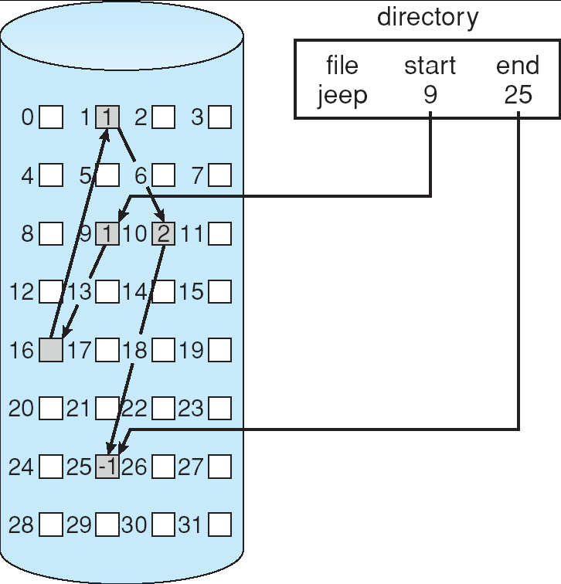
Linked Allocation 链接分配
Each file is a linked list of disk blocks: blocks may be scattered anywhere on the disk.
block=
pointer
Linked Allocation

Slide 30
Advantages
Simple – need only starting address
Free-space management system – no waste of space
Disadvantages
No random access
Wasteful of space: the space required for the pointers.
Solution: collect blocks into multiples---clusters
Reliability.
Partial solution: use double linked lists or to store the file name and relative block number in each block. (however, these schemes require even more overhead for each file.)

Slide 31
FAT Allocation 文件分配表
File-allocation table (FAT)
– disk-space allocation used by MS-DOS and OS/2.
A section of disk at the beginning of each partition is set aside to contain the FAT.
FAT has one entry for each disk block, and is indexed by block#.
Each entry contains the block# of the next block in the file.
Unused blocks are indicated by a 0 table value.
The directory entry contains the block# of the first block of the file.

Slide 32
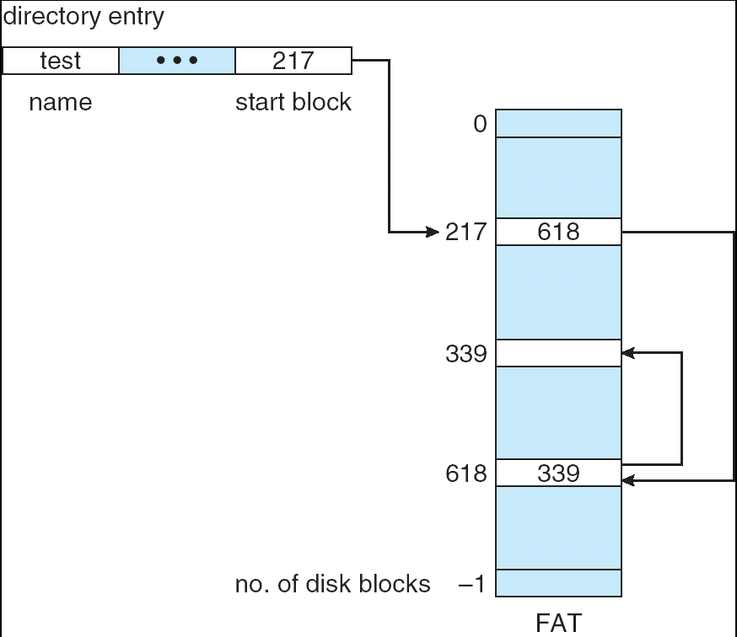
File-Allocation Table

Slide 33
The FAT allocation scheme can result in a significant number of disk head seeks, unless the FAT is cached.
A benefit is that random access time is improved

Slide 34
Indexed Allocation 索引分配
Brings all pointers together into the index block.
所有指针集中于索引块（索引表）
index table
Each file has its own index block.
The ith entry in the index block points to the ith block of the file.
索引块的第i项指向文件的第i块
The directory contains the address of the index block.
目录包含索引块的地址

Slide 35
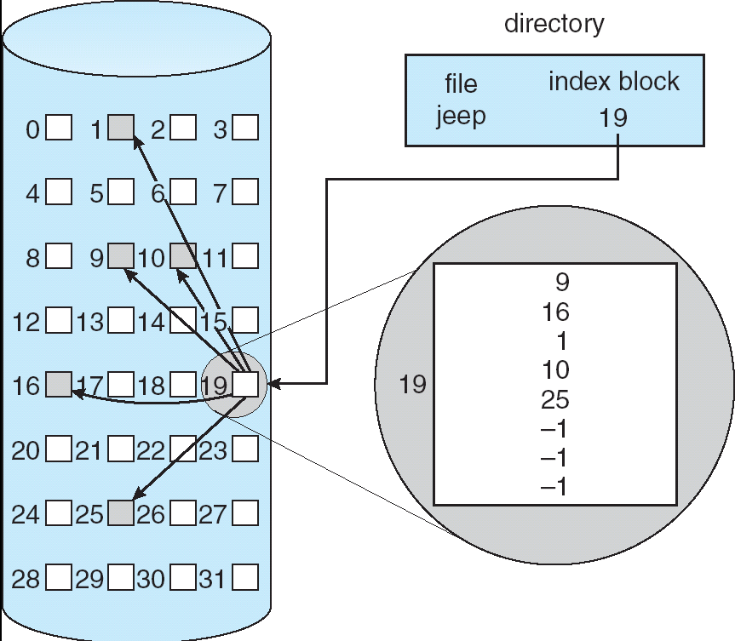
Example of Indexed Allocation

Slide 36
Advantages
Index allocation supports random access 支持随机访问
Dynamic access without external fragmentation 无外部碎片
Disadvantages
Wasteful of space 浪费空间
the pointer overhead of the index block is generally greater than the pointer overhead of linked allocation.
指针开销通常比链接分配的指针开销更大

Slide 37
Problem
How large the index block should be?
Linked scheme
link together several index blocks.链接方案
Multilevel index 多级索引
Combined scheme 组合方案

Slide 38
Linked scheme 链接方案
Mapping from logical to physical in a file of maximum size of 256K words and block size of 512 words. We need only 1 block for index table.
对于最大256K字、块大小为512字的文件的地址映射，仅需1个索引块
Q
LA/512
R
Q = displacement into index table 在索引表中的偏移量
R = displacement into block 块内偏移量

Slide 39
Mapping from logical to physical in a file of unbounded length (block size of 512 words).
无限长文件的地址映射（每块512字）
Linked scheme – Link blocks of index table (no limit on size).
链接方案－－链接（无长度限制）索引表块
Q₁
LA / (512 x 511)
R₁
Q₁ = block of index table 索引块
R₁ is used as follows: R₁ 采用如下方式使用：
Q₂
R₁ / 512
R₂
Q₂ = displacement into block of index table 索引块内索引
R₂ displacement into block of file 文件数据块内索引

Slide 40
Multilevel index 多级索引
Two-level index (maximum file size is 512³) 二级索引
Q₁
LA / (512 x 512)
R₁
Q₁ = displacement into outer-index 外部索引偏移量
R₁ is used as follows: R₁采用如下方式使用：
Q₂
R₁ / 512
R₂
Q₂ = displacement into block of index table 索引块内偏移量
R₂ displacement into block of file 文件块内偏移量

Slide 41
Multilevel index

outer-index
index table
file

Slide 42
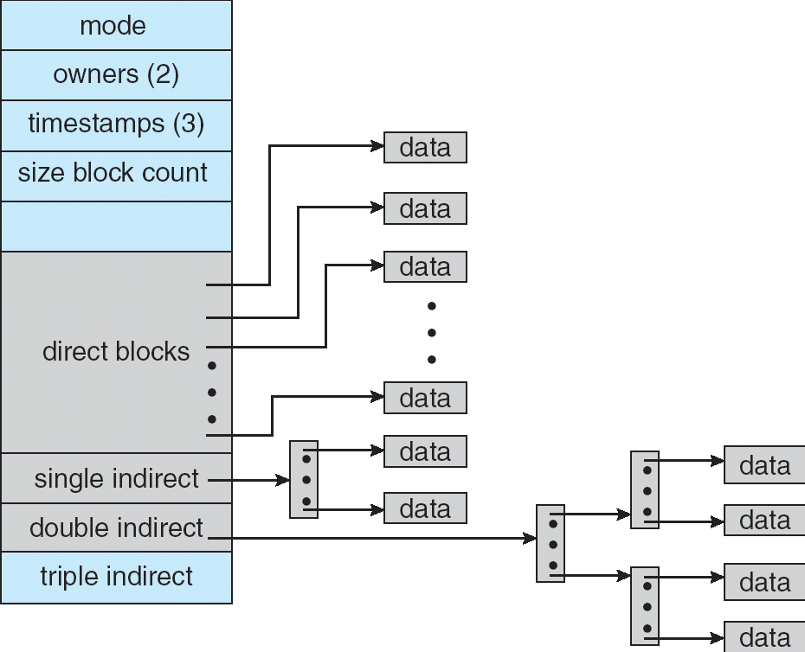
Combined Scheme: UNIX (4K bytes per block)
The UNIX inode.

Slide 43
12.5 Free-Space Management 闲空间管理
Bit vector (bit map) 位向量（位映象）
0
1
2
n-1
…
1 ⇒ block[i] free
0 ⇒ block[i] occupied
bit[i] =
{
Block number calculation
The block# of the first free block=
(number of bits per word) *(number of 0-value words) +offset of first 1 bit
首个空闲块块号＝每个字的位数*0值字数＋首个“1”位的偏移量

Slide 44
Bit map requires extra space. 位映象需要额外的空间
Example:
block size = 2¹² bytes
disk size = 2³⁰ bytes (1 gigabyte)
n = 2³⁰/2¹² = 2¹⁸ bits (or 32K bytes)
Easy to get contiguous files 易得到连续的文件

Slide 45
Linked list (free list) 链接列表（空闲列表）
Link together all the free disk blocks, keeping a pointer to the first free block in a special location on the disk and caching it in memory.
所有的空闲盘块链接到一起，将首个空闲块的指针保存在磁盘特定的位置，并把他缓存（cache）到内存。

Slide 46
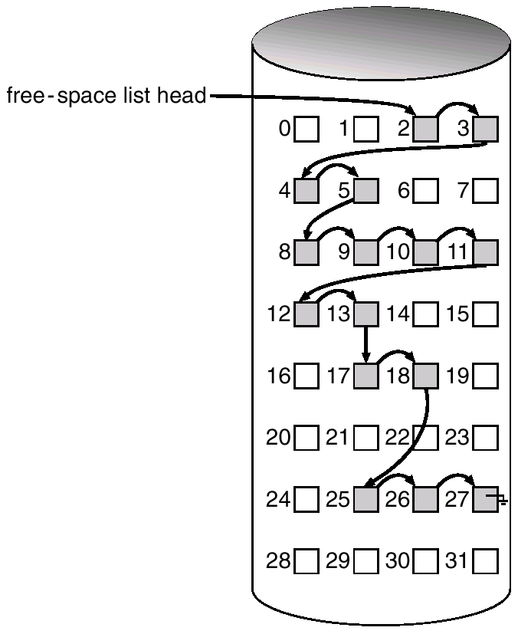
Linked Free Space List on Disk

Slide 47
This scheme is not efficient: to traverse the list, we must read each block, which requires substantial I/O time.
该方案效率不高：遍历列表需要读取每个盘块，这需要相当多的I/O时间。
The FAT method incorporates free-block accounting into the allocation data structure. No separate method is needed.
FAT方案把空闲块的记帐信息合并到分配数据结构中，不需要单独的方法（管理空闲空间）

Slide 48
Grouping 分组（成组链接法）
Store the addresses of n free blocks in the first free block. The first n-1 of these blocks are actually free. The last block contains the addresses of another n free blocks, and so on.
把n个空闲块的地址存放在第一个空闲块中，其中前n-1个块是真正空闲的，最后一个块包含另一组n块的地址，……

Slide 49
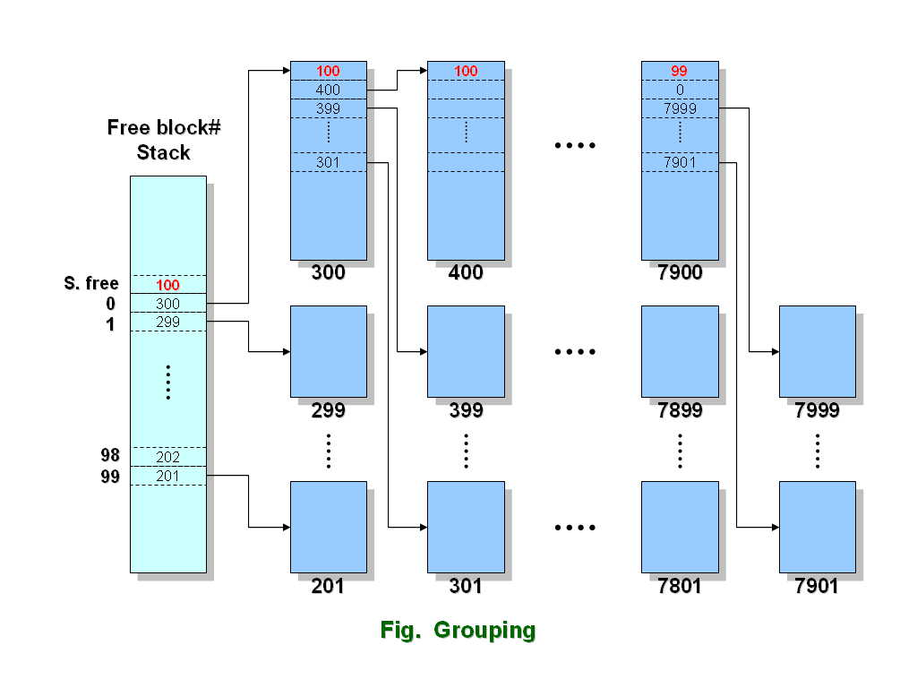

Slide 50
Advantage:
the addresses of a large number of free blocks can be found quickly, unlike in the standard linked-list approach.
优点：可以迅速找到大量的空闲盘块，不象标准链接列表方法。

Slide 51
4. Counting 计数
Keep the address of the first free block and the number n of free contiguous blocks that follow the first block.
保存首个空闲块的地址以及其后连续空闲块的数量n.
Each entry in the free space list then consists of a disk address and a count.
空闲空间列表的每个条目由一个磁盘地址和一个计数组成。

Slide 52
Exercises
12.15 Consider a file system on a disk that has both logical and physical block size of 512 bytes. Assume that the information about each file is already in memory. For each of the three allocation strategies (contiguous, linked, and indexed), answer these questions:
a. How is the logical-to-physical address mapping accomplished in this system? (For the indexed allocation, assume that a file is always less than 512 blocks long.)
b. If we are currently at logical block 10 (the last block accessed was block 10) and want to access logical block 4, how many physical blocks must be read from the disk?

Slide 53
End of Chapter 12

