Slide 1


Streaming Data at Scale with Kafka Consumer Groups
Slides and Demos

Slide 2




Justin Reock
Tech Community Thought Leader
Field CTO / Chief Evangelist
Justin has over 20 years of experience working in various software roles including JEE work. He is an outspoken free software evangelist, delivering enterprise solutions, technical leadership, various publications and community education on databases, architectures, and integration projects.
@justinreock

Slide 3
“Where there is data smoke, there is business fire.”
- Dr. Thomas Redman, President, Data Quality Solutions

Slide 4

Sharing Application Data Reliably is Difficult
Applications often have a need to send information back and forth to one another
It was once difficult if not impossible to “federate” data across disparate languages or residing on heterogeneous platforms
Java Messaging Service (JMS), for example, arose out of a growing need to share data between very different systems
Java Application
.NET Application

Slide 5
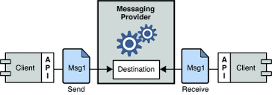
Message Oriented Middleware To The Rescue
Technically, MOM is any pattern that sends and receives messages between distributed applications
This pattern allows for asynchronous processing, and normalization of data exchanges
Clients connect to a messaging provider, and send and receive messages via that provider

Slide 6






Message Oriented Middleware Platforms

Slide 7

Message Broker
A Message Broker is an application responsible for systematically providing data in the form of a Message between endpoints
Producers and Consumers
Consumers receive data from a messaging system, and Producers enrich or provide data to the system
Queues and Topics
Queues are FIFO pipelines of messages, Topics are subscription-based message broadcast channels (Newsstand vs. Paper Route)
Persistence and Durability
Persistent messages are written to disk for HA and no loss, Durable subscribers have message retained per-subscriber
Message Oriented Middleware Concepts

Slide 8

Producer Backpressure
Journal Health
Broker Availability
Data Security
Exceptions
Dead Letters
Distributed Transactions
Low-Bandwidth Environments
Stale Data
Protocol Compatibility
Geolocational Distance
Contract Enforcement
Challenges with Traditional Message Oriented Middleware

Slide 9


Introducing some really great writers…

Slide 10
Apache Kafka For High Frequency Messaging
Kafka is a high-throughput streaming event system meant for heavy traffic
Kafka is great for Streaming Architecture and Event-Driven Architecture
Kafka is free and open source under the Apache 2.0 license
Kafka was conceived at LinkedIn with LinkedIn scale in mind
Kafka’s architecture and ability to scale will be more than enough for most businesses
Kafka has a wide library of clients making it easy to integrate with multiple platforms

Slide 11
Brokers
Producer API
Consumer API
Persistence
Durability
High Availability
Partitions
Stream Processing
Reactive Patterns
Immutable Logs
Long Retention
Ultra-Scale
Kafka Extends Traditional Message Oriented Middleware

Slide 12

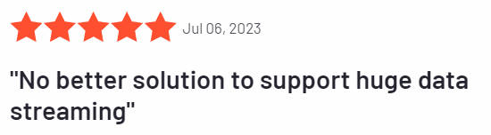









Kafka is Highly Successful
Astronomically Scalable
Optimized for High-Volume Throughput
Full Durability and Reliability
Trusted by the Fortune 100 and Fortune 500
Highly scalable, easy to configure, highly available, guaranteed sequential processing, no data loss
Notes:
Mention the need for Gartner PeerReviews

Slide 13
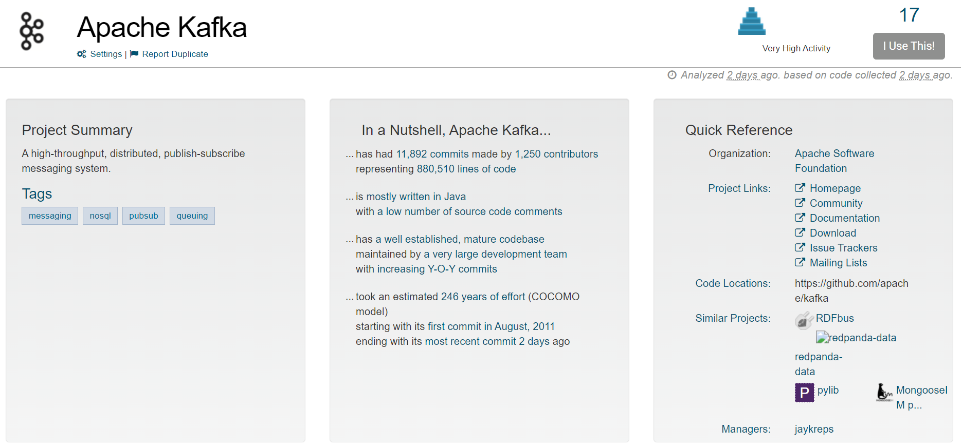
Project Metrics
OpenHub Metrics: https://openhub.net/p/apache-kafka

Slide 14
Kafka Is a Streaming Engine
Traditional messaging systems focus on reliable delivery of a single message
Kafka can present large amounts of data in historically-tagged chunks
Kafka allows queueing, but its primary use case is a Topic pattern
A Topic will have multiple interested consumers receiving streams of data
Kafka scales these Topics even further by breaking them into Partitions

Slide 15
Kafka Is a Streaming Engine
In traditional message queueing (not topics), a single message is processed at a time, even if that payload contains a lot of data
Consumer A
Consumer B
Consumer C

Slide 16
Kafka Is a Streaming Engine
With Kafka, a series or stream of messages can be processed at a time. Immutable logs allow long-term data storage, so consumers can time slice data they want to receive
Consumer A
Consumer B
Consumer C

Slide 17
Partitions For Replication and Scale
Producer
Kafka stores streamed data in Partitions
One consumer may attach to one partition
Superfluous consumers will be ignored
Partitions are replicated across brokers according to a replication factor
This allows for excellent redundancy in retaining the data and good load balancing and horizontal scale across storage
0
1
2
3
4
5
6
Consumer A-1
Partition 0
Partition 1
0
1
2
3
4
5
6
Consumer A-2
Partition n
0
1
2
3
4
5
6
Consumer A-n
Kafka Topic

Slide 18
Kafka High Level Topology
Producer
Kafka Cluster
Consumer
Producer
Consumer
Producer
Consumer
Apache Zookeeper (or KRaft)

Slide 19

Launch Kafka Cluster and View in Kafdrop
Create Topic and Attach Consumers and Producers
Demonstrate Topic Durability
Demo – Producers and Consuimers

Slide 20
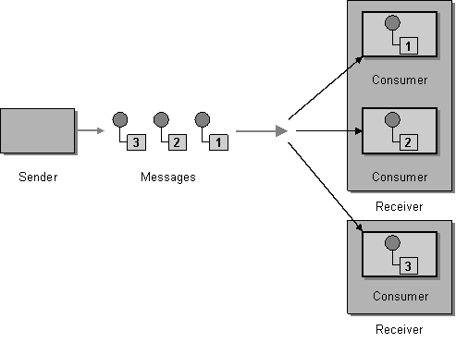
Traditional Problems with Scale
In most messaging systems, data is produced at a rate faster than it is consumed
This creates “backpressure” on Producers
Many solutions have been presented, from Producer Flow Control to horizontally-scaled Networks of Brokers
Consumers need to load balance processing of messages

Slide 21
Pattern: Queue Consumer Load Balancing
Recall that in queuing Scenarios, Consumers load balance messages from Queues
Consumer A
Consumer B
Consumer C

Slide 22

Pattern: Virtual Topic Subscriptions
Subscribers in Pub/Sub patterns are traditionally single-threaded
ActiveMQ introduced Virtual Topics to load balance across subscription threads
Hard to guarantee delivery order and idempotency across a network
Replication strategies are limited and brittle
1
Topic
Subscriber A Queue
2
3
1
Subscriber B Queue
2
3
1
Subscriber C Queue
2
3

Slide 23
Kafka Wins: Consumer Groups
Kafka Consumer Groups present a pattern that fulfills all needs while reliably replicating data across partitions and brokers
Load-balancing across single pub/sub threads and queuing patterns
Guaranteed order per-consumer
Idempotency when “ack” configured properly
1
Topic
Consumer Group A
2
3
1
Consumer Group B
2
3
1
Consumer group C
2
3

Slide 24
Consumer Group Protocol
Kafka handles mapping of consumers to partitions automatically when multiple Consumers specify the same Topic and Group ID
@KafkaListener(topics = "DemoTopic", groupId = "Consumer-Group-A")
public void listenA1(String message) { procMesg("A::1", message); }
@KafkaListener(topics = "DemoTopic", groupId = "Consumer-Group-A")
public void listenA2(String message) { procMesg("A::2", message); }
2023-11-13T01:00:18.402-05:00 INFO 30408 --- [ntainer#1-0-C-1] o.s.k.l.KafkaMessageListenerContainer : Consumer-Group-A: partitions assigned: [DemoTopic-1]
2023-11-13T01:00:18.402-05:00 INFO 30408 --- [ntainer#0-0-C-1] o.s.k.l.KafkaMessageListenerContainer : Consumer-Group-A: partitions assigned: [DemoTopic-0]

Slide 25
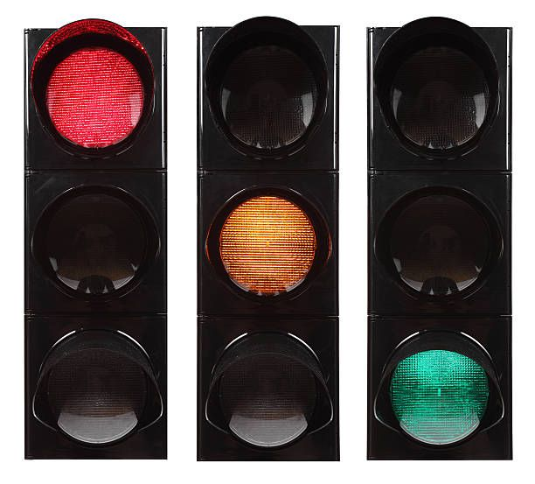
Consumer Group Protocol (V2)
V1 uses a “rebalance” process to assign partitions to consumers
Consumers are reassigned to partitions when topics change or consumers connect or disconnect
This can pause processing during rebalance
V2 improves this with “incremental rebalancing,” allowing consumer or partition changes without a full rebalance

Slide 26
Add more consumers to the existing consumer group
Note partition initialization and rebalance
Increase message production rate
Observe as messages are spread across partitions
Observe as Consumers load balance distribution
Demo – Load Balancing Queue

Slide 27
Subscribe Additional Consumer Groups to Topic
Subscribe Multiple Consumers per Consumer Group to Topic
Significantly increase Production Rate
Increase consumers as needed
Demo – Load Balancing Topic

Slide 28
Wrapping Up
Message oriented middleware patterns can help organizations reliably federate data across their systems
Traditional MOM systems can run into problems at scale
The Apache Kafka message broker contains bleeding-edge features that address many of these problems
Kafka also allows for Stream Processing and Event Driven Architecture
Consumer Groups in Kafka are used to achieve even greater scale
Data can be load balanced across queues and topic subscriptions
Consumer Groups are easy to configure and highly automated

Slide 29

Questions?

