Slide 1
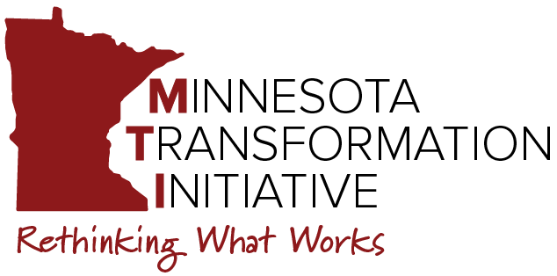
2024-2025 Cohort Technical Assistance
Community of Practice
Reallocating Resources & Scaling Up
February 20, 2025
10:00am-11:00am CT
Notes:
Staci:
Good morning everyone! Welcome to our MTI February community of practice. Today’s focus is reallocation of resources and scaling up your change initiatives. But, before we get into our topic for today, we want to give Sherry the floor for a minute to talk about our MTI initiative related to CESP exam:

Slide 2
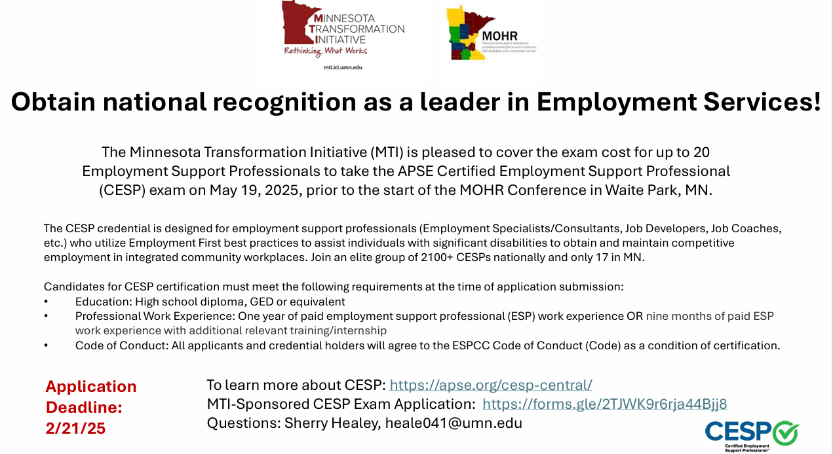
Reminder: Deadline tomorrow!
Notes:
Sherry

Slide 3
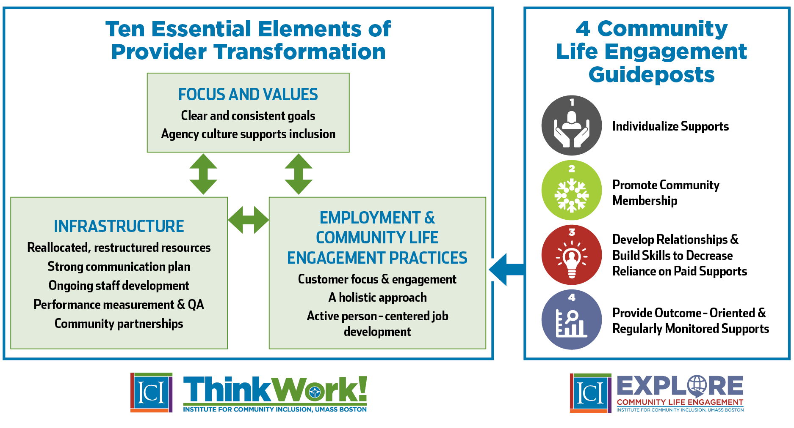

Notes:
Staci
Ok, and here is our starting point again. As a reminder: last month we focused on principles and strategies for how service providers can take a holistic approach when supporting people to reach their employment and community goals. We talked about the fact that there are individual level considerations, meaning: what are the direct support practices and values that your organization needs to have in place….but equally important are the organizational considerations. Don and I talked briefly about the structural changes that organizations need to make in order to ensure that any change initiatives are sustainable. Which directly leads to today’s topic: element #5 reallocated and restructured resources, which falls under the infrastructure heading.

Slide 4
Agency Change
State policy and legislation
Best Practices
Federal policy and legislation
Values
History
Strategic alignment of mission, vision, operations and outcomes.
Notes:
Staci
Engaging in transformation or agency change means alignment of your funding and resources with your updated mission, vision and objectives. Without this alignment, you are most likely not going to create those sustainable changes. Don and I hope to give you some considerations that we hope will lead to discussion during your individualized TA.

Slide 5
What are your organization's resources?
Financial
Human (paid staff & volunteers, board, etc.)
Physical
Intellectual
Partnerships
Data & info
Marketing
Culture
Others?
Yourselves!!! (don't forget...you make it happen)
Notes:
Don

Slide 6
Considering Organizational Structure
Traditional Hierarchical
Updated Holistic
Director
Day Services
Employment Services
Day DSPs
Manager(s)
Internal Case Manager
Admn
Job Coaches
Job Dev
35-40 People in Services
Notes:
Don

Slide 7
Example: Reallocating Staff Resources at Company ABC
Updated Services
20 Day staff
9 Employment staff
Legacy Services
25 Day staff
4 Employment staff
In this example:
Each time 5 new people get jobs, another Day position
is reallocated to Employment
Notes:
Staci
And here is an extremely rudimentary example of the reallocation of staff resources at a made up company…the ABC company. They provide day and employment services and they currently have 25 day staff and 4 employment staff. Their goal is to increase CIE outcomes and cle outcomes. To do that, they know that over time they will need to reallocate HOW they are utilizing their existing staff. As more people get jobs, they will need more employment staff. That staff will be engaging individualized job placement as well as ongoing supports. So, they are projecting that every time 5 new people get jobs, they will reallocate a day position to employment. Now again, this is a simplistic example and there are many other factors and many other ways to reallocate resources, but it’s mean to show you fundamentally how reallocation works. That Day staff bucket for your organization might be facility-based work or facility based day services or another service line that you would like to reduce or eliminate over time.

Slide 8


The Power of the Pilot
What is it?
small-scale,
time limited,
controlled trial
your test phase!
Notes:
Don

Slide 9

Things you can test
Person-centered planning
Individualized employment process
Community-based service delivery
Engagement and exploration leading to self-determination
New staffing patterns
New communication flow
Organizational structure
What else?
Notes:
Don

Slide 10

How do you engage people?
Notes:
Don

Slide 11

Alignment, Reallocation & Scaling it Up!
What other activities may need to stop?
Budgets
Staffing
Training & development
Processes
What happens if you don't scale up?
  Hint: expansion vs reallocation and transformation
Notes:
Staci
We also want to highlight the idea that activities in a pilot or transformation are not meant to be ‘add on’s. Again, you are testing your new way of doing things in the hopes that you will using it to replace the legacy models. So at some point after you’ve done your testing and planning, you’ll need to shift in to the scale up phase. This is where we often see organizations get stuck. The reality is you will need to budget for that scale up, including identifying some bridge funding until you can get yourself there. If you don’t scale up, you risk lack of sustainability and becoming overwhelmed with trying to do it all.

Slide 12

Are we there yet? Managing Fatigue
Communicate clearly & consistently
Balance stretch goals with being realistic
Prioritize pace and sequencing
Offer support & training
Celebrate successes (small & large)
Promote work-life balance
Lead by example
Notes:
Staci

Slide 13



Foundational practices:
Established desired outcomes (example: increase CIE outcomes)
Establish leadership commitment to goals
Assessment of resources and identify opportunities for alignment
Establish small-scale pilot
Reviewing job duties/expectation
Second & third-generation practices:
Begin strategic scale up based on testing
Identify bridge or additional funding sources
Report our successes
Implement systems to collect/analyze data/outcomes and refine accordingly
Using staff differently & shifting organization
Sustainability practices:
Shift from pilot scale up to standard operations
Restructured organization
Embed ongoing resource allocation and resource alignment into budget/strategic planning
Establish a culture of continuous learning
Notes:
Don (try to finish by 25 minutes after)

Slide 14

Let’s hear from you...
How are you planning to use existing resources differently through reallocation and/or restructuring in order to increase competitive integrated employment and/or community life engagement?
  What resources and how?
Notes:
Staci

Slide 15
Wrap-up & Announcements
Next CoP: March 20
  Topic area: Business and Community Engagement

