Slide 1



David Hoff
Institute for Community Inclusion
University of Massachusetts, Boston
Past President
National APSE

Slide 2




David Hoff
617-287-4308
david.hoff@umb.edu
www.communityinclusion.org
Twitter @DavidHoff10

Slide 3

Readiness for Employment:
What does it mean?

Slide 4

The
8 Myths
of
Readiness for Employment

Slide 5


Employment Readiness
Myth # 1
Let’s see
what your employment future holds
We can predict who will succeed or fail in employment.
Let’s see what your employment future is.

Slide 6

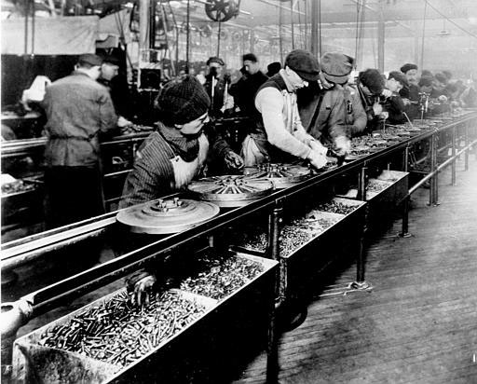
Employment Readiness
Myth # 2
Rate of production is a primary factor in determining employment readiness
Rate of production is only one of many factors in determining whether someone is a “good employee” – and in many cases is not even a consideration

Slide 7


Employment Readiness
Myth # 3
You need to know how to conduct a job search to be ready for employment

Slide 8

Employment Readiness
Myth # 4
Every employer
has the same employment standards and same methods for hiring

Slide 9


The Reality of the Employment World

Slide 10



Employment Readiness
Myth # 5
Employer standards
are inflexible

Slide 11


Employment Readiness
Myth # 6
Employers are expecting perfect employees

Slide 12
Have you ever worked with anyone who…
Couldn’t get along with others?
Acted inappropriately?
Had behavioral outbursts?
Was chronically late?
Complained about everything?
Didn’t communicate well?
Didn't work very fast?
Got distracted easily?
Didn’t take directions well…or at all?

Slide 13
Have you ever worked with anyone who…
Acted impulsively without thinking?
Refused to take public transportation?
Had a messy office?
Wasn’t organized?
Wasn’t always professional?
Was rude?
Couldn’t take criticism?
Was lazy?
Wasn’t very good at their job – but managed to still keep it?

Slide 14
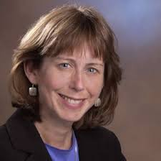
“Most of life is
showing up."
- Regina Brett

Slide 15

“Anyone in charge of an organization with more than two people is running a clinic.”
CEO of Major Corporation

Slide 16
Performance in simulated work environments for people with disabilities is a predictor of employment readiness and success
Employment Readiness
Myth # 7

Slide 17

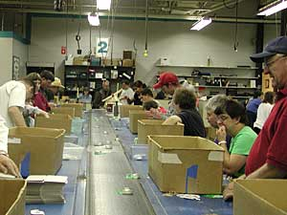
Employment Readiness
Myth # 8
Facility-based programs prepare people for employment
In fact research shows the opposite is true

Slide 18
Readiness for Employment Means:
Motivated to work
People understanding themselves: strengths, skills, interests
People understanding their support needs
Availability of supports
THE CHALLENGE:
Actual work experience has a large impact on these factors

Slide 19

ENOUGH
WITH THE
ENDLESS PLANNING
FOR EMPLOYMENT!!

Slide 20

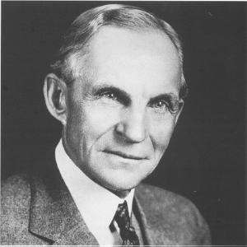
“If I had asked people what they wanted, they would have said
a faster horse.”
- Henry Ford

Slide 21
Remember
The first job isn’t the last job
Even early work experiences should be based on a good job fit/match – but in the early stages these factors may be pretty basic

Slide 22

Individuals vary where they fall on this scale
Individuals may shift where they fall over time depending on: age, work experience, education, financial need, personal circumstances
Job Reflects Who You Are
Good match between individual skills, interests, personality & employer needs
Job is Who
You Are
Job is integral part of identify.
Self-actualization.
Job is a Paycheck
Meet employer need and be compensated

Slide 23

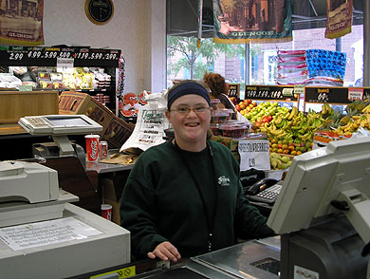
It is not acceptable that individuals with disabilities leave school with no real work experience

Slide 24


Question:
How much time should be spent on “soft skills” training?

Slide 25


"Never mistake activity for achievement."
John Wooden
Notes:
Job development is not filling out applications and internet job searches

Slide 26


Employment Readiness and
Employment First
In an Employment First environment, everyone is presumed ready for employment
But are there people of working age who aren’t ready for employment?
Are there people who will never be ready?

Slide 27

Systems and service providers should not be in the business of deciding who is “ready” for employment

Slide 28

The Role of Systems and Service Providers in Readiness for Employment
Motivate the individual
Facilitate individual planning
Provide assistance in terms of supports
Facilitate employer linkages and negotiate with business
Do everything possible to ensure a good employee-employer match

Slide 29





Filling the Gap
Skill
and Qualification Gap
Good job matching
Accommodations
Assistive technology
Quality job coaching
Short-term job tryouts/internships
Increasing job skills of job seeker through education
Job creation
Job carving
Business within a business
Others
Employer Needs
Job seeker skills & abilities

Slide 30
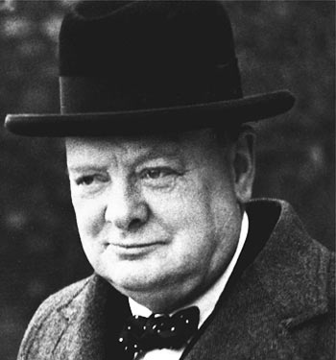
“Success consists of going from failure to failure
without loss of enthusiasm.”
Winston Churchill

Slide 31

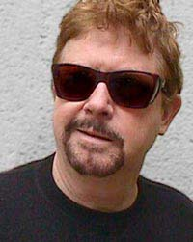
“Humanity has advanced,
when it has advanced,
not because it has been sober, responsible, and cautious,
but because it has been playful, rebellious, and immature.”
- Tom Robbins

Slide 32

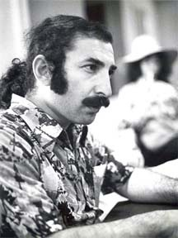
“And if that doesn’t work, what do you do next?
… and next?
… and next?”
- Marc Gold

Slide 33

Thanks for Attending!

