Slide 1

Intro slide and E1stMO logo

Slide 2
Using Technology to Provide Job Supports Remotely
David Hoff, Project Manager
Employment First Missouri

Slide 3
Getting Clear on Terminology
Assistive technology: Any item, piece of equipment, software program, or product system that is used to increase, maintain, or improve the functional capabilities of persons with disabilities.
  Self-management technology: technology that enables individuals to manage tasks on their own (e.g., apps).
Virtual service delivery: Services provided via internet/computer.
  Can be live or self-paced.
Remote supports: technology that allows staff to provide real-time supports from a different location from where the individual is located.

Slide 4

Time for a Poll
Are you currently using remote supports for individuals?

Slide 5
On-site job coaching is the least best answer.

Slide 6

Alternatives to
On-Site Job Coaching
Self-management techniques
Accommodations
Assistive technology, including
self-management technology/apps
Natural supports
Remote job coaching

Slide 7
Determining the need for staff supports
Question # 1: Does the individual require staff support on the job?
If the answer is YES…
Question # 2: Does the support need to be in-person, or is remote support an option?

Slide 8

Why remote job supports?
Does not require staff on-site
Less obtrusive
Encourages greater use of natural supports
More efficient use of resources
  Doesn’t require travel to job sites
Wider availability of job coaching
Can provide job coaching over long distances

Slide 9

of Remote Job Supports
Inability to observe all variables and nuances of workplace
Challenges in facilitating natural supports
Limits ability by job coach to build relationship with business
Limits ability to to build relationship with individual
Failure of technology
Other

Slide 10
Not an
“All or Nothing” Concept
Remote supports can be used in combination with in-person supports

Slide 11

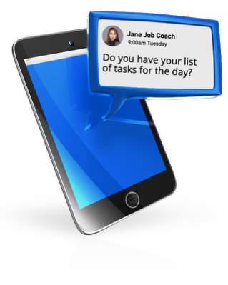
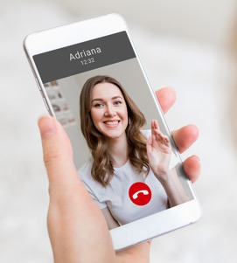


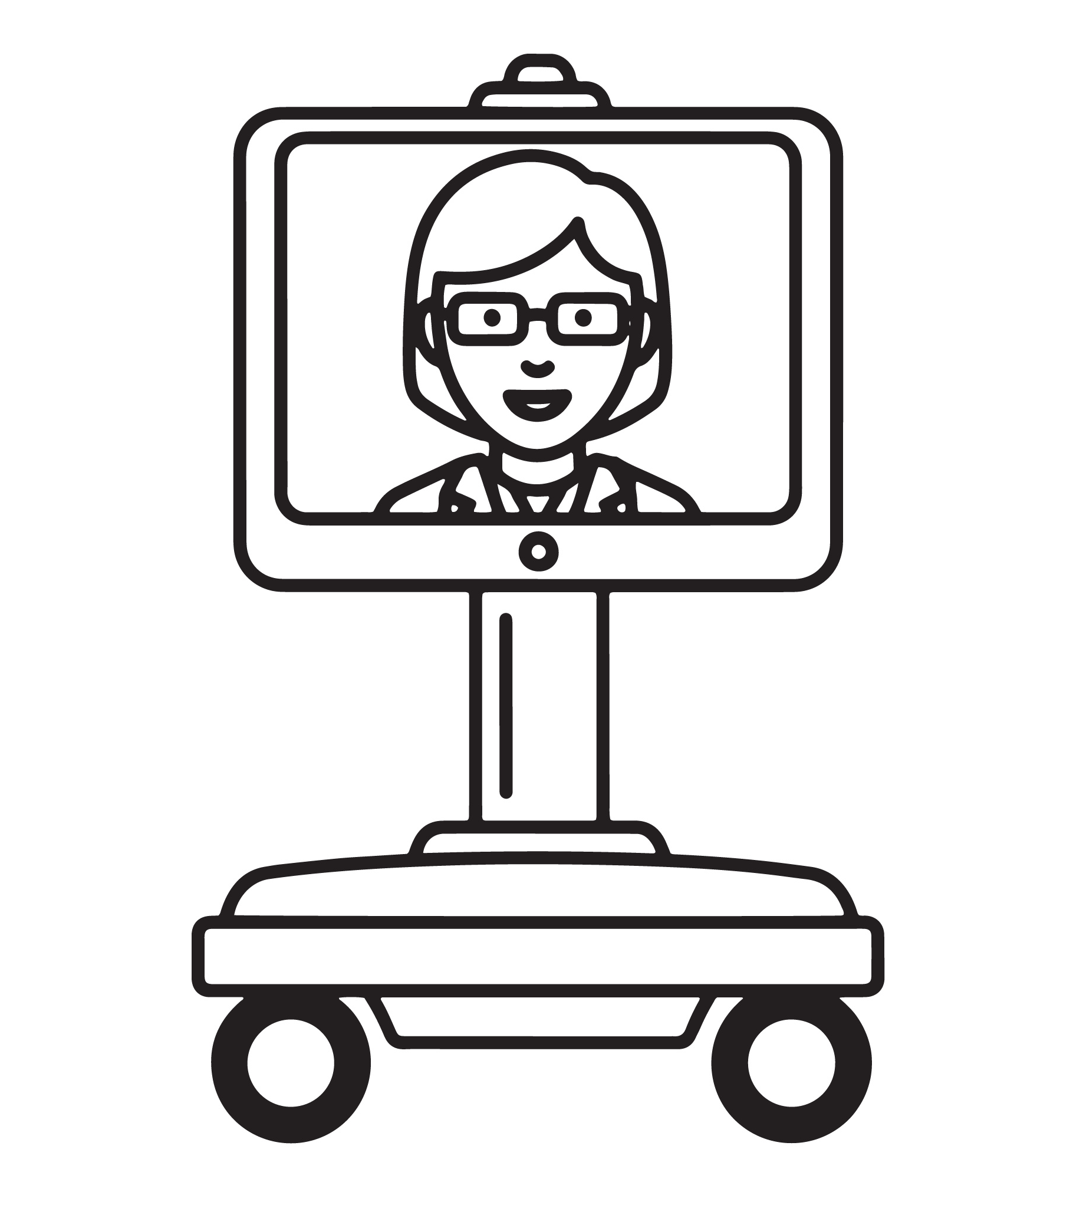
Methods for providing remote supports
Phone (voice)
Text
Video call (Facetime, Skype)
Email
Video meeting (Zoom, etc.)
Tele-presence robots

Slide 12
Remote Supports
Getting beyond check-ins

Slide 13
What can remote support be used for?
Check-in
Video observation
Instruction
Questions initiated by individual
Need for support/crisis intervention
Other

Slide 14

Let’s Discuss
What factors should be considered in provision of remote job supports?

Slide 15

Starting Point:
Individual’s choice and preferences
Comfort level with remote supports
Skills and capacity in using technology

Slide 16

Remote Supports: A Step-by-Step Process
What types of support does individual need?
What are skills, abilities, preferences of individual regarding remote supports?
Identify technology options.
If remote job coaching makes sense: discuss with individual and employer.
Get permission of guardian, if required.
Develop plan for remote supports: when, how.
Work with employer and individual on details for implementation, including training.
Pilot test.
Develop check-in schedule with individual.
Set parameters regarding individual contacting job coach as needed.
Implement.
After implementation, evaluate and make modifications as necessary.

Slide 17

Considerations in remote job supports
Consider mix of methods (video calls, video observation, text, email, etc.).
Consider mix of in-person and remote supports.
Have remote job supports as an option in all support plans.
Standard job coaching/job support best practices apply.

Slide 18

Choosing Technology
Availability of technology for both staff and individual
Features of technology for service delivery
Skill and capacity of staff and individual in using technology
Cost of technology
Security of technology
Accessibility of technology specific to accessibility needs of users

Slide 19
Guidelines on Remote Supports
Need full consent of the individual and/or guardian to participate.
Individuals will use their own equipment or equipment provided by the provider.
Individual has full control of the device and can turn it off or end services anytime they wish.
Providers have to use HIPAA compliant platforms.
Any video/web cameras should not record audio or video feed of the individual.
There must always be an option for in-person services for those who require it or choose it.
Providers must develop and maintain policies on virtual delivery of services and train staff on those policies.
Can’ t be used for the providers convenience and cannot restrict, prohibit, or limit access to the community.
Must be used to support an individual in achieving goals and outcomes identified in their Person-Centered Service Plan.
Need to have a back-up plan if technology fails.

Slide 20

Agency Policies for Remote Supports
Planning process and documentation
Technology platforms to be used
Security and maintaining confidentiality
Parameters for remote job coaching – when it can/can’t be used
Abiding by funding agency policies for remote supports
Working with individuals and businesses on remote support – permission and making arrangements
Requirements for notification of case managers, guardians, families
Technology back-up plans
Staff training requirements

Slide 21
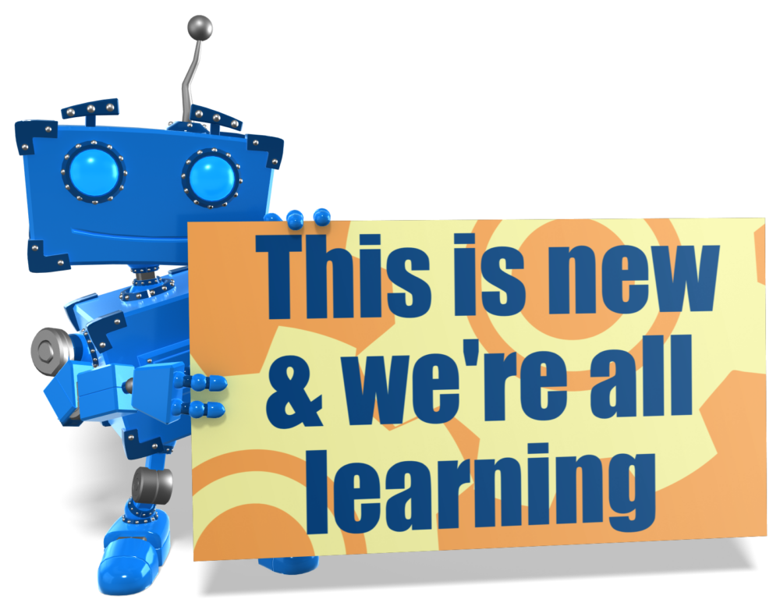
This is new & we’re all learning

Slide 22
Handout
Using Technology to Job Coach Remotely

Slide 23

Employment First Missouri
Contact Information
DAVID HOFF, Project Director – David.Hoff@umb.edu
NICK HOLZ, Training Associate - Nicholas.Holz@umb.edu
Albany, Kansas City, Springfield, Joplin regions
JESSI KEENOY, Training Associate - Jessica.Keenoy@umb.edu
Hannibal, Kirksville, Rolla, Central Missouri regions
LESLIE QUARLES, Training Associate – Leslie.Quarles@umb.edu
St. Louis Regional, Sikeston, Poplar Bluff regions

