Slide 1

Community Life Engagement (CLE)
Setting A Vision for Day Support Services in Minnesota and an Introduction to the CLE Guideposts
September 22, 2023
Notes:
Amy

Slide 2
Today's Agenda
About MTI
DHS' Vision for Day Support Services
What is Community Life Engagement?
  The guideposts
  Values of quality day services
Highlight guidepost #1
Group polls
Discussion and sharing
MTI Landing Page: https://mti.ici.umn.edu/
• About the project
• Recorded trainings
• Resources
Notes:
Amy

Slide 3





Notes:
Amy
This is the project, here's where we fit in...

Slide 4

DHS' Vision for Day Support Services in Minnesota
"DHS is in the process of developing a vision statement for Minnesota’s HCBS providers so they understand how Day Support Services create meaningful Community Life Engagement (CLE) outcomes which support MTI’s technical assistance work. We will share this statement with MTI when it is ready, but generally support the four Community Life Engagement Toolkit Guideposts as components of high-quality supports for CLE."
These guideposts that CLE supports:
are person-centered,
promote community membership and participation,
facilitate skill building and relationships,
are outcome-oriented.
Notes:
Amy

Slide 5
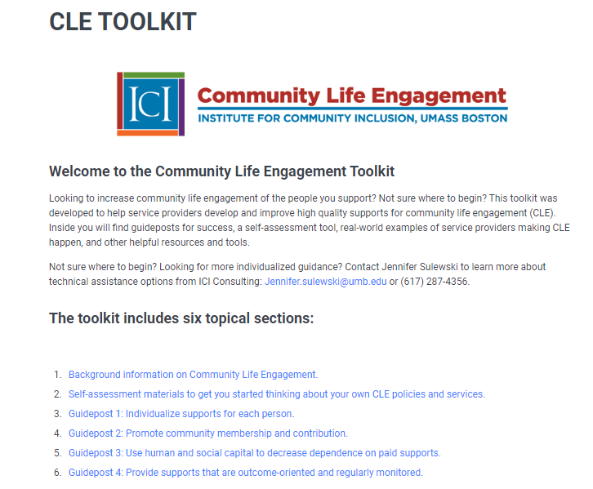
Community Life Engagement (CLE) Toolkit and Resources
Resources:
About CLE
About the research
About the Guideposts
Case studies
Self-assessment tool
Fidelity Scale
guideposts_assessment.pdf(communityinclusion.org)
https://cletoolkit.communityinclusion.org
Notes:
Amy
We have a whole toolkit focused on CLE at ICI. Here's where you can find it and what's in there...

Slide 6

What is Community Life Engagement (CLE)?
All the ways that people access and participate in their communities, outside of employment, as part of a meaningful day.
Non-work
Accessing typical community facilities (library, gym, rec center, etc.)
Volunteerism
Post-secondary &/or continuing education
Wrap-around to work
Pathway to work
Retirement activities
This Photo by Unknown author is licensed under CC BY-NC.
Notes:
Brian

Slide 7
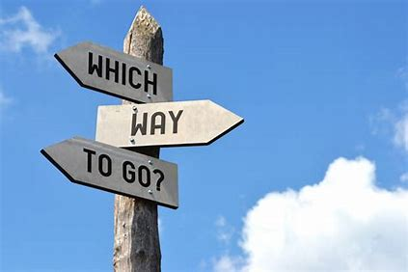
The 4 Guideposts of CLE
~Came from case studies and expert interviews
~Became a set of key principles (guideposts) providers can use to move their CLE efforts forward
Guidepost 1: Individualized supports for each person
Guidepost 2: Promote community membership and contribution
Guidepost 3: Facilitate relationships and skill building to decrease dependence on paid supports
Guidepost 4: Ensure supports are outcome-oriented and regularly monitored
Notes:
Brian

Slide 8

CLE Guidepost #1:
Individualized Supports for Each Person
Starts with understanding personal preferences, goals, interests and skills
Emphasizes person-centered planning and discovery, and
Requires creating staffing, intentional grouping, and at times additional funding (not always 1:1 support)
Notes:
Brian
Questions for the group:
What are your current practices to understand individual's preferences, interests, and skills?
Are individuals setting their goal for DSS, or is it a member of their team?
What is your staffing model for DSS? Do you deliver this service in a group setting, 1:1, or both?

Slide 9
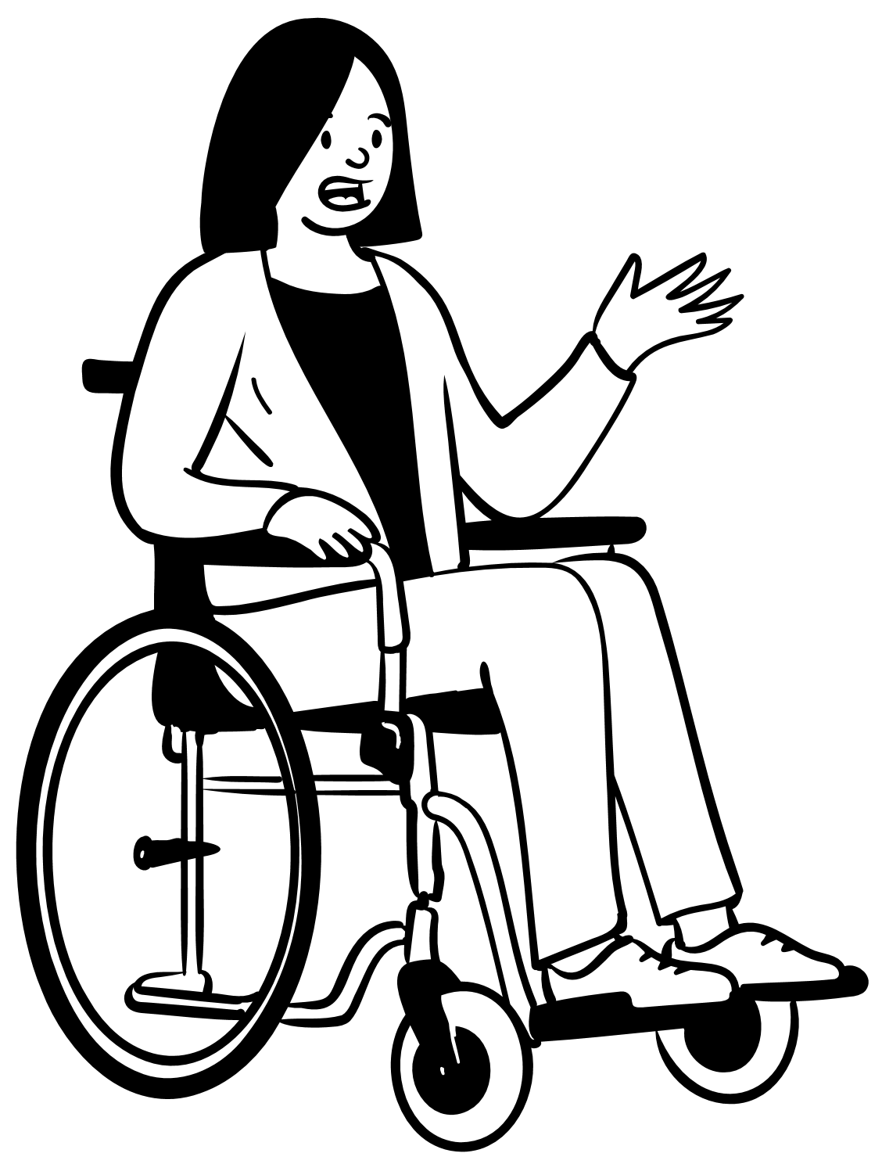
Provider Strategies Guidepost #1
Get to know people differently
  Supporting people to explore and continually get new experiences in typical community settings
  Help identify who the person is
  Identify who is important in the person's life (is it mostly paid staff and people with disabilities?)
  Identify skills/abilities
  Identify interests, likes/dislikes
  Fold the information we learn back into service delivery
Notes:
Brian
Knowing your community is crucial to providing quality DSS. Questions for the group:
What are some places in the community that you can deliver DSS?
What are some places in the community individuals have suggested?
What are some community activities individuals have expressed interest in?

Slide 10
Quality Day Services that Support CLE Outcomes
What they are not:
A substitute for paid employment
A prerequisite for employment
Activities just to fill time
Activities that individuals are “plugged” into
Random activities just to keep people busy
Simply fun, recreational activities
Notes:
Brian
Don't worry if some or all of these are in place now at your organization....there are ways to shift this

Slide 11
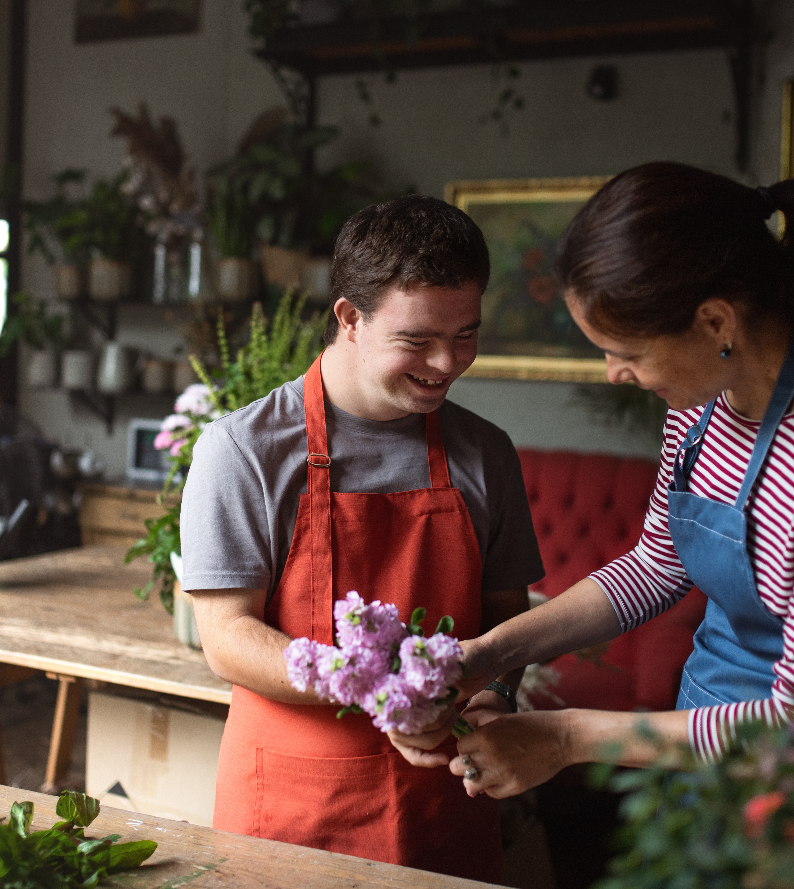
Values and Practices of Quality Day Services
A belief that people with IDD can fully participate in typical valued social roles, side-by-side with their fellow citizens without disabilities, including competitive integrated employment
Using generic, typical resources available to all
Occur in typical community settings, in small groups (no more than 3-4)
View staff role as facilitators of inclusion
Avoiding activities that reinforce stereotypes and stigma
Avoiding activities that unnecessarily segregate
Supports the development of self-advocacy skills
Support a path to employment (Employment First values)
Notes:
Brian

Slide 12
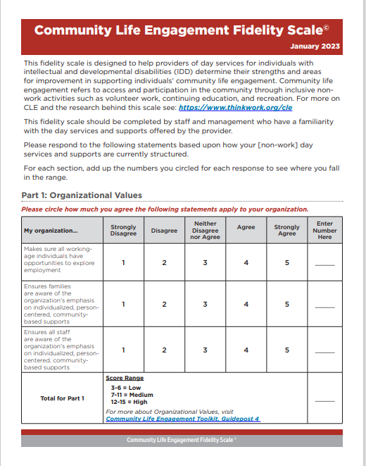
Community Life Engagement
Fidelity Scale
Use as a self- assessment tool
Completed by staff and management
Answer based on how your day services are currently structured
guideposts_assessment.pdf (communityinclusion.org)
Notes:
Amy
Thank you, Brian. In just a minute we’re going to do 2 quick poll questions, just to get a sense of where you all are on a few areas that Brian just mentioned. The 2 poll questions that come directly from the Community Life Engagement Fidelity scale. Again, the link to the fidelity scale is in the PPT Kathy can email to you. On the right you see a screenshot of what it looks like. It is an 18 question survey that is designed to be used as a self-assessment tool for non-work service providers so that you can determine your strengths and potential areas for improvement in supporting people in community life engagement. We would encourage all of you to take some time and complete the survey for your organization. The tool includes instructions on how to score and how to read your results, as well as where to get more information related to each section.

Slide 13
Group Poll #1
Does your organization provide training to staff in person-centered planning/thinking values and strategies?
    Strongly Disagree
    Disagree
    Neither Disagree nor Agree
    Agree
    Strongly Agree
*poll questions are taken from fidelity scale
Notes:
Amy

Slide 14
Group Poll #2
Does your organization offer training to individuals on self-advocacy and self-determination skills?
    Strongly Disagree
    Disagree
    Neither Disagree nor Agree
    Agree
    Strongly Agee
*poll questions are taken from fidelity scale
Notes:
Amy

Slide 15

Small Group Discussion:
What tools/strategies do you currently use to get to know people you support?
What are your greatest challenges related to providing individualized supports to people?
15 minutes
Recorder take notes for group
Report out highlights
Notes:
Amy (15 minutes) then debrief

