Slide 1

Institute for Community Inclusion
Notes:
On behalf of the Institute for Community Inclusion at UMass Boston we want to welcome you to this training. The ICI is an organization providing research, training and technical assistance on promoting full inclusion for people with disabilities.

Slide 2

IT’s Employment
PRESENTER:
  David Hoff
  Institute for Community Inclusion, UMass Boston
Notes:
This IT’S EMPLOYMENT training is being provided through a grant from the Unites States Office of Education, Rehabilitation Services Administration. It is my privilege to be your trainer for today, My name is Russ Thelin and I am coming to you from the Salt Lake City area where prior to my work with UMass Boston and the ICI I worked for 25 years within the Utah State Office of Rehabilitation, starting as a VRC and concluding my time there as the combined agency’s Executive Director.

Slide 3

Welcome
to Part 5 of
Successful Transition from School To Employment for Youth with
Intellectual Disabilities
Technology and Students with Intellectual Disabilities
Notes:
This is part four of a 5-part state learning collaborative training tailored to identified needs of the Colorado Division of Vocational Rehabilitation. Our focus today will be on approaches and models for creating pathways to employment for successful transition from school to employment for youth (and adults) with intellectual disabilities.

Slide 4
SESSION AGENDA
Technology and Students with Intellectual Disabilities
1. Assistive Technology: What are we talking about?
2. AT and Individuals with ID
3. Technology & Employment
4. Technology Framework
6. Integrating Technology in Transition
7. Building AT Competency
8. Ongoing Issues & Challenges

Slide 5
SESSION OBJECTIVES
Technology and Students with Intellectual Disabilities
1. Understand critical role of AT for youth
& adults with ID.
2. Understand use of AT for employment
success.
3. Strategies for incorporating AT into
transition, and role of VR in that process.

Slide 6

Community of Practice
Series of 6 one-hour community of practice sessions, starting in July, ever week.
CoP is intended as facilitated discussion to follow up on the topics of the 5 training sessions.
Possible topics? Questions? Input on format?

Slide 7
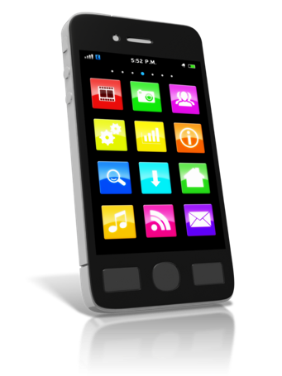






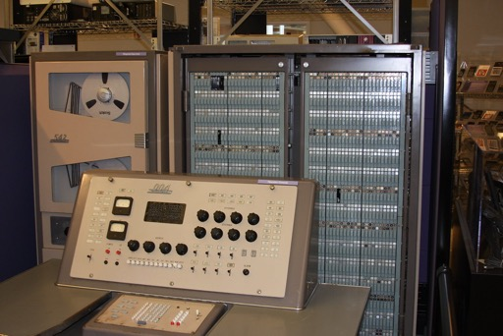



Transformation of Technology Over the Decades
This Photo by Unknown Author is licensed under CC BY
This Photo by Unknown Author is licensed under CC BY-SA
7

Slide 8
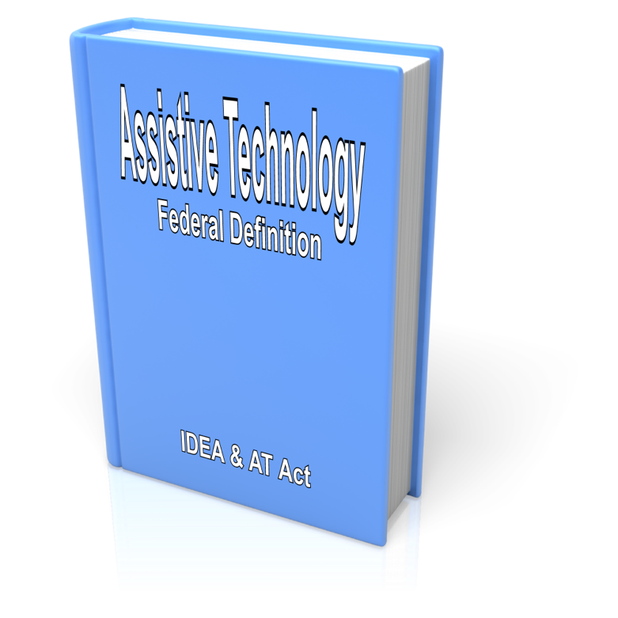
Assistive Technology Federal Definitions
IDEA and AT Act
Any item, piece of equipment, or product system,
whether acquired commercially off the shelf, modified, or customized,
that is used to increase, maintain, or improve functional capabilities of a person with a disability.

Slide 9

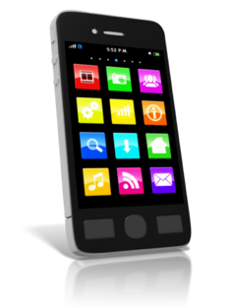
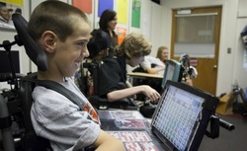
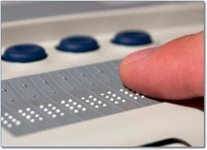
AT: What Are We Talking About?
High tech and low-tech
Readily available & disability specific
Readily available hardware
(computers, tablets, smartphones)
    Built-in accessibility and adaptations
Apps
    Pre-installed on device
    Added (general & disability specific)
Disability specific devices
This Photo by Unknown Author is licensed under CC BY-NC-ND
This Photo by Unknown Author is licensed under CC BY-SA

Slide 10
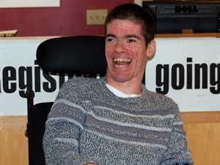
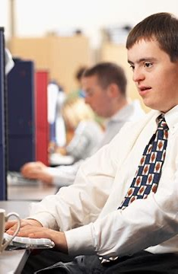
The Importance of Assistive Technology for People with Intellectual Disabilities

Slide 11
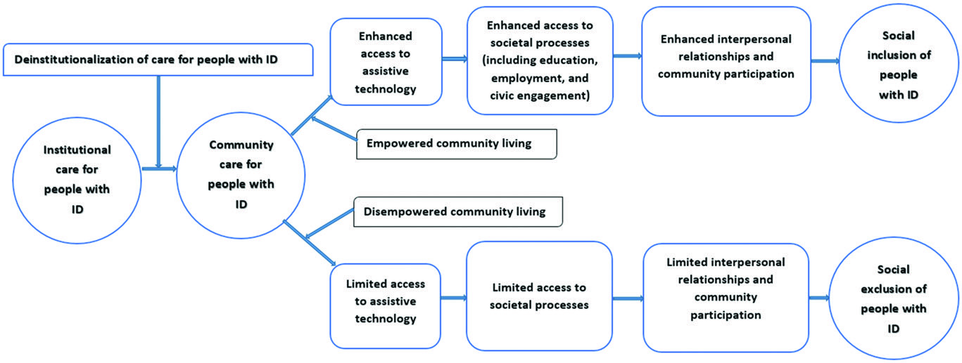
AT as Catalyst of Social Inclusion
From: Leaving No-One Behind: Using Assistive Technology to Enhance Community Living for People with Intellectual Disability, Owuor, Larkan & MacLachlan, 2017

Slide 12
From: Leaving No-One Behind: Using Assistive Technology to Enhance Community Living for People with Intellectual Disability, Owuor, Larkan & MacLachlan, 2017
“AT is a mediator for people with intellectual disabilities
to attain not just their rights
but also the highest possible
quality of life and
sense of participation and
belonging in society.”

Slide 13

Coleman Institute for Cognitive Disabilities
University of Colorado
“Technology and information access today is no longer a luxury.
It is essential for
people with cognitive disabilities to have the same access as their peers without such disabilities in order to fully participate in the worlds of today and tomorrow.”
13

Slide 14
Declaration of the Rights of People with Cognitive Disabilities to Technology and Information Access
https://www.colemaninstitute.org/category/public-policy/technology-and-information-access/

Slide 15

From: Leaving No-One Behind: Using Assistive Technology to Enhance Community Living for People with Intellectual Disability, Owuor, Larkan & MacLachlan, 2017
“There is considerable room for improvement in the area of employment outcomes for individuals with ID, and, perhaps, one way to improve these outcomes may simply be found in the palm of our hand.”

Slide 16

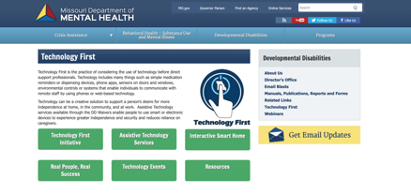
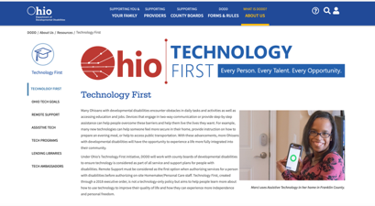
Employment First Meets Technology First
Employment First

Slide 17

Technology First: What It Means
Technology considered as source of support for all individuals.
Technology preferred over staff interventions.
Informed choice and
self-determination as drivers.
Ability to become competent in technology is presumed.
Development of competency in technology begins early and is ongoing.
Consideration of technology is incorporated within all components of services/supports

Slide 18

Damianidou, Arthur-Kelly, Lyons, & Wehmeyer, 2019
Use of technology
enables, enhances or extends
the functional capabilities of people with IDD, potentially resulting in more positive employment-related outcomes

Slide 19
The Employment Process
Person-Centered Planning
Assessment, Exploration & Discovery
Job Development &
Job Design
Initial
Job Support
Follow-Up Supports
The Employment Process

Slide 20
Exercise
Consider how technology can be used to assist and support an individual with an intellectual disability during each step of the employment process and within transition overall. In your group develop a list of examples.

Slide 21

BREAK

Slide 22
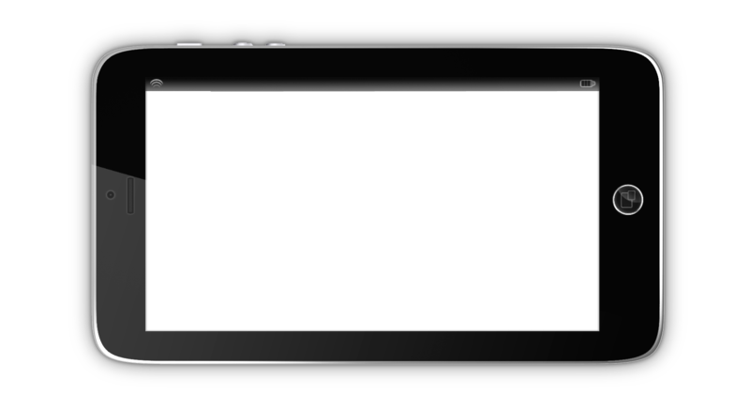
Using Technology for Remote Support,
Self-Management, and Success in Employment

Slide 23

Technology Supports for Employment
Wayfinding/
Transportation
Communication
Task Instructions
Reminders
Self-Care
Checklists
Scheduling & Time Management
Task Training Through Video Modeling
Social Interactions & Behavior Management
Remote Staff Support

Slide 24

For individuals with ID, use of portable electronic assistive technology results in:
increased independence and correct responding to work-related tasks
reduction in the level of external prompting required for participants to successfully complete tasks
From: Portable Electronic Assistive Technology to Improve Vocational Task Completion in Young Adults with an Intellectual Disability: A Review of the Literature, Collins & Collet-Klingenbert, 2016

Slide 25

Using Video

Slide 26

Video Modeling
Basic Video Modeling:
Employee reviews video examples before engaging in tasks.
Simultaneous Video Modeling:
Video of task being performed is played one time from beginning to end; individual follows along to complete tasks.
Continuous Video Modeling:
Video is played on a loop.
Video Prompting or Cueing:
While performing task, individual watches short video segments of each step needed to complete task. After performing each step, moves on to next video clip.

Slide 27

Portable electronic assistive technology to improve vocational task completion in young adults with an intellectual disability: A review of the literature, Collins & Collet-Klingenberg, 2017
Use of technology able to provide timely instruction on how to complete tasks serves two very important purposes for individuals with ID:
Reduces on-site supports provided by a job coach because prerecorded video sequences provide actionable steps that individual can follow to get the job done.
By virtue of having less in-person supports provided by a coach, technology facilitates independence and improved social experiences with peers at work.
Video
Checklist

Slide 28

Other Uses of Video
Error Correction Video Feedback: When individual makes error, they review video of task being performed correctly.
Video Feedback: Individual is videotaped as they engage in tasks, then evaluates their performance.
Video Stories: Filming an individual telling a story about their routines at work or in the community, which they regularly view.

Slide 29
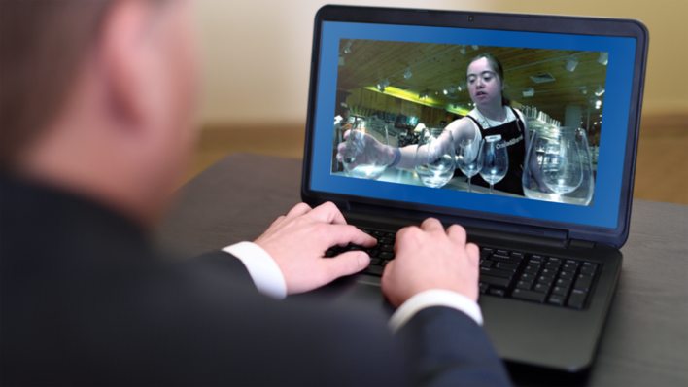
The Emerging Role of Remote Job Supports
Less obtrusive
More efficient use of resources
Wider availability of job coaching
Does not require staff on-site

Slide 30

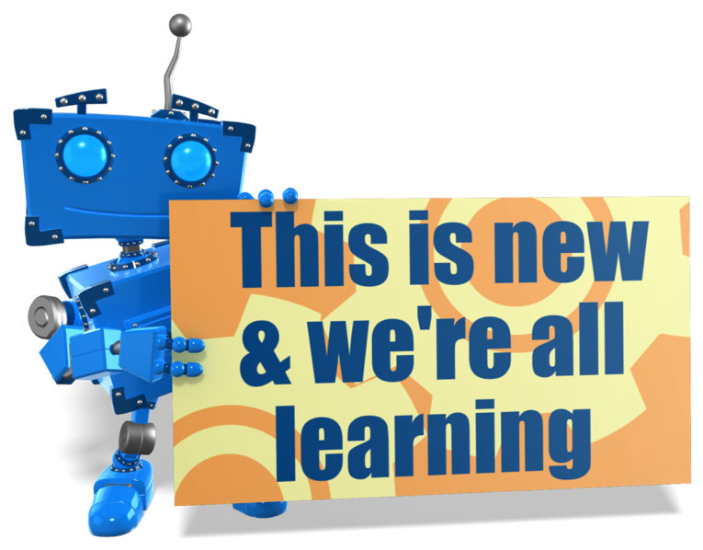
Using technology for supports can be a game changer

Slide 31

Steve Jobs
“I don’t focus on the technology.
I focus on what’s in it for the customer.
I want to give the customer an incredible experience.”
This Photo by Unknown Author is licensed under CC BY-NC
Notes:
Need to know you are part of bigger historic movement.
What you do preserves and strengthens everyone's rights.

Slide 32
Technology Framework
Technology Framework
Individual
Environment
Implement
&
Evaluate
Gap & Barrier Analysis
Narrow the Gap
Notes:
Based on SET

Slide 33
Individual
Challenging tasks
Strengths
Compensatory strategies
Self-maintenance strategies
Learning preference or style
Progressive or stable nature
Natural motivators
Access & experience with tech
Technical skill level
Technology preferences
Current supports available
Accessibility needs
Individual
Feel free to share examples of these factors.

Slide 34
Environment
In what environment is the barrier occurring?
Resources available to everyone in the environment
Policies & attitudes related to technology
Required tasks
Safety, security, or environmental concerns that may impact the use of tech
Available supports
Environmental infrastructure
Environment
Feel free to share examples of these factors in the chat.

Slide 35
Gap & Barrier Analysis
Gap & Barrier Analysis
Task or tasks that are not being completed to expectations
Environmental barrier
Individual barrier or skill gap
Interaction between environment and individual barrier
What strategies have been tried in this environment and how effective have they been?
Feel free to share examples of these factors.

Slide 36
Narrow the Gap
Narrow the Gap
Necessary skills & training needs
Costs associated with tech
Could the tech be distracting or isolating?
Safety or security concerns
Supports available to assist
Is the tech adaptable?
Who will own the technology?
How will the tech be transported?
Availability of a demo or trial
Accessibility features
Is tech associated with a request for an accommodation?
Age appropriateness
Feel free to share examples of these factors.

Slide 37
Implement & Evaluate
Implement & Evaluate
Follow up considerations:
Is the tech working?
Person is able to access & operate tech
Technology works in the environment
Are task expectations being met?
Is the tech creating distractions or barriers?
Feedback from the individual, employer, & supports
Necessary environmental changes
Further training or supervision needs
Unintended impacts
Consider task analysis to assess data
Feel free to share examples of these factors.

Slide 38


At the end of transition, every student should understand:
AT as a concept
Their specific employment-related needs that can be addressed through AT
How to identify, select, and obtain AT for employment
How to use specific AT to support employment success
Their right to AT in terms of employment
How to advocate for AT in employment
Their AT support needs and available resources

Slide 39
Exercise
In your breakout group, discuss:
Strategies for meeting these goals within the transition process
The role of VR in supporting the student to meet these goals
Partners who can assist

Slide 40
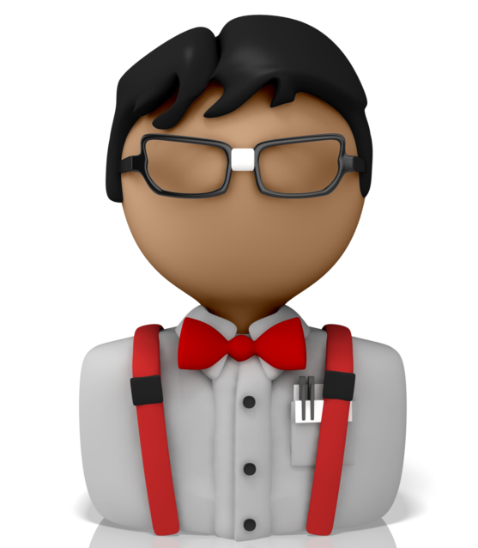

Tech Expert
But know where to find me!
40

Slide 41
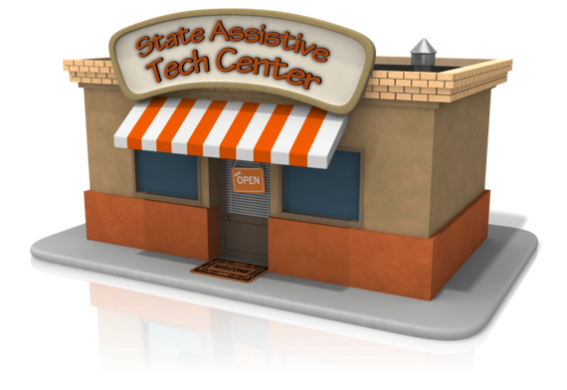
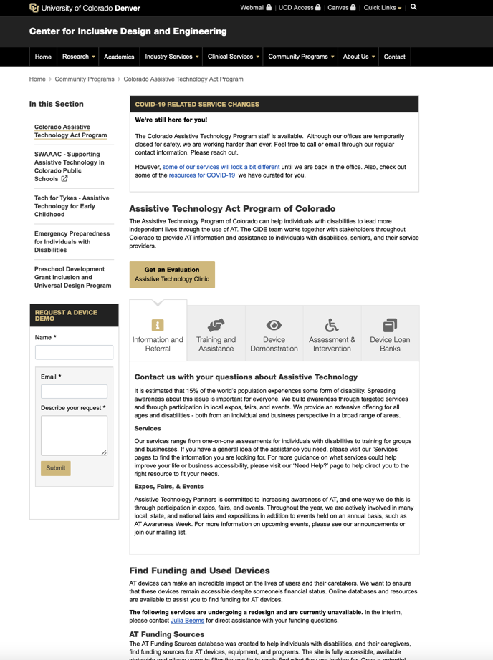
State Assistive Technology Center

Slide 42
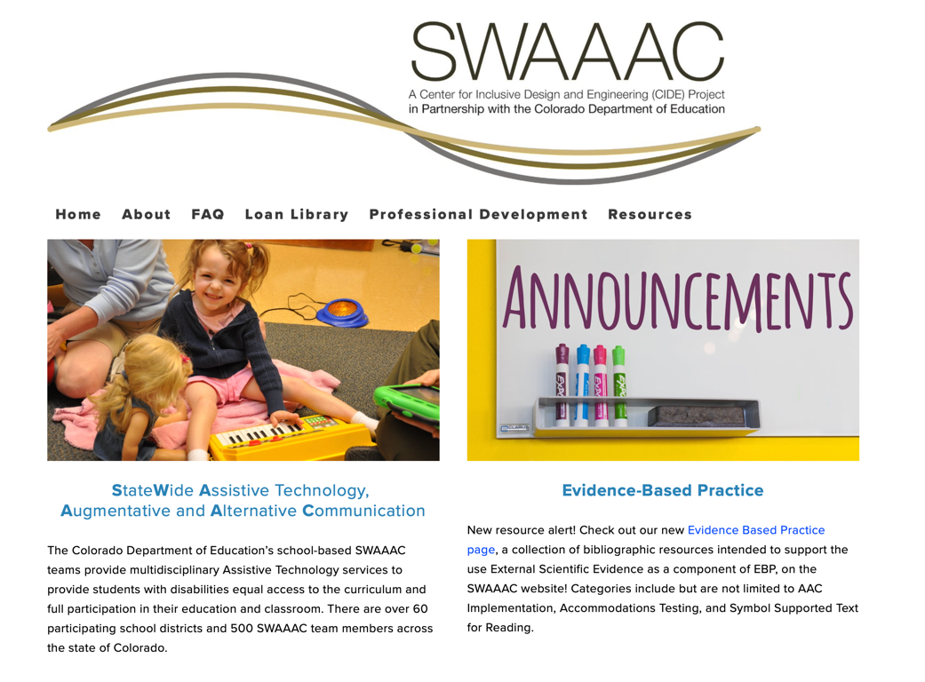
http://www.swaaac.org

Slide 43
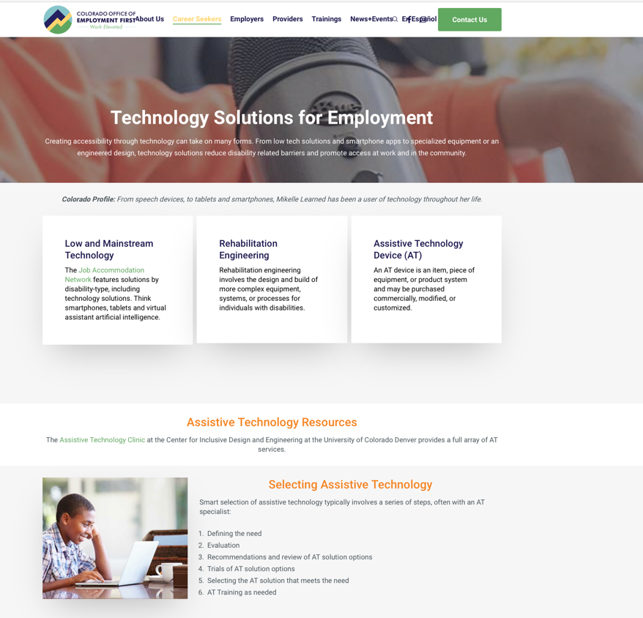
https://employmentfirstcolorado.org/ready-for-work-technology

Slide 44


National Resources
https://askjan.org
www.at3center.net
Feel free to share additional technology resources

Slide 45

Building AT Competency
VR staff
School staff
Service providers
Youth
Families
Others

Slide 46
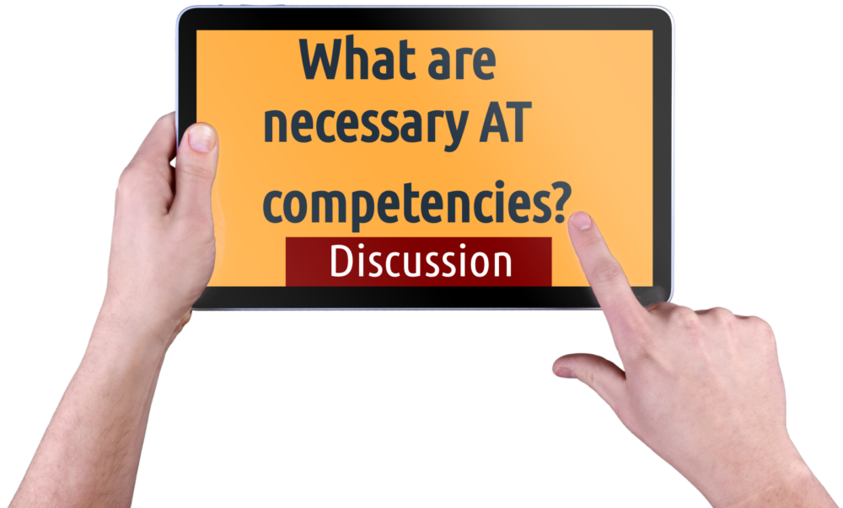
Discussion

Slide 47


Questions and Challenges
Ongoing AT Support
Lack of Awareness of Options
Employer Support
Ownership
Funding
System Policies
Training
Technology Ever Evolving
47

Slide 48

Mizuta Masahide
(17th century Japanese poet and samurai)
“My barn having burned down,
I can now see the moon.”

Slide 49
ICI Publications https://covid19.communityinclusion.org

Slide 50
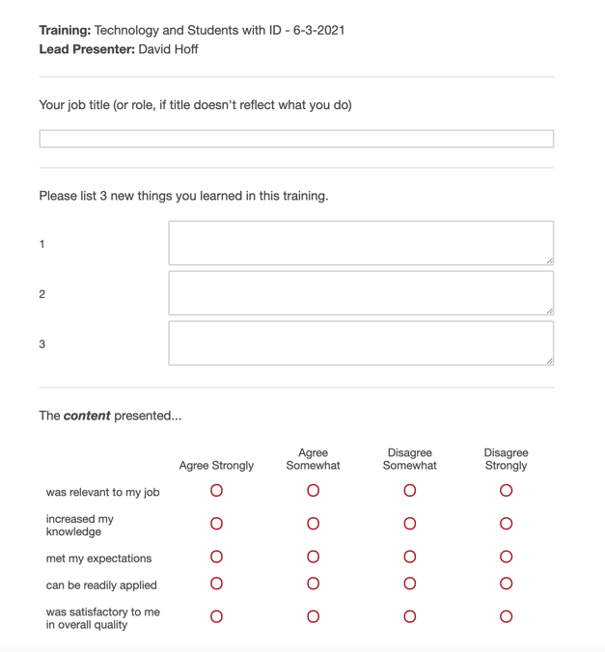
Evaluation
https://umassboston.co1.qualtrics.com/jfe/form/SV_3mJt0XEM2kPHIHk

Slide 51

Thank You
THANK YOU FOR WHAT YOU DO!
QUESTIONS OR COMMENTS?
David Hoff: david.hoff@umb.edu
Russ Thelin: russell.thelin@umb.edu
Mary DiBiase: mary.dibiase@umb.edu

