Slide 1
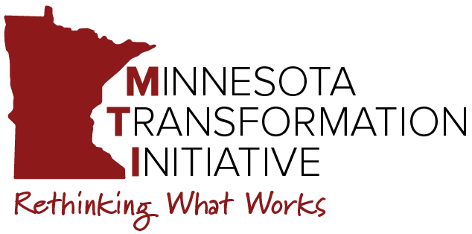
Udac's
Blueprint for Transformational Change
A Technical Assistance 2.0 Progress Report
Where are we?

Slide 2
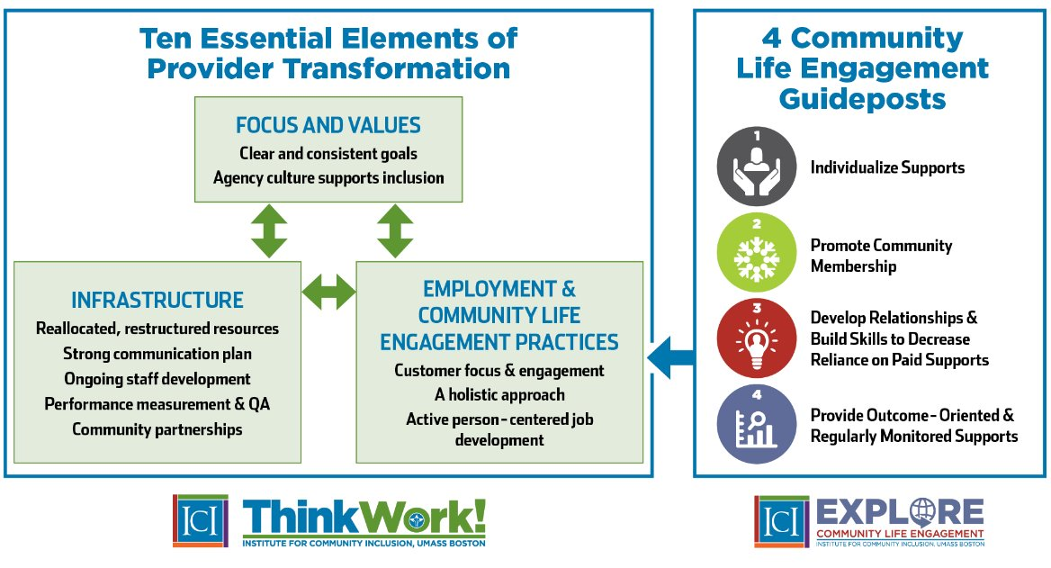

Slide 3
Udac Transformation Activities
BOD commitment to transformation
Launch of new business service model after COVID pandemic shutdown
MTI TA 1.0 Plan
New strategic plan: Center of Excellence on Employment & Community Inclusion
Dropped 14(c)/Closed Door Policy
Repurpose of unused building space & lease to local schools & business
New Videos: “Transformation Success in Duluth." Vision & Mission videos
MTI TA Plan 2.0
Advancing commitment to the vision and "why" of transformation
Continued and renewed focus on staff development and capacity building
National APSE Award: National Organization of Excellence Award, 2023
Clear and Consistent Goals
Strong Company Culture Supporting Inclusion
Focus & Values
Clear & Consistent Goals
Company Culture Supports Inclusion
Bucket 1

Slide 4
Transformational, strategic business plan
Reuse & repurpose of Udac building & facilities
Restructuring of management & staffing roles
Breaking down Employment & Day Service silos
Reallocating financial & staff resources
Reformatted position descriptions and created tiers
SARS Project
Infrastructure
Reallocated, Restructured Resources
Strong Communication Plan
Ongoing Staff Development
Performance Measurement & QA
Community Partnerships
Rebranding & new company communication plan
Billboard showcasing National APSE award
Multiple statewide and national presentations
"Center of Excellence in Employment & Community Inclusion"
Ongoing MTI CoP & Quarterly Trainings—Topical
Middle-Manager Training (L & M course)
Progressive position descriptions and pay for Career & Life Coaches
Updated data, case mgt & financial systems better aligned with managing transformation
New & refreshed business partnerships
New & refreshed community partnerships (CLE)
Ambassadors for Respect program
Providing mentoring to other organizations
Include Exhibit
Bucket 2

Slide 5
Rebranding of communication messaging
Communication of transformation efforts with all key stakeholders (BODs, Staff, Business Leaders, Funding Agencies, & Community Partners)
Updating of contract agreements with governmental agencies, business leaders, others
Exploring Community Careers program
Launch of business Internship program
Employment & Community Life Engagement Practices
Customer Focus & Engagement
A Holistic Service Approach
Active, Person-Centered Employment Development
Adoption of Person-Centered Planning Tools, Practices (e.g., Discovery, Other)
Implementation of E1MN Engagement Practices (CIE Exploration & Informed Choice)
Adoption & Integration of CIE and CLE outcomes
Community Life Engagement CoP participation
Adopted Capable Adult Model
Restructuring of staff roles, duties, & expectations
Increasing staff skills and capacities to deliver CIE/CLE outcomes
Robust staff development training (Employee onboarding, MTI, online training—DirectCourse)
Advanced training to develop CIE (i.e., certification in Discovery & Customized Employment, CESP)
Increased from 3 job matches to 60+ job matches
Bucket 3

Slide 6
A Snapshot: Udac's Transformational Journey So Far
Staff Growth & Empowerment Focus
Growth Within the Organization
Best Practice Implementation and Integration
Refine and Stabilize
Hard Reset/Service Redesign
Infrastructure Focused Changes
Outcomes

