Slide 1
The SGA Project Demonstration:
A VR Model for Improving Outcomes for SSDI Beneficiaries
Presenters
Allison Taylor
Institute for Community Inclusion
Purvi Sevak and Frank Martin
Mathematica Policy Research
Evidence-Based Practices in Vocational Rehabilitation:
Advancing the State of the Science
May 23, 2018

Slide 2
Funding and Disclaimer
The Institute for Community Inclusion (ICI) at the University of Massachusetts-Boston and Mathematica Policy Research led the Substantial Gainful Activity (SGA) Project Demonstration through a grant received from the U.S. Department of Education, Rehabilitation Services Administration (RSA).
The views and opinions expressed here are those of the authors and do not necessarily reflect the views, opinions, or policies of the Kentucky Office of Vocational Rehabilitation, the Minnesota Department of Employment and Economic Development, or RSA.
The authors are solely responsible for any errors.

Slide 3
Overview
Goals and design of the SGA Project Demonstration (Allison)
Implementation and challenges in two vocational rehabilitation (VR) agencies (Frank)
Perspectives of VR customers (Allison)
Impacts of the SGA Project Demonstration on VR outcomes (Purvi)
Implications (Purvi)

Slide 4
SGA Project Goals and Objectives
Develop an employment-services model that will improve the chances that VR clients receiving Social Security Disability Insurance (SSDI)-only benefits attain employment with earnings above the SGA level (now $1,180 per month)
  Develop model of promising strategies that are within the control and scope of VR agencies
  Document experiences of states in implementing the model and evaluate its effectiveness
  If found effective, develop and disseminate information that can help other state VR agencies implement it
Notes:
The overarching goal of the SGA Project was to improve employment and earning outcomes for SSDI-only clients, and to help DI beneficiaries improve their quality of life. Through our evaluation we also wanted to gather information on strategies that can be used to help other state agencies implement SGA innovations in the future

Slide 5
How We Identified Promising Practices
Interviews with state VR directors
RSA-911 Trend Analysis comparing VR agencies by their performance on wage outcomes for SSDI-only customers
Case studies of eight state VR agencies
Expert panel
Notes:
In the first two years of the project:
20-30 state VR directors
RSA 911
Case studies
Expert Panel
Found through interviews that states did not have specific interventions designed for SSDI-only customers.

Slide 6
The SGA Project Intervention
An early and rapid coordinated team approach (CTA) would improve engagement, employment, and wage outcomes of SSDI-only non-blind customers of VR at closure from VR
If we build office-level capacity to implement an early and rapid CTA, will those offices get better employment outcomes for SSDI beneficiaries?
Recruited two agencies, in Kentucky and Minnesota, to implement (2015–2017) and evaluate the model
Notes:
The question remained: If we build office-level capacity to implement an early and rapid coordinated team approach, will those offices get better employment outcomes for SSDI beneficiaries?

Slide 7
Design of the SGA Project Demonstration
Office-level (clustered) random assignment
  Offices grouped into strata based on geographic location, urban versus rural, and past SSDI client outcomes
  Offices from each stratum randomly assigned to deliver usual VR services or enhanced (SGA Project) services
All non-blind, SSDI-only VR applicants in Kentucky and Minnesota were part of the demonstration
  Roughly 1,000 in each state—half at enhanced-service and half at usual-service offices

Slide 8
SGA Project: Innovations, Implementation, and Challenges
Frank Martin
Mathematica Policy Research
Evidence-Based Practices in Vocational Rehabilitation:
Advancing the State of the Science
May 23, 2018
Notes:
I will present findings on the implementation efforts in KY and MN

Slide 9
Overview
Enhanced service innovations
Implementation measures
Staff experiences
Challenges encountered
Lessons learned
Notes:
Enhanced services i.e. treatment sites compared to usual services or control
Selected measures from implementation
Highlight staff experiences implementing the intervention
Challenges encountered across states and a few of the lessons learned

Slide 10
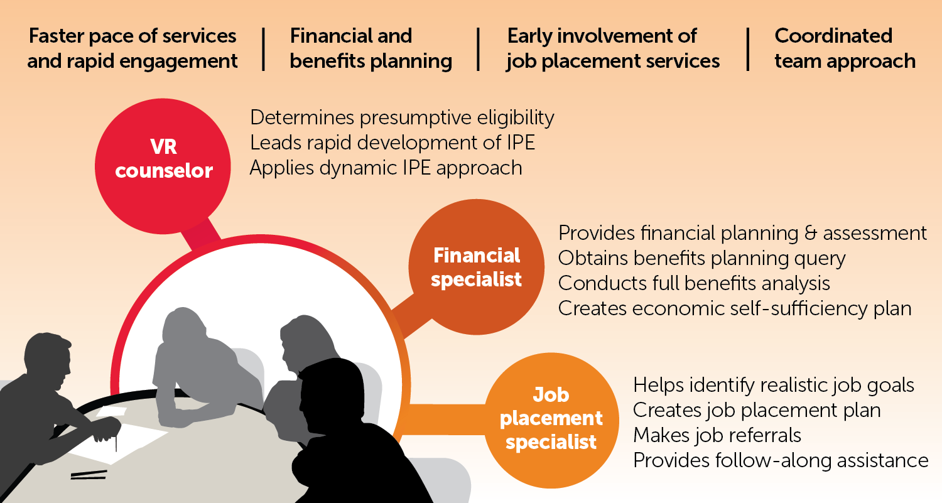
SGA Model of Enhanced Service Innovations
IPE: Individualized Plan for Employment
Notes:
The SGA Project model was similar in both states with just a few exceptions. Each state engaged in faster pace of services including rapid eligibility determination within 2 days and IPE within 30 days of application. There was a push to use presumptive eligibility.
The VRC played a lead role in development of IPE in both states
Development IPE: The IPE is not final, but a draft and amended as needed. In this view, the IPE is not a binding agreement but a document that can be modified and evolve, based on new information.
Both states offered financial counseling and support that was embedded in the agency. Kentucky hired three Kentucky Work Incentive Coordinators (KWICs) who were responsible for the entire state.
MN employed a financial planner in each office. Most were CWICS, not all. If BSA needed the person was referred to a CWIC
Job placement and financial specialist staff in each office, not multiple offices. Use of job placement specialists much earlier in the VR process. JPS provided input on the labor market, job referrals, and related services.
The three staff make up the CTA. The Team identified clients goals, reviewed important financial information, discussed ideas for IPE development
In addition, both states received early and ongoing training and technical assistance from ICI’s team.
Both KY and MN received an initial 3 day training
Financial specialists had special training with ICI experts
Regular, quarterly site visits
Local and state wide in person meetings and support [cross-site meeting in KY to discuss shared concerns]

Slide 11
Selected Implementation Measures
Increased pacing and financial counseling
  Eligibility determination within 2 days
  IPE signed within 30 days of application
  Financial counseling benefits summary and analysis
  First coordinated team meeting: 5 business days in Kentucky, 7 days in Minnesota
Notes:
These are selected implementation measures we are reporting today.
As I mentioned, the target for eligibility determination was 2 days from application and the target for IPE was 30 days after application.
Clients should receive benefits counseling and a BSA was expected
A coordinated team approach meeting should have occurred for clients with the first meeting occurring within 5 business days after eligibility in KY and in MN they set their target at 7 days after application

Slide 12
Kentucky Enhanced Versus Usual Services
SGA Project innovations represented a substantial shift from usual operating procedures
  Pacing targets were aggressive relative to usual services
  Usual services rely on vendors for financial counseling
  Added job placement specialist (JPS) capacity
  JPS involvement before IPE
  Coordination among vocational rehabilitation counselors (VRCs), Kentucky work incentive coordinators (KWICs), and JPS early in process does not occur under usual practice
Notes:
How did enhanced services compare to usual VR services in Kentucky?
Eligibility determination was 2 days (normally 60 days) Pacing at usual service for eligibility determination was 60 days
Financial counseling from a KWIC , compared to referral to vendors under usual service.
JPS early, prior to IPE and frequent follow up
Coordinated team approach and initial meeting within 5 days of eligibility
(Note re: Data on Deaf clients. KY data on deaf clients not included in analysis because rehab. Counselors for Deaf were not randomized to T or C. Also Deaf clients could choose preferred counselor, regardless of T or C designation.)

Slide 13
Kentucky: Innovation
Implementation (select measures)
Notes:
Data collected during the demonstration suggest that participants did not fully or consistently receive all components of the innovation.
About 40 percent of applicants had eligibility determinations within 2 day target (60 days at usual service sites)
39 percent of those with an IPE had one within 30 days of application. (Overall –27 percent of applicants received an IPE within 30 days)
About half (47 percent) of clients received a benefits summary and analysis.
And although most clients participated in an initial CTA meeting (56 percent), just 27 percent of those who had a meeting completed it within the project goal of 5 business days of eligibility determination

Slide 14
Minnesota Enhanced Versus Usual Services
SGA Project innovations represented an alteration in financial planning and teaming
  Presumptive eligibility expected within 2 days compared with 10 days under usual services
  In-house financial planning compared to a special work incentive coordinator (WIC) request
  JPS integrated with team and coordinated in-house compared with community rehabilitation provider (CRP) after the IPE
  CTA with meeting within 7 days of application; no formal teaming under usual services
Notes:
How did enhanced services differ from usual services in MN?
In MN the pace was quicker, but faster pacing was part of their normal practice
The new target for eligibility was 2 days, compared to 10 days under usual services.
Similar to KY they had in-house financial planner – under usual services financial planning is contracted to a WIC
In-house job placement specialist was also involved earlier in the process.
Regarding coordinated team approach, the CRP and VRC meet and discuss under usual, but not in a formal way, nor prior to IPE

Slide 15
SGA Project—Minnesota Context
Existing focus on improving VR pacing pre-SGA by VR director
Long history of motivational interviewing training at several levels of intensity
Existing strong links with Social Security Administration (SSA) for benefit verification―quick turnaround already
Use of dynamic IPE approach
Existing emphasis on VRC and CRP teaming
Lack of timely benefits analysis
Notes:
Context in MN differed….
MN also differed in terms of practice patterns.
More use of motivational interviewing, strong ties to SSA and they had already embraced the dynamic IPE approach i.e. IPE as a living document.
One of their big concerns with usual services was the lack of timely benefits analysis.

Slide 16
Minnesota: Innovation Implementation (select measures)
Notes:
Here are the implementation measures for MN. Data collected during the demonstration suggest that participants did not fully or consistently receive all components of the innovation.
Just over a third had their eligibility determinations within the 2 day target. (Compared to 10 days at usual practice sites)
44% received an IPE within the project goal of 30 days (compared to 90 days), [over one-third (35 percent) total of all eligible had IPE within 30 days)
48 percent received a financial plan [this differs from KY where a BSA was required, if BSA was needed a CWIC referral was made
Similar to Kentucky re: CTA implementation -- Although most clients (53 percent) participated in an initial CTA meeting, just 27 percent of those who had an initial CTA meeting completed it within the project goal of 7 days after application. -- so Team meetings occurred but not as rapidly as intended.
We did not report metrics for job placement services…

Slide 17
Staff Experiences and Challenges with
SGA Project Innovation
KWIC involvement and the benefit summary and analyses were considered by many as among the most significant and beneficial innovations of the SGA Project
Early KWIC involvement was essential to provide accurate information to clients and address concerns about benefit loss
Notes:
We also learned from the VR staff and administrators about their experiences and challenges with the innovations
In Kentucky, we heard a lot of great comments about KWIC involvement and their role in the demonstration.
Many staff noted it is one of the most beneficial components of the demonstration.
Similar comments about the value of financial planning in MN
Later in the presentation today, Allison will present more findings on the perspective of consumers/clients’ who participated in the demonstration.

Slide 18
Both States Had Similar
Implementation Challenges
Confusion among staff about roles and responsibilities
VRCs needed additional training on team facilitation
Large caseloads and logistical barriers were an occasional impediment to pacing and service delivery
Difficulty in teaming adoption because of communication and logistical barriers (particularly in rural areas)
Notes:
Training was an issue for some sites and staff, especially with regard to roles – making certain everyone was on the same page with regard to client interaction, steps, and data entry.
Some JPS expressed a reluctance to meetings or follow-up meetings with clients in supported employment or long-term training was unnecessary
There was a need for more guidance on intervention teaming and how to team
We heard from VRCs and JPS in Kentucky that it was difficult to do enhanced services while maintaining a large caseload. Staffing shortages also created tension
Team meetings sere logistically difficult in some sites due to distance. Some VRCs said clients expressed dissatisfaction with the frequent number of meetings and constant follow-ups.

Slide 19
State-Specific Implementation Challenges
Kentucky
  Some VRCs initially resisted adopting pacing and the faster approach to IPE
  Finding and retaining qualified KWICs
  Linkages to SSA are important
Minnesota
  Early involvement of JPS was not universally accepted by VRCs
  Some VRCs felt a loss of control as “farmed out” to financial and placement specialists
  Large rural areas were difficult for one JPS to serve
Notes:
There was resistance and lack of buy-in among some VRCs in KY. Many VRCs had a slow and deliberate practice pattern and they liked it. Many did not know or about or embrace presumptive eligibility – a few believed it could lead to reprimand
In Kentucky, they could only secure three KWICs. These individuals served the entire state, resulting in substantial travel for CTA and other meetings.
KWIC caseloads were unevenly distributed (95 to 225 clients), and those with large. According to Virginia Commonwealth University’s Work Incentive Planning and Assistance National Training Center, an appropriate caseload size is approximately 100 clients for a new CWIC.
Staff described their experience with delays in receiving SSA documentation or medical documentation slowing the pace of service delivery.
JPS role was not embraced in MN initially and in fact there was some confusion about this in KY too.
In MN, the CRP in rural areas had more local labor market information. So many preferred the usual practice of CRP compared to using a JPS.

Slide 20
Implementation Lessons
More comfortable with a faster pace and seeing the IPE as an evolving document
VRCs can use developmental IPEs effectively
Not everyone needs full benefits analysis
JPS role not a big change, but early involvement perceived as leading to developing more realistic employment goals
Notes:
A few lessons from implementation –
Overtime and with TA, VRCs became more comfortable with faster pacing; many remarked that faster is better for all clients.
Training helped VRCs understand developmental IPEs
Many clients for SSDI are not seeking a change in status, but resources for work or long-term training and do not necessarily need a benefits summary and analysis
Job placement activity was not a major change – most said they were doing the same thing – just before the IPE
Now, I’ll turn it over to Purvi to discuss Impacts Analysis and Lessons Learned.

Slide 21
Perspectives of VR Clients in the
SGA Project Demonstration
Allison B. Taylor
Institute for Community Inclusion
Evidence-Based Practices in Vocational Rehabilitation:
Advancing the State of the Science
May 23, 2018

Slide 22
Overview―Qualitative Study
Purpose: Gather the experiences and perspectives of VR customers who receive SSDI benefits in Minnesota and Kentucky
Sample:
  48 VR customers w/SSDI (KY 25, MN 23)
  Most from treatment sites (75% treatment, 25% control)
Method:
  1 to 3 in-depth qualitative interviews

Slide 23
Participants’ Demographics
 | Qualitative study | SGA project overall
Gender
Male | 40% | 53%
Female | 60% | 47%
Race/Ethnicity
Black | 21% | 16%
White | 77% | 80%
Latino | 2% | 3%
Age
Range | 26–65 | 18–65
Median | 51 | 49
Qualitative Data
Notes:
Slightly over-sampled for black women, but otherwise demographics largely match the overall population.
First column – participants in the qualitative study; second column is the SGA project overall as a reference. (all SSDI customers enrolled in VR in KY/MN during study period)
Greater proportion of women. Slightly higher numbers of black/af amer participants, which is good. It would have been better to have even more diversity, but I’m glad we were able to over-sample for black participants a bit, esp. as these two states are overall very white.

Slide 24
Research Questions
What are the experiences and perspectives of VR customers with SSDI?
      How do they make decisions about working?
      What is the role of VR in those decisions?

Slide 25
Factors in Decisions About Working
SSDI and Other Benefits
DECISIONS ABOUT WORKING
Disabilities
Family
Transportation
Activity/Social
Engagement
Personal/Social
Meanings of Work
Notes:
Decisions are complex and dynamic, based on many interlocking variables:
Intrinsic motivations to work (personal & social meanings of work) are at least as important as financial
Financial motivations tied to engagement in community, enhancing family and social connections

Slide 26
“Reclaiming life” (female, 50s, Minnesota)
Here I am thinking, ‘Yeah, I’m ready, let’s do it. I want to get off this disability. I want to make as much money as I can make and take care of myself and plan ahead.’
But I need to think about, what if I have to go back on disability and do this all over again—the one or two years to get it back? But they explained it to me. I wouldn’t have to go through all that, which is good.
… I just had to be determined and take it as it comes because I’ve had a lot of time to think about it. And I have to do something. I’m feeling physically ready to give it a shot.… I’m looking at reclaiming life.
Notes:
[MN-T-105]:
Married woman in her 50s. Her husband lives in another country, and they have been working with a lawyer to help him to immigrate. She currently lives with and cares for her mother and stepfather, who both have medical conditions. She has made the decision to try working again and wants to go off SSDI.
[QUOTE]
This quote reflects the nuanced, sometimes contradictory, but very real experience people with disabilities have when making decisions about employment. For this person, who still faces many challenges due to her disability, returning to work has financial implications, but it also carries meaning far beyond a paycheck – it means “reclaiming life.”
She is worried what will happen if she loses her SSDI, but the financial/benefits counselor at VR explained that if she needs to go back on SSDI, she can. Armed with that information, she’s ready to try.

Slide 27
Fear and Confusion
Confusion
  SSDI and work incentives rules
  VR services
Fear and anxiety
  Unpredictability of illnesses and disabilities
  Loss of financial stability and safety net
Notes:
Participants wanted to work, but they were often confused about what would happen if they did and fearful of losing the safety net of SSDI.

Slide 28
“The fear of not knowing”
(male, 30s, Kentucky)
I was 26-ish when I first started thinking about getting back to work… Even the fear of losing the little I was getting, the fear of not knowing.…
I didn’t know if … I could do a full day of work…. Everything was just so uncertain. It would have been really nice to have a little bit of certainty in … understanding what happens with SSI and SSDI and Medicare or Medicaid when you start working….
Notes:
[KY-T-026]
Single man in his 30s. This slide talking about his first encounter with VR, soon after the accident that caused his disability.
[Mentions SSI – my understanding is that he had SSI and SSDI the first time he went to VR when he was younger but no longer has it.]

Slide 29
SGA Model:
Rapid Engagement and Team Approach
Responsive: Customers come to VR ready to work don’t want to wait for help
Holistic: With job placement and financial counseling, the counselor can focus counseling
Flexible: Team members can be more or less active, depending on customers’ needs.
Transparent: Everyone’s role is explained and customer knows what services are available
Notes:
Not everyone needed each member of the team, but having them there at the beginning helped them understand what was available. For example, a woman in her 30s whose immediate goal was education didn’t need the job placement person at first but now knows that is a service she can use in the future. A few people were fairly clear on the SSDI rules and didn’t need extensive financial and benefits counseling but most did. Also key is that many didn’t know they were confused until they got the benefits counseling.

Slide 30
“I miss my family to death”
(male, 50s, Kentucky)
[Having a job] helps me with all my free time. I don’t have to sit there 24 hours a day just watching the TV. I can go see my family now, which back in the day I didn’t have the money to go see them … and now I can see them at least once or twice a week. And that’s been great because I miss my family to death.
Notes:
1st interview, ambivalent about even getting a job. Went to VR on the urging of probation officer, hadn’t yet returned for a 2nd mtg. Worried about losing SSDI and Medicare if he started working at all.
His motivations for working revolved around his family and his desire to be a “productive citizen.”
2nd interview, he had gone to a follow up meeting at VR – CTA meeting.
He learned from the benefits counselor that he would not lose his disability.
Job placement - a job opening, hired.
One of the things missing from his life was spending time with family – his aunts and uncles, sister, son and grandchildren.
3rd interview, he had been at his job 5 months,
still spending time with his family.
He even helped his son get a job with his employer.
He may not work full-time and go off SSDI, but is now considering.

Slide 31
SGA Model:
Financial and Benefits Counseling
Provides clarity around work incentives and financial impacts of returning to work
Customers might not realize they are confused and might not ask for this help, but if it’s offered, they can benefit from it
Reduces anxiety and fear of unknown by removing some of the perceived risk
Particularly useful for people with strong motivations to return to work but are overwhelmed by the process or fearful of taking the leap to full-time
Notes:
SSDI and work incentives rules are very confusing, even for the most savvy – including a participant with an MBA and another with an HR background.

Slide 32
“It gave me confidence”
(male, 30s, Kentucky)
The financial planning lady, she had a very thorough discovery of what all of my benefits are, what all my income sources are, what they could be in the future … and whether it was worth it for me.
… One of the biggest worries with me at the very beginning was, “If you work too much, you’re going to lose these benefits.” … It gave me confidence that, yeah, here’s my window.
… I think it’s a great thing to have in place because it actually motivates―it allows people in my situation to make a plan like this and be comfortable moving on the plan.
Notes:
This person had an MBA, so he was pretty savvy about financial planning, and he might not have asked for financial counseling, but he was still confused about the work incentives rules and really benefitted from the financial planning process.

Slide 33
Implications of Consumers’ Perspectives
Recognize that factors in employment decisions might not be pragmatic or self-evident, and fear plays a role.
Flexible, dynamic IPE works for customers whose situation, needs, and outlook change
Pacing can be increased; people in our study went to VR when they were ready to work
Financial and benefits counseling can reduce confusion and fear about consequences of working, thus removing perceived barriers
Notes:
VR staff should recognize that motivations to work may not always be pragmatic or obvious and ask open-ended questions to learn their needs, desires, and fears.
Flexible, dynamic IPE works for customers whose situation, needs, and outlook change.
– e.g., many saw working part-time as a trial, to see if they could eventually going off SSDI.
Pacing can be increased. People go to VR when they are ready to work.
- Everyone was ready to work, some would even forgo the “perfect” fit for some opportunity to re-engage socially. No one was overwhelmed by the pace, and most were frustrated by how slowly the process was going, even with the increased pacing.

Slide 34
Impacts of the SGA Project Innovations
Purvi Sevak
Mathematica Policy Research
Evidence-Based Practices in Vocational Rehabilitation:
Advancing the State of the Science
May 23, 2018

Slide 35
Overview
Design of the demonstration
Evaluation methods
Impacts in Kentucky
Impacts in Minnesota
Potential for longer-term impacts
Implications

Slide 36
Estimated Impacts Using VR Agencies’ Data
Four primary outcomes:
  Pace of services: IPE within 30 days of application
  Successful client engagement: not exiting VR before obtaining competitive employment
  Competitive employment: closing with competitive employment
  SGA-level earnings: closing with SGA-level earnings
Data: VR case file data reflecting service delivery and client outcomes through late April 2017

Slide 37
Estimated Impacts as Difference in Usual- and Enhanced-Service Offices
Usual- and enhanced-service offices were otherwise similar
  No significant differences in primary outcomes before the SGA Project demonstration
  No significant differences in clients’ characteristics
Used regression models to control for clients’ characteristics and pre-demonstration office-level outcomes
Statistical adjustments to account for office-level clustered randomization

Slide 38
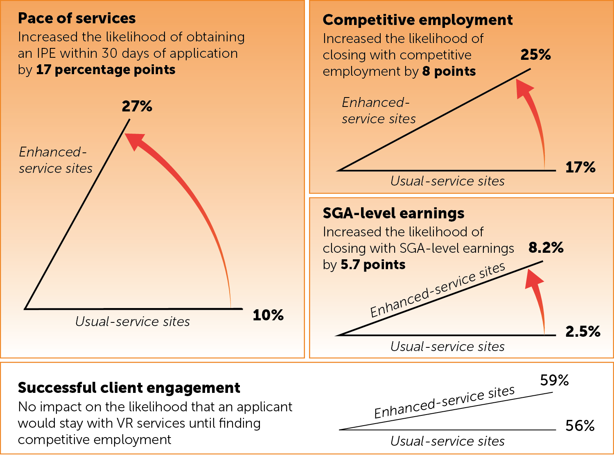
SGA Project Innovations Improved Pace and Employment in Kentucky

Slide 39
Faster Pace and Increased Authorization for Specific Services in Kentucky
Relative to usual-service clients, enhanced-service clients were
  More likely to receive
    Job placement services (18 percentage points)
    Other employment-related services (14 percentage points)
    Benefit counseling services (41 percentage points)
  Receiving services sooner
    Job placement services (47 days)
    Other employment-related services (82 days)
    Benefit counseling services (29 days)
Includes staff-provided and authorized services

Slide 40
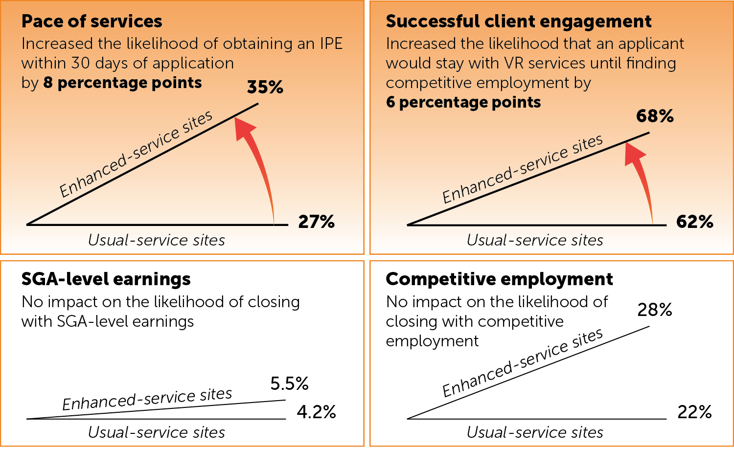
SGA Project Innovations Improved Pace and Engagement in Minnesota

Slide 41
Some Changes in Service Delivery in Minnesota
Relative to usual-service clients, enhanced-service clients were
  Less likely to be referred to providers for job placement or benefits counseling services
  Not different in the referrals to providers for other employment services or training services

Slide 42
Impacts on Non-SGA Project Clients
None that we could detect in either state
  No significant differences in the four primary outcomes between non-SGA Project clients at the enhanced- and usual-service sites
Suggests that counselors did not divert attention from non-SGA Project clients
There was minimal spillover of the SGA Project innovations to non-SGA Project clients

Slide 43
Longer-Term Impacts Are Still Unknown
35% to 40% of cases were still open in each state
  Estimated impacts could change as cases close
  Because the impacts in Kentucky were large, we expect them to persist even as more cases close
  Significant employment impacts in Minnesota might become evident as more cases close
Evaluation could examine only short-term outcomes
  SSA and RSA administrative data could reveal impacts on longer-term earnings, suspension of benefits, and SSA payments to VR agencies

Slide 44
Implications for VR Practice
It is possible to move the needle
  At least for short-term VR process and closure outcomes
A faster pace of services is possible without negative consequences
  Might not be feasible for all clients
Technical assistance and monitoring are helpful in executing innovations

Slide 45
Implications for VR Research
Relative importance of individual intervention components should be tested
  Faster pacing of eligibility and IPE
  Collaborative team approach
  Financial counseling
Data linkages with SSA needed for evaluation of long-term impacts
  Earnings, federal disability benefits, and SSA cost reimbursement impacts
Office-level random assignment is a feasible and rigorous evaluation approach that should be considered to test other VR innovations

Slide 46
Contact Information
Allison Taylor, Institute for Community Inclusion Allison.taylor@umb.edu
Frank Martin, Mathematica Policy Research fmartin@mathematica-mpr.com
Purvi Sevak, Mathematica Policy Research psevak@mathematica-mpr.com

