Slide 1


Slide 2
Leadership Essentials for Middle Managers: Guiding Change from Within
Date here
Module #4: Aligning Mission, Vision and Values with Resources
Presenter
Credentials/organization
Presenter
Credentials/organization
Presenter
Credentials/organization

Slide 3

MTI works with partners across Minnesota’s employment systems to build capacity, improve and align systems, and implement practices to set competitive integrated employment as the standard for Minnesotans with disabilities.

Slide 4
Course Modules:
#1: Course Orientation
#2: Leadership
#3: Federal & State Policy
#4: Aligning Mission, Vision and Values with Resources
#5: Best Practices in Employment & Day Services
#6: Organizational Transformation (change)
#7: Managing Through Change
#8: Creating Systems for Quality Improvement
We are here!
Notes:
Staci

Slide 5

Learning Objectives
Module #4 Learning Objectives
Describe the importance of clarifying the mission, vision and values of your organization
Describe what resource allocation is and how it can impact transformation
Describe how to ensure your department's resources align with mission, vision and values
Notes:
Staci

Slide 6
Organizational Transformation
State policy and legislation
Best Practices
Federal policy and legislation
Values
History
Strategic alignment of mission, vision, processes and outcomes.
Notes:
Staci
This is all about connecting the dots

Slide 7
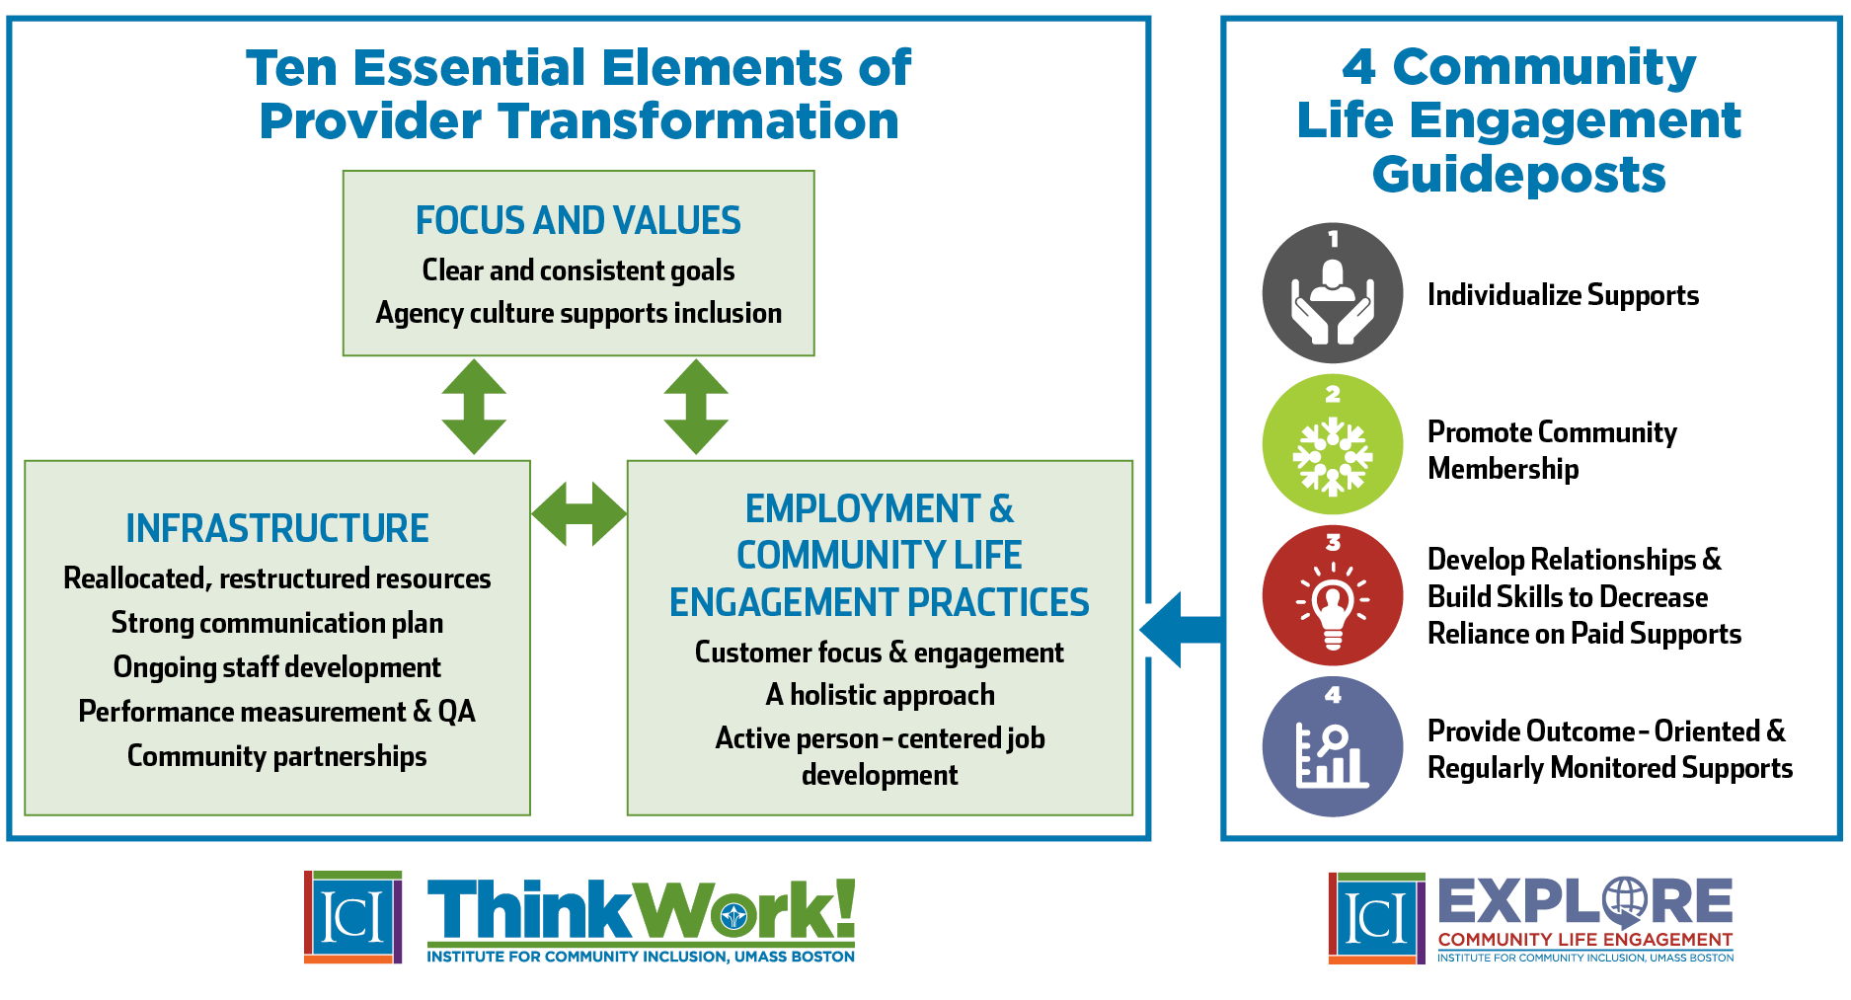


Notes:
Staci

Slide 8
What are your organization's resources?
Financial
Human (paid staff & volunteers, board, etc.)
Physical
Intellectual
Partnerships
Data & info
Marketing
Culture
Others?
Yourselves!!! (don't forget...you make it happen)
Notes:
Don

Slide 9

Things you can test in a pilot
Person-centered planning
Individualized employment process
Community-based service delivery
Engagement and exploration leading to self-determination
New staffing patterns
New communication flow
Organizational structure
What else?
Notes:
Don

Slide 10

How do you engage people?
Notes:
Don

Slide 11
Poll Question #1
In your position, do you help track quantifiable (measurable) outcomes related to competitive integrated employment and/or community life engagement?
Yes
No
I'm not sure

Slide 12
Poll Question #2
Based your organization's transformation goals, do you (in your role) have the proper resources in place to meet them?
Yes
No
I'm not sure

Slide 13

Group Discussions
What resources do you have available to support the mission, vision and values of your organization and how does that link to your work in your department?
Are there ways you could be using existing resources differently in order to increase competitive integrated employment and/or community integration?

Slide 14

Questions?

Slide 15
Insert QR code here
Session Evaluation

