Slide 1


Slide 2
Leadership Essentials for Middle Managers: Guiding Change from Within
Date here
Module #8 Creating Systems for Quality Improvement
Presenter
Credentials/organization
Presenter
Credentials/organization
Presenter
Credentials/organization

Slide 3

MTI works with partners across Minnesota’s employment systems to build capacity, improve and align systems, and implement practices to set competitive integrated employment as the standard for Minnesotans with disabilities.

Slide 4
Course Modules:
#1: Course Orientation
#2: Leadership
#3: Federal & State Policy
#4: Aligning Mission, Vision and Values with Resources
#5: Best Practices in Employment & Day Services
#6: Organizational Transformation (change)
#7: Managing Through Change
#8: Creating Systems for Quality Improvement
We are here!
Notes:
We are at session 8 today.... our last session... The topic today is Creating Systems of Quality improvement..... the timing on this last module today hopefully gets you thinking about where you started and what happens next with your role as a manager and leader. As you went through the modules starting with leadership and on until today... as you have put in the time with the online course, with your mentors and in these virtual sessions, you have built the foundation needed to continue moving forward... you may not have completely mastered each of these topics..... but as an emerging leader.... you know policy as it relates to your position... you know best practices and how they will uniquely fit the mission of your organization... you know about the organizational transformation.... how to manage through organizational change and where your role is vital to the success of that change... today we are going to review the module you are completing on how organizational create systems to always look towards improvement.

Slide 5

Learning Objectives
Module #8 Learning Objectives
•Describe why systems for quality improvement are important for organizations
•Describe how data can be used to improve outcomes
•Identify what types of data YOU should consider tracking and how you might use it
Notes:
Quick reminder of the learning objectives from the online learning..... we will review parts of this quickly in a second... but to build the start for our session today in this months course you focused on these three things as a reminder 1) systems for quality improvement 2) how data can be used 3) what that can mean for you in your role and in your organization... or more specifically the ways you can use data...

Slide 6

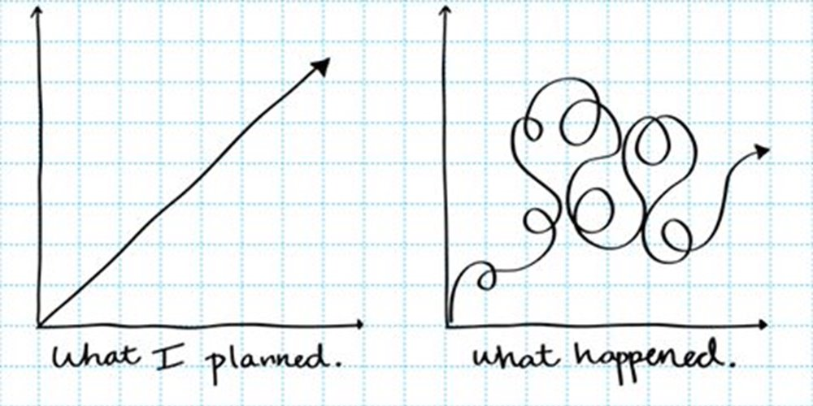
Learning Objectives
Quick Review
Starts with clear and Consistent Goals (Element 1)
  Goals
    Big Hairy Audacious Goals
  Outcomes
  Indicators of success
Data, metrics, measures, analysis
  Employment and the full working life
  Data collection
Quality
  Quality assurance
  Quality Improvement
  Employment
  Community Life Engagement
Outcome measures
Process Measures
Notes:
As some reminders from this months course material. Quality improvement is connected to your organizations goals... In one of our first meetings we talked about organizations big hairy audacious goals.... goals that everyone can get behind and can certainly evolve over time to meet match the organizations direction and intentions. I will pass it over to Don Lavin for an example later and this could be something you discuss in the breakout rooms in a few minutes......
We continued in the course from goals on to outcomes and data. Hopefully today in the breakouts and poll questions we can get to some examples in your organizations and application. As your organization seeks to improve and change you want to make decision guided by the data you collect. It is important then to collect data that tells you what you need to know about the services and supports you are providing on and individual level to support work, community life engagement and that whole working life and the steps your organization is taking in your processes that are measured to make sure you reach the holistic, full organizational change you want. We are looking for holistic change and data-driven decisions and continuous quality improvement whether you are just starting to make organizational change or you are a year or years into the process is how we do it...
Finally for our quick review is quality
Quality assurance refers to the acceptable standard required of an organization in terms of outcomes for an organization, services and supports. Quality improvement works with QA to look at areas to get better or improve the quality of outcomes..... Again here to we are talking about that working life... so what does quality look like for employment, what does quality look like for community life engagement:
There are more than these and you may want to think about what these quality outcome measures look like in your organization, but for employment some of those qulity: Number of people in competitive and integrated employment, Hours worked... thinking about the quality some might be Access to benefits & promotion, New skills learned, Natural supports, or as an organization how many different industries are you supporting people in jobs... again examples
For Community life engagement and quality... are we not just in the community but are we part of the community: how many people are part of social organizations or members of interests group or clubs, Relationships and/or natural supports developed, how independent are people from their paid staff in the community, different skills people are supported to learn in the community... I will mention that time in the community is important as well when it is connected to these other quality outcomes... alone "time", or just a number of activities may not give use the full picture.
I will move the next slide with a few more things. We are looking for what the people we support see as their vision for a full life. Full life is not only work, but what wraps around that job. Community engagement is not just getting out of the building but the ways engagement in the community fills a need for connection.... So the question about your systems for quality improvement, the measures and data you collect analyze and share are.... Is the information you are collecting and the process and systems you have in place giving you what you need for your organization.... and do you have what you need in your role to know you are supporting quality outcomes....
Last with any organizational change is not linear. We don’t go step 1-10 in order. Each of your organizations will uniquely approach what data you collect, the outcomes you decided on as an organization and an individual team... and how you will collect and use that data...the 10 essential elements provide a map.... but change looks less like the steps above... and more like the visual at the bottom... I know you have seen it before.... but I sure like how an image like that explains what a one-person at a time approach looks like in very few words.....

Slide 7
Quality Cycle: Plan, Do, Check, Act
Track outcomes
Share data with stakeholders
Correct course as needed
Celebrate successes
Identify desired outcomes
Implement
What gets measured, gets done!
Notes:
Bryn
At the most basic level, what we are talking about here is called the quality cycle: sometimes described as Plan, Do, Check, Act. Essentially, it means an organization, a department or even your team within n organization, should very clearly be identifying what are the desired goals and outcomes you are setting out to achieve. Based on those outcomes, you're going to be implementing the strategies, procedures, policies, that you believe will lead to the identified outcomes. You're going to track the outcomes to see if you are getting the results you wanted.... making improvements and corrections as needed until you reach and celebrate the successes... then you are refining existing or setting new goals to start the process over again.
The graphic describes a framework to think about and make sure that you as a leader, your team and your organization are measuring the right things... evidence of the best practices.... so you have confidence when you describe your success and use that data to make improvements.

Slide 8

“Without data, you’re just another person with an opinion.”
~ W. Edwards Deming
Notes:
Bryn
Finally from Deming, an expert on the field of public service we all work in... he says without data you are just another person with an opinion. The evidence for change is.... that much stronger........when your years of experience, your hypothesis, your approach, your skill as a leader, manager and direct support... your intuition in this field......... is paired with outcomes and data that can clearly show you, your team and your organization are moving in thte right direction.

Slide 9
Poll Question #1
In my role as a manager, supervisor, leader, I regularly use data to make decisions?
Yes
No
I'm not sure
Notes:
Bryn
Ok we have a couple of poll questions here just to get us thinking. The first poll question.... In your role, do you regularly use data to make decisions....

Slide 10
Poll Question #2
My organization has a Quality Assurance plan in place?
Yes
No
I'm not sure
Notes:
Bryn
Poll question number two..... My organization has a Quality Assurance plan in place
If yes, what are some metrics your organization uses to measure quality?
Do you share this information with your team?
Do you share this information with folks receiving services?
If no, how does your leadership/organization ensure you are meeting the needs of folks receiving services?

Slide 11
Poll Question #3
My organization currently has a Big Hairy Audacious Goal (BHAG) in place related to employment and/or community engagement goals
Yes
No
I'm not sure
Notes:
Don

Slide 12

What’s Your BHAG?
“We’re going to get 60 jobs in 2006”
Notes:
Introduce by Bryn and have Don take over
In the past we have followed up each of the first two poll questions with a third poll question asking about what you know ion your role as middle managers about your organizations BHAG... or Big hairy audacious goal.... Today instead as a lead in for our breakout discussions I wanted to give the fllor to Don Lavin to give an example of an organizations initial BHAG and what that goal looked like as far as quality outcomes at a similar point in the process your provider organizations may be at right now.... I will hand it over to Don.

Slide 13

Facilitated Small Group Discussions
*identify a note-taker/reporter
How does your organization measure quality?
How do you as a middle manager/leader measure quality?
Do DSPs know how your organization measures quality? How is it shared?
Notes:
Bryn
Thank you Don.... with the review... the poll questions in mind and especially the example here from the provider like yours... we want to move into some breakout sessions that discuss what measuring and capturing quality services and outcomes look like..... We may want to put these questions in the chat as we go into the breakout rooms for a few minutes consider the following questions.... How does your organization measure quality? …......How do you as a middle manager/leader measure quality?............Do DSPs know how your organization measures quality?...... and how are the quality measures metrics goals and outcomes shared........ Please choose a spokesperson and notetaker for each breakout to share the discussion when we come back together....

Slide 14

Share one positive outcome from your participation in this course:
Something you've learned
Something you've accomplished
Something you look forward to
Something you are going to work on or accomplish in the future
Anything else
Notes:
Bryn
We want to move now to wrapping up the course with some takewawys from the months you have bee working through the online content.... Please share at least one positive piece you have taken from the course.....Something you've learned.....Something you've accomplished ….Something you look forward to........Something you are going to work on or accomplish in the future.... or …. Anything else..... I will call out each organization....... Lets start with Phase....... Wabasha......... Udac....... ATHC....... MSS........Epic.......

Slide 15

Course wrap-up
Logistics
Make sure assignments and quizzes are completed
Certificate of completion
Mentors are available for support as needed
Survey
Notes:
Bryn
A few housekeeping things here for the course wrap-up.... first if you have any assignments still to complete...... we are really close to the end of the month..... all the assignments need to be completed ideally by the end of this week, but at the latest on Monday 6.30.2025..... If you are having issues with a particular grade or assignment reach out to your mentors and they can help you.... In the assignment, under "certificate of completion you will need to complete the survey as well to finish the course..... We will need to submit grades by Monday so you can receive and access your certificate for the course.... Any questions there?....

Slide 16

Thank You!
Notes:
Open to all MTI team members

Slide 17
Insert QR code here
Session Evaluation

