Slide 1


Real Jobs and Real Careers:
Making It Happen for
Students with Disabilities
David Hoff
Project Director
Institute for Community Inclusion
University of Massachusetts, Boston

Slide 2


Contact Information
David Hoff
617-287-4308
david.hoff@umb.edu
www.communityinclusion.org
@davidhoff10

Slide 3
Same career development strategies as any other teenager and young adult
Basic Premise # 1

Slide 4
Successful employment for people with disabilities: the same as everyone else
Clear goals
Experience in trying new things
Use of personal networks
A good job match
A supportive work environment

Slide 5
Stages of Career Development
(Super)
Age 11-12:
Interest
Age 13-14:
Capacity
Age 15-17:
Tentative
Age 25-30:
Trial & Stabilization
Age 18-21:
Crystalize Preference
Early 20’s:
Specify Vocational Preference

Slide 6

Employment Readiness Myth
Employers are expecting perfect employees

Slide 7
Couldn’t get along with others?
Acted inappropriately?
Had behavioral outbursts?
Was chronically late?
Complained about everything?
Didn’t communicate well?
Didn't work very fast?
Got distracted easily?
Have you ever worked with anyone who:

Slide 8
Acted impulsively without thinking?
Didn’t take directions well…or at all?
Had a messy office?
Wasn’t organized?
Wasn’t always professional?
Was rude?
Couldn’t take criticism?
Was lazy?
Have you ever worked with anyone who:

Slide 9
Disability Specific Strategies:
Supplement,
Not Replace
Basic Premise # 2

Slide 10
Disability-Specific Considerations
Disclosure
Accommodations
Benefit issues
Self-Advocacy

Slide 11



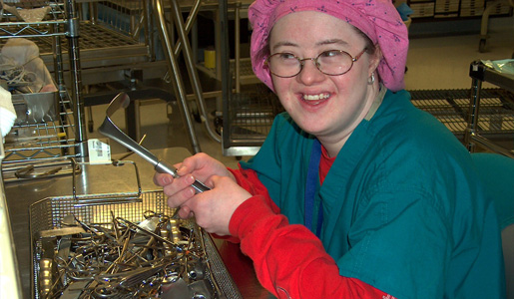


The best source of support will always be the individual’s community
Basic Premise # 3

Slide 12

Employment: THE
BIG PICTURE!

Slide 13





Slide 14
Employment First – the concept that employment should be the first and primary service option for people with disabilities - continues to grow.
Employment First Movement now in most States
30+ States with an
Official Policy - including Massachusetts

Slide 15
Employment First: What Is It?
General theme:
Employment in the community is the first/primary service option for individuals with disabilities
APSE Statement on Employment First
Employment in the general workforce is the first and preferred outcome in the provision of publicly funded services for all working age citizens with disabilities, regardless of level of disability.

Slide 16

Excerpt from Massachusetts Employment First Policy
July 2010
For working age adults served by DDS, integrated, individual employment is the preferred service option and optimal outcome. In the development of service plans and service delivery, assistance and supports for individual, integrated employment will be prioritized.

Slide 17
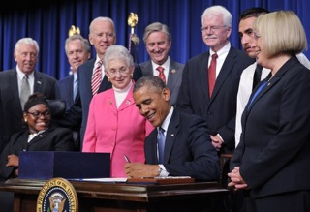
WIOA
The Workforce Innovation and Opportunity Act
of 2014
Signed into law July 22, 2014
Reauthorizes the Workforce Investment Act of 1998, including the Rehabilitation Act

Slide 18
“The foundation of the VR program is the principle that individuals with disabilities, including those
with the most significant disabilities,
are capable of achieving high quality, competitive integrated employment
when provided the necessary
skills and supports.”

Slide 19
“Congress makes clear that youth with significant disabilities
must be given every opportunity to receive the services necessary
to ensure the maximum potential
to achieve competitive integrated employment.”

Slide 20
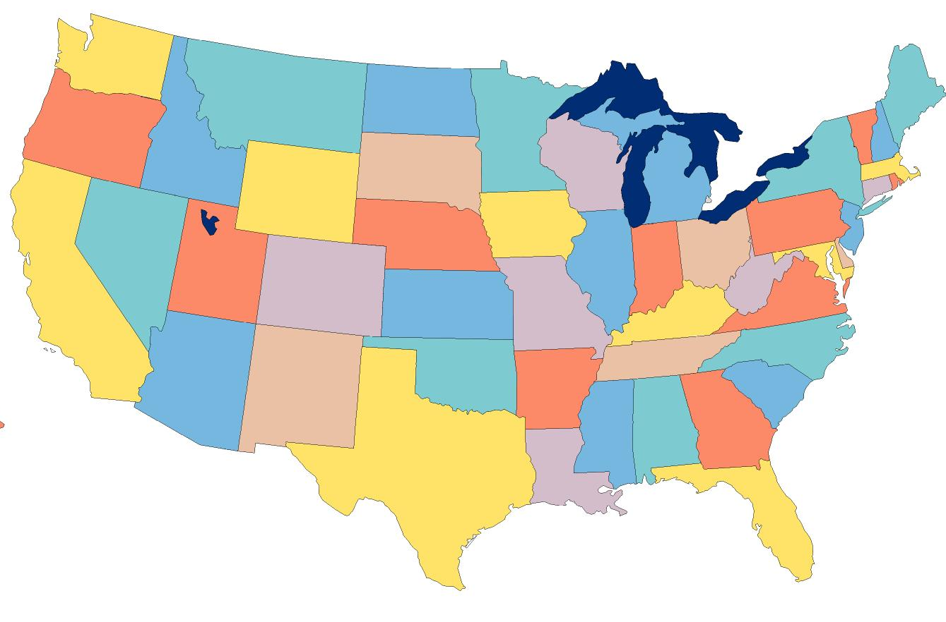

Employment of individuals with disabilities fully integrated within the general workforce is expected and preferred.
The National Message

Slide 21

Public Systems and New Opportunities

Slide 22

Delivering on the Transition Promise: Partnerships
Education
Dept. of Workforce Development: Career Centers & Youth Services
Public VR: MRC/MCB
Department of Developmental Services
Department of Mental Health

Slide 23


Under WIOA
15% of state Title I VR Funds must be used for
“pre-employment transition services”
  Title I Funds FY 2015 (MA): $56 million
Required services:
  job exploration counseling
  work based learning experiences
  counseling on post-secondary opportunities
  workplace readiness training
  training on self-advocacy
Additional specified activities allowed if funding is available

Slide 24



VR
Employment Transition Coordination Requirements
Attend IEP Meetings
Work with workforce boards, One-Stops, & employers to develop employment opportunities
Work with schools to ensure provision of
pre-employment transition services
When invited, attend person-centered planning meetings

Slide 25





Other agency?
Who pays for what?

Slide 26
Special Jobs
at
Special Places
for
Special People

Slide 27
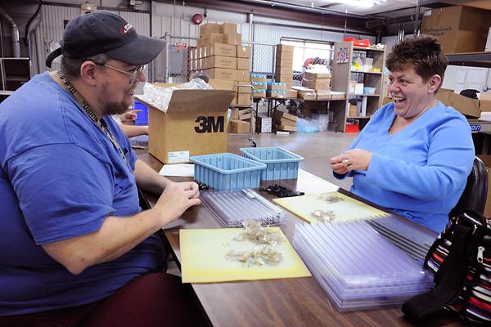

Sheltered Workshops
Enclaves & Mobile Work Crews

Slide 28

WIOA Section 511:
Restrictions on Sub-Minimum Wage
Required (as of 2016) for individuals 24 & under before being placed in a position that pays less than minimum wage
Steps include:
  MRC/MCB Pre-employment transition services or IDEA transition services
  Either being determined ineligible for MRC/MCB or an unsuccessful MRC/MCB closure
  Provision of career counseling & referrals designed to assist individual to achieve competitive integrated employment

Slide 29



As of July 22nd, schools no longer allowed to contract with organizations to pay individuals sub-minimum wage

Slide 30


DDS Policy
New entries to sheltered workshops ended on January 1, 2014.
Funding of sheltered workshops ends on June 30, 2016
Phase-out of sub-minimum
wage payments by
June 2018

Slide 31
Workforce Development System Opportunities

Slide 32

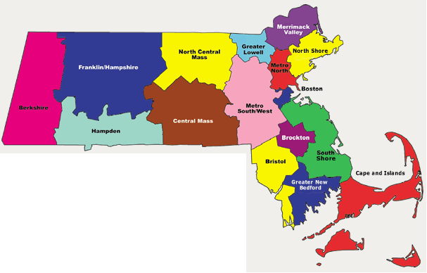
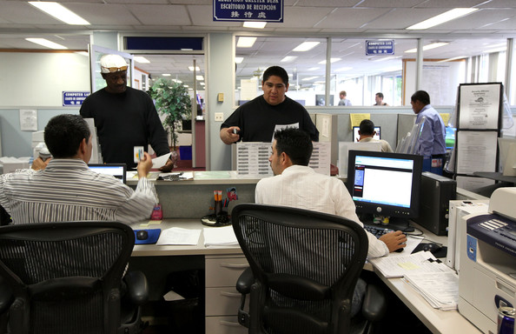
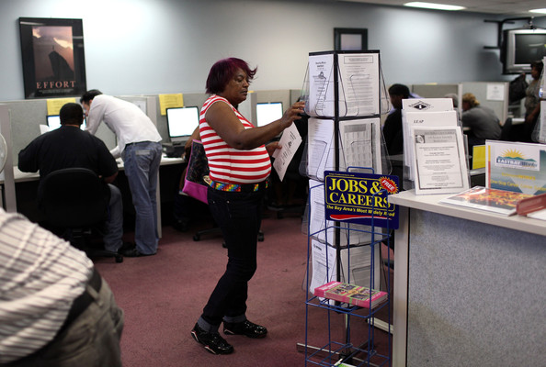

16
Massachusetts Workforce Boards
32

Slide 33
Workforce Development Youth Services
Variety of services available for eligible youth to assist with employment & career development
Primarily administered by local workforce boards

Slide 34
WIOA Youth Services | Out of School (75% of funding) | In-School (25% of Funding)
Available To ➔ | Eligible youth age 16 to 24 | Students with Disabilities (age 14 to 21)
Disability Eligibility | Any youth meeting the ADA definition | Any youth meeting the ADA definition who is on SSI or low income (considered a family of 1 for income purposes)

Slide 35
There are also other youth services administered by
Workforce Boards and Workforce System
E.G.: Connecting Activities

Slide 36



Best Practices:
Transition and Employment

Slide 37



Best Practices: Transition & Employment
Presume all students can succeed in employment
Employment addressed annually as core element of IEP starting at age 14
Decision to not pursue employment requires high level of documentation
Typical student work experiences based on a person-centered approach
Integrate students into school-to-career opportunities available to all students.
Facilitate/encourage use of natural supports on the job
Stronger links with vocational education programs

Slide 38

Schools “owning” jobs
Job “programs” with limited options that aren’t person-centered
Group employment as the primary experience
Using segregated facility-based programs
Inappropriate “volunteering” for jobs
Permanent on-the-job staff supports
Experiences not reflective of career development stages
Leaving school with no real work experience

Slide 39

“What you do may seem insignificant, but it is most important that you do it.”
Mahatma Gandhi

Slide 40

“ A ship in harbor is safe --- but that is not what ships are built for. ”
John A. Shedd
Notes:
40

Slide 41
“It is very clear to me now,
that the manner in which we interface with people with apparent disabilities
is far more reflective of our own personal capacities, than those of the person we interface with.”
Kay Drais, Parent

