Slide 1


Believing in Employment:
What It Really Means,
Where We Go From Here
David Hoff
Institute for Community Inclusion
University of Massachusetts, Boston
www.communityinclusion.org
david.hoff@umb.edu - 617-287-4308

Slide 2
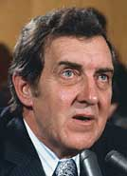
“There’s no point in speaking unless you can improve on the silence.”
- Edmund Muskie
- Edmund Muskie

Slide 3
Employment:
What are we talking about?

Slide 4

Competitive Integrated Employment
Wages & benefits: similar to those without
disabilities performing same work
Location typically found in the community
  Not created with specific intent of employing
  people with disabilities
Same opportunities for advancement as other workers
Same conditions of employment as employees without disabilities
Both within the work unit and entire workplace, must interact with co-workers, customers, and vendors to the same extent as employees without disabilities in comparable positions

Slide 5
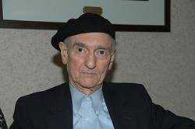

Wolf Wolfensberger
Physical integration is a precondition for the attainment of social integration
“Ultimately, integration is only meaningful if it is social integration –
if it involves social interaction and acceptance, and not merely physical presence.”

Slide 6

Presumption of employability
Strength-based
Job placements = good match between individual’s skills, personality, interests,
Individual fully engaged and empowered throughout the process
Driven by individual’s interests and preferences

Slide 7

Why is it that everything we know about a good job search for people without disabilities, we too often forget when it comes to a job seeker with a disability?

Slide 8
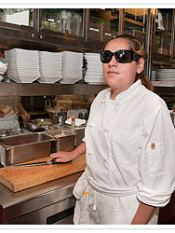
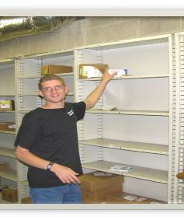
Persons with disabilities succeed on the job and in careers for the same reasons as other individuals

Slide 9

Clear goals
Experience in trying
new things
Use of personal networks
A good job match
A supportive work
environment

Slide 10
Persons with disabilities are unemployed for many of the same reasons as any other individual
Lack of education
Lack of skills
Poor personal networks
Cultural expectations

Slide 11
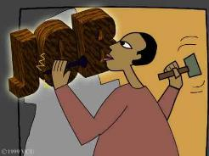
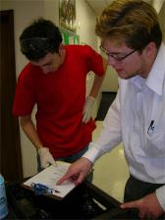
Deviate from typical employment process only as absolutely necessary
(but sometimes it’s necessary)

Slide 12
Do you REALLY believe in employment?
Everyone has an employment plan
Plan regularly updated
Individuals in charge of their employment plan
Staff spending most of their time on employment
Exploration and assessment occurring in the community
Understand and highly engaged with your local labor market
Job development ≠ filling out job applications and internet searches
Tracking employment processes and outcomes
Employment goals/benchmarks
Budget dollars focused on employment
Staff have necessary competencies
Truly informed choice regarding employment

Slide 13
The
“Choice”
Issue

Slide 14
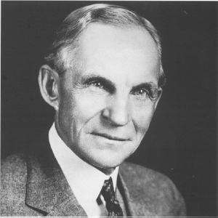
- Henry Ford
“If I had asked people what they wanted, they would have said
a faster horse.”

Slide 15


Do you want to work in the community?
NOT INFORMED CHOICE

Slide 16

Ensuring truly INFORMED CHOICE
about employment
Affirmative Steps
Provide information about the benefits of working
in integrated settings.
Facilitate visits or other experiences in such settings: situational assessment, informational interviews, job shadowing, job tours, etc.
Peer-to-Peer Opportunities: Individuals with disabilities & families.
Identify and address any concerns or objections raised by individual or relevant decision-maker.

Slide 17
People with disabilities should have the same level of choice in their lives as those without disabilities

Slide 18


Create a program for individuals to participate in
Old Paradigm
New Paradigm
Support individuals to fully participate in existing opportunities in the community

Slide 19
The Changing Role of the Professional
FROM
Caretaker
Trainer
Authoritative figure
TO
Facilitator of inclusion
Facilitator of community supports
Support professional
Social change agent

Slide 20
This is a social justice and social change movement

Slide 21
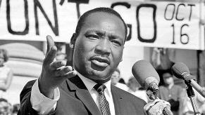

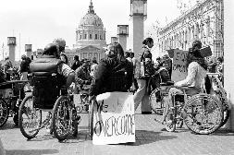

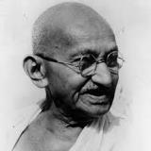
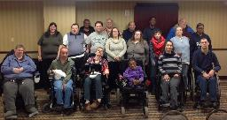
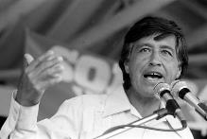
Civil Rights Worker

Slide 22
Jobs and Community
Jobs and Community

Slide 23

It’s not just about changing individual lives.

Slide 24
“It is very clear to me now,
that the manner in which we interface with people with apparent disabilities
is far more reflective of our own personal capacities, than those of the person we interface with.”
Kay Drais, Parent

Slide 25

Old habits die hard

Slide 26
Typical employment in the general workforce
Create a
pre-vocational “program”
Create an enclave
Start an agency business
Create a non-work “program”

Slide 27

“What you do
proves
what you believe.”
Simon Sinek

Slide 28
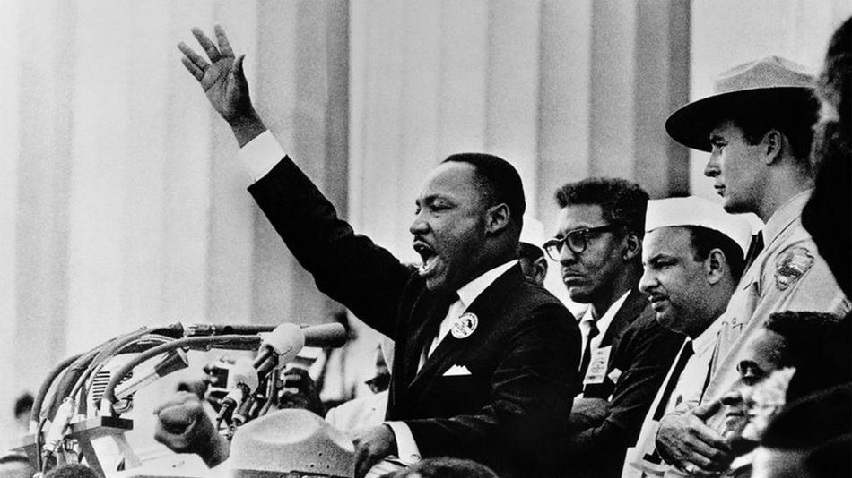
“Martin Luther King gave the
‘I Have a Dream’ speech,
not the
‘I Have a Plan’ speech.”
Simon Sinek

Slide 29
Do you want a program?
Or do you want a job?

Slide 30
What’s your response?
Don’t want to work
Only want to work a few hours
Can’t work because of benefits
Better off in a day program
Happy in sheltered work
Person isn’t work ready
Individual loses a job

Slide 31
What’s your response?
Production rate is too slow
Service provider: Let’s start a business.
Let’s create an enclave
No jobs
Business: We have no openings.
Provider not finding jobs
Too disabled to work

Slide 32

Trends and
Opportunities

Slide 33


APPS:
The New Revolution in Job Supports

Slide 34
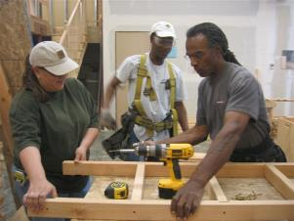




Expand Boundaries of
Industry-Based Credential Training for Skill Enhancement

Slide 35
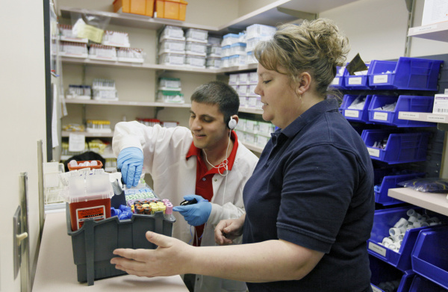
New support models:
Embedded job coaches
Compensating employers for supports

Slide 36
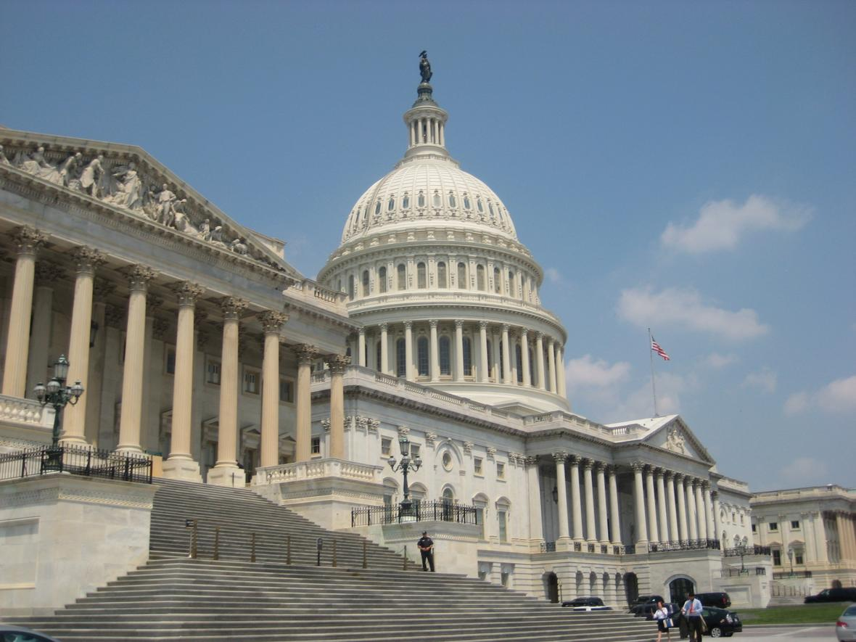

Federal Policy: Murky Future

Slide 37



Slide 38


Proposed cuts to discretionary
programs and Social Security benefits
Tax cut proposals
Efforts to eliminate regulations
Few undersecretary/commissioner appointments to date

Slide 39
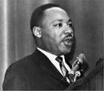
“We must accept finite disappointment,
but never lose infinite hope.”
Martin Luther King, Jr.

Slide 40
“When you are born in a world you don’t fit in,
it’s because you were born to help create a new one.”

Slide 41
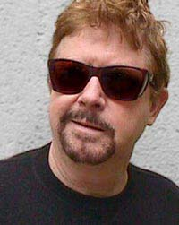
“Humanity has advanced, when it has advanced, not because it has been sober, responsible, and cautious, but because it has been playful, rebellious, and immature.”
- Tom Robbins

Slide 42
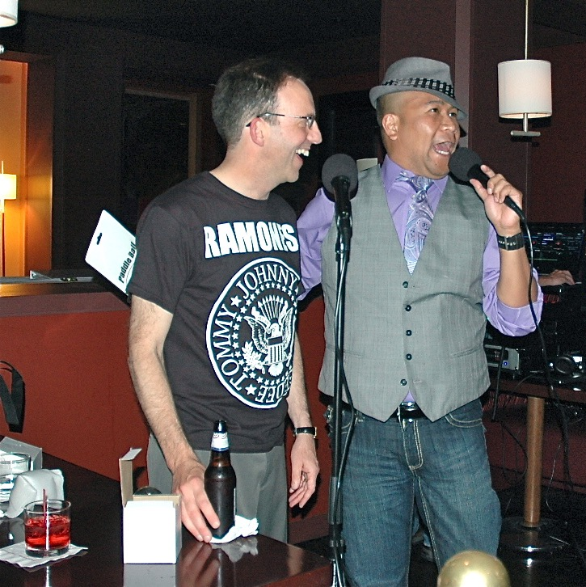

Slide 43
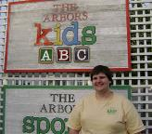
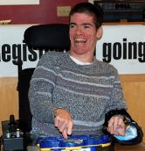

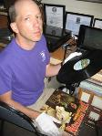
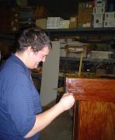

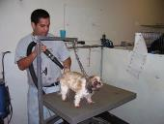
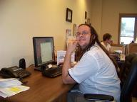
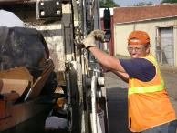

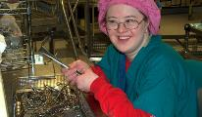
Let’s make employment for people with disabilities
NOTHING SPECIAL

Slide 44
Thanks!

