Slide 1



Benefit Issues:
Is It Time to Change the Conversation?
David Hoff
Program Director
Institute for Community Inclusion
UMass, Boston

Slide 2


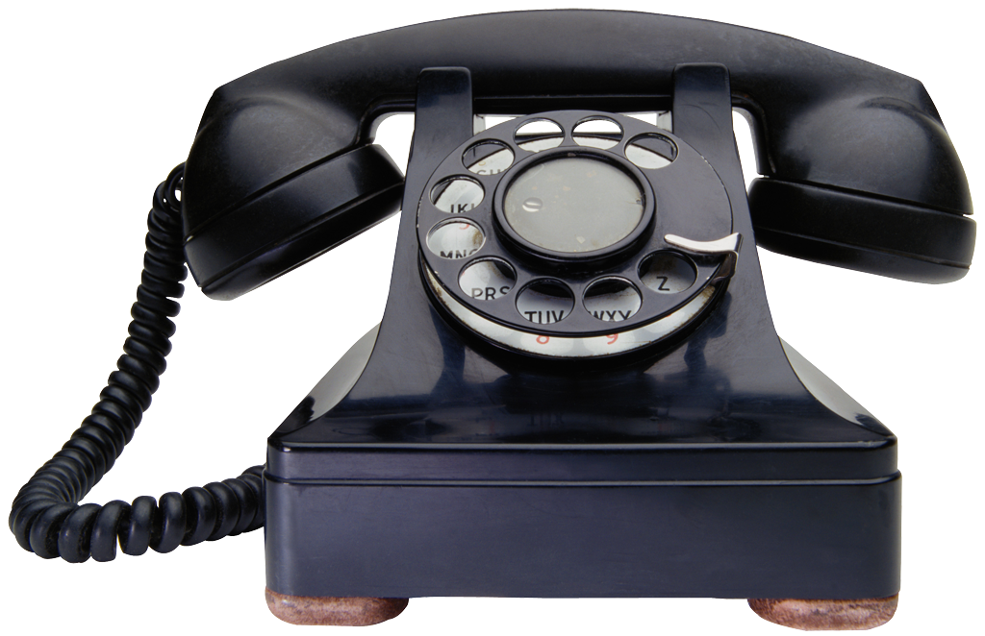
David Hoff
617-287-4308
david.hoff@umb.edu
www.communityinclusion.org

Slide 3

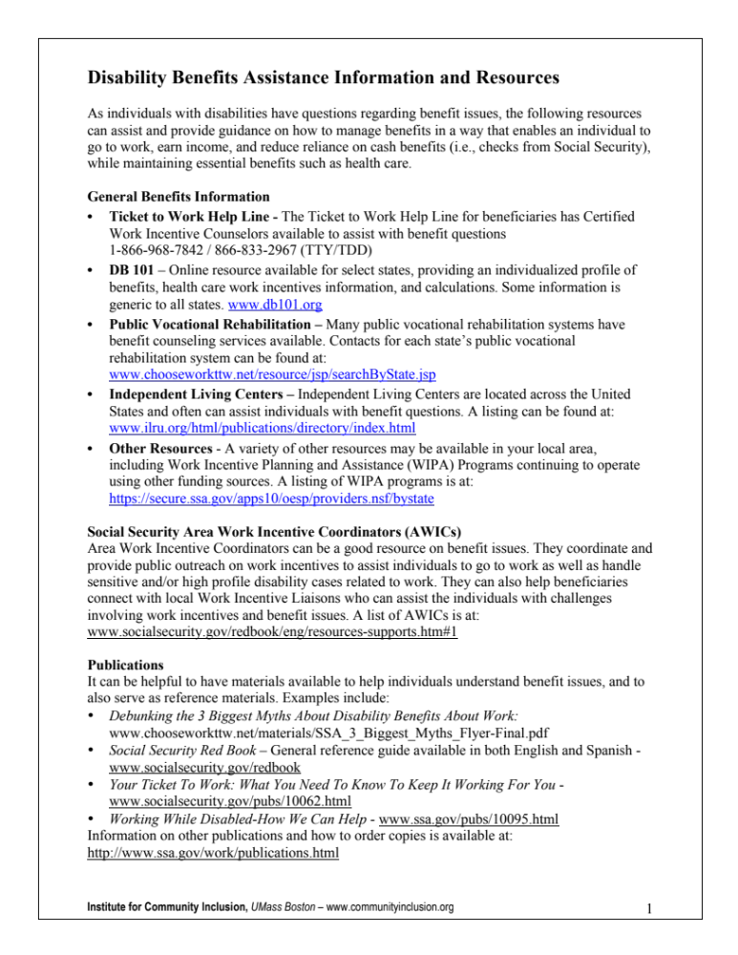
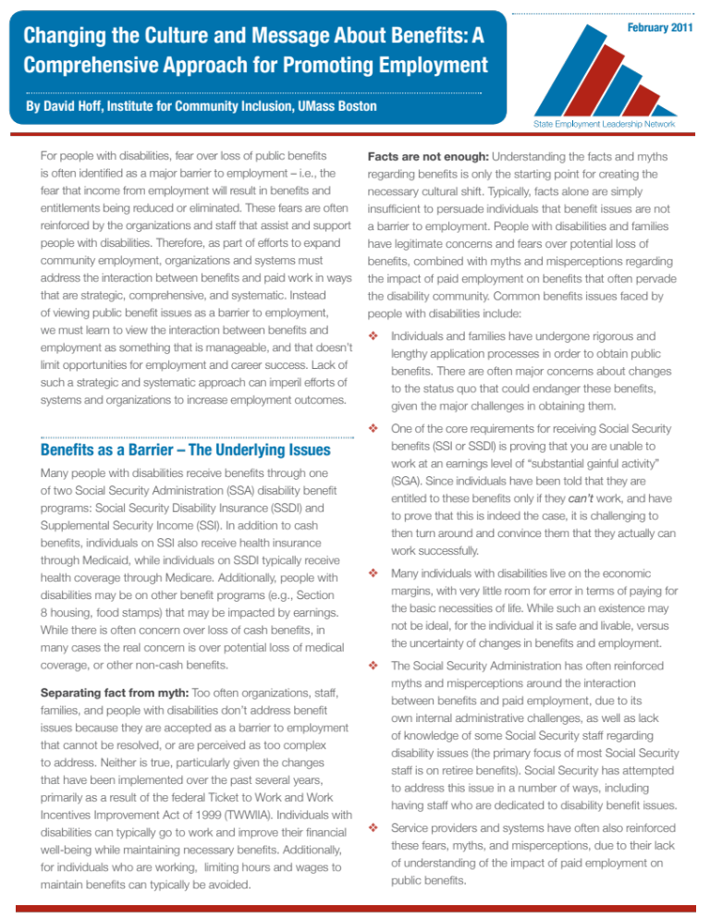
Handouts
SELN: Changing the
Culture and Message
About Benefits
Disability Benefits Information and Resources
I will be happy to send copies of the PowerPoint

Slide 4
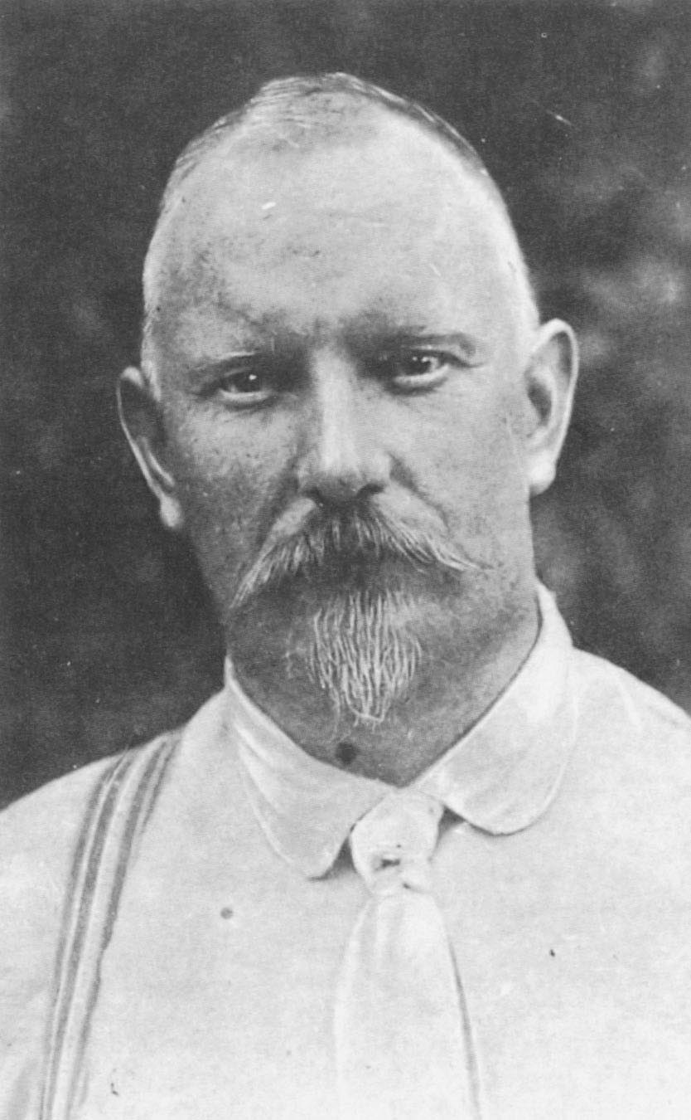
“Look for the ridiculous in everything
and you will find it.”
Jules Renard

Slide 5

The Current
Conversation

Slide 6


Earn only enough,
so your benefits aren’t impacted.

Slide 7

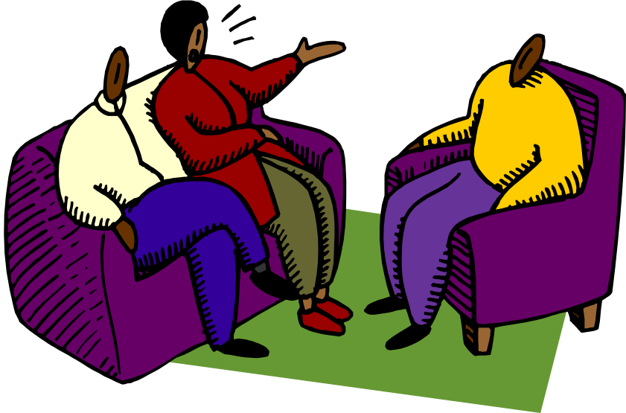
Going to work and managing your benefits is too complicated.

Slide 8


You’ll lose your medical coverage if you go to work.
Benefits are too complex. You’re better off not working.

Slide 9

You’re better off not working.

Slide 10
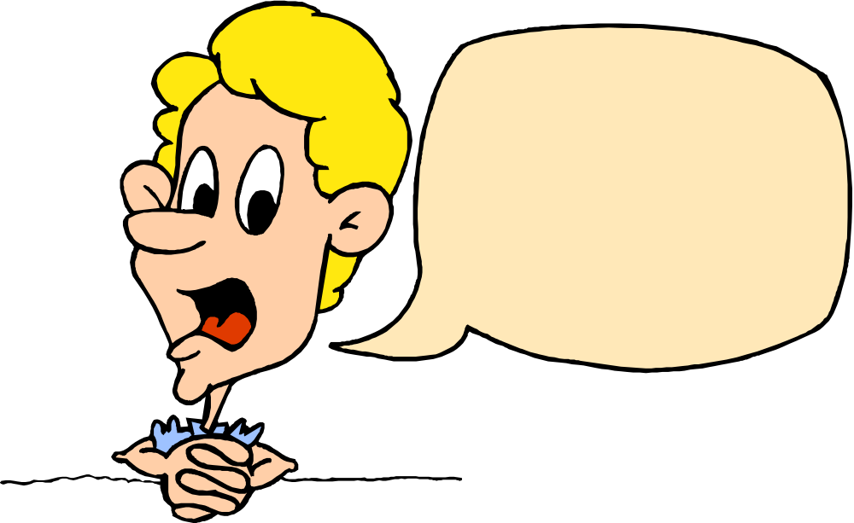
Social Security told me I get these benefits because
I can’t work.

Slide 11
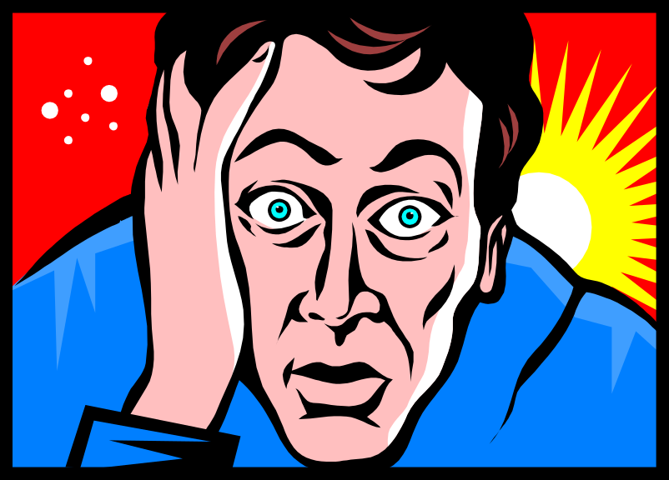
After all the trouble with Social Security to get these benefits, I just want to leave well enough alone.

Slide 12

My friend’s brother went to work for a month and lost all his benefits.

Slide 13


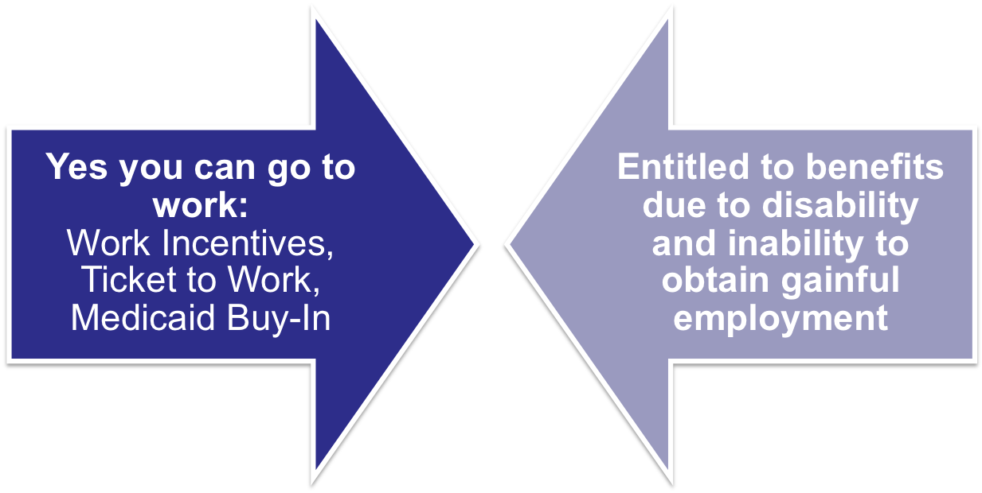
Mixed Messages

Slide 14

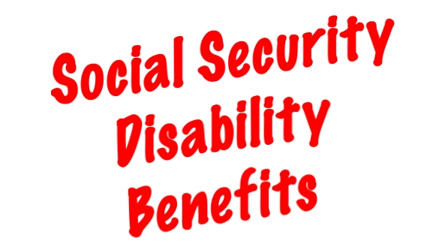
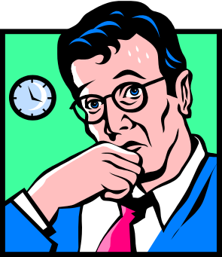

Workers limiting/cutting their work hours – with the encouragement of service providers & families
Workers turning down raises
Benefits counselors encouraging people not to work
Benefits counselors telling people to quit their job for 2 years to reset the benefits clock

Slide 15
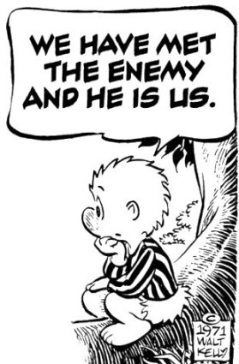

Slide 16

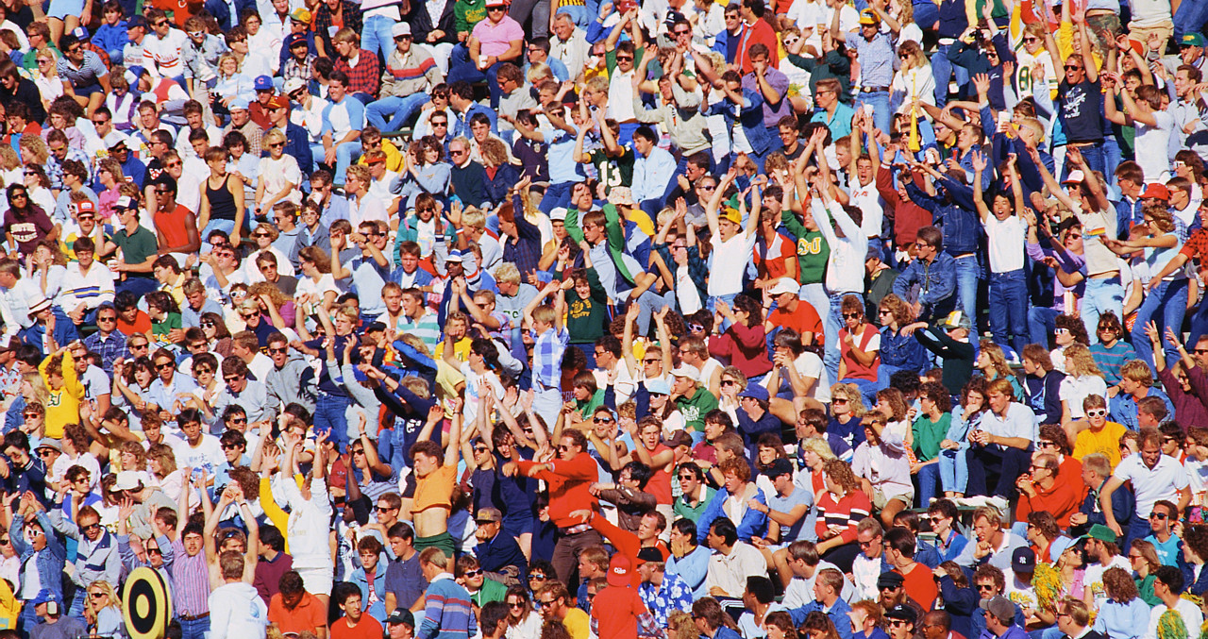

You’re better off
not working.
Social Security told me I can’t work.
It’s too complicated.
“Public benefits are not a barrier to employment.”
Limit your
hours.
You’ll
lose your health care!

Slide 17


So, how do we change the conversation?

Slide 18


Changing the Benefits
Conversation - Step # 1:
Getting Our Facts Straight

Slide 19

True or False:
A non-blind individual receiving a monthly SSI check will stop receiving a check when their income goes over SGA
of $1,040 per month.
Answer: False.
SGA is only used to qualify for SSI. SSI checks are gradually reduced in relation to income. For a single individual, they will continue to receive a check until they earn approximately $1,500 per month.

Slide 20

An individual on SSI will lose their free
Medicaid when they:
a) Start earning money from a job.
b) Stop receiving their SSI check.
c) Earn $15,000 per year.
d) Earn $27,500 per year.
Answer: d
In Oklahoma, $27,500 is the threshold amount under 1619(B).

Slide 21

An individual on SSDI will lose their free
Medicare when they:
a) Start earning money from a job.
b) After working for 12 months above SGA.
c) Three years after cash benefits end.
d) Seven and a half years after cash benefits end.
Answer: d
Free Medicare is available for 7 ½ years after cash benefits end, and can be purchased after that.

Slide 22

The Basics That Everyone Involved with Assisting People with Disabilities with Employment Should Know
Impact of working on cash SSI and SSDI benefits
Impacting of working on Medicare and Medicaid
Awareness of work incentives (IRWE, PASS, BWE, Expedited Reinstatement)
Where to find benefits expertise

Slide 23
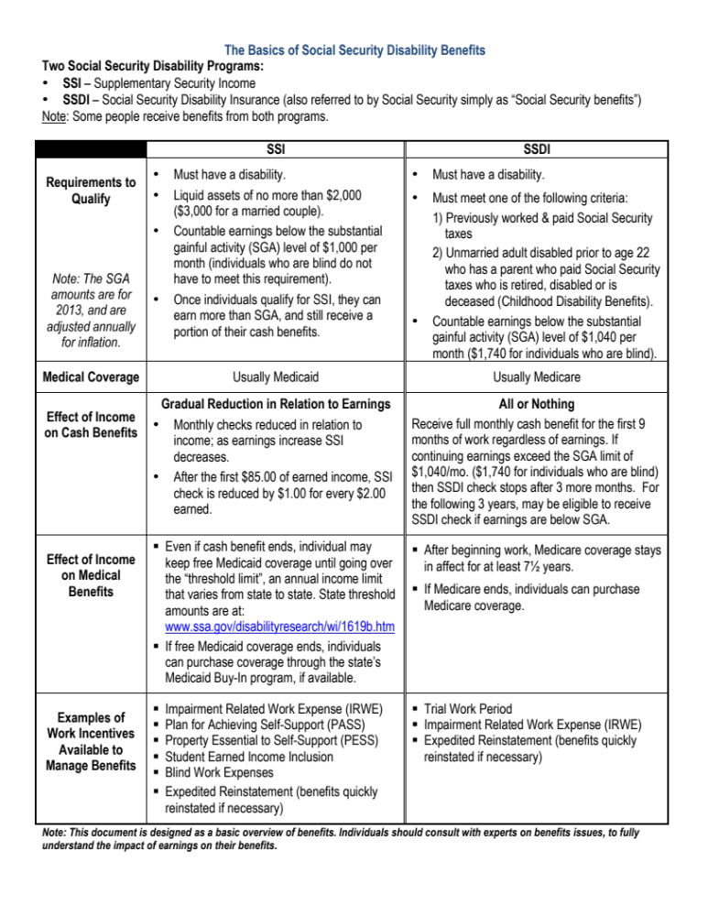

All the Basics are Right Here
Consider customizing to your state and use as handout for individuals and staff

Slide 24
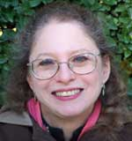
“We are not rationale human beings.
We are all masses of contradictory impulses.”
Judi Chamberlin

Slide 25

What is needed is a cultural change from
MAXIMIZE PRESERVATION OF BENEFITS
to
PRO-EMPLOYMENT BENEFITS MANAGEMENT

Slide 26


Changing the Benefits
Conversation - Step # 2:
Creating the Right Message

Slide 27

What Should the Message Be?
Receiving benefits is not a barrier to employment
Hours of works and earnings don’t need to be limited
You can go to work and necessary benefits can be maintained
Resources & experts are available
Your concerns are legitimate
Others

Slide 28


MOST IMPORTANT MESSAGE
“Yes, I believe you can work, and there is a job out there for you that’s a good match for your skills and interests.”

Slide 29

“It is nearly impossible to make your own future,
when you are not part of the economic fabric
of the culture you live in.”
Patricia Deegan
20th World Congress Rehab International
Oslo, Norway – June 2004

Slide 30


Changing the Benefits
Conversation - Step # 3:
Make your Message Consistent, Clear, and Ongoing

Slide 31


Rules of Messaging
Be clear
Be consistent
Use multiple trusted sources & mechanisms
Message needs to be ongoing and constant

Slide 32

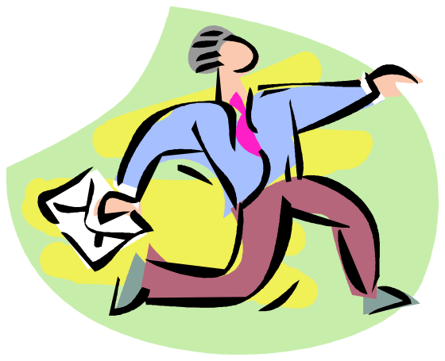
Who delivers the message?
All staff (not just employment)
Funding agencies
Teachers
Peer-to-peer: individuals and families
Outside benefit experts
Others

Slide 33
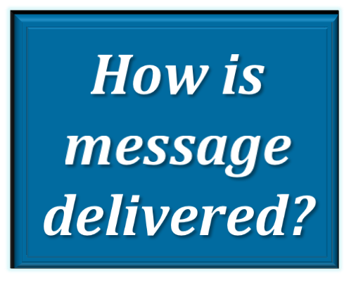


Integrate within standard communication
Individual meetings
Group meetings
Staff meetings
Newsletters
Emails
Website
Bulletin boards, posters
Others

Slide 34


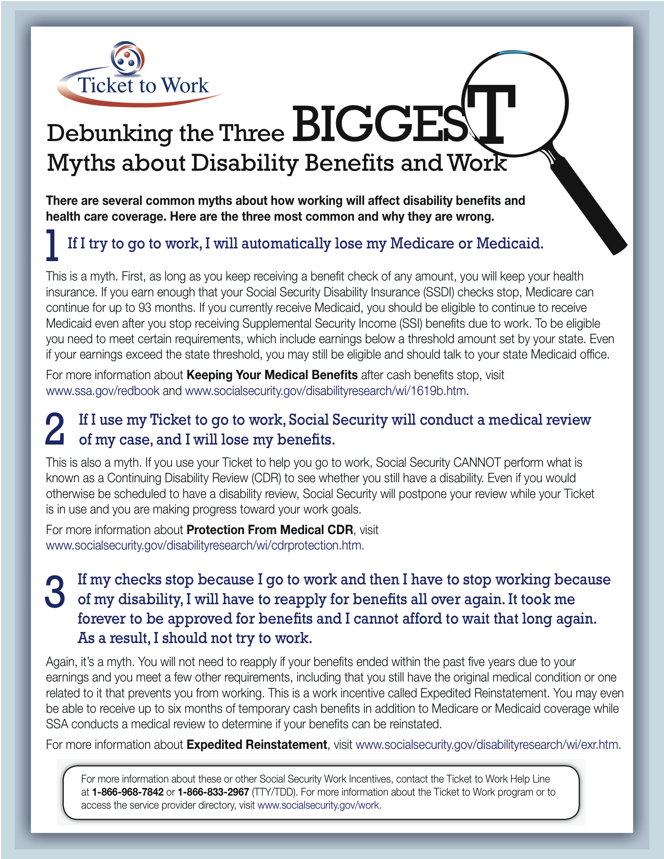
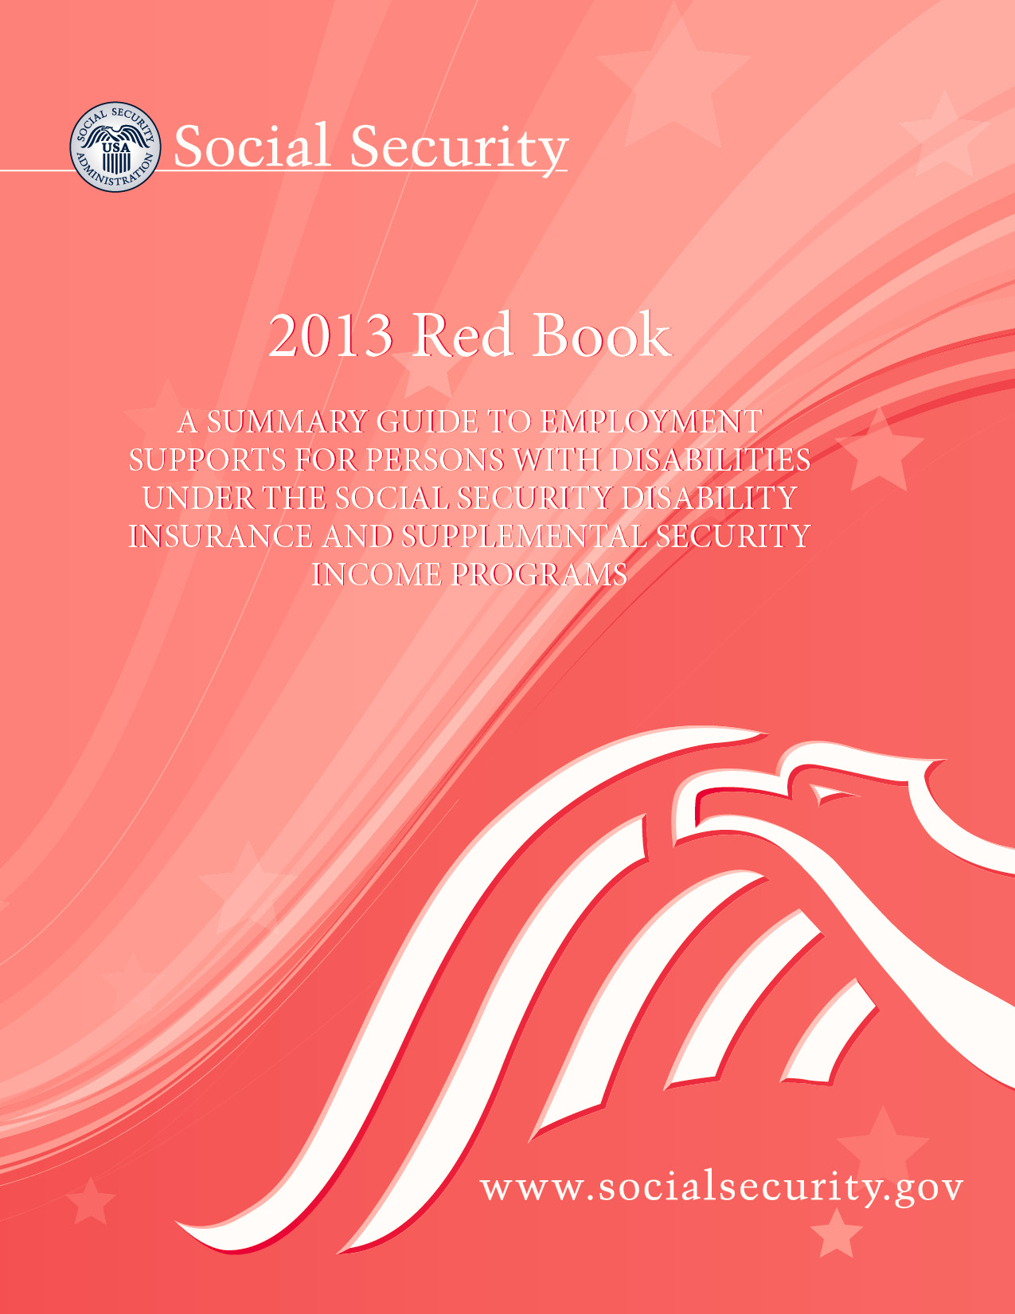
Use Social Security Publications

Slide 35

Benefits Communication
Do’s and Don’ts
Don’t let benefit issues/concerns go unaddressed
Do make sure everyone maintains a positive message regarding benefits
Don’t just passively accept or reinforce the idea that a person can’t go to work because of benefit issues

Slide 36


Public Systems
Reinforce internally & externally that benefits are not a barrier to employment
Require service providers to provide basic benefits assistance as a core assistance
Support service providers to build a core knowledge base
Work with existing benefit resources to develop linkages and leverage

Slide 37



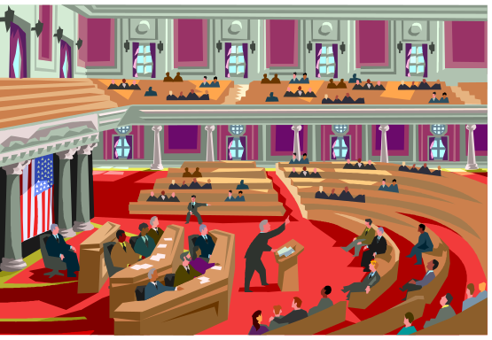
There is also another benefits conversation going on

Slide 38

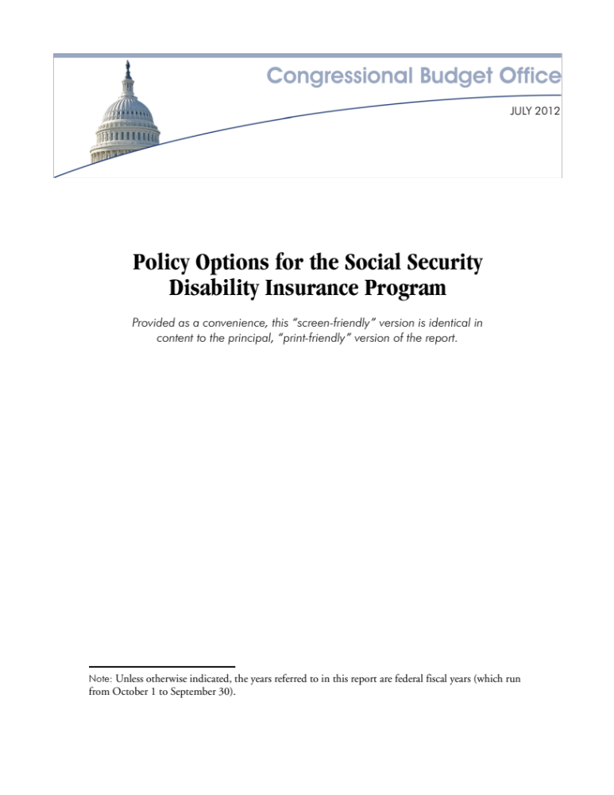
In Congress: Concern Over Growing Social Security Disability Roles
Congressional Research Service: SSDI Trust Fund will Run Out in 2016

Slide 39




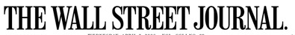
In the Mainstream Media
The Other Welfare: Increased Number of Young Children on SSI
Unfit for Work:
The Startling Rise of Disability in America
Two Lawyers Strike Gold in U.S. Disability System

Slide 40
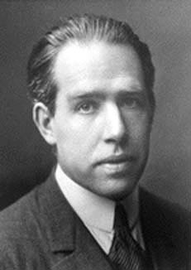
“Prediction is very difficult, especially about the future.”
Niels Bohr

Slide 41



Questions, Comments, Discussion,
Next Steps

Slide 42

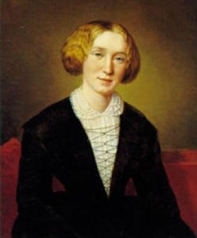
“It's never too late to be who you might have been.”
George Eliot

Slide 43


“ A ship in harbor is safe ---
but that is not
what ships are built for. ”
John A. Shedd

Slide 44

Thanks for Attending!

