Slide 1

Institute for Community Inclusion
Notes:
On behalf of the Institute for Community Inclusion at UMass Boston we want to welcome you to this training. The ICI is an organization providing research, training and technical assistance on promoting full inclusion for people with disabilities.

Slide 2
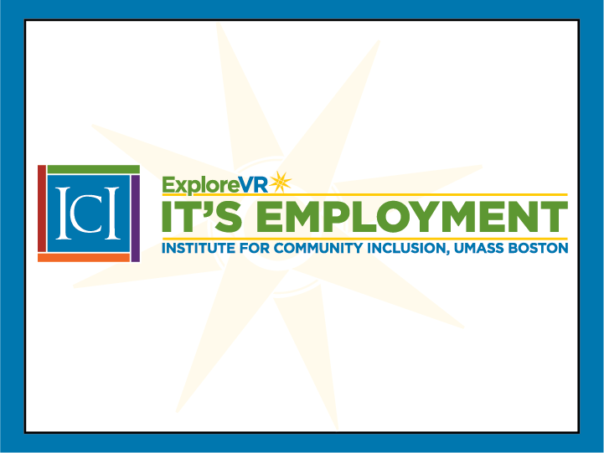
IT’s Employment
PRESENTER:
  David Hoff
  Institute for Community Inclusion, UMass Boston
Notes:
This IT’S EMPLOYMENT training is being provided through a grant from the Unites States Office of Education, Rehabilitation Services Administration. It is my privilege to be your trainer for today, My name is Russ Thelin and I am coming to you from the Salt Lake City area where prior to my work with UMass Boston and the ICI I worked for 25 years within the Utah State Office of Rehabilitation, starting as a VRC and concluding my time there as the combined agency’s Executive Director.

Slide 3

Welcome
to Part 3 of
Successful Transition from School To Employment for Youth with
Intellectual Disabilities
Career Counseling for
Youth with ID
Notes:
This is part four of a 5-part state learning collaborative training tailored to identified needs of the Colorado Division of Vocational Rehabilitation. Our focus today will be on approaches and models for creating pathways to employment for successful transition from school to employment for youth (and adults) with intellectual disabilities.

Slide 4
SESSION AGENDA
Career Counseling for Youth with Intellectual Disabilities
1. Individuals with intellectual disabilities:
Considerations in VR services
2. Ensuring alignment with the career
development process
3. Best practices in Work-Based Learning
4. Ensuring informed choice

Slide 5
SESSION AGENDA
Career Counseling for Youth with Intellectual Disabilities
5. Benefit issues
7. Cross-cultural issues

Slide 6
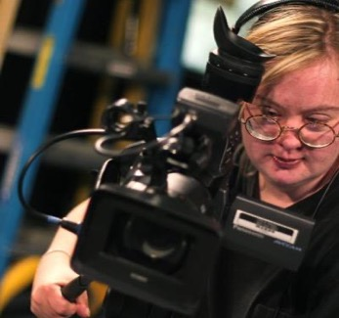
“Listen to our dreams about having a job.
We want to work just like others.”
Stirling Peebles
Green Mountain Self-Advocates

Slide 7

DVR Counselor Tasks
Provide vocational guidance & counseling.
Ensure individual has opportunities for appropriate experiences when necessary to develop preferences.
Provide necessary support services to assist individuals in identifying & understanding preferences in light of their strengths, resources, concerns, priorities, abilities, capabilities and interests.
Ensure individual has opportunities to choose among various options.

Slide 8


Impact of Intellectual Disability on Individual
Social skills
Communication skills
Increased time needed for cognitive process and learning
Low literacy (reading, writing, math)
Challenges with abstract concepts
Challenges w/transferring learning
This Photo by Unknown Author is licensed under CC BY-NC-ND

Slide 9
Social & Societal Impact of Intellectual Disabilities
Low & narrow expectations
  Personally & externally
Limited experience
Deference to others
Individual acquiesces to authority – “aim to please”
Lack of skills in choice making & self-determination
Stereotypes regarding societal role and abilities
Others

Slide 10
Exercise
Addressing impact of ID in Vocational Rehabilitation Counseling
Given the nature and impact of intellectual disabilities, consider how these issues can be addressed within the delivery of VR services and the transition process in a way that empowers the individual, and facilitates informed choice and self-determination.

Slide 11

Discussion
Strategies for Addressing Impact of ID

Slide 12
Determining whether individuals with ID can benefit in terms of an employment outcome from VR services
How much of an issue is severity of disability?

Slide 13




Trial Work Experiences
What trial work experiences are currently available?
Are they of sufficient variety?
Are sufficient supports available?

Slide 14
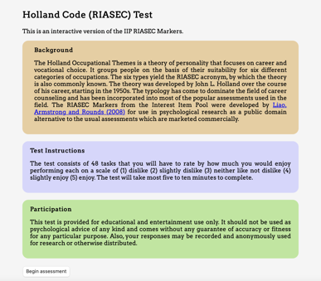
Comprehensive Assessment Activities
What tools and strategies do you typically use for assessment?
Are these appropriate for individuals with ID?
How might they be modified to best address their needs?

Slide 15
Assessment Strategies
Explore past experiences using a person-centered approach
Don’t be limited to closed-format approaches. Use an open inquiry approach.
Help youth identify strengths and positives from those experiences
Facilitate a variety of individually driven experiences
Facilitate ongoing reflection by the youth

Slide 16
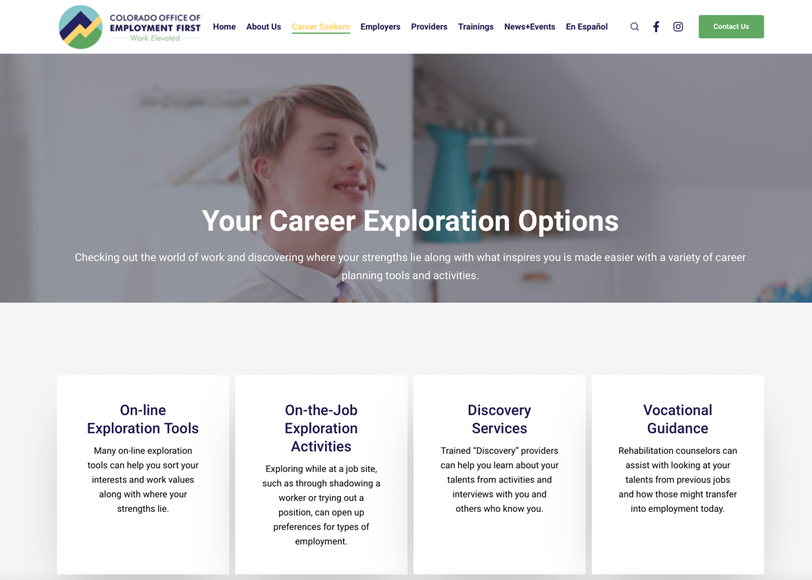
https://employmentfirstcolorado.org/career-exploration

Slide 17
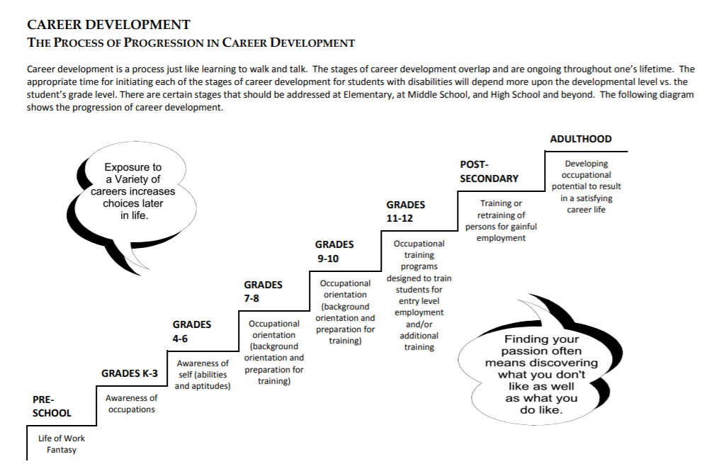
Career Development The Process of Progression in Career Development
Career Development: The Process of Progression in Career Development:
https://www.cde.state.co.us/cdesped/tk_tab05_careerdevelopment
Notes:
The Colorado Department of Education created this wonderful chart that shows the progression of career development. It is helpful to think about career development as a continuum of learning, just as we talk about self-determination and decision making as being on a continuum of learning.
Career planning often starts with fantasy and excitement for certain types of professions and professionals. The awareness of different occupations, ourselves and our skills and what is required to work in different jobs starts to form as we see more of the world and have more chances to watch and talk with other people. As we mature, we start to think about what is meaningful to us– this is in terms of the work we like to do, the people we want to work with, but also in terms of what we want to invest in when starting a career.
This chart shows a nice, neat progression of developmental ages as people gather information and process it. However, what if someone doesn’t start this process in pre-school, or doesn’t move through the stages as quickly as this chart shows they could? What if we have a 14 year old who is still in the fantasy stage and hasn’t developed the awareness of the occupational requirements, their own skills, and what is required to prepare? We can all think of the 14-16 year olds who want to be professional athletes but who have average athletic ability. Or who want to be a doctor, but struggle to understand the high school science classes.
I would like to challenge you to think about this progression chart, and instead of saying they are being unrealistic, then think about how you can help them gather more information so they can integrate what they have learned toward career goals that fit them more closely.

Slide 18
INCOME Framework
Imagining
INforming
Choosing
Obtaining
Maintaining
Exiting
Beveridge, Craddock, Liesener, Stapleton, Hershenson, 2002

Slide 19

Imagining
Individual develops awareness that work, job, or careers exist, or that occupations or jobs exist they were not aware of
Three stages:
  Awareness
    Realizing there is such a thing as work and occupations that have direct significance to one’s self
  Fantasy
  Reality-based imagining
Career Counseling With People with Disabilities
Sears, Jones & Strauser, 2013

Slide 20
INforming
Individual obtains information about one’s self, the world of work, opportunities that exist within the environment, and one’s cultural context
Includes:
  individual developing work competencies (work habits and interpersonal skills)
  acquisition of information about oneself and world of work (provided by feedback they receive from their environment)
  developing awareness of cultural supports and barriers that exists in the environment
Career Counseling With People with Disabilities
Sears, Jones & Strauser, 2013

Slide 21
Career Self-Efficacy
Individual
Cultural Characteristics
Environmental
Career Counseling With People with Disabilities
Sears, Jones & Strauser, 2013

Slide 22
Creating Career Self-Efficacy
Environmental feedback received serves as strong indicator of individual’s career path
Via feedback from parents, peers, school, etc., individuals form beliefs about :
  abilities
  existing opportunities
  cultural supports and barriers
  resulting in individual’s career-related self-efficacy and outcome expectations.
Career Counseling With People with Disabilities
Sears, Jones & Strauser, 2013

Slide 23

Choosing
Individual integrates information about themselves and world of work, from previous statuses (Imagining and iNforming).
Chooses occupations, jobs, or educational programs from those known to the individual at time choice is made.
Not all decisions are logical: for some individuals family can be a critical factor in choosing; others may rely on chance, intuition, or impulse to guide their decision making.
Career Counseling With People with Disabilities
Sears, Jones & Strauser, 2013

Slide 24
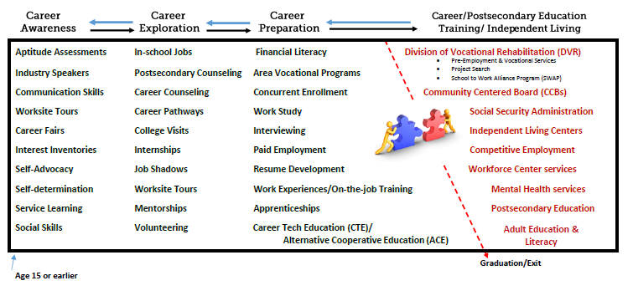
Evolving career development experiences
Goal: Continuum of supports, services, information to support young adults toward employment.
Notes:
Another way to think about these developmental steps and the continuum of learning about careers, is this wonderful chart that Colorado also has developed that gives examples of what activities support a student from career awareness, to career exploration, to career preparation and then ultimately to a career. Again, these stages will differ in terms of when a student begins and how quickly or slowly, they progress through the stages, but the transition and the learning continuum is important.
The only piece that could be emphasized more with both of these charts, is the idea of self-advocacy, decision making and self-determination as a necessary component in each of the phases of career development, and not just in the beginning of the process.

Slide 25

Enhancing Belief in Career Self-Efficacy
Structure experiences that help youth with disabilities:
Succeed in pre-career
decision-making activities
Observe other individuals successfully performing career-related activities
Participate in challenging
career-related activities
Identify and resolve anxiety- provoking issues related to making the transition from school to the adult career world
Predictors of Career Exploration Intentions: A Social Cognitive Career Theory Perspective, Ochs & Roessler, 2004

Slide 26

Striking the Right Balance
Individual who is perceived to have limited abilities is often given unchallenging tasks that essentially convey a disbelief in individual’s ability to perform.
Inconsequential or simple tasks can reinforce lower career and academic expectations that parents and school counselors express for youth with disabilities.
Tasks must not be so difficult that mastery is unlikely or so easy that message of lowered ability expectations is conveyed.
Career Expectations and Aspirations of Youth With and Without Disabilities, Fisher & Harnisch, 1992

Slide 27

BREAK

Slide 28
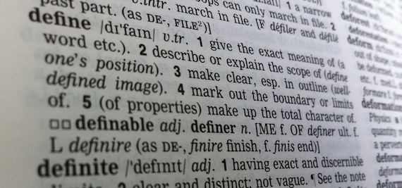
Work-Based Learning
A supervised and structured program that uses worksite experiences as means for gaining knowledge about work skills, strengths, and career preferences
Knowledge gained at the worksite may be linked with classroom instruction and a program of study
Experiences range in intensity, structure and scope, aligned with stages of career development
This Photo by Unknown Author is licensed under CC BY-SA

Slide 29

Why Work-Based Learning?
Avoids arbitrary set of career exploration activities
Uses a systematic approach
Focuses on what is learned from experience

Slide 30
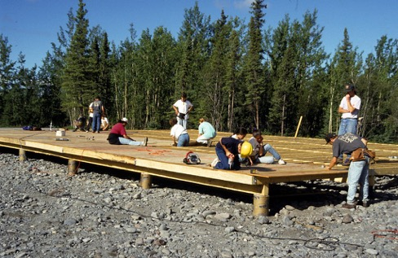
Examples: Work-Based Learning
Examples:
Work-Based Learning
Internships
Apprenticeships
Short-term employment
On-the-job trainings
Job shadows
Informational interviews
Job tours
Workplace mentoring
Service learning
Volunteer work
This Photo by Unknown Author is licensed under CC BY-NC-ND

Slide 31
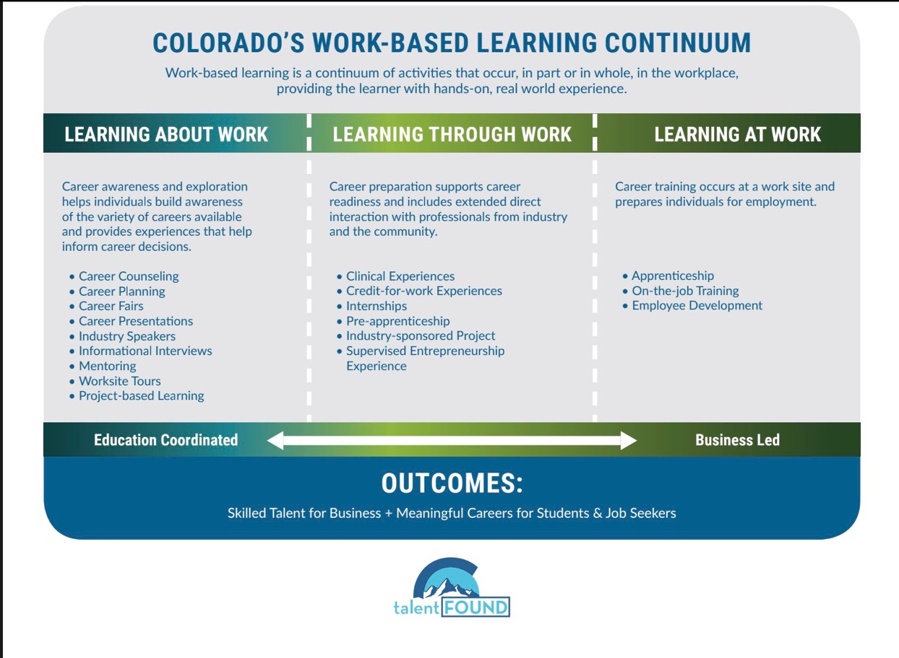
Colorado’s Work-Based Learning Continuum

Slide 32

Work-Based Learning Best Practices
Provide exposure to wide range of jobs and careers including those outside of “traditional” employing industries for youth and individuals with disabilities.
Strong links with labor market.
Experiences are age and stage appropriate.
Work site learning is structured and links back to classroom instruction.
Employer shares learning goals of instructors and students.
Work-Based Learning
Best Practices

Slide 33
Work-Based Learning Best Practices
Periodic assessment and feedback built in.
Results and progress are well documented.
Individuals are fully involved in choosing and structuring their experiences and have opportunity for reflection.
Outcomes are clear and measurable.
Strong supports for student and business.
Work-Based Learning
Best Practices

Slide 34

Pre-ETS Work-Based Learning
WIOA
May include in-school or after school opportunities, or experience outside the traditional school setting (including internships), provided in an integrated environment in the community to the maximum extent possible
Pre-ETS
Work-Based Learning

Slide 35

Areas for Reflection
Student likes and dislikes about experience
  Tasks, environment, co-workers, etc.
Successes & challenges
Areas to work on improving & build skills in
Supports and assistance needed
Possible accommodations & assistive technology
Handling disclosure of disability
How lessons learned can be applied in choosing future experiences, and building blocks for employment preferences
Others

Slide 36





Options for Reflection
1:1 with VR or school staff
Group and Peer-to-peer
Writing & journaling
Use of pictures and video

Slide 37
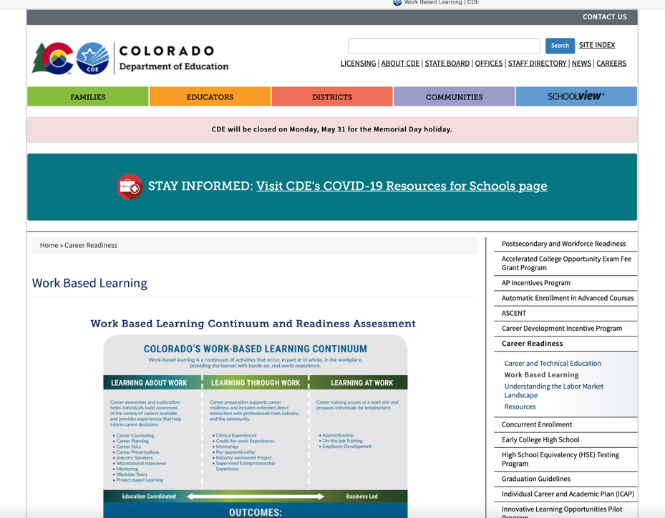
www.cde.state.co.us/postsecondary/workbasedlearning

Slide 38
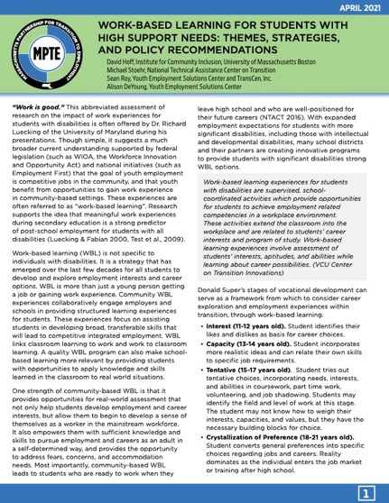
Work-Based Learning Guide and Resource Handout
Work-Based Learning Guide & Resource Handout

Slide 39

Andraea Lavant Quote
“Everybody else in life gets the
opportunity to make mistakes.
You go out on your own, but because disabled people are often sheltered and other people are making decisions for us,
we don't have those opportunities to live completely wholly in that way.”
Andraéa LaVant
Impact Producer, Crip Camp

Slide 40

Informed Choice & Self-Determination:
Another Look

Slide 41

The role of the professional is to create and facilitate the ideal circumstances for individuals to make their own choices and decisions regarding employment

Slide 42

“DVR staff shall inform each applicant and recipient of services through appropriate modes of communication about the availability of and opportunities to exercise informed choice.”
How does this happen?

Slide 43

Examples of “Un-Informed” Choice

Slide 44


Not Informed Choice
NOT INFORMED CHOICE
Do you want to work in the community?

Slide 45

Ensuring Informed Choice & Self-Determination
Explain concepts of “choice” and “self-determination”
Create understanding of career decision-making process
Provide lots of opportunities for choice making and generating additional information to inform choices
Ongoing reflection by individual
Effective ways of communicating preferences and choices

Slide 46

Encouraging Choice
& Self-Determination
“What type of things are you interested in?”
“Tell me more about why you’re interested in that.”
“Why is that important to you?”
“What kind of experiences do you have?”
“How would you go about learning more about that?”
“What’s important to you about working?”
“What did you learn from that experience?”
“What else do you want to explore?”
Others

Slide 47

Informed Choice and Promoting Self-Determination:
Phrases to Avoid
”I think you should…”
“The best type of job for you is…”
“You don’t really want to do that, do you?”
“I don’t think you would be good at that.”
“What do you want to do that for?”
Others

Slide 48

Should staff remain neutral about individual working?

Slide 49
Informed Choice Publication

Slide 50


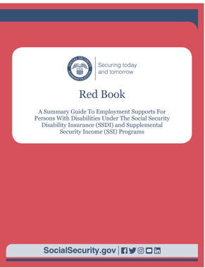
Benefit Issues

Slide 51
“Receiving cash benefits in early ages may have negative impacts on self-concept of youth with intellectual disabilities, confirming their beliefs that they cannot work.”
Demographic Variables, Vocational Rehabilitation Services, and Employment Outcomes for Transition-Age Youth With Intellectual Disabilities, Kaya, 2018

Slide 52
Engaging Youth & Families on Benefit Issues
Make sure professionals in transition team are in alignment regarding “pro-employment” approach to benefits
Have basic information readily and consistently available
Link with benefits counseling (WIPA, etc.)
Consider how youth can be better engaged in benefits conversation
Use peer-to-peer: families, individuals
Other strategies

Slide 53

“Let’s work the problem people.
Let’s not make things worse by guessing.”
Gene Kranz (Ed Harris), Apollo 13

Slide 54
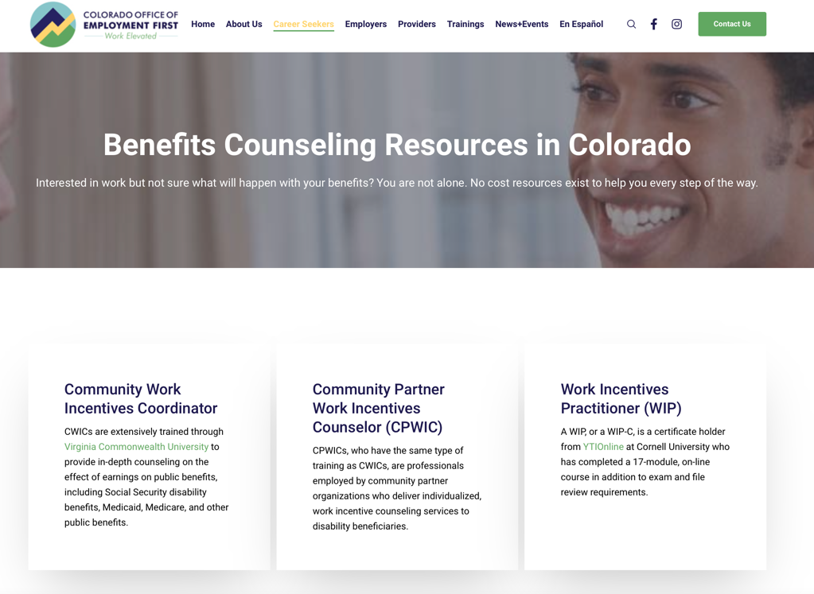
https://employmentfirstcolorado.org/disability-benefits-benefits-counseling/

Slide 55

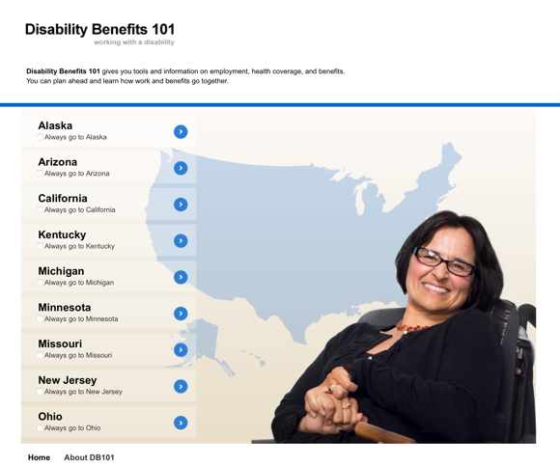
Coming Soon
Coming Soon!

Slide 56

Cross-Cultural Issues

Slide 57
Cross-Cultural Issues: Strategies
Understand your own cultural baggage
Understand the youth and family’s worldview
  Disability, work, communication, independence vs. interdependence, family hierarchy.
Function in a manner that is culturally competent
  Anticipate where your and the individual’s/family worldview potentially conflict.
  Build a strong rapport w/individual & family.
  Ensure anything proposed has strong buy-in, meets cultural expectations, and does not in any way disrespect the individual or family’s cultural perspective.

Slide 58

http://cirrie-sphhp.webapps.buffalo.edu/culture/monographs

Slide 59
Resource Handout

Slide 60

“Presume competence. And what we mean by presuming competence is when you meet a person with a disability you assume they are capable.
Don’t assume that someone can or can’t do things but make sure they tell you what they need for accommodations and give them the chance to be in the driver’s seat.”
Max Barrows
Green Mountain Self-Advocates

Slide 61
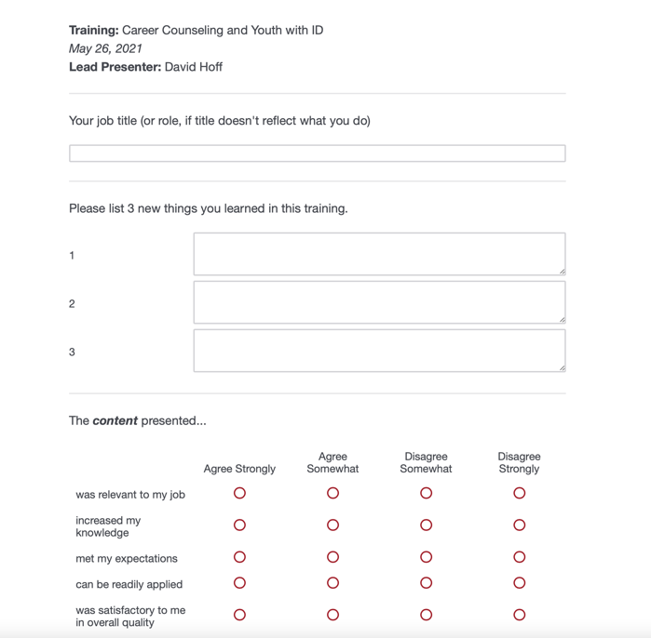
Evaluation
https://umassboston.co1.qualtrics.com/jfe/form/SV_etl29yc9SFtWljU

Slide 62

Thank You
THANK YOU FOR WHAT YOU DO!
QUESTIONS OR COMMENTS?
David Hoff: david.hoff@umb.edu
Russ Thelin: russell.thelin@umb.edu
Mary DiBiase: mary.dibiase@umb.edu

