Slide 1



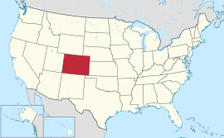
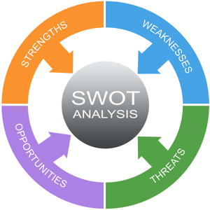
Colorado SWOT Analysis Summary
EFSLMP Vision Quest
Workforce Development
May 26, 2016

Slide 2
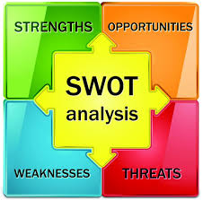
Strengths
School-to-Work Alliance (SWAP) structure and school relationships
Mutual meeting of DVR and education goals
Significant source of cash match for DVR
Relatively positive data for Colorado in terms of employment of people with disabilities

Slide 3
Weaknesses
High level of reliance by DVR on SWAP for its budget
Misalignment of SWAP with overall DVR priorities in terms of population served
SWAP viewed as default option for DVR in terms of transition
Per Indicator 14, many individuals leaving school and not engaged in further education or employment
Mismatch between students in SWAP and Pre-Employment Transition Services
School reliance on sub-minimum wage
School lack of work-based learning opportunities
Local control of education results in lack of consistent
cross-system coordination and engagement

Slide 4
Opportunities
Commitment by DVR within WIOA state plan to revamp transition
Rebuilding of DVR youth service unit
Changes under WIOA provide opportunity to re-work transition
Movement of DVR to Department of Employment and Labor
Colorado Career Pathway initiatives for students
Stronger linkages with workforce development youth services
Strong cross-agency integrated approach on transition with DIDD and OBH
New state focus on work-based learning
Section 511 as a catalyst for reduced use of sub-minimum wage and systems change

Slide 5
Threats
High reliance on school funding for DVR budget creating
  Major challenges in making changes in SWAP
  Re-thinking overall transition efforts
DVR supplanting education obligations with Pre-Employment Transition Services

Slide 6

Transition Policy Recommendations
Clarify roles of DVR and Education in delivery of Pre-Employment Transition Services with emphasis on actual work experience
Enhance existing definitions of Pre-Employment Transition Service components to ensure consistent quality and maximizing work-based learning
Determine target population for Pre-Employment Transition Services and how students will be identified
Define expected and allowable roles of education agencies, DVR, workforce development, Community Centered Boards, and other entities regarding transition
Expanded role of workforce development in transition

Slide 7
Section 511 Recommendations
Policy statement regarding intent of 511 to divert and transition individuals from sub-minimum wage employment
Polices at state and local level regarding DVR and education responsibilities
Policy from CDE reiterating federal prohibition on schools contracting for paying individuals sub-minimum wage
Cross-agency policies between DVR and DIDD and County-Centered Boards on roles and responsibilities in implementation
Policy directives to sub-minimum wage holder regarding Section 511 responsibilities
High degree of awareness about Section 511 among individuals and families
Standards for self-advocacy, self-determination, and peer mentoring

Slide 8

Questions and Discussion

