Slide 1
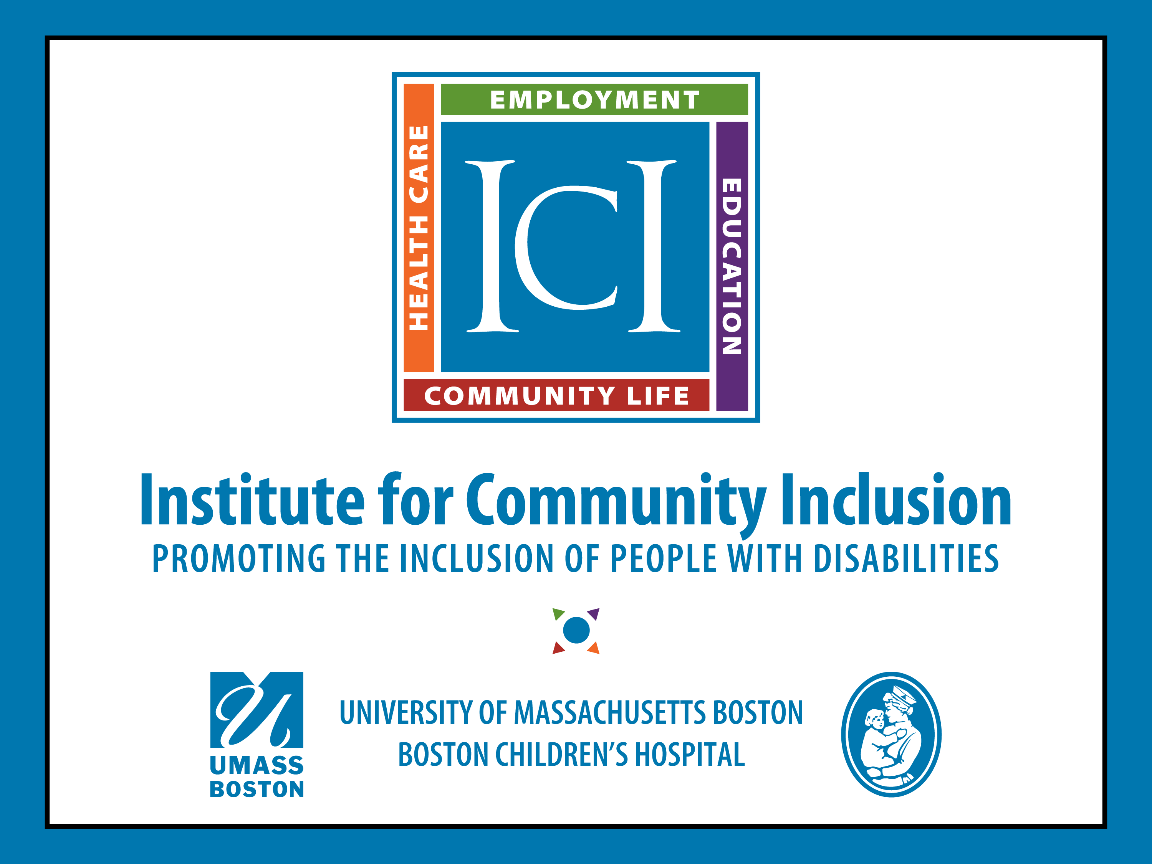

Slide 2
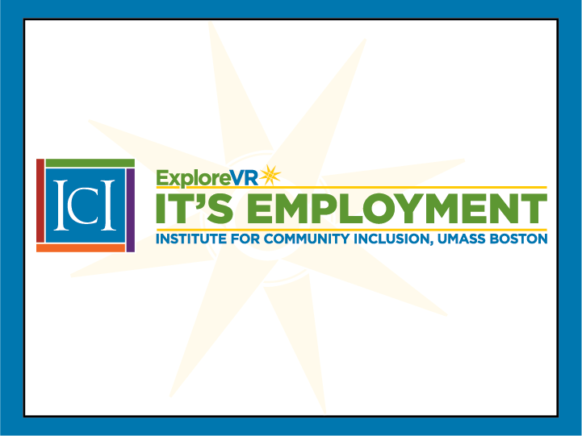
Community of Practice:
Navigating Informed Choice and
Self-Determination with Youth with ID
Facilitators: David Hoff, Russell Thelin, Mary DiBiase
UMass, Boston Institute for Community Inclusion
Funded by Rehabilitation Services Administration (RSA) ​(H263C190011)

Slide 3
Upcoming Communities of Practice
July 27th – 1:00: Employment First: What It Means in Services for Youth with ID
August 11th – 10:00: Working Creatively Within the DVR Counselor Role to Meet the Needs of Youth with ID
August 26th – 1:00: Strategies for Effective Collaboration Between DVR and Schools
September 9th – 3:00: Engaging Youth with Intellectual Disabilities in Underutilized Career Path Options: Apprenticeships, CTE, Entrepreneurship, OJT, etc.
September 22nd – 11:00: Rural Issues and Transition

Slide 4
Self-Determination
Self-determination definition: acting as the causal agent in one’s life.
  Causal agents have the skills & attitudes that enable them to make or cause things to happen in their lives.
People who are self-determined self-initiate and self-regulate their actions to solve problems, make decisions, and set goals that impact their lives.
Adolescents become more self-determined as they:
  identify their interests and preferences
  set and work toward goals aligned with those interests and preference
  engage in problem solving and decision making as they encounter barriers in working toward their goals
  advocate for themselves and their needs
Students need support to learn and practice these skills in an integrated way if they are to lead self-determined lives.
Source: Shogren, K. A., Raley, S. K., Burke, K. M., & Wehmeyer, M. L. (2019). The Self-Determined Learning Model of Instruction Teacher’s Guide. Lawrence, KS: Kansas University Center on Developmental Disabilities.

Slide 5
Informed Choice Definition
The process of choosing from options based on accurate information, knowledge and experiences

Slide 6
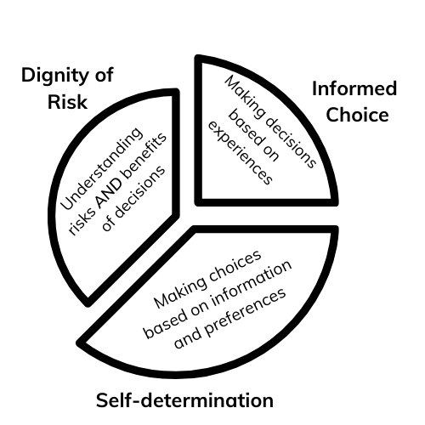
UNDERSTAND THE CONNECTION
Notes:
Before we go any further into this, I want to review the connection of informed choice, self-determination and dignity of risk. There really isn’t any of these that comes first in the development of skills– they are all firmly entwined and connected.
However, for this discussion let’s start with self-determination. If we possess the agency to determine our life’s course, then we are making choices based on information we have gathered and preferences that we feel strongly about.
That leads us to informed choices– making an informed choice means that we have been able to listen to and experience information, can weigh the pros and cons, and then make decisions based on that information and thought process. Making informed choices doesn’t mean that we get everything we want because we decided to make that choice. It means that we were provided all of the relevant information, had opportunities to hear from others, and made a decision that seemed like it was the best one
Our dignity of risk comes from experiencing the consequences of decisions that we made– the consequences could be positive and maybe as good or better than we hoped. Or they could be disappointing because things didn’t pan out they way we had expected. The importance of having the dignity of risk is it gives us information that we didn’t have before, so that we can develop our next steps in our planning and decision making process. Even we as professionals need to be comfortable with the dignity of risk, and have the perspective that everything doesn’t have to work out the way we hoped. If we arranged a work experience at a job that the student was really excited about, but they ended up hating it, or maybe was completely overwhelmed. That doesn’t mean we failed– it means that we all talk about and use that information in making our next steps or plans.

Slide 7
Embedding Self-determination- 1
Doesn’t make sense as a stand-alone activity
Skills move along a learning continuum
Integrate into all settings
Notes:
Really, when we talk about embedding self-determination into the larger context of pre-ets and transition planning, what we are really saying is that we have high expectations for our students and that we want to support them in achieving as much agency and independence as possible when managing their own lives. Therefore, it doesn’t make sense to think about supporting the development of these skills in stand-alone or one and done activities. Now, will there be times that it is helpful to provide training on specific components like soft skill, or when it makes sense to disclose a disability? Absolutely! We just want to make sure we are providing those same skill development opportunities in real world settings so they can practice and make sense of how the information applies to them.
I have mentioned this before, but it is important to remember the variety of skills that are important to self-determination– like decision making, listening skills, communication skills and being able to ask for input– they all exist on a continuum of learning. We hopefully keep getting better at these skills throughout life and I don’t know about, but I am certainly still working on making good decisions.
And finally, having the opportunity to practice these skills in all areas of life is going to be the most meaningful to students. For example, if we have a student who is working on listening skills and understanding how she needs to process the information she gets from others to help her make a decision, that should NOT just happen in one area of her life…it should happen at school, when meeting with her VR counselor and at home– that way she can learn how to apply the skill in a broad context, which is going to support her success when she works at a new job or lives with a new group of friends.

Slide 8
Embedding Self-determination- 2
SELF-DETERMINATION SKILLS ON THE CONTINUUM:
Developing a sense of “Agency” = the capacity of individuals to act independently and to make their own free choices
PRACTICE: Solve problems that act as barriers to achieving goals
PRACTICE: Participate in decisions that impact the quality of their lives
Create action plans to move along the continuum
Notes:
Self-determination can also be viewed as having a personal sense of AGENCY or having the capacity to act independently and to make choices.
What affects our ability to possess self-determination or agency? There are many variables that affect how we present ourselves in the world, including social class, religion, gender, ethnicity, and customs.– and those may determine or limit our decisions. However, another primary factor and possibly a limitation, is the extent to which we developed the skills to consider information, make decisions, and make our preferences known. People with intellectual disabilities, in particular, have a tendency to be cared for and nurtured as a result of their disability, rather than supported in the development of this important skill set.
So, if we are going to determine how to support individuals with disabilities in terms of developing self-determination skills, or skills that facilitate decision making, then we need to first determine where the individual is at, and start building the skill set from that point. We have to remember that disability or not, we are all at different places in our confidence, experience, and comfort levels, and the students we work with are no exception to this.
When we look at self-determination skills as a skill set that we are continually building up and developing, it is helpful to remember some core elements that need to always be incorporated. Our students should have opportunities to practice and refine their abilities to solve problems that get in their way so they can keep getting better at removing barriers, as well as
to practice participating in decisions that impact their lives so that they can keep getting better at deciphering good information from bad information, and to keep getting better at learning from the information that comes as a result of their decisions, whether they worked out or not.
And from that practice, students can keep developing next steps in terms of moving along the continuum and managing our day-to-day decisions.

Slide 9
Everyone believes in self-determination and informed choice.
But do their actions say something different?

Slide 10

In your role, what are key strategies in facilitating self-determination & informed choice?

Slide 11

Within the transition process, where are the opportunities for students practicing and building skills in self-determination and informed choice?

Slide 12

Does self-determination and informed choice mean that students can do whatever they want?
If a student “chooses” not to pursue employment, is that okay?

Slide 13

What do you find are the best methods for teaching students with ID about self-determination and informed choice?

Slide 14

What are the
“do’s and don’ts” regarding questions and phrases to facilitate self-determination and informed choice?

Slide 15

How do you ensure that all partners in transition are aligned with self-determination and informed choice?

Slide 16

What are the biggest challenges to self-determination and informed choice for students with ID?

Slide 17

What do you do if a teacher/educator takes actions not aligned with self-determination and informed choice?

Slide 18

What do you do if a parent does not support support self-determination & informed choice?

Slide 19

Are there resources you use for self-determination and informed choice?

Slide 20

Other thoughts & ideas on integrating self-determination and informed choice within transition process for students with ID

Slide 21

Reminder: Next CoP
July 27th – 1:00:
Employment First: What It Means in Services for Youth with ID

Slide 22
Thank you!
David Hoff David.Hoff@umb.edu
Russ Thelin Russell.Thelin@umb.edu
Mary DiBiase Mary.Dibiase@umb.edu
Notes:
Please feel free to stay in touch with myself, Russ or David, and we look forward to seeing you next week for a session creating pathways to employment.

