Slide 1


The Direct Service Crisis:
What Do We Do?
David Hoff
Institute for Community Inclusion
University of Massachusetts Boston
617-287-4308 – david.hoff@umb.edu

Slide 2

No charge technical assistance and training project available to
Division of Developmental Disability providers
Website: employmentfirstmo.org

Slide 3
Handouts
Resources on Recruiting and Retaining Staff
APP Handout

Slide 4

Two Choices
Recruit & Retain Sufficient Staff
Provide services with less staff

Slide 5

Creative sources for staff recruitment

Slide 6

Making organizations attractive places to work

Slide 7

Retention Strategies

Slide 8

Effective vs. Efficient
Effective: Producing intended or expected result
Efficient: Performing in the best possible manner with least waste of time and effort

Slide 9
Pursuit of Appropriate Goals –
Doing Right Things
Effective
Pursuing goals but costs are too high (inefficient) | Pursing right goals and efficient (high Return on Investment, cost efficient)
Pursuing wrong goals and inefficient (not producing enough and expensive) | Pursuing wrong goals but is efficient (not producing enough but low cost)
Ineffective
Inefficient
Efficient
Use of Resources –
Doing Things Right
Source: insightsquared.com

Slide 10

What will be the best route to employment success?
Situational Assessment
Person-Centered Planning
Job Creation
Job Development
Community Exploration
PASS
Employment Success
Benefits Planning
Find a Job
Pursue Job Leads
Develop Resume
Plan Job Search

Slide 11
More intensive intervention
Less intensive intervention
EMPLOYMENT STRATEGIES & TECHNIQUES
Full scale discovery Job creation Job carving Customized strategies Short-term job trials | Comprehensive person-centered planning Professional job development Job coaching More complex accommodations Job skill training | Assistance with job search plan Job search guidance & counseling Guidance on disability issues/disclosure Simple accommodations | Standard job search practices Resume assistance Help with job leads Brush up interview skills
More time & resources
Less time & resources

Slide 12

Time is Precious
Enough time
Using that time efficiently and effectively
CRITICAL NEED
Better understanding of what service practices are….and are not effective in terms of
quantity and quality of outcomes
Notes:
SLOW
Example of TA with providers
We’re so glad someone is willing to do job development – but we need to care how they do it

Slide 13
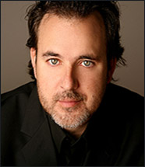
“The length of a minute is relative, depending on
which side of the bathroom door
you are on.”
Ken Miller

Slide 14

Do we really know what works?

Slide 15

”We’re all just
winging it.”
Mason, Sr.
“Boyhood”

Slide 16

Increasing Effectiveness and Efficiency

Slide 17



Use of Technology

Slide 18
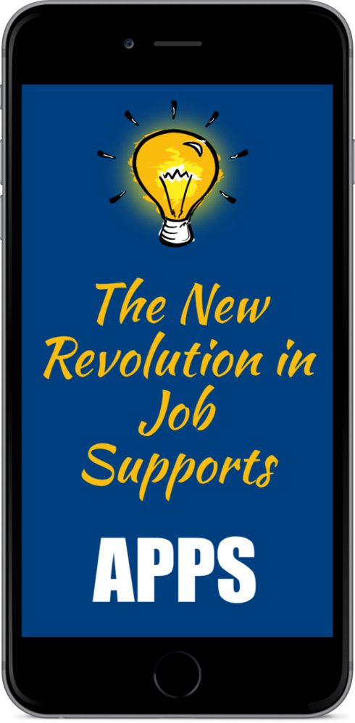



Slide 19

Readily available and pre-installed APPs and technology can be used for variety of job placement support needs
Can assist with: attendance, tardiness, leaving early, attitude, appearance, appropriateness, taking initiative, communication, abusing break times, staying on task, etc.
Types of APPs – Examples:
  Picture schedules
  Video modeling, Video Prompting, Continuous Video Modeling, Video Feedback
  Task sequencing
  Time management
  Communication
  Transportation

Slide 20


The Role of Funders/Service Systems:
How can they help?

Slide 21

Public Policy Agenda for Strengthening Workforce

Slide 22

Other Ideas

Slide 23

Service Strategies
and Performance

Slide 24
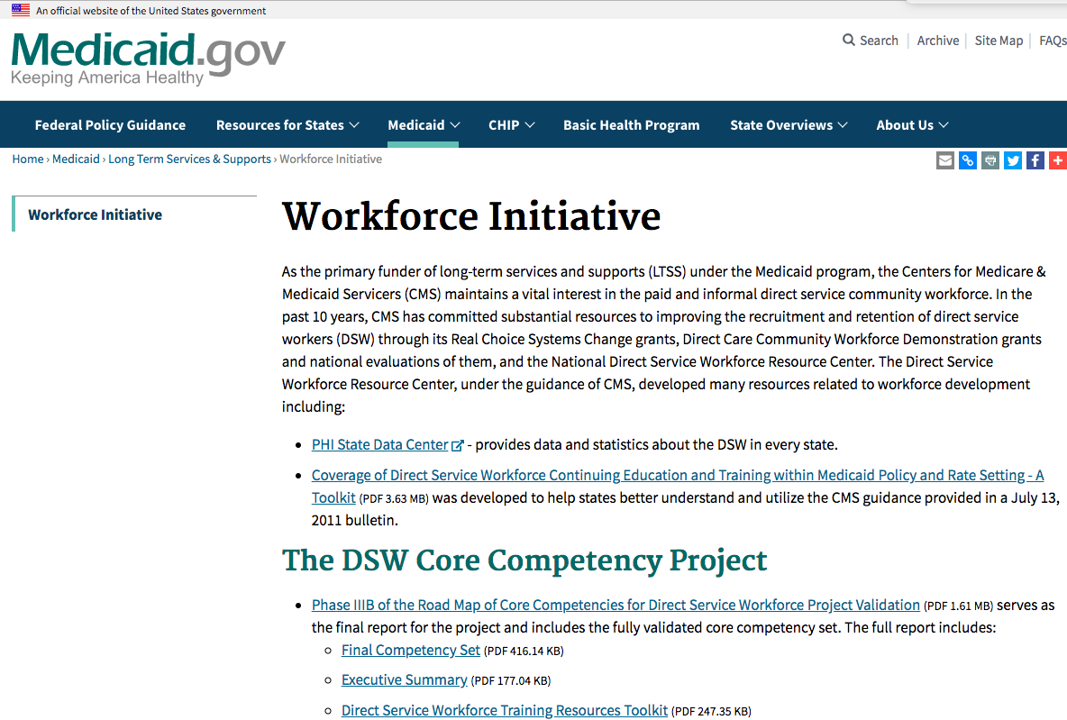
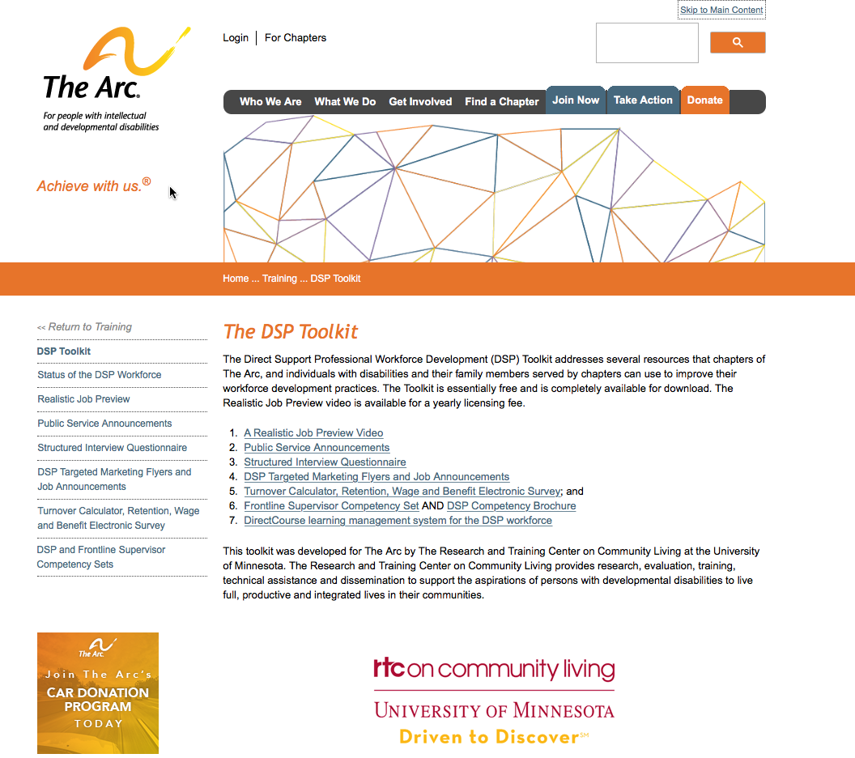

Resources
Medicaid Workforce Initiative
ARC DSP Toolkit
Institute on Community Integration
University of MN
Monograph
National Alliance for
Direct Support Professionals

Slide 25


