Slide 1

David Hoff, M.S.W.
Program Director
Institute for Community Inclusion
University of Massachusetts, Boston www.communityinclusion.org
Voice: 617-287-4308
E-mail: david.hoff@umb.edu
Disability Rights
History and Current Law

Slide 2





Disability Rights Reflect Evolution of Disability Models
Moral Model
Tragedy-Charity Model
Medical-Functional Model
Social
Model
Disability is out of order with nature; reflective of “displeasure of deity”
Disability: victim of circumstance, deserving of pity and charity
Disability is to be treated and cured by professionals; impact of disability limits impact to fully participate in society.
Disability is component of diverse tapestry of society
Challenges faced by people with disabilities arise primarily from social and societal forces rather than individual pathology
  Elizabethan Poor Laws (1601): disabled or “crippled” people are helpless poor entitled to money and food from society
Approximately
40 years old

Slide 3

Old
Disability Paradigm
View/treat people with disabilities as “defective” in need of “fixing”
Disability = unable, incapable
Individual is to overcome limitations caused by disability in order to participate in society
Approach: out of sight, out of mind
SOURCE: Robert Silverstein, Emerging Disability Policy Framework

Slide 4
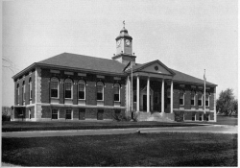
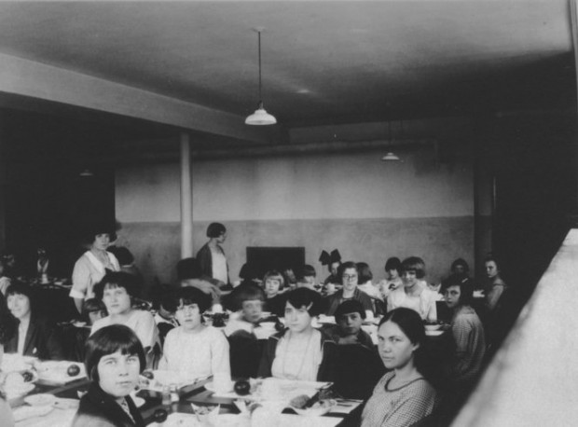

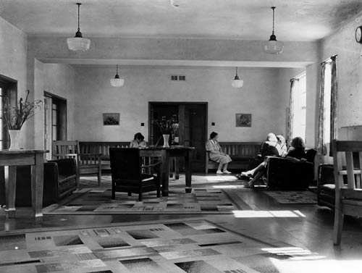
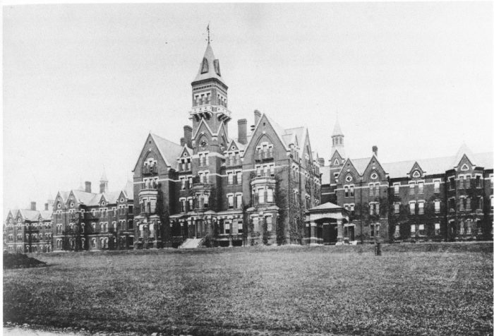

Slide 5
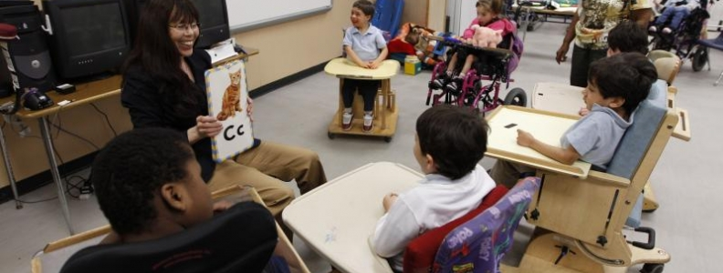

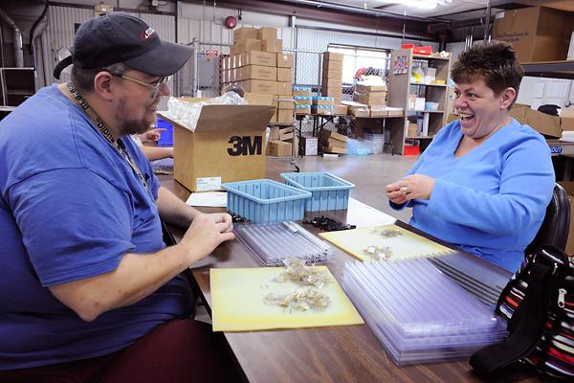

Slide 6


New Disability Paradigm
Disability: natural part of human experience that in no way diminishes a person’s right to fully participate in all aspects of American life
Mission of public policy:
Fix environment not individual
SOURCE: Robert Silverstein, Emerging Disability Policy Framework

Slide 7


“My disability exists
not because I use a wheelchair,
but because the broader environment
isn't accessible.”
Stella Young

Slide 8


Goals of Disability Policy
Goal # 1: Equality of opportunity
  Individualization
  Genuine, effective and meaningful opportunity - determine how society can “fix” the environment to provide effective and meaningful opportunities
  Inclusion and integration
Goal # 2: Full participation
Goal # 3: Independent living
Goal # 4: Economic self-sufficiency
SOURCE: Robert Silverstein, Emerging Disability Policy Framework

Slide 9


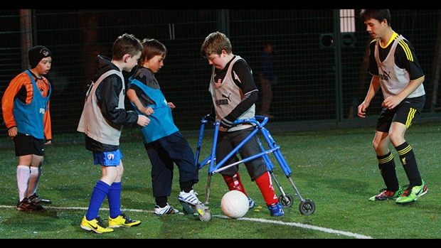


Slide 10





Slide 11



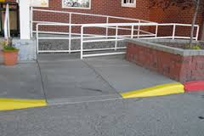


Slide 12


The Changing Role of the Professional
FROM
Caretaker
Authoritative figure
TO
Facilitator of inclusion
Facilitator of community supports
Support professional
Social change agent

Slide 13



Models Can Conflict
Medical - Functional Model
Individuals with Disabilities
Families
Professionals
Service Providers
Social Model
Charity Model

Slide 14



Social Security:
Example of Conflicts of Models of Disability in Disability Policy

Slide 15



Slide 16

Major Federal Disability Legislation –
Evolution of the ADA
1968 - Architectural Barriers Act
  Required buildings & facilities designed, constructed, altered, or financed by federal government to be usable and accessible by persons with disabilities
1973 - Rehabilitation Act of 1973
  “Section 504” prohibits discrimination against people with disabilities in programs receiving federal funds
  Widely recognized as first civil rights legislation for persons with disabilities in the world

Slide 17
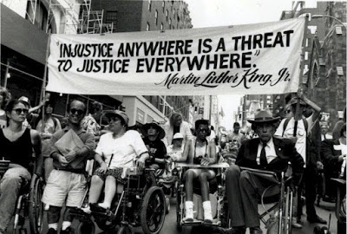

Slide 18

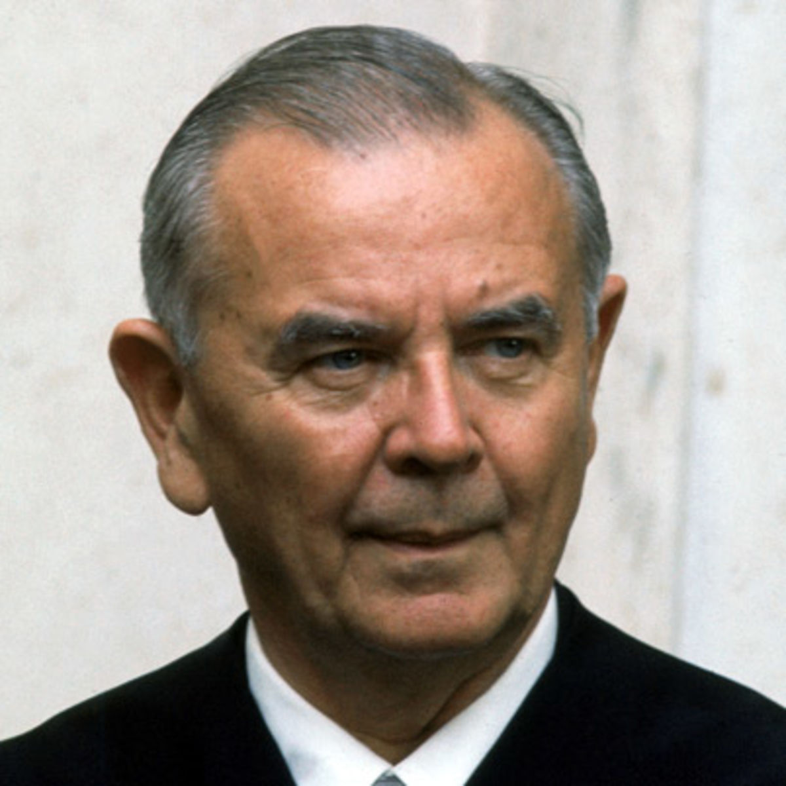
“Congress acknowledged that society's accumulated myths and fears about disability and disease are as handicapping as are the physical limitations that flow from actual impairment.”
Justice William Brennan

Slide 19
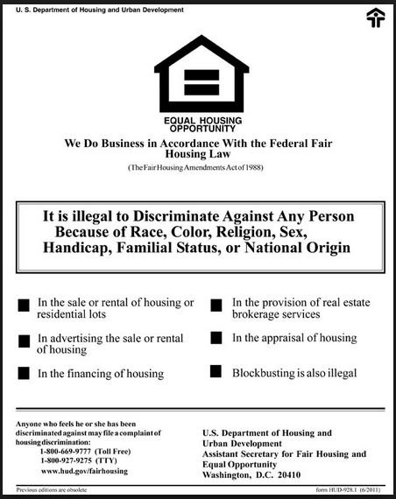
Major Federal Disability Legislation –
Evolution of the ADA
1988 - Fair Housing Act Amendments
  Added persons with disabilities as a group
  protected from discrimination in housing
  First time individuals with disabilities were added as a protected class in general
  civil rights legislation

Slide 20

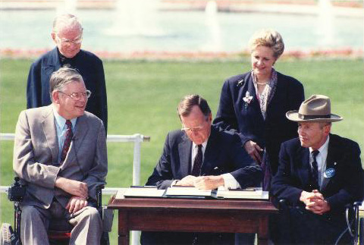
Major Federal Disability Legislation –
Evolution of the ADA
1990 - Americans with Disabilities Act (ADA)
  Guaranteed civil rights of people with disabilities
  by prohibiting discrimination against anyone
  who has a mental or physical disability
  in area of employment, public services, transportation,
  public accommodations, and telecommunications

Slide 21
“DISABILITY”
AS DEFINED BY THE ADA
A physical or mental impairment that substantially limits one or more major life activities
A record of such an impairment
Being regarded as having such an impairment, even when no limitations exist

Slide 22
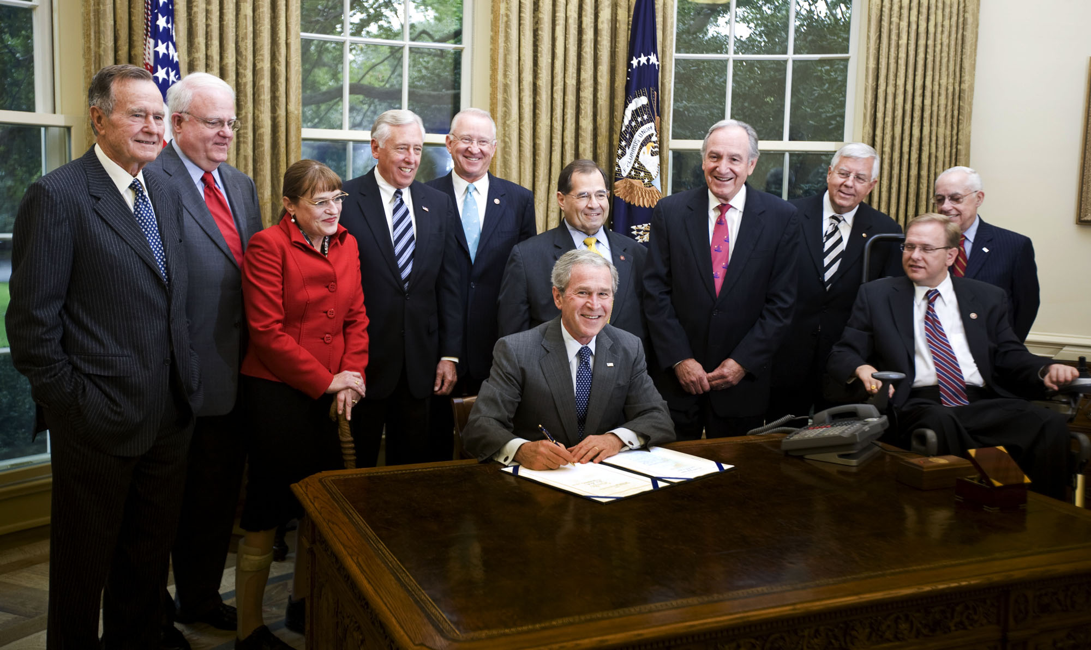
Major Federal Disability Legislation –
General
2008 - ADA Amendments Act
  Made changes to definition of term "disability" by rejecting several Supreme Court decisions and portions of EEOC's ADA regulations

Slide 23
“MAJOR LIFE ACTIVITY”
AS DEFINED BY THE ADA
ANYTHING AN AVERAGE PERSON CAN DO WITH LITTLE OR NO DIFFICULTY, SUCH AS:
SEE
SPEAK
WALK
TALK
EAT
SLEEP
BREATHE
HEAR
LEARN
THINK
READ
CONCENTRATE
WORK
PERFORM
MANUAL TASKS
LIFT
BEND
WALK
STAND
Expanded under ADA Amendments Act of 2008

Slide 24
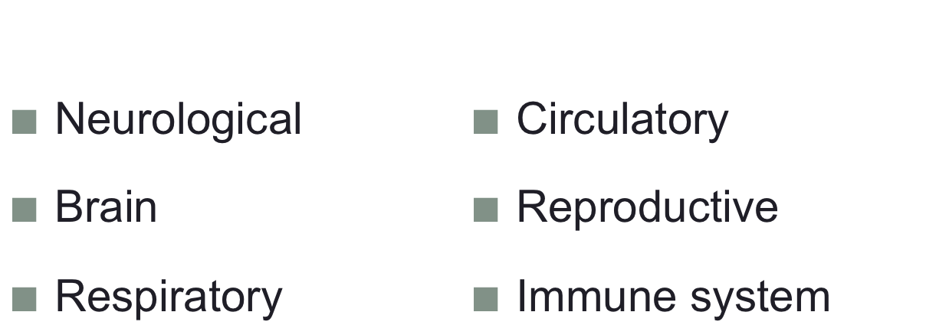
Per
ADA Amendments Act of 2008
“major life activity” as defined by ADA also includes “operation of major bodily functions” such as:

Slide 25
DEFINITION OF DISABILITY: BROAD, NOT NARROW
ADA Amendments Act of 2008:
narrow definition of disability not permitted
Definition of disability to be viewed in favor of broad coverage of individuals, to the maximum extent permitted by the ADA

Slide 26

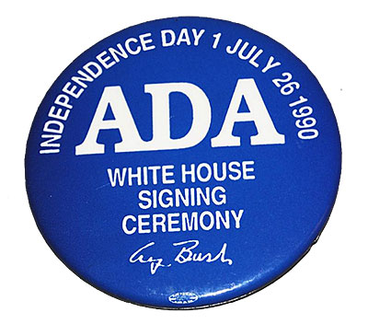
ADA
General Theme
Changes, modifications, and accommodations must be made unless they will prove to prove to be too difficult due to impact or cost

Slide 27
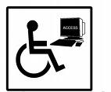
ADA: TITLE I - EMPLOYMENT
“QUALIFIED INDIVIDUAL”
An individual with a disability who, with or without reasonable accommodation,
can perform the essential functions
of the employment position

Slide 28
ADA: TITLE I - EMPLOYMENT
“REASONABLE ACCOMMODATION”
Required for applicants & workers with disabilities (at employer expense) when such accommodations would not impose undue hardship

Slide 29

TITLE II:
PUBLIC SERVICES
Discrimination by state and local government services prohibited
Programs, when viewed in their entirety, are readily accessible to and usable by individuals with disabilities.
Do not need to remove physical barriers, such as stairs, in all existing buildings, as long as programs are accessible to individuals who are unable to use an inaccessible existing facility.
Must provide programs and services in integrated setting, unless separate setting is necessary to ensure equal opportunity
No unnecessary eligibility standards or rules that deny individuals with disabilities equal opportunity to enjoy services

Slide 30

TITLE II:
PUBLIC SERVICES
Requires reasonable modifications in policies, practices, and procedures that deny equal access to individuals with disabilities, unless fundamental alteration in the program would result.
Must furnish auxiliary aids and services to ensure effective communication, unless undue burden or fundamental alteration would result.
No special charges
Public transportation systems must be accessible to people with disabilities. Transit authorities must provide supplementary paratransit services or other special transportation services for individuals with disabilities who cannot use fixed-route bus services

Slide 31

TITLE III:
PUBLIC
ACCOMMODATION
Applies to broad range of entities engaged in private commerce including restaurants, hotels, grocery stores, retail stores, etc., as well as privately owned transportation systems
Existing facilities must remove architectural barriers to make their goods and services usable by people with disabilities, to the extent that it is readily achievable
Construction of new building facilities and alterations of existing facilities must comply with ADA Accessibility Guidelines

Slide 32

TITLE III:
PUBLIC
ACCOMMODATION
Requires public accommodations to make reasonable modifications to policies, practices, and procedures, unless those modifications would fundamentally alter nature of the services provided by the public accommodation
Places of public accommodation must also ensure effective communication by providing auxiliary aids and services for people with communication disabilities
Auxiliary aids requirement is flexible in terms of method used

Slide 33

TITLE IV:
TELECOMMUNICATION
Requires establishment of telephone relay services for individuals with hearing and/or speech impairments, for use of TTY or other non-voice device
Additional requirement of closed-captioning of public service announcements

Slide 34




Slide 35

Major Federal Disability Legislation –
Education
1975 - Education for All Handicapped Children Act
  Mandated a free appropriate public education
  for all children with disabilities in a state,
  regardless of nature or severity of
  child’s disability
1986 - Education of the Handicapped Act Amendments
  Included new grant program for states to develop early intervention system for infants and toddlers with disabilities and provide greater incentives for states to provide preschool programs for children with disabilities

Slide 36

Major Federal Disability Legislation –
Education
1990 Individuals with Disabilities Education Act (IDEA)
  Renamed EHA, and reauthorized programs to improve support services for students with disabilities,
  especially in transition and assistive technology
2004 IDEA Reauthorization
  Strengthened Individualized Education Planning (IEP) process

Slide 37



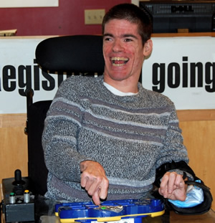

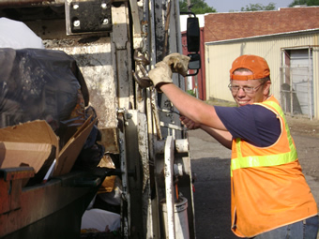

Slide 38


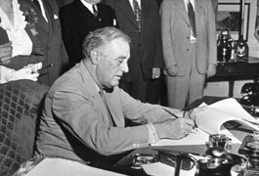
Major Federal Disability Legislation - Employment
1918 - Soldier’s Rehabilitation Act
  Creates vocational rehabilitation program for disabled veterans
1935 - Social Security Act
  Creates income insurance program when
  illness or disability prevents staying in workforce
1938 - Fair Labor Standards Act
  Establishes national minimum wage
  Allows individuals with disabilities to be paid less than minimum wage, based on rate of production

Slide 39
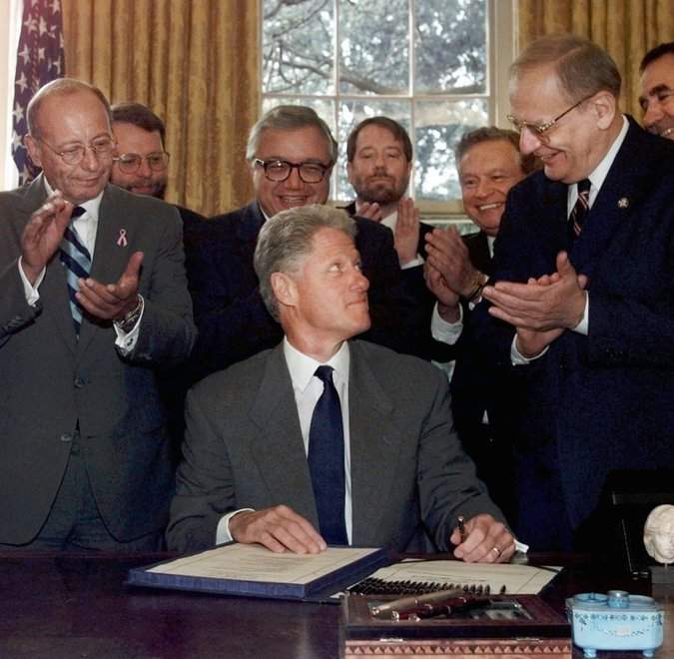
Major Federal Disability Legislation - Employment
1998 - Workforce Investment Act of 1998 (WIA)
  Consolidated federal job training programs, and
  reauthorized Rehabilitation Act of 1973.
  Clear message that people with disabilities are
  to be served within “generic” system
1999 - Ticket to Work and Work Incentives Improvement Act (TWWIIA)
  Created and enhanced “work incentives” and assistance for individuals with disabilities to go to work including benefits counseling service and ability to buy Medicaid if earnings or assets are too high

Slide 40
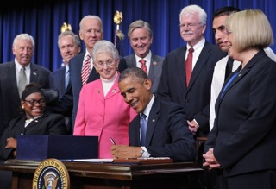
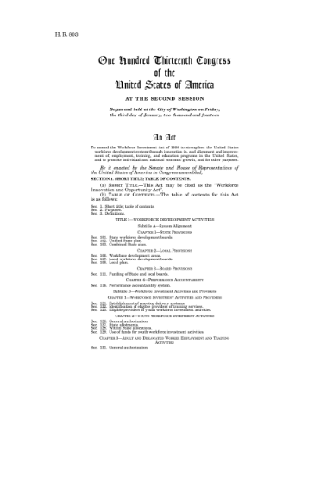
Major Federal Disability Legislation - Employment
2014 - Workforce Innovation and
Opportunity Act (WIOA)
  Authorizing legislation for workforce development
  system; reauthorizes Rehabilitation Act of 1973
  “Competitive Integrated Employment” as expected outcome
  Significant expansion of role of public VR in transition from school to adult life
  Major limitations on use of sub-minimum wage
  Enhanced role of generic workforce system for people with disabilities

Slide 41


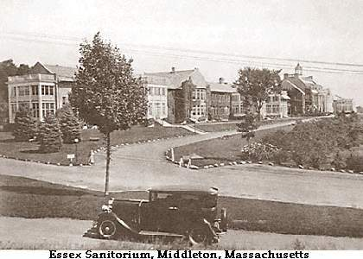



Slide 42

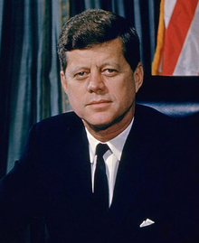
“For far too long the shabby treatment of the many millions of the mentally disabled in custodial institutions and many millions more now in communities needing help
has been justified on grounds of
inadequate funds, further studies
and future promises.
We can procrastinate no more.”
- President John F. Kennedy
February 1963

Slide 43

Major Federal Disability Legislation – Deinstitutionalization and Health Care
1980 - Civil Rights of Institutionalized Persons Act
  Authorized US Dept. of Justice to sue states for alleged violations of rights of institutional persons, including persons in mental hospitals or facilities for people with intellectual and developmental disabilities
1981 - Omnibus Budget Reconciliation Act
  Authorized “home and community-based waivers”
  to enable states to furnish personal assistance and
  other services to individuals who, without such services,
  would require institutional care

Slide 44

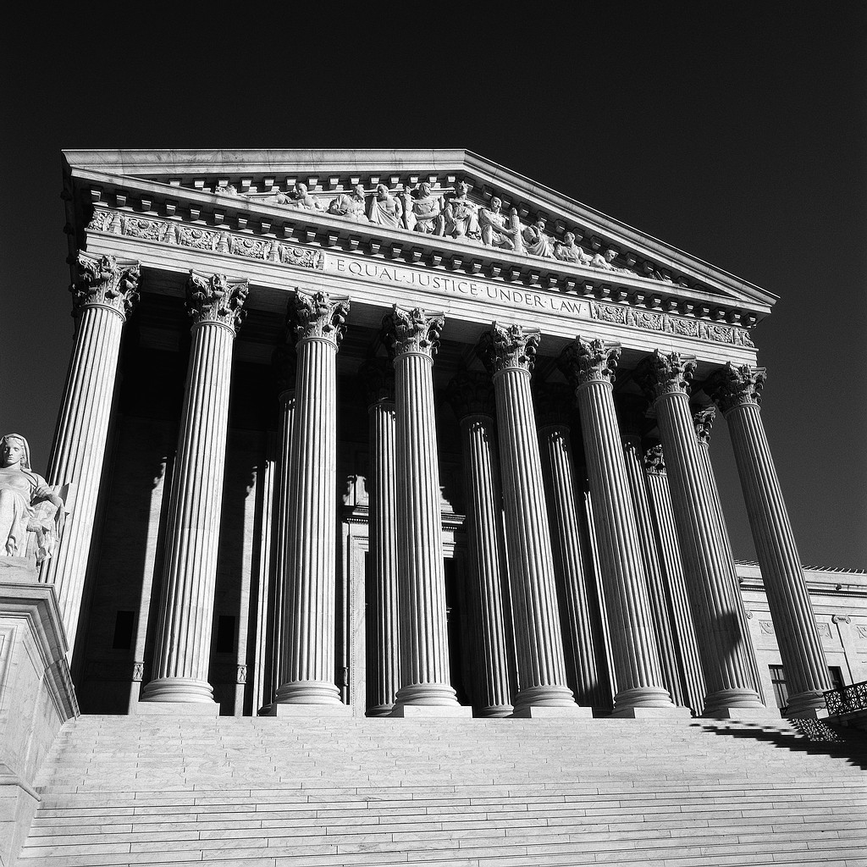
Major Disability
Case Law
June 1999 – U.S. Supreme Court, Olmstead Decision
  Unjustified segregation of persons with disabilities constitutes discrimination in violation of Title II of ADA
  Public entities must provide community-based services to persons with disabilities when:
    Such services are appropriate
    The affected persons do not oppose
    community-based treatment
    Community-based services can be reasonably accommodated

Slide 45

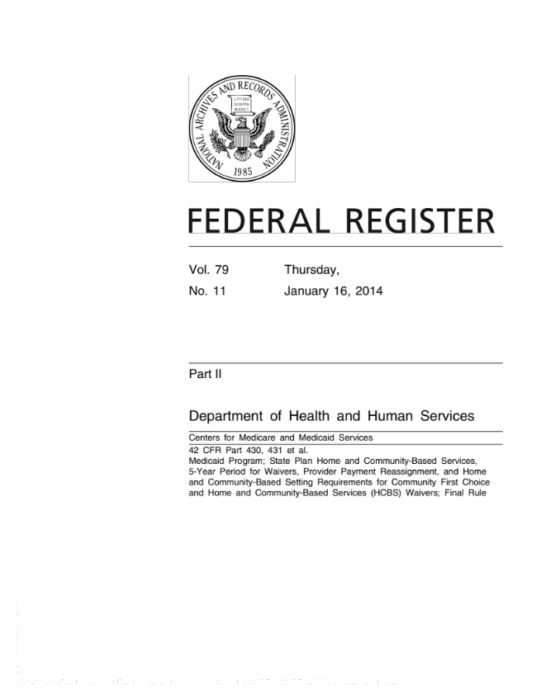
Major Federal Policy Development – Deinstitutionalization and Healthcare
2014 - Center for Medicare and Medicaid Services (CMS) Final Rule
  Medicaid funds used for Home and Community Based Services must be
  in “most integrated setting”

Slide 46

Major Federal Disability Legislation – Deinstitutionalization and Health Care
2010 – The Patient Protection &
Affordable Care Act
  Can no longer be denied health insurance due to
  pre-existing conditions
  No annual or life-time limits on benefits
  May not be denied coverage or benefits due to disability
  New health insurance options for people with disabilities
  Improved access to Medicaid and new Medicaid options

Slide 47

More Than Healthcare
Medicaid pays for standard healthcare: preventive care, hospitalization, medication, therapy, emergency care, etc.
Also pays for a wide variety of services and supports that allow individuals with disabilities to live in the community and maximize their independence

Slide 48


Kaiser Commission on
Medicaid and Uninsured
Medicaid at 50
“It is fair to say that Medicaid has been the principal engine of expanded access to home and community-based services that make independent living and community integration possible for people with disabilities as well as elderly Americans.”

Slide 49

Examples of Long-Term Services & Supports
Home health services
Case management
Supported employment
Assistive technology
Personal care
Non-medical transportation
Respite care
Services to transition people from institutions to home & community
Residential and day habilitation
Home modifications
Homemaker services

Slide 50



Medicaid Funding for Specific Disability Populations
Medicaid is primary funder of community services and supports provided by state Intellectual and developmental disability agencies
Medicaid is also a significant funder of community services and supports for other populations, with funding for individuals with mental health issues increasing

Slide 51


Discussion:
Is it okay to fund
non-medical services via Medicaid?

Slide 52
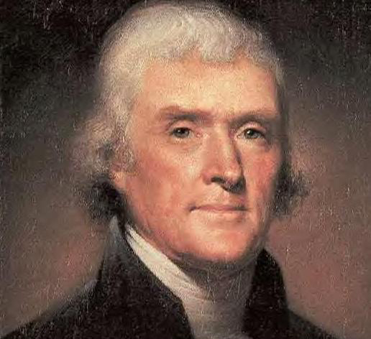
“The care of human life
and happiness,
and not destruction,
is the first and only
legitimate object
of good government.”
- Thomas Jefferson

