Slide 1



Employment First Meets Technology First:
It’s More Than Just The Device
Employment First
Employment First
David Hoff & Jessi Keenoy
Institute for Community Inclusion
UMass Boston

Slide 2
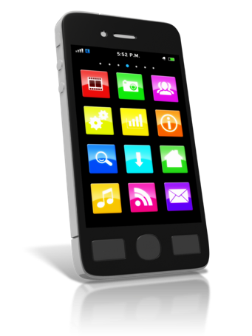






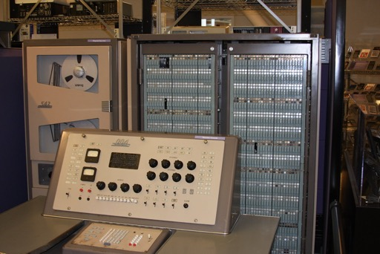



Transformation of Technology Over the Decades
This Photo by Unknown Author is licensed under CC BY
This Photo by Unknown Author is licensed under CC BY-SA
2

Slide 3

Coleman Institute for Cognitive Disabilities
University of Colorado
“Technology and information access today is no longer a luxury.
It is essential for
people with cognitive disabilities to have the same access as their peers without such disabilities in order to fully participate in the worlds of today and tomorrow.”
3

Slide 4
Declaration of the Rights of People with Cognitive Disabilities to Technology and Information Access
https://www.colemaninstitute.org/category/public-policy/technology-and-information-access/

Slide 5
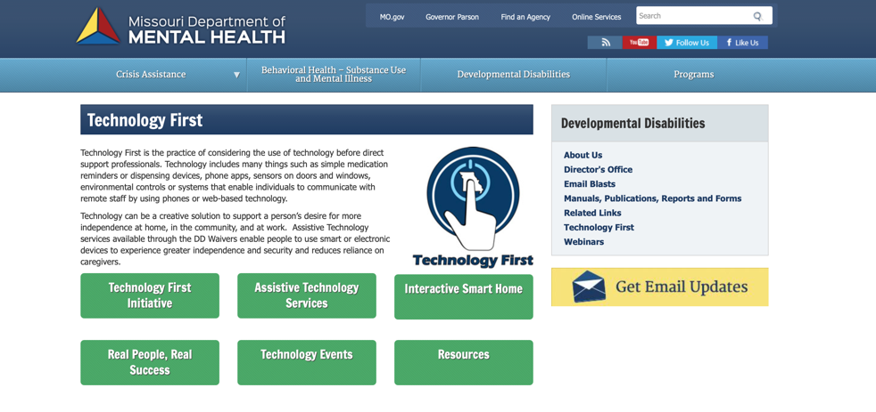
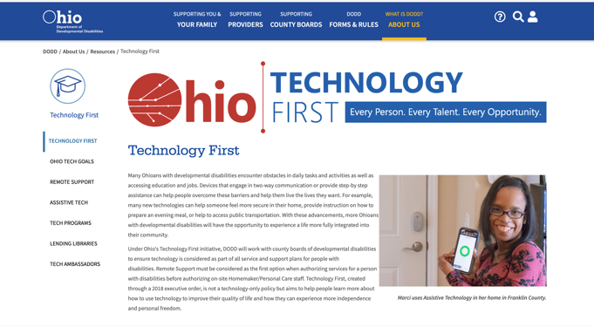
Technology First

Slide 6

Technology First: What It Means
Technology considered as source of support for all individuals.
Technology preferred over staff interventions.
Informed choice and
self-determination as drivers.
Ability to become competent in technology is presumed.
Development of competency in technology begins early and is ongoing.
Consideration of technology is incorporated within all components of services.

Slide 7





Marriage of
Employment First MO &
Technology First MO
Employment First MO asked to support Technology First MO
Community of Practice, facilitated by ICI
  Members: 3 employment providers, MO AT project, DD staff, DD council
  Meets monthly: sharing technology ideas & implementation,
  capacity-building strategies
  Outputs: Developed framework, written products

Slide 8

Scope of Focus
Readily Available
Embedded Apps & Tools
Accessibility Features
Apps
  Video modeling
  Communication
  Task sequencing
  Focus & sustained effort
  Mindfulness
  Scheduling
Notes:
Embedded apps & tools: Notes, camera, contact lists, calendar, reminders, etc.
Accessibility Features: Speak selection
Apps: video modeling, CAN Plan – U of Victoria, communication apps.

Slide 9
The Employment Process
Person-Centered Planning
Exploration & Discovery
Job Development &
Job Design
Initial Placement Support
Follow-Up Supports
The Employment Process
Please share in the chat your ideas for integrating technology within the employment process.

Slide 10

Steve Jobs
“I don’t focus on the technology.
I focus on what’s in it for the customer.
I want to give the customer an incredible experience.”
This Photo by Unknown Author is licensed under CC BY-NC
Notes:
Need to know you are part of bigger historic movement.
What you do preserves and strengthens everyone's rights.

Slide 11


Tech Expert
But know where to find me!
11

Slide 12

Approach to Technology
Empower staff
Build on existing strengths & skills
Person-centered and individualized
Solution-focused
Self-determination & skill development
Not all or nothing – in combination with other supports
Notes:
Access to experts is limited. Not everyone can go through a tech assessment and not everyone
needs to go through an assessment.
Honor individual choices and preferences
Solution focused – keep it simple and focus on one barrier at a time
Staff do not have to be experts themselves, but willing to learn and try new things.
You are already using a lot of the skills that are needed – Person Centered Approach
How are you using technology to address barriers in your own life and work?
You probably use technology to solve address barriers in your own life and work.
Keep it simple- focus on one barrier at a time, sometimes start low tech.
Foster self-determination – teach people rather than doing it for them

Slide 13
Technology Framework
Technology Framework
Individual
Environment
Implement
&
Evaluate
Gap & Barrier Analysis
Narrow the Gap
Notes:
Based on SET

Slide 14
Individual
Challenging tasks
Strengths
Compensatory strategies
Self-maintenance strategies
Learning preference or style
Progressive or stable nature
Natural motivators
Access & experience with tech
Technical skill level
Technology preferences
Current supports available
Accessibility needs
Individual
Feel free to share examples of these factors in the chat.

Slide 15

Technology Availability & Skills Assessment

Slide 16
Environment
In what environment is the barrier occurring?
Resources available to everyone in the environment
Policies & attitudes related to technology
Required tasks
Safety, security, or environmental concerns that may impact the use of tech
Available supports
Environmental infrastructure
Environment
Feel free to share examples of these factors in the chat.

Slide 17
Gap & Barrier Analysis
Gap & Barrier Analysis
Task or tasks that are not being completed to expectations
Environmental barrier
Individual barrier or skill gap
Interaction between environment and individual barrier
What strategies have been tried in this environment and how effective have they been?
Feel free to share examples of these factors in the chat.

Slide 18
Narrow the Gap
Narrow the Gap
Necessary skills & training needs
Costs associated with tech
Could the tech be distracting or isolating?
Safety or security concerns
Supports available to assist
Is the tech adaptable?
Who will own the technology?
How will the tech be transported?
Availability of a demo or trial
Accessibility features
Is tech associated with a request for an accommodation?
Age appropriateness
Feel free to share examples of these factors in the chat.

Slide 19
Implement & Evaluate
Implement & Evaluate
Follow up considerations:
Is the tech working?
Person is able to access & operate tech
Technology works in the environment
Are task expectations being met?
Is the tech creating distractions or barriers?
Feedback from the individual, employer, & supports
Necessary environmental changes
Further training or supervision needs
Unintended impacts
Consider task analysis to assess data
Feel free to share examples of these factors in the chat.

Slide 20
Step by Step Approach to Applying the Framework
Piloting an assessment tool
Domains can be used together or individually
Variety of sources and methods to gather information
Focus on one barrier at a time
Honor individual choice & preferences
Involve support team

Slide 21

Building Capacity
Incorporate into staff training, job description, competency requirements
Leadership buy-in & support
Engagement of individuals at every step
Communities of practice
Get help from the experts

Slide 22
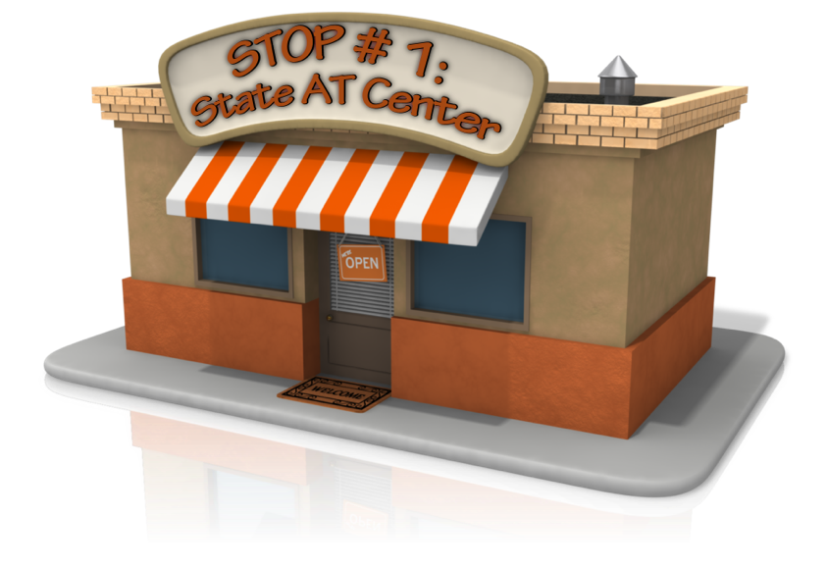

Stop #1: State AT Center
Contact information for state AT programs: www.at3center.net

Slide 23



Other Resources
Feel free to share additional technology resources in the chat

Slide 24

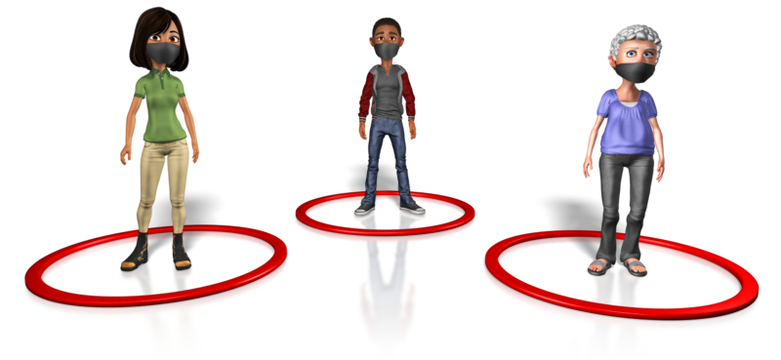
Lessons from Covid
24

Slide 25

Mizuta Masahide
(17th century Japanese poet and samurai)
“My barn having burned down,
I can now see the moon.”

Slide 26
ICI Publications https://covid19.communityinclusion.org

Slide 27


Questions and Challenges
Confidentiality
Resources
Employer Support
Ownership
Funding
System Policies
Training
Transition
27

Slide 28

Lessons Learned
Be creative & willing to try new things
Increase expectations & access
Return on investment
Notes:
Don’t be afraid to take risks, step out of your comfort zone.
10% knowing the tech and 90% creativity
Everyone can benefit from tech in some way – up to us to figure it out.
Increase expectations – we can learn new things.

Slide 29

Davidisms
“Using technology is 10% knowing the tech and 90% creativity.”
“Everyone can benefit from technology in some way. It is up to us to figure out how.”
David Baker, MoAT

Slide 30
Special Thanks to the Missouri Technology Pilot Learning Community!
Alece Ausberger, Farmer’s House
David Baker, MO-AT
Rhian Beldon, LOQW
Kelly Cogan, Farmer’s House
David Hoff, ICI
Nick Holz, ICI
Brenda Knutson, Farmer’s House
Fontella Jackmon-Jones, ACT
Missy Johns, LOQW
Jessi Keenoy, ICI
Sandy Keyser, MO DMH DD
Jessica Mahon, ACT
Chaz Nickolaus, MO DD Council
Cory Schlegel, ACT
Duane Shumate, MO DMH DD
Steven Taylor, MO DMD DD
Notes:
Need to know you are part of bigger historic movement.
What you do preserves and strengthens everyone's rights.

Slide 31


Contact Information
David Hoff:
Email: david.hoff@umb.edu
Phone: 617.480.9230
Jessi Keenoy:
Email: jessica.keenoy@umb.edu
Phone: 573.303.8770
https://employmentfirstmo.org
www.communityinclusion.org
Notes:
Need to know you are part of bigger historic movement.
What you do preserves and strengthens everyone's rights.

