Slide 1

Employment First:
Time to Get Real
David Hoff
Institute for Community Inclusion
UMass Boston
APSE Past President
#APSE2014

Slide 2


Contact Information
David Hoff
617-287-4308
david.hoff@umb.edu
www.communityinclusion.org
Twitter @DavidHoff10
#APSE2014

Slide 3

“I NEVER THOUGHT MY SPEECHES WERE TOO LONG;
I’VE ENJOYED THEM.”
Hubert Humphrey
#APSE2014

Slide 4
Employment First: What Is It?
General theme:
Employment in the community is the first/primary service option for individuals with disabilities
APSE Statement on Employment First
Employment in the general workforce is the first and preferred outcome in the provision of publicly funded services for all working age citizens with disabilities, regardless of level of disability.
#APSE2014

Slide 5
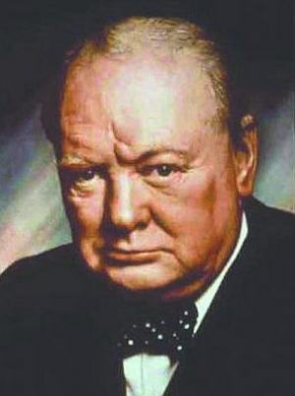
“You can always count on Americans to do the right thing - after they’ve tried everything else.”
Winston Churchill

Slide 6





#APSE2014

Slide 7

We have the technology.
#APSE2014

Slide 8
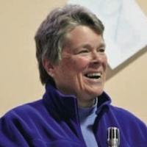
“It is nearly impossible to make your own future,
when you are not part of the economic fabric
of the culture you live in.”
- Patricia Deegan
#APSE2014

Slide 9
#APSE2014

Slide 10
Employment First is a social justice and social change movement.
#APSE2014

Slide 11
“It is very clear to me now,
that the manner in which we interface with people with apparent disabilities
is far more reflective of our own personal capacities, than those of the person we interface with.”
Kay Drais, Parent

Slide 12
Jobs and Community
Jobs and Community
#APSE2014

Slide 13

It’s not just about changing individual lives.
#APSE2014

Slide 14
Typical employment in the general workforce
Create a
pre-vocational “program”
Create an enclave
Start an agency business
Create a non-work “program”
#APSE2014

Slide 15
“There are always
two choices.
Two paths to take.
One is easy.
And its only reward is
that it‘s easy.”
#APSE2014

Slide 16
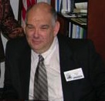
“You only make it difficult, because you choose to make it difficult.”
Michael Long
California Department of Developmental Services
Office of Consumer Affairs
#APSE2014

Slide 17

No more service system groupies.
#APSE2014

Slide 18

Program
World
#APSE2014

Slide 19
More Real Lives
Less Programs
#APSE2014

Slide 20
The
“Choice”
Issue
#APSE2014

Slide 21
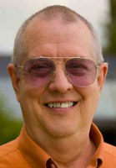
“What drives me up the wall is the intentional teaching of fear of having any kind of meaningful life because ‘You will decompensate’ or
‘You are stress sensitive’.
The most stressful thing in the world is being a couch potato with nothing to do, nowhere to go, and no one to talk to.”
Ed Knight, Ph.D.
#APSE2014

Slide 22

#APSE2014

Slide 23

Real Reform
Stop Tweaking
#APSE2014

Slide 24
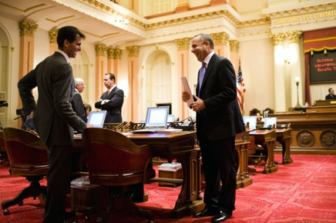

Public Policy Advocacy
#APSE2014

Slide 25

Direct Support Professional
Challenges
#APSE2014

Slide 26
Peer
Peer
#APSE2014

Slide 27
Transition:
Opportunity & Challenge
#APSE2014

Slide 28
Limits of Traditional
Placement
#APSE2014

Slide 29
“Anyone in charge of an organization with more than two people is running a clinic.”
CEO of Major Corporation

Slide 30
Diversity
Disability
#APSE2014

Slide 31
What’s your response?
Don’t want to work
Only want to work a few hours
Can’t work because of benefits
Better off in a day program
Happy in sheltered work
#APSE2014

Slide 32
What’s your response?
Service provider: let’s start a business
Let’s create an enclave
No jobs
Business: We have no openings
Service system:
provider not finding jobs
Too disabled to work

Slide 33
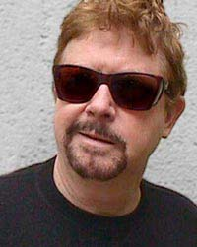
“Humanity has advanced, when it has advanced, not because it has been sober, responsible, and cautious, but because it has been playful, rebellious, and immature.”
- Tom Robbins

Slide 34
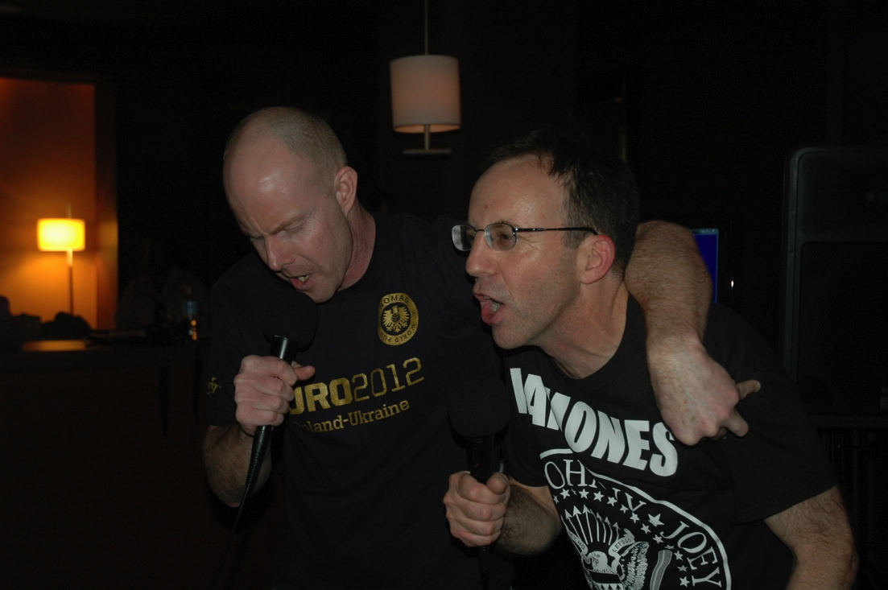

Slide 35

“For far too long the shabby treatment of the many millions of the mentally disabled in custodial institutions and many millions more now in communities needing help has been justified on grounds of inadequate funds, further studies and future promises.
We can procrastinate no more.”
- President John F. Kennedy
February 1963

Slide 36
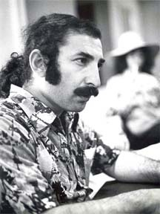
“And if that doesn’t work, what do you do next?
… and next?
… and next?”
- Marc Gold
#APSE2014

Slide 37
#APSE2014

Slide 38
Thanks!
#APSE2014

