Slide 1
Cook X me

Slide 2
Concept
Cook-user :
Make food
Post his event:
-meal + date + time + area + price + Pax( how many present + how many guest)
Reply to public message
Profil:
-

Slide 3
Concept
X-user :

Slide 4
List
Location? Where do you want to eat?
Date
How many guest?
2)

Slide 5

Profil
Map
Rating:
Meal quality
Cleanliness
Kindness
Like
Name
Age
Nationality
Language flag
Type de lieu
Personnal Introduction
Number of Xuser
Review

Slide 6
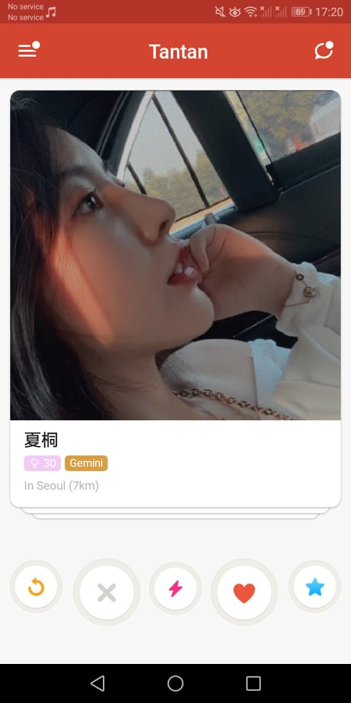
Swipe
Menu
Starter
Main Course
Dessert
Drinks
Logo veggie vegan halal casher allergies
time
price
(Pax)
Picture
Rating

Slide 7
List
Menu
Starter
Main Course
Dessert
Drinks
Logo veggie vegan halal casher allergies
time
Name
(Pax)
Picture
Price
Rate
Book here

Slide 8
Meal
Date/Hour
Pax
Guest Pax
Starter/Main Course/Dessert/Drinks
Logo food info
Prix

Slide 9
A Xuser – B cookuser
B create a profil cook
Valid the profil
B create a event [create a menu] automaticaly published
A choose location+date+Pax,

