Slide 1
Cook X me

Slide 2
Concept
Cook-user :
Make food
Post his event:
-meal + date + time + area + price + Pax( how many present + how many guest)
Reply to public message
Profil:
-

Slide 3
Concept
X-user :

Slide 4
Sign up
All the profil info
+
Phone number + mail
+
Credit card
+
Cook Section (option)
IBAN
Adress

Slide 5
List
Location? Where do you want to eat?
Date
How many guest?
2)

Slide 6

Profil-cook-xuser
Map
Rating:
Meal quality
Cleanliness
Kindness
Like
Name
Age
Sex
Nationality
Language flag
Type de lieu
User since
Personnal Introduction
Number of Xuser
Review

Slide 7
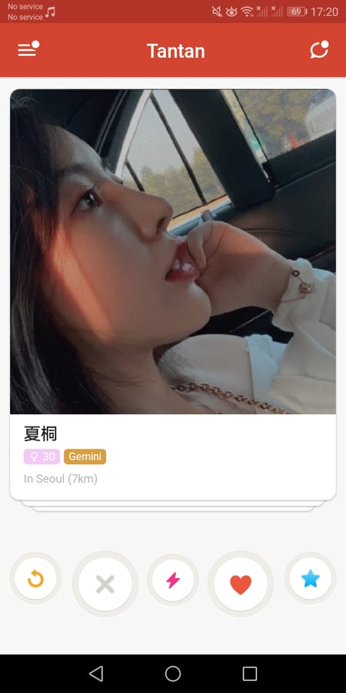
Swipe
Menu
Starter
Main Course
Dessert
Drinks
Logo veggie vegan halal casher allergies
time
price
(Pax)
Picture
Rating

Slide 8
List
Menu
Starter
Main Course
Dessert
Drinks
Logo veggie vegan halal casher allergies
time
Rate
Picture
(Pax)
Price
N/a/s
voir profil
Book here

Slide 9
Meal
Date/Hour
Pax
Guest Pax
Starter/Main Course/Dessert/Drinks
Logo food info
Prix
+ Side event (add description)
|Adress| not displayed

Slide 10
A Xuser – B cookuser - WeX
B create a profil cook / or login.
We validate the profil cook.
B create an event [create a menu] automaticaly published on his wall
A input location+date+Pax, the list is displayed. A select an event. A have to create a profil/ or login.
We validate the profil.

Slide 11
A Xuser – B cookuser –WeX
A arrive and post a message
We validate the message
B receive notification, reply
We validate the message
A booX B event add details: pax, arrival time, add his CB, confirm.
B receive notification about A with the profil access + detail. Accept A before the next 30 minutes or refuse.
If accepted B receive A phone number/email.
A receive the answer. If accepted receive the adress and phone number/ email of B.
WeX received money.

Slide 12
A Xuser – B cookuser –WeX
A and B receive a notification for rating at the end of the event.
A grade B for cook profil and review
B grade A friendly rate and review
We validate the review and post.
Cases : A is not stisfied B is nt satisfied

Slide 13
A Xuser – B cookuser –WeX
Money movement:
A gets debited from the booking moment
B received the money at the end of the event
A get refund 100% the day before and 50% 12h before
If A doesnt showup nothing change
If B had a fake event and - A give notice before the end of the event B money is frozen we check the situation and if its checks-out A get refund
- A notice it after the end of the event we check the situation and if its checks-out B gets is account frozen and A get refund by us.

