Slide 1
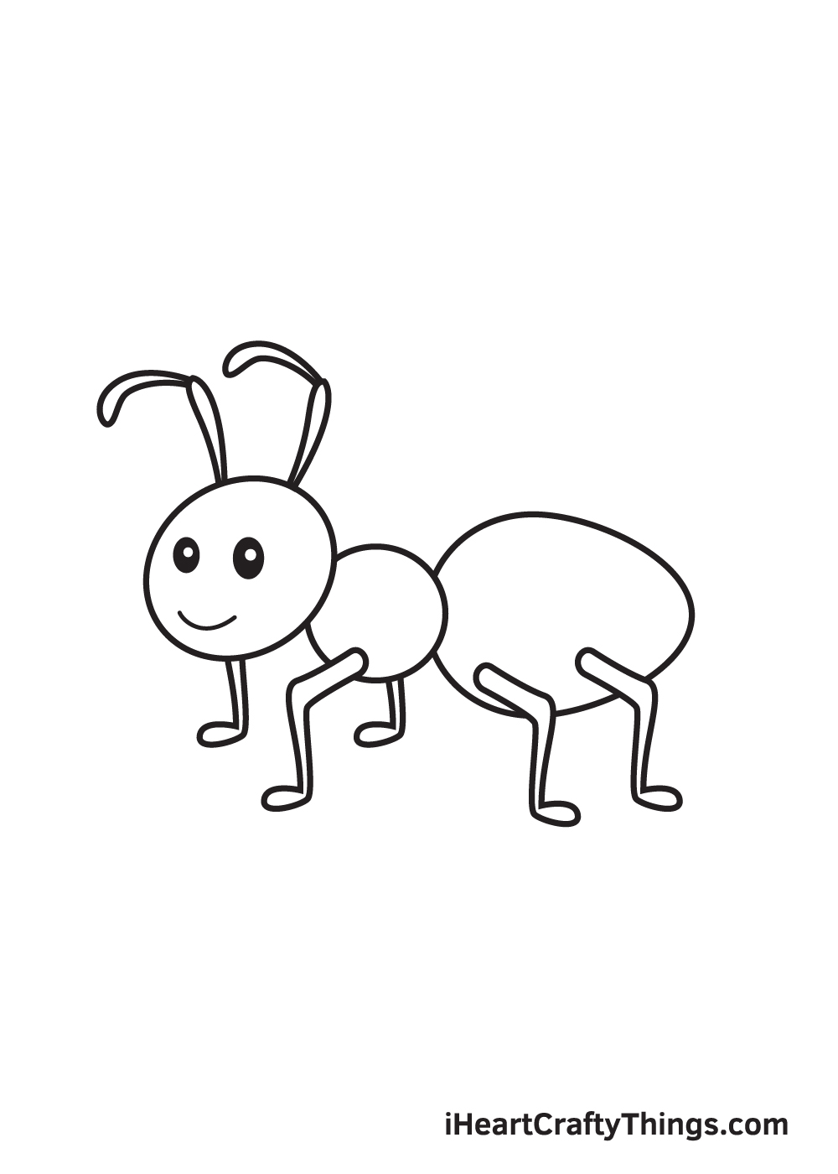
The Carpenter Ants
Assignment 5

Slide 2
Agenda
SafetyNet Mission
Selected Interface
Lo-Fi Prototype
Tasks
Methodology
Results/Changes

Slide 3
SafetyNet
The support you need, guilt-free.
Solution Overview:
Disabilities often lead to a sense of guilt in asking for help on a daily basis. In order to eliminate this feeling of a burden from the lives of those who need assistance, we introduce Safety Net, a help-request platform that leverages one's personal, trusted network to decentralize the asking process. Add friends, family, and trusted individuals to your entourage so that next time you need to ask the inevitable, you are supported by the ones you love. If you don’t have a network, you can connect with one of our trusted community partners. Your net will be notified and see how helpful they’ve been to successfully distribute the deeds for you, leaving you to simply select helpers from your net.
Notes:
(The value proposition should concisely convey what customers get out of your product in a short phrase (e.g., stripe.com “Payment infrastructure for the Internet”, evernote: “Remember everything!”)_
Possible names: benefriend, entourage, crew, auxi, uplift, hand, boost, alloy, safety net, Need a hand, supporters, catalyst, friendly hands
Possible value props:
Getting the support you need from your network
receiving help, removing the burden
Receiving trusted support, removing the burden
Empowering those through the masses
Getting you the support you need without the burden of reaching out.
Taking the guilt out of asking for help.
by distributing support amongst a network of trusted individuals.
connecting individuals to their support system

Slide 4
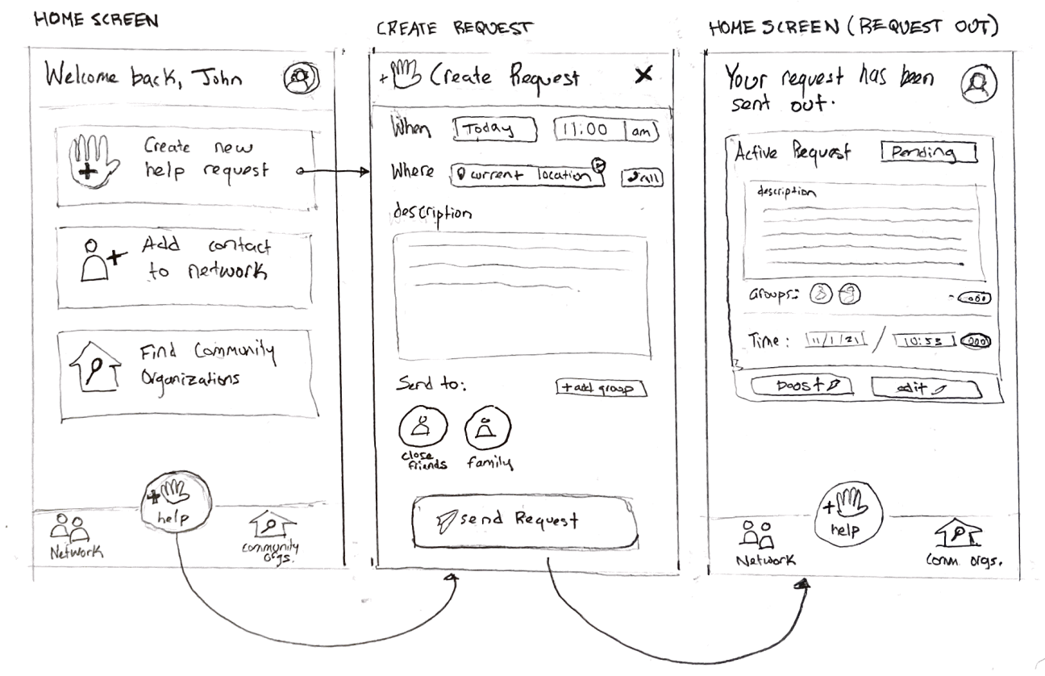
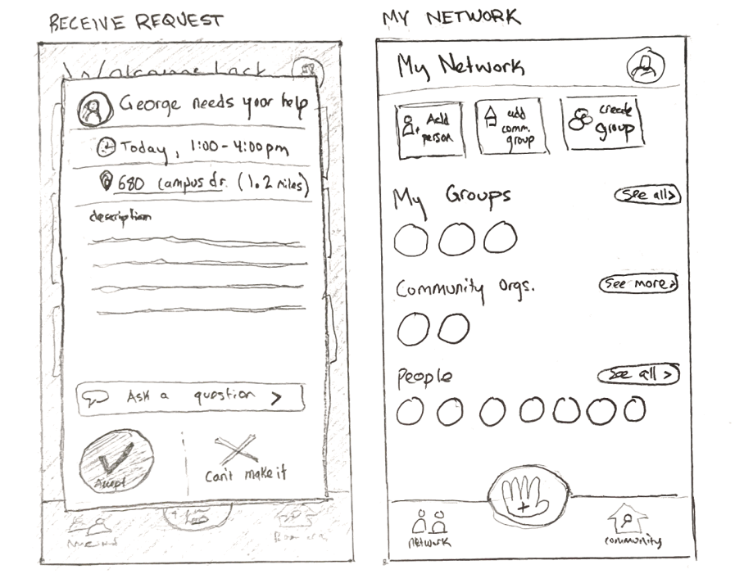
Selected Interface: Mobile

Slide 5
Selected Interface: Mobile
We chose a mobile interface because…
Accessibility: Users need to be able to request help whenever they need it
Convenience: Requesting/providing help should be as streamlined as possible

Slide 6
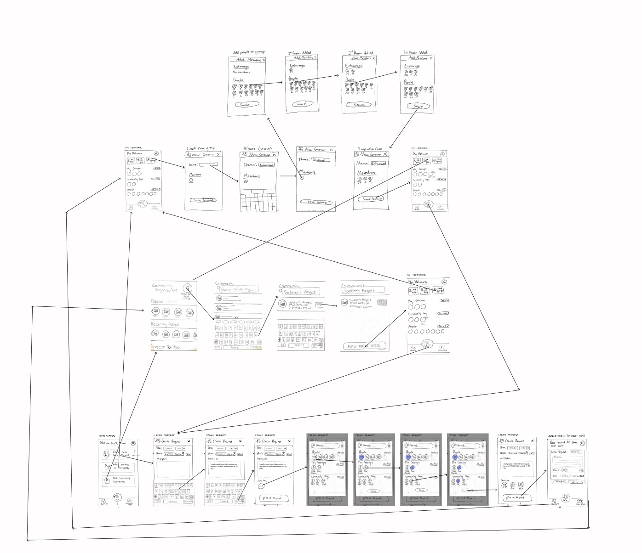
Lo-Fi Prototype
Structure
Screens drawn on paper and uploaded to Marvel Pop
Interaction:
Send out help request
Create new friend group
Search for and add new community organization
Any one task could be accessed from the end of another one
Notes:
Who: One Stanford student + two discord respondents
How: Recorded Zoom call + Marvel Pop

Slide 7
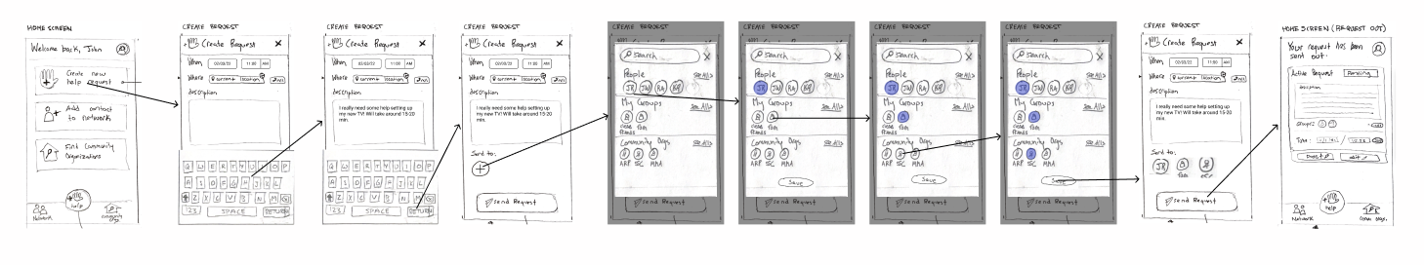
Simple Task: Sending out a request
Users create a new request, setting the date, time and message, and then select who in their SafetyNet they will reach out to. Finally they send the request and can view the pending request.

Slide 8
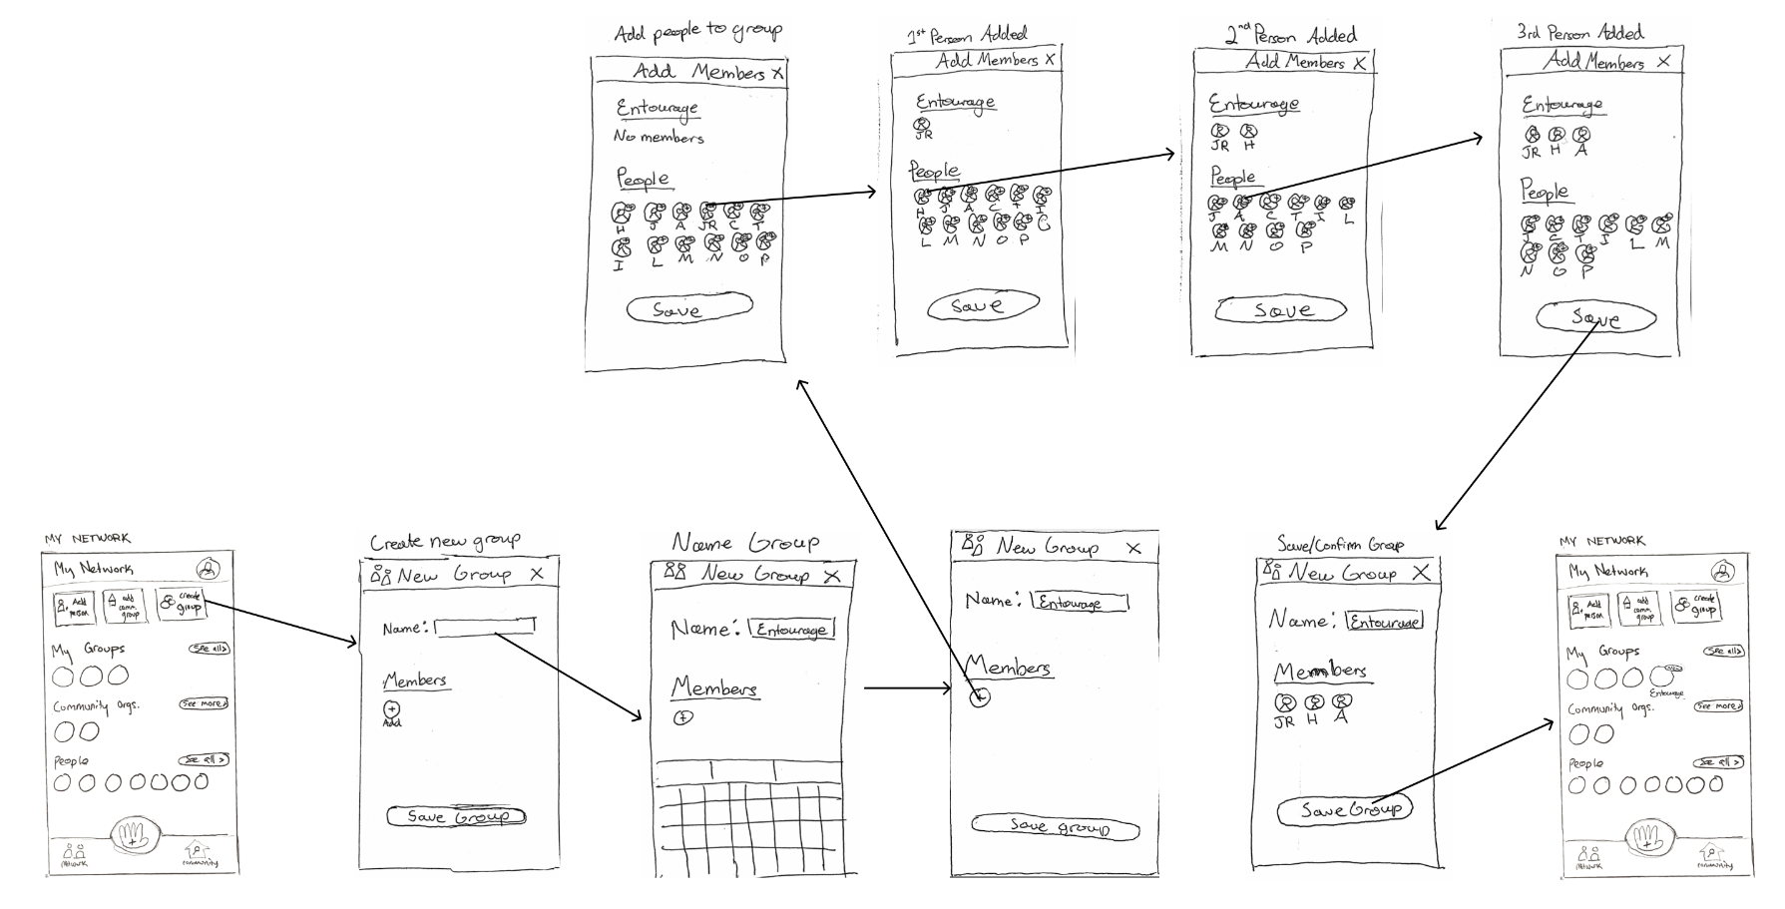
Moderate Task: Adding a new friend group
Users create a new “net” within their network and add individuals they would like to be a part of the subgroup.

Slide 9
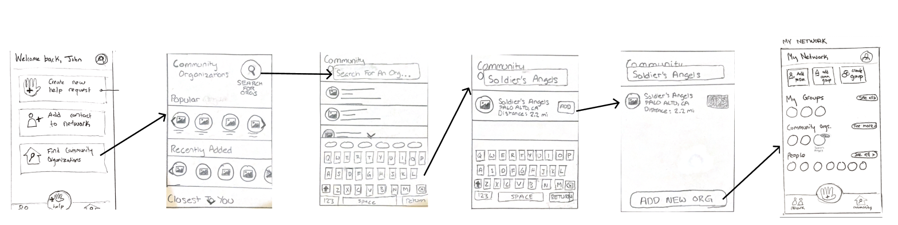
Complex Task: Connecting with community
Users explore community organizations by popularity and locality or search for an organization using the search bar. Finally, they can add the organization to their network.

Slide 10
Testing Methodology
Participants:
One stanford student, a sibling, and a caretaker
Environment:
Tested over Zoom by sharing screen and using Marvel prototype program
Roles:
Facilitator: Ryan
Demo-er/recorder: John
Note taker: Kathryn
Observer: JR
Measures:
Erroneous navigation clicks
Questions on higher level concepts (post overview)
Facial expressions
Procedure:
Solution overview + platform demo
User creates help request (simple)
User creates new friend group (moderate)
User searches for and add new community organization (complex)
Wrap up questions and comments
Notes:
Learnable
Given overview of friend groups, user understands purpose of community organizations on their own
Efficient
Tasks are performed quickly

Slide 11
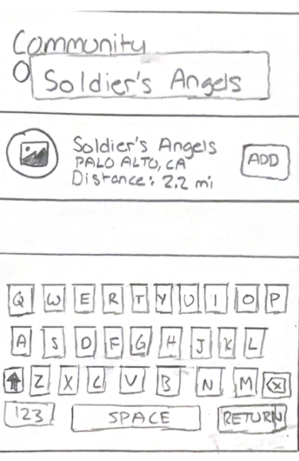
Results
Community organization role was unclear
More info on orgs—what it is, how big it is, how comfortable they feel with them
Mistaken for groups they can be a part of rather than groups that can assist the user

Slide 12
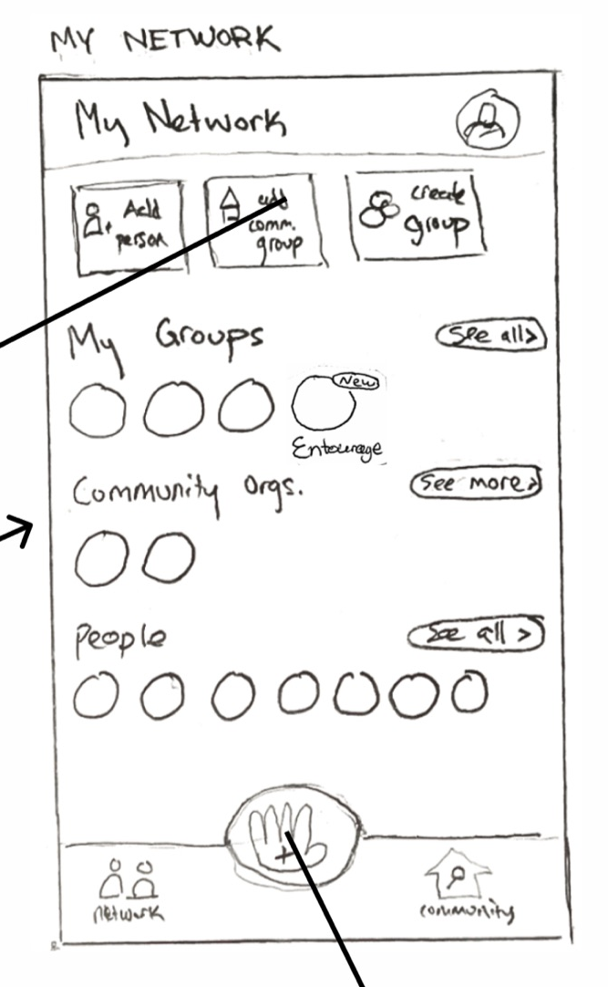
Results
2.
Separation of network into individuals, groups, and community organizations had mixed reviews
Liked the separation of network because you don’t want to have to add every individual every time and there are certain groups you ask for help in certain situations
Not completely clear on how the groups differ and can be used in different situations

Slide 13
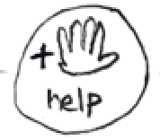
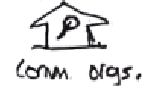

Results
3.
Users didn’t understand certain features, but had good intuition about what they would do
“Why are there multiple help buttons? Which do I click?”
“What does boost do? It probably sends out a reminder notification.”
“What does this button do? My best guess is it searches for community organizations.”

Slide 14
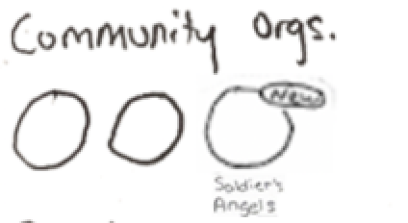
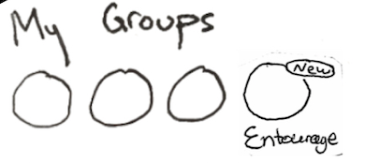
Results
4.
Loved to see how new groups added were highlighted on the main screen immediately after
“Ohh okay, cool.”
“Wow, there it is.”

Slide 15
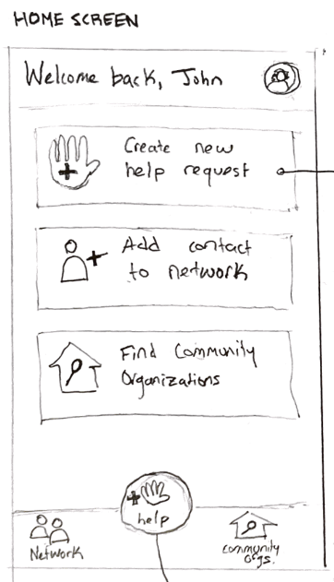
Potential UX Changes
Multiple buttons for same action is confusing—change to one
Add information about community organizations/click feature to explore about them before adding
Have a tutorial or “guided” pop-ups for first interaction with less intuitive actions (e.g. Boost)
Make the community organization and network tabs more intuitive in what they afford

Slide 16
Summary
Educating users during onboarding about how app works for senders and respondents is a must.
Language is really important and could use more thought(people, groups, community org, etc.)
Need to give users the information they need to make decisions (community org. adding)
Need to have better defined pages (Networks/Community Orgs. have a lot of overlap)

Slide 17
Thank You
Questions?

