Slide 1
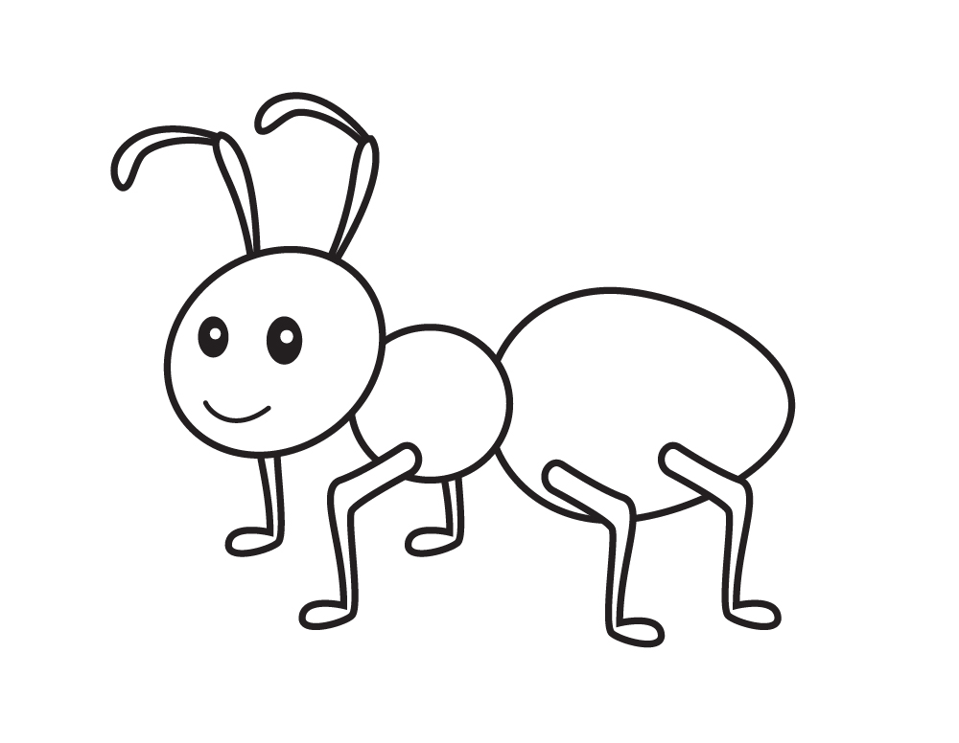
Carpenter Ants
Accessible Design for Different Abilities
Notes:
Ants - Great team chemistry

Slide 2
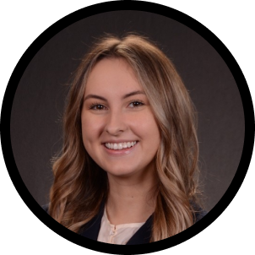

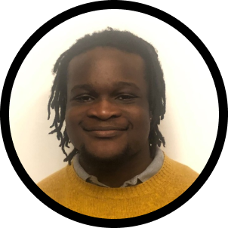
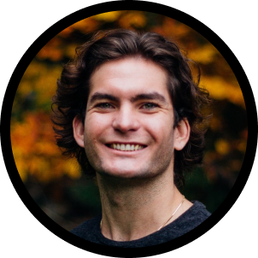
Our Team
Kathryn
John
JR
Ryan
English - CS Coterm
Product Design
Computer Science - AI
Computer Science - HCI
Chicago,
IL
San Francisco,
CA
Matthews,
NC
Ormond Beach,
Fl

Slide 3
Domain Possibilities
Societal Pressure
Youth
Workplace
Relationships
Education
Personal Development

Slide 4
Domain Possibilities
Societal Pressure
Youth
Workplace
Relationships
Education
Personal Development
Notes:
Relationships is all encompassing (i.e. friendships, classmates, family, etc.)
Looked at two different domains that we mentioned earlier

Slide 5

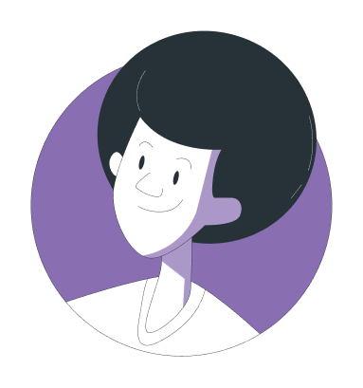
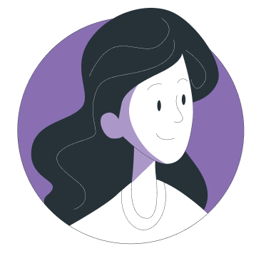
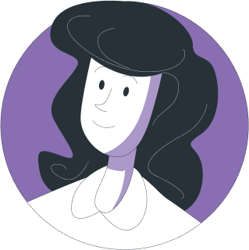
Interviewees
Reid
Mercy
Mike
Lydia
21 years old
College Student
Stargardt's disease
(Visually impaired)
61 years old
Stay-at-home mom
23 year old daughter with Sotos Syndrome and ADHD
31 years old
Professor
Misdiagnosed Pseudotumor cerebri
(Blind)
21 years old
Stanford Student
Dyslexia
Notes:
Kept them anonymous to protect their identities
Why they were chosen?
Diverse set of people interviewed involved with education:
2 Physical disabilities, 2 cognitive disabilities,
mother of someone with a disability
3 students - 1 teacher
How were they recruited or compensated?
Emailed and texted through our own family/friend networks, but not people we were close to - they were not compensated.
where they were interviewed?
We interviewed all of them on zoom

Slide 6
Some Questions We Asked
How have you been able to adapt to limitations or barriers you have faced?
A time you felt empowered by overcoming some aspect of your disability?
Something you spend a lot of time doing that other people don’t have to worry about?
Was there ever a time you did something that someone said you couldn’t do?
Notes:
Mention we tailored additional questions to the person based on their connection to disability
AND did focus on
Questions about their educational experience
Questions about relationships

Slide 7
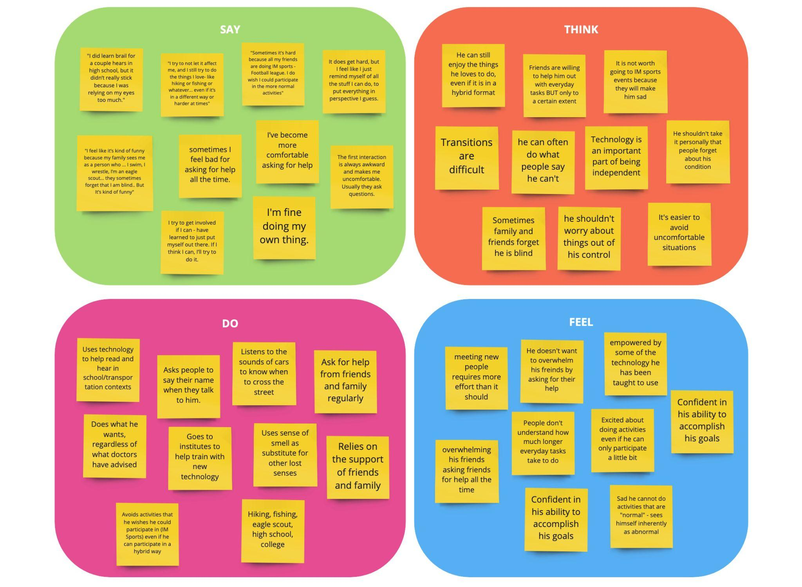
Reid
21 years old
College Student
Stargardt's disease
(Visually impaired)
Notes:
So we began to interview and unpack some rich stories. - after each interview, we created an empathy map and began to synthesize

Slide 8

Reid
21 years old
College Student
Stargardt's disease
(Visually impaired)
“Even people in my family… forget that I can’t see. Sometimes I feel bad for asking for help all the time… to my family and my friends.”
Notes:
I’m just going to run through some highlighted quotes for each participant and then we will look at a summarized empathy map.
In the case of Ried
This highlighted the sense of guilt he had to being a burden on his friends/family
Desire to be independent

Slide 9
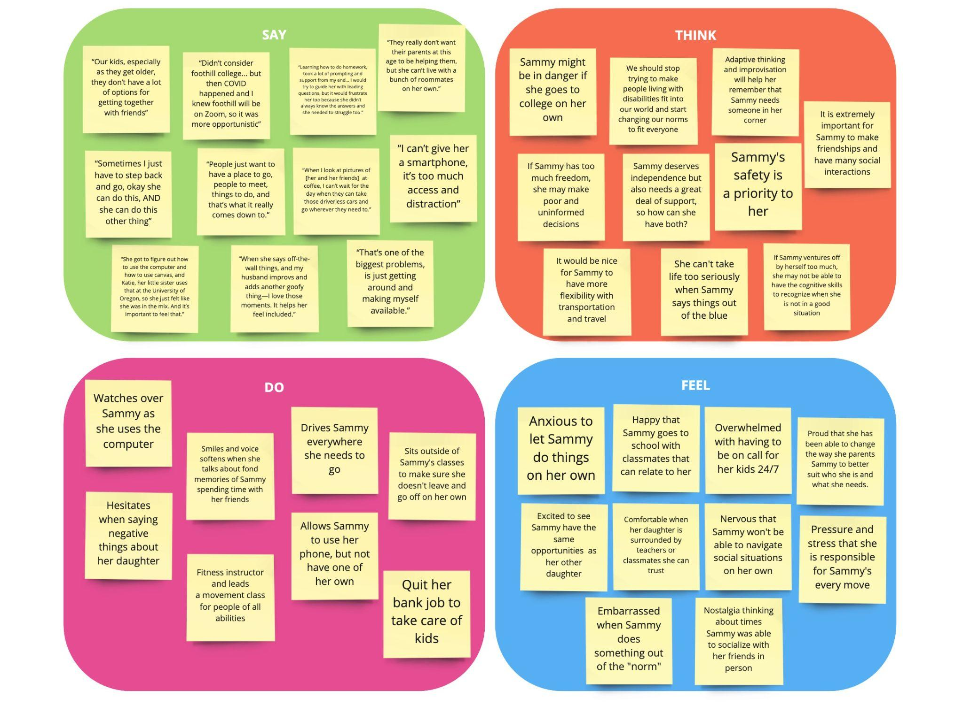
Mercy
61 years old
Stay-at-home mom
23 year old daughter with Sotos Syndrome and ADHD

Slide 10
Mercy
61 years old
Stay-at-home mom
23 year old daughter with Sotos Syndrome and ADHD
“She got to figure out how to use the computer and how to use canvas, and Katie, her little sister, uses that at the University of Oregon, so she just felt like she was in the mix. And it’s important to feel that.”
Notes:
Highlights he daughter’s desire to participate in activities that most people participate in
Feel like an insider

Slide 11
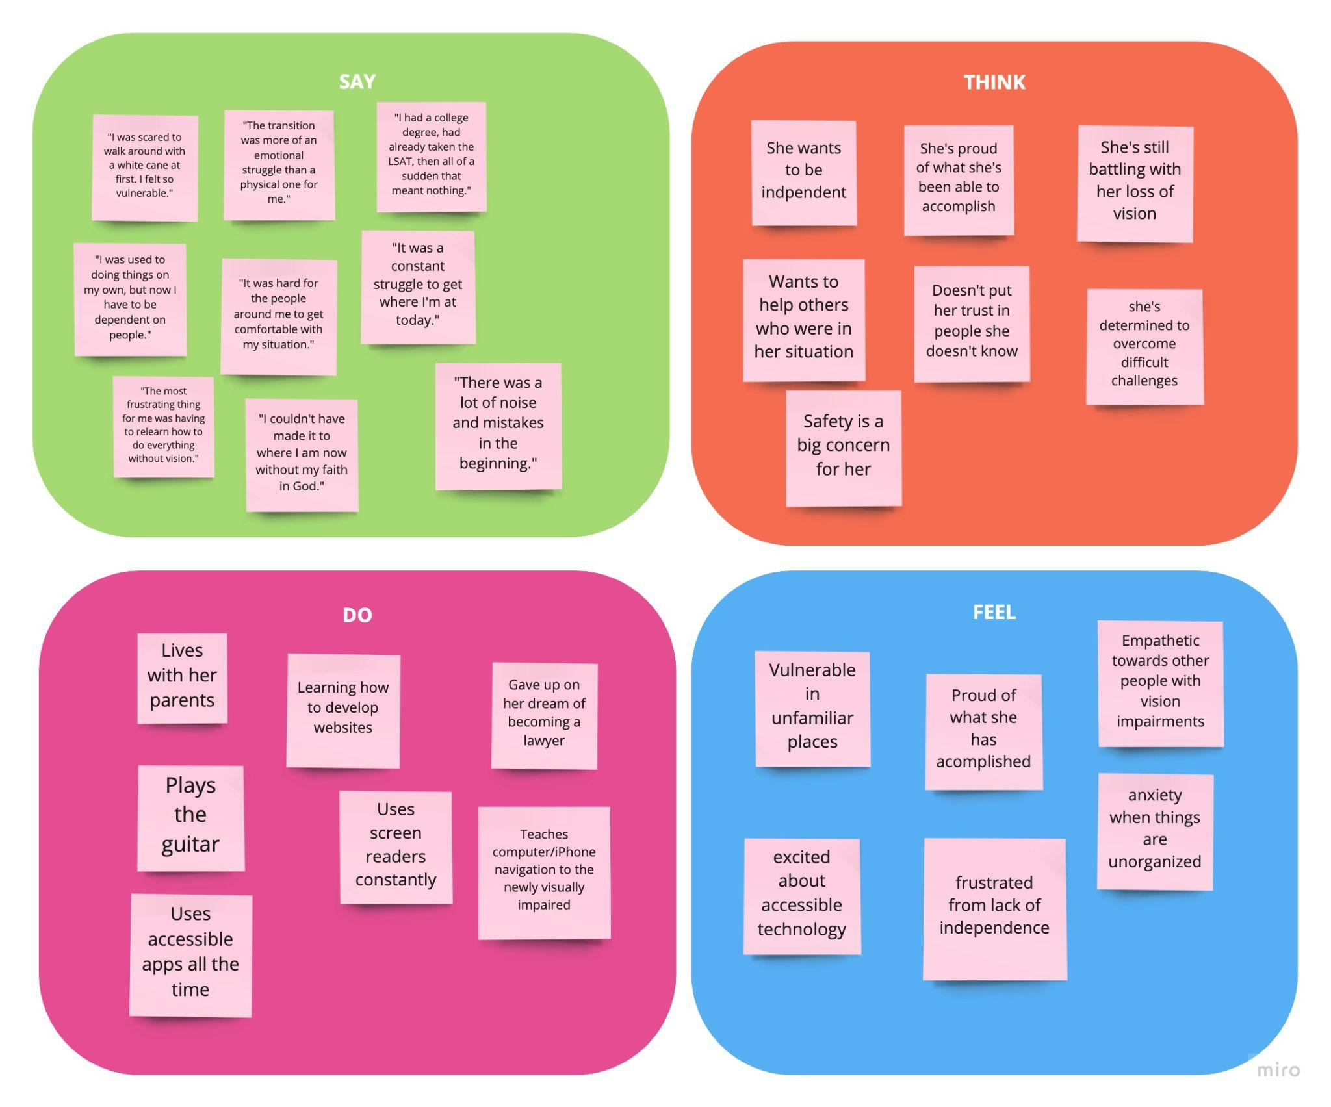
Mike
31 years old
Professor
Blind

Slide 12
Mike
31 years old
Professor
Blind
"I was scared to walk around with a white cane at first. I felt so vulnerable."
Notes:
Highlights how the visibility of a disability can deter someone from feeling safe or leaving their home

Slide 13
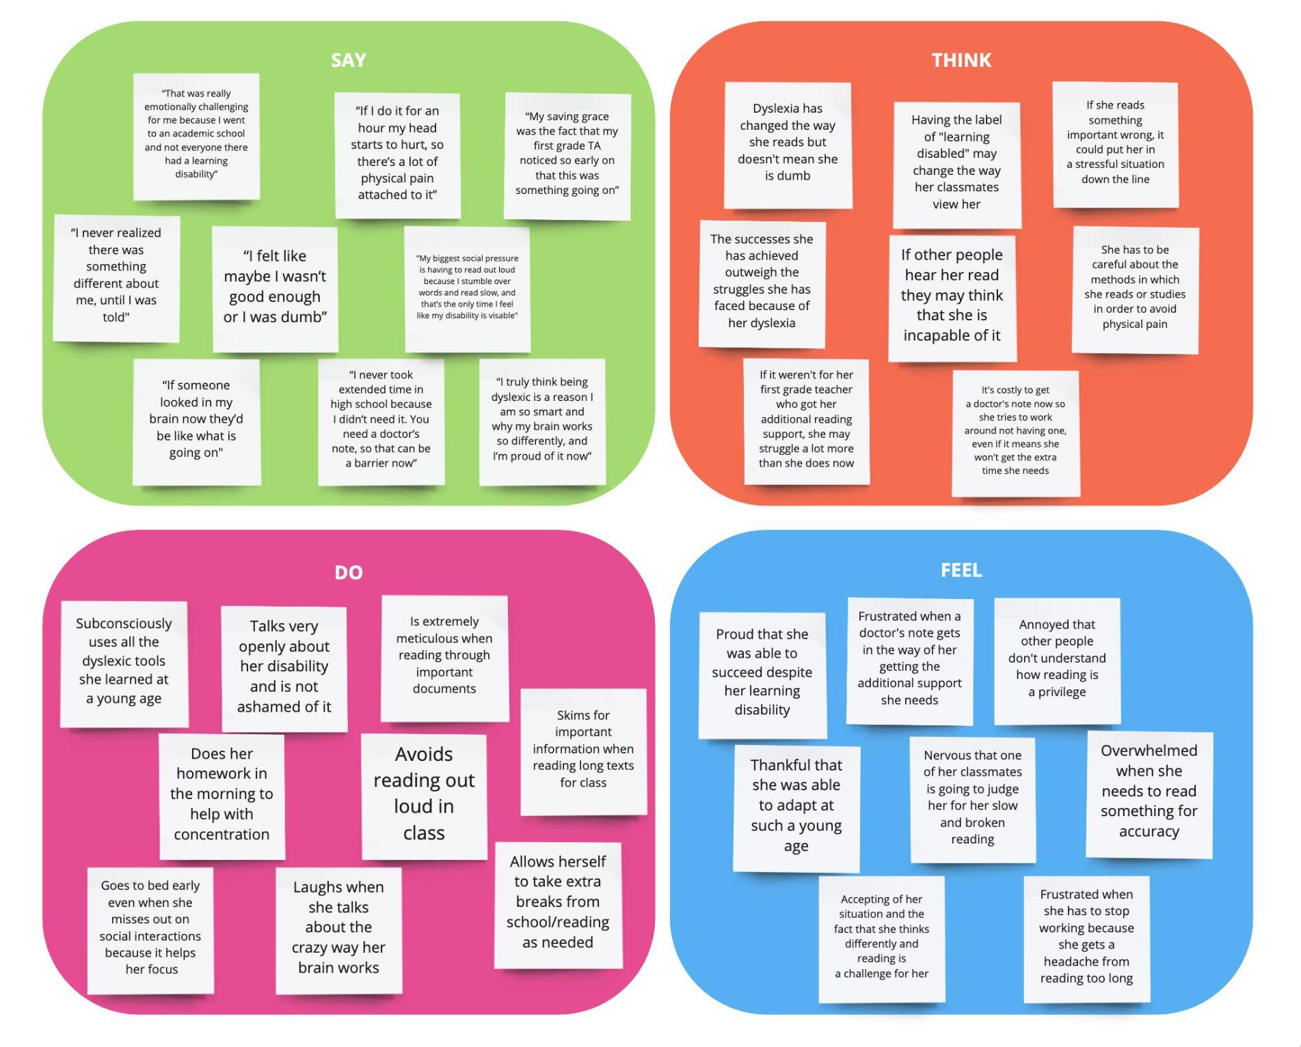
Lydia
21 years old
Stanford Student
Dyslexia

Slide 14
Lydia
21 years old
Stanford Student
Dyslexia
“That was really emotionally challenging for me because I went to an academic school and not everyone there had a learning disability”
Notes:
Highlights the self-conscious nature of standing out and
feeling like they needed to hide their label

Slide 15
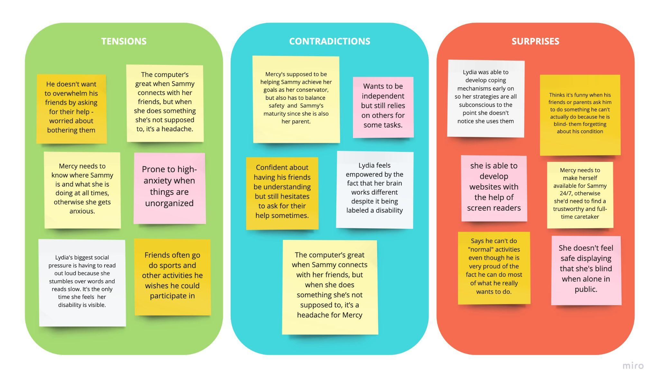
Tensions, Contradictions, and Surprises
Notes:
Before we look at the summarized empathy map, we picked out some standout quotes, and stories from the interviews:
TENSION
Lydia having to read out loud in class - only time her disability feels visibile
CONTRADICTION
Contradictions between how he knows his friends will react to asking for help (with grace) vs what he actually thinks and says (they will feel burdened)
SURPRISE
Mike Perception of iInability to participate in “normal activities” - even though there are hybrid ways that he says he was able to participate.

Slide 16
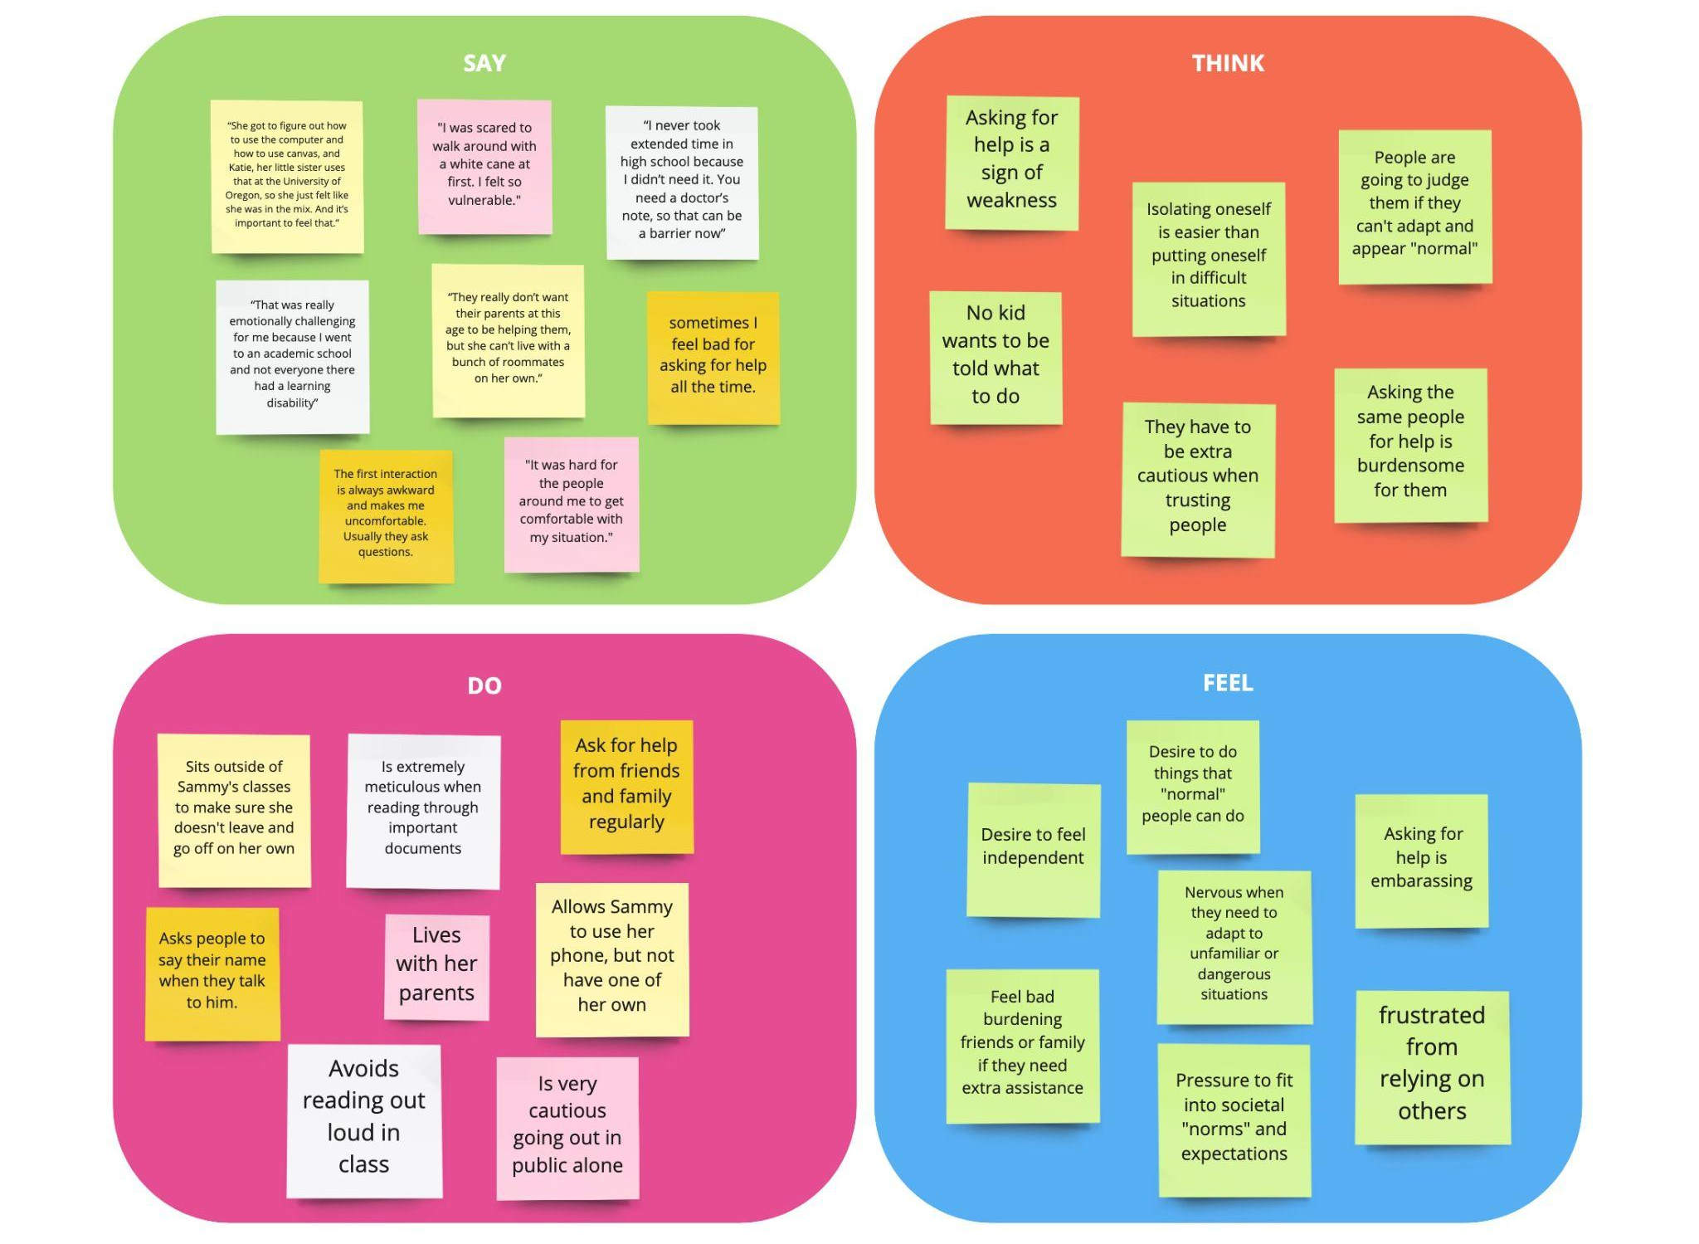
Synthesized Empathy Map
Notes:
After we flared out on each empathy map we tried to converge onto one single empathy map that summarized all of our interviews
Grabbing the most interesting quotes and DOs, we came up with some more generalized thinks and feels.
What we discovered:
Asking for help is thought of as a weakness
Asking people for help can feel burdensome
Adapting to new situations is stressful, especially social situations - feeling of becoming labeled
There is a strong desire to be independent

Slide 17
Insights and Needs
Asking for help all the time chips away at one’s independence but also is a source of tension between family and friends.
The visibility of a disability can make individuals feel unsafe or abnormal, leading to decreased participation in activities they enjoy.
Need to ask for help without feeling overbearing.
Need to find hybrid ways to participate in “normal” activities
Need to feel confident in ones safety when traveling or leaving home.

Slide 18
Summary
We talked to individuals with disabilities about adapting to society.
We learned that maintaining a sense of independence is extremely important.
We also learned that safety becomes a concern heightened by their disabilities.
We found a desire to separate social relationships from their disability needs.
Notes:
Inferences, Conclusions, and Questions
Why

Slide 19
Thank you!

