Slide 1
Plant-pollinator networks
Activity MRS

Slide 2


Notes:
Pollination is one of the best studied types of interaction in Ecology and Evolutionary Biology. While these interactions were traditionally studied in a pairwise fashion,

Slide 3
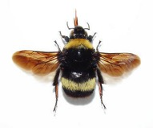



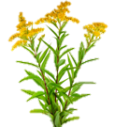

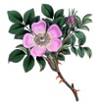
Notes:
networks have been utilized more recently to capture the complexity of the community context in which interactions occur.

Slide 4
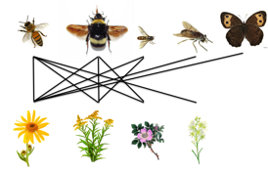





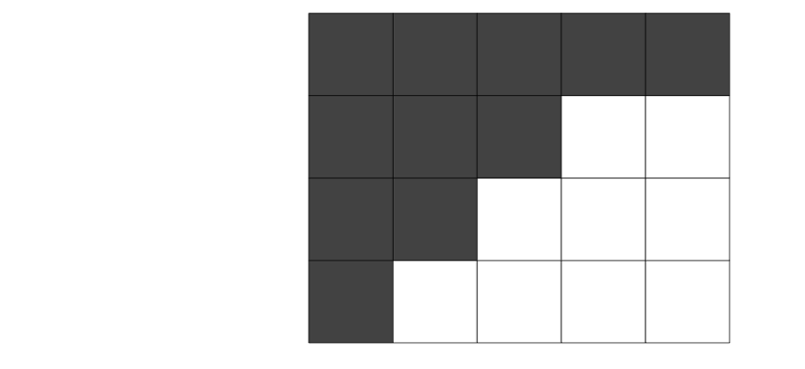




Notes:
A useful way to visualize these networks is in a nested matrix organization where the plants are sorted top to bottom by generalization and pollinators are sorted left to right by generalization. Such that we have interactions packed into the top left corner, which represents the most densely connected part of the network which I’ll call the core of the nested network.
Plant pollinator networks typically have this nested organization

Slide 5
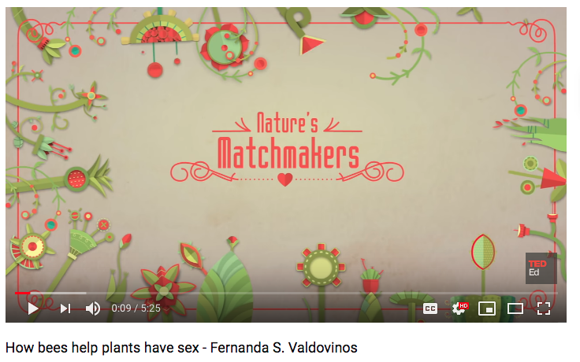
https://www.youtube.com/watch?v=Y5uRVv7GGQM#action=share

Slide 6
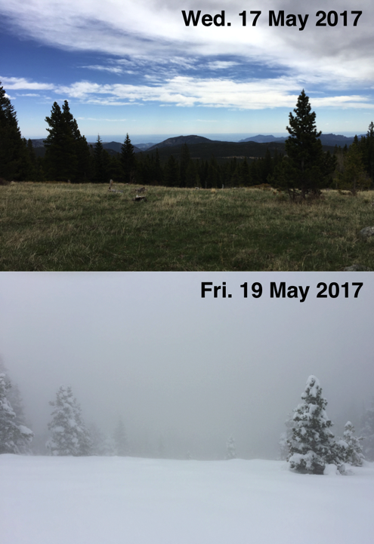
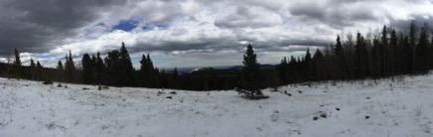
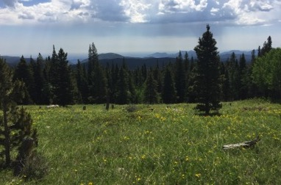
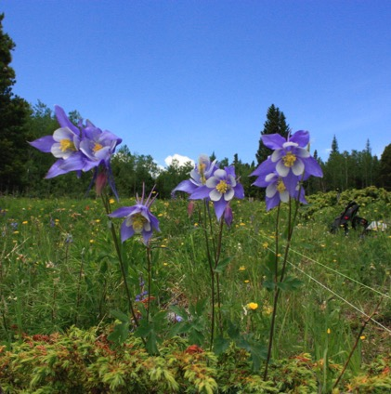
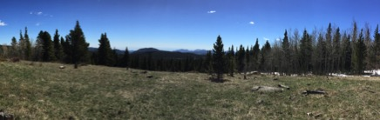
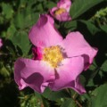
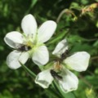
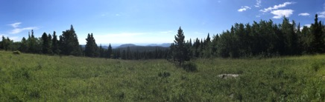
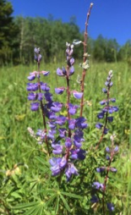
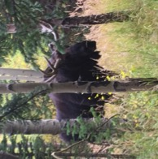
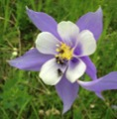
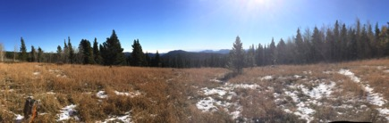
Elk Meadow, Mountain Research Station
near Nederland, Colorado USA
Elevation: 2980m (9777 ft.)

Slide 7
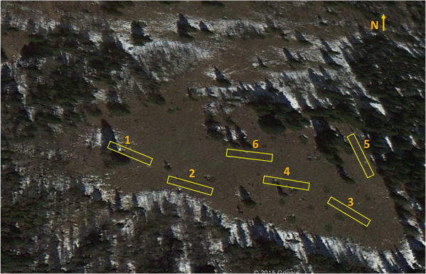
Sampling design
6 plots - 2 x 30m
15 min. surveys
Once per wk.
Flower abundance counts
Insects collected and identified
Flowering period (June-Oct.)
2015-18 (quantitative interactions)
30 m
2 m
May | June | July | Aug. | Sept. | Oct.
2015 | 2016 | 2017 | 2018 | 2019

Slide 8

















Flower phenology
Taraxacum officinale
Fragaria virginiana
Mertensia lanceolata
Dodecatheon pulchellum
Taraxacum officinale
Fragaria virginiana
Mertensia lanceolata
Dodecatheon pulchellum
Thermopsis rhombifolia
Cymopterus lemmonii
Rosa blanda
Lupinus argenteus
Thermopsis rhombifolia
Cymopterus lemmonii
Rosa blanda
Lupinus argenteus
Potentilla pulcherrima
Sedum lanceolatum
Campanula rotundifolia
Zigadenus elegans
Achillea millefolium
Solidago multiradiata
Chamerion angustifolium
Orthocarpus luteus
Potentilla pulcherrima
Sedum lanceolatum
Campanula rotundifolia
Zigadenus elegans
Erigeron eximus
Achillea millefolium
Solidago multiradiata
Chamerion angustifolium
Orthocarpus luteus
Erigeron eximus

Slide 9

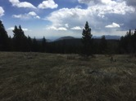

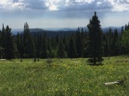
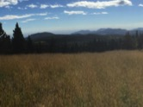

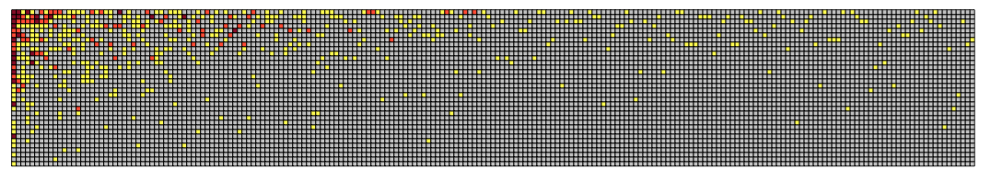
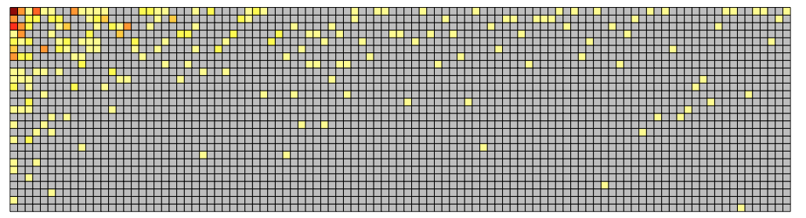
Notes:
2711 interactions
673 unique interactions
between 37 plants and 209 insects

Slide 10
Structural properties of plant-pollinator networks
low connectance - of all the possible links that could be made between plants and pollinators, only a small proportion are actually realized
Nestedness – If we rank plants and pollinators by the number of partners they have, we find this phenomenon - Specialist tend to interact with generalists and generalists tend to interact with other generalists.
Modularity – Some pollination networks show some degree of modularity where there are subsets of pollinators that that tend to interact with subsets of plants.
a right skewed degree distribution (or distribution of number of links) that typically fitting a power law or truncated power law function for plants and pollinators (Jordano et al. 2003).
Notes:
These studies have yielded some interesting emergent properties. That is, structural similarities can be observed across networks. These generalizations include:
Some of these things have implications for mechanisms of how networks are assembled and how robust networks are.

