Slide 1
Benefits of a CI/CD Pipeline
Juan Pablo Restrepo

Slide 2
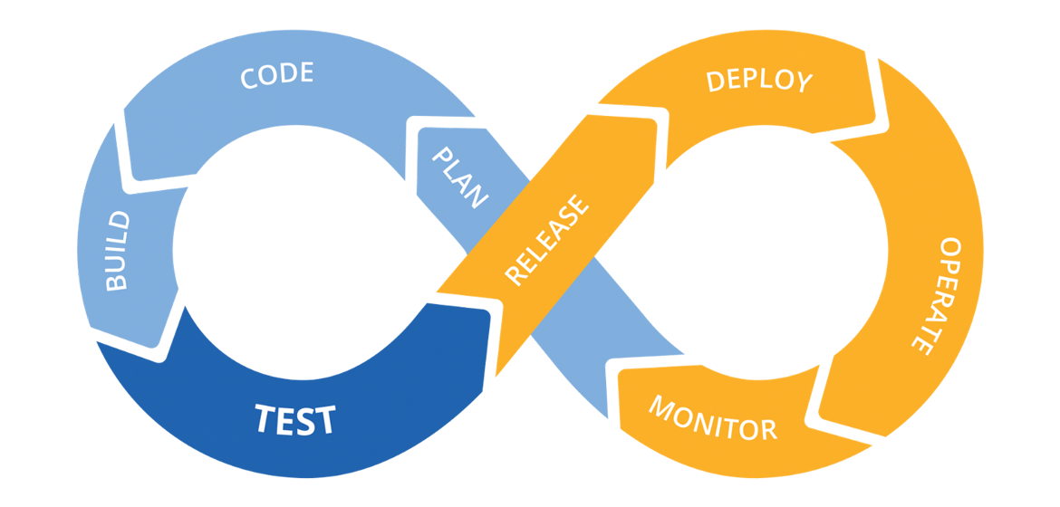
What is CI/CD?
Image: https://www.mabl.com/blog/what-is-cicd

Slide 3
Benefits of CI/CD: a path to more revenue and less costs
Less time on bugs of new features
Less bugs in production for our customers
Less infrastructure costs
More reliability
Lower downtimes

Slide 4
Benefits of CI/CD: a path to more revenue and less costs
Less time to market is the most important Benefit of a CI/CD Pipeline.
Time to market, which is the time required to deliver a feature to customers, would decrease significantly thanks to implement CI/CD. This occurs because CI/CD is a methodology and a set of tools that enhance the performance of the development and infrastructure teams. Less time to market can be an accelerator of new revenue.

