Slide 1
Introvert or Extrovert: A Myers-Briggs Experiment
Jose Reyes
02/01/2018

Slide 2
Introduction

Slide 3
Human Personality
For ages scholars have studied & aimed to classify human personality.
Various approaches:
Humorism: Ancient Greeks used the balance of body fluids to classify personality.
Phrenology/Physiognomy: Classify personality based on outward appearance.
Psychological: Myers-Briggs, Rorschach, and Thematic Apperception Test (TAT).

Slide 4
Assessing Personality
Reasons why:
Form an accurate picture of an individual.
If personality is know, easy to predict future actions.
Easy to identify preferred preferences.
Problems:
Time-consuming
Issues of low-reliability
Issues of low-validity

Slide 5
The Solution
If we can analyze social media posts to assess personality we can:
Identify key words/speech patterns that determine personality type.
Firms can use findings to better target marketing campaigns.
Education institutions can better tailor their lessons to students of different personality types.
Using Python and the Myers-Briggs Personality Indicator dataset from the Kaggle website, we will aim to classify people as Introverts or Extroverts using text data.

Slide 6
The Dataset

Slide 7
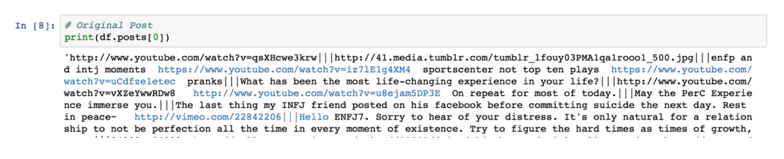
Dataset Inspection
Dataset contains 2 columns:
A collection of a user’s internet posts, concatenated as a string.
The user’s Myers-Briggs Personality Identifier (MBTI).
8,675 Observations
Sample posts:

Slide 8
Data Wrangling

Slide 9
Assumptions
Each observation is a unique observation, no unique identifier.
All user posts are truly self-reported, no high jacked accounts.
All user posts were posted over time, not all posts in one day.

Slide 10
Initial Data Quality Findings
Relatively clean dataset with minor exceptions:
Posts separated by a triple pipe (“|||”)
Posts contain URLs, numeric data, and MBTI codes.
Posts contain a multiple of stop words (i.e. “the”, “of”, “a”, “though” … etc.)

Slide 11
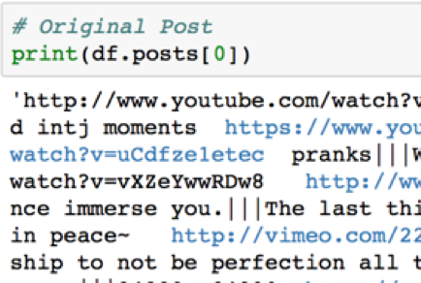
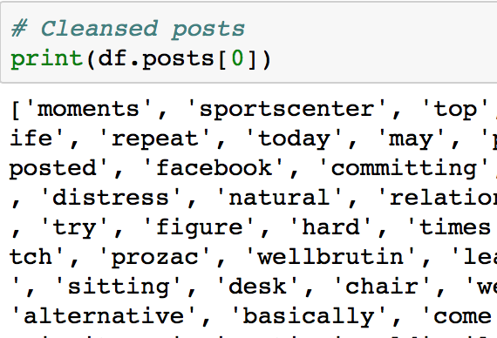
Data Wrangling
Original Posts (Sample)
Cleansed Posts (Sample)

Slide 12
Data Wrangling (con’t)
Additional data wrangling includes value transformation:
Creation of a 3rd column: “Attitude”
Denotes if user is Introvert or Extrovert, based on MBTI value. If MBTI starts with “I,” user is Introvert. If MBTI starts with “E,” user is Extrovert.
Creation of a 4th column: “word_qty”
Denotes word count of the cleansed string.

Slide 13
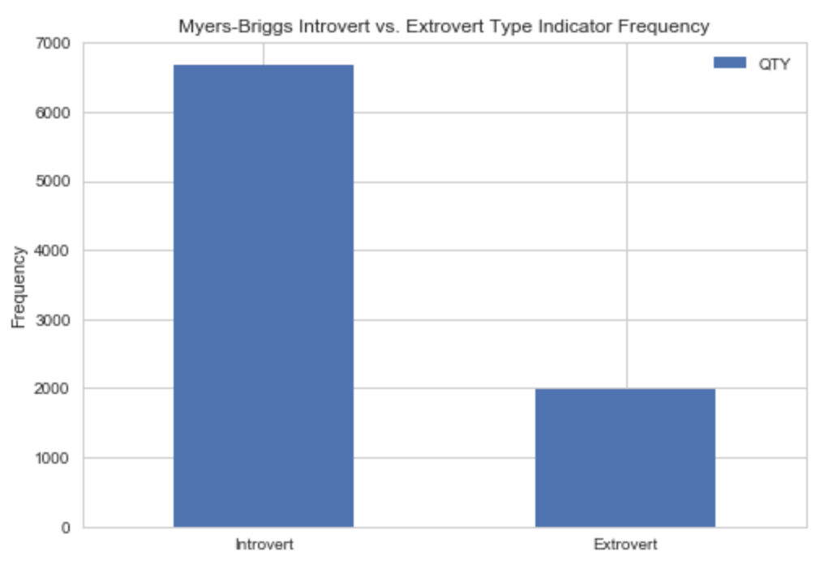
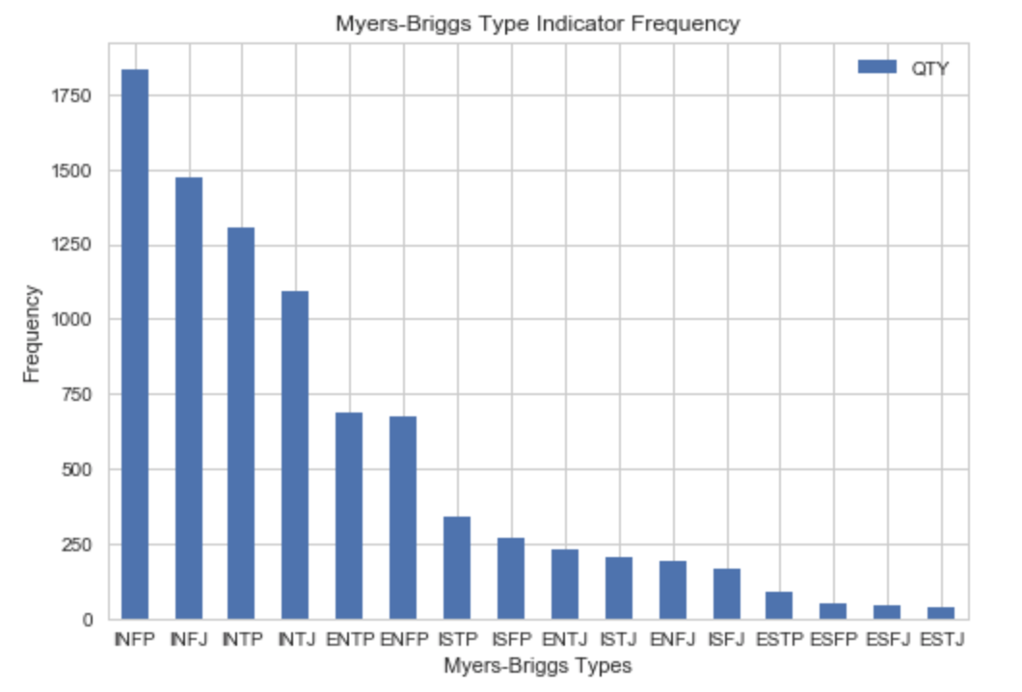
Inferential Statistics

Slide 14
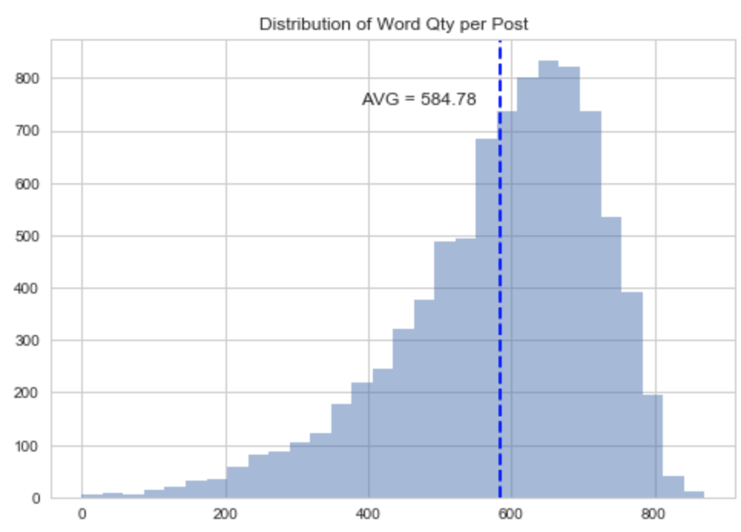
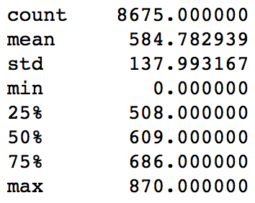
Inferential Statistics (con’t)
String Word Count Distribution
String Word Count Descriptive Statistics

Slide 15
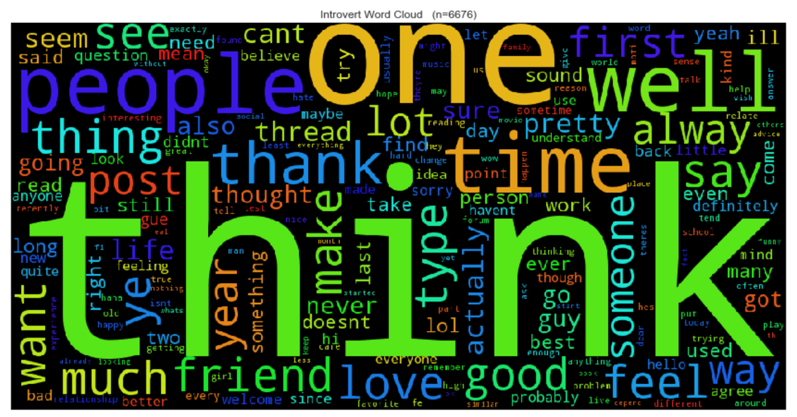
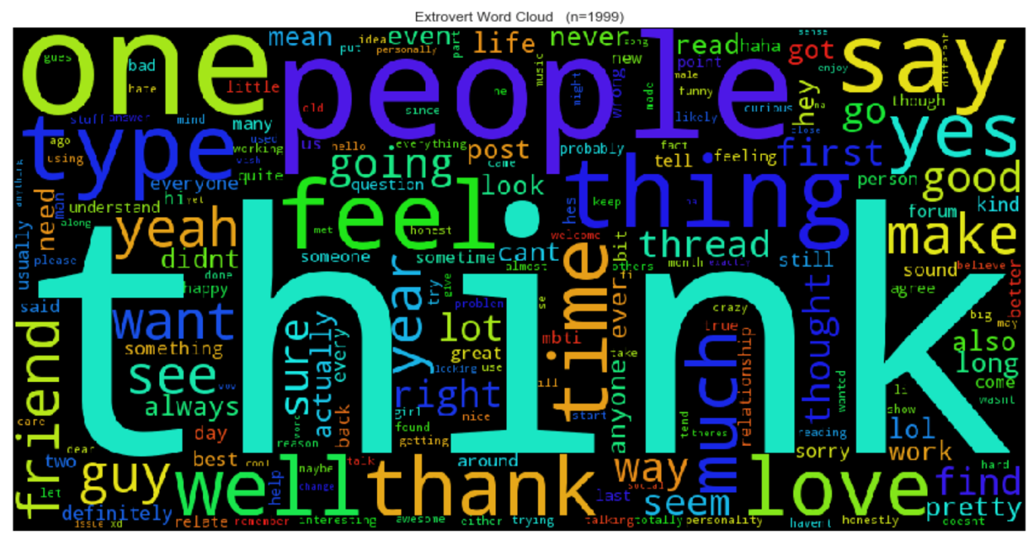
Inferential Statistics (con’t)
Word Cloud of Introvert posts: n=6,676
Word Cloud of Extrovert posts: n=1,999

Slide 16
Building the Algorithm

Slide 17
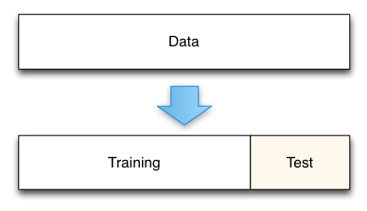
Training/Testing Set Creation
Utilized Python’s Scikit-Learn machine learning library.
Dataset was split into striated training and testing sets:
Training set = 90% of data
Testing set = 10% of data
Strings were transformed to numeric vectors: CountVectorizer & TfidfVectorizer

Slide 18
Results
Algorithm | Best Test Score
Multinomial Naïve Bayes | 77.76% (Count Vectorizer)
Logistic Regression | 78.11%* (Tfidf Vectorizer)
Support Vector Machines (SVM) | 77.65% (Count/Tfidf Vectorizers)
Decision Tree | 77.30% (Count Vectorizer)
Random Forest | 76.96% (Count Vectorizer)
Each algorithm was trained using the training set.
Each algorithm was fitted to the testing set to assess model performance.
Each algorithm was fine-tuned to improve performance.

Slide 19
Discussion/Recommendations

Slide 20
Discussion
A score of 78.11% is not ideal for real-life applications.
Dataset is highly skewed, too many introverted MBTIs.
With limited data we’re unable to generate a meaningful model:
The lack of a unique user identifier provides no knowledge potential duplicates.
No socio-economic, demographic or time-series data provided.

Slide 21
Recommendations
Review user posts with higher scrutiny and remove remaining stop words.
Consolidate words with same root word (i.e. “testing”, “tested”, “test”).
Re-run study with equal amounts of introverted and extroverted participants.
Collect additional data: demographic information and time spent generating posts.

Slide 22
Questions?

