Slide 1
From Mechanistic Model to
Variant-Level Inference
Rule-based modeling of LDLR variant effects
Tianyi Zhang
Faeder Lab
University of Pittsburgh
Oct 6, 2026
Notes:
Introduce the overall project goal: using a mechanistic LDLR uptake model to move from variant phenotype toward variant-level mechanistic interpretation.

Slide 2
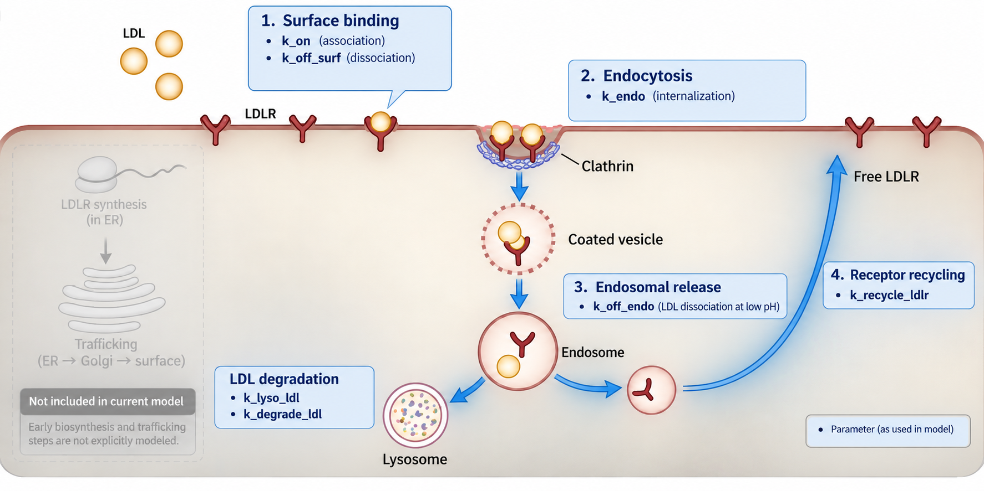
LDL uptake review
Notes:
Review the LDLR uptake cycle and show which biological steps are represented by model parameters: surface binding, endocytosis, endosomal release, recycling, and LDL degradation. Also clarify that early LDLR synthesis and ER/Golgi trafficking are not explicitly included in the current model. This gives the biological meaning of the parameters used later.

Slide 3
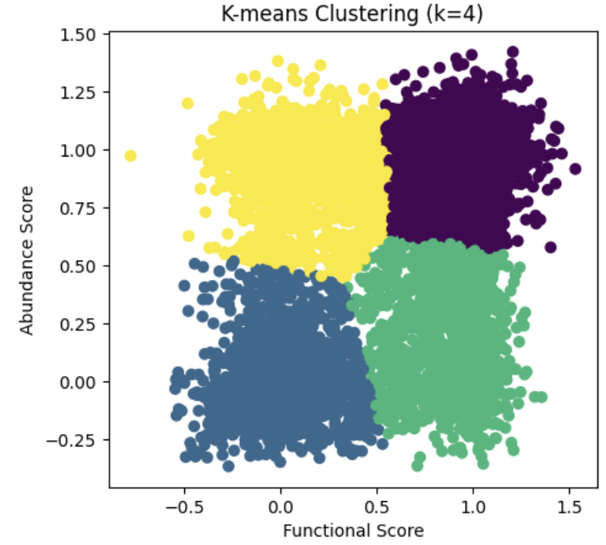
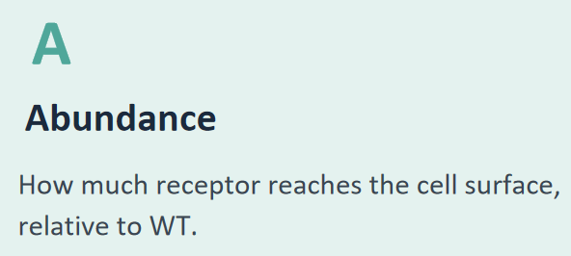
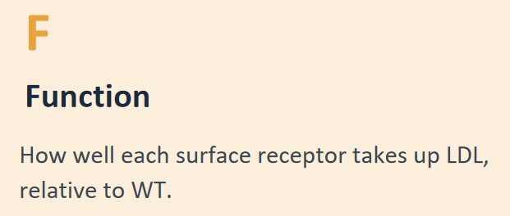
Four phenotype classes from A/F space
Cluster 0
WT-like
high A, high F
Cluster 3
Function-defect
high A, low F
Cluster 2
Abundance-defect
low A, high F
Cluster 1
Severe / null
low A, low F
~14,600 LDLR missense variants, each scored on both A and F (Tabet et al., Science 2025).
Notes:
Explain what A and F measure in the experimental variant dataset. Describe how the variants were separated into four phenotype clusters using A/F space and what the four clusters mean: WT-like, severe/null, abundance-defect, and function-defect. These phenotype classes will be used throughout the later model and mutation analyses.

Slide 4
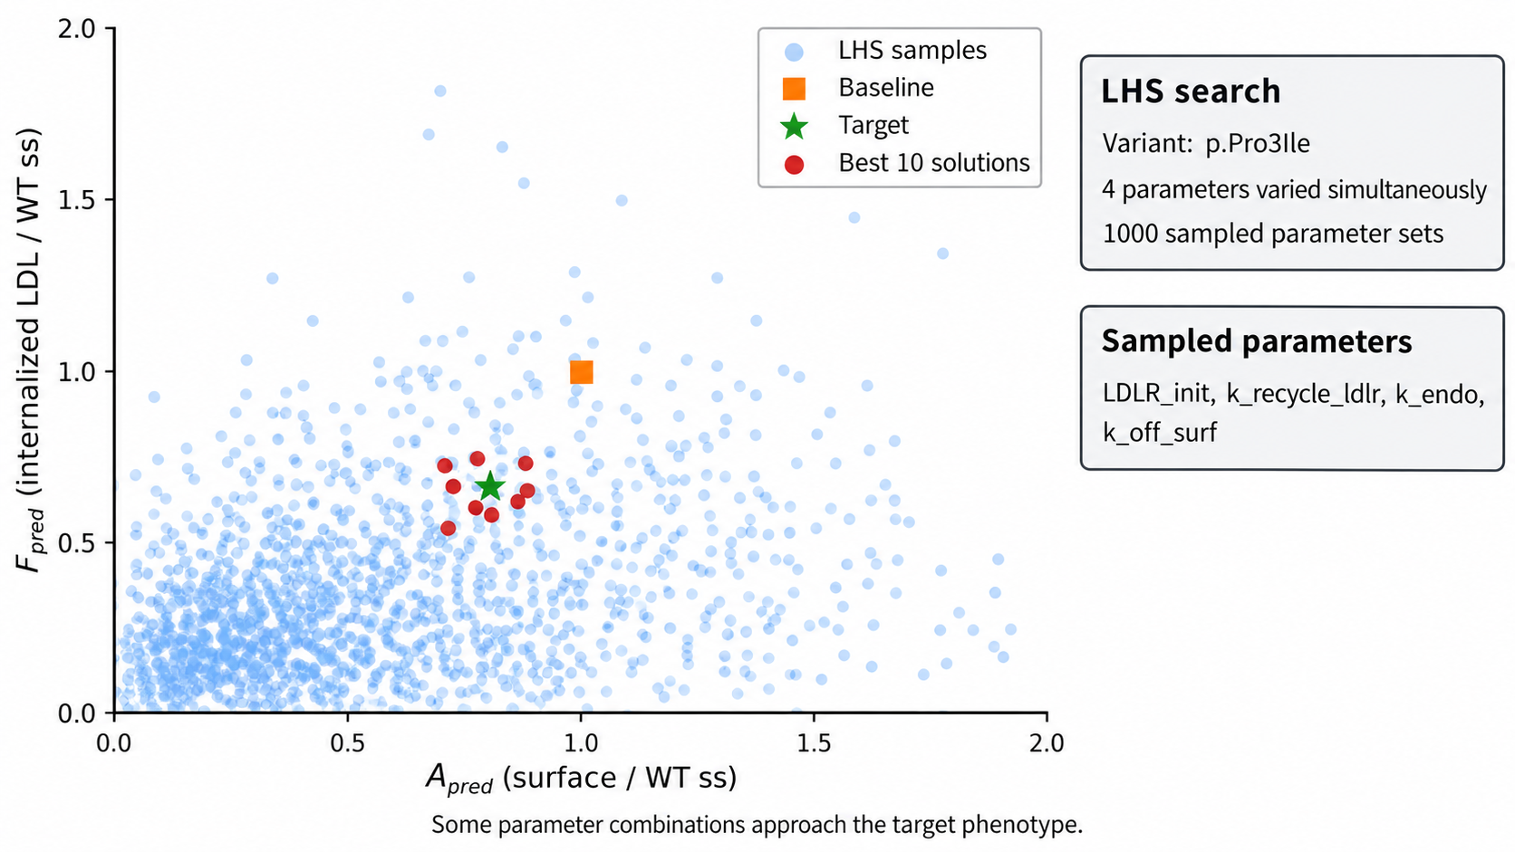
Latin Hypercube Sampling explores the reachable A–F space
Notes:
Explain why Latin Hypercube Sampling was used: to efficiently test many combinations of model parameters rather than changing only one at a time. Use p.Pro3Ile as an example to show that different parameter combinations generate different A/F outputs and that some sampled combinations can approach the experimental target. This establishes that the model can explore a substantial phenotype space.

Slide 5
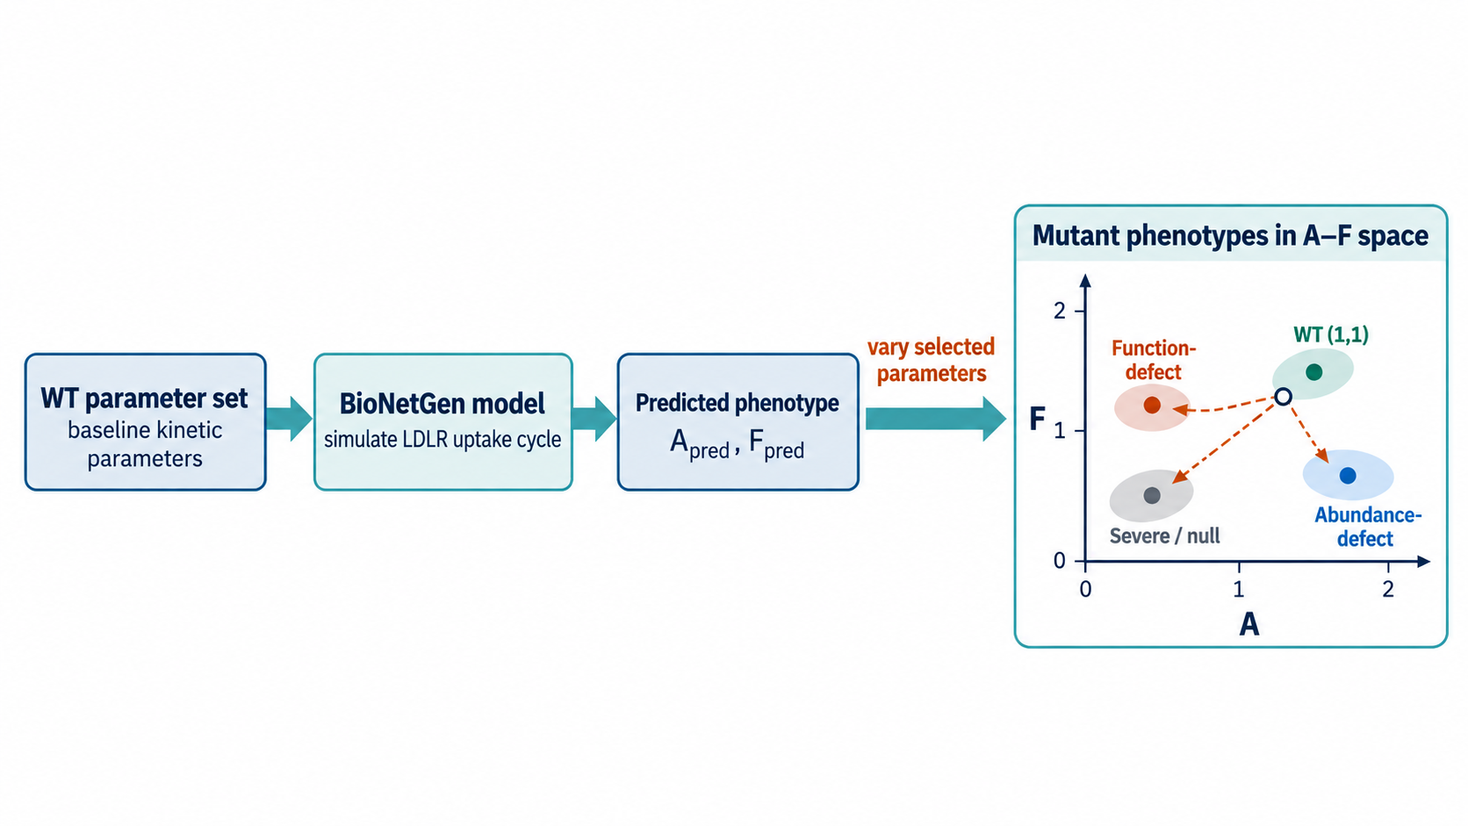
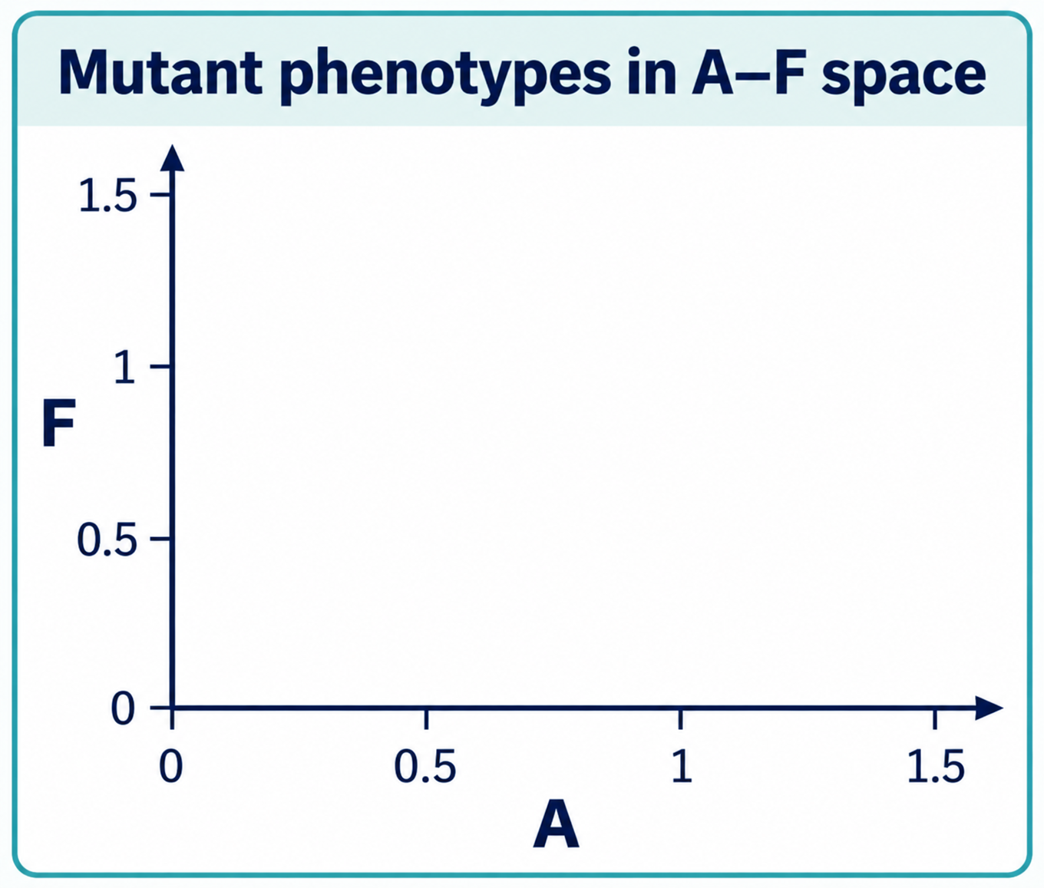
Can the model reproduce mutant phenotypes?
Abundance
defect
WT(1,1)
Severe
/null
Function
defect
Notes:
Introduce the first major question: starting from the WT parameter set, can changing model parameters move the predicted phenotype toward the mutant regions observed experimentally? Explain the forward direction: parameters → BioNetGen model → predicted A/F.
This sets up why we first explore parameter space before trying to interpret individual variants.

Slide 6
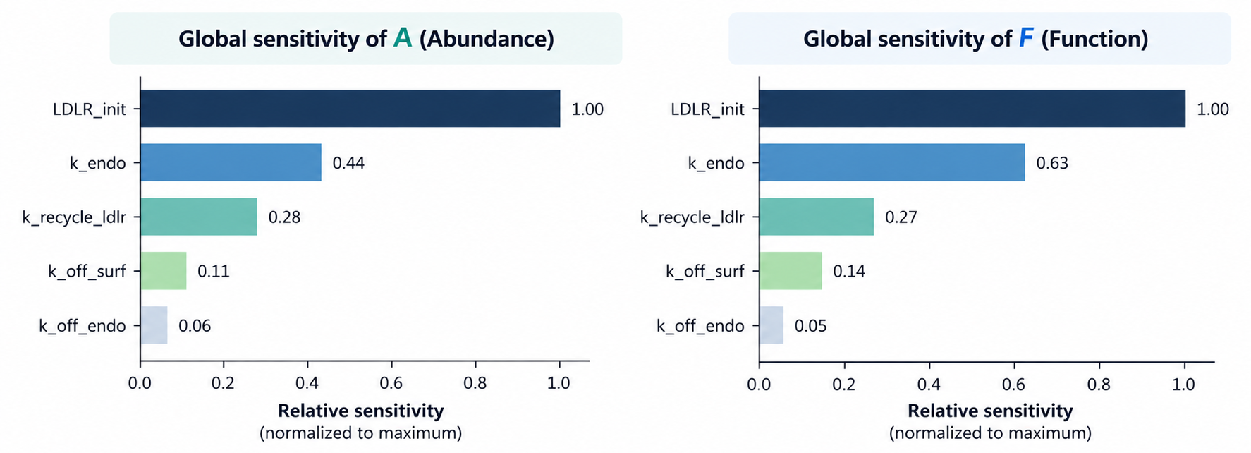
Sensitivity analysis identifies influential parameters
Notes:
Discuss which model parameters have the greatest influence on A and F. Explain that sensitivity analysis is not telling us which parameter a mutation actually changes; instead, it tells us which parameters are capable of strongly affecting the phenotype. This helps prioritize parameters before attempting inverse fitting.

Slide 7
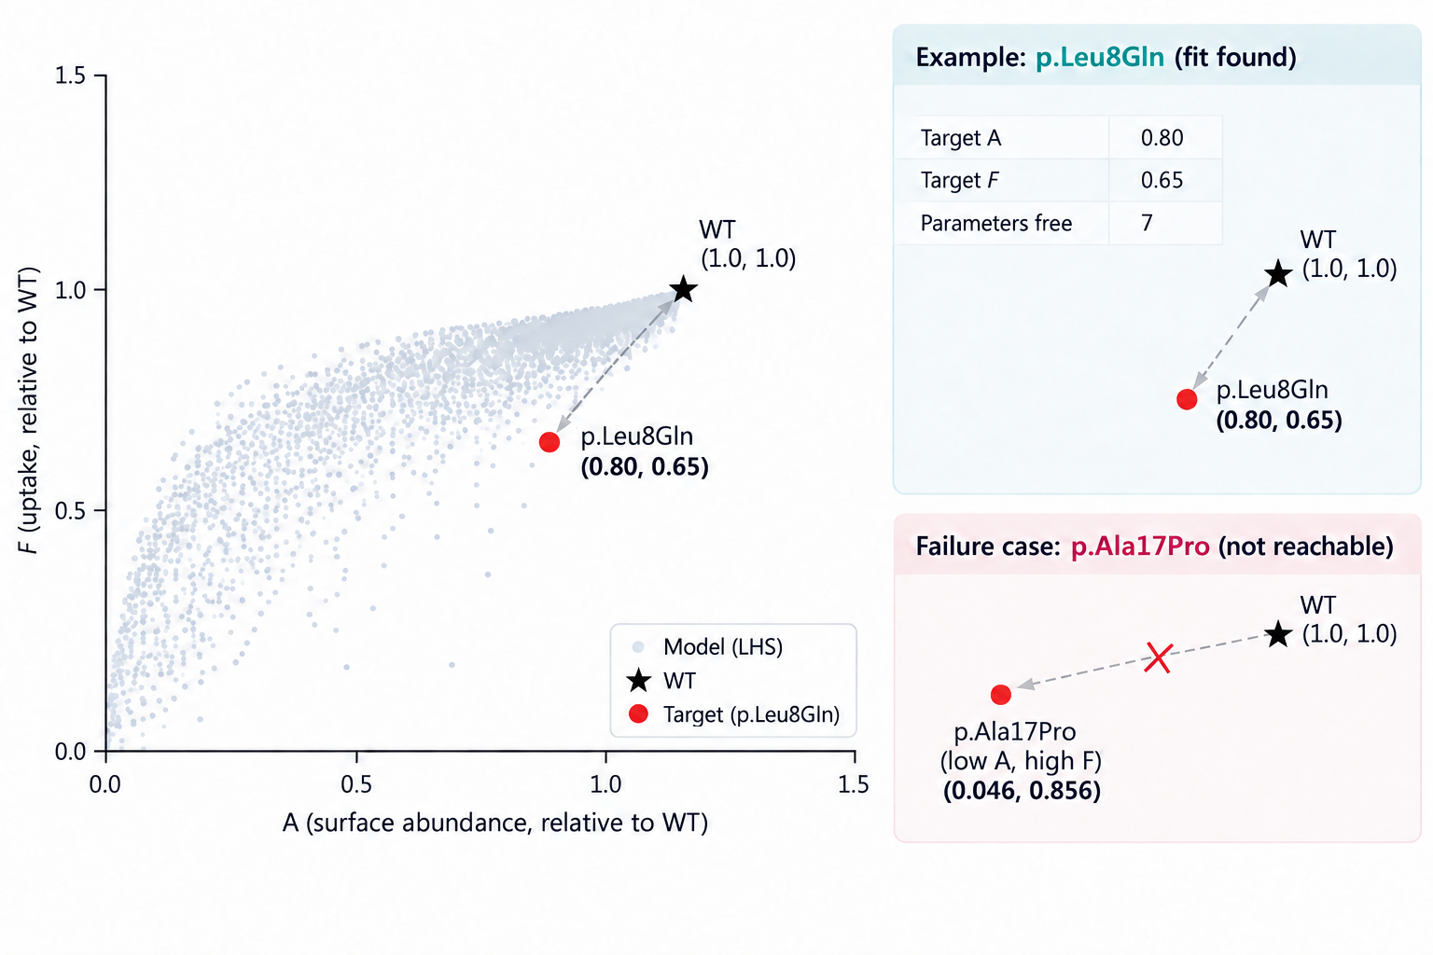
Inverse fitting and model reachability
Notes:
Move from the forward problem to the inverse problem:
observed phenotype → possible parameters.
Show that a target such as p.Leu8Gln can be fitted, but other phenotypes, particularly very low abundance with high function, may fall outside the model's reachable space. The key conclusion is that fitting alone is not enough: even when a phenotype is reachable, A/F by itself does not necessarily tell us the true molecular mechanism.
Connection to Part 2: because phenotype alone is insufficient, we need additional biological information from the variants.

Slide 8
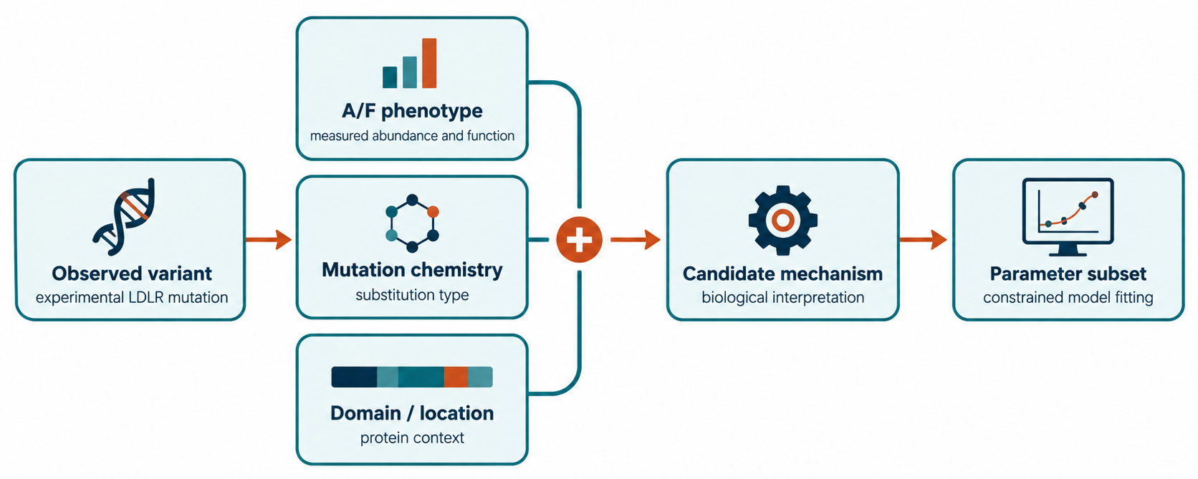
Ground the model in variant data
Notes:
Introduce the new strategy: combine the observed A/F phenotype with mutation chemistry and protein domain/location. The purpose is to use experimental variant information to narrow the possible biological mechanisms and therefore narrow the model parameter subset. This page is the conceptual bridge between model exploration and biological interpretation.

Slide 9
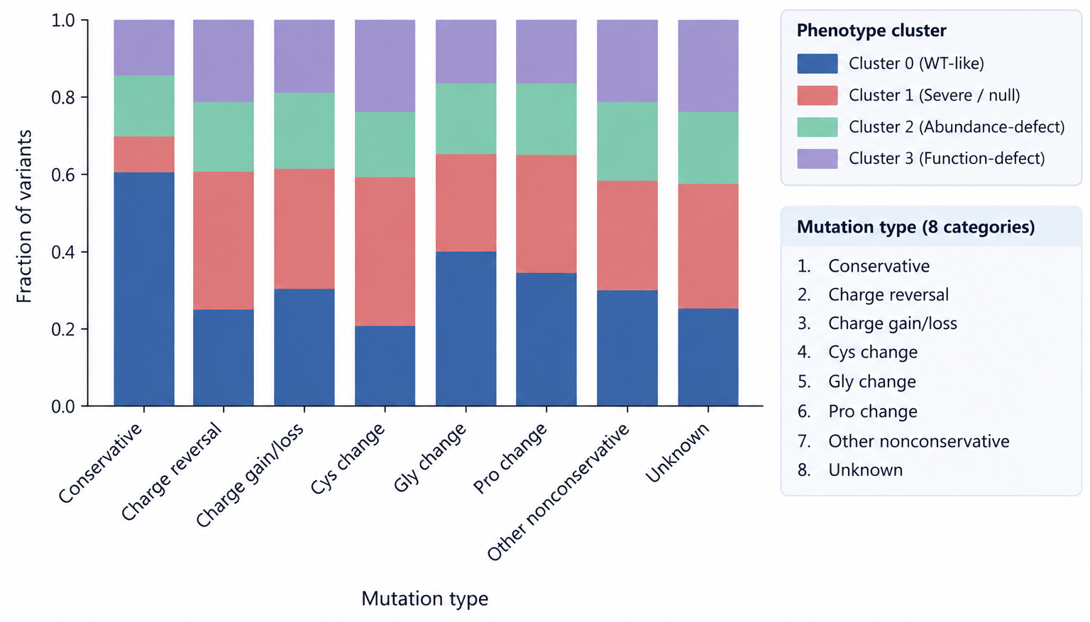
Mutation type shows trends but does not uniquely determine phenotype
Notes:
Explain how variants were classified into eight mutation categories such as conservative, charge reversal, Cys change, Gly change, etc. Compare the phenotype-cluster distributions across mutation types. The main result is that mutation type shows some trends, but each mutation category still produces multiple phenotype classes.Mutation chemistry contains useful information, but it is not enough by itself, so we next ask whether location in LDLR matters.

Slide 10
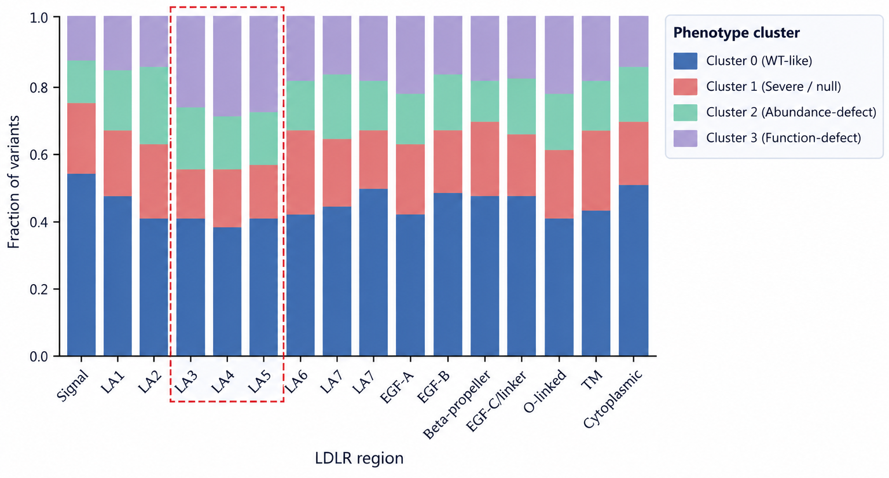
LDLR phenotype depends strongly on protein region
Notes:
Compare phenotype distributions across LDLR regions. Highlight the strong pattern in LA3–LA5, where there is a larger fraction of function-defect variants compared with many other regions. The main conclusion is that the effect of a mutation depends strongly on where the residue is located, so domain information adds information that mutation type alone misses.

Slide 11
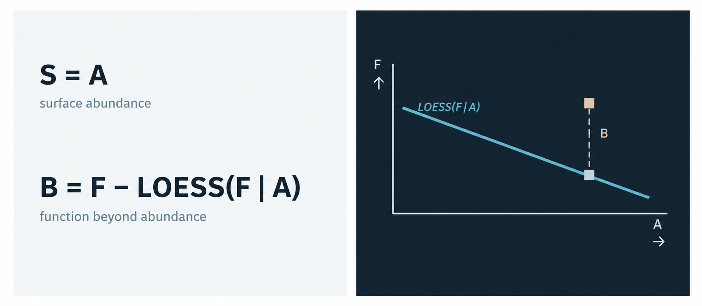
Predict phenotype components before mechanism
Notes:
Explain why Part 3 temporarily skips the mechanistic layer and predicts phenotype directly from variant features. Before building the full features → θ → mechanistic model → phenotype pipeline, we first test whether the features contain enough information to predict the phenotype components.
Introduce the two targets:
S = A: surface abundance.
B = F − LOESS(F | A): the component of function not explained by abundance.
The purpose of B is to separate function-related variation from the effect of simply having more or less receptor at the surface.
Now that B and S are defined as the prediction targets, the next question is what information about each variant we use to predict them — the 26-feature vector.

Slide 12
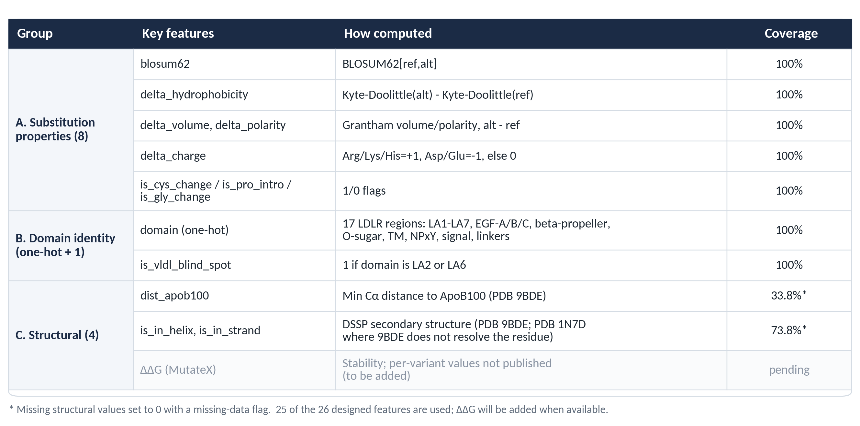
The 26-feature vector
Notes:
This page will explain what information we use to describe each LDLR variant before prediction.
The 26 features are grouped into three types:
Substitution properties — what biochemical change occurred, such as BLOSUM62, hydrophobicity, volume, polarity, charge, and Cys/Pro/Gly changes.
Domain identity — where the mutation occurs in LDLR.
Structural features — distance to ApoB100 (from 9BDE) and secondary structure (from 9BDE, and from 1N7D where 9BDE does not resolve the residue). MutateX ΔΔG is part of the design, but per-variant values were not published available yet.
This is the quantitative extension of Part 2: instead of only using broad mutation classes and domains, we now encode each variant with a richer feature vector.
Also mention that the substitution and domain features have full coverage, while the structural features are only partially available, which will become an important limitation later.
Once every variant is represented by these 26 features, the next question is whether they are actually predictive of B and S

Slide 13
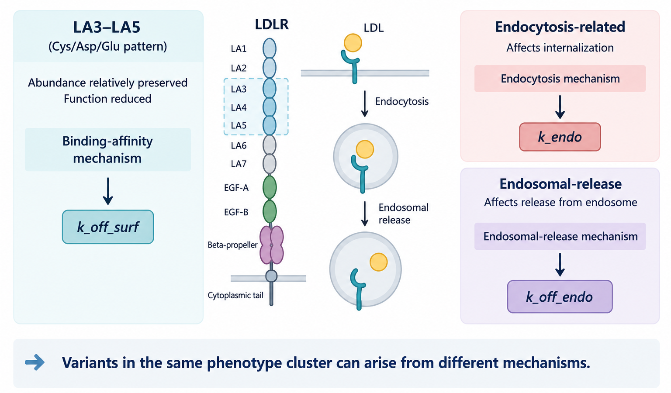
Domain + mutation pattern suggests distinct mechanisms
Notes:
Bring Part 1 and Part 2 together. Explain that combining phenotype, mutation pattern, and domain knowledge can suggest different mechanistic interpretations that map onto different model parameters—for example binding-related effects, endocytosis-related effects, and endosomal-release effects. The important takeaway is:variants with similar A/F phenotypes can still arise from different mechanisms.

Slide 14
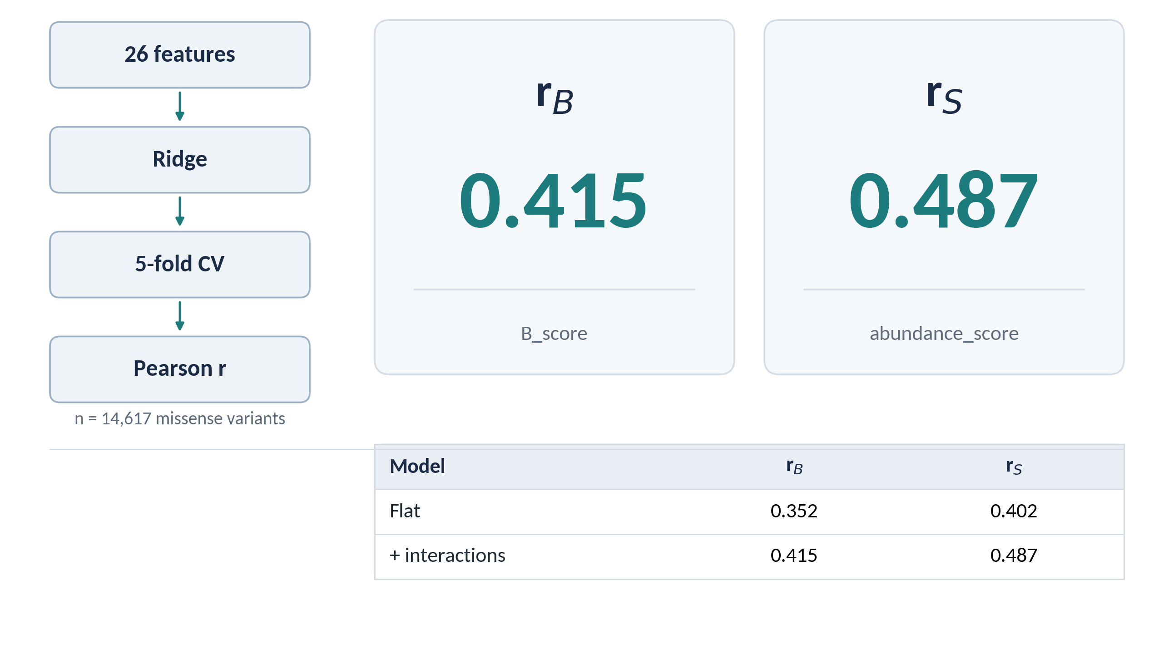
Can the 26 features predict B and S?
Notes:
This page tests whether the 26 variant features contain enough information to predict the two phenotype components across the whole protein.
The calculation is simple conceptually:
26 features → ridge regression → 5-fold cross-validation → Pearson
For each target, B or S, we fit a ridge regression using the standardized feature vector. With 5-fold cross-validation, each variant is predicted by a model that was trained without that variant. We then calculate Pearson correlation between the predicted and observed values. The same procedure is used for B and S; only the target changes.
We tested two versions of the model:
Flat model: the 26 features are used directly, with domain represented as a one-hot feature. This effectively assumes that a feature has the same general effect across LDLR regions.
+ interactions: we add domain × feature interaction terms, allowing the effect of a feature to differ depending on the domain. For example, ΔΔG can have a different relationship with phenotype in LA4 than in another domain.
Adding these domain-specific interactions improved the global results:
So the main conclusion is that the 26 features contain real but moderate predictive signal, and allowing feature effects to depend on protein region improves prediction.
These are whole-protein averages. A global r cannot tell us whether prediction is equally moderate everywhere or very good in some domains and poor in others. So next we examine the model locally by protein region.

Slide 15
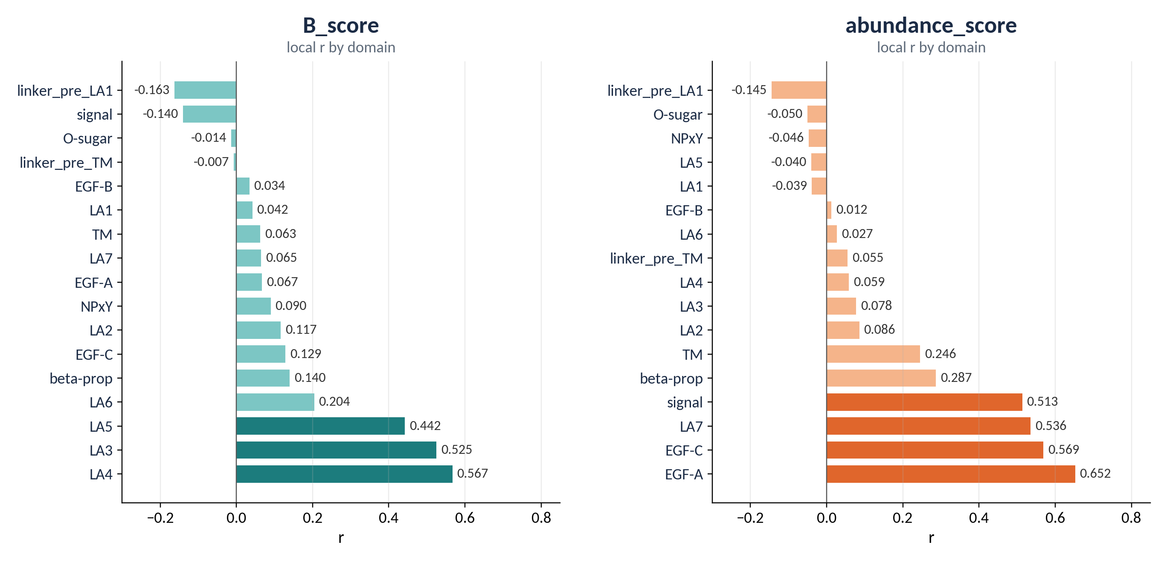
Predictability is strongly domain-specific
Notes:
This page asks whether the global performance from the previous slide is uniform across LDLR, or whether it changes by region.
The calculation is the same as before: we use the same out-of-fold predictions from the ridge model, but instead of computing one Pearson r across all 14,617 variants, we compute r within each domain separately.
For B, the strongest local prediction is concentrated in:
LA3, LA4, LA5
For S, a very different set of regions performs best:
LA7, EGF-A, signal peptide, EGF-C
So the main result is that the global is hiding very different local patterns. The regions where B is predictable are not the same regions where abundance is predictable.
This is also consistent with Part 2: LA3–LA5 were already highlighted as function-related regions, and here they are again the strongest regions for predicting B.
Low local r does not always mean the model is simply bad in that domain. Next we ask why predictability differs across regions.

Slide 16
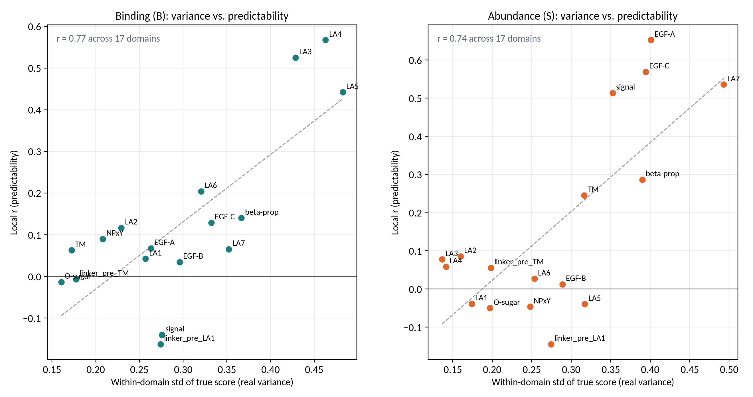
Local predictability tracks phenotypic variance
Notes:
This page explains why some domains have high local r and others have low local r.
For each LDLR domain, I compare two things:
the within-domain standard deviation of the true score — how much real phenotype variation exists in that domain;
the local prediction r— how well the model predicts variants within that same domain.
Across the 17 domains, these are strongly correlated.
The dashed line is a linear fit across the 17 domains. It shows the predictability we'd expect from a domain's variance alone. Domains above it do better than expected, domains below it do worse, and the β-propeller sits below the line in both panels.
So domains with more real variation are generally easier to predict.
This is important because a low local r does not always mean the model is failing. In some domains, most variants have very similar true scores, so there is very little variation for any model to explain.
For example, LA3–LA5 have high B variance and high r_B, while LA7 and EGF-A have high S variance and high r_S.
Connection to next page: this lets us distinguish variance-limited regions from genuine model failures. The next slide focuses on the β-propeller, where there is real variation but prediction is still poor.

Slide 17
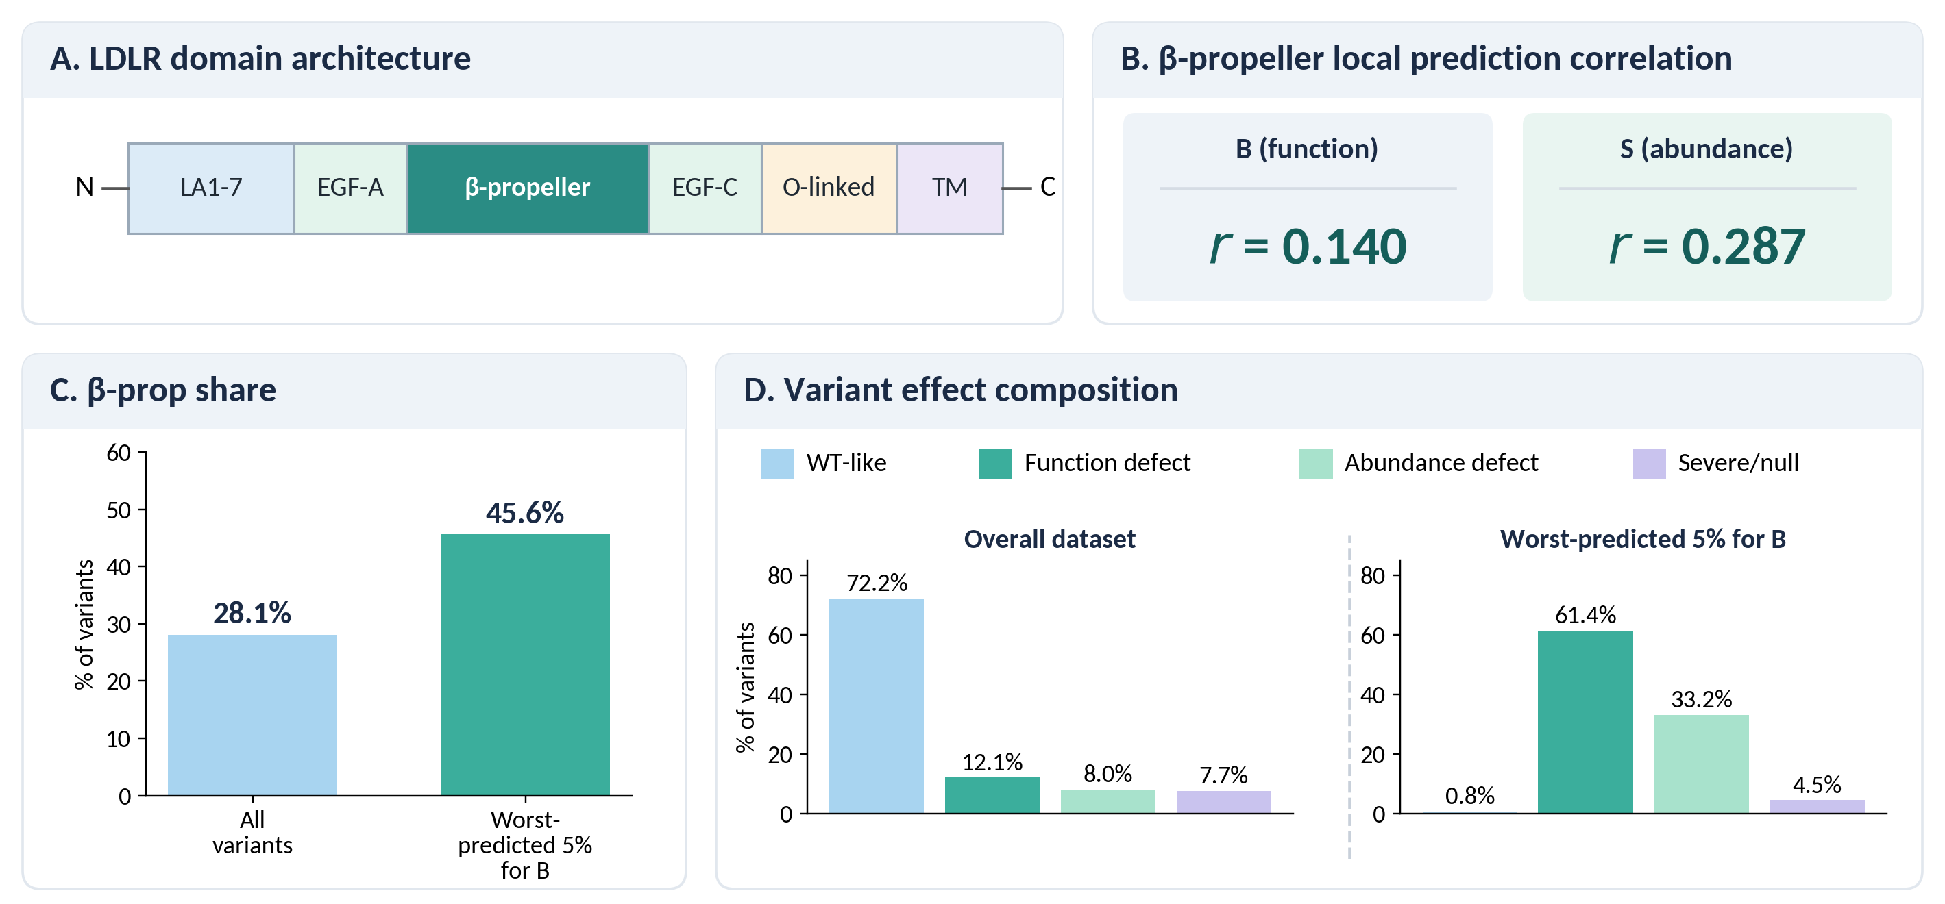
Case study: Beta-propeller has real variation but low predictability
Notes:
This page focuses on the β-propeller as a concrete example of a prediction gap.
From the previous slide, we saw that low local r can sometimes happen simply because a domain has very little true phenotype variation. The β-propeller is different: it has meaningful variation in the experimental scores, but the model still predicts it poorly.
Using the same out-of-fold predictions as before, the β-propeller has: r_B = 0.140 and r_S = 0.287
So the model is not capturing the variation in this region nearly as well as it captures B in LA3–LA5 or S in LA7/EGF-A.
The failure analysis supports the same conclusion. The β-propeller represents about 28.1% of all variants, but 45.6% of the worst-predicted 5% for B, so it is clearly overrepresented among large prediction errors.
This makes the β-propeller especially interesting mechanistically. In Part 2, we already proposed that β-propeller mutations may affect endosomal LDL release, which would map to k_off_endo. The current 26-feature set does not explicitly capture that pH-dependent conformational mechanism.

Slide 18
Future direction
1. Test the β-propeller mechanism in the model
Can varying k_off_endo, alone or with k_endo and k_recycle_ldlr, reproduce β-propeller phenotypes?
2. Complete the structural features
Add MutateX ΔΔG, and propeller–LA4/5 distances from 1N7D (the contact involved in endosomal release).
3. Guide the mechanistic modeling
Prioritize LA3–5 (binding: k_off_surf), LA7/EGF-A (abundance: LDLR_init, k_recycle_ldlr) and the propeller (k_off_endo, possibly more than one mechanism).

Slide 19
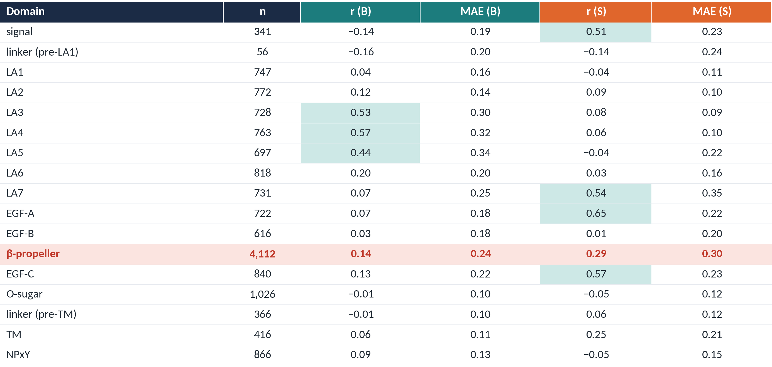
r and MAE by domain
Notes:
This table gives the full per-domain numbers behind slide 15, with MAE added next to r. The highlighted cells are the best-predicted domains: LA3–5 for B, and EGF-A, EGF-C, LA7 and signal for S. The β-propeller row shows the problem: low r (0.14 for B, 0.29 for S) and the highest MAE for S (0.30). So the errors there are large, not just hard to rank. Several domains with low r, such as O-sugar and the pre-TM linker, have small MAE, which means there's little variation to explain rather than poor prediction.

Slide 20
Acknowledgements
Faeder lab
Jim Faeder
Achyudhan Kutuva
Alexander DiBiasi
Anamarie Martinez-Turak
Paul Sharoubeem
Emma Franken
Nikita Rajesh
Robin Danko
Samiran Chakraborti
Roth Lab
Fritz Roth
Cindy Zhang

Slide 21
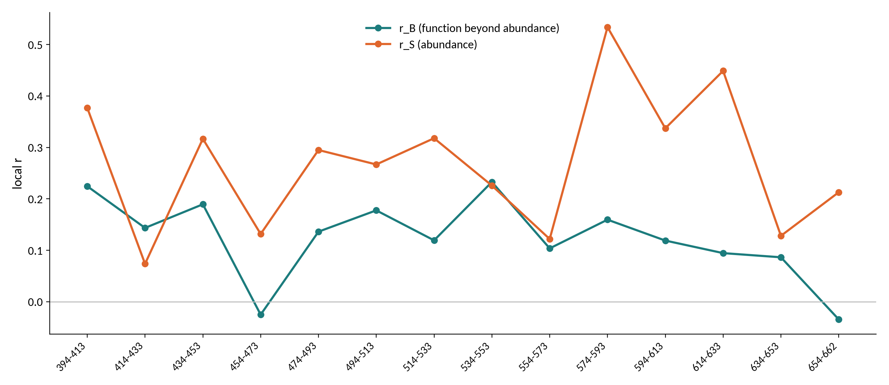
β-propeller position-window scan
Notes:
Here I split the β-propeller into 20-residue windows and computed local r in each. For B, r stays low across the whole propeller, mostly below 0.2, so no single sub-region is well predicted. For S, a few windows do better, especially around residues 574–593 and 614–633 (r ≈ 0.45–0.53). So the difficulty with B is spread across the propeller, not confined to one region.

Slide 22
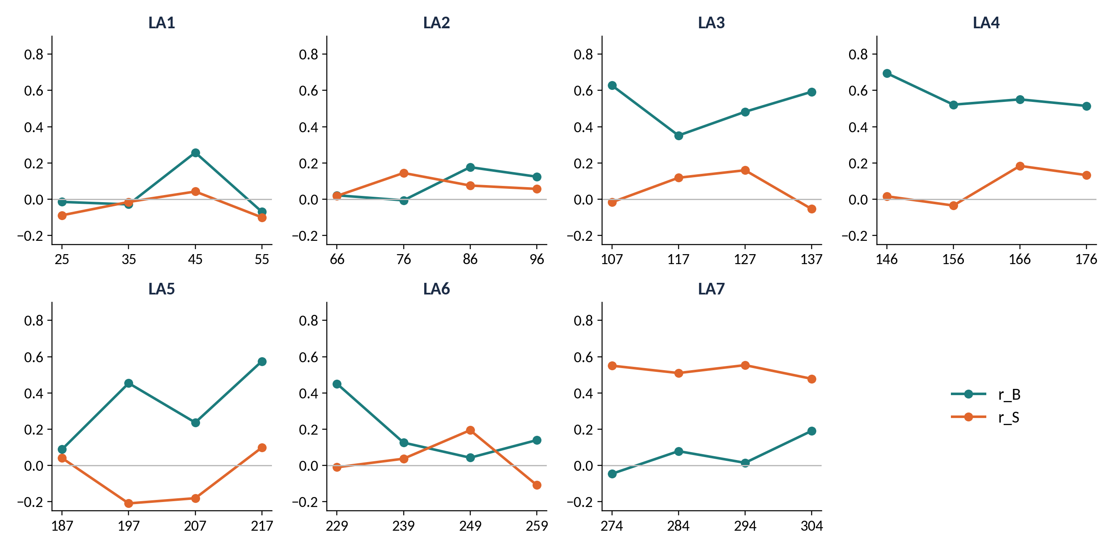
LA repeats position-window scan
Notes:
The same analysis in 10-residue windows for each LA repeat. In LA3 and LA4, B is well predicted in nearly every window, so the signal is consistent across the repeat, not driven by a few residues. LA5 is more uneven, and LA1 and LA2 stay low. For S, LA7 is consistently high across all windows, matching its strong domain-level r_S.

