Slide 1

Sentiment Analysis using Tidymodels and Keras
The purpose of this project is to leverage the Tidymodels environment to compare classifying movie reviews. For Neural Network algorithms we will have to Leverage Keras/Tensorflow

Slide 2
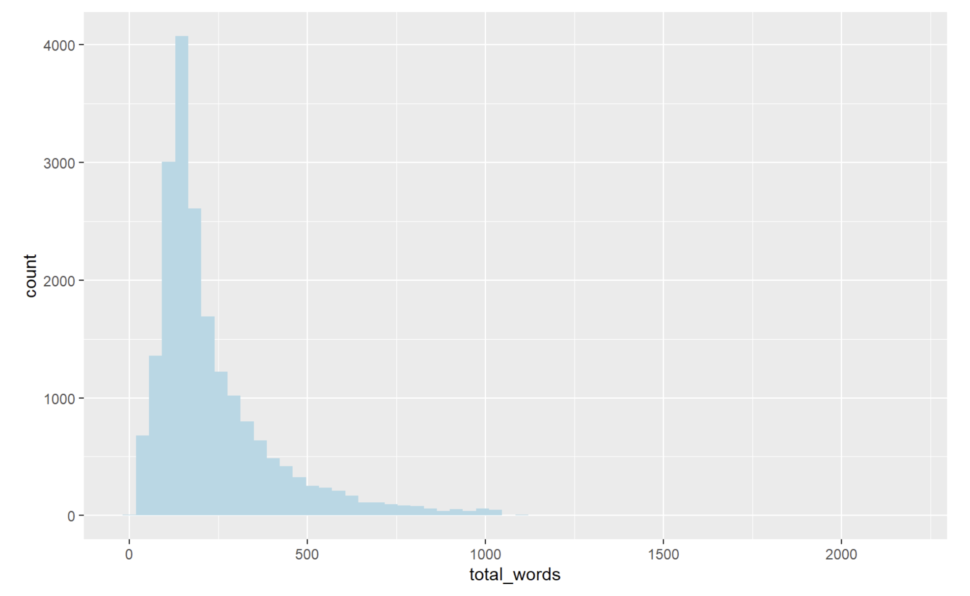
Our Dataset – IMDB Movie Reviews
Movie reviews by general audiences made on the IMDB website
50,000 reviews
50% are positive and 50% are negative sentiment
All reviews are labeled
Average review is 300 words long
File located at:
https://my-cunymsds.com/data607/data/IMDB_dataset.csv

Slide 3
What is our Goal?
Use Tidymodels to create a sentiment classifier of reviews (positive or negative)
Specific models to use in Tidymodels will be:
SVM (Support Vector Machine)
XGBoost
Random Forest
Neural Network (Single Layer Perceptron)
For more complex Deep Neural Network we will have to use KERAS / TENSORFLOW
Multi-layer deep neural network
Convolutional Neural Network
4. Compare performance (accuracy and training time) for all models

Slide 4
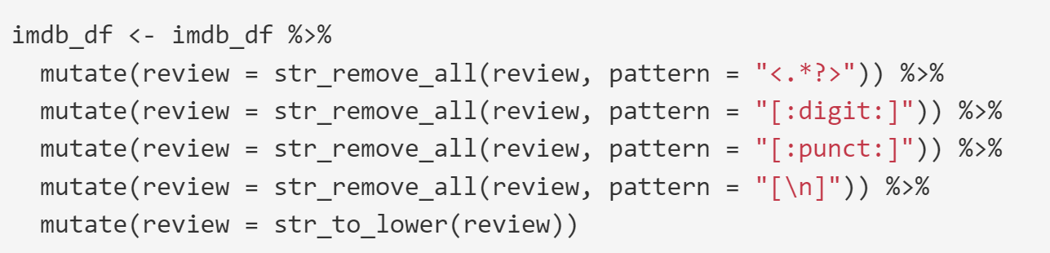
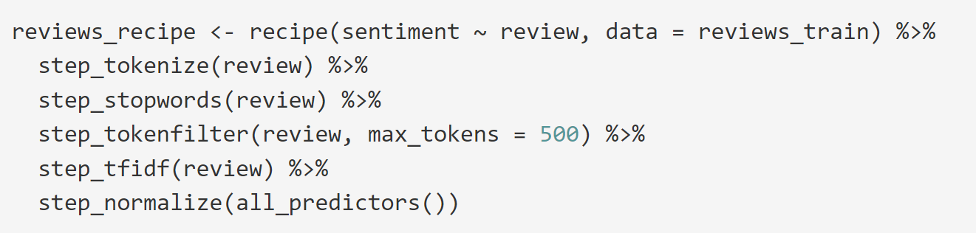
TidyModels – Prepare date for ML
A few things to notice in the dataset we will need to take care of:
Punctuations and digits are removed first
Through Tidymodels RECIPES we will do the following:
Tokenize the reviews into single words (Move the columns as features)
Remove STOPWORDS
Use TDIDF to assign values to each token column
Normalize the values
Training Data vs. Validation vs. Test Data

Slide 5
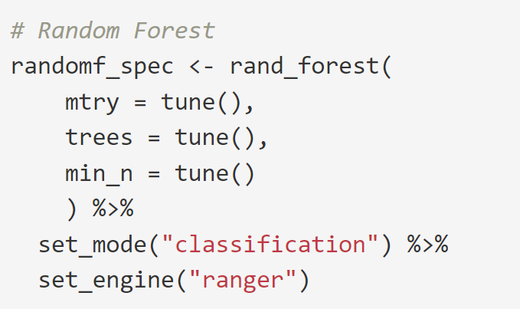
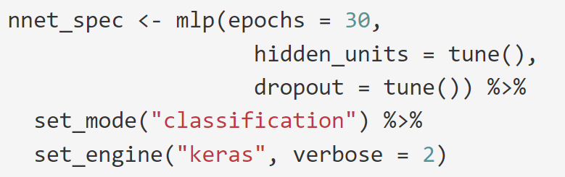
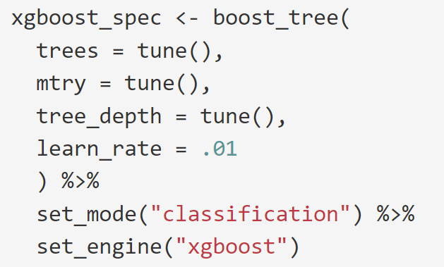
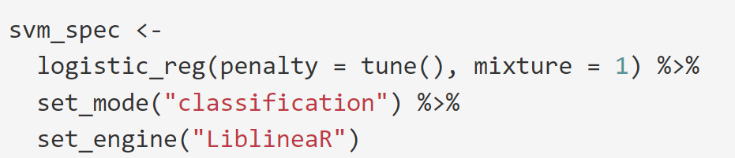
TidyModels
Four Model were stacked to run in parallel (through R package) for posterior comparison
First I used the full dataset with 50,000 records but after 2 days running noticed that RANDOM FOREST would take several days to complete
I reduced the dataset to 20,000 records and still took 1.3 days
We can do Neural Network under Tidymodels, but is limited to single hidden layer. For larger more complex models we will have to switch to Keras / Tensorflow

Slide 6
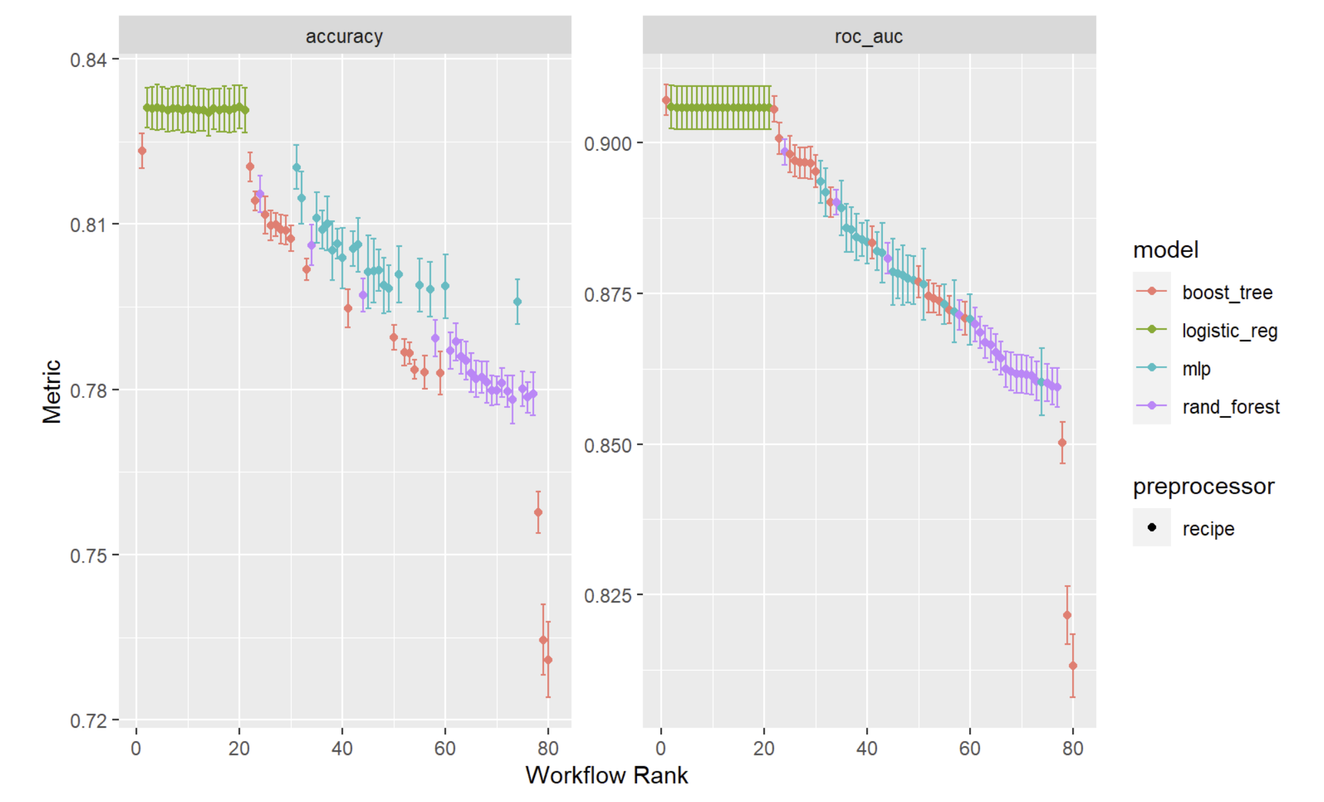
What where the results?
Based on ROC_AUC one of the 10 runs of XGBoost had a higher ROC_AUC, but all SVM (logistic reg) were 2nd to 11th in the ranking.
All runs of SVM had the highest accuracy numbers of the lot at 83%
Highest variability was XGBoost, noting how variable is to hyperparameter tuning (Accuracy varied from 82% down to 73%)

Slide 7
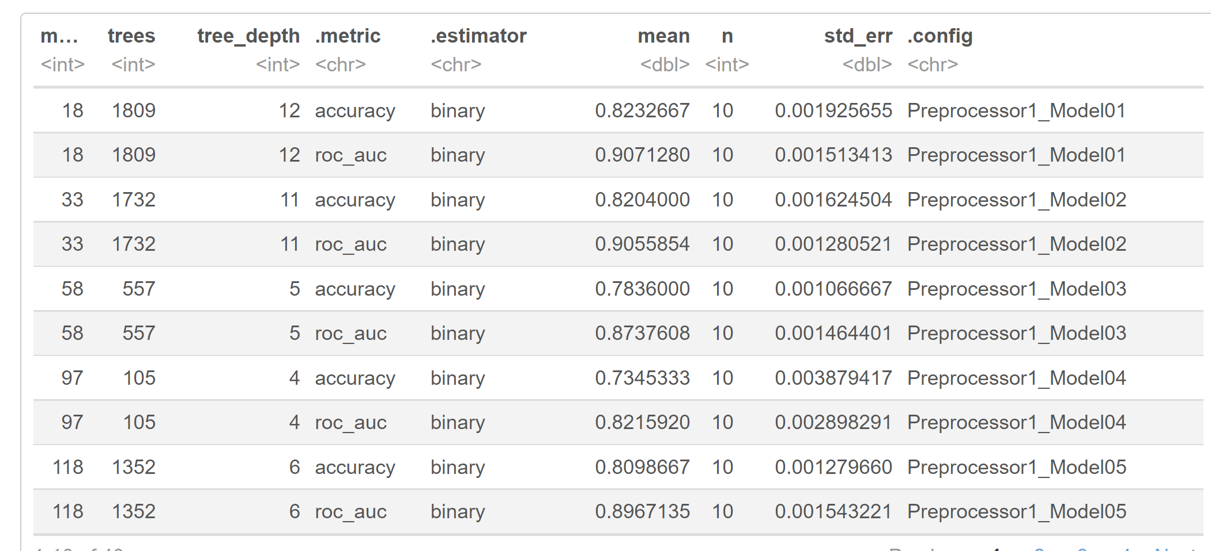
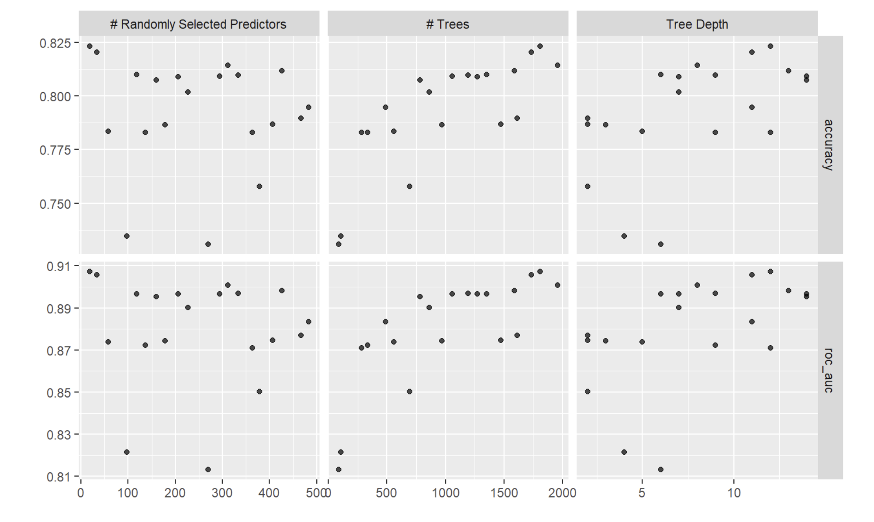
Hyper-parameter Tuning
Here you can see the importance of hyperparameter tuning.
Models can vary considerably depending on how hyper parameters are set.
Tidymodels allow to stack all your models and their different hyperparameter permutations and rank them so you can see which model and hyperparameter combination gave you the best results in training and validation (not testing)

Slide 8
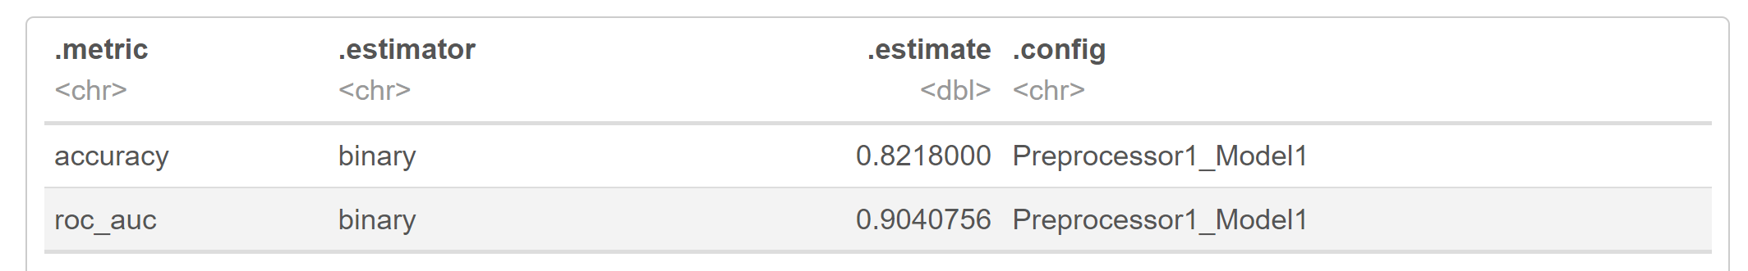
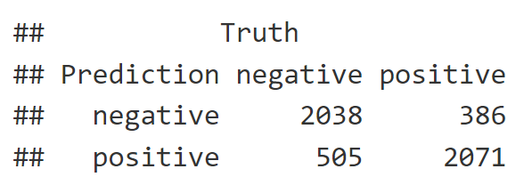
Our selected model – XGBOOST
Based on ROC_AUC observed in training we selected XGBOOST as our model
In testing, XGBOOST gave us an accuracy of 82.18%
Recall the only reason we ended up selecting XGBOOST was because we ranked all models based on ROC_AUC and 1 (and only 1 of the 10) runs of XGBoost came out higher than all 10 runs of SVM.

Slide 9
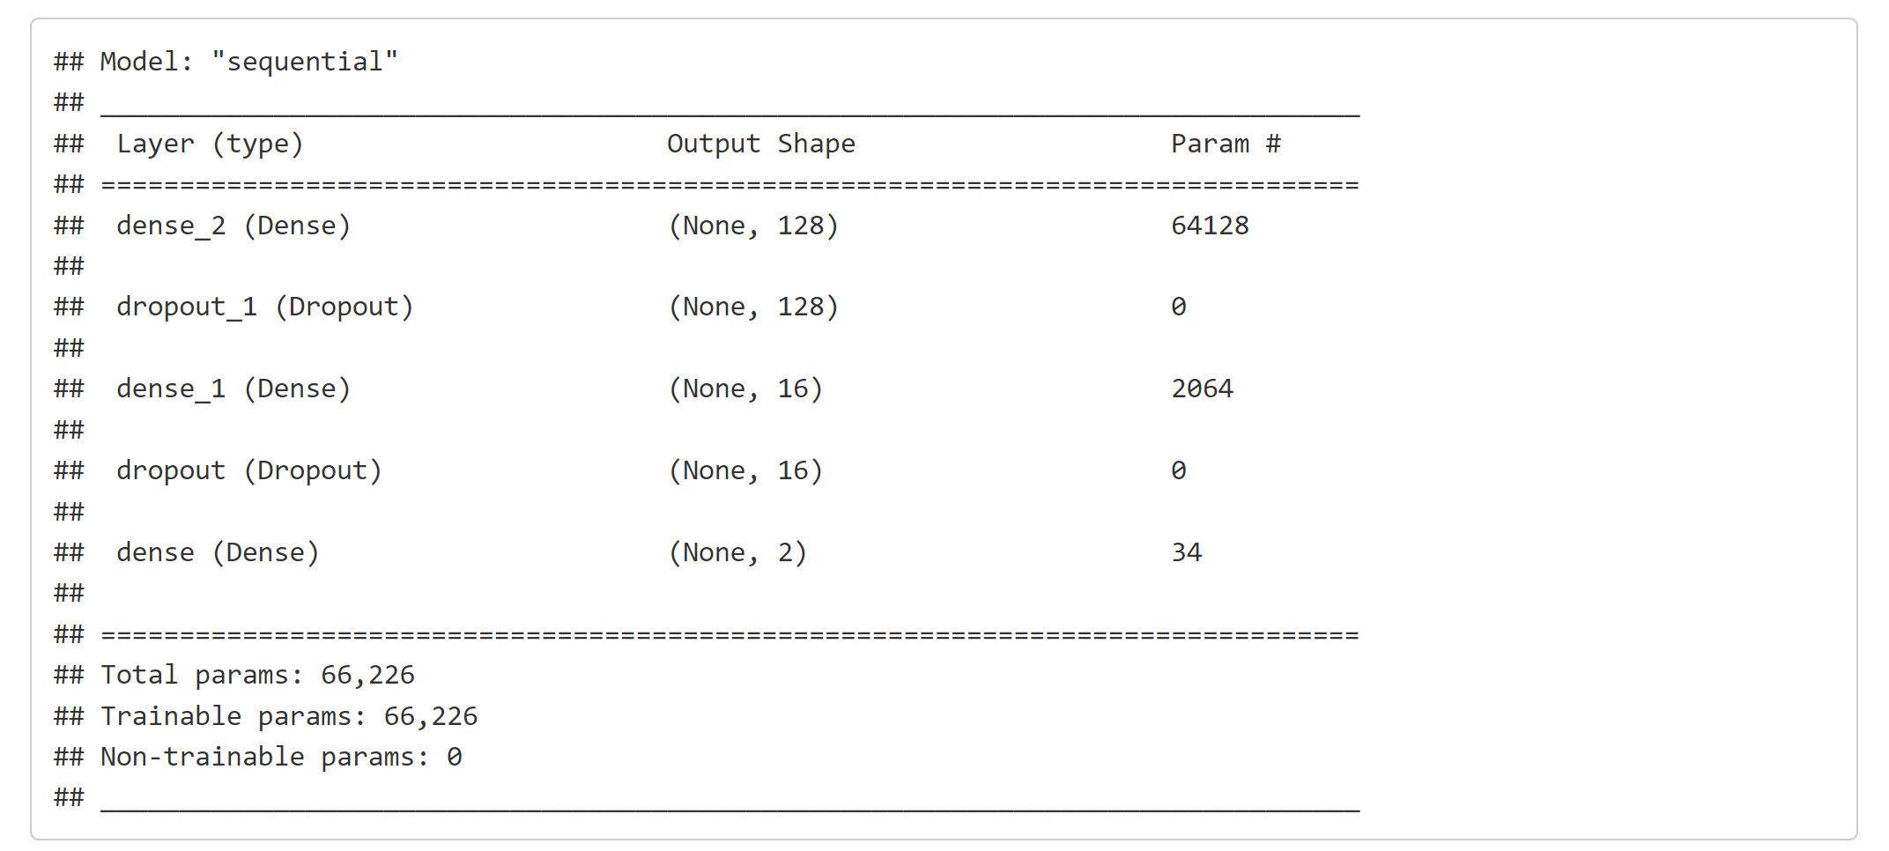
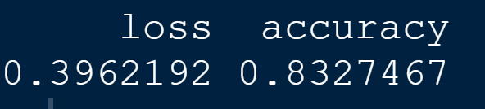
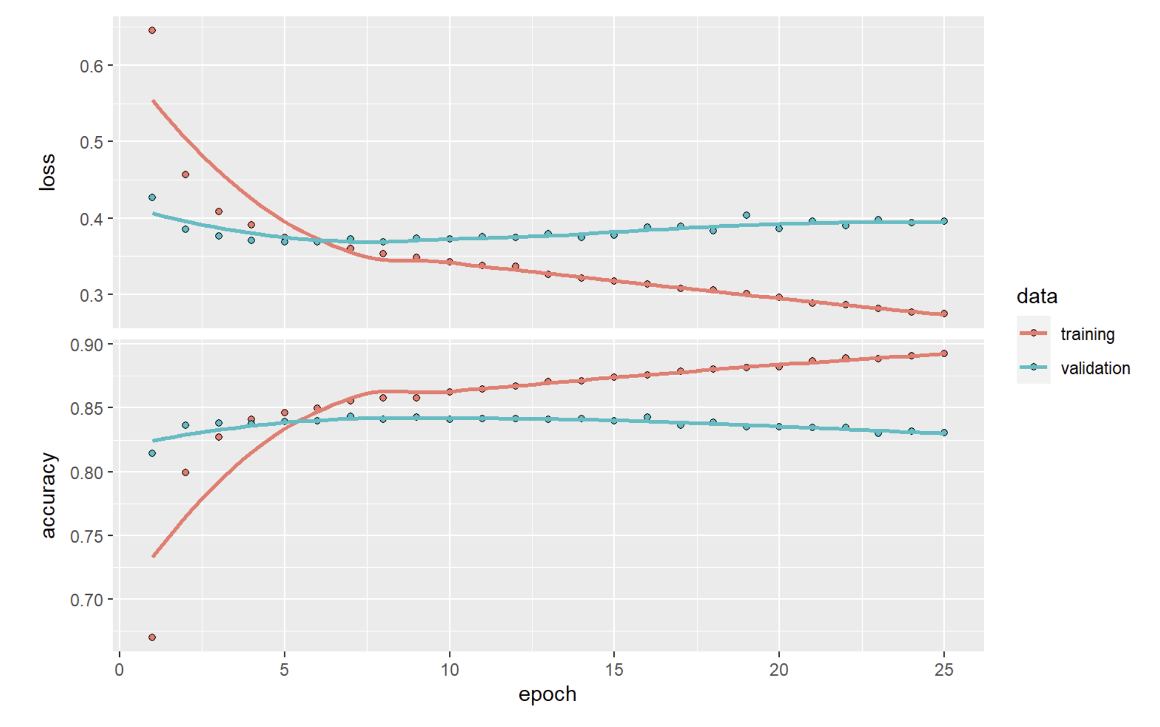
KERAS / TENSORFLOW -> Deep Neural Network
Accuracy with unseen Test Data
To create a more complex Neural Network we had to switch and use the Keras framework.
TensorFlow is an open-sourced end-to-end platform, a library for multiple machine learning tasks, while Keras is a high-level neural network library that runs on top of TensorFlow.
In this case we created a DNN with two hidden layers one with 128 nodes and a second one with 16 nodes (Plus input 500 and output 2.
DNN can easily overfit. Please notice it in the training vs validation chart. Training was quickly increasing reaching 90% while validation was going down. In fact stopping at 8 epochs gave 83.3% testing accuracy
66,000+ parameters to configure

Slide 10
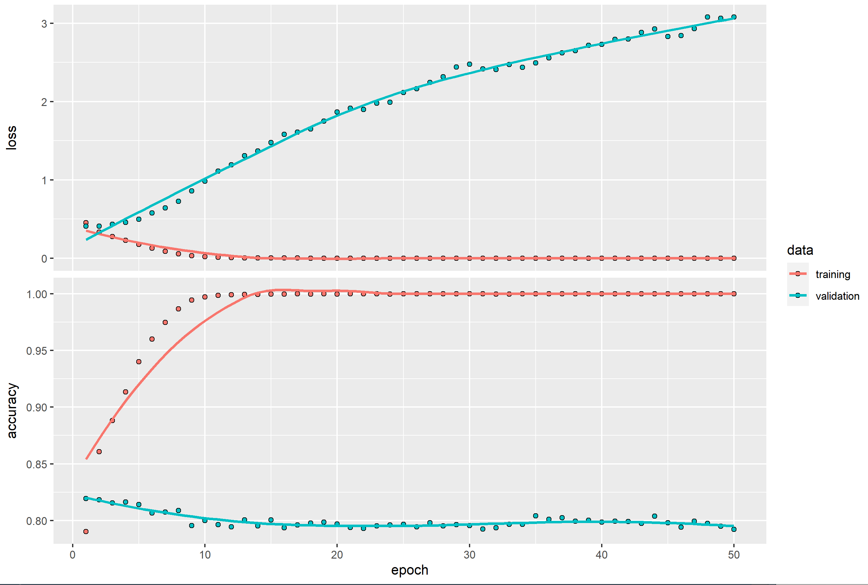
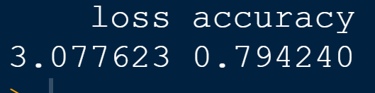
Deep Neural Network and Overfitting
On purpose we continued training the Neural Network until it reached 100% accuracy with the TRAINING set, BUT you can see that as the accuracy increases with training the accuracy decreases with the VALIDATION set.
Result was a lower accuracy with TEST data at 79.4% even though the model was able to classify 100% correctly every review in the training set of 40,000 reviews!
Accuracy with unseen Test Data

Slide 11
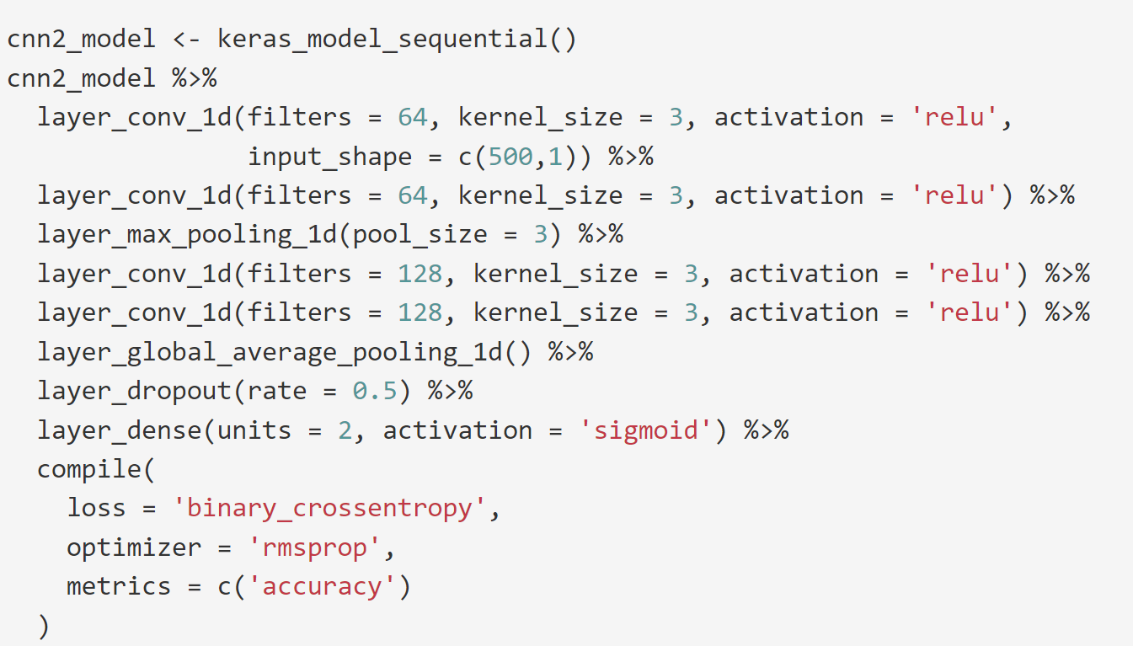
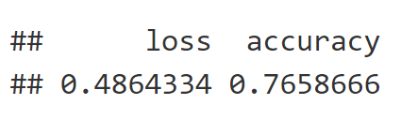
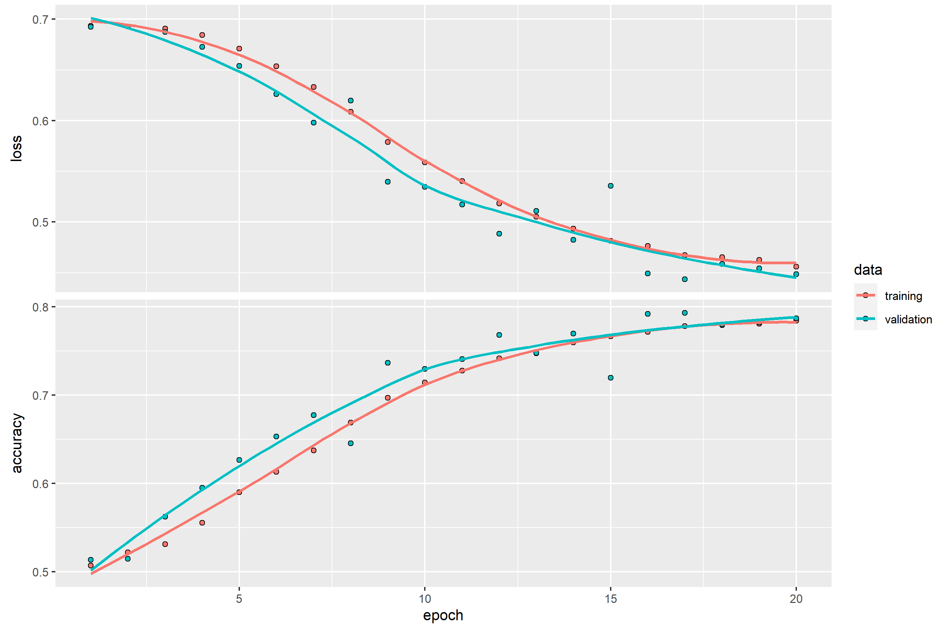
KERAS / TENSORFLOW -> Convolutional Neural Network
CNN are a different type of Neural Network, which make use of the mathematical CONVOLUTIONS (One function mixing with another function to create a third function).
CNN are very popular with IMAGE classification.
In this case we got decent results at 76.6% but not as good as other models we used.
Please note also the we did a good job of not overfitting

Slide 12
Overall Results and Conclusions
General Finding and Conclusions
Tidymodels makes it relatively easy to compare many models and to do hyper tunning.
Be aware of computing times. The combination of validations (normally 10 runs) times different hyperparameters (10-20) can make your training run 100-200 longer.
Random Forest is a beast consuming time.
Tidymodels has limited use of GPU through KERAS engine but only for a single layer NN
For more complex and wide use of GPU you will need to use Keras
MODEL | Number or Rows in Dataset | Accuracy | Time to Train
Random Forest | 20,000 | 81.5% (Training/Validation) | 1.3 DAYS
Single Layer Neural Network | 20,000 | 82.0% (Training/Validation) | 20 minutes
XGBoost | 20,000 | 82.3% (Training) 82.2% (Test) | 3.2 Hours
SVM | 20,000 | 83.1% (Training/Validation) | 12 minutes
KERAS – Multi-Layer Deep Neural Network | 50,000 | 88% (Training) 83.2% (Test) | 3 minutes
KERAS – Convolutional Neural Network | 50,000 | 76.6%(Training( 77.3% (Test) | 5 minutes
XGBoost | 50,000 | 82.6% (Training) | 1.2 hours
SVM | 50,000 | 83.5%(Training) 84.1% (Testing) | 21 minutes
KERAS Neural Network (Overfitted) | 50,000 | 100% (Training) 79.4% (Testing) | 3 minutes

Slide 13
Thank you!

