Slide 1
58%
Intermediate very high
degradation
46%
Widespreadmoderate
degradation
Localised very high
degradation
Widespreadhigh
degradation
Widespread very high
degradation
73%
14%
Collapsed
cED(0.8)>0.5
cED(0.3)>0.8
cED(0.8)>0.3
cED(0.5)>0.8
48%
cED(0.8)>0.8
Low degradation
22%
Intermediate high
degradation
27%
cED(0.5)>0.5

Slide 2
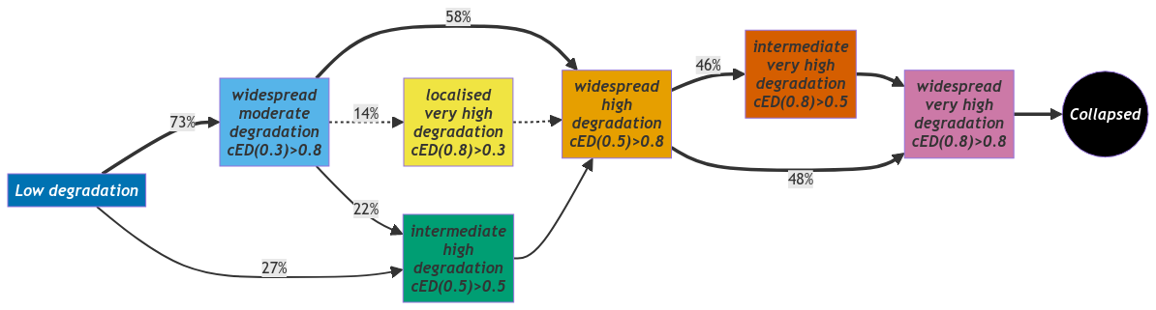

Slide 3
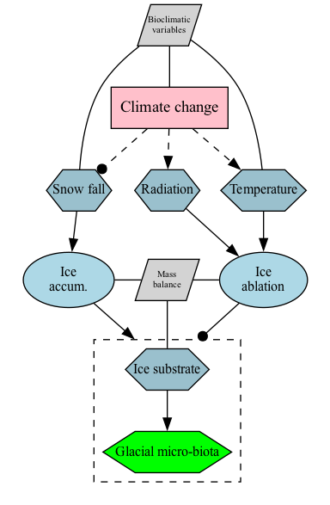
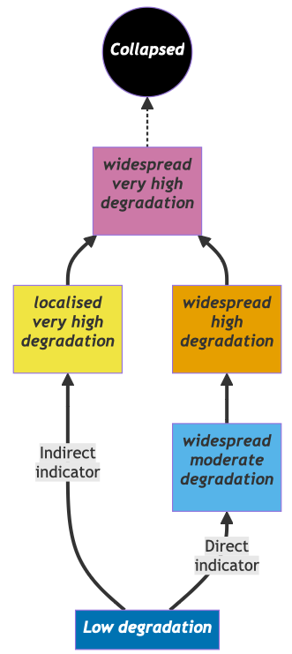
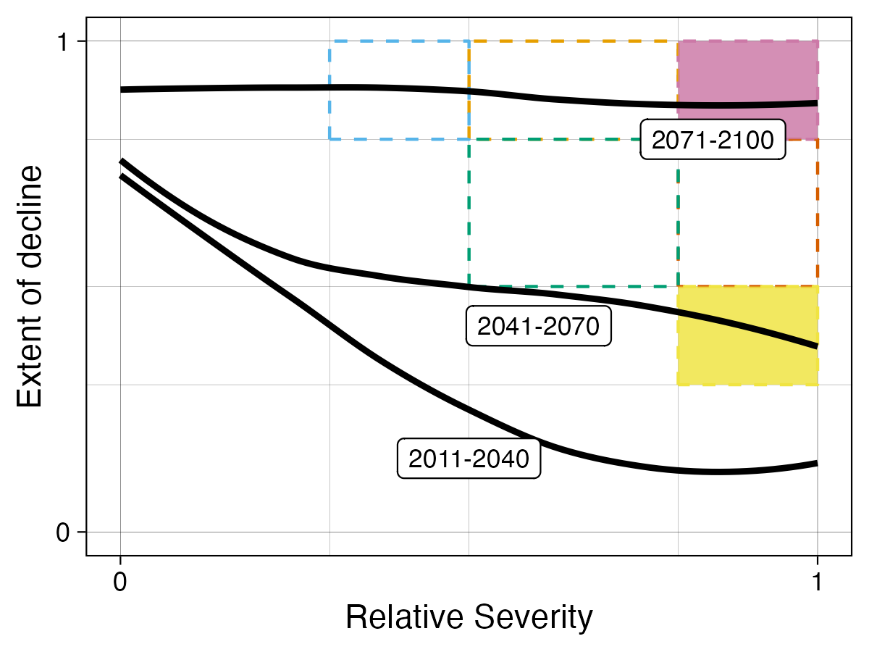
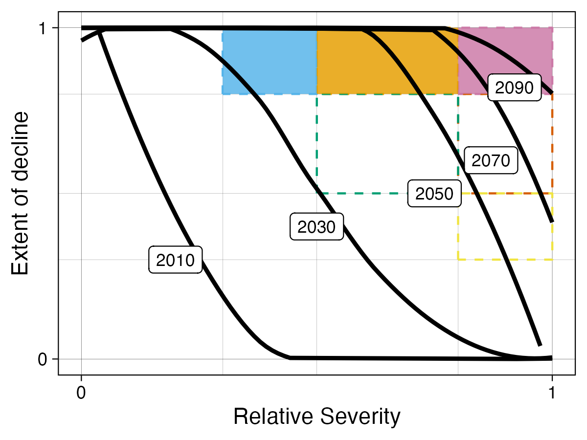
Indirect indicator
Direct indicator

