Slide 1
Game Design
Peter Shankar
CSE 497 – Topics on AI & Computer Game Programming

Slide 2
Introduction – Game Design
Rules of Play: Game Design Fundamentals
  Katie Salen & Eric Zimmerman
Game Design: Theory & Practice
  Richard Rouse III

Slide 3
Introduction – Game Design
Game design concepts have existed for some time, but recently gained much attention via computer technology
Not standardized or process driven – like software engineering
Broad conceptual definitions
Design -> Game Design -> Computer Game Design

Slide 4
Outline
Game Design Core Concepts
  What is Game Design?
  Successful Game Design
  “Meaningful play”
    Semiotics
    Systems
    Interactivity
    Choice
Design Approaches
  Brainstorming
  What players want/expect?
  Sid Meier Interview

Slide 5
What is Design?
Design is the process by which a designer creates a context to be encountered by a participant, from which meaning emerges.
As it pertains to games:
  Designer: the individual game designer, or a whole culture
  Context: spaces, objects, narratives, and behaviors
  Participants: players
  Meaning: meaningful play

Slide 6
Successful Game Design
The goal of a successful game design is the creation of meaningful play
  The intellectual dueling of two players in a well-met game of Chess
  The improvisational, team based coordination of Basketball
  The Dynamic shifting of individual and communal identities in the online role-playing game EverQuest
  The lifestyle-invading game Half-Life, played on a college campus

Slide 7
Meaningful Play
Two Definitions
  Descriptive: Emerges from the relationship between player action and system outcome; it is the process by which a player takes action within the designed system of a game and system responds to the action. The meaning of an action in a game resides in the relationship between action and outcome.
  Evaluative: Occurs when the relationships between actions and outcomes in a game are both discernable and integrated into the larger context of the game.
The two ways of defining meaningful play are closely related. Designing successful games requires understanding meaningful play in both senses.

Slide 8
Semiotics
Study of meaning. It is primarily concerned with the question of how signs represent, or denote.
People use signs to designate objects or ideas. Because a sign represents something other than itself, we take the representation as the meaning of the sign.
  Example: 6 points in football means a TD

Slide 9
4 Semiotic Concepts
A sign represents something other than itself
Signs are interpreted
Meaning results when a sign is interpreted
Context shapes interpretation
  Structure – Most smoogles have comcom

Slide 10
Systems
Has many parts that interrelate to form a complex whole
All systems have the following elements:
  Objects are the parts, elements, or variables within the system
  Attributes are qualities or properties of the system and its objects
  Internal relationships are relations among the objects
  Environment is the context that surrounds the system

Slide 11
Game Systems
These four elements (objects, attributes, internal relationships, environment) of a system can be framed differently within a gaming system.
  Formal
  Experiential
  Cultural
All three ‘frames’ exist simultaneously

Slide 12
Game Systems Cont.
A game as a formal system is always embedded within an experiential system, and a game as a cultural system contains formal and experiential systems.
Cultural System
Experiential System
Formal System

Slide 13
Chess as a Formal System
Objects: pieces on the board, the board, etc.
Attributes: characteristics given to the objects, defined by the rules
Internal Relationships: spatial relationships, positions on the board
Environment: the play itself

Slide 14
Chess as an Experiential System
Objects: the players themselves
Attributes: the pieces a player holds, state of the game
Internal Relationships: player interaction, social, psychological, emotional communication
Environment: board, pieces, immediate setting of the game -> anything that facilitated the play

Slide 15
Chess as a Cultural System
Objects: the game of Chess itself, in its broadest cultural sense
Attributes: the designed elements of the game, as well as information on how, when, where, why the game was made and used
Internal relationships: linkages between the game and culture
Environment: culture itself, in all of its forms

Slide 16
Interactivity
4 modes of interactivity
  Cognitive interactivity: interpretive participation
  Functional interactivity: utilitarian participation
  Explicit interactivity: participation with designed choices and procedures
  Beyond-the-object-interactivity: participation within the culture of the project

Slide 17
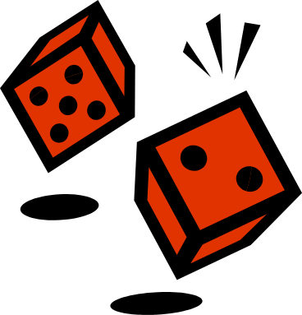

Interactivity in Game Design
3rd mode (explicit interactivity) comes closest to defining what we mean when we say games are interactive
Interactivity and gameplay are often synonymous
Designed interaction
  Rolling dice on a craps table vs. rolling an apple

Slide 18
Choice
Micro level: each decision at it’s smallest level
Macro level: the accumulated choices to form a larger choice/outcome
Players should understand that their choices at the micro level influence choices at the macro level

Slide 19
Diagnosing Choice
Ask these questions for every choice made:
  What happened before the player was given the choice?
  How is the possibility of a choice conveyed to the player?
  How did the player make the choice?
  What is the result of the choice? How will it affect future choices?
  How is the result of the choice conveyed to the player?

Slide 20
Diagnosing Choice – Failure States
Feeling as if decisions are arbitrary
Not knowing what to do next
Losing a game without knowing why
Not knowing if an action had an outcome

Slide 21
Putting Game Design Concepts Together
Players look for “meaning” to their play.
  Want to interact in systems
    Formal, experiential, cultural
  Semiotics – meaning through representation
Interactivity is gameplay
  Choice is tricky, we want a players choices to be meaningful on a macro/micro level

Slide 22
Game Design Procedures
No standard procedures
  Understanding what players want/expect
  Brainstorming
  Sid Meier

Slide 23
Successful Computer Game Design – What do players want?
What do players want?
  Challenge
  Socialize
  Dynamic experiences
  Bragging rights
  Emotional experience
  Fantasize

Slide 24
Successful Computer Game Design -What do players expect?
Players expect:
  A consistent world
  Understand the world bounds
  Reasonable solutions to work
  Direction
  Accomplish incremental tasks
  Immersion

Slide 25
Successful Computer Game Design -What do players expect? (cont.)
Players expect
  Fail
  Fair chance
  Not need to repeat themselves
  Not get hopelessly stuck
  Do, not watch
  Don’t know what they want, but know it when they see it

Slide 26
Brainstorming a Computer Game
Starting Points
Working with Limitations
Established Technology

Slide 27
Starting Points
Starting with Gameplay
Starting with Technology
Starting with Story

Slide 28
Working with Limitations
Embrace Your Limitations
  Odyssey: The Legend of Nemesis
  Damage Incorporated
  Centipede 3D

Slide 29
Odyssey: The Legend of Nemesis
Designed around the story
  Non-linear, very dynamic
Author overtook design of this game
  Some technology already developed
  Added some AI features to make it work for him
The technology and gameplay largely supported what he wanted to do with the story

Slide 30
Damage Incorporated
Designed around technology
Had games like Marathon and Marathon 2 in mind
MacSoft obtained a sophisticated license to some technology that they wanted to implement in a game
Crafted gameplay/story around the technology so the story would take full advantage

Slide 31
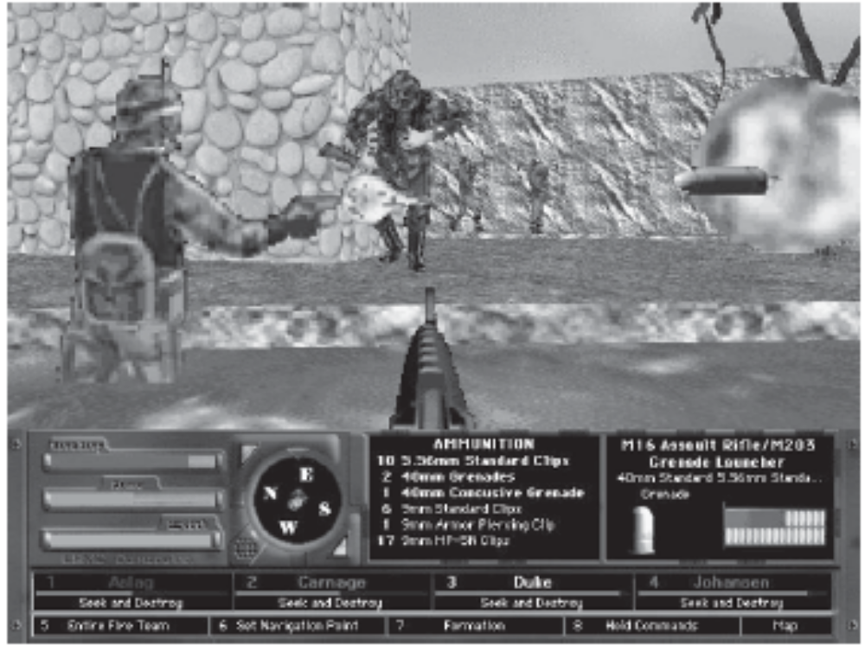
Damage Incorporated

Slide 32
Centipede 3D
Game mechanics similar to original
Started with gameplay
Set out to look for an engine that could handle the game
Not much of the story – they wanted to capture the simple playability of the original

Slide 33
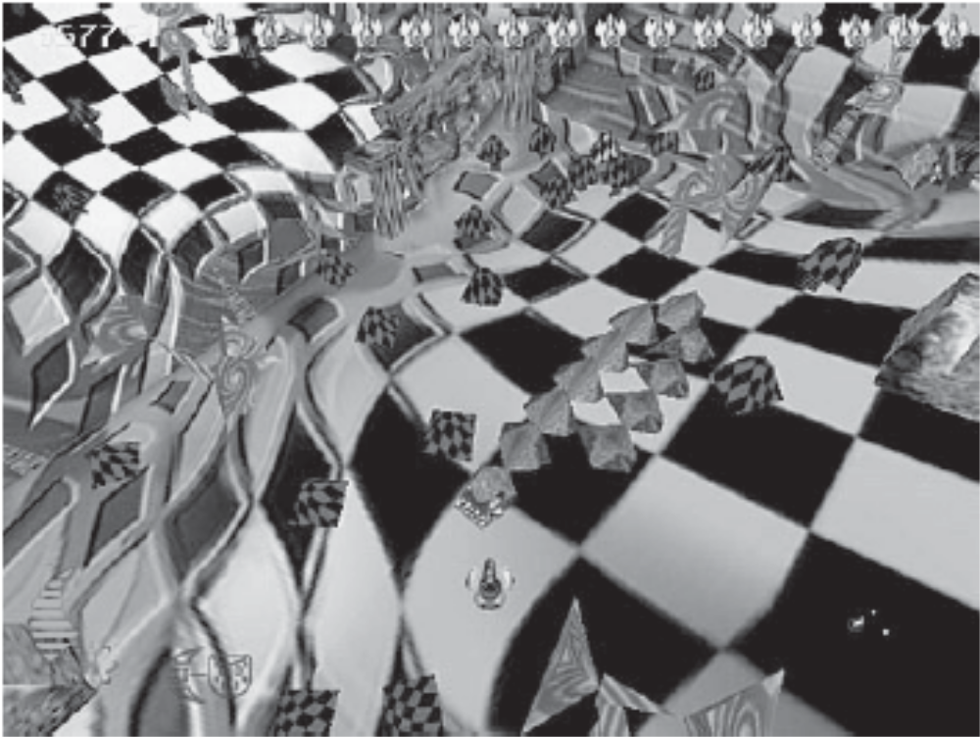
Centipede 3D

Slide 34
Established Technology
The Case of the Many Mushrooms
  Centipede 3D
  Escalating polygon counts – slowed down play
The Time Allotted
  Project time considerations
  New technology developed

Slide 35
Sid Meier Interview
Serves as both lead programmer and lead designer
  Personal decision
Primary tool is the prototype
  History, story, behind the game
  3-4 cool things that are going to happen in the game
  Giving the team a good sense of what the game should be
Don’t make it complete
  Leave room for expansion/deviation

Slide 36
Sid Meier Interview Cont.
Technology is ready for a certain type of game
Topic before genre
What makes games interesting is many interoperating systems
Changing game state
  Dramatic changes from the beginning to the end of the game – Railroad Tycoon

Slide 37
Sid Meier Interview Cont.
Addictive play
  “interesting decisions”
  Many things happening at the same time
  Figure out what is the interesting part about the theme
  Let the player use his own knowledge in making decisions
  Reward players, setup milestones

Slide 38
Sid Meier Interview Cont.
Game design is a slow process
  Does not follow processor speed, video card advancements etc.
  Build on what’s been done before
Games have a personal touch
  Development is largely done in big groups now
  But good games have some insight on the individual level

Slide 39
Conclusion
Game Design is ultimately a creative process and everyone develops differently
But there are some things successful games have in common
  People want to make meaningful choices
  They like to see the functioning of many systems
  They like dynamic states

